Slide 1
Advancing Pharmacist Roles in Substance Use Disorders ECHO
Mitigating Risks:
Pharmacist Role in Suicide Assessment
LCDR Teresa Grund R.Ph. BCPS. BCPP
October 5th 2021

Slide 2
No Disclosures
No Conflicts of Interest

Slide 3
Objectives
Identify three different suicide screening tools
Identify Pharmacist role in suicide assessment and care coordination
Empower pharmacist to engage in suicide assessments
Notes:
I am hoping by the end of this presentation you will be able to identify 3 screening tools and where to acquire training for them, Identify what roles pharmacist can play in suicide assessment and care coordination and provided you with increased confidence to engage in suicide assessments in your current environment.
You might be saying “ I am not trained to screen for these types of “behavioral health issues or That’s nursings job when they screen the patient, or only a mental health specialist should be asking those kind of questions. I am going to take the next couple of slides to tell you why I thinks pharmacist should play a role suicide assessments.
Let’s start with what we know.

Slide 4

“Pharmacist are the most accessible and frequently visited health care provider.”³
Notes:
As we know, pharmacist are the most accessible and frequently visited Health Care provider and because we are often considered the most trusted In light of these perceptions we should play a role in mental health assessment regardless of our current circumstances, roles, and duties and as PHS officers, our communities, coworkers, family and friends look to us for medical advise ,help, and answers.
Book club, ”I am worried about… Wednesday night basketball” my dad’s not doing well , the person 2 offices down” I can’t fall sleep at night”

Slide 5

SUBSTANCE USE AND SUICIDE: A NEXUS REQUIRING A PUBLIC HEALTH APPROACH (2016)
https://store.samhsa.gov/sites/default/files/d7/priv/sma16-4935.pdf⁴
Notes:
We know that 41000 deaths by suicide each year in the US of those deaths 20% had opioids on board and 22% alcohol on board. This same reports states that up to 40% of suicide attempts involve alcohol.
when added with the fact that over 40% of these of the suicide attempts had seem their provider in the last 30 days and we just identify that we are the often the most frequently visited so, I ask you, how many of them saw their pharmacist in those same 30 days?

Slide 6

Typical pharmacist reaction to patients
who present with suicidal indicators:
Notes:
Let’s talk about why we don’t already do these screenings, this is the reaction most pharmacists when a person is exhibiting signs they might be having suicidal thoughts. WE run . We have no idea what to do with what this info. so we ignore, side step it or diminish it .
As pharmacist we’ll talk about bowel movements –in detail, look at rashes- anywhere. We’ll do foot exams on- anyone.
But suicide we don’t want to deal with,

Slide 7

Why do we Run?
FEAR
Notes:
Why don’t we deal with suicide because we are afraid. Afraid we’ll say something wrong, or make it worse.

Slide 8
Myth Versus Fact
Fact:
Asking directly about suicidal intent
*Lowers anxiety
*Opens up communication
*Lowers the risk of an impulsive act
Myth:
Confronting a person about suicide will only
*Make them angry
*Increase the risk of suicide.

Slide 9
Behavioral Clues
Any previous suicide attempt
Co-occurring depression, moodiness, hopelessness
Putting personal affairs in order
Giving away prized possessions
Sudden interest or disinterest in religion
Acquiring a gun or stockpiling pills
Drug or alcohol abuse, or relapse after a period of recovery
Notes:
Those of use working the substance use field also know that are patients are at higher risk for suicide. Some is the increased risk come from the psychoactive effects of the substance themselves. Depression from alcohol use and methamphetamine withdrawal and anxiety from opioid withdrawal and the methamphetamine use.

Slide 10
Situational Clues
Sudden unexpected loss of freedom/fear of punishment
A recent unwanted move
Loss of any major relationship
Death of a spouse, child, or best friend, especially if by suicide
Diagnosis of a serious or terminal illness
Anticipated loss of financial security
Being fired or being expelled from school
Notes:
Others are indirect effects of the substance use disorder such as involvement with law enforcement, loss of relationships, financial issues. All of these are risk factors for suicide and unfortunately are experienced by our patient population at a rate than the general population.

Slide 11
The Barriers
Time.
How do you decide which screening to use?
What do we do if a patient indicates they are have thoughts of suicide?
Not trained to do suicide screenings.
Don’t want to make it “worse”.
Notes:
As we developed the bh med management clinic we discovered some barriers for pharmacists to fill competent to screen patients for mental wellness
I’m not trained for this, What do I do if they are thinking of suicide,
There are tons of screenings, which one do I use?. I do not have time for this!
Understanding the barriers is the key overcoming the fears

Slide 12
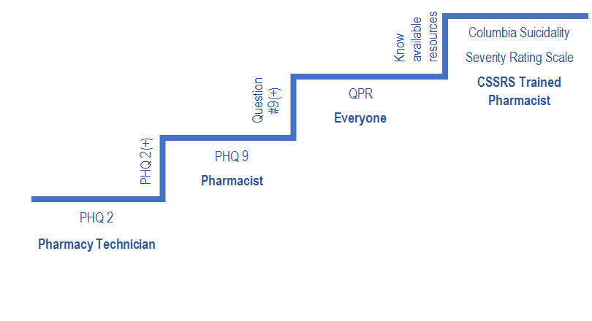
Systematic Hierarchy for Suicide Screening
Notes:
Using this stepwise approach enables pharmacist to wrap our guideline, algorithm, protocol loving minds, to know what to do next.
We will be discussing the PHQ2 ,the PHQ9,Question persuade refer (QPR) and The Columbia suicidality severity rating scale.

Slide 13
Patient Health Questionnaire -2 (PHQ-2 )²
Purpose
Screens for depression
Benefits
Two questions
Brief
Minimal training needed
Can be administered by front line health care worker (pharmacy technician or office staff)

Slide 14
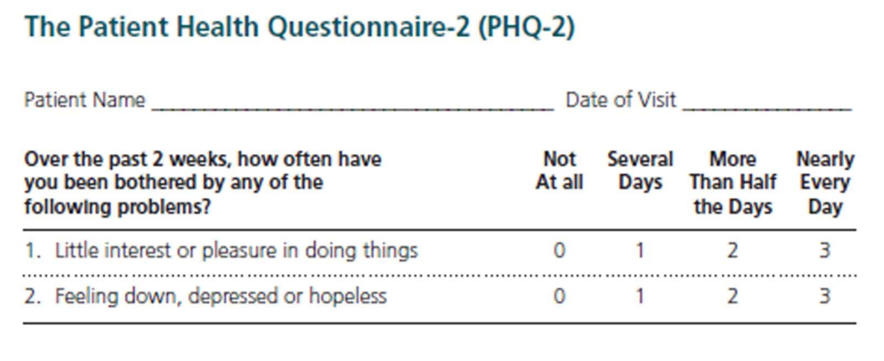
PHQ2©
Notes:
We have pharmacist and students do a PHQ 2 in every clinic visit. Its Easy enough that you can do verbally or give the patient a form to fill out.
0-not at all
1-several days
2-more than half the days
3- nearly every day
Any score of 3 or greater indicate the need for further screening

Slide 15
Patient Health Questionnaire -9 (PHQ-9 )
Purpose
Screens for depression
Benefits
More in-depth
Used for screening, monitoring, and diagnosis
Asks specifically about suicidal thoughts
Requires minimal training
Administered by clinical personnel

Slide 16
PHQ-9
Severity Score
5-9 Minimal symptoms
10-14 Minor depression, Dysthymia,
15-19 Major Depression, Moderately Severe
>20 Major Depression, Severe

Slide 17
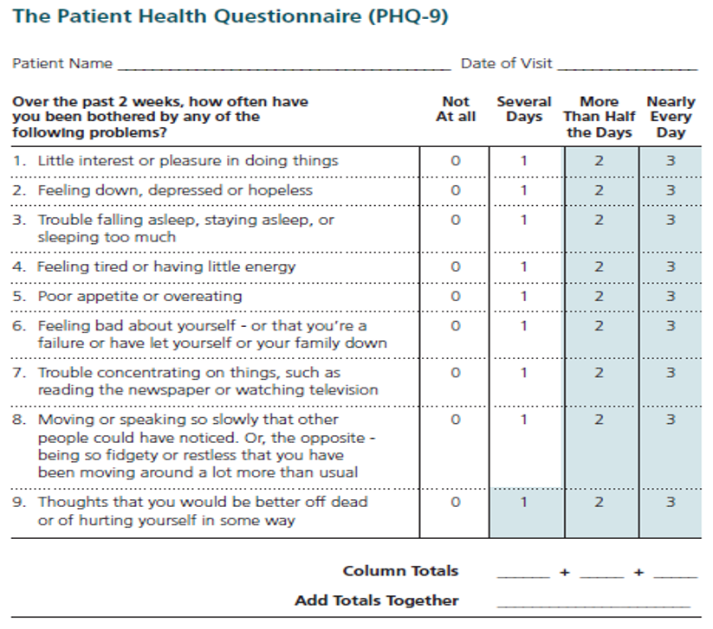
PHQ-9 Screening Tool©
Notes:
The first 2 questions on phq9 are the same questions on the phq2 . Same scoring as the PHQ2
Because of it complexity, usually patient receives a form to fill out.
Add up the total for each columns. Add the totals of each column together and that gives you the score.

Slide 18
PHQ 9 Question #9
“Thoughts that you would be better off dead or of hurting yourself in some way?”
0= not at all
2= more than half the days
3= nearly every day
1= several days
Notes:
Most pharmacists get to this question and start thinking “please don’t be positive, please don’t be positive”
So what do we do when Question # 9 is positive? Patient may be in a mental health crisis.
If we came upon someone in Cardiac Crisis, most all us know CPR and we would know what to do.

Slide 19
Question Persuade Refer⁵
QPR
The Equivalent to CPR
Emergency Mental Health Intervention
Notes:
We do QPR. Just like you would do CPR in a Cardiac Crisis, we should do QPR in a mental health Crisis.

Slide 20
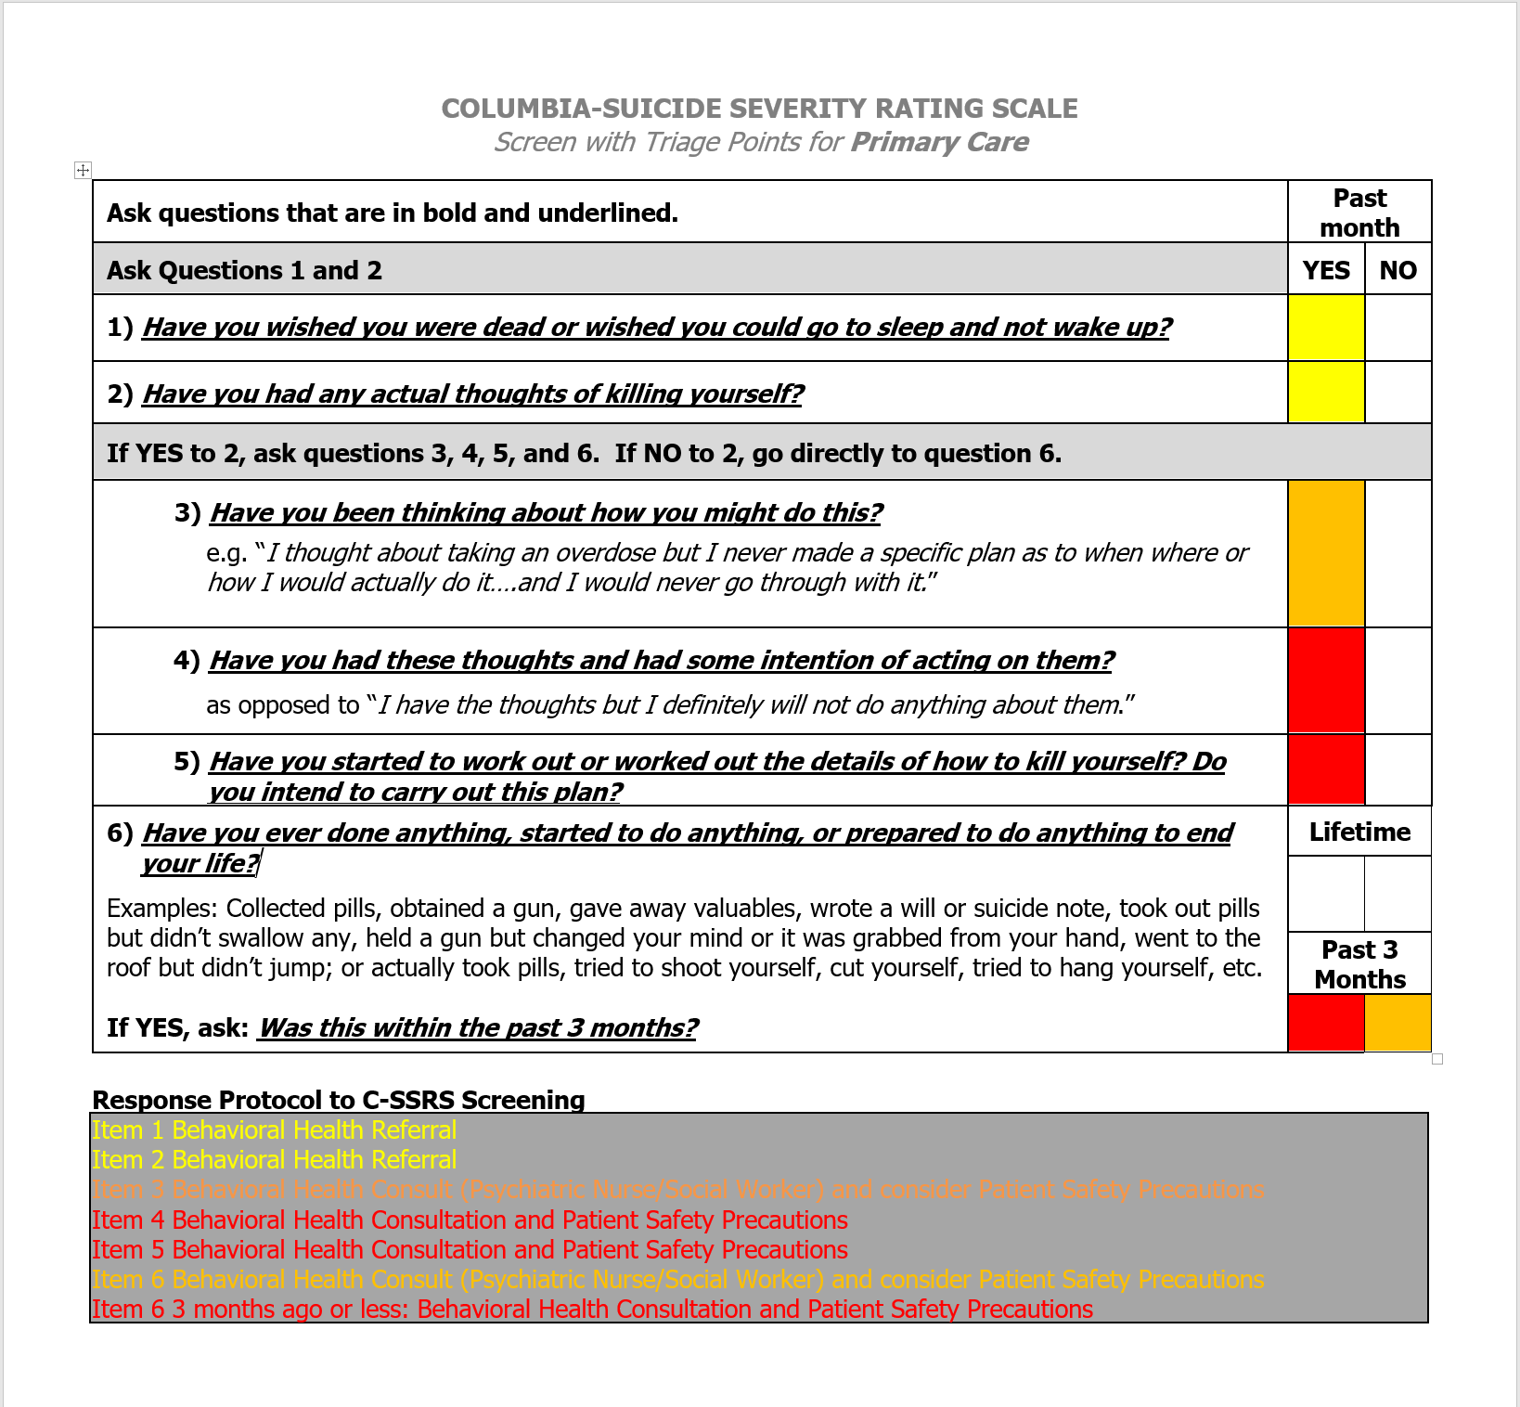
Columbia-Suicide Severity Rating Scale©
(Screener-with triage points) (CSSR-S)¹
Notes:
6 questions
Assess Suicidal ideation and behaviors
Include triage points
Triage Categories
Low risk- yellow
Moderate risk- orange
High risk- red

Slide 21
Create a local Mental Wellness Resource List
May be in house or in the community
GOOGLE search
Contact behavioral health department or local offices.
Website info
Referral process
Phone numbers
Contacts
Notes:
If your doing any type of mental wellness assessment it important to know what resources are available in your environment . Your goal is to get them connected to someone who is trained to help them. I had a APPE student create a resource list national, state,and local resources.
In our pharmacy we have 3 behavioral health medication management pharmacist who where trained in suicide assessments and safety plans. So the pharmacist in our department and refer patients to one of us for a Columbia suicide severity rating scale and safety plan if needed. If the only resource, you have is a national hotline then know that and use it.

Slide 22
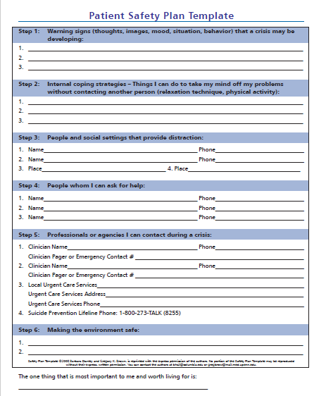
Patient Safety Plan Precautions⁶

Slide 23
KE is a 30-year-old female who presents to the pharmacy for tobacco cessation clinic. The pharmacist completes medication reconciliation, standard screenings, and vitals. Results are as follows:
.
SCREENINGS | VITALS | MEDICATIONS
Tobacco use daily | BP 131/72 | IBUPROFEN 800MG PO TID PRN
CAGE 0/4 | PULSE 75 | ORTHO TRI-CYCLEN 1 TAB PO QDAY
PHQ2 3 |  | OMEPRAZOLE 20MG PO HS
GAD 7 2
PREGNANT NO
BREAST FEEDING NO
ILLICIT DRUG USE NO
Notes:
So let’s look a case and see how it all fits together.
READ CASE
Based on these findings how can we best help KE today?

Slide 24
Next step?
A. Send patient directly to the E.D.
B. Do nothing. Continue TCC visit
C. Administer a PHQ 9
D. Tell patient they have depression and need to follow up with
behavioral health
Notes:
What do you think?

Slide 25
Next step?
A. Send patient directly to the E.D.
B. Do nothing. Continue TCC visit
C. Administer a PHQ 9
D. Tell patient they have depression and need to follow up with
behavioral health
Notes:
What do you think?

Slide 26
Pharmacist Administers a PHQ 9
Patient Scores a 15
Notes:
Now what?

Slide 27
Next step?
A. Send patient directly to the E.D.
B. Do nothing. Continue TCC visit
C. Review Question number 9 on the PHQ 9
D. Tell patient they have depression and need to follow up with
behavioral health
Notes:
What do you think?

Slide 28
Next step?
A. Send patient directly to the E.D.
B. Do nothing. Continue TCC visit
C. Review Question number 9 on the PHQ 9
D. Tell patient they have depression and need to follow up with
behavioral health
Notes:
What do you think?

Slide 29
Question #9
Positive
Score 1
Notes:
Crossing your fingers didn’t work, what are you going to do?

Slide 30
Next step?
A. Send patient directly to the E.D.
B. Do nothing. Continue TCC visit
C. Question, Persuade, Refer (QPR)
D. Tell patient they have depression and need to follow up with
behavioral health
Notes:
What do you think?

Slide 31
Next step?
A. Send patient directly to the E.D.
B. Do nothing. Continue TCC visit
C. Question, Persuade, Refer (QPR)
D. Tell patient they have depression and need to follow up with
behavioral health
Notes:
Now having a resource guide is key at this point. Knowing who or where you are going to refer this patient in advance can significantly increase your willingness to engage in the conversation with patients.

Slide 32
Systematic Hierarchy for Suicide Screening
Notes:
As you can see, you have completed a suicide screening in a systematic, step wise approach. As you can see the Columbia is the next step in this process, but not necessary if the current environment and training does not support this advanced screening.
Another advantage of this systematic approach is the ability to now communicate with BH staff member in language they understand and can clinically process and apply.

Slide 33
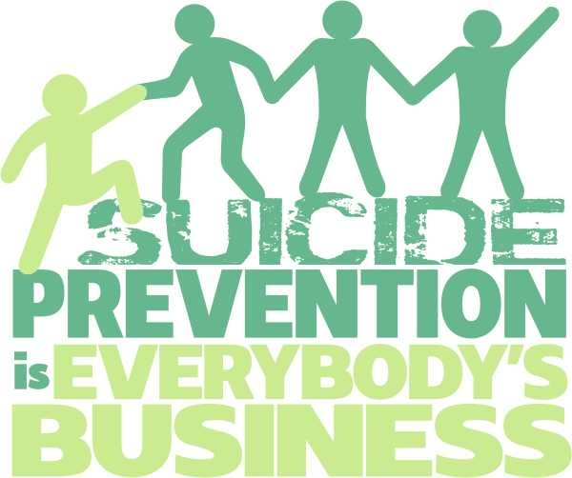

Slide 34
Training Options
VA Healthcare Clinical Pharmacy Bootcamp SUD 2020 Day 2 Topic 4
https://vapharmacytraining.remote-learner.net/course/view.php?id=687
Question Persuade Refer (QPR)
https://qprinstitute.com/
The Columbia Suicide Severity Rating Scale (CSSRS)
http://cssrs.columbia.edu/
The Patient Health Questionnaire. (PHQ9)
http://www.phqscreeners.com/
Applied Suicide Intervention Skills Training (ASIST)
http://www.livingworks.net/programs/asist
Suicide Alertness for Everyone (safeTALK)
https://www.sprc.org/resources-programs/suicide-alertness-everyone-safetalk
Patient Safety Plan Template (Stanley Brown Safety Plan Template)
https://suicidepreventionlifeline.org/wp-content/uploads/2016/08/Brown_StanleySafetyPlanTemplate.pdf
https://vimeo.com/355995975
https://vimeo.com/355997966
https://vimeo.com/355998927
https://vimeo.com/356000311

Slide 35
References
¹The Columbia Lighthouse Project. Retrieved May 12, 2018, from http://cssrs.columbia.edu/
²The Patient Health Questionnaire. Retrieved May 12, 2018, from http://www.phqscreeners.com/
³Manolakis, P. G., & Skelton, J. B. (2010). Pharmacists Contributions to Primary Care in the United States Collaborating to Address Unmet Patient Care Needs: The Emerging Role for Pharmacists to Address the Shortage of Primary Care Providers*. American Journal of Pharmaceutical Education, 74(10). doi:10.5688/aj7410s7
⁴https://store.samhsa.gov/sites/default/files/d7/priv/sma16-4935.pdf
⁵QPR Gate Keeper Training. Retrieved May 12, 2018, from https://qprinstitute.com/individual-training
⁶https://sprc.org/sites/default/files/resource-program/Brown_StanleySafetyPlanTemplate.pdf

