Slide 1

Contingency Management and Stimulant/Methamphetamine Use Disorder
CAPT Ted Hall, PharmD
DHHS/USPHS/IHS
Advanced Practice Pharmacist II
Clinical Psychiatric Pharmacist Prescriber
Ho-Chunk Nation Health Department

Slide 2
Presentation Overview
  Discuss the unique pathophysiology and psycho-social nuances of Stimulant Use Disorder/Methamphetamine Use Disorder
  Introduce Contingency Management treatment, benefits, and current barriers for implementation.
  Discuss off-label non-FDA approved anecdotal medication assisted treatment for Methamphetamine Use Disorder.

Slide 3
Disclaimer:
The opinions and conclusions expressed today are those of the author and do not necessarily represent the views of the Department of Health and Human Services, US Public Health Service, the Indian Health Service or the Ho-Chunk Nation.
No financial disclosures to report.
Off-label non-FDA approved medication utilization will be identified clearly when discussed.

Slide 4
Addiction Definition: DSM 5
Diagnostic and Statistical Manual of Mental Disorders 5th Edition (DSM 5)
  Substance Use Disorder:
    “The essential feature of a substance use disorder is a cluster of cognitive, behavioral, and physiological symptoms indicating that the individual continues using the substance despite significant substance-related problems” (pg. 483 DSM5)

Slide 5
Addiction Definition: ASAM
American Society of Addiction Medicine
  Short Definition: Addiction is a primary, chronic disease of brain reward, motivation, memory and related circuitry. Dysfunction in these circuits leads to characteristic biological, psychological, social and spiritual manifestations. This is reflected in an individual pathologically pursuing reward and/or relief by substance use and other behaviors. (Adopted by the ASAM Board of Directors 04/19/11)
http://www.asam.org/for-the-public/definition-of-addiction

Slide 6
Addiction Definition: ASAM
American Society of Addiction Medicine
  Short Definition: Addiction is characterized by inability to consistently abstain, impairment in behavioral control, craving, diminished recognition of significant problems with one’s behaviors and interpersonal relationships, and a dysfunctional emotional response. Like other chronic diseases, addiction often involves cycles of relapse and remission. Without treatment or engagement in recovery activities, addiction is progressive and can result in disability or premature death.
  (Adopted by the ASAM Board of Directors 04/19/11)
http://www.asam.org/for-the-public/definition-of-addiction

Slide 7
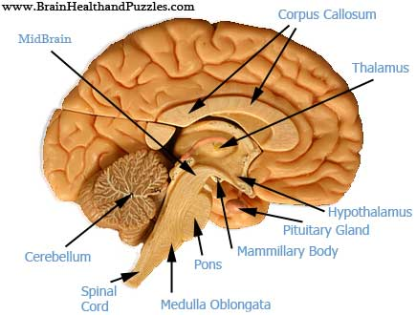
Chronic Brain Disorder: Organic Brain
Cerebrum (Cortex): responsible for higher functioning, reasoning, rational action
Limbic System: “emotional brain”; responsible for basic survival such as fight, flight, freeze and instant gratification (reward center).
Cerebellum: (Brain Stem): involuntary functions such as breathing, heart beating, etc.
http://clipart-library.com/clipart/gie5Gr85T.htm

Slide 8
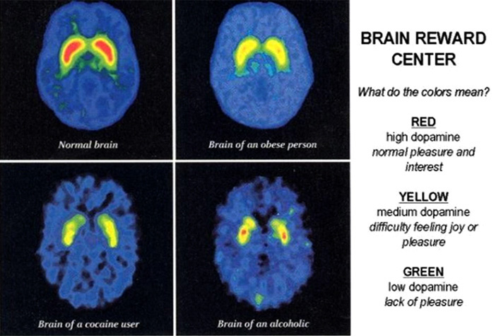
Chronic Brain Disorder: Neurochemical Brain
Serotonin: mood, sleep, emotion
Norepinephrine: mental arousal, elevated mood
Endorphins/Enkaphalins: natural opiates/pain modulators and anti-anxiety chemicals. Produce physical dependence
Dopamine: reward chemical, controls arousal levels of the brain, vital for giving physical motivation. Critical chemical in addiction
http://www.thinwomanbrain.com/the-food-addicts-brain.php

Slide 9
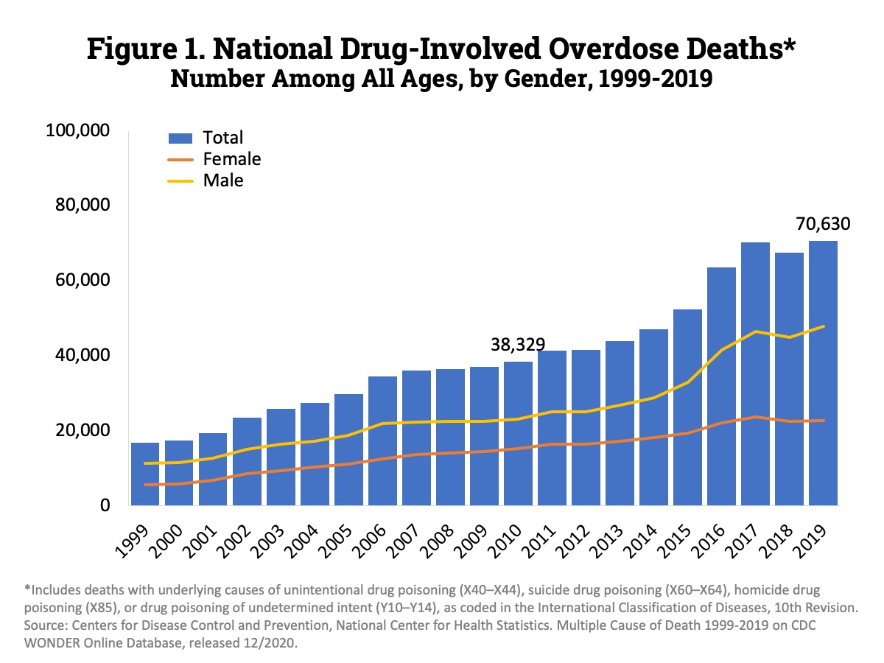
Overdose Rate
Overall overdose death rate nearly doubled since 2010
https://www.drugabuse.gov/related-topics/trends-statistics/overdose-death-rates; Revised May 2021

Slide 10
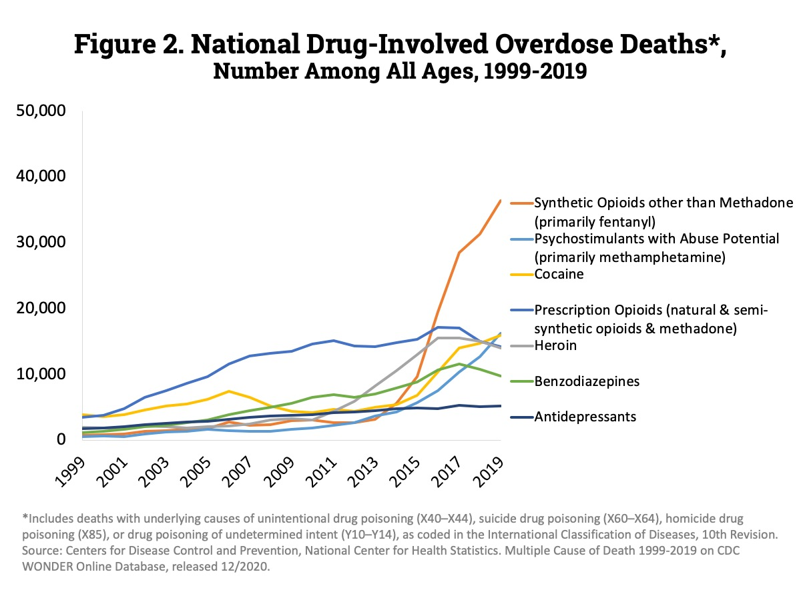
Overdose Rate
Fentanyl and psychostimulants (amphetamines) steady incline since 2015
https://www.drugabuse.gov/related-topics/trends-statistics/overdose-death-rates; Revised May 2021

Slide 11
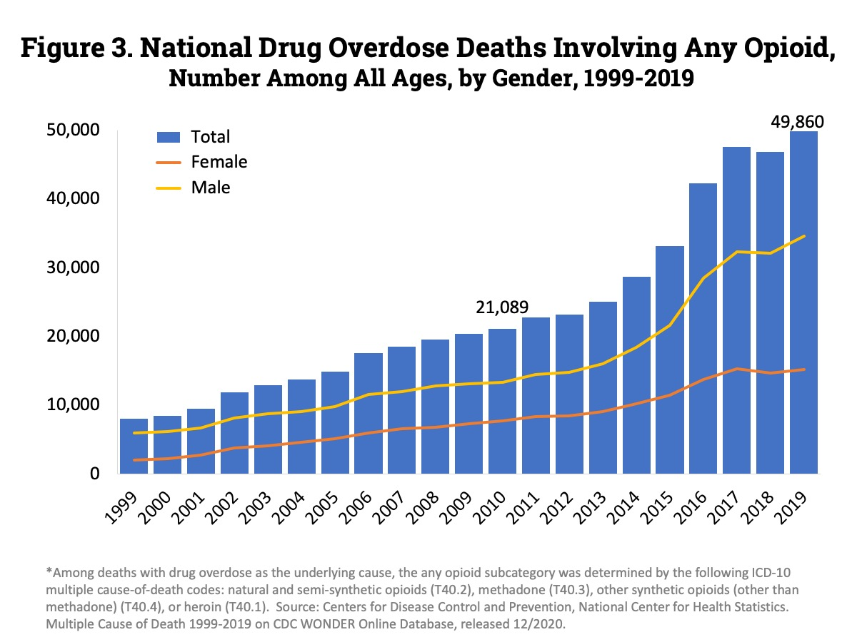
Overdose Rate
https://www.drugabuse.gov/related-topics/trends-statistics/overdose-death-rates; Revised May 2021

Slide 12
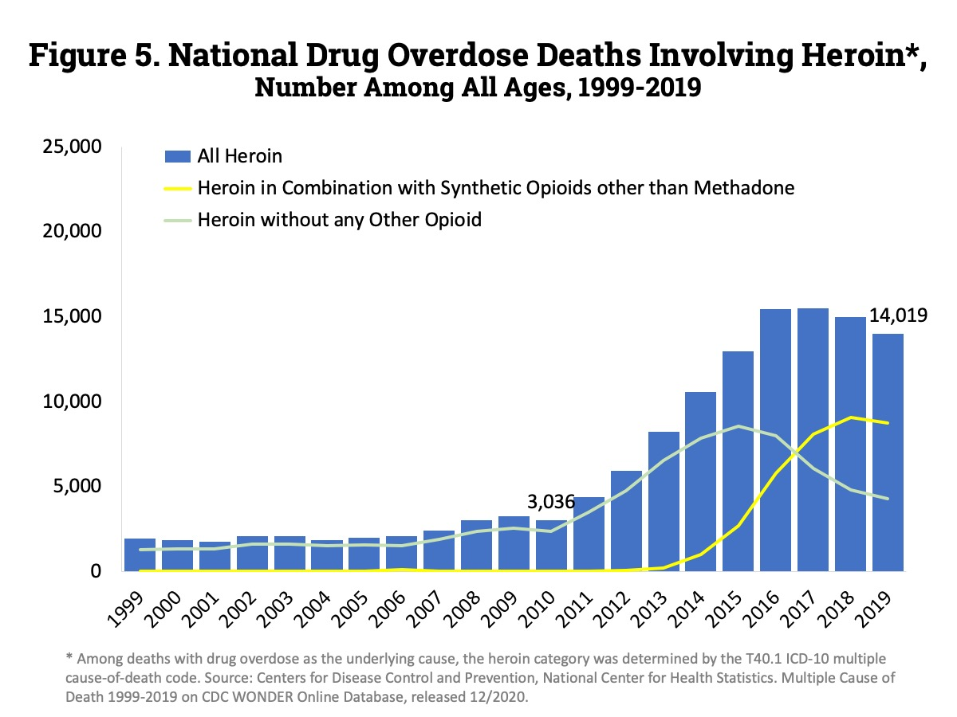
Overdose Rate
https://www.drugabuse.gov/related-topics/trends-statistics/overdose-death-rates; Revised May 2021

Slide 13
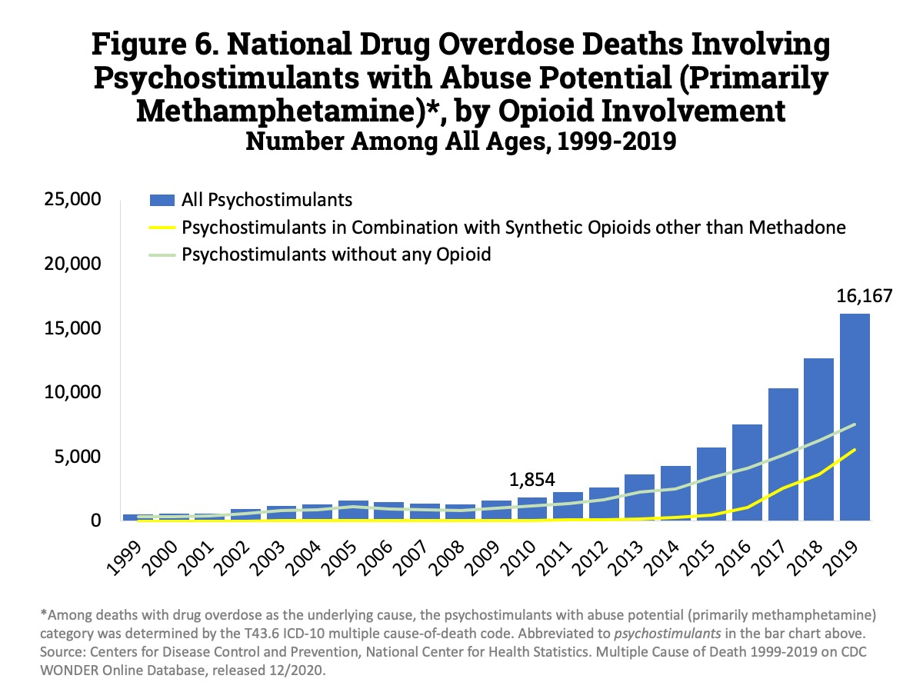
Overdose Rate
https://www.drugabuse.gov/related-topics/trends-statistics/overdose-death-rates; Revised May 2021
Notes:
1999- 547; 2018- 12,676 and 2019- 16,167, increased by 3,491 deaths

Slide 14
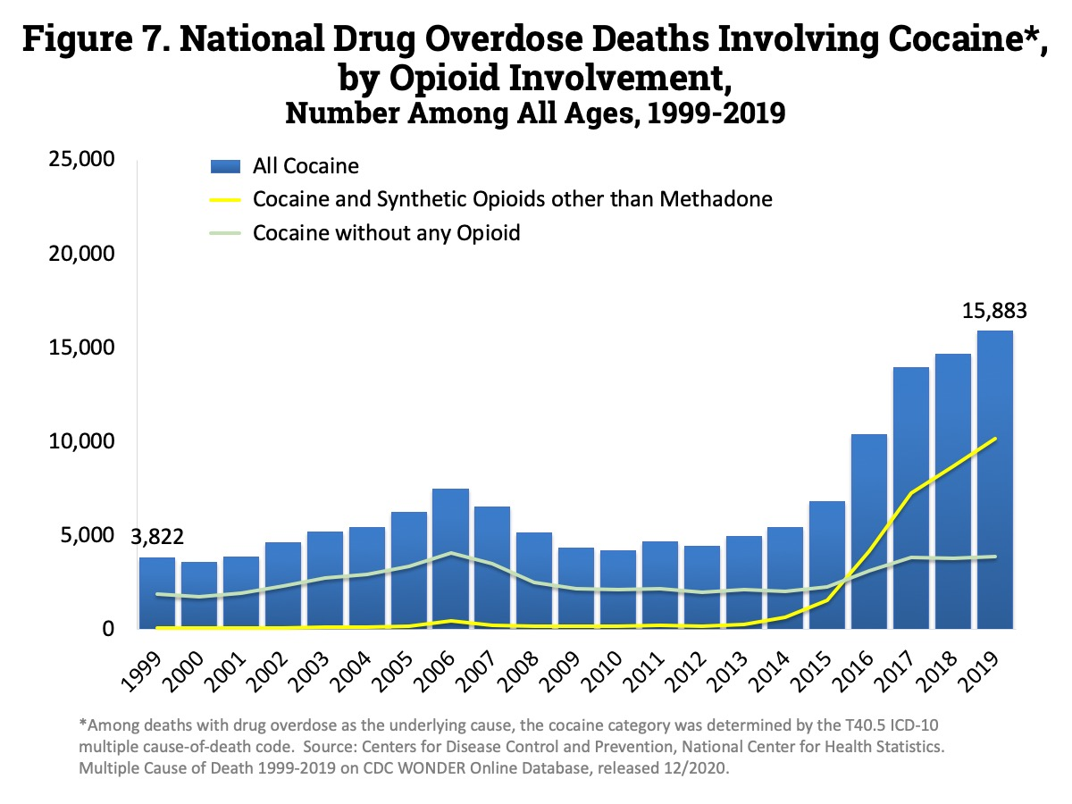
Overdose Rate
https://www.drugabuse.gov/related-topics/trends-statistics/overdose-death-rates; Revised May 2021
Notes:
1999- 3,822 and 2018- 14,666 and 2019-

Slide 15
Opioids vs. Stimulants
Opioids
(heroin/fentanyl)
Stimulants (methamphetamine/cocaine)
CNS depressants
Respiratory depression/overdose death risk
Somnolence, drowsiness, euphoria, constipation
Natural mechanism for metabolism- enzymatic breakdown
  Endorphins (endogenous morphine)
CNS stimulants
Severe insomnia, tachycardia, rapid speech, involuntary motor movements, increased attention, euphoria/”rush”, decreased appetite
Psychosis, hallucinations, paranoia
Methamphetamine- all inorganic chemicals
Prolonged use can lead to potentially irreversible brain damage

Slide 16
Route of Administration Effects
Swallowing- absorbed in gut; extensive metabolism (liver)/dilution before enters brain; delayed desired effects.
Snorting- absorbed through nasal capillaries; extensive metabolism (liver); quicker desired effects.
Smoking- absorbed through lungs; less metabolism; quicker desired effects.
Intravenous- directly transported to the brain; virtually no metabolism; immediate and intense desired effects; more severe treatment resistance and insidious prognosis

Slide 17
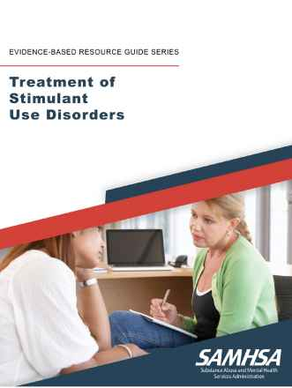
Non-Pharmacological
Evidence-Based Treatment
SAMHSA Treatment of Stimulant Use Disorders Evidence-Based Guidebook.
  Non-pharmacological interventions
    Cognitive Behavioral Therapy (CBT)
    Motivational Interviewing
    Contingency Management (CM)
    Community Reinforcement Approach
Not in Guidebook
  Dialectical Behavioral Therapy- Borderline Personality Disorder Treatment
    Effective interventions for Substance Use Disorders
    Distress Tolerance, Radical Acceptance, and Mindfulness coping strateties
https://store.samhsa.gov/product/Treatment-of-Stimulant-Use-Disorder/PEP20-06-01-001

Slide 18
Contingency Management (CM)
A type of behavioral therapy in which individuals are “reinforced”, or rewarded, for evidence of positive behavior change.
  Most often involve provision of monetary-based reinforcers for submission of drug-negative urine specimens.
    Reinforcers: Vouchers exchangeable for retail goods or the opportunity to win prizes
Principles:
  Operant Condition: behavior that is reinforced in close proximity to an occurrence will increase in frequency
    Positive reinforcement
Barriers to implementation:
  Few are aware or trained in this intervention
  Expensive- evidence suggests $400-$500 per patient; lesser amounts are ineffective
    Federal limits are $75-$100 per patient
  Ideological concerns- “bribing”
  Federal and State laws make it illegal
    Anti-Kick Back Statute and Civil Monetary Penalties
https://www.ncbi.nlm.nih.gov/pmc/articles/PMC3083448/

Slide 19
Non-FDA Approved Pharmacological Interventions- “Ted Talk”
Cravings:
  Extended released injection or oral naltrexone (Vivitrol/Revia)
    Opioid receptor antagonist/blocker
    Clinical Trials: New England Journal of Medicine January 2021 (Vivitrol and bupropion combination) and many others
  Selegiline
    Active metabolites: (R)-desmethylselegiline, (R)-methamphetamine, (R)-amphetamine, (1S,2R)-norephedrine, (1R,2R)-norpseudoephedrine, (1S,2R)-ephedrine, (1R,2R)-pseudoephedrine, (R)-p-hydroxyamphetamine, and (R)-p-hydroxymethamphetamine.
Abstinence:
  Acamprosate (Campral)
    Stabilizes GABA and Glutamate

Slide 20
Non-FDA Approved Pharmacological Interventions- “Ted Talk”
Anxiety/Insomnia:
  Clonidine: alpha2-adrenergic receptor agonist; central activity on pons of cerebellum (regulates basic survival functions- fear, anxiety, emotions)
  Hydroxyzine: antihistamine
  Gabapentin: anti-epileptic and neuropathic pain analgesic
  Trazodone: SSRI anti-depressant used for sedation
Depression:
  Bupropion- effects dopamine; main circuitry involved in stimulant use disorder
  SSRI’s- effects serotonin; preferred escitalopram for anxiety depression
Concentration/“Racing Thoughts”:
  Guanfacine (Intuniv ER)
  Non-stimulant ADHD medication; centrally acting alpha2-adrenergic receptor agonist.
Psychosis/Hallucinations:
  Antipsychotics: Risperidone (Risperdal), Quetiapine (Seroquel)

Slide 21
Non-FDA Approved Pharmacological Interventions- “Ted Talk”
Depression:
  Bupropion- effects dopamine
  SSRI’s- effects serotonin
    prefer escitalopram (Lexapro)
Concentration: guanfacine (Intuniv (ER)
  Non-stimulant ADHD medication; centrally acting alpha2-adrenergic receptor agonist.
Psychosis/Hallucinations: antipsychotics
  Risperidone (Risperdal)
  Quetiapine (Seroquel)
Notes:
Guanfacine stimulates postsynaptic alfa-2A adrenergic receptors so it inhibits the production of cAMP and closes HCN channels enhancing the effectiveness of the signal of the pyramidal neurons of the prefrontal cortex (PFC), thus improving working memory and attention.

Slide 22
Stigma
Language Matters!
Changing Federal Terminology Regarding Substance Use and Substance Use Disorders Memo from Office of the White House/Office of National Drug Control Policy Director Michael Botticelli January 2017¹
  “Changing the Language of Addiction Memo”- mandate to use non-stigmatizing language for substance use; using Substance Use Disorder (SUD) in place of ‘addiction’.
  Research has shown:
    People with SUD are viewed more negatively than people with physical or psychiatric disabilities
    Even highly trained substance use disorder and mental health clinicians significantly more likely to assign blame and believe individuals should be subjected to punitive rather than therapeutic measures when case vignette was referred to “substance abuser” rather than “person with a substance use disorder”.
Avoid terms such as:
  Junkie, Tweaker, Addict, Druggie, Clean/Dirty (urine), etc..

Slide 23

ALWAYS….

Slide 24
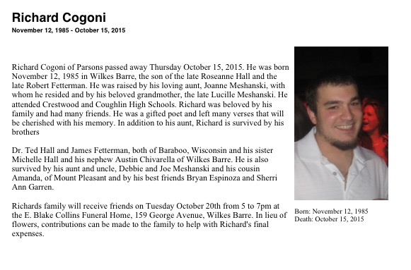
Remember…

Slide 25


Contact Information
  CAPT Ted L. Hall, PharmD
  Ho-Chunk Nation Health Department
  S2845 White Eagle Road
  Baraboo, WI 53913
  (O) 608-355-1240 ext. 35582
  (C) 608-301-5390
  Ted.Hall@ho-chunk.com

