Slide 1
Skin and Soft Tissue Infections
James B. McAuley, MD MPH FIDS
Clinical Director
Whiteriver Service Unit, Indian Health Service

Slide 2
disclosures
Presenter has nothing to disclose
This material is the result of work supported with resources and the use of facilities at the Whiteriver Indian Hospital located in the Phoenix Area of the Indian Health Services.
The content does not represent the views of the Indian Health Services or the United States Government
All patient pictures are public domain, not patients cared for by WRSU

Slide 3
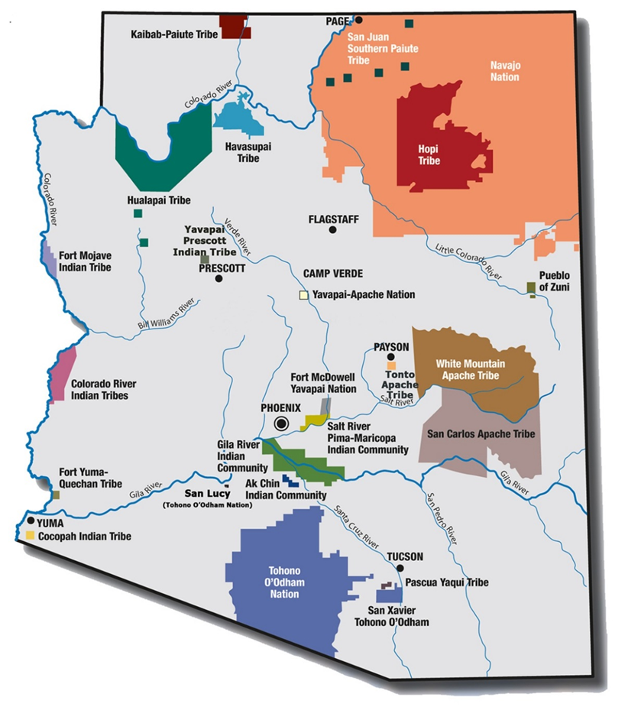
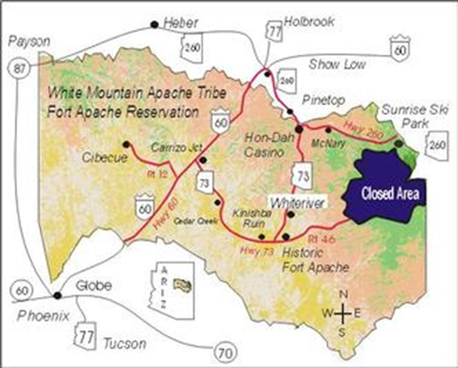
White Mountain Apache Reservation ~ 3-4 hour drive from Phoenix, Tucson, Grand Canyon, Albuquerque
A bit smaller than Delaware
One of the few reservations that includes the community’s traditional lands

Slide 4
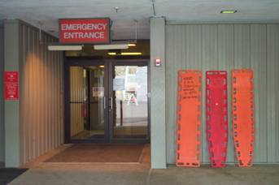
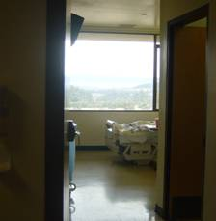
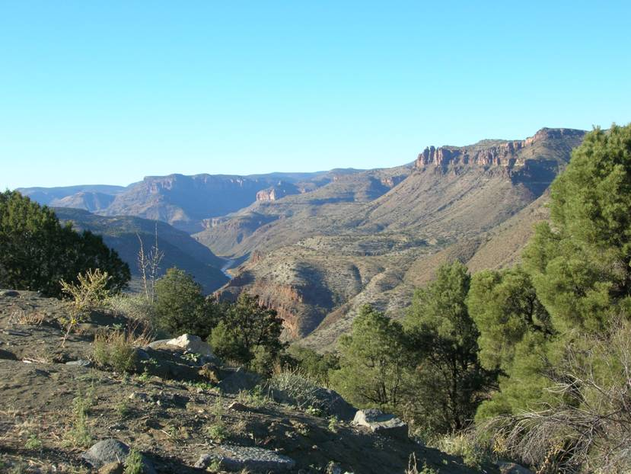
Whiteriver Indian Hospital
In 2019:
24 bed rural hospital
39,798 ED visits
98,304 outpatient visits to Family Practice, Internal Medicine, and Pediatrics, Pharmacy
50 deliveries
900 transports (1/2 by air)
Patients: Apache (86%), Navajo (9%), Hopi (1%) and other Tribe (4%)
Notes:
4

Slide 5
The issue of diabetic foot infections,
and more broadly – skin and soft
tissue infections, in American Indians
and Alaskan Natives – is a complex
interplay between the host, the organism(s),
and the environment. All set in the historical
context of genocide and chronic oppression.
The presentation will touch on IDSA SSTI
treatment guidelines, highlight some early
observations at Whiteriver and raise more
questions than answers.
Diabetes
MSSA
MRSA
GAS
Care

Slide 6
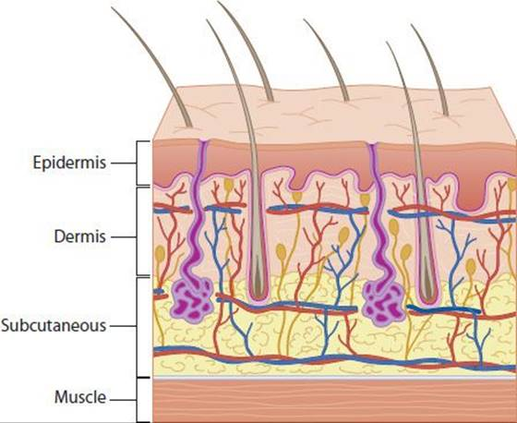

Slide 7
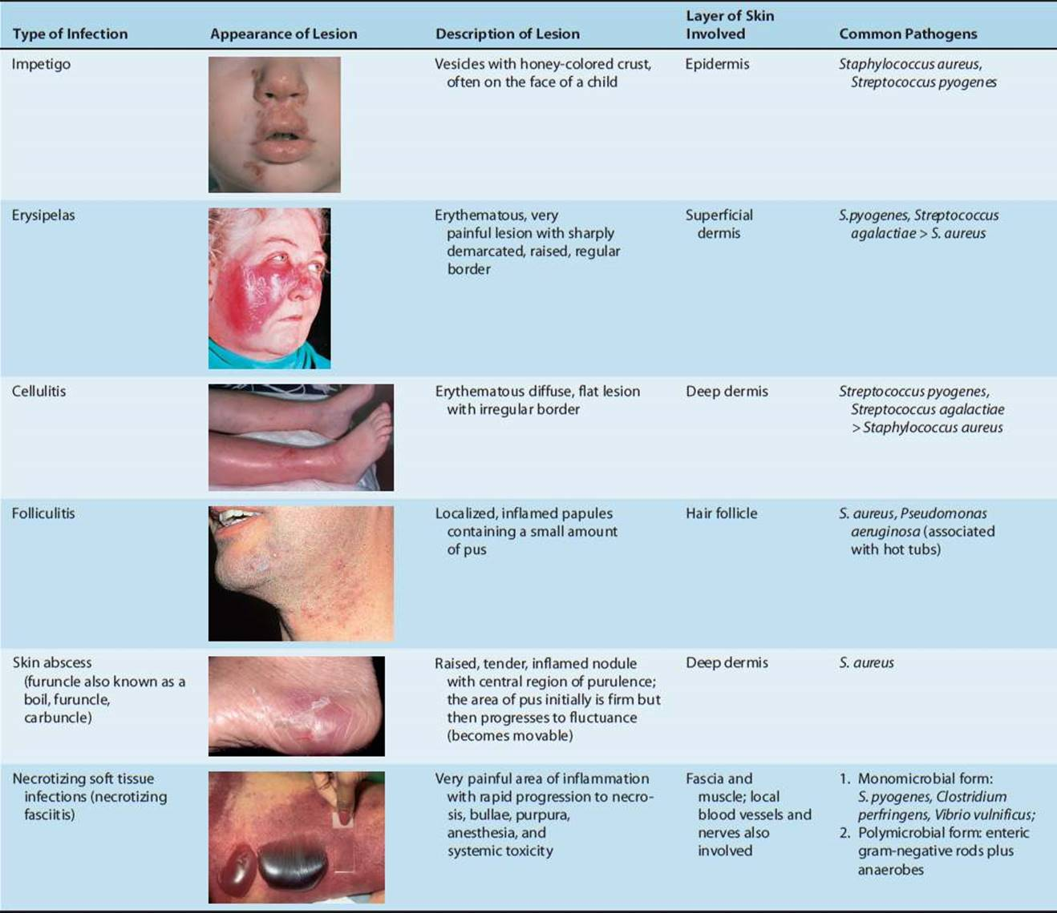

Slide 8
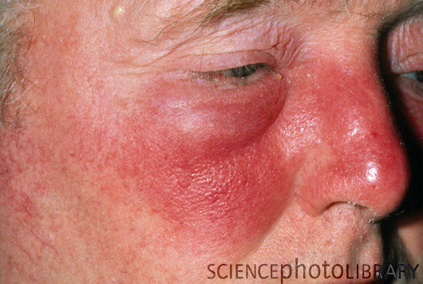

Slide 9
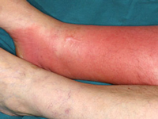

Slide 10
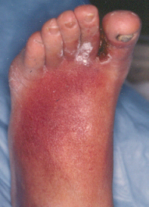

Slide 11
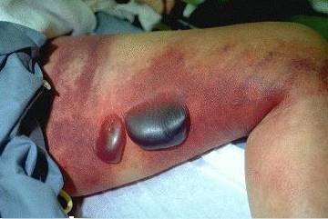

Slide 12
Diabetic Foot Infections
- Diabetic foot ulcers secondary to peripheral artery disease and neuropathy develop in 25% of adults with diabetes
- Persons with diabetes account for half of all lower extremity (LE) amputations (~37,000/year)
- One year mortality following LE amputation is ~50%
- AI/AN Medicare patients had the highest rate of DFU and amputation of any racial/ethnic group in the US
Margolis DJ, et al. 2011 https://pubmed.ncbi.nlm.nih.gov/22049561/

Slide 13
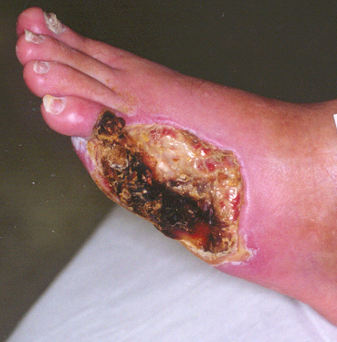

Slide 14
Skin and Soft Tissue Infections – Whiteriver Indian hospital - 2016
- Noted 16 cases of necrotizing fasciitis or invasive GAS from June-October 2016 - Calls to nearby IHS facilities indicated this was somewhat common across the region.
- Unexpectedly high number of acute rheumatic fever cases
- WRSU staff began studying the problem.
  Evaluate GAS pharyngitis – application of standard diagnostic criteria
  Evaluated POC PCR for detection of GAS for ED/OPD skin infections
  Evaluated SSTI hospitalizations
  Developed surveillance for iGAS and invasive S aureus with JHU CAIH

Slide 15
52% of skin lesions grew a pathogen
POC PCR had excellent correlation
with culture for GAS
POC MSSA/MRSA testing is also
commercially available

Slide 16
81% of specimens detected GAS, MSSA,
MRSA or some combination of the three
54% of GAS (+) also grew MRSA (22%)
or MSSA (32%)
68% of GAS (–) grew MRSA (56%) or
MSSA (12%)
Clinical differentiation (purulence) lacked
specificity
POC PCR with GAS/MSSA/MRSA would be
ideal for antibiotic stewardship
https://doi.org/10.1093/ofid/ofz360.517

Slide 17
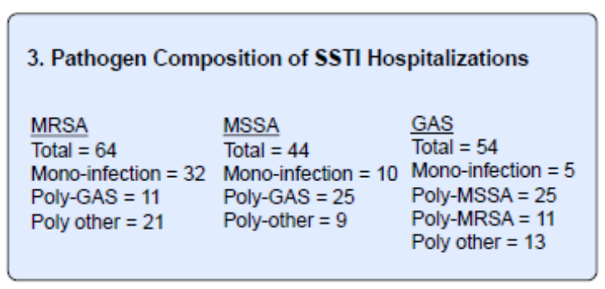
Hospitalization for SSTI in AN American Indian Population
- From June 2017 – May 2018 there were 1,883 hospitalizations with 289 unique individuals representing 343 (18.2%) SSTI hospitalizations: 52% male, mean age 43.
  20.2 SSTI hospitalizations per 1,000
  50% cellulitis, 13 cases of necrotizing fasciitis (76/100,000 population – US 0.3-5/100,000)
  53% had a wound culture taken – 91% identified a pathogen

Slide 18
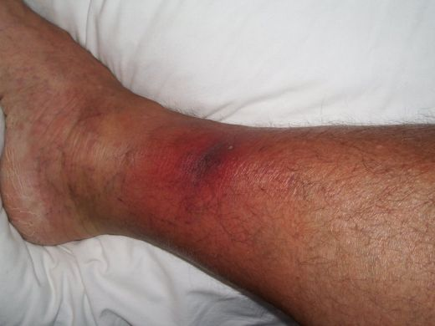

Slide 20
Based upon these initial studies – iGAS was incorporated into the ABS (Active Bacterial Surveillance) conducted by Johns Hopkins Center for American Indian Health
March 2017-February 2020
- Active laboratory surveillance for severe and invasive GAS
- Invasive GAS from sterile site, Severe GAS from non-sterile site but patient required hospitalization
- emm-types evaluated for iGAS and GAS pharyngitis
Presented at IDWeek 2019 https://doi.org/10.1093/ofid/ofz360.526

Slide 21
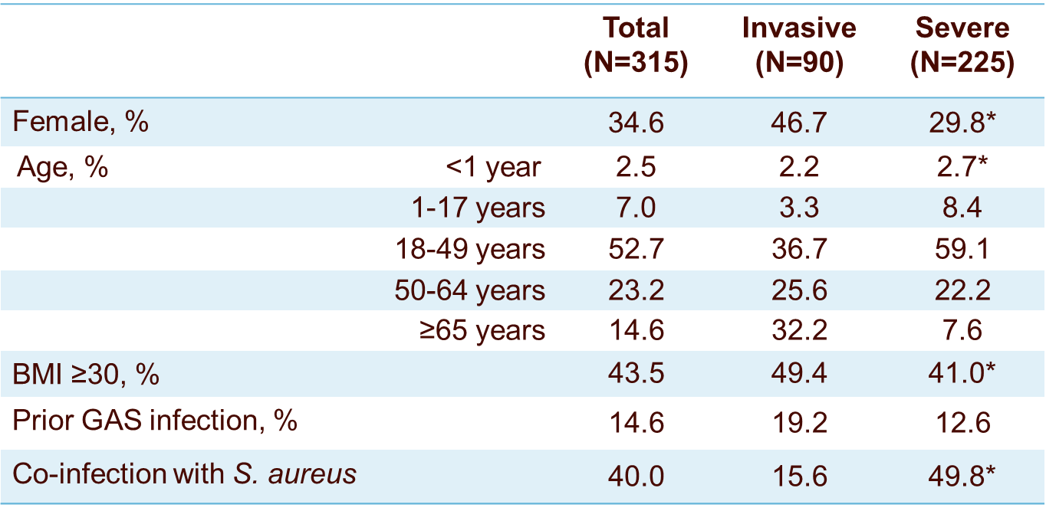
Characteristics of Invasive & severe cases
35% of invasive or severe GAS in persons over 18 year of age
occurred in persons with diabetes

Slide 22
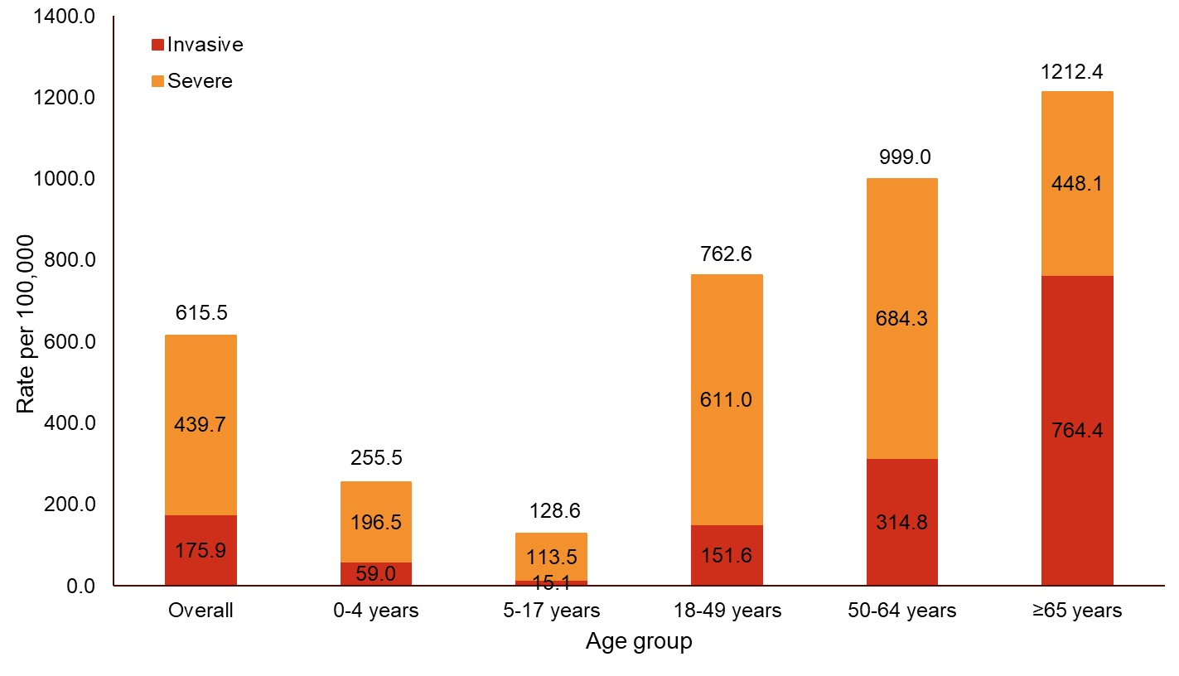
Incidence rates by age

Slide 23
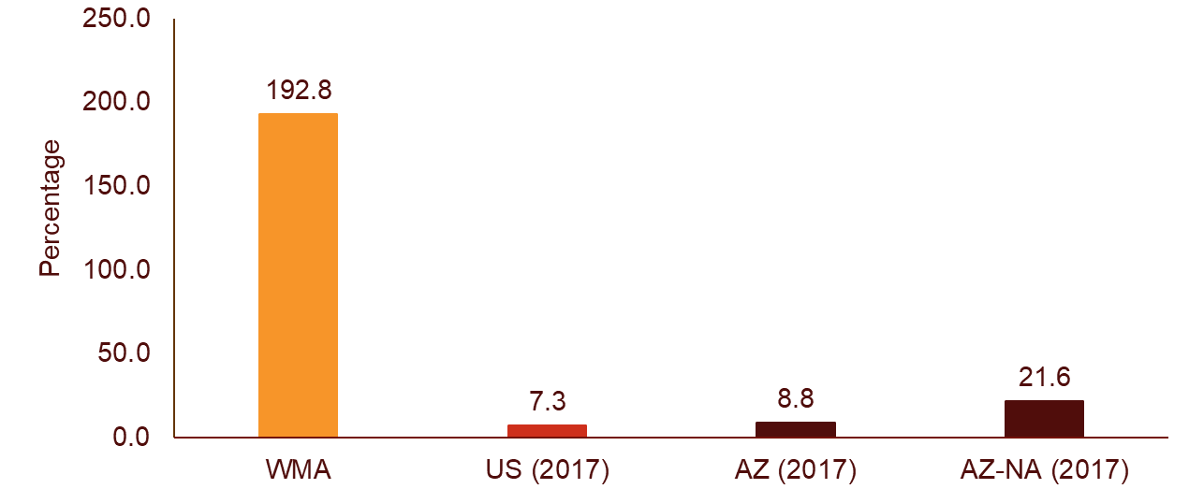
Comparison of iGAS on the WMA Tribal lands to the US General Population
26x greater rate

Slide 24
Emm-type and potential prevention
Variable results year to year and slight differences between pharyngeal and sterile site isolates.
A 30 valent emm-type GAS vaccine would provide protection against 100% of the pharyngeal isolates and a 30 valent emm-type + mrp would provide protection against 98% of invasive isolates in our population.
9% clindamycin resistant and 19% tetracycline resistant

Slide 25
Invasive Staphylococcus Aureus – May 2016-April 2018
- 53 cases identified
  49% were diabetic and 42% were obese
  76% were MRSA
  7.5% required amputation and 7.7% died
  Age-adjusted Invasive S aureus incidence was 156.3/100,000
    138.2 for MRSA – US rate is 18.8 for invasive MRSA

Slide 26
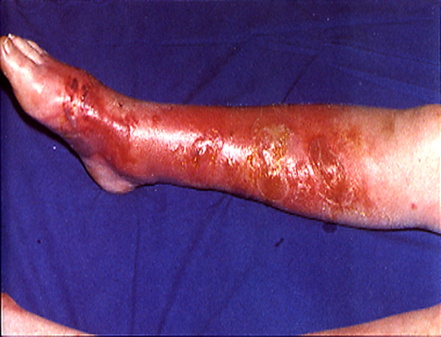

Slide 27
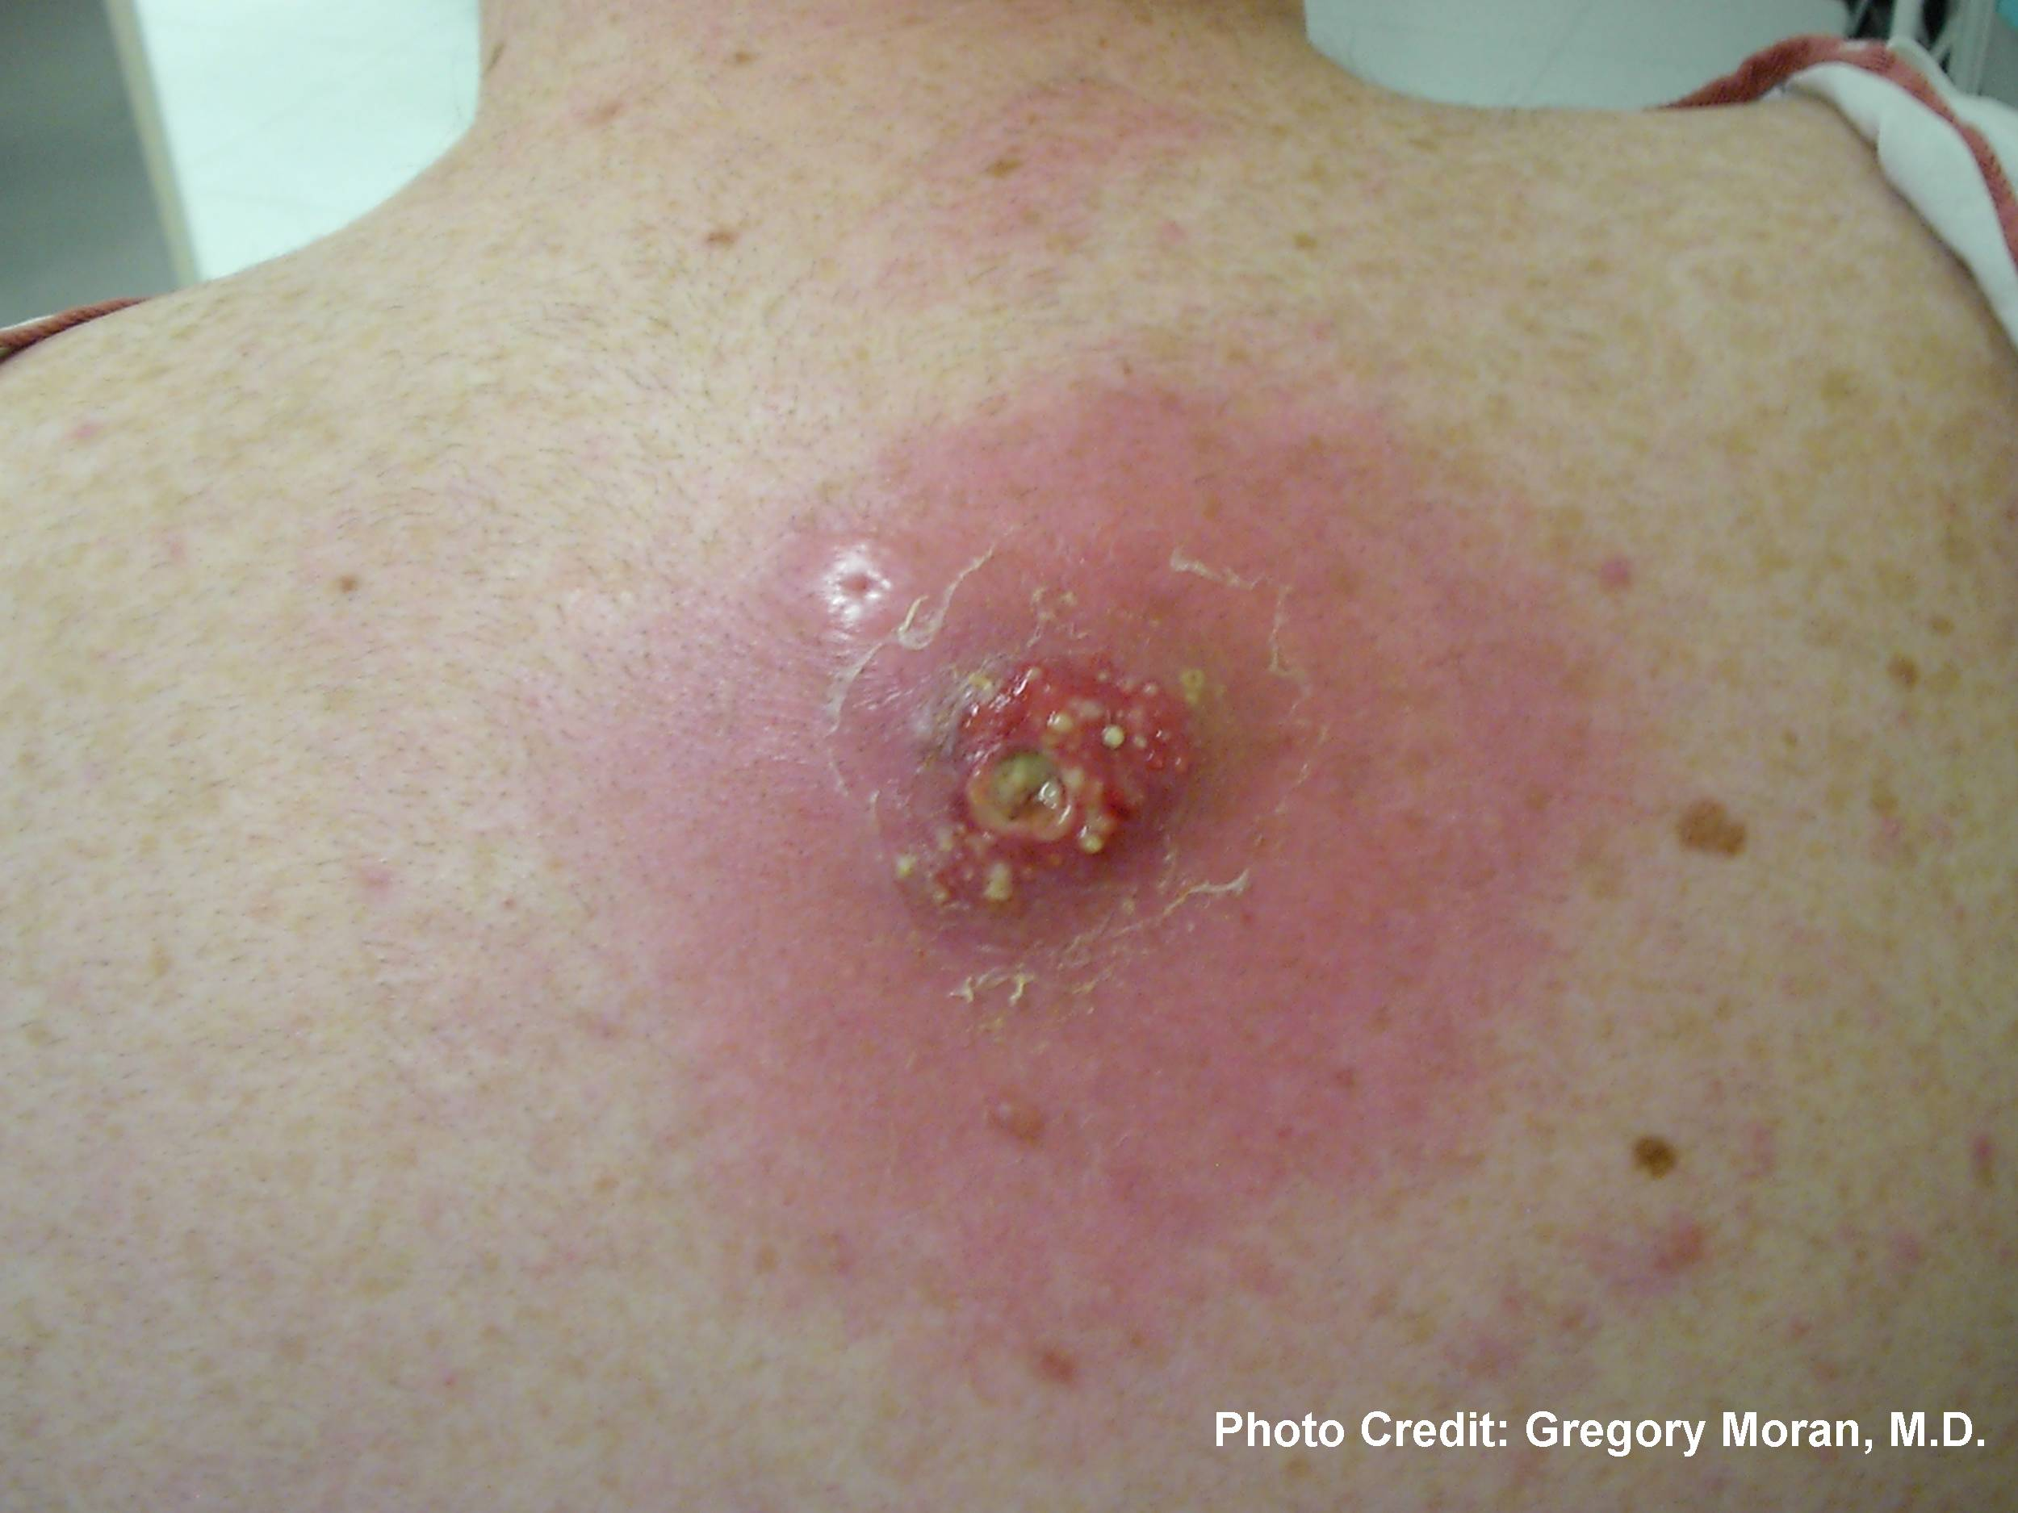

Slide 32
Failure of Beta-lactam Antibiotics (Eagle Effect) and Superiority of Clindamycin in the Treatment of Invasive Streptococcus pyogenes Infections
Zimbelman JD, Palmer AL, Todd JK. Pediatric Research 43:161 (1998)

Slide 33
GAS as a Health Disparities Disease
- Significant disparities in iGAS rates between indigenous and non-indigenous populations of Australia, New Zealand, and Canada, but much less is understood regarding iGAS among AI/AN in the United States.
- 46% of iGAS in Alaska is among AI/AN (20% of population)
- Post-strep sequelae (RF, PSGN) without recent data
- Role of SES needs to be defined, role of historical trauma not yet understood (ACEs and chronic disease)

Slide 34
conclusions
Skin and soft tissue infections, particularly those caused by Streptococcus pyogenes and Staphylococcus aureus disproportionately affect American Indians and Alaskan Natives (AI/AN)
Rates of diabetic foot ulcer are higher for AI/AN than in other racial/ethnic groups
Providing care requires a comprehensive approach – beginning with an understanding of the epidemiology of the disease, the historical and cultural context, the available assets to address the issues, and advocating for new tools as appropriate.
Routine guidelines (IDSA) may not be appropriate for AI/AN communities where mixed GAS/MSSA/MRSA infections are common

Slide 35
Youngest person (12 months) with Rheumatic Fever reported in well over 50 years
Too young to be tested for GAS per current GAS pharyngitis guidelines
Led us to evaluate GAS pharyngitis – finding 30% of adults presenting with
a sore throat have GAS
In our community the ‘standard’ guidelines for diagnosing and treating Group A Strep
pharyngitis do not work as well as in the broader US population.

