Slide 1
Indian Country Infectious Disease ECHO
COVID-19 Update
Jonathan Vilasier Iralu, MD, FACP, FIDSA
Indian Health Service Chief Clinical Consultant
for Infectious Diseases

Slide 2
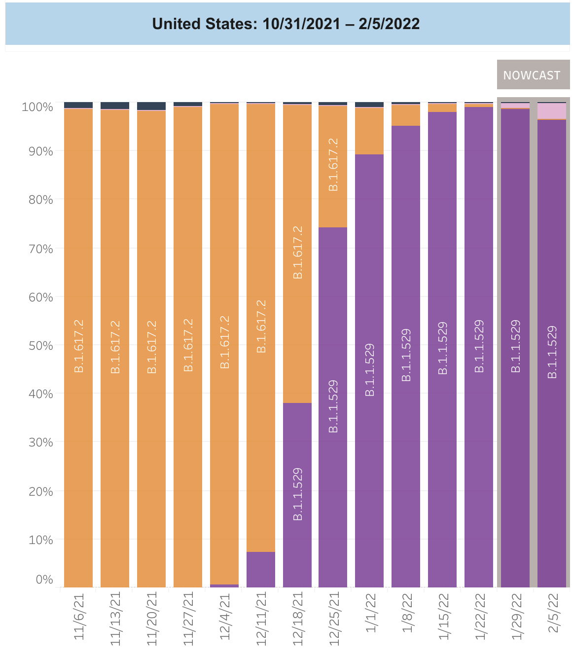
Virology
Omicron Variant
  Makes up all of US cases now
  Includes BA.1, BA.2, BA.3 sub-lineages
    96.4% B.A1
    3.6% B.A2
https://www.cdc.gov/mmwr/volumes/71/wr/mm7106e2.htm?s_cid=mm7106e2_x

Slide 3
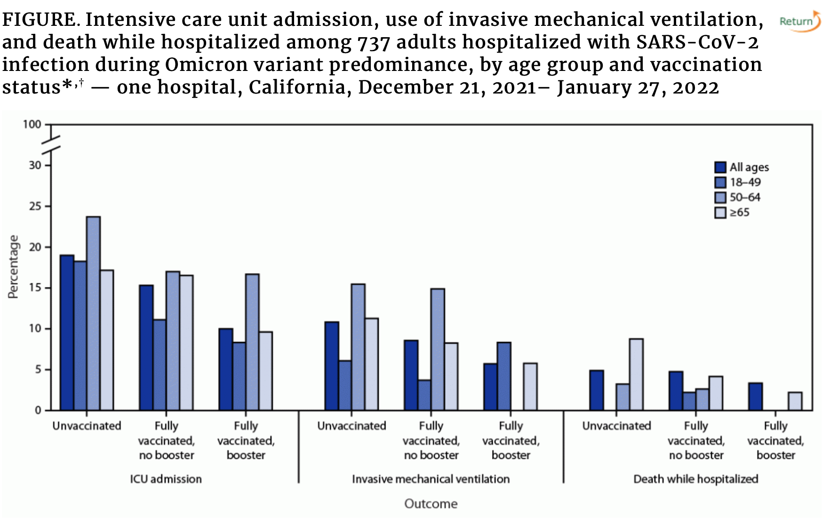
Omicron Variant:
Modes et al.
Single LA Hospital
During the delta period, 25% of admissions were vaccinated vs 40% during the omicron period
Vaccination resulted in
  Lower chance ICU admission
  Lower chance of death if > 65 years old
https://www.cdc.gov/mmwr/volumes/71/wr/mm7106e2.htm?s_cid=mm7106e2_x

Slide 4
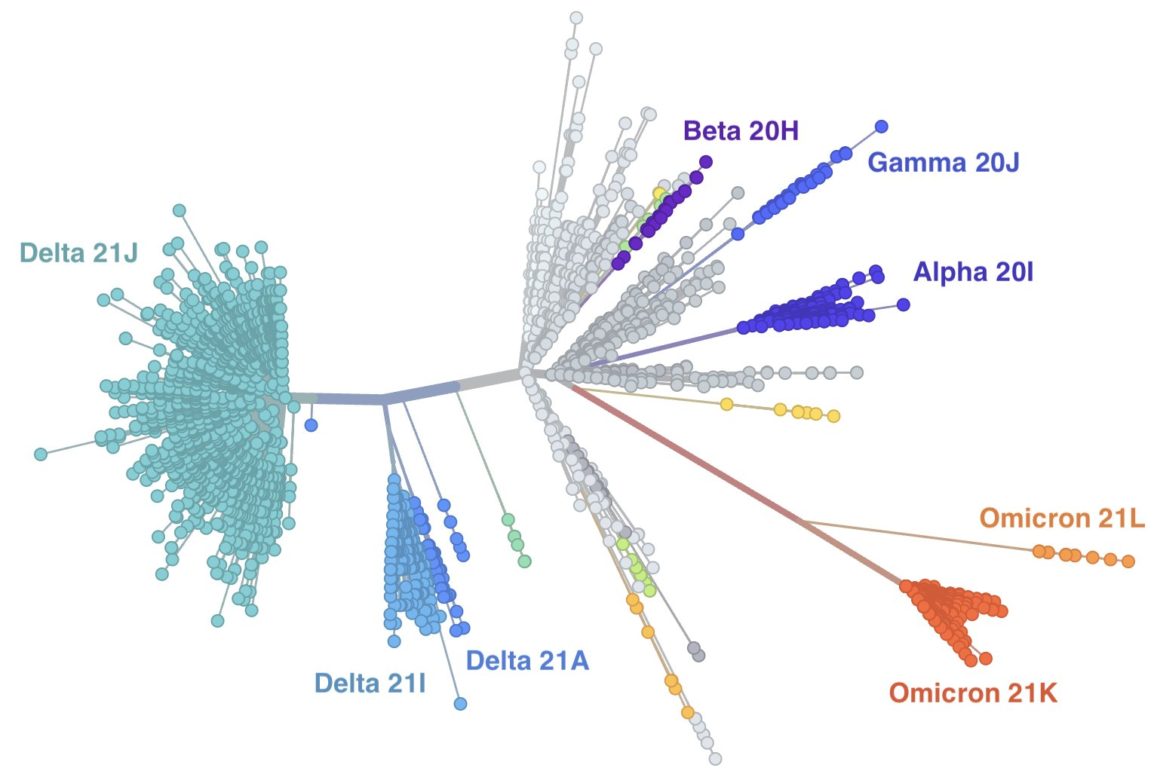
8
https://nextstrain.org/ncov/gisaid/global?l=unrooted&m=div
Notes:
Tree comprised of sequences uploaded from around the world

Slide 5
Early evidence suggests BA.2 is more transmissible than BA.1.
9
BA.2
BA.1
Transmission of SARS-CoV-2 Omicron VOC subvariants BA.1 and BA.2: Evidence from Danish Households: Lyngse et al, medRxiv

Slide 6
NIH Treatment Guidelines
NIH Treatment Guidelines Update
Pre-Exposure Prophylaxis:
  Use Tixagevimab/Cilgavimab (Evusheld) for age 12 and up, 40 kg an up and
    Moderately to severely immunocompromised and may have inadequate response to vaccine
    Not able to receive vaccine due to history of severe adverse reaction to a vaccine
Post Exposure Prophylaxis
  DON’T USE BAM/ETE or CAS/EMD due to circulation of Omicron
https://www.covid19treatmentguidelines.nih.gov/about-the-guidelines/whats-new/

Slide 7
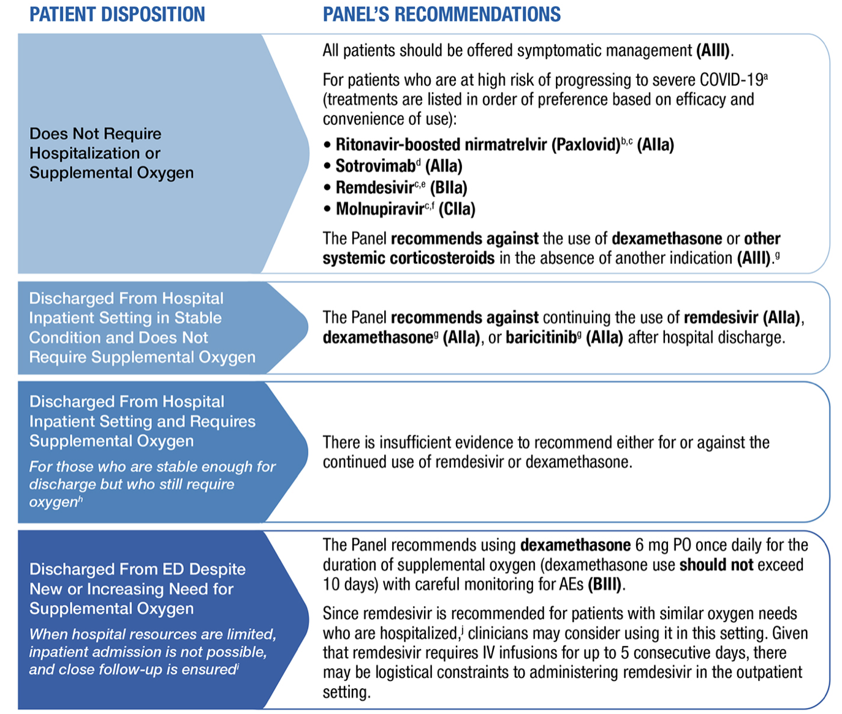
NIH Treatment Guidelines Update
Non-hospitalized
Not hospitalized, no O2
  Nirmatrelvir/r (Paxlovid)
  Sotrovimab
  Remdesivir
  Molnupiravir
  No steroids
No Beds & D/C from ED
  Dexamethasone while on O2
  Consider Remdesivir x 5d
  https://www.covid19treatmentguidelines.nih.gov/management/clinical-management/nonhospitalized-adults--therapeutic-management/

Slide 8
How to prioritize drugs in limited supply…
NIH Tier system
  Immunocompromised or Unvaccinated (Age > 75 or >65 with risk factors)
  Unvaccinated and age > 65 or <65 with risk factors
  Vaccinated, but at high risk (age>75 or >65 with risk factors) especially if unboosted
  Vaccinated at risk for severe disease (Age >65 of< 65 with risk factors)
  https://www.covid19treatmentguidelines.nih.gov/management/clinical-management/nonhospitalized-adults--therapeutic-management/

Slide 9
Who is immunocompromised?
Been receiving active cancer treatment for tumors or cancers of the blood
Received an organ transplant and are taking medicine to suppress the immune system
Received a stem cell transplant within the last 2 years or are taking medicine to suppress the immune system
Moderate or severe primary immunodeficiency (such as DiGeorge syndrome, Wiskott-Aldrich syndrome)
Advanced or untreated HIV infection
Active treatment with high-dose corticosteroids or other drugs that may suppress your immune response
https://www.cdc.gov/coronavirus/2019-ncov/vaccines/recommendations/immuno.html

Slide 10
Who is severely immunocompromised?
Patients who are within 1 year of receiving B cell-depleting therapies (e.g., rituximab, ocrelizumab, ofatumumab, alemtuzumab)
Patients who are receiving Bruton tyrosine kinase inhibitors
Chimeric antigen receptor T cell recipients CART
Post-hematopoietic cell transplant recipients who have chronic graft versus host disease or who are taking immunosuppressive medications for another indication
Patients with hematologic malignancies who are on active therapy
Lung transplant recipients
Patients who are within 1 year of receiving a solid organ transplant (other than a lung transplant)
Solid organ transplant recipients with recent treatment for acute rejection with T cell- or B cell-depleting agents
Patients with severe combined immunodeficiencies
Patients with untreated HIV who have a CD4 T lymphocyte cell count <50 cells/mm³
https://www.covid19treatmentguidelines.nih.gov/management/clinical-management/nonhospitalized-adults--therapeutic-management/

Slide 11
Interim CDC COVID vaccine guidance 2/11/2022
Primary vaccine series is recommended for everyone > 5 years
A third dose recommended for >5 years moderately-severely immuno-compromised followed by a booster for > 12 years
Boosters for 12 and up:
  > 5 months for mRNA general population and 2 months for J and J
  > 3 months for mRNA immunocompromised and 2 months for J and J
No delay required after monoclonal Ab Rx for COVID-19
https://www.cdc.gov/vaccines/covid-19/clinical-considerations/covid-19-vaccines-us.html

Slide 12
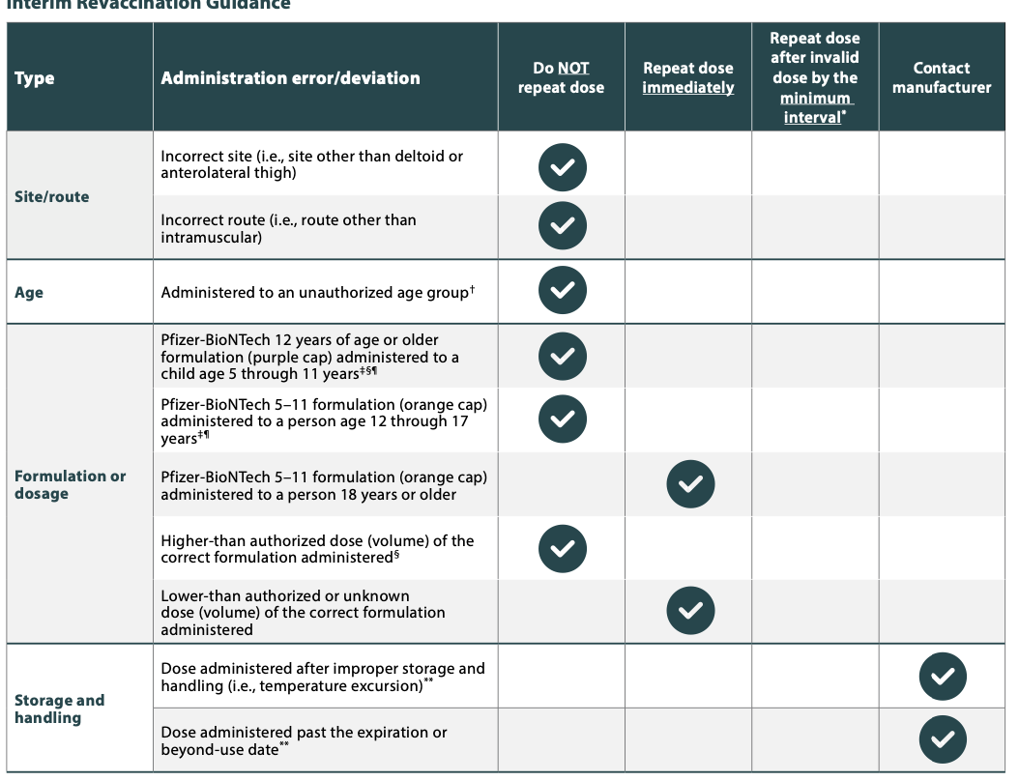
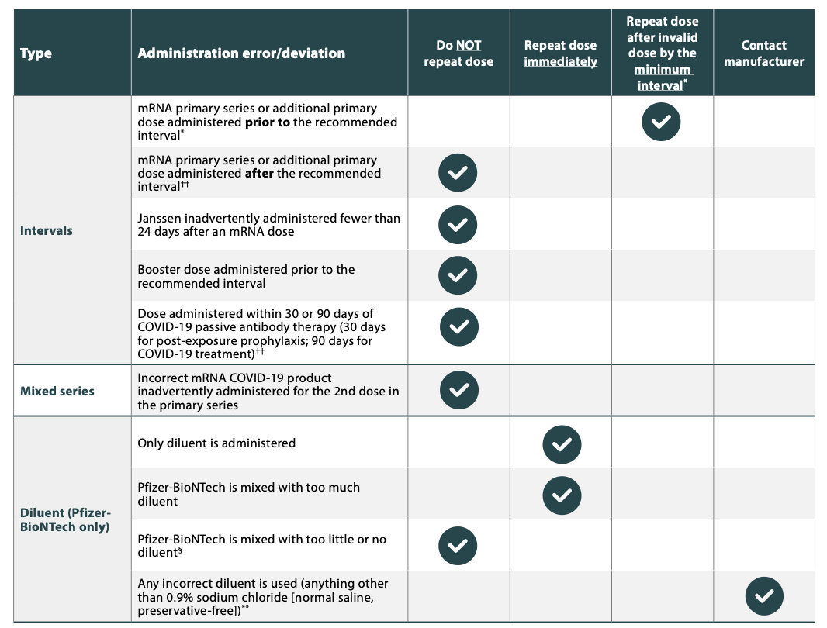
COVID-19 Vaccine Errors
https://www.cdc.gov/vaccines/covid-19/downloads/covid19-vaccine-errors-deviations.pdf

Slide 13


