Slide 1
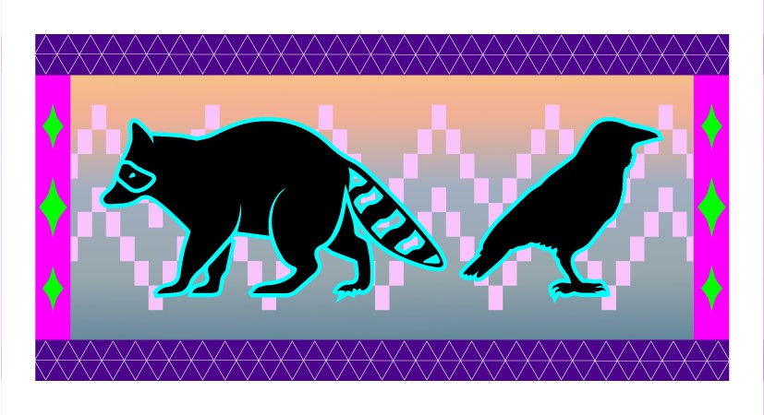
Tricksters Stories: Indigenous Trauma Care
Danica Love Brown, PhD, MSW, CACIII
Choctaw Nation of Oklahoma
Northwest Portland Area Indian Health Board
Behavioral Health Manager

Slide 2
“Meet the Trickster, a crafty creature or being who disrupts the order of things, often humiliating others and sometimes himself in the process. Whether a coyote or a rabbit, raccoon or raven, tricksters use cunning to get food, steal precious possessions, or simply cause mischief.”
Notes:
This presentation is an attempt to help us to understand WHY Natives respond and react to service providers the way they do. If you are triggered by what is being shared in this workshop, I suggest that you take the time to assess this to look at your biases and where and why this is affecting you they way it is. Unfortunately, we will not have time in this workshop to process all the feelings that tend to come up for people. I ask that you please be respectful of this process. If you need to talk after the workshop, please let me know.
For tribal people on Turtle Island, current and past political and social events help shape the context of their lives in ways that many other Americans do not experience. The study of trauma, historical and present, has connected historical genocide, assimilation, oppression and disparate treatment to such symptoms as depression, suicidal thoughts, anger, anxiety, low self-esteem and difficulty in both recognizing and expressing emotions and impact substance misuse
A culturally responsive mental health system must recognize the broader social and political factors that underlie mental health issues for communities of color. For example, data57 show that therapy cannot be successful unless it recognizes the range of social and political issues that contribute to client distress, instead of only identifying the individual issues that result from attempts to adjust to the social and political conditions.
Even the American Psychological Association (APA) guidelines recognize the importance of sociopolitical factors in a client’s treatment, such as the generational history, the history of migration, the citizenship status, English fluency, the extent of support from the family and community, and the level of stress resulting from acculturation.58
A successful mental health system must find ways to integrate mainstream services with culturally-traditional services to address the mental health needs of communities of color within the broader context of their lives

Slide 3
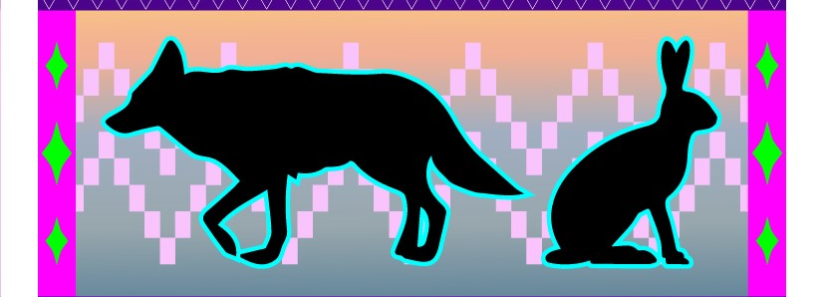
Trickster Spirits and the Opioid Response
Coyote wanders into your life...he'll lend you a pair of eyes ...he'll burn a hole in the darkness.... He is the smoking mirror, night and sorcery, ancestral memory, the enemy on both sides, the crossroads, the compass, the silent wind and thunderous war inside you. ... He holds up the mirror relentlessly until you staring back at yourself....that seems alright to him - Diary of a Dog
Notes:
SUD can impact anyone, because it is a chronic health condition and not a moral failing. As a community, we can look towards the story of the Trickster or “The Tricky One” to learn how SUD can impact Native communities in similarly sneaky and cunning ways. In oral tradition, Trickster is a scared being that assumes many forms. He can be old-man coyote among some tribes, raven in Northwestern tribes, or, more generically, "The Tricky One" (such as Wakdjunkaga among the Winnebago or Manabozho among the Menomini), to mention just a few of his manifestations.
Trickster scandalizes, disgusts, amuses, disrupts, chastises, and humiliates (or is humiliated by) the animal-like proto-people of pre-history, yet he is also a creative force transforming their world, sometimes in bizarre and outrageous ways, with his instinctive energies and cunning. Eternally scavenging for food, he represents the most basic instincts, but in other narratives, he is also the father of the Native people and a strong conductor of spiritual forces in the form of sacred dreams. In respect to substance use disorders, the substances we use are first medicines meant to cure and heal. At some point this transforms into misuse of the medicine, then moves into dependency.
We can imagine that there is a Trickster spirit that is the culprit in this. A spirit that is attempting to teach us important lessons; lesson of humility, compassion, of living in balance with the natural world, respect for the spirit in the medicines we use. The use of the word medicine is not in the Western context of prescription, but rather the energy that traditional medicines carry.
So, there are multiple aspects to consider when looking at opioid misuse and SUD.
First, the essence of opioids and other medicines is a powerful spirit or a prescription to be used.
Second, the current perception of SUD stigmatizes and produces shame or guilt.
In order to help heal and learn the lessons that Trickster has to offer, we need to address our relationships to medicines rather than SUD processes by shifting our understanding and relationship with medicine.

Slide 4
Relationship with Medicine
Reestablish our relationship with medicine
Change our relationship with medicine people
Develop a relationship with the spirit of substances and substance misuse

Slide 5
Trauma
“Using trauma terminology implies that the individual is responsible for the response, rather than the broader systemic force caused by the state’s abuse of power”
Linklater, 2014
Notes:
Is an extraordinary psychological experience caused by treats to life and body or personal encounters with violence or death
Disasters: natural
Atrocities: human
It is important to acknowledge that the term “trauma” comes from a western medical context.
Alternative terms, centered in an Indigenous world view, to consider would be “parallel realities” or “multiple realities”, which “recognize the value and legitimacy of these experiences, which often revel important content that is vital to one’s healing process (Linklater, 2014, pg 24).
Developing an Indigenous or decolonial understanding of trauma helps eliminate the stigma that is tied to western understanding and helps us to create space of growth and healing.

Slide 6
Our bodies are designed to remember danger
Each of us begins to maintain a database of threats in the environment.

Slide 7
Historical Trauma
Historical trauma - Cumulative emotional and psychological wounding from massive group trauma across generations, including lifespan.
(Brave Heart, 2004)
Notes:
Historical trauma results from the long-term effects of the oppressive traumatizing policies, attitudes, and beliefs of the colonizer towards AI; the lack of resources and opportunities for AI; and current treatment of AI in this country. Brave Heart Yellow Horse (2004) defines historical trauma as “…cumulative emotional and psychological wounding over the lifespan and across generations, emanating from massive group trauma” (pg. 4), and Duran (2006) refers to this a “soul wounding.” These “soul wounding” symptoms of historical loss are interconnected; each one affecting the other to varying degrees. Historical trauma “can often produce complex and profound individual and collective bio-psycho-social-cultural-spiritual responses” related to significant health disparities (Beltrán & Begun, 2014, pg. 160). There is a direct connection between colonization to the effects of historical trauma - depression, substance abuse, and suicidal ideation and other health risk factors. The negative impact of broad social factors that have been influenced by colonization, such as racism, acculturation, poverty, are translated into everyday physical and emotional distress experienced by American Indian’s. This trauma is epigenetically transferred from generation to generation and is expressed in many ways that are connected to the disproportionate rates of poverty, chronic physical and mental health issues, mortality rates, and substance abuse/dependency rates.
Historical trauma response (HTR) is a constellation of features in reaction to massive group trauma, includes historical unresolved grief (similar to Child of Survivors Complex re: Jewish Holocaust survivors and descendants, Japanese American internment camp survivors and descendants)
There is an epigenetic transfer of the trauma.
Trauma can be passed down to offspring due to epigenetic changes in DNA. But positive experiences seem able to correct that. ... In recent years researchers have learned that trauma can be inherited—passed down due to changes in DNA, what's known as epigenetics.

Slide 8
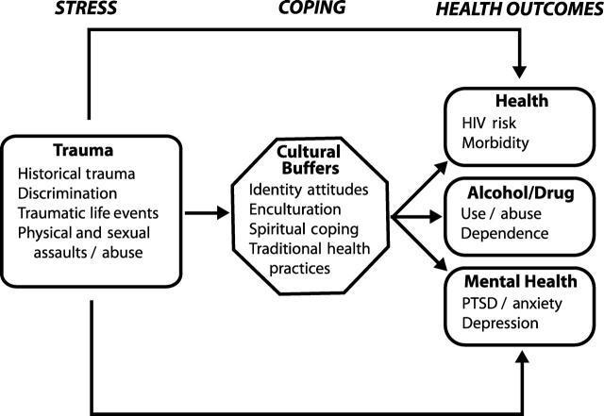
Indigenist Stress Coping Model
Walters, Karina L, Simoni, Jane M, & Evans-Campbell, Teresa. (2002). Substance Use Among American Indians and Alaska Natives: Incorporating Culture in an "Indigenist" Stress-Coping Paradigm. Public Health Reports (1974), 117(Suppl 1), S104–S117.
Notes:
Particularly powerful is the process by which colonization has become internalized among AI peoples and serves to shape health outcomes. Genocide against the indigenous people in the Americas is one of the most massive and longest lasting campaigns in human history.
Historical traumatic events have contributed to these disparities related to social and behavioral factors, such as, resulting in increased younger female headed households, significantly higher poverty rates, larger families, lower median income, lower education, etc., including substance misuse (CDC, 2013).
A significant body of robust research (Brave Heart Yellow Horse, 1998 and 2004; Brown, 2007; Duran, E., 2006; Duran and Duran, 1995; Evan-Campbell, 2008; Stites, 2001, Walters, 1999; Walters et al, 2002a) demonstrates the harmful impact of colonialism on indigenous cultures in the America’s and its continued impact on indigenous peoples across the planet, manifesting through cultural and historical trauma which has been shown to have a direct relationship to the internalized and lateral oppression seen in AI communities that impacts the quality of life for indigenous peoples and health outcomes in this generation.
These scholars have theorized that there is a connection between historically anchored traumatic events and current health inequities among American Indians”. This connection is relational as highlighted by the indigenous people’s relationship with the land, each other and spirit. Including substance misuse

Slide 9
Gabor Mate’, MD
The question is never
‘why the addiction’
but
‘why the pain’
In the Realm of the Hungry Ghosts: Close Encounters with Addiction
Notes:
Substance dependence always originate in pain, The very same brain centers that interpret and feel physical pain and become activated during the experience of emotional rejection: on brain scans they “light up” in response to social ostracism just as they would when triggered by physical stimuli. The hurt is at the center of all addictive behaviors.

Slide 10
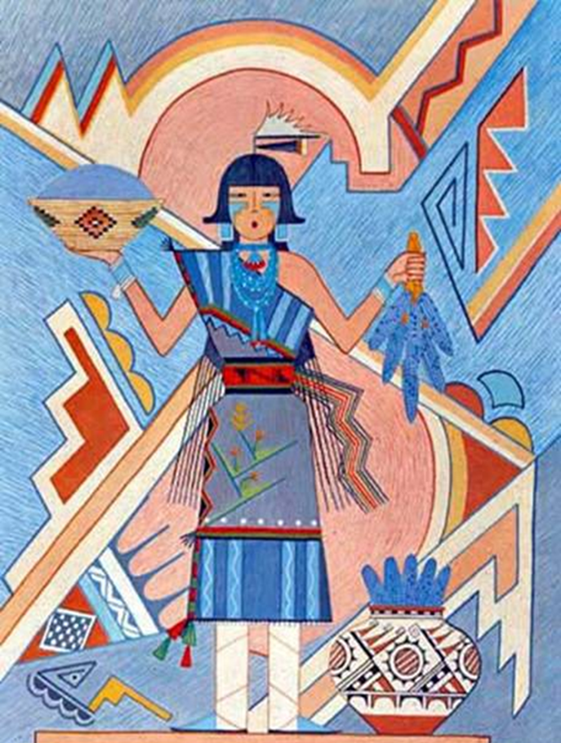
What works
Those who are fluent in many theories and models of treatment.
Who are client centered/counselor driven.
Focus on strengths and protective factors
Who are able to develop trusting therapeutic relationships.
Who are work within their area of expertise.
Culture as prevention

Slide 11
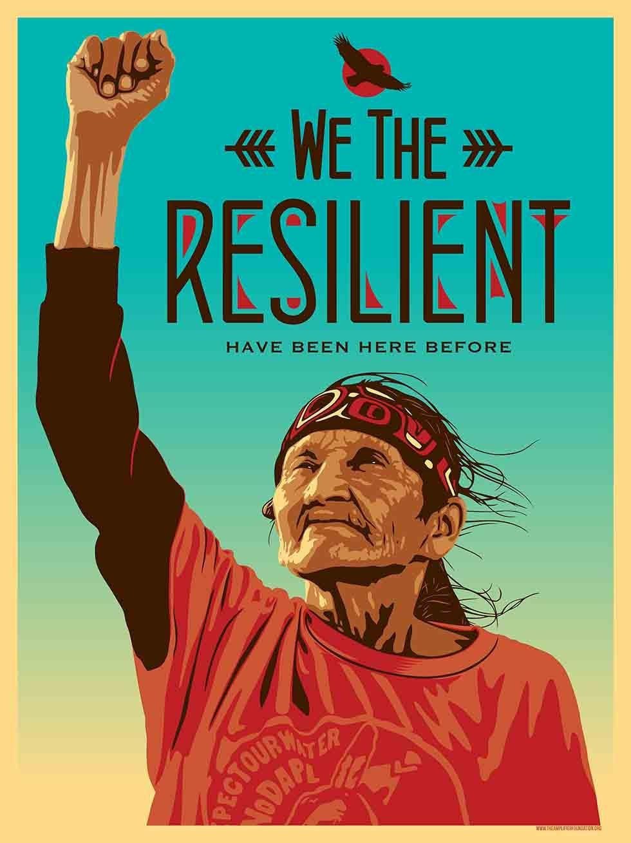
If trauma impacts the epigenetic transfer of trauma, culture and connection can mitigate these affects. If we want to prevent substance misuse we need to focus more on stress, trauma, and poverty while providing intervention options that are grounded on Traditional Indigenous Knowledge. (Brown, 2020)
Notes:
We can heal our communities through culture, connection, and developing interventions and policies that are grounded in traditional indigenous knowledge, tribal best practices, and evidence-based practice. This is not just true in the case of SUD, but in other conditions as well.

Slide 13
Adverse Childhood Experiences Study: https://www.cdc.gov/violenceprevention/childabuseandneglect/acestudy/index.html Mate, G. (2009). In the realm of the hungry ghosts: Close encounters with addiction. Berkeley, CA: North Atlantic Books. Prochaska, J. O., & DiClemente, C. C. (1983). Stages and processes of self-change of smoking: Toward an integrative model of change. Journal of Consulting and Clinical Psychology, 51(3), 390-395. Rollnick, S., Miller, W. R., & Butler, C. (2008). Motivational interviewing in health care: helping patients change behavior. Guilford Press. Brave Heart Yellow Horse, M. (2004). The historical trauma response among Natives and its relationship to substance abuse: A Lakota illustration. In E. Nebelkopf & M. Phillips (Eds.), Healing and mental health for Native Americans: Speaking in red. (pp. 7-18). Walnut Creek: Alta Mira Press. Also in Journal of Psychoactive Drugs, 35(1), 7-13.
Suggested Resources:
Danica Love Brown, MSW, CACIII, PhD
dbrown@npaihb.org
NPAIHB Resources: http://www.npaihb.org/opioid/#SUDTraining

