Slide 1

Recognizing syphilis and responding to outbreaks
Melanie Taylor MD, MPH
Medical Epidemiologist
CDC Division of HIV Prevention
MDT7@cdc.gov
February 17, 2022

Slide 2
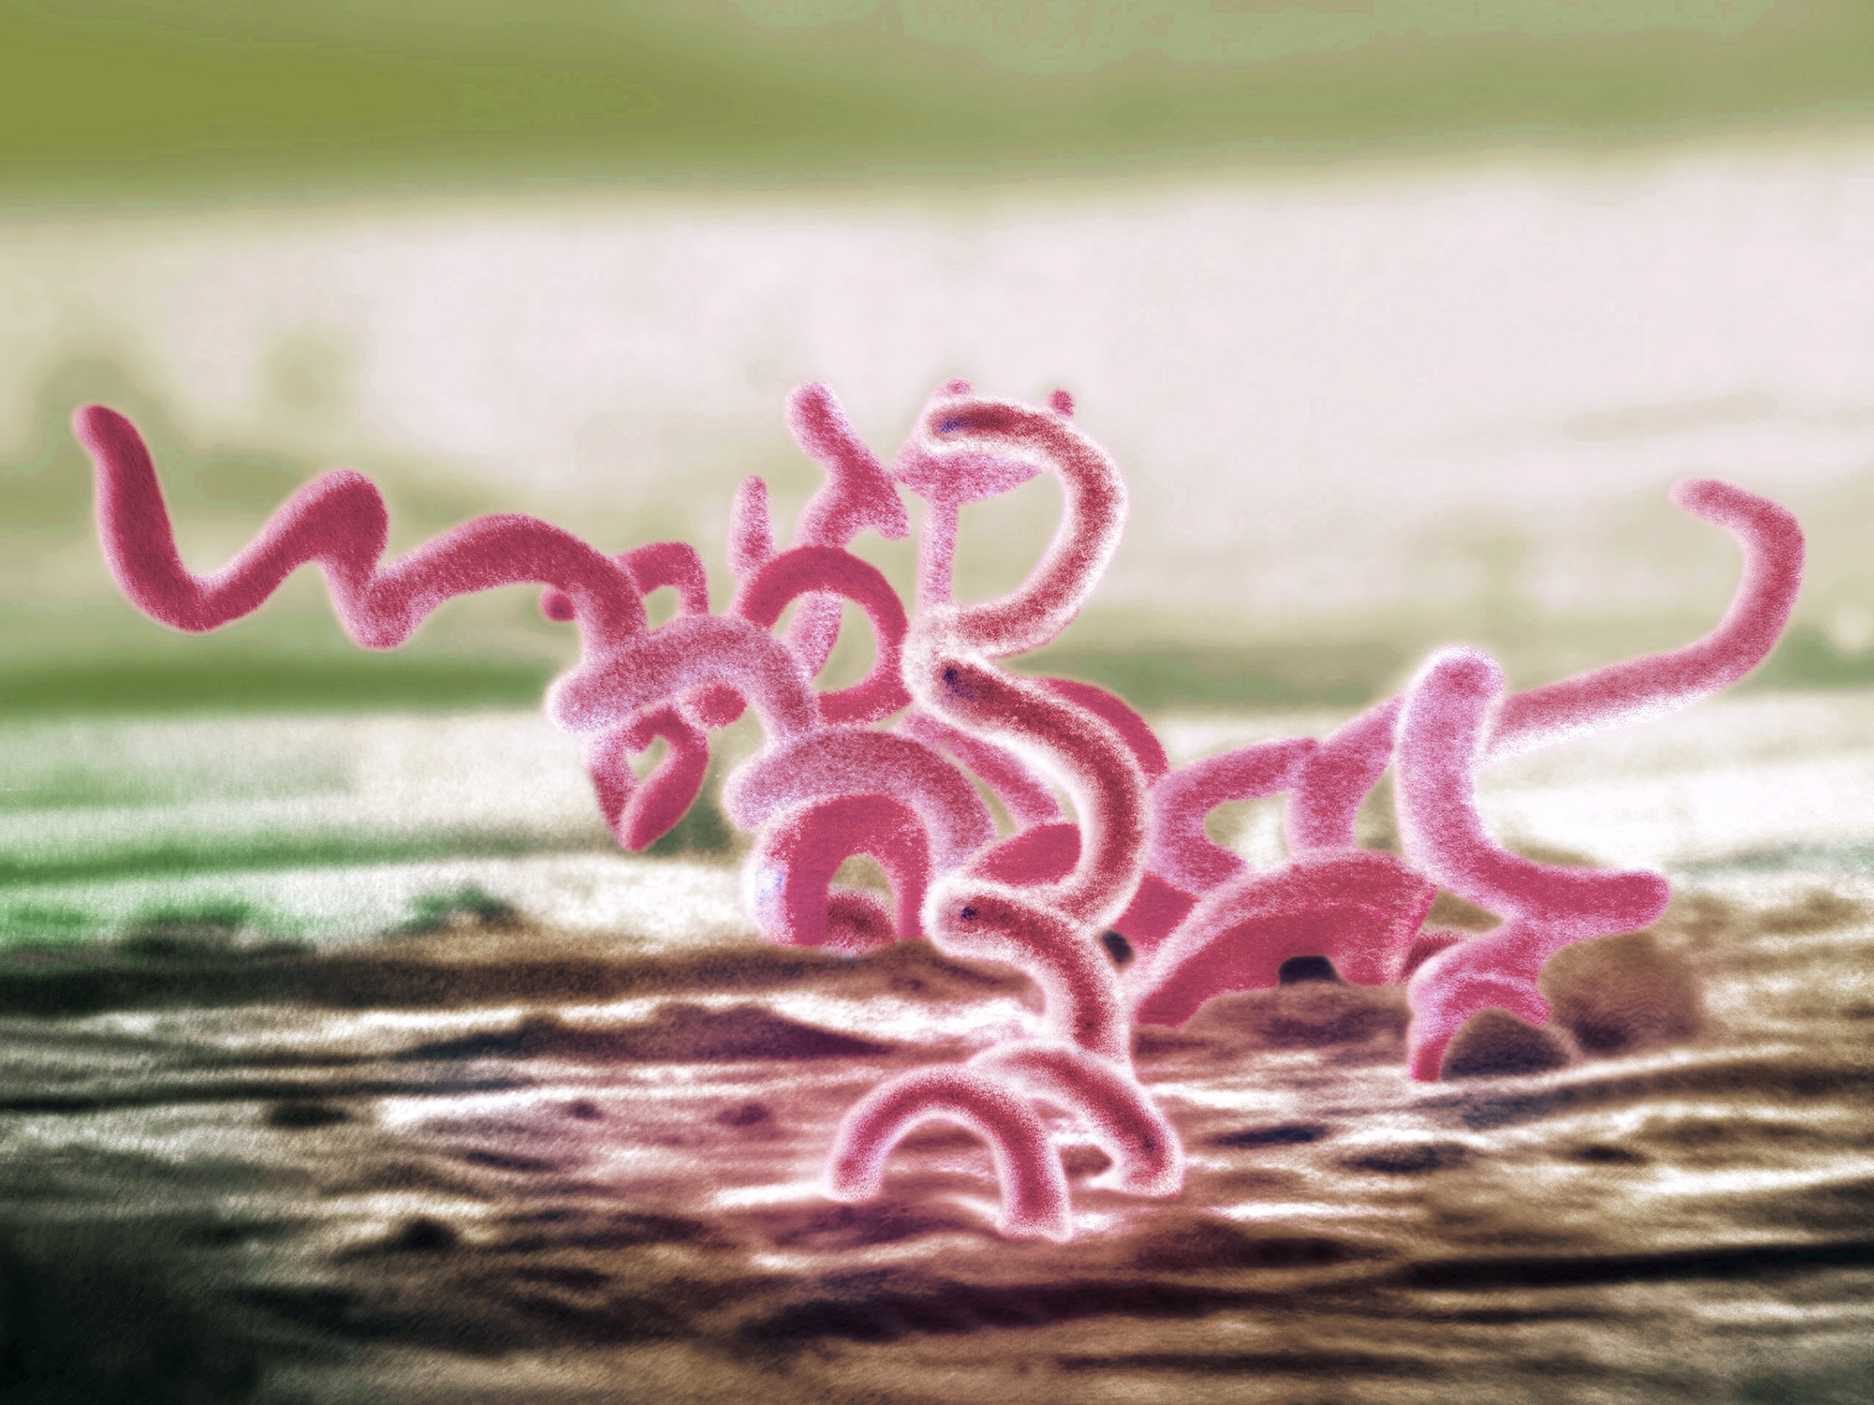
Syphilis
Treponema pallidum
Sexual, vertical, and horizontal transmission
Curable with penicillin
4 stages
  Primary
  Secondary
  Early (non-primary, non-secondary)
  Unknown duration or late
Notes:
Horizontal transmission is rare but can occur from blood transfusion or organ transplantation “Prior to the standard practice of using gloves by healthcare providers, there were reports of extragenital syphilitic lesions on the fingers and in the nose of physicians.^{12,39} In addition, the transmission of syphilis via human bite in both sexual and non-sexual circumstances has been reported,^{13–15} as well as transmission via mouth-to-mouth feeding of infants with pre-chewed food from infected relatives”
Stoltey JE, Cohen SE. Syphilis transmission: a review of the current evidence. Sex Health. 2015;12(2):103-109. doi:10.1071/SH14174
Tertiary syphilis is no longer consider a stage of syphilis rather the clinical signs are called “late”

Slide 3
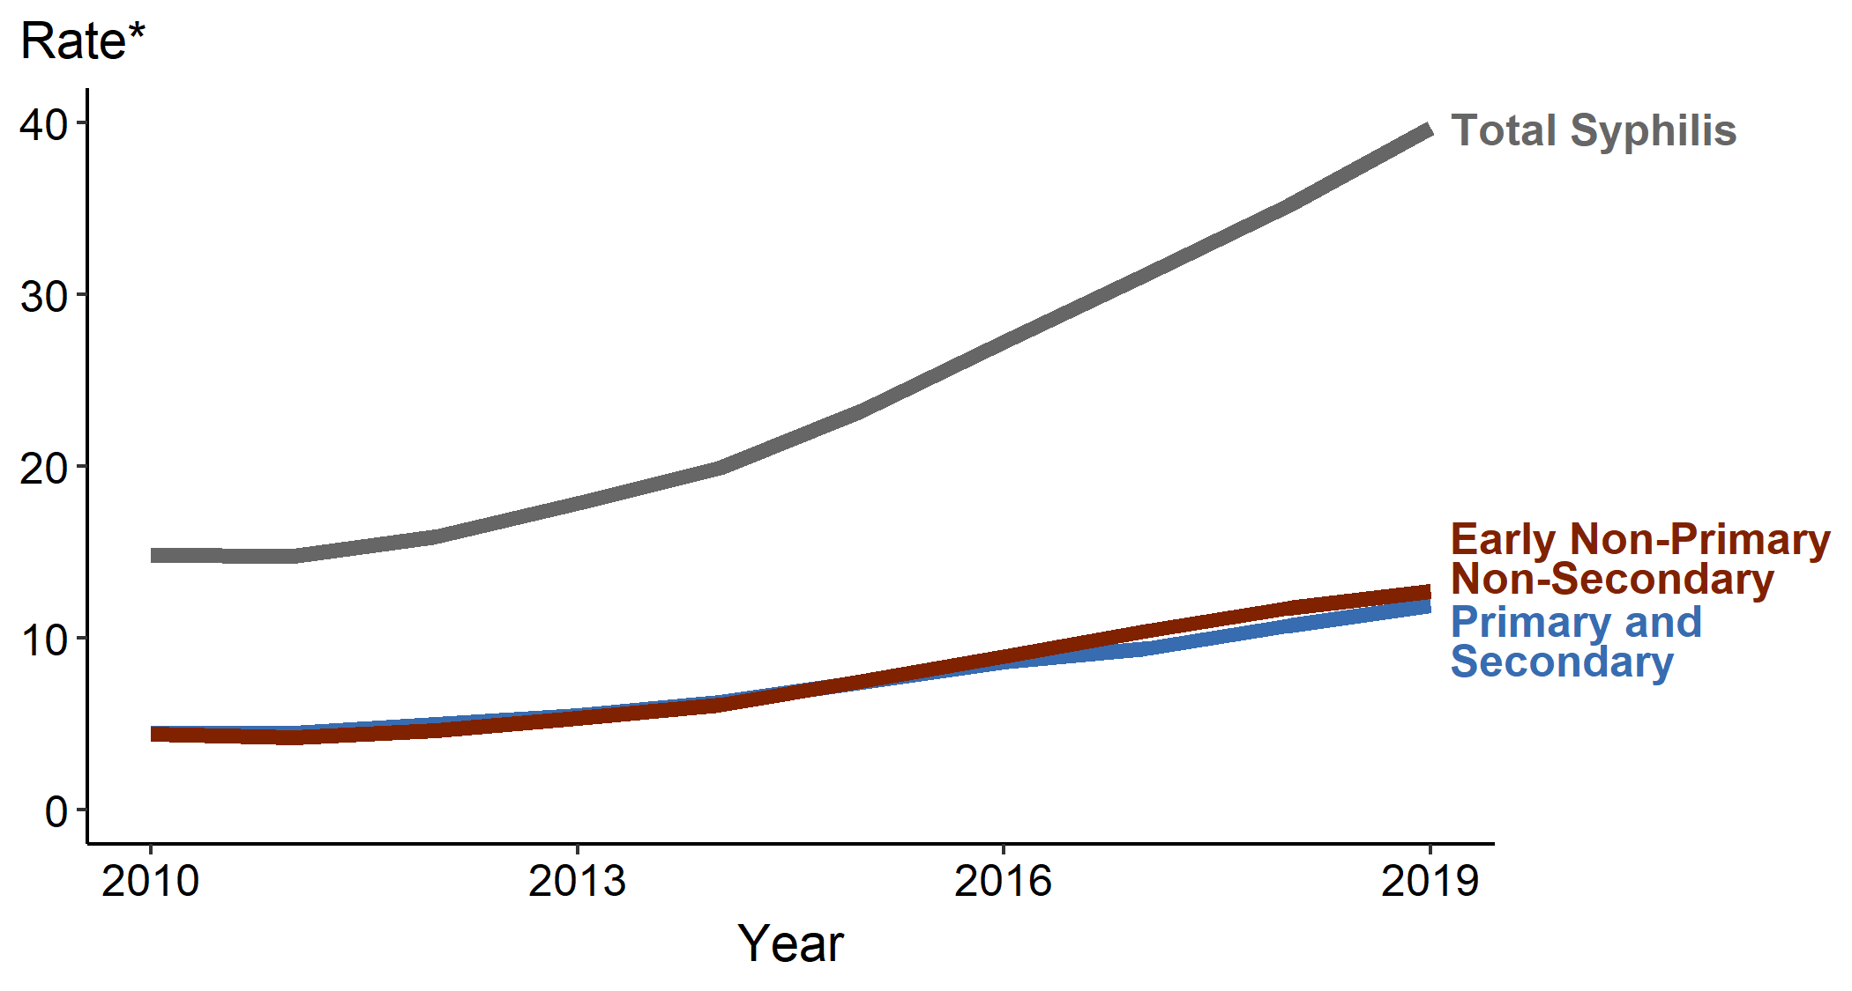
Syphilis — Rates of Reported Cases by Stage of Infection, United States, 2010–2019
https://www.cdc.gov/std/statistics/2019/figures/SYPH-1.htm

Slide 4
Case Definitions: Primary Syphilis
Clinical Description
Characterized by one or more ulcerative lesions (e.g. chancre), which might differ in clinical appearance.
Classic Presentation
Single painless ulcer or chancre at the site of infection
Atypical Presentation
Multiple, atypical, or painful lesions at the site of infection
Vaginal
Tongue
Penile
https://www.cdc.gov/std/syphilis/images.htm and https://www.cdc.gov/std/statistics/2019/case-definitions.htm
Notes:
Case Definitions in Effect During 2019 (cdc.gov)
“Syphilis, primary
Clinical description
A stage of infection with Treponema pallidum characterized by one or more ulcerative lesions (e.g., chancre), which might differ considerably in clinical appearance.
Laboratory criteria for diagnosis
Confirmatory:
Demonstration of T. pallidum by darkfield microscopy in a clinical specimen that was not obtained from the oropharynx and is not potentially contaminated by stool, OR
Demonstration of T. pallidum by polymerase chain reaction (PCR) or equivalent direct molecular methods in any clinical specimen.
Supportive:
A reactive nontreponemal serologic test (Venereal Disease Research Laboratory [VDRL], rapid plasma reagin [RPR], or equivalent serologic methods), OR
A reactive treponemal serologic test (T. pallidum particle agglutination [TP-PA], enzyme immunoassay [EIA], chemiluminescence immunoassay [CIA], or equivalent serologic methods).*
* These treponemal tests supersede older testing technologies, including microhemagglutination assay for antibody to T. pallidum [MHA-TP].
Case classification
Probable: a case that meets the clinical description of primary syphilis and the supportive laboratory criteria.
Confirmed: a case that meets the clinical description of primary syphilis and the supportive confirmatory criteria.”

Slide 5
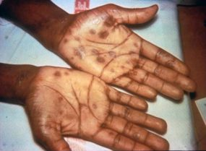
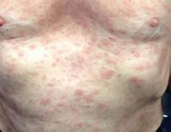
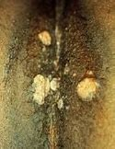
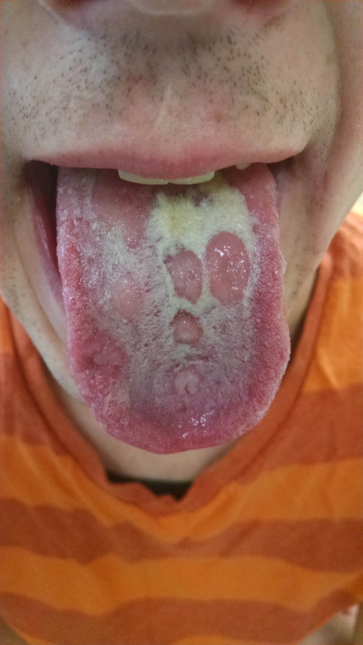
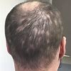
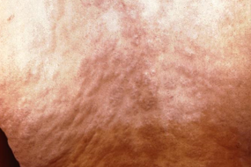
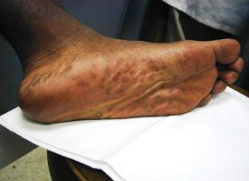
Case Definitions: Secondary Syphilis
Clinical Description
Characterized by localized or diffuse mucocutaneous lesions (e.g., rash – such as non-pruritic macular, maculopapular, papular, or pustular lesions), often with generalized lymphadenopathy. Other signs can include mucous patches, condyloma lata, and alopecia. The primary ulcerative lesion may still be present.
Torso/back rash
Palmar/plantar rash
Condyloma lata
Alopecia
Mucous patches
https://www.cdc.gov/std/syphilis/images.htm
https://www.cdc.gov/std/statistics/2019/case-definitions.htm
Notes:
Case Definitions in Effect During 2019 (cdc.gov)
“A stage of infection caused by T. pallidum characterized by localized or diffuse mucocutaneous lesions (e.g., rash – such as non-pruritic macular, maculopapular, papular, or pustular lesions), often with generalized lymphadenopathy. Other symptoms can include mucous patches, condyloma lata, and alopecia. The primary ulcerative lesion may still be present. Because of the wide array of symptoms and signs possibly indicating secondary syphilis, serologic tests for syphilis and a physical examination are crucial to determining if a case should be classified as secondary syphilis.
Laboratory criteria for diagnosis
Confirmatory:
Demonstration of T. pallidum by darkfield microscopy in a clinical specimen that was not obtained from the oropharynx and is not potentially contaminated by stool, OR
Demonstration of T. pallidum by polymerase chain reaction (PCR) or equivalent direct molecular methods in any clinical specimen.
Supportive:
A reactive nontreponemal serologic test (VDRL, RPR, or equivalent serologic methods), AND
A reactive treponemal serologic test (TP-PA, EIA, CIA, or equivalent serologic methods).”

Slide 6
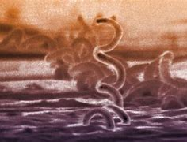
Case Definitions: Early Late (non-primary non-secondary)
Clinical Description
Stage of infection caused by T. pallidum in which initial infection has occurred within the previous 12 months, but there are no current signs or symptoms of primary or secondary syphilis.
Less than 12 months duration by (1) interval from prior negative syphilis test (or 4-fold titer increase) OR (2) report of symptoms consistent with syphilis within prior 12 months OR (3) sexual contact with a known case (or sexual debut) within prior 12 months
https://www.cdc.gov/std/statistics/2019/case-definitions.htm)
Notes:
Case Definitions in Effect During 2019 (cdc.gov)
“Case classification
Probable: a person with no clinical signs or symptoms of primary or secondary syphilis who has one of the following:
No prior history of syphilis, AND a current reactive nontreponemal test (e.g., VDRL, RPR, or equivalent serologic methods), AND a current reactive treponemal test (e.g., TP-PA, EIA, CIA, or equivalent serologic methods), OR
A prior history of syphilis and meets the supportive laboratory criteria.
AND evidence of having acquired the infection within the previous 12 months based on one or more of the following criteria:
Documented seroconversion or fourfold or greater increase in titer of a nontreponemal test during the previous 12 months, unless there is evidence that this increase was not sustained for >2 weeks
Documented seroconversion of a treponemal test during the previous 12 months
A history of symptoms consistent with primary or secondary syphilis during the previous 12 months
Meets epidemiologic criteria.
Epidemiological criteria:
A history of sexual exposure to a partner within the previous 12 months who had primary, secondary, or early non-primary non-secondary syphilis (documented independently as duration <12 months).
Only sexual contact (sexual debut) was within the previous 12 months.”

Slide 7
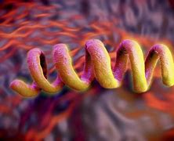
Case Definitions: Unknown duration or late
Clinical Description
Stage of infection caused by T. pallidum in which initial infection has occurred >12 months previously or in which there is insufficient evidence to conclude that infection was acquired during the previous 12 months.
Unknown or greater than 12 months duration by: (1) interval from prior negative syphilis test (or 4-fold titer increase) OR (2) report of symptoms consistent with syphilis occurring > 12 months ago OR (3) sexual contact with a known case > 12 months ago (4) Neurologic, ocular, otic signs without evidence of acquiring infection in prior 12 months.
Notes:
Case Definitions in Effect During 2019 (cdc.gov)
“Syphilis, unknown duration or late
Clinical description
A stage of infection caused by T. pallidum in which initial infection has occurred >12 months previously or in which there is insufficient evidence to conclude that infection was acquired during the previous 12 months.
Case classification
Probable: a person with no clinical signs or symptoms of primary or secondary syphilis who meets one of the following sets of criteria:
No prior history of syphilis, and a current reactive nontreponemal test (e.g., VDRL, RPR, or equivalent serologic methods), and a current reactive treponemal test (e.g., TP-PA, EIA, CIA, or equivalent serologic methods), OR
A prior history of syphilis, and a current nontreponemal test titer demonstrating fourfold or greater increase from the last nontreponemal test titer, unless there is evidence that this increase was not sustained for >2 weeks, OR
Clinical signs or symptoms and laboratory results that meet the likely or verified criteria for neurologic, ocular, otic, or late clinical manifestations syphilis (see below)
AND who has no evidence of having acquired the disease within the preceding 12 months (see Syphilis, early non-primary non-secondary).
Comments: Although cases of syphilis of unknown duration are grouped together with late syphilis for the purposes of surveillance, the conservative clinical and public health responses to these cases will differ when there is uncertainty about the duration of infection. When faced with uncertainty, clinicians should act conservatively and treat unknown duration syphilis as if it were late infection, with three doses of benzathine penicillin. In contrast, the most conservative approach for STD control programs would be to manage cases of syphilis of unknown duration as early non-primary non-secondary infections and search for partners who may have been recently infected. Because this would not be feasible for most STD control programs, programs should consider prioritizing cases of syphilis of unknown duration with higher nontreponemal titers (e.g., 1:32 or higher) for investigation and partner services. Although nontreponemal titers cannot reliably distinguish between early infection (<12 months duration) and late infection (>12 months duration), nontreponemal titers usually are higher early in the course of syphilis infection.

Slide 8
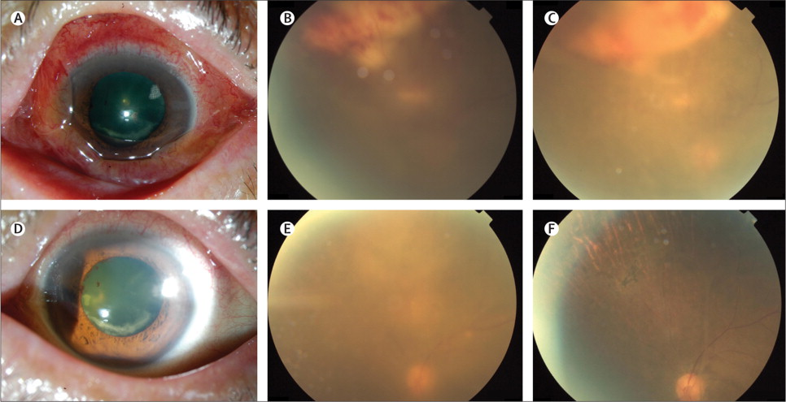
Neurologic manifestations can occur at any stage
Neurosyphilis | Ocular syphilis | Otosyphilis
Infection of the central nervous system with T. pallidum, as evidenced by manifestations including: Syphilitic meningitis, meningovascular syphilis, General paresis, Dementia, Tabes dorsalis | Infection of any eye structure with T. pallidum. Manifestations can involve any structure in the anterior and posterior segment of the eye including: Conjunctivitis Anterior uveitis Posterior uveitis Panuveitis Posterior interstitial keratitis Optic neuropathy Retinal vasculitis Ocular syphilis may lead to decreased visual acuity including permanent blindness. | Infection of the cochleovestibular system with T. pallidum, as evidenced by manifestations including sensorineural hearing loss, tinnitus, and vertigo. Typically presents with cochleo-vestibular symptoms including Tinnitus Vertigo Sensorineural hearing loss Unilateral/Bilateral Have a sudden onset Progress Rapidly Otic syphilis can result in permanent hearing loss
https://www.thelancet.com/journals/laninf/article/PIIS1473-3099(13)70198-1/fulltext

Slide 9
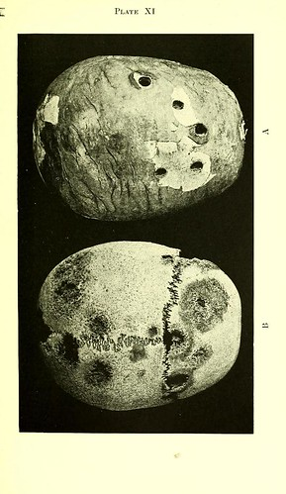
Late Clinical Manifestations/Tertiary Syphilis
Clinical description
Late clinical manifestations of syphilis (tertiary syphilis) may include inflammatory lesions of:
1. Cardiovascular system (e.g., aortitis, coronary vessel disease),
2. Skin (e.g., gummatous lesions),
3. Bone (e.g., osteitis),
4. Other structures including the upper and lower respiratory tracts, mouth, eye, abdominal organs, reproductive organs, lymph nodes, and skeletal muscle)
5. Neurologic manifestations (e.g., general paresis and tabes dorsalis)
Notes:
Case Definitions in Effect During 2019 (cdc.gov)
“Late Clinical Manifestations:
Late clinical manifestations of syphilis usually develop only after a period of 15–30 years of untreated infection. Therefore, if the patient has late clinical manifestations of syphilis, the case should be reported with the appropriate stage of infection (for the vast majority of cases, unknown duration or late syphilis) and late clinical manifestations should be noted in the case report data.
Clinical description
Late clinical manifestations of syphilis (tertiary syphilis) may include inflammatory lesions of the cardiovascular system (e.g., aortitis, coronary vessel disease), skin (e.g., gummatous lesions), bone (e.g., osteitis), or other tissue. Rarely, other structures (e.g., the upper and lower respiratory tracts, mouth, eye, abdominal organs, reproductive organs, lymph nodes, and skeletal muscle) may be involved. In addition, certain neurologic manifestations (e.g., general paresis and tabes dorsalis) are also late clinical manifestations of syphilis.
Classification of late clinical manifestations of syphilis (tertiary syphilis)
Likely: a person with a reactive nontreponemal test (e.g., VDRL, RPR, or equivalent serologic methods) and a reactive treponemal test (e.g., TP-PA, EIA, CIA or equivalent serologic methods) with either of the following:
Characteristic abnormalities or lesions of the cardiovascular system (e.g., aortitis, coronary vessel disease), skin (e.g., gummatous lesions), bone (e.g., osteitis), or other tissue, in the absence of other known causes of these abnormalities, OR
Clinical signs and symptoms consistent with late neurologic manifestations of syphilis (e.g., general paresis, including dementia, or tabes dorsalis) in a case that meets the criteria for likely neurologic manifestations of syphilis (see above).
Verified: a person with a reactive nontreponemal test (e.g., VDRL, RPR, or equivalent serologic methods) and a reactive treponemal test (e.g., TP-PA, EIA, CIA or equivalent serologic methods) and either of the following:
Characteristic abnormalities or lesions of the cardiovascular system (e.g., aortitis, coronary vessel disease), skin (e.g., gummatous lesions), bone (e.g., osteitis), or other tissue in the absence of other known causes of these abnormalities, in combination with either demonstration of T. pallidum in late lesions by special stains or equivalent methods, or by PCR or equivalent direct molecular methods, or demonstration of pathologic changes that are consistent with T. pallidum infection on histologic examination of late lesions, OR
Clinical signs and symptoms consistent with late neurologic manifestations of syphilis (e.g., general paresis, including dementia, or tabes dorsalis) in a case that meets the criteria for verified neurologic manifestations of syphilis (see above).”

Slide 10
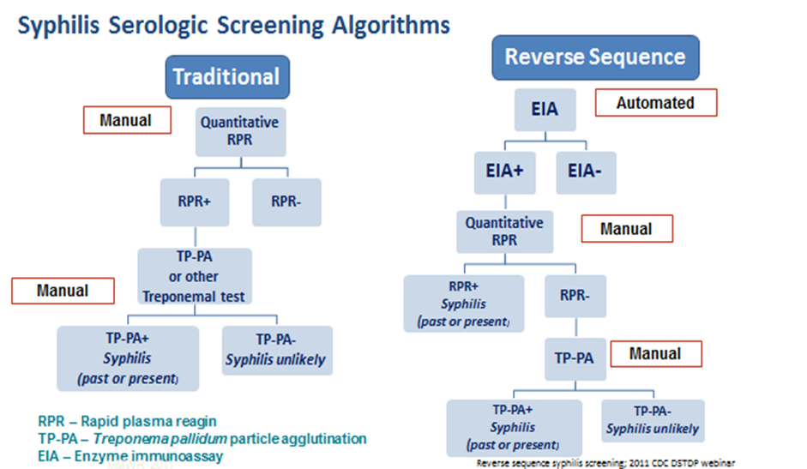
Serologic diagnosis

Slide 11
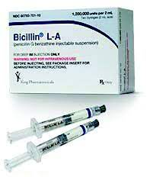
Treatment of syphilis: Overview
Stage
Primary | Secondary | Early non-primary | Late Latent/ or Unknown Duration | Neurosyphilis, ocular syphilis and otosyphilis
Benzathine penicillin 2.4 million units IM in a single dose | Benzathine penicillin 2.4 million units IM in a single dose | Benzathine penicillin 2.4 million units IM in a single dose | Benzathine penicillin 2.4 million units total administered as 3 doses of 2.4 million units IM each at 1-week intervals | Aqueous crystalline penicillin G 18-24 million units per day, administered as 3-4 million units by IV every 4 hours or continuous infusion for 10-14 days Alternative: procaine penicillin G 2.4 million units IM 1x/day PLUS probenecid 500 mg orally 4x/day, both for 10-14 days
https://www.cdc.gov/std/treatment-guidelines/default.htm

Slide 12
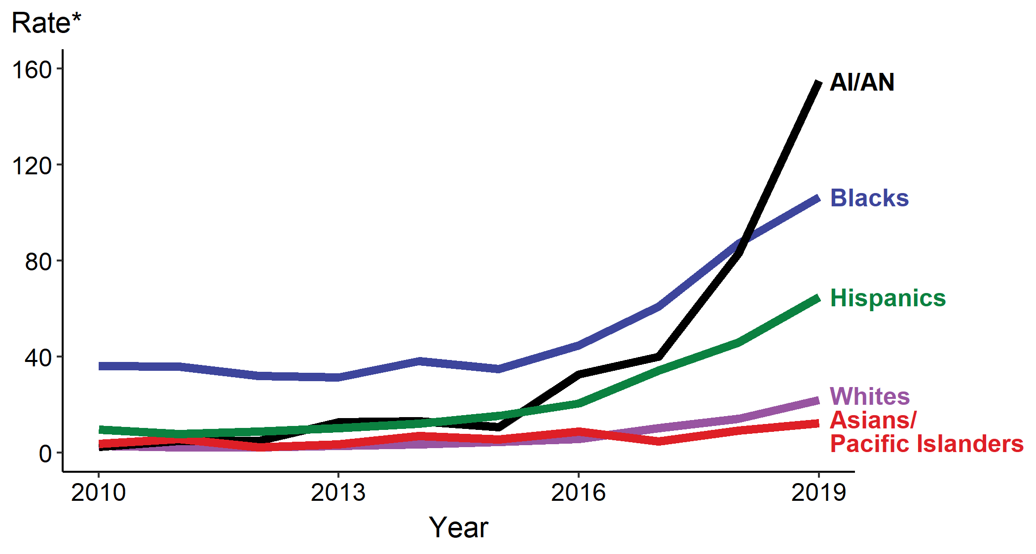
Congenital Syphilis — Rates of Reported Cases by Year of Birth, Race, and Hispanic Ethnicity of Mother, United States, 2010–2019
* Per 100,000 live births
ACRONYMS: AI/AN = American Indians/Alaska Natives
https://www.cdc.gov/std/statistics/2019/overview.htm#Syphilis
Notes:
Rates of reported congenital syphilis cases increased for all race/Hispanic ethnicity groups during 2015–2019, including a 1,347.7% increase among American Indians/Alaska Natives (from 10.7 to 154.9 cases per 100,000 live births), a 391.1% increase among Whites (from 4.5 to 22.1 cases per 100,000 live births), a 318.7% among Hispanics (from 15.5 to 64.9 cases per 100,000 live births), a 204.0% increase among Blacks (from 35.0 to 106.4 cases per 100,000 live births), and a 123.6% increase among Asian/Pacific Islanders (from 5.5 to 12.3 cases per 100,000 live births).
National Center for Health Statistics bridged race categories are presented to allow the display of data across several years.
See Technical Notes (www.cdc.gov/std/statistics/2019/Technicalnotes) for information on syphilis case reporting and reporting STD case data for race/Hispanic ethnicity.
Data points are available at www.cdc.gov/std/statistics/2019/data.zip

Slide 13
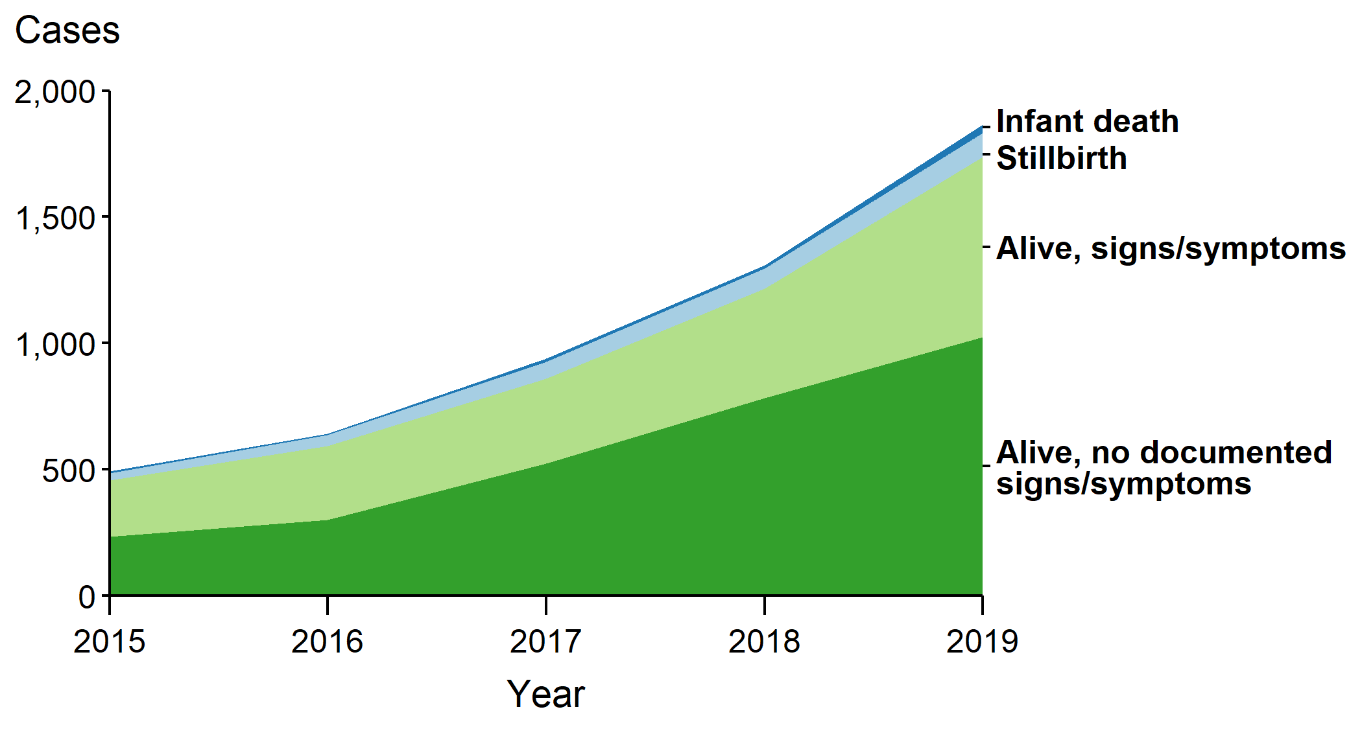
Congenital Syphilis — Number of Reported Cases by Vital Status and Clinical Signs and Symptoms* of Infections, United States, 2015–2019
* Signs/symptoms include long bone changes, snuffles, condyloma lata, syphilitic skin rash, pseudoparalysis, hepatosplenomegaly, edema, jaundice, hepatitis, reactive CSF-VDRL, elevated CSF WBC or protein, or evidence of direct detection of T. Pallidum.
NOTE: Of the 5,269 congenital syphilis cases reported during 2015–2019, 22 (0.4%) did not have sufficient information to be categorized
https://www.cdc.gov/std/statistics/2019/overview.htm#Syphilis
Notes:
In 2019, there were 128 congenital syphilis-related deaths (94 stillbirths and 34 infant deaths), and an increase of 36.2% from 2018 (94 to 128 deaths) and of 255.6% from 2015 (36 to 128 deaths).
See Technical Notes (www.cdc.gov/std/statistics/2019/Technicalnotes) for information on syphilis case reporting.
Data points are available at www.cdc.gov/std/statistics/2019/data.zip

Slide 14
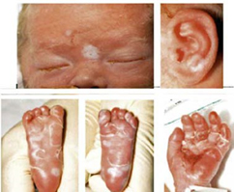
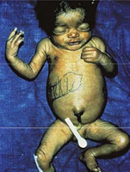
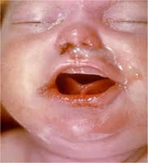
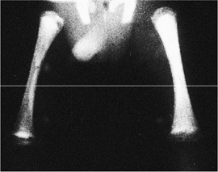
Congenital Syphilis (CS)
https://www.cdc.gov/ncbddd/birthdefects/surveillancemanual/quick-reference-handbook/congenital-syphilis.html

Slide 15
Scenario 1: Confirmed, proven or highly probable congenital syphilis | Scenario 2: Possible congenital syphilis | Scenario 3: Congenital syphilis less likely | Scenario 4: Congenital syphilis unlikely
Neonate with: a physical exam consistent with CS serum quantitative nontreponemal serology 4-fold greater than mother’s or a positive darkfield or PCR test of placenta, body fluids or positive silver stain of placenta or cord | Neonate with a normal physical exam and a serum quantitative nontreponemal serologic titer equal to or < 4-fold of the maternal titer at delivery and one of the following: • The mother was not treated, was inadequately treated, or has no documentation of treatment. • The mother was treated with erythromycin or a regimen not recommended in these guidelines • The mother received recommended regimen but treatment was initiated <30 days before delivery. | Neonate with a normal physical examination and a serum quantitative nontreponemal serologic titer equal or <4-fold of the maternal titer at delivery and both of the following are true: • The mother was treated during pregnancy, treatment was appropriate for the infection stage, and the treatment regimen was initiated ≥30 days before delivery. • The mother has no evidence of reinfection or relapse | Neonate with: a normal physical exam serum quantitative nontreponemal serology equal to or less than 4-fold mother’s at delivery and Mother’s treatment was adequate before pregnancy Mother’s nontreponemal titer remained low and stable before and during pregnancy and at delivery
Evaluation: CSF with VDRL, cell ct, protein, CBC/diff, long bone radiographs, neurologic eval (eye, auditory, imaging) | CSF analysis for VDRL, cell count, and protein** CBC, differential, long-bone radiographs | No evaluation is recommended | No evaluation is recommended
Treatment: Aqueous crystalline penicillin G 100,000–150,000 units/kg/body wt./day, administered as 50,000 units/kg body wt./dose IV q 12 hours during the first 7 days of life and q 8 hours thereafter for a total of 10 days OR Procaine penicillin G 50,000 units/kg body weight/dose IM in a single daily dose for 10 days | Treatment: Aqueous crystalline penicillin G 100,000–150,000 units/kg/body wt./day, administered as 50,000 units/kg body wt./dose IV q 12 hours during the first 7 days of life and q 8 hours thereafter for a total of 10 days OR Procaine penicillin G 50,000 units/kg body weight/dose IM in a single daily dose for 10 days OR Benzathine penicillin 50,000 units/kg body wt. single IM injection | Treatment: Benzathine penicillin G 50,000 units/kg body weight/dose IM in a single dose * Another approach involves not treating the newborn if follow-up is certain but providing close serologic follow-up every 2–3 months for 6 months for infants whose mothers’ nontreponemal titers decreased at least fourfold after therapy for early syphilis or remained stable for low titer, latent syphilis (VDRL <1:2 or RPR <1:4). | No treatment recommended Benzathine penicillin 50,000 units/kg body weight as a single IM injection might be considered, if follow-up is uncertain and the neonate has a reactive nontreponemal test. Neonates should be followed serologically to ensure the nontreponemal test returns to negative
https://www.cdc.gov/std/treatment-guidelines/default.htm

Slide 16
Syphilitic Stillbirth
Clinical case definition
A fetal death that occurs after a 20-week gestation OR in which the fetus weighs >500g AND the mother had untreated or inadequately treated* syphilis at delivery.
* Adequate treatment is defined as completion of a penicillin-based regimen, in accordance with CDC treatment guidelines, appropriate for stage of infection, initiated 30 or more days before delivery.
Comments: For reporting purposes, congenital syphilis includes:
cases of congenitally acquired syphilis among infants and children
syphilitic stillbirths
https://www.cdc.gov/std/statistics/2019/case-definitions.htm)

Slide 17
Syphilis Outbreak Response in American Indian Communities

Slide 18
(1) Central Arizona, 2016-2017
Primary | Secondary | Early | Late | Congenital
N = 85 cases
54% women
14% incarcerated
25% drug use
Screening
Site Visit
*Benzathine penicillin
No BPG*
Browne K, Ridpath A, Scranton R et al. Abstract # 39462. 2018 National STD Prevention Conference Washington, D.C., Aug. 27-30, 2018. https://cdc.confex.com/cdc/std2018/webprogram/Paper39462.html
Notes:
This slide shows the epi curve for cases that occurred between 2016 and 2017 on the reservation. In just two years, the tribe reported 85 cases, the majority of which were newly infected. The colored bars represent the stage of disease with the majority of cases staged as early, as represented by the pink bars [62% of cases were staged as early (pink), 21% primary (dark red), 12% secondary (red), 2% late (blue), and 2% were congenital cases (black).]
The outbreak started with a case of primary syphilis that occurred in April 2016. Although the case was treated within 2 weeks of symptom onset, this first case was unusual for the area. Partners tested negative but were not epi-treated and no index was identified. A few months later, cases started popping up every month, leading to a peak in March. The tribe began reaching out for technical assistance from ADHS and CDC and, starting in February, we conducting several site visits to provide training and assist with partner services activities. Between February and March of 2017 the PHNs coordinated mass screenings in the community and in the jails. At this time they were also beginning to run low on Bicillin which was ultimately depleted in April.

Slide 19
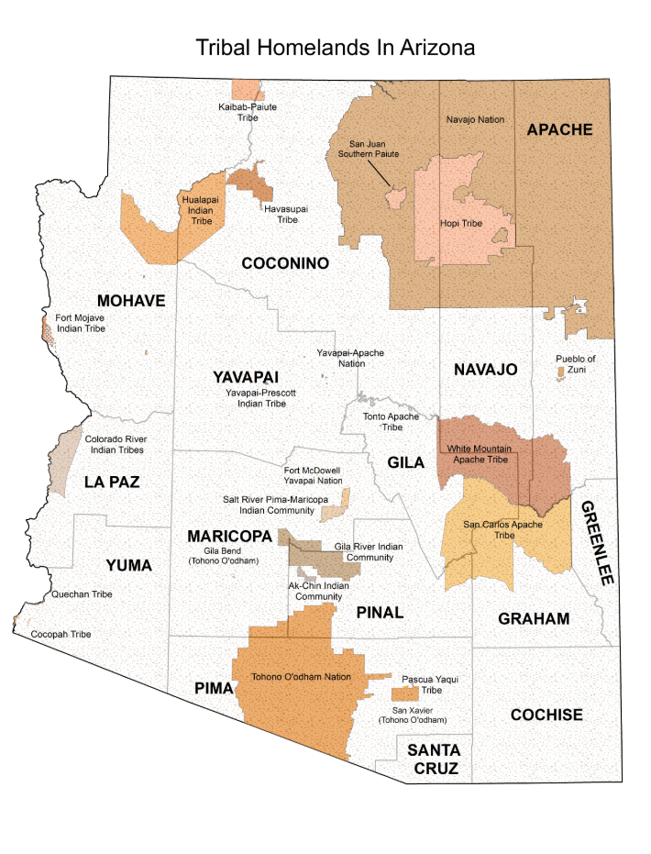
Central Arizona, 2016-2017
Methods of Case Finding
Partner Services | 51%
Screening Provider screen (74%) Prenatal screen (11%) Jail screen (7%) Community screen (7%) | 32%
Self-Referral | 14%
Referred by partner | 2%
Browne K, Ridpath A, Scranton R et al. Abstract # 39462. 2018 National STD Prevention Conference Washington, D.C., Aug. 27-30, 2018. https://cdc.confex.com/cdc/std2018/webprogram/Paper39462.html

Slide 20
South Dakota/North Dakota: Syphilis Outbreak 2013-2015
Bowen VB, et al. Multi-state syphilis outbreak among American Indians, 2013-2015. Sexually Transmitted Diseases. 2018;45(10):690-95

Slide 21
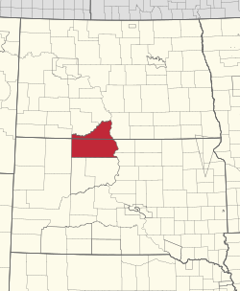
(2) South Dakota/North Dakota
    2013-2015 high-yield syphilis case-finding and treatment activities
    Increase prenatal screening, (1st,3rd trimesters and at delivery)
    Improve community awareness and symptomatic test seeking,
    Educate providers and increase general population screening for syphilis,
    Implement electronic medical record reminders for providers,
    Screen high-morbidity communities and at high-risk venues (corrections),
    Prioritize training and delivery of sexual partner notification and management
    Field treatment of cases and partners
Bowen VB, et al. Multi-state syphilis outbreak among American Indians, 2013-2015. Sexually Transmitted Diseases. 2018;45(10):690-95

Slide 22
Southern Arizona Syphilis Outbreak, 2007-2009
Johnson M, et al. Syphilis Outbreak Among American Indians --- Arizona, 2007–2009. MMWR Morb Mortal Wkly Rep. 2010 February 19; 59(6): 158–161

Slide 23

Southern Arizona Syphilis Response
  Identification of syphilis, HIV, chlamydia, and gonorrhea screening program on the reservation to include:
    Clinic- and hospital-based screening of all persons aged 12–55 years receiving health care (including pregnant women),
    Screening of all incarcerated adults and juvenile detainees,
    Screening of students at seven high schools and of youths at six social events,
    Screening of workers at two worksites, and door-to-door screening in seven of the reservation’s 11 districts.
    Case investigation and clinical management of sexual partners
    Community awareness campaign
Johnson M, et al. Syphilis Outbreak Among American Indians --- Arizona, 2007–2009. MMWR Morb Mortal Wkly Rep. 2010 February 19; 59(6): 158–161

Slide 24

Considerations for syphilis outbreak response
Expand case finding and prompt treatment
  Effective disease intervention (case investigation with identification and management of sexual partners)
  Expand screening to populations at risk (health facility- and community-based)
  Ensure access to prompt treatment (health facility or field-based)
  Case surveillance to guide response
Increase community awareness and engagement
  Public health announcements with information on testing locations
  Engagement with community and venue leadership (health facilities, CBOs, corrections, schools, community events) to expand awareness and screening
  Educational outreach using prevention interventions

Slide 25


Slide 26
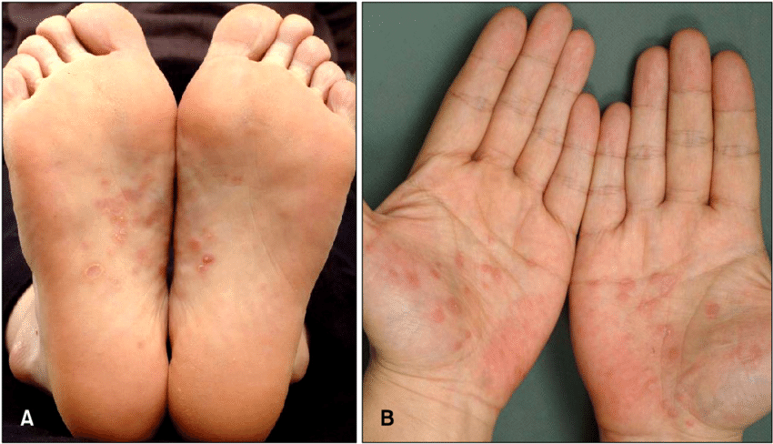
Look….to find syphilis
.

