Slide 1
Indian Country Infectious Disease ECHO COVID-19 Update
Jonathan Vilasier Iralu, MD, FACP, FIDSA
Indian Health Service Chief Clinical Consultant
for Infectious Diseases

Slide 2
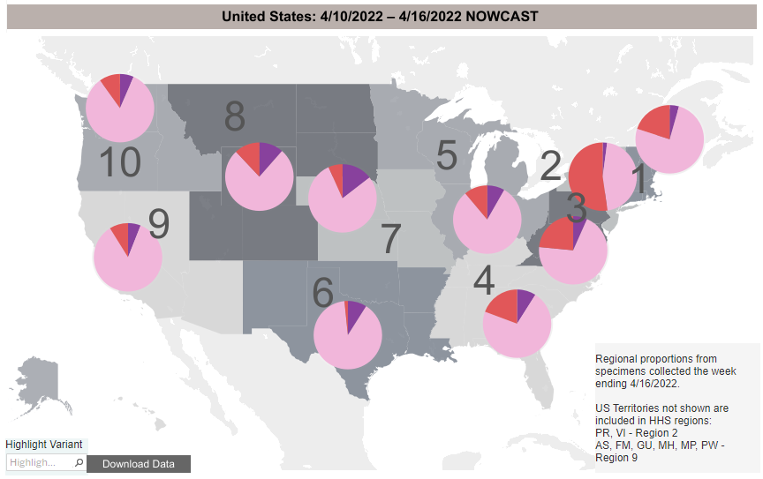
Virology: BA.2 is, unfortunately, in the pink
https://covid.cdc.gov/covid-data-tracker/#variant-proportions

Slide 3
Variant shift therapeutic implications
Sotrovimab no longer authorized for use anywhere in the US
Preferred drugs of choice recommended by NIH 4/1/2022
Nirmatrelvir/r for 5 days (< 5 days of symptom onset)
Remdesivir daily for 3 days (< 7 days of symptom onset)
Alternate Rx: (only recommended if preferred options not available
Bebtelovimab IV x 1 (< 7 days of symptom onset)
Molnupiravir (< 5 days of symptom onset)
https://www.covid19treatmentguidelines.nih.gov/management/clinical-management/nonhospitalized-adults--therapeutic-management/

Slide 4
Oral Nirmatrelvir for High Risk, Non-hospitalized adults with Covid-19
EPIC-HR investigators (Hammond et al, NEJM, 4/14/2022)
Randomized 2246 to Main Protease M^{pro} inhibitor Nirmatrelvir vs placebo
If within 3 days of symptom onset, RR reduction for hospitalization/death was 89%
Observed 0 deaths with the drug vs 7 with placebo
Side effects 22.6% with drug vs 23.9% with placebo
Dysgeusia and diarrhea were more common with the drug than with placebo
https://www.nejm.org/doi/full/10.1056/NEJMoa2118542

Slide 5
AI/AN Mortality Disparities
In-Hospital Mortality Disparities among AI/AN, Black and White patients with COVID-19.
Musshafen et al, Jama Network Open, 3/30/2022, University of Mississippi
Retrospective analysis of the Mississippi Inpatient Outpatient Data System:
all adults > 18 years old, hospitalized with COVID 3/1/2020-12/31/2020
18,731. hospitalized: 1.2% AI/AN, 49.1% Black, 48.7% White
Black patients had a 75% lower odds of in-hospital mortality compared with AI/AN (OR 0.25)
White patients had a 77% lower odds of in-hospital mortality compared with AI/AN (OR 0.23)
AI/AN with COVID-19 had lower co-morbidity risk scores that Black or white patients
“Despite empirical associations between reduced comorbidity risk scores and reduced odds of inpatient mortality, AI/AN patients were significantly more likely to die in the hospital of COVID-19 than Black or White patients at every level of comorbidity risk”
https://jamanetwork.com/journals/jamanetworkopen/fullarticle/2790506?widget=personalizedcontent&previousarticle=347063

Slide 6
Does COVID-19 cause DM in children?
Risk for Newly Diagnosed Diabetes > 30 Days After SARS-CoV-2 Infection among Persons Aged < 18 year. Barrett et al, MMWR Jan 14, 2022/Vol 71/No.2
Analyzed claims for patients with COVID-19 in
IQVIA database: patients with COVID-19 diagnosis 3/1/2020-2/26/2021
Health Verity database: patients with any encounter possibly related to COVID 2/2020-6/2021
Hazard ratio for new DM diagnosis was
2.66 (IQVA) compared with nondiabetics
1.31 (HealthVerity) compared with nondiabetics
Hazard ratio for new DM diagnosis was 2.16 in IQVIA cohort c/w pre pandemic non-COVID acute respiratory illness patients
https://www.cdc.gov/mmwr/volumes/71/wr/mm7102e2.htm

Slide 7
How about in Adults? Newly diagnosed diabetes vs pre-existing diabetes upon admission for COVID-1
Cromer et al, J of DM and Its Complications, 2022
Reviewed 1902 adult admissions for COVID at Mass General 3/1/20-9/27/20
Used A1c > 6.5% or ICD coding to define pre-admission DM and glucose > 300 to define new DM in previously undiagnosed patients
594 (31.2%) had preexisting DM and 77 had new DM (13% of total)
42.9% of those with new DM had a history of prediabetes before admission
New DM were younger, less likely to be non-Hispanic White, and to have HTN, CAD, CHF, and CKD
New DM patients had lower random glucose and A1c but higher CRP, ferritin, LDH, AST &ALT
Stress hyperglycemia is suggested as the likely mechanism
Half had regression of DM at follow-up
https://pubmed.ncbi.nlm.nih.gov/35148936/

Slide 8
New CDC quarantine/isolation calculator
Designed to help people with COVID-19 quarantine and isolation
https://www.cdc.gov/coronavirus/2019-ncov/your-health/quarantine-isolation.html#

Slide 9
Vaccine Update Update March 29, 2022
Second mRNA booster allowed for persons over age 50 or who are immunocompromised at least 4 months since the initial booster
Persons who received J and J vaccine and a booster dose at least 4 months ago may receive a second booster with an mRNA vaccine

Slide 10
Vaccine Update: To boost or not to boost…
Fourth Dose of BNT162b2 mRNA Covid-19 Vaccine in a Nationwide Setting. (Magen et al, NEJM. 4/13/2022)
Analyzed 182,122 individuals in Israel, age > 60, re-boosted after 4 months
Only had 30 days of follow up
Vaccine effectiveness during Omicron wave:
45% against PCR positive infection
55% against symptomatic COVID-19
74% against death
https://www.nejm.org/doi/full/10.1056/NEJMoa2201688

