Slide 1




Ending the Epidemics in Indian Country: HCV
May 10, 2022
Jorge Mera, MD, FACP | ECHO Clinical Director | Northwest Portland Area Indian Health Board | jorge-mera@cherokee.org

Slide 2
Presentation
A 42-year-old American Indian/Alaska Native male is referred to the primary care clinic for evaluation of possible rheumatoid arthritis.
He was originally seen in the urgent care for evaluation bilateral hand and wrist pain of 2 months duration.
He does not have a relevant past medical history
Today except for bilateral pain in both wrists and MCPs he feels well. Physical exam is unremarkable. Labs that include CBC, CMP, ESR and add uric acid level, HgbA1c, Hepatitis C serology and fourth generation HIV test are ordered.
The HCV antibody test is positive
HgA1C is 7.8
Other tests are normal
He uses recreational marijuana and denies any use of other drugs.
Hand and wrist X rays, CBC, ESR and CRP were unremarkable, a rheumatoid factor was also ordered, the result is positive.

Slide 3
Questions
Why was he screened for HCV?
Can his joint pains be extrahepatic manifestations of HCV?
What are the next steps in evaluating a patient with a positive HCV antibody?
What is the role of primary care in the management of HCV?

Slide 4
Outline
HCV Screening Recommendations
CDC
AASLD/IDSA
HCV General Concepts
The Virus
Patient Management
Evaluation
Disease Progression
Epidemiology
Treatment
Follow-up
Notes:
,

Slide 5
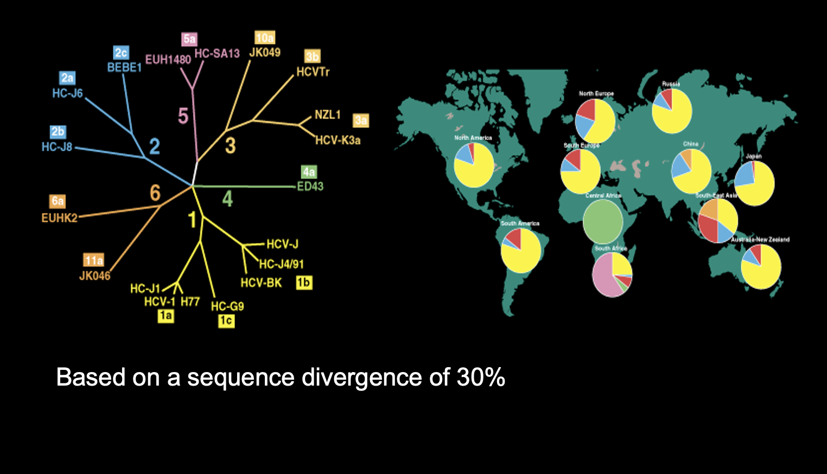
The Virus: Family Flaviviridae
Genus Hepacivirus
  7 Genotypes
RNA Virus
Do not differ in:
  Transmissibility
  Level of replication
  Rate of progression of the resulting liver disease
  Response to treatment
Does not integrate in Chromosomal DNA
Replicates in hepatocytes, T cells, B cells and Monocytes
“Using trauma terminology implies that the individual is responsible for the response, rather than the broader systemic force caused by the state’s abuse of power”
Linklater, R. (2014). Decolonizing trauma work : Indigenous stories and strategies. Black Point, Nova Scotia: Fernwood Publishing.

Slide 6

HCV: Transmission
Blood
  IVDU is the leading cause in the United States
    Snorting
  Percutaneous injuries
  Dental
  Tattooing
  Blood transfusion (Before 1992)
Sexual contact
  Rare in heterosexual
  More frequent in HIV + MSM
Mother-to-child
  The rate is 1.7% - 4.3 %
  Increased in IVDU, HIV co-infection, VL (?)
PWID
Sexual
Transfusion
Other*
Unknown
*Nosocomial; Health-care work; Perinatal
Centers for Disease Control and Prevention. Viral Hepatitis Surveillance—United States, 2016.
Atlanta: US Department of Health and Human Services, Centers for Disease Control and Prevention; 2018.
Available at: https://www.cdc.gov/hepatitis/statistics/2016surveillance/index.htm.
Notes:
,

Slide 7
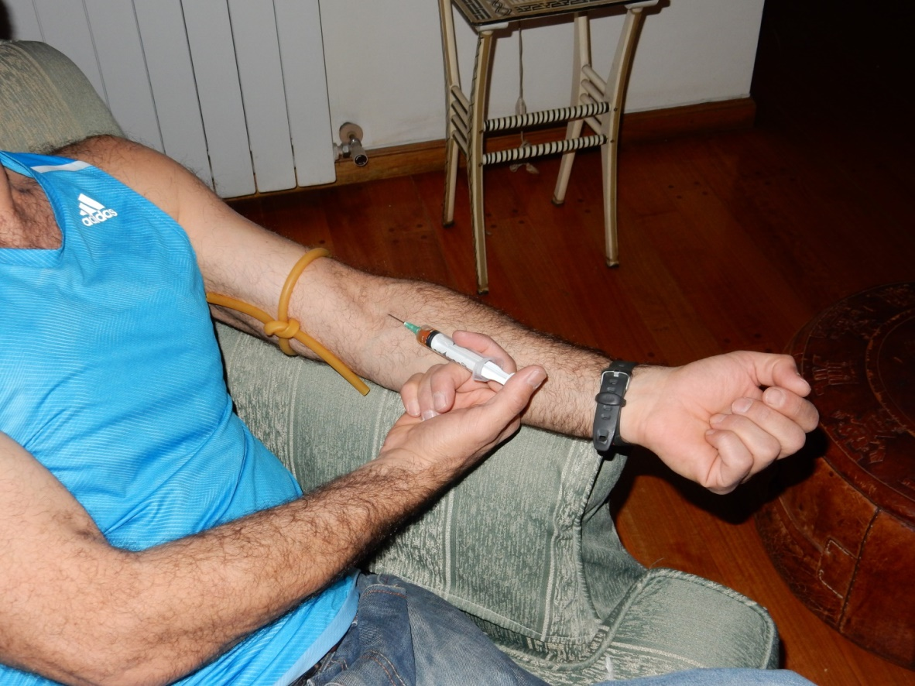
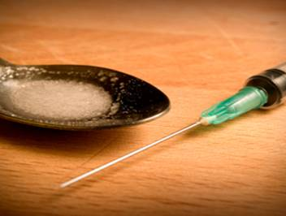
HCV and Injection Drug Use
In the US > 80% of HCV
Transmission Occurs in PWID
Equipment
Needle
Syringe
Cooker
Table
Tourniquet
Palmateer N, Hutchinson S, McAllister G et al. Risk of transmission associated with sharing drug injecting paraphernalia: analysis of recent hepatitis C virus (HCV) infection using cross-sectional survey data. J Viral Hepatol 2014 Jan;21(1):25-32
Notes:
,

Slide 8
Rates of HCV Infections are Rising Among Younger PWIDs
Among people aged 18-29, HCV increased by 400% and admission for opioid injection by 622%¹
Among people aged 30-39, HCV increased by 325% and admission for opioid injection by 83%¹
HCV seroprevalence among PWIDs is ~55% in North America²
1. Zibbell JE, et al. Am J Public Health. 2018 Feb;108(2):175-181;
2. Degenhardt L, et al. Lancet Glob Health 2017;5:e1192-e1207.

Slide 9
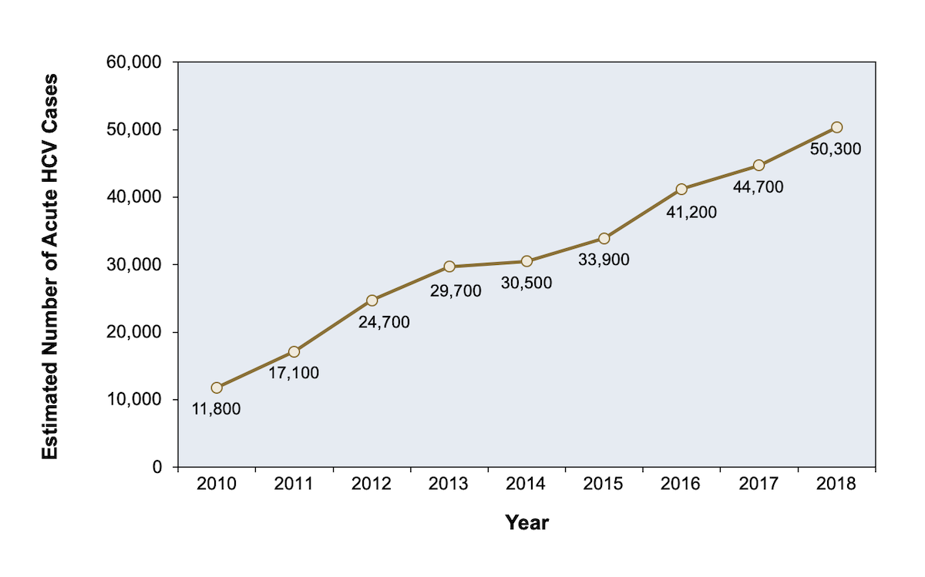
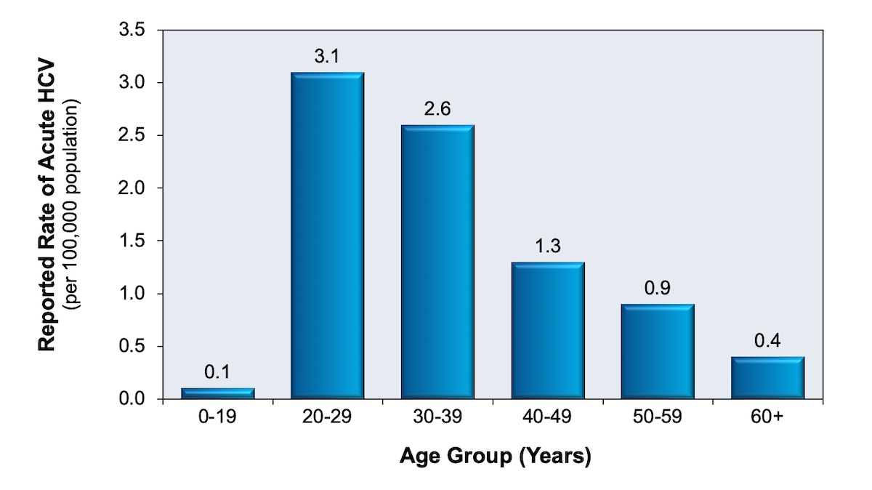
Acute HCV on the Rise: Younger People Affected

Slide 10
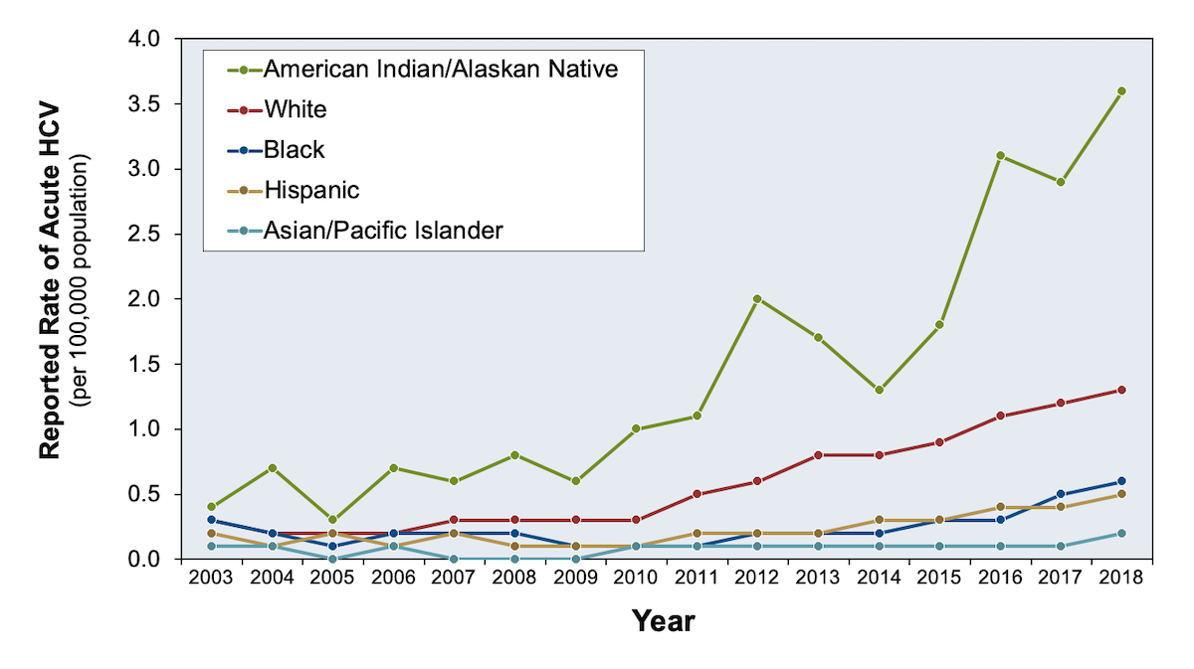
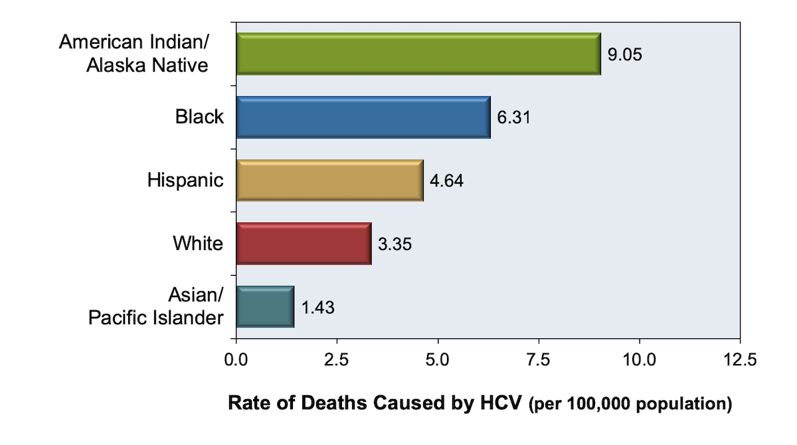
Racial/Ethnic Disparities: Incidence and Mortality

Slide 11
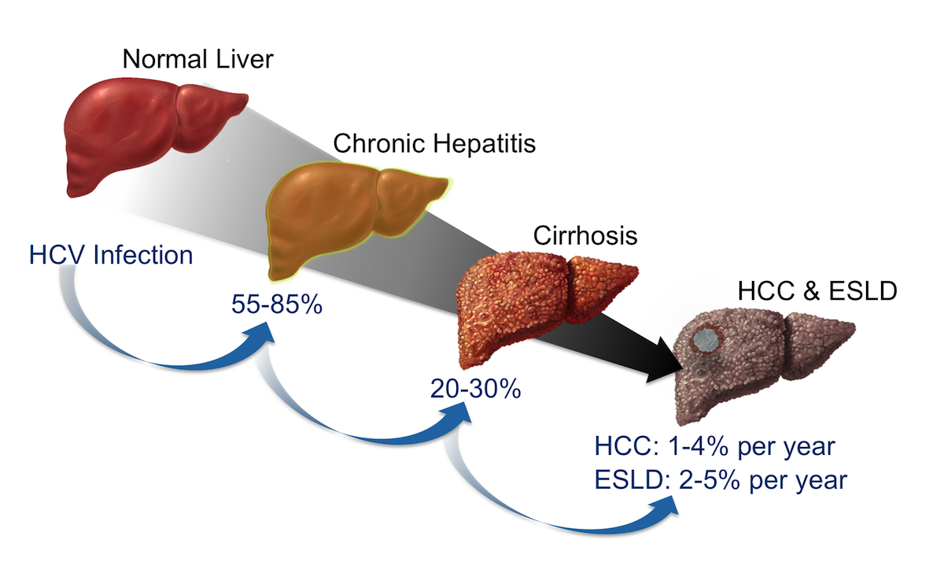
Natural History Following Initial Infection with HCV
Abbreviations: ESLD = end-stage liver disease HCC = hepatocellular carcinomaSource: Lingala S, Ghany MG. Natural History of Hepatitis C. Gastroenterol Clin North Am. 2015;44:717-34.
Notes:
Following initial infection with HCV, approximately 55 to 85% of persons develop chronic infection. Among those with chronic infection, approximately 20 to 30% will eventually develop cirrhosis. Patients who have HCV-related cirrhosis have a 2 to 7% per year risk of developing either end-stage liver disease or hepatocellular carcinoma. Abbreviations: ESLD = end-stage liver disease HCC = hepatocellular carcinomaSource: Lingala S, Ghany MG. Natural History of Hepatitis C. Gastroenterol Clin North Am. 2015;44:717-34.

Slide 12
Progression of HCV Disease
Cirrhosis (%)
0
5
10
15
20
25
30
Years
Thein H-H et al. AIDS. 2008;22:1979-1991.
Thein H-H et al. Hepatology. 2008;48:418-431.

Slide 13
Current HCV Screening Goal
Offer HCV screening to every American Indian and Alaskan Native patient at least once in their life… and more often based on risk.

Slide 14
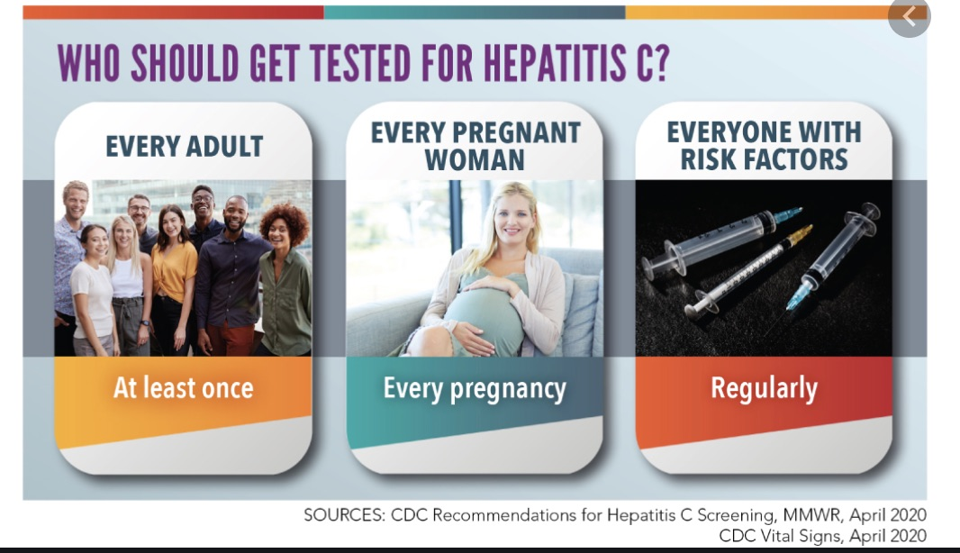
CDC is augmenting previous guidance with two new recommendations:
Hepatitis C screening at least once in a lifetime for all adults aged ≥18 years, except in settings where the prevalence of HCV infection is <0.1% and
Hepatitis C screening for all pregnant women during each pregnancy, except in settings where the prevalence of HCV infection is <0.1%.
The recommendation for HCV testing that remains unchanged is regardless of age or setting prevalence, all persons with risk factors should be tested for hepatitis C, with periodic testing while risk factors persist.
Any person who requests hepatitis C testing should receive it, regardless of disclosure of risk, because many persons might be reluctant to disclose stigmatizing risks.
Schillie S, Wester C, Osborne M, Wesolowski L, et al. MMWR Recomm Rep 2020;69(No. RR-2):1–17.

Slide 15
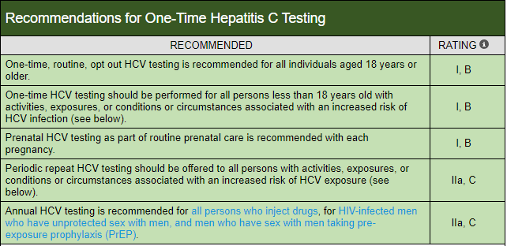
AASLD/IDSA Recommendations

Slide 16
Evolution of HCV Screening Recommendations
1998
2012
2020
Risk-based Screening
Birth-Cohort Screening, plus
Universal Screening, plus
Risk-based Screening
Risk-based Screening

Slide 17
HCV Screening Evolution at CNHS
Period | Interventions | Number of Unique Patients Screened (% seropositive) | Number of Patients Screened per month | % HCV Seropositive Patients Born after 1965 | Cumulative % of Population
2006 - 9/2012 | High Risk Patients Patients with cirrhosis Patients with elevated LFT’s | 5,425 (10.8%) | 57 | ? | 6.7 %
10/2012 -10/2015 | Baby Boomer Screening Electronic Health Reminders Provider Education | 17,134 (5.9%) | 357 | 47% | 28%
11/2015 -8/2017 | Universal Screening Lab Triggered Screening Dental Clinic Screening OBGYN Screening ED/UC Screening | 20,822 (3.6%) | 905 | 57% | 54%
Cherokee Nation Health Services, 2018
Notes:
In this table we can visualize the different screening interventions and their impact on total number of unique patients screened. In the first period, 2006-2012, only patients that were perceived as high risk (PWID), patients being evaluated for cirrhosis or patients being evaluated for abnormal LFT’s were screened. A total of 5425 patients were screened with a seropositivity rate of 10.8 %. In the second period, 2012-2015 screening interventions included the presence of an electronic health reminder that would trigger if a patient was born between 1945-1965 (baby boomer birth cohort screening) and workshops carried out through the CNHS to educate providers on the importance of HCV screening, interpretation of the lab results and referral information. During this period 17134 patients were screened with a seropositivity rate of 5.9 %). During the third period, 2015-2017, screening was expanded to Universal Screening, all patients between 20-69 years old, and screening was also expanded beyond primary care to OBGYN, ED/UC and the dental clinics. Screening modalities included EHR reminders and lab triggered screening.

Slide 18
HCV Screening: Beyond Baby Boomers and Primary Care
Medication assisted treatment programs
Behavioral health clinics
Emergency department/Urgent cares
Prisons/Jails
Homeless Shelters
Clinics on the move – mobile units
Community events
Surgery centers
Universal Screening
Expanded Sites
Age-based
Without regard for risk factors
Hospitalized patients

Slide 19
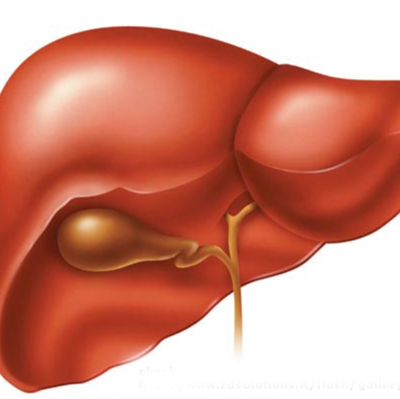
Hepatitis C - Not Just a Liver Disease
40% of people with HCV will develop at least 1 extrahepatic manifestation
Often not clinically recognized
Extrahepatic manifestations can occur at any stage of disease
  Not just in advanced liver disease

Slide 20
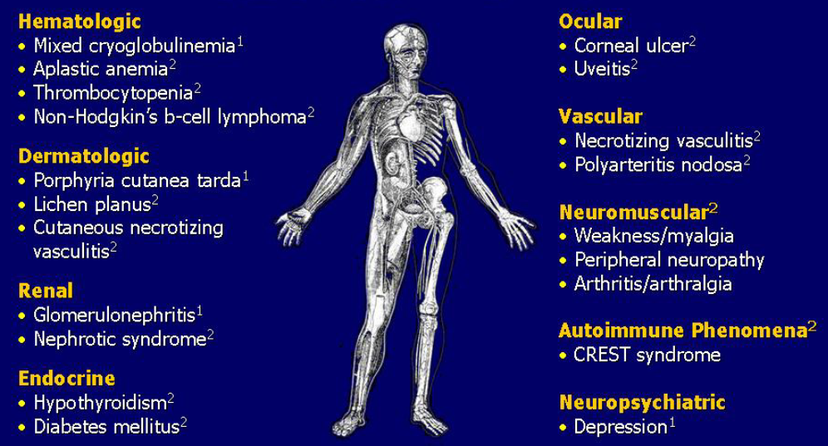

Extrahepatic Manifestations Associated with HCV

Slide 21
Immune Related vs Inflammatory Related
Immune-related extrahepatic manifestations¹
Mixed cryoglobulinemia
Cryoglobulinemic vasculitis
B-cell Non-Hodgkin's lymphoma
Sicca syndrome
Arthralgia/myalgia
Autoantibody production (i.e. cryoglobulins, rheumatoid factor, anticardiolipin, antithyroid and anti-smooth muscle antibodies)
Polyarteritis nodosa
Monoclonal gammopathies
Immune thrombocytopenia
Inflammatory-related extrahepatic manifestations​²
Type 2 diabetes mellitus type 2​
Insulin resistance​
Glomerulonephritis​
Renal insufficiency​
Fatigue​
Cognitive impairment​
Depression​
Impaired quality of life​
Polyarthritis/fibromyalgia​
Cardiovascular disorders (i.e., stroke, ischemic heart disease)​
1. The relationship between HCV infection and immune-related diseases has been formally demonstrated by epidemiological, clinical, immunological and pathological data, and results of therapeutic trials.
2. Other nonliver-related HCV disorders such as cardiovascular , renal, metabolic and CNS diseases have been reported. For these manifestations, most evidence comes from large epidemiological studies; without mechanistic studies and therapeutic trials available for confirmation.
Cacoub P, Comarmond C, Domont F, Savey L, Desbois AC, Saadoun D. Extrahepatic manifestations of chronic hepatitis C virus infection. Ther Adv Infect Dis. 2016;3(1):3-14. doi:10.1177/2049936115585942

Slide 22
Diabetes
1.7-fold increased risk of developing diabetes in persons with chronic HCV infection compared with those not infected with HCV
Persons with chronic HCV also have an increased risk of developing insulin resistance without diabetes
Data suggest that insulin resistance accelerates hepatic fibrogenesis
Potential mechanisms have been considered to explain the association between HCV and insulin resistance, including:
HCV induced fibrosis and cirrhosis
HCV direct viral effect on inflammatory cytokines
Combined effects of obesity and HCV infection altering the insulin signaling cascade

Slide 23
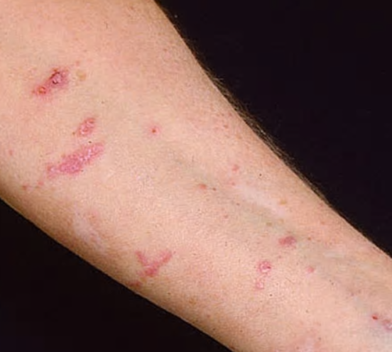
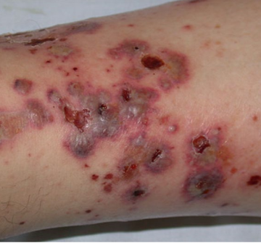
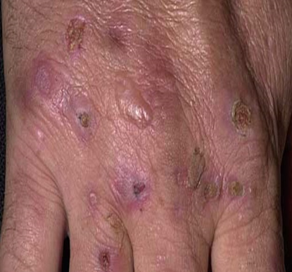
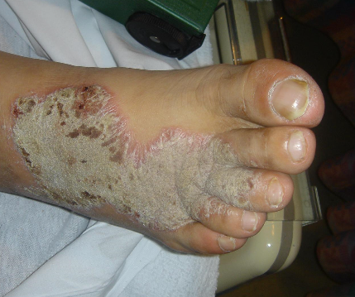
Dermatologic Manifestations
1
2
1: Lichen planus
2: Leukocytoclastic vasculitis
3: Necrolytic acral erythema
4: Porphyria cutaneous tarda
3
4

Slide 24
HCV Workflow
Confirm Diagnosis
Lab/Imaging workup
Fibrosis Staging
Critical Information
Treatment
Cure
Surveillance

Slide 25
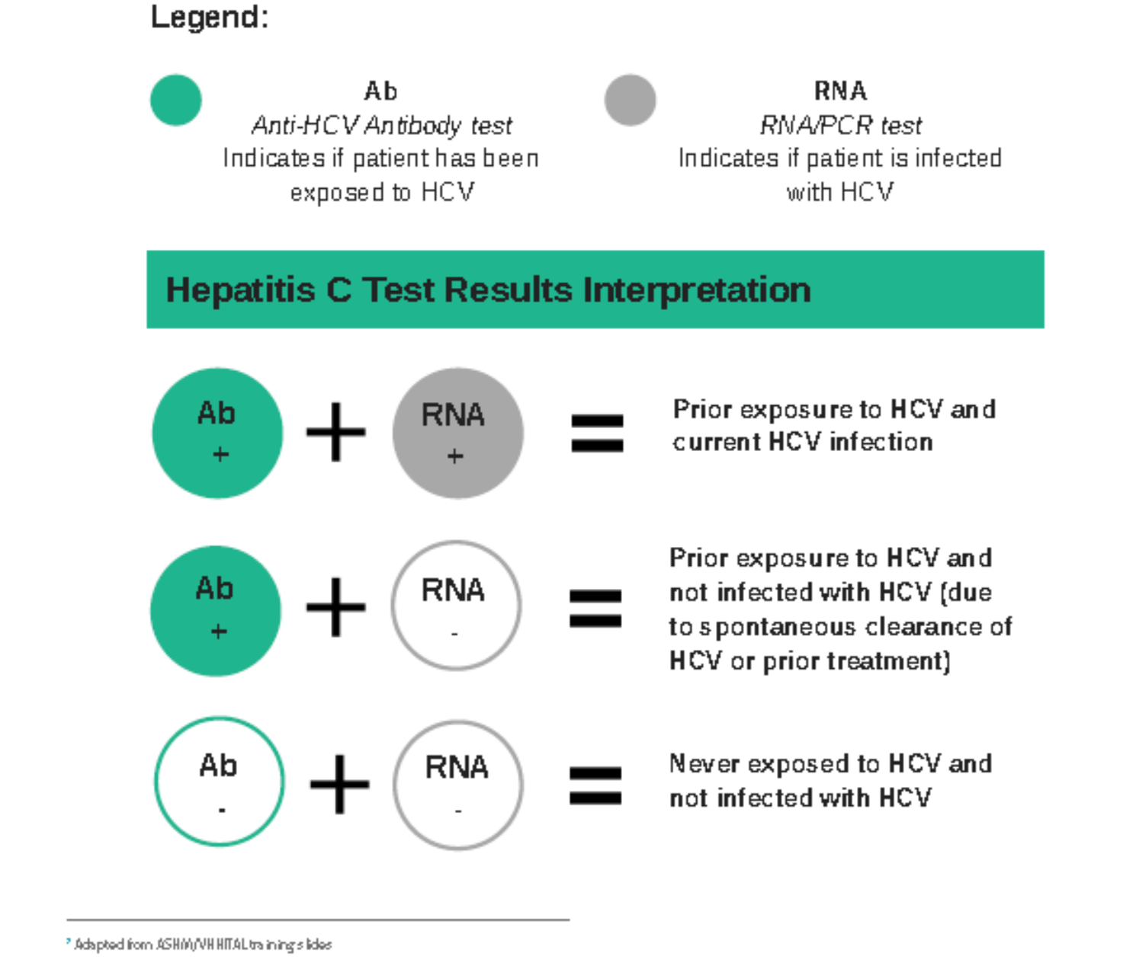
Confirm the Diagnosis
Notes:
,

Slide 26
Laboratory Workup
Viral Load
Hepatitis C RNA and genotype?
Hepatitis Serology
Hep A Total antibody
Hep B surface antibody (HBsAb), Hep B surface antigen (HBsAg), Hep B core antibody (HBcAb)
HIV serology
CBC with differential
Comprehensive metabolic panel
Optional
25 OH Vitamin D
Urinary drug screen
For patients with cirrhosis
PT/INR
Alpha Fetoprotein Tumor Marker (AFP)
For unclear liver fibrosis staging
Fibrotest/Fibrosure
Iron profile (Fe, TIBC, Ferritin)
Number of virus particles
  (RNA) per mL of blood
Confirms active infection
  15-30% of acutely infected patients spontaneously resolve
Defines the duration of treatment
  For genotype 1 (when treating it with Sofosbuvir/Ledipasvir)
It defines cure
  When the viral load is not detected 12 weeks after treatment is complete - sustained virological response (SVR 12)
Does not predict liver disease progression

Slide 27

Liver Fibrosis Staging
F0 No fibrosis
F1 Scattered portal fibrosis
F2 Diffuse periportal fibrosis
F3 Bridging fibrosis
F4 Cirrhosis
          Compensated
          Decompensated
            History or presence of ascites
            Hx of esophageal bleeding due to esophageal varices
            Hx or presence of hepatic encephalopathy

Slide 28
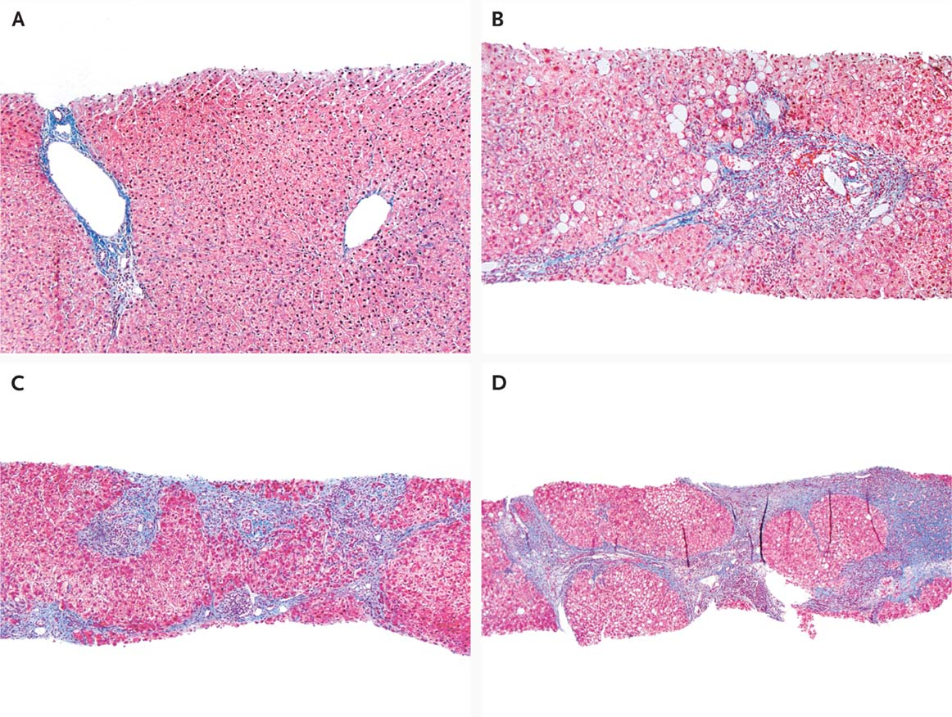

Liver Biopsy
Portal tract
Central vein
Stage 2: Portal and periportal fibrosis
Liver Biopsy
Stage 3: Bridging Fibrois
Stage 4: Regenerative nodules
Rosen HR. N Engl J Med 2011;364:2429-2438
Notes:
Figure 2 Histologic Features of HCV Infection, According to Different Scoring Systems. Panel A (trichrome stain) shows the portal tract (left) and central vein (right) without substantial fibrosis. This corresponds to Batts–Ludwig stage 0, Metavir stage 0, and Ishak stage 0. Panel B (trichrome stain) shows portal fibrous expansion with periportal fibrosis. This corresponds to Batts–Ludwig stage 2, Metavir stage 2, and Ishak stage 3. Panel C (trichrome stain) shows bridging septal fibrosis with architectural distortion in the absence of regenerative nodules. This corresponds to Batts–Ludwig stage 3, Metavir stage 3, and Ishak stage 4. Panel D (trichrome stain) shows marked bridging fibrosis with numerous regenerative nodules. This corresponds to Batts–Ludwig stage 4, Metavir stage 4, and Ishak stage 6. Photographs courtesy of Maxwell Smith, M.D., Department of Pathology, University of Colorado, Denver. In the Metavir scoring system (0 to 4), stage 1 denotes minimal fibrosis, 2 scarring that extends outside the areas that contain blood vessels, 3 bridging fibrosis, and 4 cirrhosis. In the Batts–Ludwig system (0 to 4), stage 1 denotes portal fibrosis, 2 periportal or early bridging fibrosis with intact architecture, 3 fibrosis with architectural distortion, and 4 cirrhosis. In the Ishak system (0 to 6), stage 2 denotes fibrous expansion of most portal areas, 3 fibrous expansion of most portal areas with occasional portal-to-portal bridging, 4 fibrous expansion of most portal areas with marked bridging (both portal-to-portal and portal-to-central), 5 incomplete cirrhosis characterized by marked bridging and occasional nodules, and 6 probable or definite cirrhosis.11

Slide 29
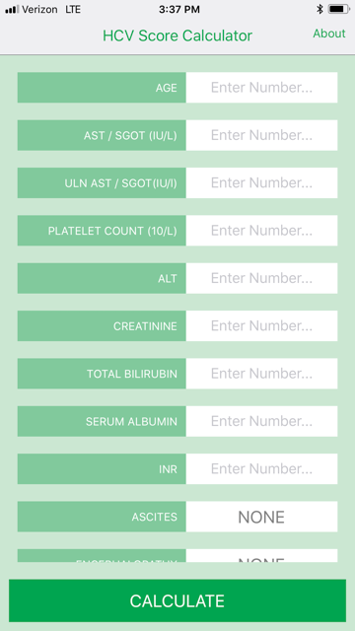
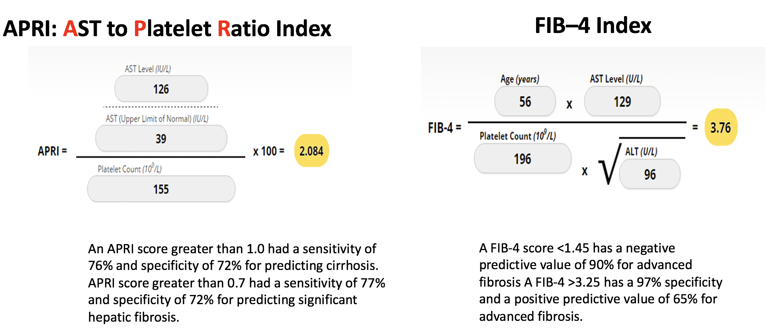
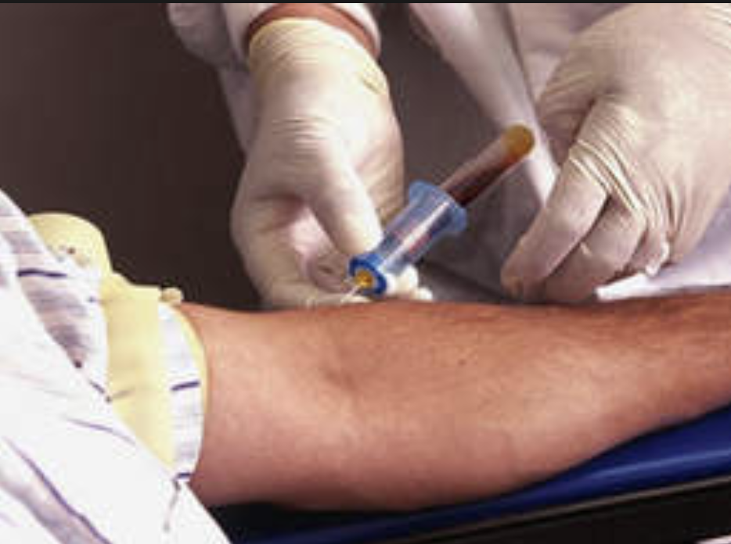
Non-Invasive Liver Fibrosis Staging in the Office
Fibrotest/Fibrosure
Lin ZH, Xin YN, Dong QJ, et al. Hepatology. 2011;53:726-36 Sterling RK, Lissen E, Clumeck N, et. al. Hepatology 2006;43:1317-1325 University of Washington: Hepatitis C Online www.hepatitisc.uw.edu/

Slide 30
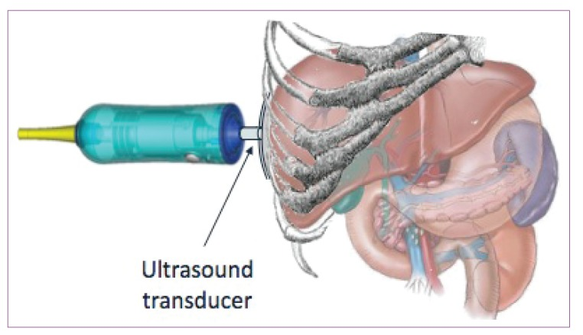
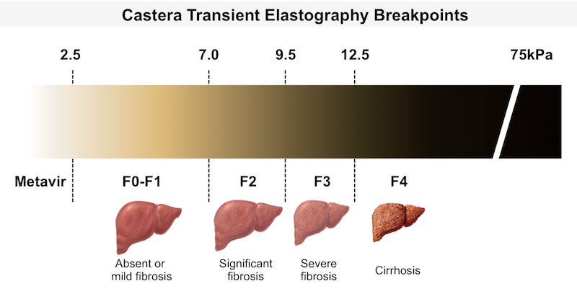
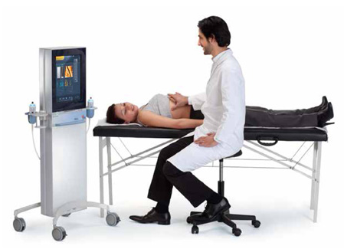
Fibroscan
The probe of the Fibroscan device is positioned in an intercostal space near the right lobe of the liver, and a 50-MHz wave is passed into the liver from a small transducer on the end of the probe. The device then measures the velocity of the shear wave (in meters per second) as this wave passes through the liver, and this measurement is converted to a liver stiffness measurement.
http://www.ncbi.nlm.nih.gov/pmc/articles/PMC3594956/

Slide 31
Liver Fibrosis Staging Interpretation
Biopsy (Metavir) | Fibroscan | Fibrosure | APRI | FIB-4
F4 | > 12.5 kPa | > 0.75 | > 1.0 | > 3.25
F3 | 9.6 12.4 kPa | 0.58 – 0.74
F2 | 7.1-9.5 kPa | 0.49 – 0.57 | < 1.0 | ?
F1 | < 7.0 kPa | 0.23 – 0.48 |  | < 1.45
F0 |  | < 0.22

Slide 32
Fibrosis Staging Algorithm
Chronic HCV
Concordant
Two Non-Invasive liver fibrosis Staging Tests
(APRI,FIB-4)
Discordant
Obvious Signs of Cirrhosis
Fibroscan/Fibrosure
Treat
Screen for Varices and HCC
HCC: Hepatocellular Carcinoma
Adapted from Boghal H, Sterling RK, Infect Dis Clin N Am 26 (2012) 839-847

Slide 33

Why is it Important to Stage Liver Fibrosis?
Treatment will be different between those patients with compensated vs decompensated cirrhosis
All patients with cirrhosis (F4) will need
  HCC surveillance
  Esophageal varices
  Hepatic encephalopathy
Patients with decompensated cirrhosis need to be referred to a liver transplant center

Slide 34
Imaging
Ultrasound
Specific for advanced liver disease but not sensitive
Nodular liver
Ascites
Splenomegaly
Portal vein diameter and flow
Liver cancer surveillance
May find other comorbidities such as fatty liver
Fibroscan
Used for liver fibrosis staging

Slide 35
Other Critical information
Compliance
  Untreated psychiatric illness/Active drug use/Active alcohol abuse
Other medications
  Antacids, PPIs, anticonvulsants and others
    Drug interaction should be done on all patients prior to determining treatment
For those with decompensated cirrhosis
  Child Pugh score / Meld score
Previous antiviral treatment
Pregnancy risk

Slide 36
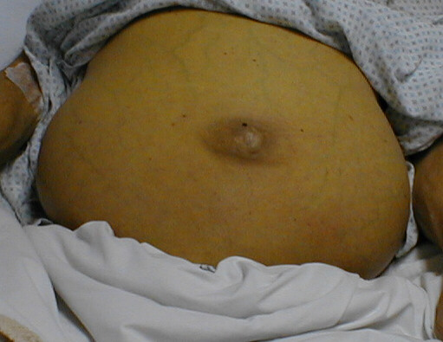
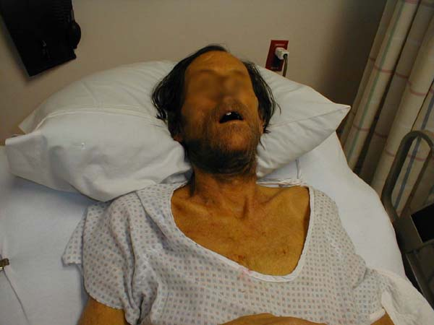
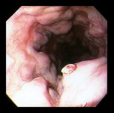
HCV Treatment: What Are We Trying To Prevent?
-Ascites
“The goal of treatment of HCV-infected persons is to reduce all-cause mortality and liver-related health adverse consequences, including end-stage liver disease and hepatocellular carcinoma, by the achievement of virologic cure as evidenced by an SVR”
AND
Decrease Transmission
-End Stage Liver Disease
-Hepatocarcinoma
-Esophageal Varices
SVR: sustained virological response hcvguidelines.org

Slide 37
Information Needed To Select Treatment
With pangenotypic agents genotype is not needed
Liver Fibrosis Staging
Cirrhosis vs no Cirrhosis
If Cirrhotic: Compensated vs Decompensated
Previous treatment status
Drug interaction check
Anti seizure meds, PPI, statins, etc.
Check Hepatitis B status to monitor reactivation
but…
Exposure to Sofosbuvir? NS5A? Proteases inhibitors?

Slide 38
HCV Therapies – Direct Acting Antivirals (DAAs)
Medication | NS5B Inh | NS5A Inh | NS3/4A PI | Other
Harvoni® | sofosbuvir | ledipasvir
Epclusa® | sofosbuvir | velpatasvir
Vosevi® | sofosbuvir | velpatasvir | voxilaprevir
Mavyret® |  | pibrentasvir | glecaprevir
Zepatier® |  | elbasvir | grazoprevir
NS5B Inh – Nonstructural protein 5B Polymerase Nucleotide Analog Inhibitor
NS5A Inh – Nonstructural protein 5A Inhibitor
NS3 PI – Nonstructural protein 3/4A Protease Inhibitor
Notes:
Harvoni = le DIP as vir and soe FOS bue vir
Epclusa = soe-FOS-bue-vir, vel-PAT-as-vir
Vosevi = soe-FOS-bue-vir, vel-PAT-as-vir, vox-i-LA-pre-vir
Mavyret = glec A pre vir and pi BRENT as vir
Zepatier = ELB as vir and graz OH pre vir

Slide 39
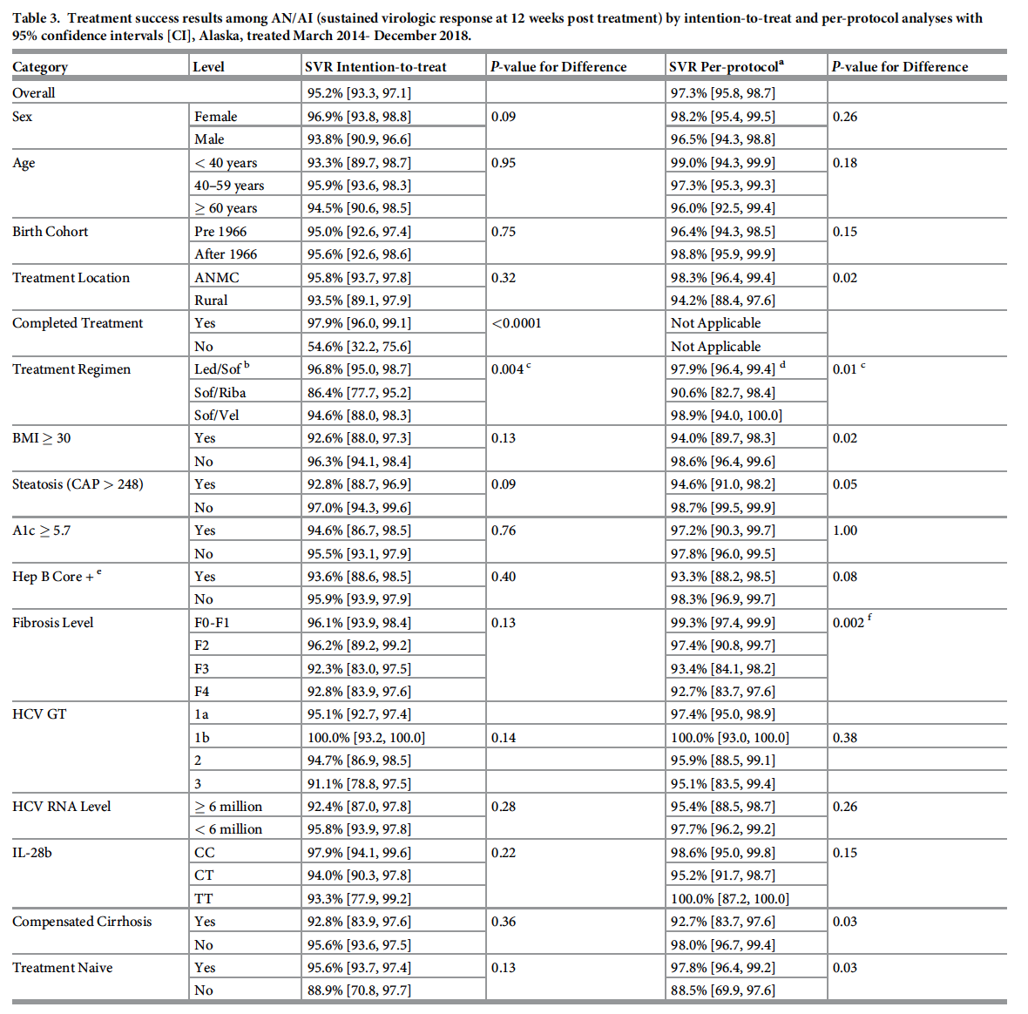
The Alaska Native/American Indian experience of hepatitis C treatment with sofosbuvir-based direct-acting antivirals
In the real-world setting, sofosbuvir-based treatment is safe, effective, and well tolerated in AN/AI patients. Sustained virologic response was high regardless of HCV genotype or cirrhosis status.
PLOS ONE https://doi.org/10.1371/journal.pone.0260970 December 2, 2021

Slide 40
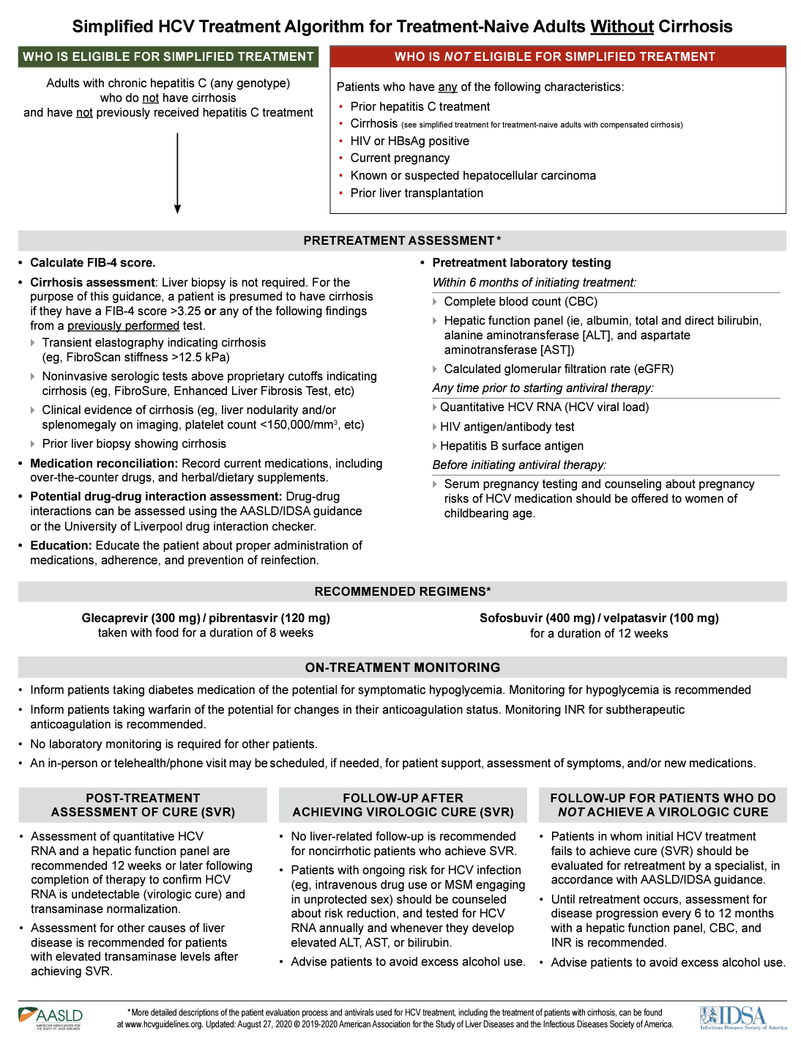

Slide 41
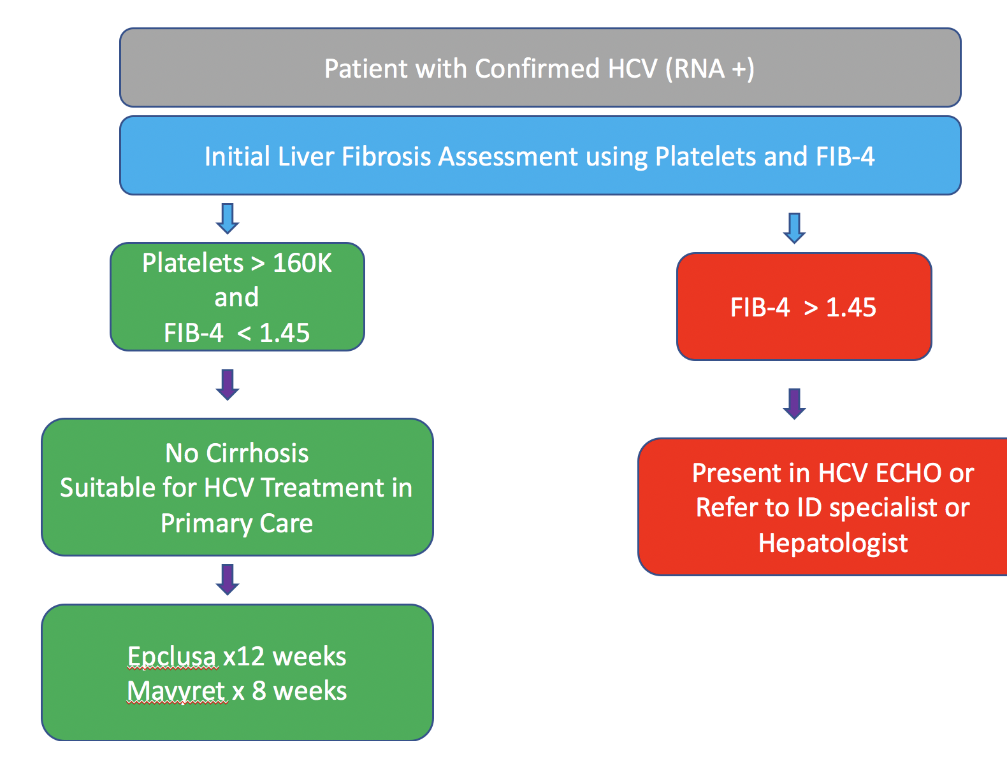

HCV Evaluation and Treatment:
Simplified Algorithm
*
ProjectECHO: Moving Knowledge Instead of Patients
*Contraindications to simplified HCV treatment: Pregnancy, HIV or HBV coinfection, Liver transplantation, treatment experienced, cirrhosis or liver cancer

Slide 42
Our Goal is to Test and Treat:
Not quite there yet
We need
  Point of care HCV RNA or Antigen
  Point of care HBsAg
  Point of care CBC
  Point of care pregnancy test
  DAAs at lower prices
  DAAs on the shelve
  Commitment from leadership, providers and patients

Slide 43
Follow-up after Cure
Persons at risk for re-infection
  Counseling
  Harm reduction
    MAT
    SSP
    Safe sex
    PrEP
  Surveillance for reinfection
Person’s fibrosis (stage 3/4)
  Counseling
  Harm reduction
  (alcohol and obesity)
  Surveillance for HCC
  Screening for esophageal
  varices
  Screening for encephalopathy
Falade-Nwulia O, et al. J Hepatol. 2017;66:267-269. AASLD/IDSA HCV Guidelines. 2017.

Slide 44
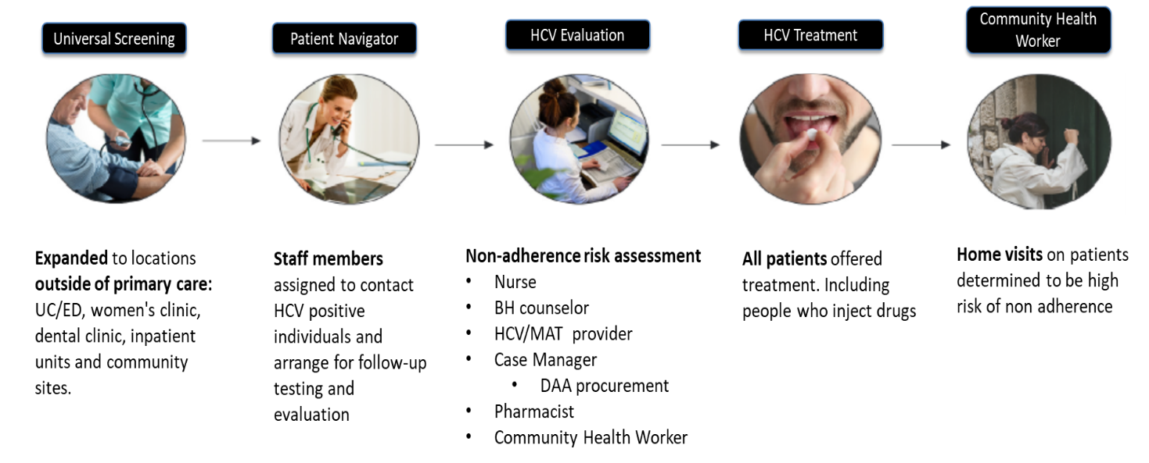
HCV Care Model: Lessons Learned
-Project ECHO:
Key in training PCPs
-Cure rates did not vary among provider type
Once clinical capacity is met the rate limiting step to link to care and treat depends on other factors:
Difficult to reach patients/doctors
Patients with other medical priorities
Patients with other socio/economic priorities
Incarceration
Delays in DAA acquisition
Cherokee Nation’s Community-Based Hepatitis C Elimination Model: November 2015-June 2019 Results. Essex W, Feder M, Winters A, Nakatsukasa W, Mera J. Presented at AASLD 2019, Boston, USA.

Slide 45
Conclusions
HCV causes high morbidity and Mortality in AI/AN communities
Primary care providers play a major role in:
  Decreasing morbidity and mortality by treating HCV
  Decreasing transmission by:
    Providing medication assisted treatment/naloxone
    Advocating for SSPs
    Patient education
Planning and commitment can accelerate the process to HCV elimination

Slide 46
Helpful Resources
IndianCountryECHO.org/program/hepatitis-c/
Text HCV 97779
http://www.hcvguidelines.org/
http://www.hepatitisc.uw.edu/
On-line curriculum on liver disease and HCV, includes clinical studies, clinical calculators, slide lectures
ECHO guidelines

