Slide 1
Sexually Transmitted Disease
Review of Surveillance, Screening and Treatment Recommendations for Chlamydia, Gonorrhea and Syphilis
Melanie Taylor, MD, MPH
CDC/NCHHSTP/DHP
Notes:
This slide set was prepared by the Division of STD Prevention, National Center for HIV/AIDS, Viral Hepatitis, STD, and TB Prevention (NCHHSTP), Centers for Disease Control and Prevention (CDC). These slides display trends for STDs in the United States through 2019. Data presented include case reports provided to CDC through the National Notifiable Diseases Surveillance System (NNDSS) and data collected through projects and programs that monitor STDs in various settings, including the STD Surveillance Network (SSuN), and the Gonococcal Isolate Surveillance Project (GISP).
For more information on data sources, data collection and reporting practices, and case definitions, please see the Technical Note, available at https://www.cdc.gov/std/statistics/2020/technical-notes.htm
All data points for figures presented in these slides are available at https://www.cdc.gov/std/statistics/2020/data.zip
NOTE: This slide set is in the public domain. You may reproduce these slides without permission; however, citation as to source is appreciated.
Centers for Disease Control and Prevention. Sexually Transmitted Disease Surveillance 2020. Atlanta: U.S. Department of Health and Human Services; 2022.
You are also free to adapt and revise these slides; however, you must remove the CDC name and logo if changes are made.

Slide 2
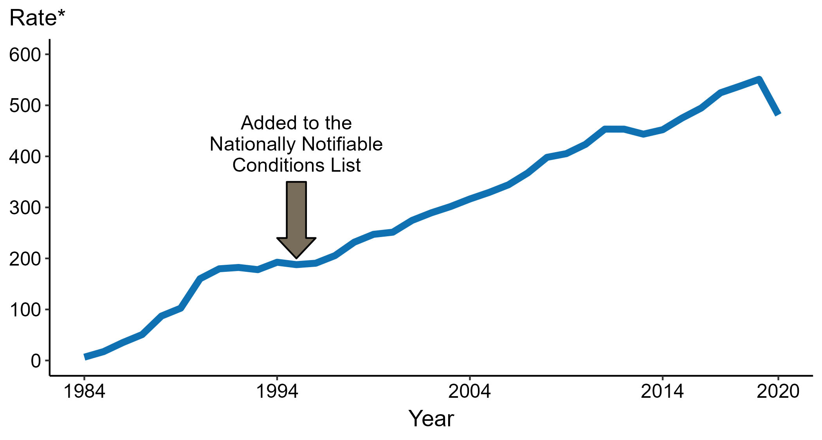
Chlamydia — Rates of Reported Cases by Year, United States, 1984–2020
* Per 100,000
Notes:
Data collection for chlamydia began in 1984 and chlamydia was made a nationally notifiable condition in 1995; however, chlamydia was not reportable in all 50 states and the District of Columbia until 2000. Steady increases in chlamydia case rates beginning in 1996 are due, in part, to improved reporting, increased screening, and use of more sensitive diagnostic tests.
In 2020, 1,579,885 total cases of chlamydia were reported in the United States. During 2019 to 2020, the rate of reported chlamydia decreased 12.6% (from 551.0 to 481.3 per 100,000).
The COVID-19 pandemic has introduced uncertainty and difficulty in interpreting 2020 case data. See Impact of COVID-19 on STDs (https://www.cdc.gov/std/statistics/2020/impact.htm) for more information.
See Technical Notes (https://www.cdc.gov/std/statistics/2020/technical-notes.htm) for information on chlamydia case reporting.
Data points are available at: https://www.cdc.gov/std/statistics/2020/data.zip

Slide 3
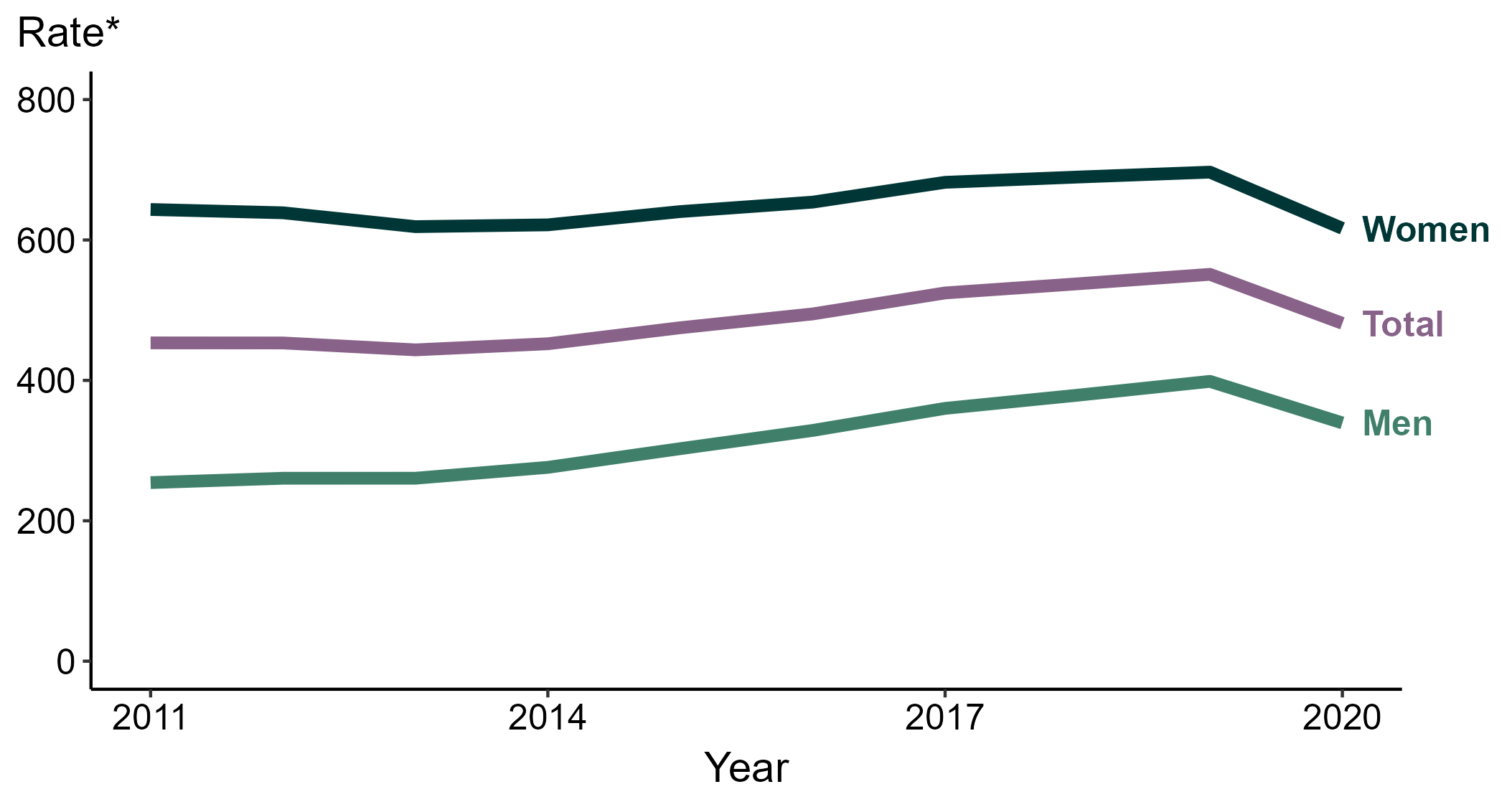
Chlamydia — Rates of Reported Cases by Sex, United States, 2011–2020
* Per 100,000
Notes:
During 2019 to 2020, the chlamydia rate among women decreased 11.5% (from 696.6 to 616.5 per 100,000) and the rate among men decreased 14.9% (from 398.6 to 339.4 per 100,000).
Over the last 5 years, the chlamydia rate among men increased 3.3% (from 328.7 to 339.4 per 100,000) and the rate among women decreased 5.7% (from 653.9 to 616.5 per 100,000). Over the last 10 years, the chlamydia rate among men increased 33.4% (from 254.4 to 339.4 per 100,000) and the rate among women decreased 4.2% (from 643.4 to 616.5 per 100,000).
The COVID-19 pandemic has introduced uncertainty and difficulty in interpreting 2020 case data. See Impact of COVID-19 on STDs (https://www.cdc.gov/std/statistics/2020/impact.htm) for more information.
See Technical Notes (https://www.cdc.gov/std/statistics/2020/technical-notes.htm) for information on chlamydia case reporting.
Data points are available at: https://www.cdc.gov/std/statistics/2020/data.zip

Slide 4
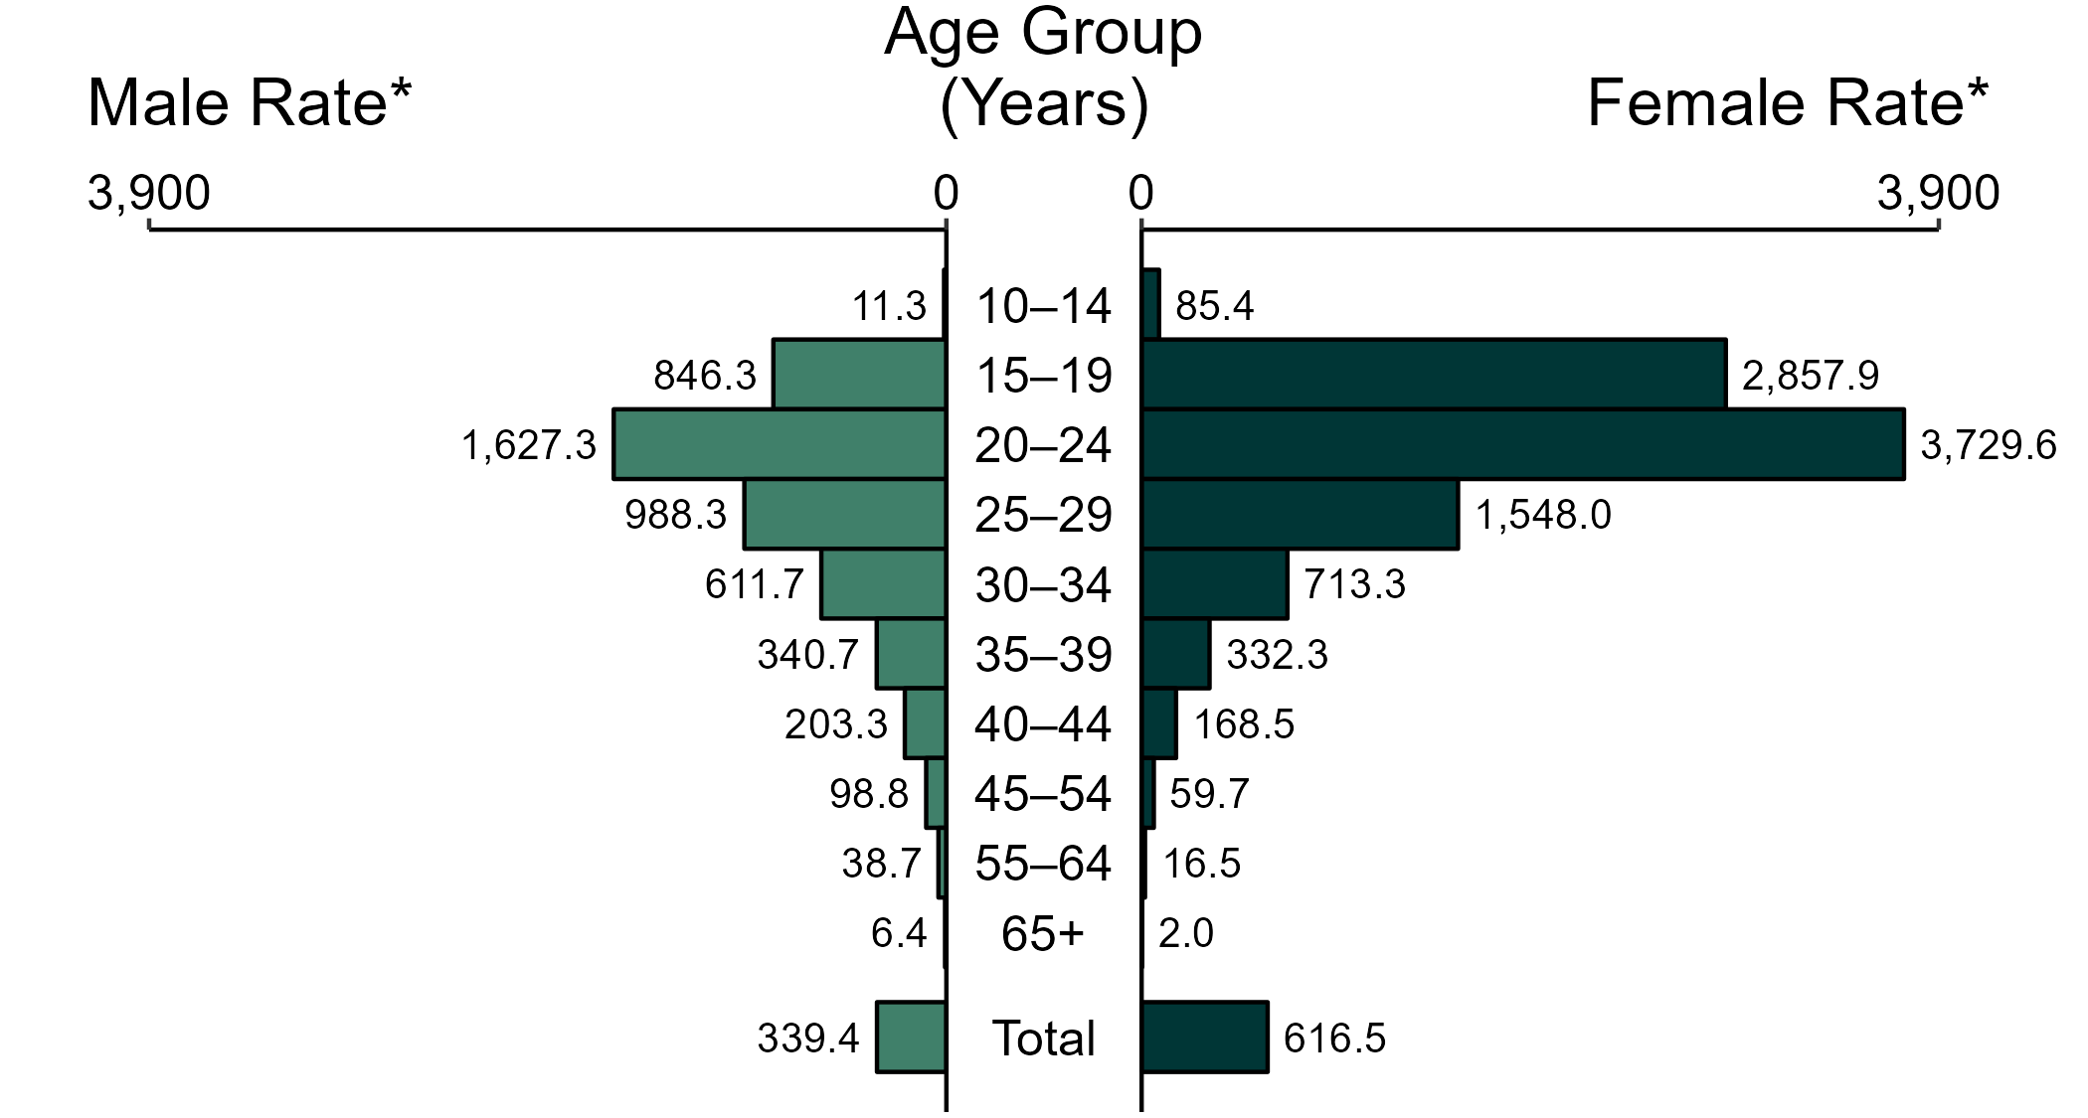
Chlamydia — Rates of Reported Cases by Age Group and Sex, United States, 2020
* Per 100,000
NOTE: Total includes all ages.
Notes:
In 2020, women aged 20 to 24 years had the highest rate of reported cases of chlamydia (3,729.6 per 100,000), followed by those aged 15 to 19 years (2,857.9 per 100,000) and 25 to 29 years (1,548.0 per 100,000). Among men, those aged 20 to 24 years had the highest rate of reported cases of chlamydia (1,627.3 per 100,000), followed by those aged 25 to 29 years (988.3 per 100,000) and 15 to 19 years (846.3 per 100,000).
The COVID-19 pandemic has introduced uncertainty and difficulty in interpreting 2020 case data. See Impact of COVID-19 on STDs (https://www.cdc.gov/std/statistics/2020/impact.htm) for more information.
See Technical Notes (https://www.cdc.gov/std/statistics/2020/technical-notes.htm) for information on chlamydia case reporting.
Data points are available at: https://www.cdc.gov/std/statistics/2020/data.zip

Slide 5
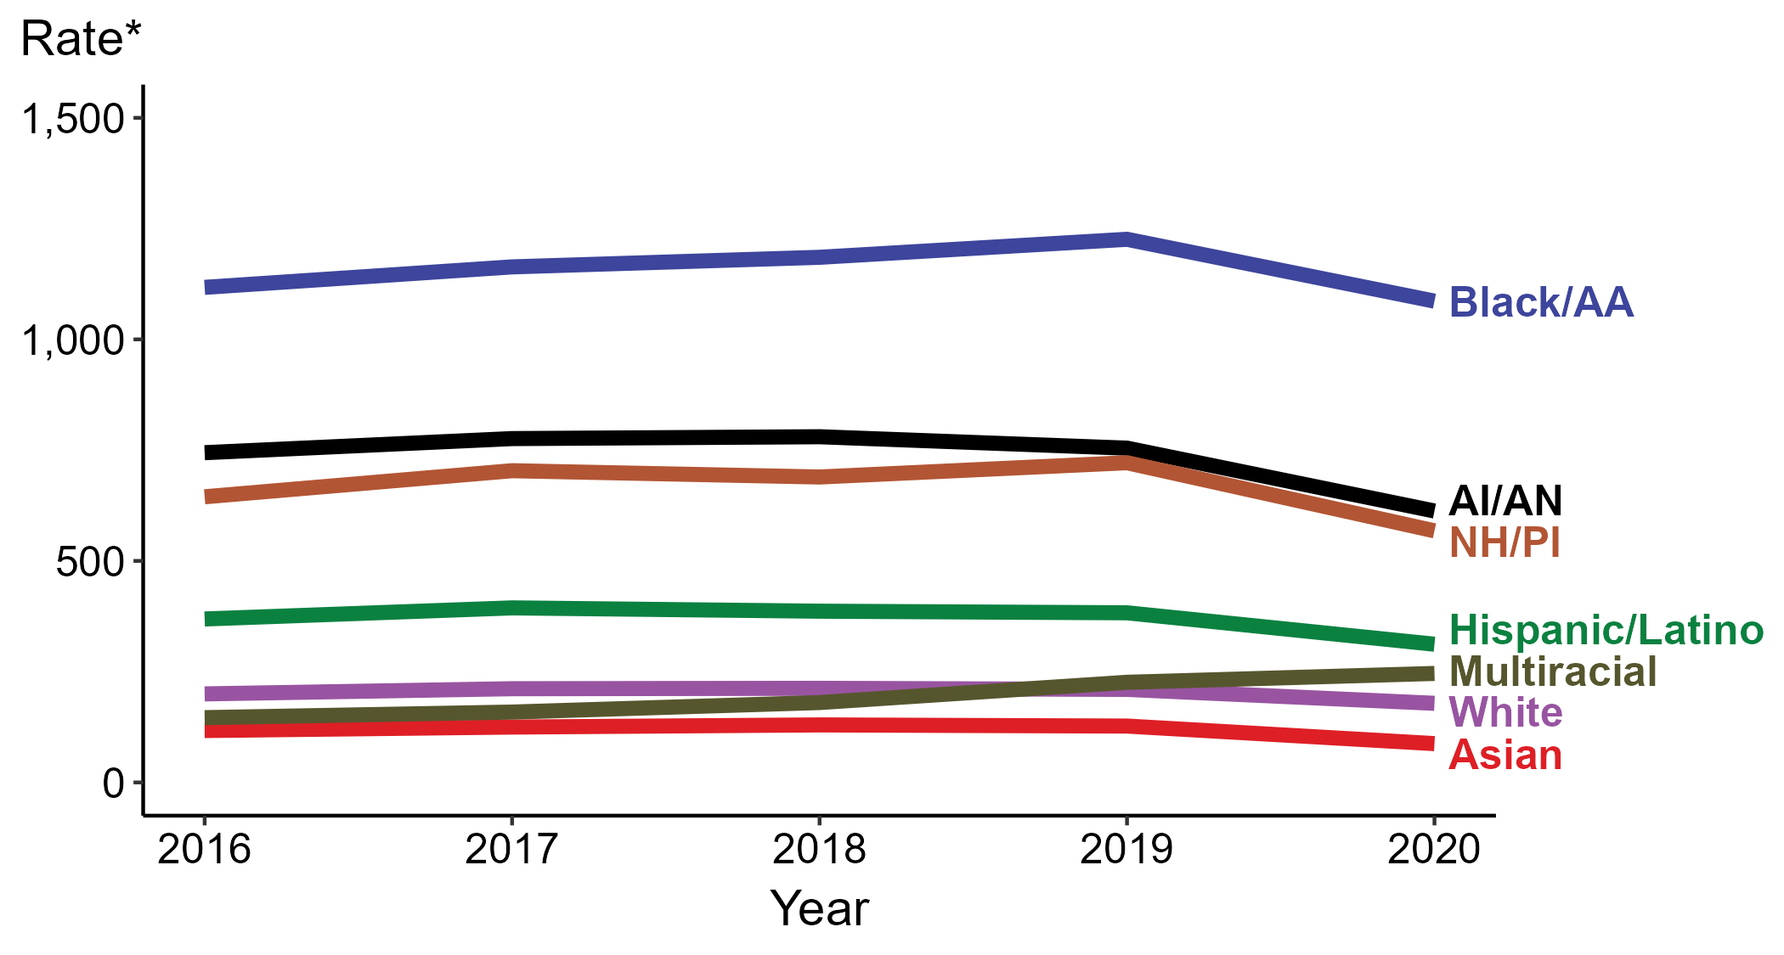
Chlamydia — Rates of Reported Cases by Race/Hispanic Ethnicity, United States, 2016–2020
* Per 100,000
ACRONYMS: AI/AN = American Indian/Alaska Native; Black/AA = Black or African American; NH/PI = Native Hawaiian/Pacific Islander
Notes:
In 2020, the highest rate of reported cases of chlamydia was among non-Hispanic Black or African American persons (1,086.3 cases per 100,000; 11.4% decrease from 2019), followed by non-Hispanic American Indian or Alaska Native persons (612.6 cases per 100,000; 18.8% decrease from 2019), non-Hispanic Native Hawaiian or other Pacific Islander persons (567.9 cases per 100,000; 21.3% decrease from 2019), Hispanic or Latino persons of any race (312.0 cases per 100,000; 18.5% decrease from 2019), non-Hispanic persons of multiple races (246.0 cases per 100,000; 8.8% increase from 2019), non-Hispanic White persons (178.6 cases per 100,000; 15.0% decrease from 2019), and non-Hispanic Asian persons (87.6 cases per 100,000; 31.1% decrease from 2019). Non-Hispanic persons of multiple races had the greatest 5-year increase in rates of reported cases of chlamydia (146.2 to 246.0 per 100,000; 68.3% increase from 2016).
For this figure, race/Hispanic ethnicity is categorized first by reported Hispanic ethnicity, then by reported race. Therefore, cases categorized as Hispanic/Latino can be of any race; cases categorized into a race group include both non-Hispanic persons and persons of unknown Hispanic ethnicity. Not all US jurisdictions reported cases in Office of Management and Budget compliant race categories during 2016 to 2020. This may minimally under- or overestimate rates for Asian, Native Hawaiian or other Pacific Islander, or multiracial individuals. No population data exist for unknown or other race; therefore, rates are not calculated. For completeness, data in this figure include cases reported from all jurisdictions.
The COVID-19 pandemic has introduced uncertainty and difficulty in interpreting 2020 case data. See Impact of COVID-19 on STDs (https://www.cdc.gov/std/statistics/2020/impact.htm) for more information.
See Technical Notes (https://www.cdc.gov/std/statistics/2020/technical-notes.htm) for information on chlamydia case reporting and reporting of race/Hispanic ethnicity for STD cases.
Data points are available at: https://www.cdc.gov/std/statistics/2020/data.zip

Slide 6
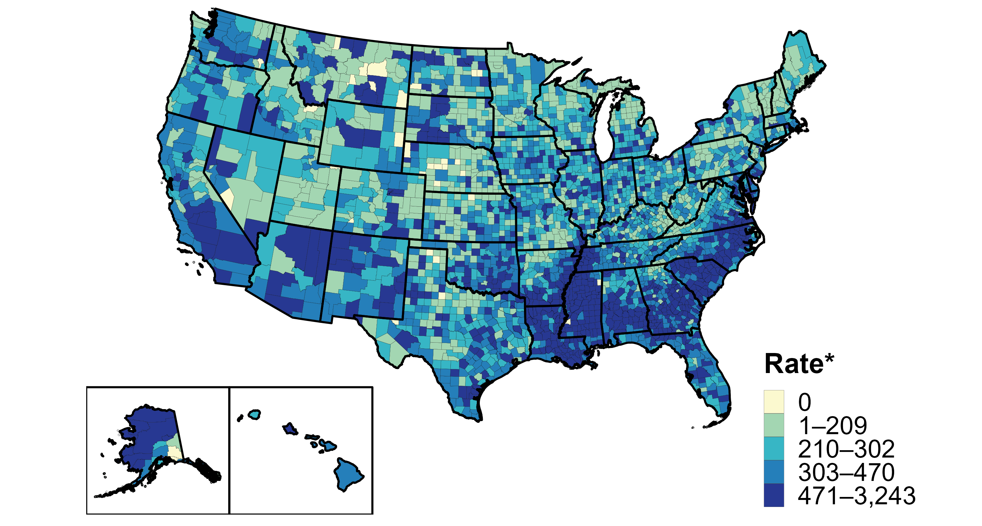
Chlamydia — Rates of Reported Cases by County, United States, 2020
* Per 100,000
Notes:
In 2020, 99% of all counties and county equivalents in the United States reported at least one case of chlamydia. Out of 3,143 counties and county equivalents, 102 (3%) reported over half of all cases of chlamydia.
The COVID-19 pandemic has introduced uncertainty and difficulty in interpreting 2020 case data. See Impact of COVID-19 on STDs (https://www.cdc.gov/std/statistics/2020/impact.htm) for more information.
See Technical Notes (https://www.cdc.gov/std/statistics/2020/technical-notes.htm) for information on chlamydia case reporting.
Data points are available at: https://www.cdc.gov/std/statistics/2020/data.zip

Slide 7
Chlamydia Screening
Annual screening for young sexually active women (<25 yrs)
Screening of sexually active young men should be considered in areas with high prevalence of infection
Pregnant women <25 years and pregnant women at risk, repeat in 3rd tri.
At minimum, annual* screening of MSM at sites of exposure (urethral/pharyngeal/rectal)
At minimum, annual* screening of HIV-infected persons.
At minimum, bi-annual* screening for persons on PrEP,
Women <35 years and men <30 years of age in corrections facilities at intake as opt out screening
*More often based on risk
STI Treatment Guidelines (cdc.gov)

Slide 8
Laboratory diagnosis of Chlamydia
Nucleic acid amplification testing (NAAT)
Optimal sampling for women is via vaginal swab either self-collected or provider collected. First catch urine can also be used.
Optimal sampling for men is via first catch urine
Men and women should be also tested at pharyngeal and rectal sites via swab based on reported sites of exposure.
STI Treatment Guidelines (cdc.gov)

Slide 9
Chlamydia Treatment
Recommended Regimen
  Doxycycline 100mg BID x 7 days
Alternative Regimens
  Azithromycin 1gm orally in a single dose OR
  Levafloxacin 500mg QD x 7 days
*Retest persons diagnosed with chlamydia or gonorrhea 3 months after treatment to detect repeat infection

Slide 10
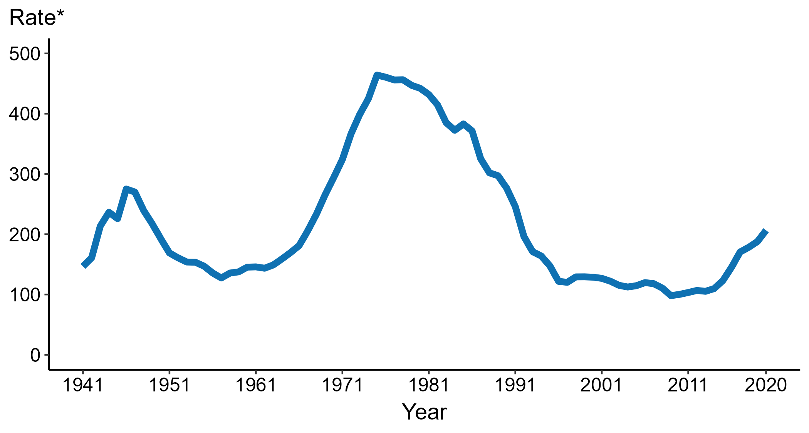
Gonorrhea — Rates of Reported Cases by Year, United States, 1941–2020
* Per 100,000
Notes:
Data collection for gonorrhea began in 1941 and gonorrhea was made a nationally notifiable condition in 1944. Steep declines in cases rates in the 1940s and 1950s likely reflect expanded use of penicillin to treat infection.
In 2020, 677,769 total cases of gonorrhea were reported in the United States. During 2019 to 2020, the rate of reported gonorrhea increased 10.0% (from 187.8 to 206.5 per 100,000).
The COVID-19 pandemic has introduced uncertainty and difficulty in interpreting 2020 case data. See Impact of COVID-19 on STDs (https://www.cdc.gov/std/statistics/2020/impact.htm) for more information.
See Technical Notes (https://www.cdc.gov/std/statistics/2020/technical-notes.htm) for information on gonorrhea case reporting.
Data points are available at: https://www.cdc.gov/std/statistics/2020/data.zip

Slide 11
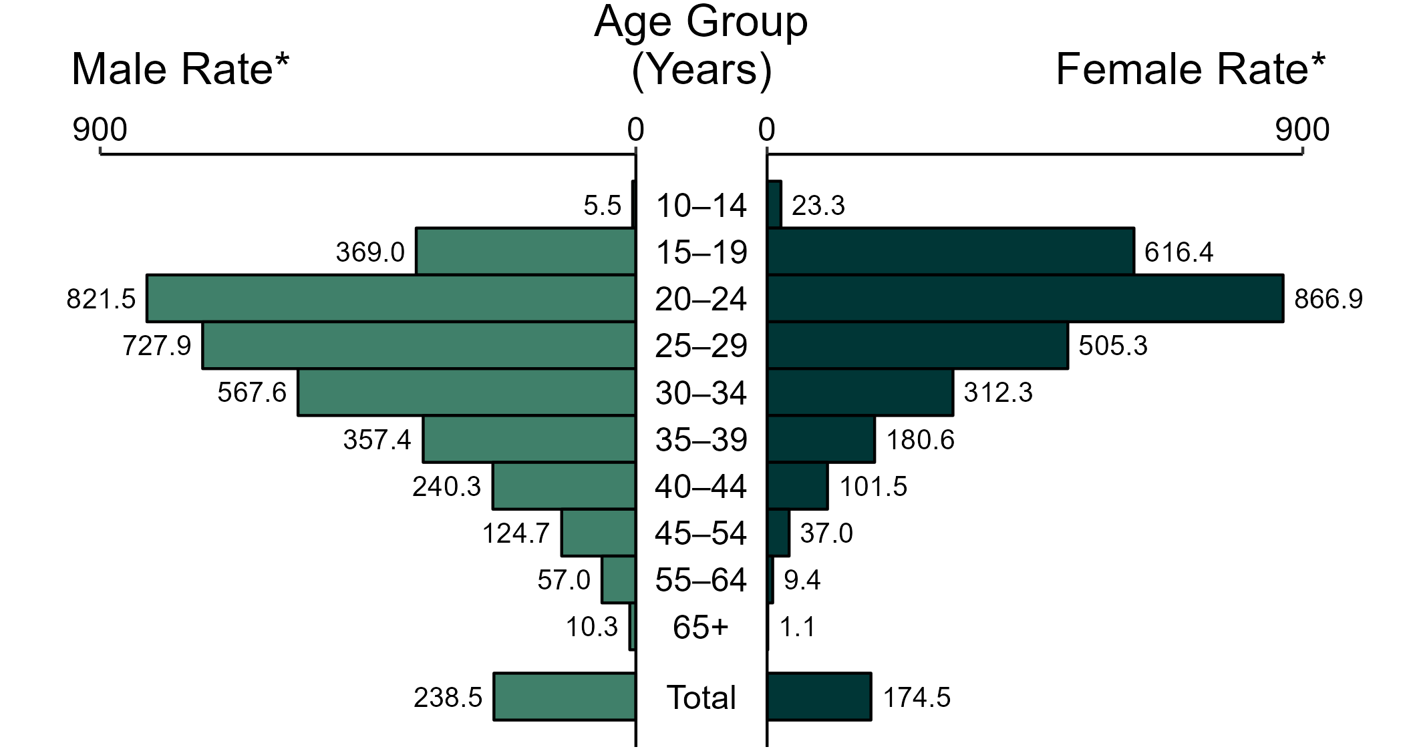
Gonorrhea — Rates of Reported Cases by Age Group and Sex, United States, 2020
* Per 100,000
NOTE: Total includes all ages.
Notes:
In 2020, women aged 20 to 24 years had the highest rate of reported cases of gonorrhea (866.9 per 100,000), followed by those aged 15 to 19 years (616.4 per 100,000) and 25 to 29 years (505.3 per 100,000). Among men, those aged 20 to 24 years had the highest rate of reported cases of gonorrhea (821.5 per 100,000), followed by those aged 25 to 29 years (727.9 per 100,000) and 30 to 34 years (567.6 per 100,000).
The COVID-19 pandemic has introduced uncertainty and difficulty in interpreting 2020 case data. See Impact of COVID-19 on STDs (https://www.cdc.gov/std/statistics/2020/impact.htm) for more information.
See Technical Notes (https://www.cdc.gov/std/statistics/2020/technical-notes.htm) for information on gonorrhea case reporting.
Data points are available at: https://www.cdc.gov/std/statistics/2020/data.zip

Slide 12
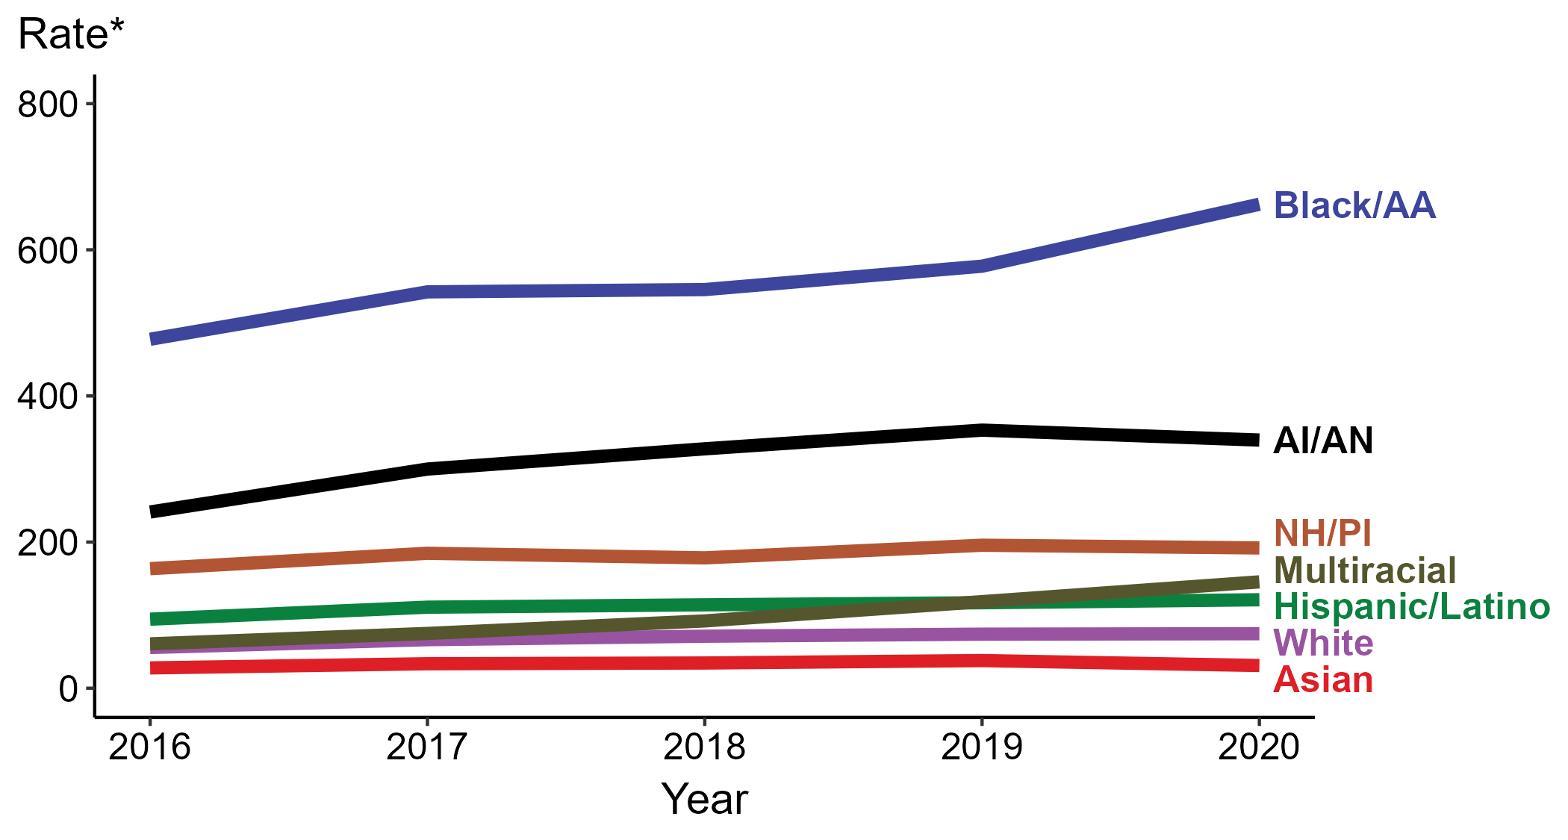
Gonorrhea — Rates of Reported Cases by Race/Hispanic Ethnicity, United States, 2016–2020
* Per 100,000
ACRONYMS: AI/AN = American Indian/Alaska Native; Black/AA = Black or African American; NH/PI = Native Hawaiian/Pacific Islander
Notes:
In 2020, the highest rate of reported cases of gonorrhea was among non-Hispanic Black or African American persons (662.4 cases per 100,000; 14.7% increase from 2019), followed by non-Hispanic American Indian or Alaska Native persons (339.6 cases per 100,000; 3.9% decrease from 2019), non-Hispanic Native Hawaiian or other Pacific Islander persons (192.0 cases per 100,000; 1.9% decrease from 2019), non-Hispanic persons of multiple races (145.5 cases per 100,000; 22.9% increase from 2019), Hispanic or Latino persons of any race (121.0 cases per 100,000; 3.4% increase from 2019), non-Hispanic White persons (74.6 cases per 100,000; 0.8% increase from 2019), and non-Hispanic Asian persons (31.1 cases per 100,000; 17.7% decrease from 2019). Non-Hispanic persons of multiple races had the greatest 5-year increase in rates of reported cases of gonorrhea (60.7 to 145.5 per 100,000; 139.7% increase from 2016).
For this figure, race/Hispanic ethnicity is categorized first by reported Hispanic ethnicity, then by reported race. Therefore, cases categorized as Hispanic/Latino can be of any race; cases categorized into a race group include both non-Hispanic persons and persons of unknown Hispanic ethnicity. Not all US jurisdictions reported cases in Office of Management and Budget compliant race categories during 2016 to 2020. This may minimally under- or overestimate rates for Asian, Native Hawaiian or other Pacific Islander, or multiracial individuals. No population data exist for unknown or other race; therefore, rates are not calculated. For completeness, data in this figure include cases reported from all jurisdictions.
The COVID-19 pandemic has introduced uncertainty and difficulty in interpreting 2020 case data. See Impact of COVID-19 on STDs (https://www.cdc.gov/std/statistics/2020/impact.htm) for more information.
See Technical Notes (https://www.cdc.gov/std/statistics/2020/technical-notes.htm) for information on gonorrhea case reporting and reporting of race/Hispanic ethnicity for STD cases.
Data points are available at: https://www.cdc.gov/std/statistics/2020/data.zip

Slide 13
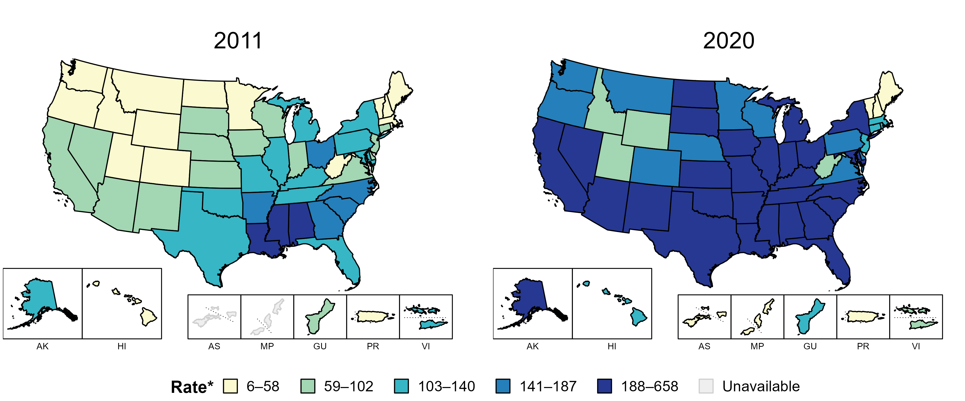
Gonorrhea — Rates of Reported Cases by State, United States and Territories, 2011 and 2020
* Per 100,000
Notes:
In 2011, eight states and the District of Columbia (DC; 16.1% of available areas) had a rate of reported gonorrhea greater than or equal to 141 cases per 100,000 population. This increased to 38 states and DC (69.6% of available areas) in 2020.
American Samoa and the Commonwealth of the Northern Mariana Islands began reporting data on gonorrhea cases to CDC in 2018; data are not available for those areas prior to that year.
The COVID-19 pandemic has introduced uncertainty and difficulty in interpreting 2020 case data. See Impact of COVID-19 on STDs (https://www.cdc.gov/std/statistics/2020/impact.htm) for more information.
See Technical Notes (https://www.cdc.gov/std/statistics/2020/technical-notes.htm) for information on gonorrhea case reporting and on interpreting reported rates in US territories.
Data points are available at: https://www.cdc.gov/std/statistics/2020/data.zip

Slide 14
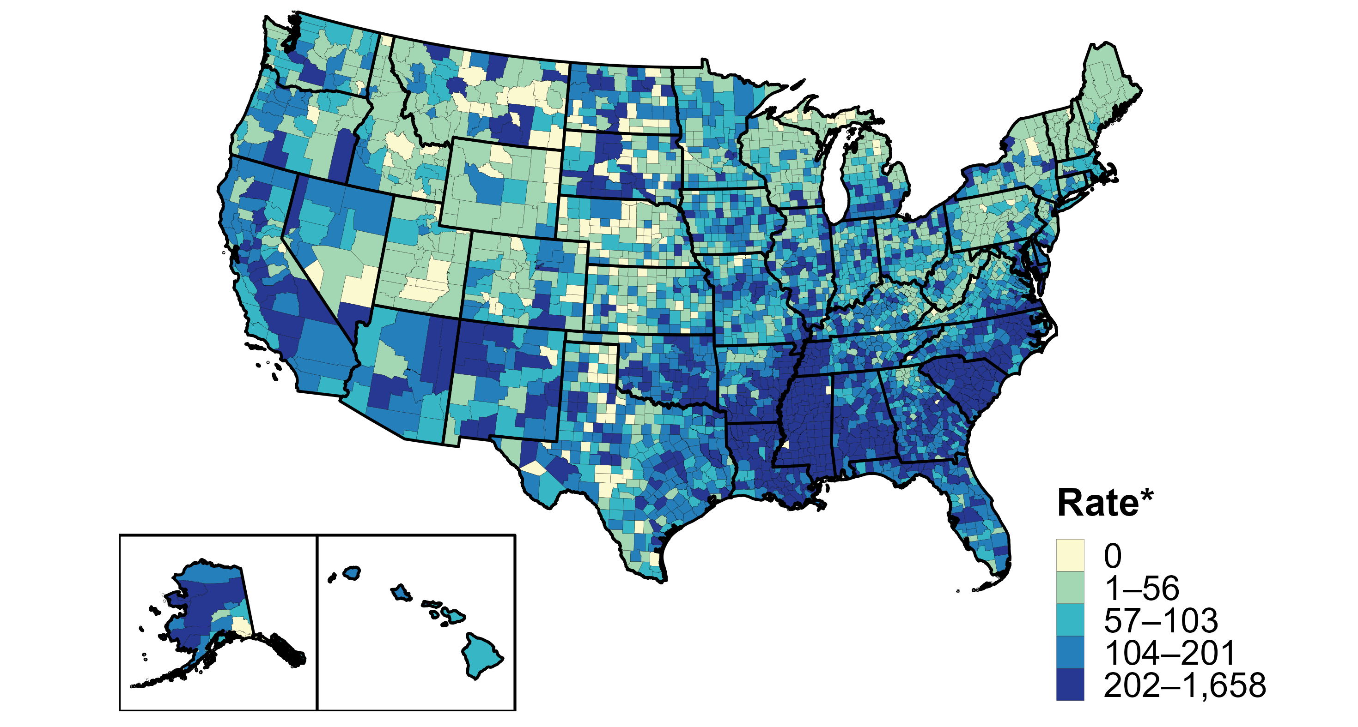
Gonorrhea — Rates of Reported Cases by County, United States, 2020
* Per 100,000
Notes:
In 2020, 94% of all counties and county equivalents in the United States reported at least one case of gonorrhea. Out of 3,143 counties and county equivalents, 78 (2%) reported over half of all cases of gonorrhea.
The COVID-19 pandemic has introduced uncertainty and difficulty in interpreting 2020 case data. See Impact of COVID-19 on STDs (https://www.cdc.gov/std/statistics/2020/impact.htm) for more information.
See Technical Notes (https://www.cdc.gov/std/statistics/2020/technical-notes.htm) for information on gonorrhea case reporting.
Data points are available at: https://www.cdc.gov/std/statistics/2020/data.zip

Slide 15
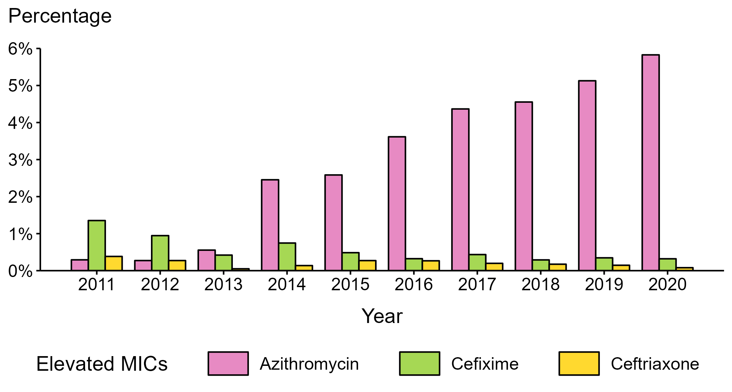
Neisseria gonorrhoeae — Percentage of Isolates with Elevated Minimum Inhibitory Concentrations (MICs) to Azithromycin, Cefixime, and Ceftriaxone, Gonococcal Isolate Surveillance Project (GISP), 2011–2020
NOTE: Elevated MICs = Azithromycin: ≥ 2.0 µg/mL; Cefixime: ≥ 0.25 µg/mL; Ceftriaxone: ≥ 0.125 µg/mL
Notes:
During 2011–2020, the percentage of Neisseria gonorrhoeae isolates that exhibited elevated ceftriaxone minimum inhibitory concentrations, defined as ≥ 0.125 µg/mL, fluctuated between 0.1% and 0.4%. In 2020, 0.1% of isolates had elevated ceftriaxone minimum inhibitory concentrations. The percentage of isolates with elevated cefixime minimum inhibitory concentrations (≥ 0.25 µg/mL) declined from 1.4% in 2011 to 0.3% in 2020. During 2012–2014, the percentage of isolates with elevated azithromycin minimum inhibitory concentrations (≥ 2 µg/mL) ranged from 0.3% to 2.5% with a sharp increase during 2013–2014 (0.6% to 2.5%); during 2014–2020, the percentage increased from 2.5% to 5.8%.
The COVID-19 pandemic has introduced uncertainty and difficulty in interpreting data collected in 2020. See Impact of COVID-19 on STDs (https://www.cdc.gov/std/statistics/2020/impact.htm) for more information.
See Technical Notes (https://www.cdc.gov/std/statistics/2020/technical-notes.htm) for information on GISP methodology.
Data points are available at: https://www.cdc.gov/std/statistics/2020/data.zip

Slide 16
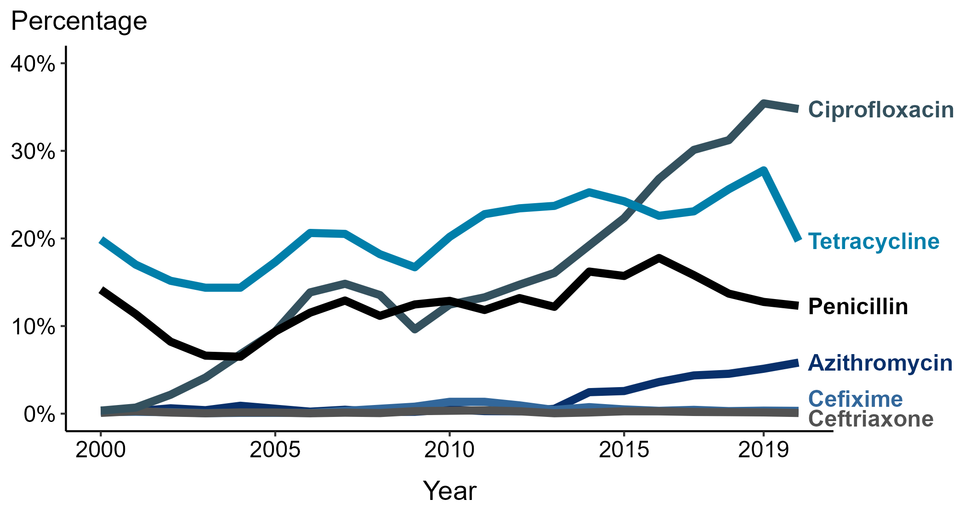
Neisseria gonorrhoeae — Prevalence of Tetracycline, Penicillin, or Ciprofloxacin Resistance* or Elevated Cefixime, Ceftriaxone, or Azithromycin Minimum Inhibitory Concentrations (MICs)†, by Year — Gonococcal Isolate Surveillance Project (GISP), 2000–2020
* Resistance: Ciprofloxacin: MIC ≥ 1.0 µg/mL; Penicillin: MIC ≥ 2.0 µg/mL or Beta-lactamase positive; Tetracycline: MIC ≥ 2.0 µg/mL
† Elevated MICs: Azithromycin: MIC ≥ 1.0 µg/mL 29 (2000–2004); ≥ 2.0 µg/mL (2005–2020); Ceftriaxone: MIC ≥ 0.125 µg/mL; Cefixime: MIC ≥ 0.25 µg/mL
NOTE: Cefixime susceptibility was not tested in 2007 and 2008.
Notes:
In 2020, 34.8% of Neisseria gonorrhoeae isolates collected from GISP sites were resistant to ciprofloxacin, 19.7% to tetracycline, and 12.3% to penicillin.
The COVID-19 pandemic has introduced uncertainty and difficulty in interpreting data collected in 2020. See Impact of COVID-19 on STDs (https://www.cdc.gov/std/statistics/2020/impact.htm) for more information.
See Technical Notes (https://www.cdc.gov/std/statistics/2020/technical-notes.htm) for information on GISP methodology.
Data points are available at: https://www.cdc.gov/std/statistics/2020/data.zip

Slide 17
Gonorrhea Screening Recommendations
Annual screening for young sexually active women (<25 yrs)
Screening of asymptomatic sexually active young men is not currently recommended due to inconclusive cost benefit data analyses
Pregnant women <25 years and older women at risk, repeat in 3rd trim.
At minimum, annual* screening of sexually active MSM at exposed sites (urethral/pharyngeal/rectal)
At minimum, annual* screening of HIV-infected persons
At minimum, bi-annual* screening for persons on PrEP.
Women <35 years and men <30 years of age in corrections facilities at intake as opt out screening
*More often based on risk
STI Treatment Guidelines (cdc.gov)

Slide 18
Laboratory diagnosis of Gonorrhea
Nucleic acid amplification testing (NAAT)
Optimal sampling for women is via vaginal swab either self-collected or provider collected. First catch urine and liquid- based cytology specimens can also be used.
Optimal sampling for men is via first catch urine
Men and women should be also tested at pharyngeal and rectal sites via swab based on reported sites of exposure.
Culture remains available for antimicrobial susceptibility testing
Gram stain has low sensitivity
STI Treatment Guidelines (cdc.gov)

Slide 19
Treatment of Uncomplicated Gonococcal Infection of the Cervix, Urethra, or Rectum Among Adults and Adolescents
Ceftriaxone 500 mg* IM in a single dose for persons weighing <150 kg
For persons weighing ≥150 kg, 1 g ceftriaxone should be administered.
*If chlamydial infection has not been excluded, providers should treat for chlamydia with doxycycline 100 mg orally 2 times/day for 7 days.
**Retest persons diagnosed with chlamydia or gonorrhea 3 months after treatment to detect repeat infection
STI Treatment Guidelines (cdc.gov

Slide 20
Gonococcal Infections: Alternative Regimens
If cephalosporin allergy:
Gentamicin 240 mg IM in a single dose PLUS
Azithromycin 2 g orally in a single dose
If ceftriaxone administration is not available or not feasible:
Cefixime 800 mg* orally in a single dose
*If chlamydial infection has not been excluded, providers should treat for chlamydia with doxycycline 100 mg orally 2 times/day for 7 days
**Retest persons diagnosed with chlamydia or gonorrhea 3 months after treatment to detect repeat infection
STI Treatment Guidelines (cdc.gov

Slide 21
Recommended Regimen for Uncomplicated Gonococcal Infection of the Pharynx Among Adolescents and Adults
Ceftriaxone 500 mg IM in a single dose for persons weighing <150 kg
For persons weighing ≥150 kg, 1 g ceftriaxone should be administered.
*If chlamydial infection has not been excluded, providers should treat for chlamydia with doxycycline 100 mg orally 2 times/day for 7 days.
**Retest persons diagnosed with chlamydia or gonorrhea 3 months after treatment to detect repeat infection
STI Treatment Guidelines (cdc.gov

Slide 22
Treatment of Disseminated Gonorrhea
Gonococcal-Related Arthritis and Arthritis-Dermatitis Syndrome*
  Ceftriaxone 1 g IM or by IV every 24 hours
  Alternative Cefotaxime 1 g by IV every 8 hours
  Alternative Ceftizoxime 1 g every 8 hours
Gonococcal Meningitis and Endocarditis*
  Ceftriaxone 1–2 g IV every 12-24 hours and Endocarditis
*If chlamydial infection has not been excluded, providers should treat for chlamydia with doxycycline 100 mg orally 2 times/day for 7 days.
STI Treatment Guidelines (cdc.gov

Slide 23
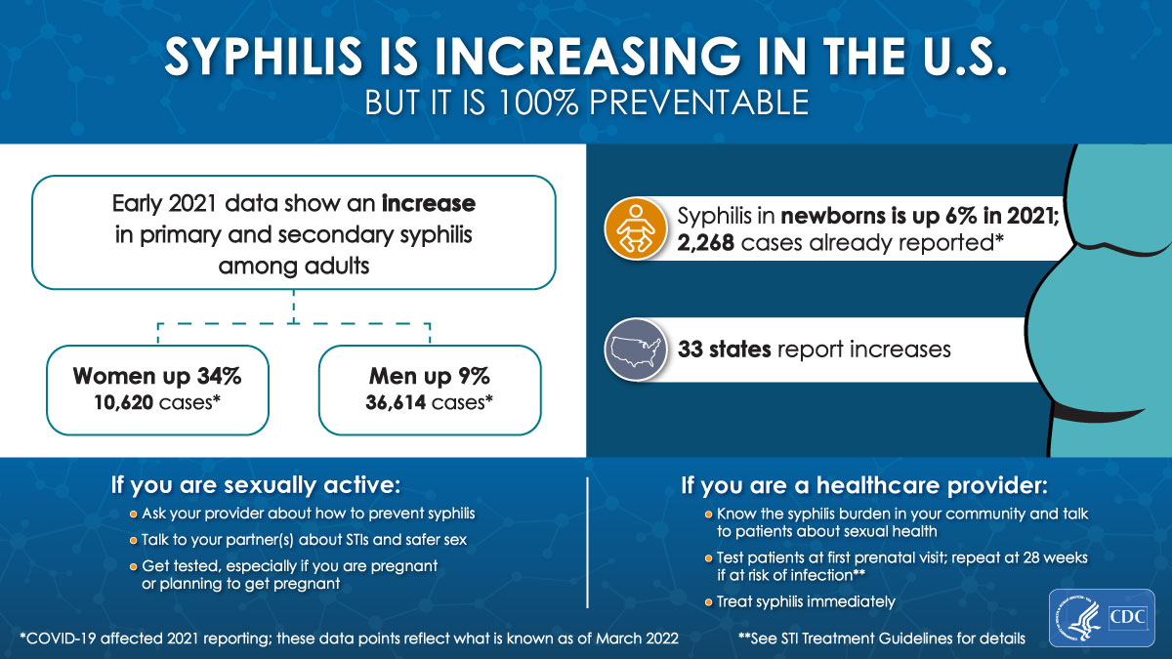

Slide 24
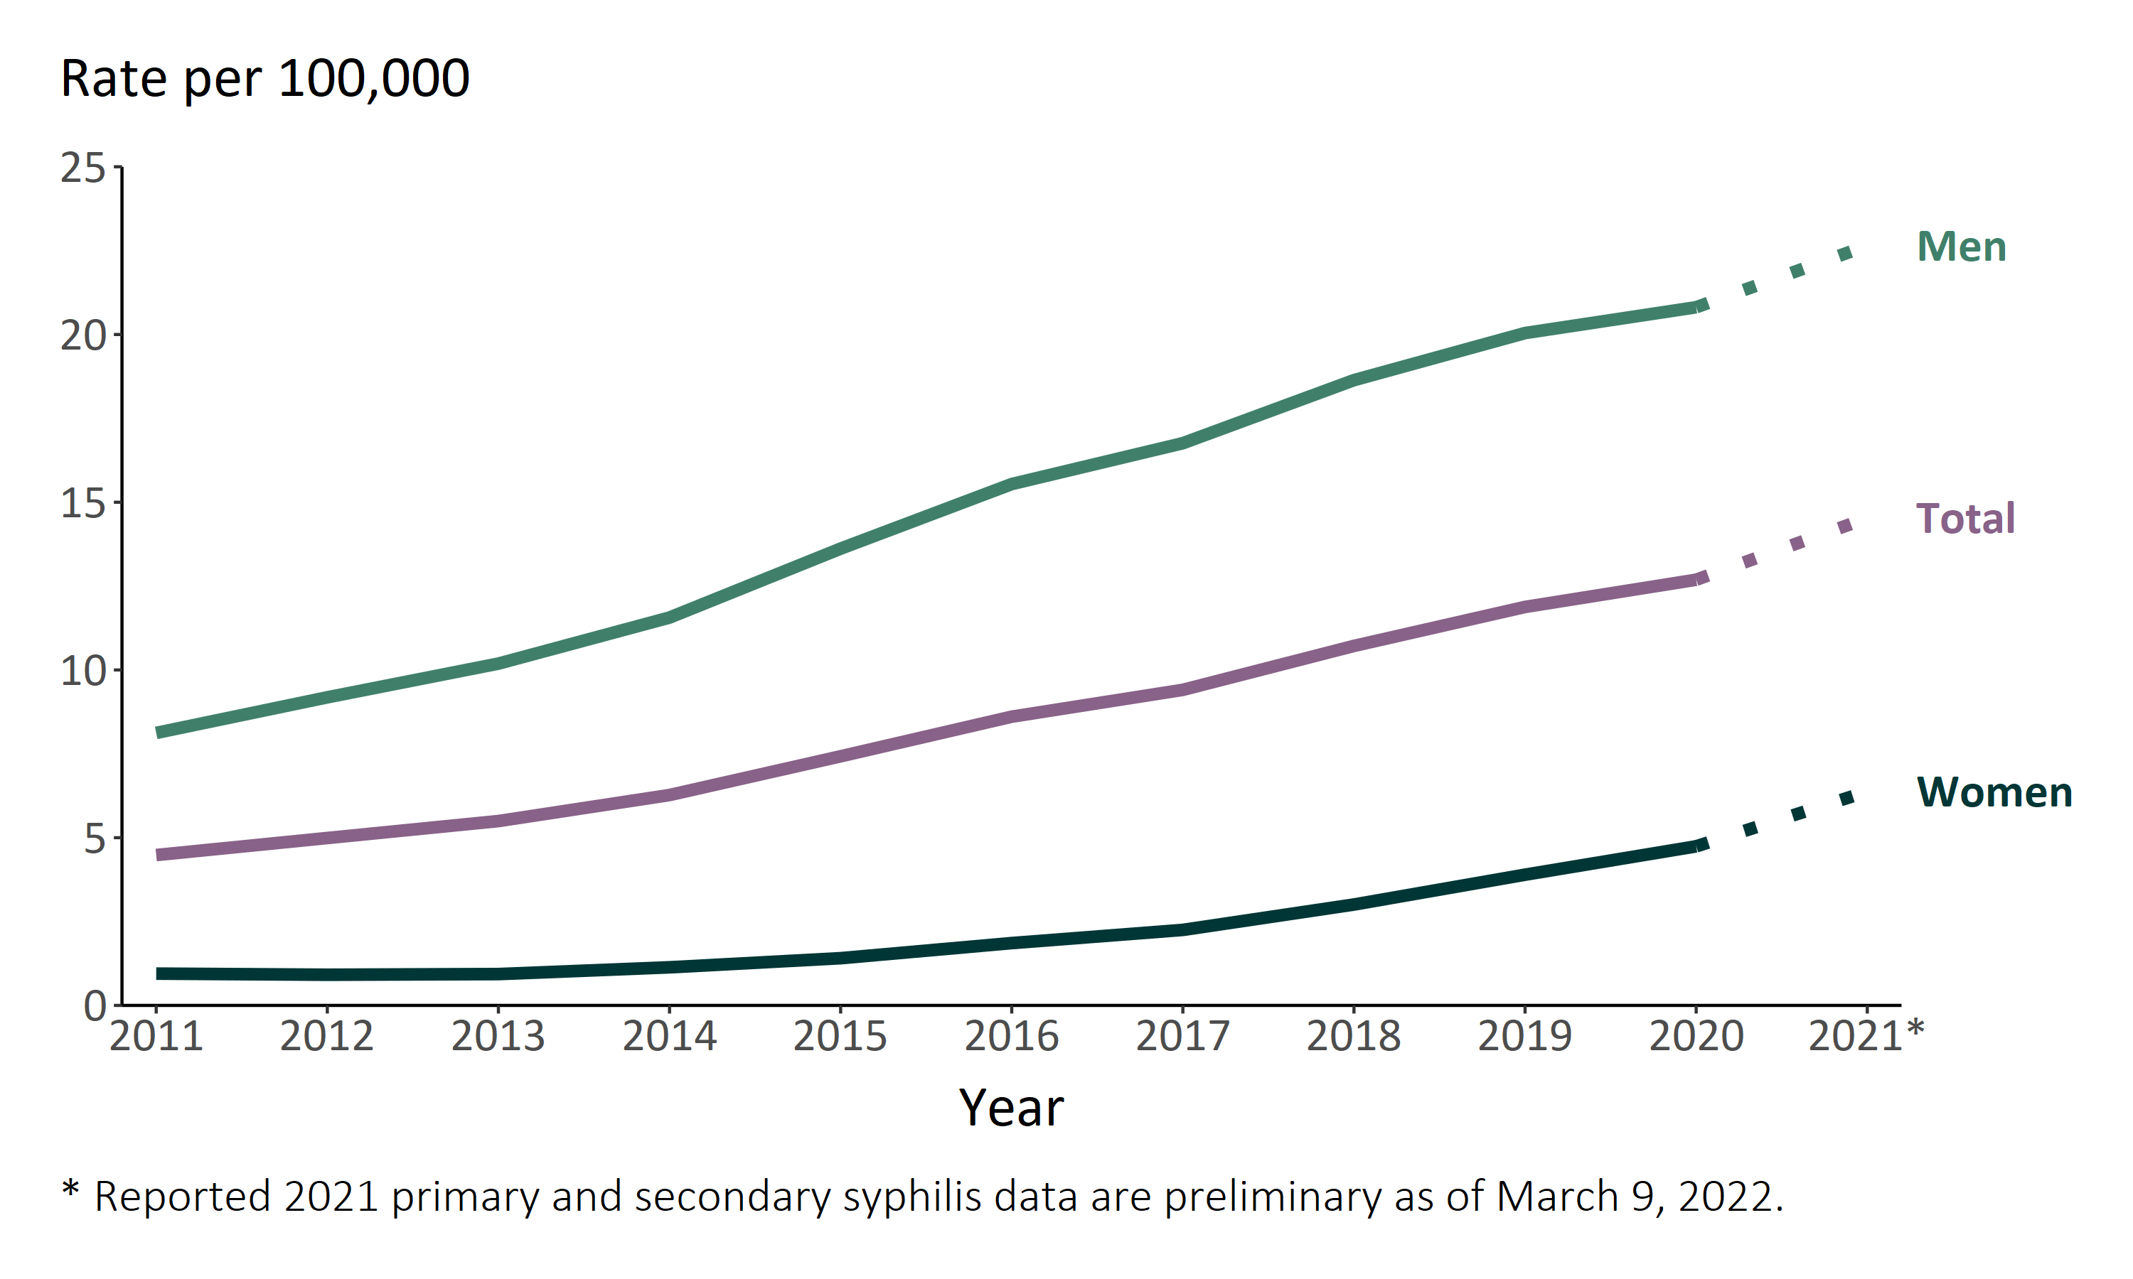
Rates of primary and secondary syphilis continued to increase in the United States during 2021*
Primary and Secondary Syphilis — Rates of Reported Cases by Sex, United States, 2011–2021*
Notes:
Rates of reported primary and secondary syphilis continue to increase among both men and women based on preliminary 2021 data. During 2020 to 2021, the primary and secondary syphilis rate among women increased 36.2% (from 4.7 cases to 6.4 cases per 100,000) and the rate among men increased 8.7% (from 20.8 cases to 22.6 cases per 100,000). The 2021 primary and secondary syphilis data are preliminary and reflect cases reported through National Notifiable Diseases Surveillance System (NNDSS) as of March 9, 2022.
The COVID-19 pandemic has introduced uncertainty and difficulty in interpreting case data collected in 2020 and 2021. See 2020 Surveillance Report Impact of COVID-19 on STDs (https://www.cdc.gov/std/statistics/2020/impact.htm) for more information.
See 2020 Surveillance Report Technical Notes (https://www.cdc.gov/std/statistics/2020/technical-notes.htm) for information on syphilis case reporting.
Data points are available at https://www.cdc.gov/std/statistics/2020/preliminaryData.zip

Slide 25
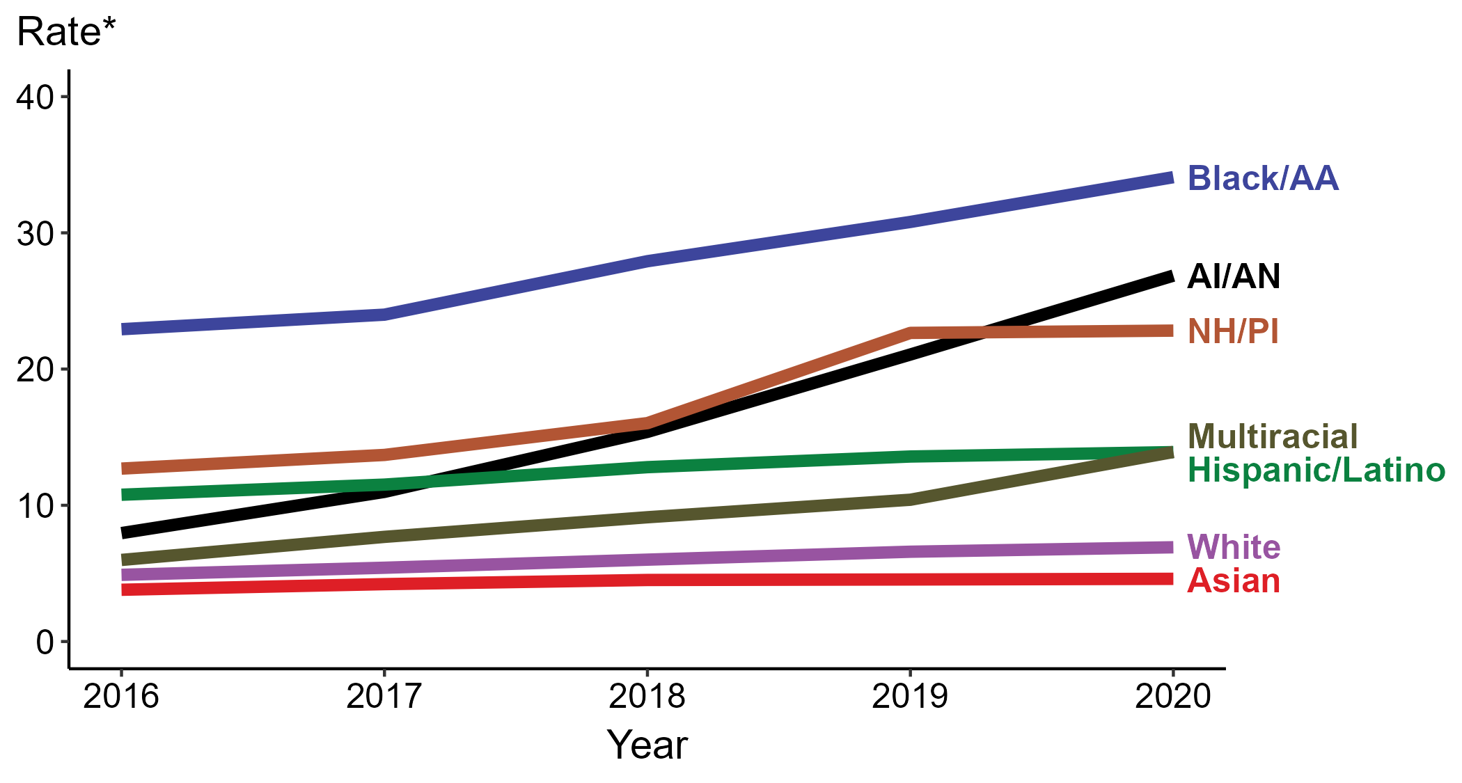
Primary and Secondary Syphilis — Rates of Reported Cases by Race/Hispanic Ethnicity, United States, 2016–2020
* Per 100,000
ACRONYMS: AI/AN = American Indian/Alaska Native; Black/AA = Black or African American; NH/PI = Native Hawaiian/Pacific Islander
Notes:
In 2020, the highest rate of reported cases of primary and secondary syphilis was among non-Hispanic Black or African American persons (34.1 cases per 100,000; 10.7% increase from 2019), followed by non-Hispanic American Indian or Alaska Native persons (26.9 cases per 100,000; 27.5% increase from 2019), non-Hispanic Native Hawaiian or other Pacific Islander persons (22.8 cases per 100,000; 0.4% increase from 2019), non-Hispanic persons of multiple races (13.9 cases per 100,000; 33.7% increase from 2019), Hispanic or Latino persons of any race (13.9 cases per 100,000; 2.2% increase from 2019), non-Hispanic White persons (6.9 cases per 100,000; 4.5% increase from 2019), and non-Hispanic Asian persons (4.6 cases per 100,000; 0.0% change from 2019). Non-Hispanic American Indian or Alaska Native persons had the greatest 5-year increase in rates of reported cases of primary and secondary syphilis (8.0 to 26.9 per 100,000; 236.2% increase from 2016).
For this figure, race/Hispanic ethnicity is categorized first by reported Hispanic ethnicity, then by reported race. Therefore, cases categorized as Hispanic/Latino can be of any race; cases categorized into a race group include both non-Hispanic persons and persons of unknown Hispanic ethnicity. Not all US jurisdictions reported cases in Office of Management and Budget compliant race categories during 2016 to 2020. This may minimally under- or overestimate rates for Asian, Native Hawaiian or other Pacific Islander, or multiracial individuals. No population data exist for unknown or other race; therefore, rates are not calculated. For completeness, data in this figure include cases reported from all jurisdictions.
The COVID-19 pandemic has introduced uncertainty and difficulty in interpreting 2020 case data. See Impact of COVID-19 on STDs (https://www.cdc.gov/std/statistics/2020/impact.htm) for more information.
See Technical Notes (https://www.cdc.gov/std/statistics/2020/technical-notes.htm) for information on syphilis case reporting and reporting of race/Hispanic ethnicity for STD cases.
Data points are available at: https://www.cdc.gov/std/statistics/2020/data.zip

Slide 26
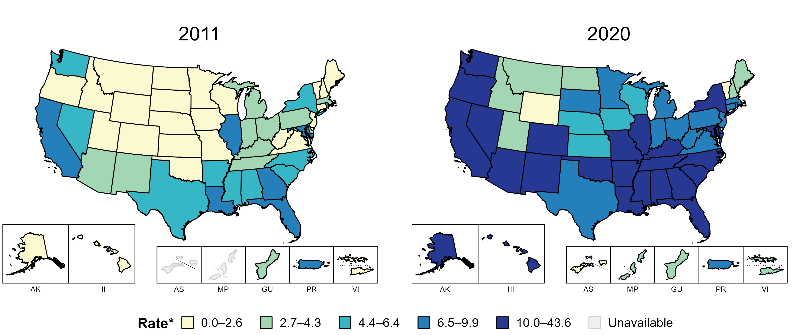
Primary and Secondary Syphilis — Rates of Reported Cases by State, United States and Territories, 2011 and 2020
* Per 100,000
Notes:
In 2011, six states, the District of Columbia (DC), and one US territory (14.3% of available areas) had a rate of reported primary and secondary syphilis greater than or equal to 6.5 cases per 100,000 population. This increased to 38 states, DC, and one US territory (71.4% of available areas) in 2020.
American Samoa and the Commonwealth of the Northern Mariana Islands began reporting data on primary and secondary syphilis cases to CDC in 2018; data are not available for those areas prior to that year.
The COVID-19 pandemic has introduced uncertainty and difficulty in interpreting 2020 case data. See Impact of COVID-19 on STDs (https://www.cdc.gov/std/statistics/2020/impact.htm) for more information.
See Technical Notes (https://www.cdc.gov/std/statistics/2020/technical-notes.htm) for information on syphilis case reporting and on interpreting reported rates in US territories.
Data points are available at: https://www.cdc.gov/std/statistics/2020/data.zip

Slide 27
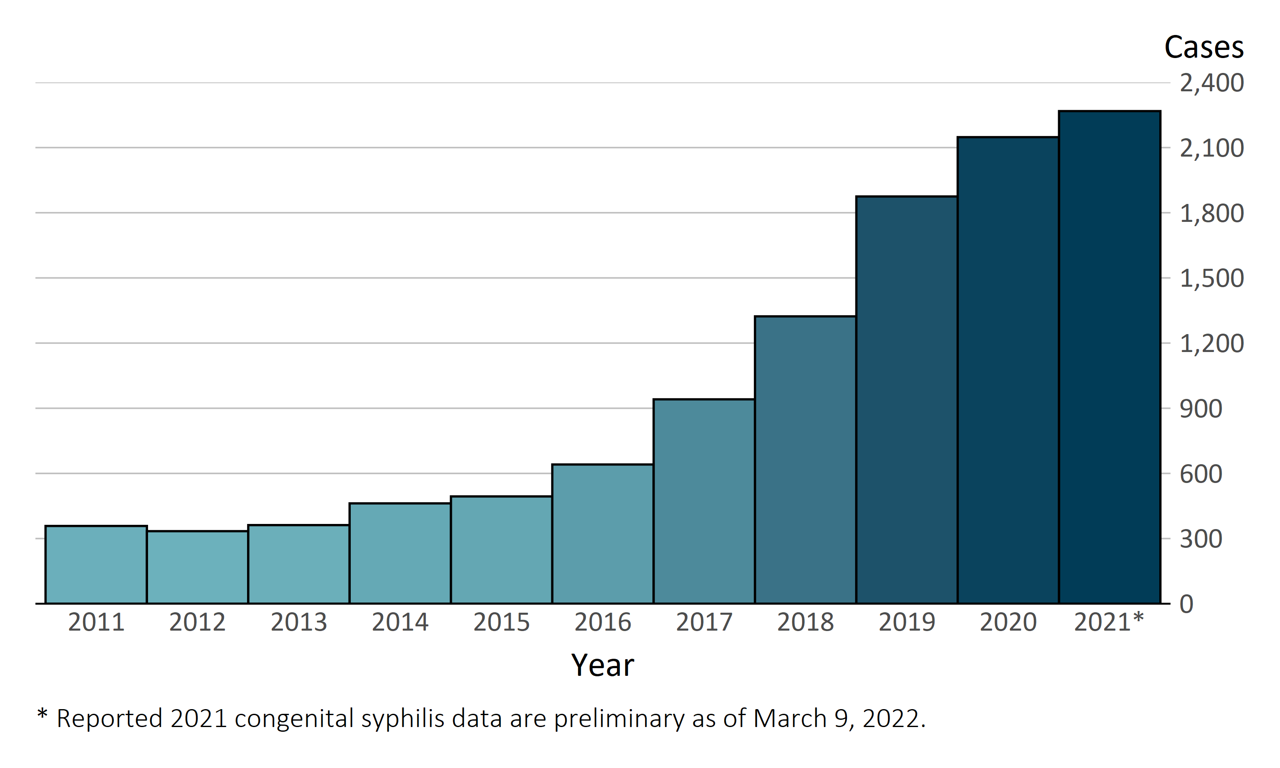
In the United States, 2,268 infants born in 2021* have already been reported as cases of congenital syphilis
Congenital Syphilis — Reported Cases by Year of Birth, United States, 2011–2021*
Notes:
As of March 9, 2022, 2,268 infants born in 2021 have been identified and reported to CDC as cases of congenital syphilis. This number represents 105.6% of all cases reported for 2020 (n=2,148), and prior reporting trends indicate the total number of cases reported will continue to increase before the reporting period closes in summer of 2022. The 2021 congenital syphilis data are preliminary and reflect cases reported through National Notifiable Diseases Surveillance System (NNDSS) as of March 9, 2022.
The COVID-19 pandemic has introduced uncertainty and difficulty in interpreting case data collected in 2020 and 2021. See 2020 Surveillance Report Impact of COVID-19 on STDs (https://www.cdc.gov/std/statistics/2020/impact.htm) for more information.
See 2020 Surveillance Report Technical Notes (https://www.cdc.gov/std/statistics/2020/technical-notes.htm) for information on syphilis case reporting.
Data points are available at https://www.cdc.gov/std/statistics/2020/preliminaryData.zip

Slide 28
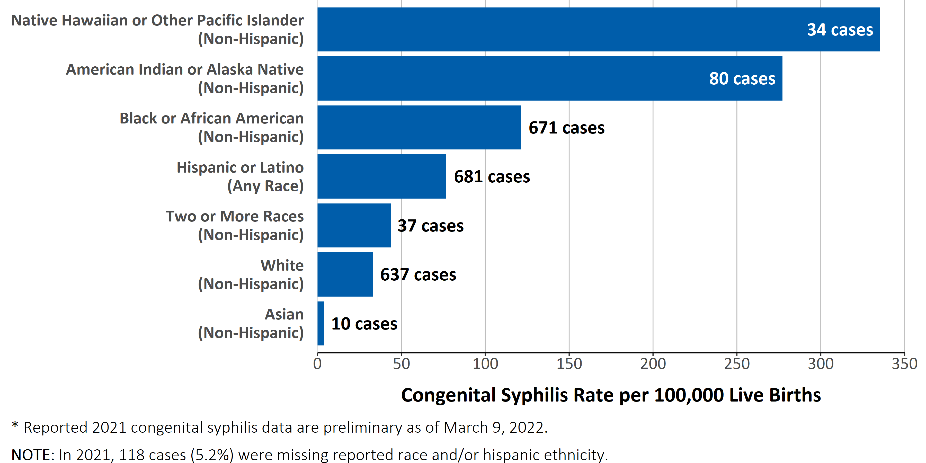
Racial and ethnic disparities in rates of reported congenital syphilis continued to persist in 2021*
Congenital Syphilis — Case Counts and Rates of Reported Cases by Race and Hispanic Ethnicity, United States, 2021*
Notes:
Based on preliminary 2021 congenital syphilis case data, rates of congenital syphilis are highest among mothers who were non-Hispanic Native Hawaiian or other Pacific Islander (335.4 cases per 100,000 live births), followed by mothers who were non-Hispanic American Indian or Alaska Native (277.2 cases per 100,000 live births) and mothers who were non-Hispanic Black or African American (121.3 cases per 100,000 live births). The 2021 congenital syphilis data are preliminary and reflect cases reported through National Notifiable Diseases Surveillance System (NNDSS) as of March 9, 2022.
The COVID-19 pandemic has introduced uncertainty and difficulty in interpreting case data collected in 2020 and 2021. See 2020 Surveillance Report Impact of COVID-19 on STDs (https://www.cdc.gov/std/statistics/2020/impact.htm) for more information.
See 2020 Surveillance Report Technical Notes (https://www.cdc.gov/std/statistics/2020/technical-notes.htm) for information on syphilis case reporting and reporting of race/Hispanic ethnicity for congenital syphilis cases.
Data points are available at https://www.cdc.gov/std/statistics/2020/preliminaryData.zip

Slide 29
Syphilis Screening
Screening of pregnant women at first prenatal visit, during 3rd trimester and again at delivery
At minimum, annual* screening of sexually active MSM at exposed sites (urethral/pharyngeal/rectal)
At minimum, annual* screening of HIV-infected persons
At minimum, bi-annual* screening for persons on PrEP.
Women <35 years and men <30 years of age in corrections facilities at intake as opt out screening
*More often based on risk
STI Treatment Guidelines (cdc.gov)

Slide 30
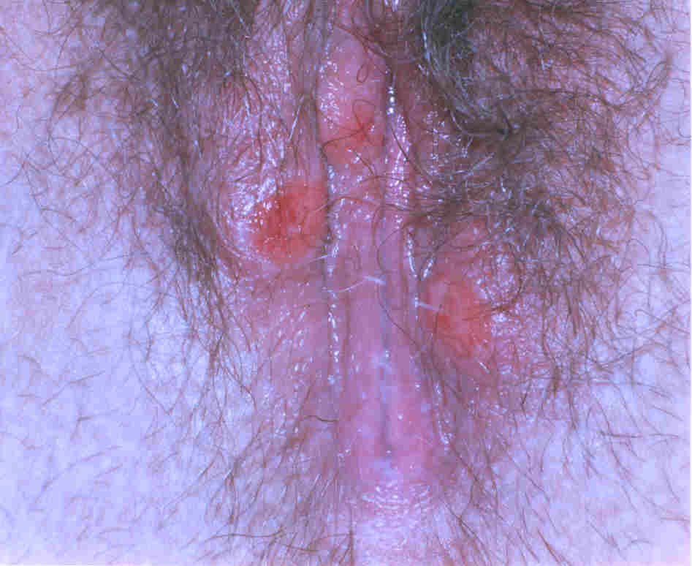
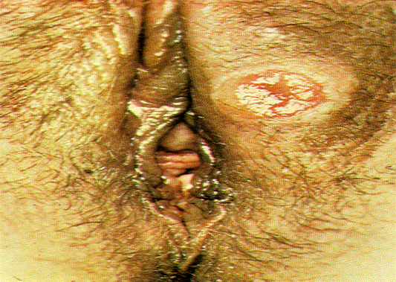
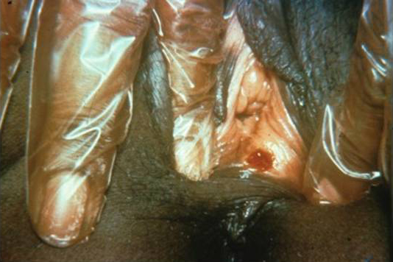
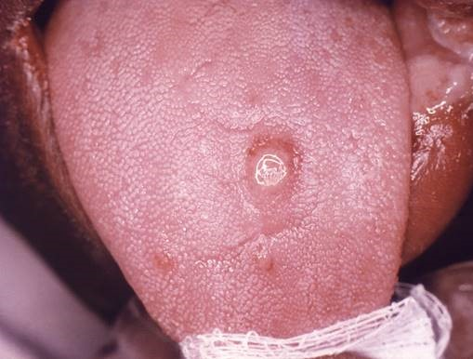
Syphilis: Clinical Stages
Primary
Chancre
Secondary
Latent
Tertiary
“Kissing” Lesion
Appears 10 to 90 days after infection
Sore goes away even if person is not treated
Patient may never be aware of a chancre
Painless ulcer
Skin rash
Mucocutaneous lesions
Generalized lymphadenopathy
No visible signs/symptoms
Early latent (<1 year)
Late latent (>1 year)
Cardiovascular
Gummatous lesions (skeletal, spinal, mucosal, ophthalmic)

Slide 31
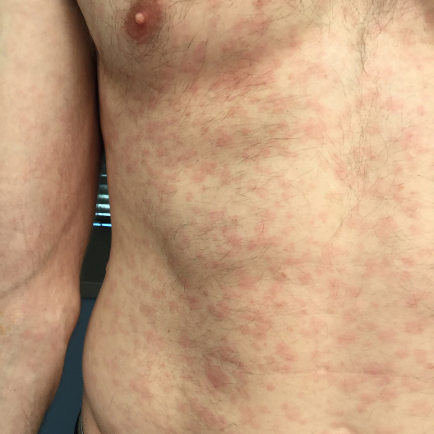
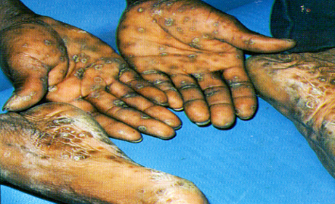
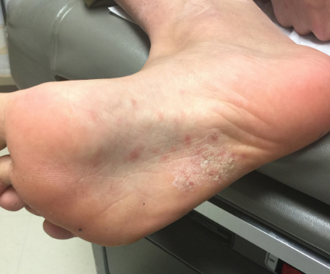
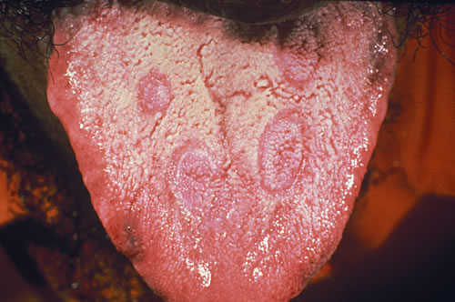
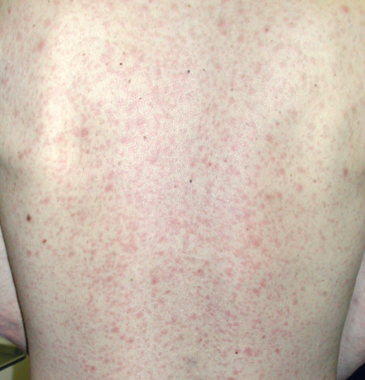
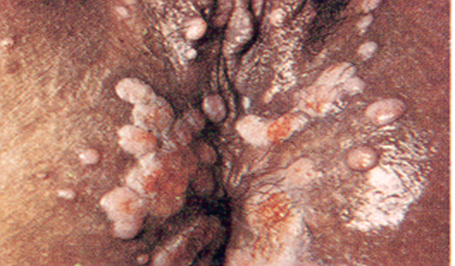
Syphilis: Clinical Stages
Secondary
Primary
Rash
Painless ulcer or chancre
Mucocutaneous lesions
Lymphadenopathy
Hair loss
Usually occurs 3 to 6 weeks after primary syphilis
Patients may only have one subtle skin change
Symptoms also go away even if not treated!

Slide 32
Syphilis: Clinical Stages
Early vs Late
Primary
Secondary
Latent
Painless ulcer or chancre
Rash
Mucocutaneous lesions
Lymphadenopathy
NO SYMPTOMS
EARLY LATENT
<=1 year since infection
LATE LATENT
>1 year since infection
EARLY SYPHILIS
Primary, Secondary, or Early Latent
(greatest potential for
vertical transmission)

Slide 33
Laboratory Diagnosis of Syphilis
Traditional Algorithm begins with nontreponemal test (e.g. RPR, VDRL) with confirmation using a treponemal test (e.g. TPPA, EIA, FTA-ABS, TPHA)
Reverse Sequence algorithm begins with treponemal test with confirmation using a nontreponemal test

Slide 34
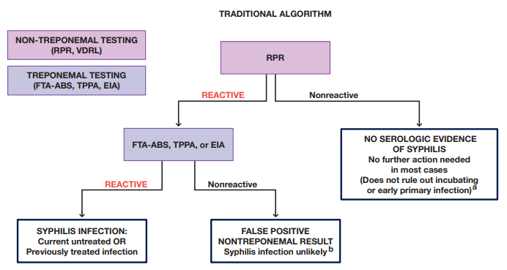
The Diagnosis, Management and Prevention of Syphilis (nycptc.org)

Slide 35
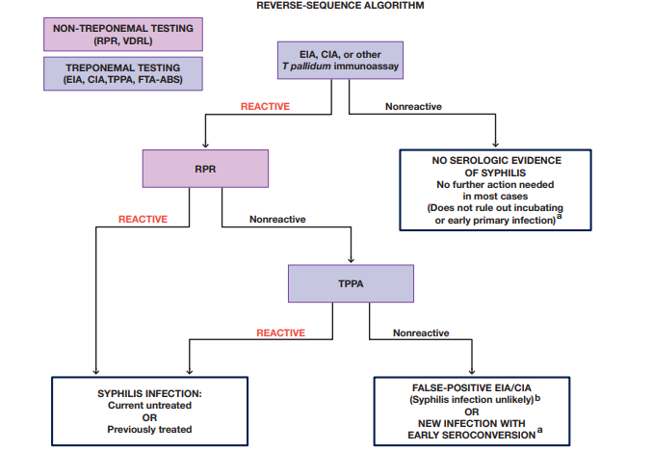
The Diagnosis, Management and Prevention of Syphilis (nycptc.org)

Slide 36
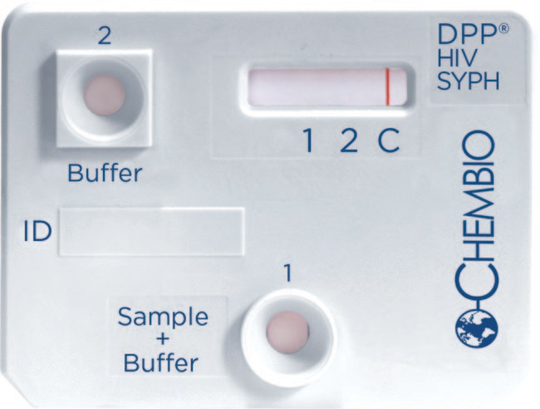
Rapid Dual HIV/Syphilis Test
Single manufacturer with
FDA approval in the U.S.
Fingerstick
15 minutes for results
CLIA approval imminent
Sensitivity: >99% for HIV and >94% for T. pallidum
DPP HIV-Syphilis System | FDA
Chembio Diagnostic Systems, Inc. DPP HIV-Syphilis Technology: Chembio DPP | Fisher Scientific

Slide 37
Adult Syphilis Treatment
Primary, Secondary and Early Latent Stages
  Benzathine penicillin G 2.4 million units IM in a single dose
Unknown Duration and Late Latent
  Benzathine penicillin G 7.2 million units total, administered as 3 doses of 2.4 million units IM each at 1-week intervals
Neurosyphilis, Ocular Syphilis, or Otosyphilis Among Adults
  Aqueous crystalline penicillin G 18–24 million units per day, administered as 3–4 million units IV every 4 hours or continuous infusion for 10–14 days
  Alternative: Procaine penicillin G 2.4 million units IM once daily PLUS Probenecid 500 mg orally 4 times/day, both for 10–14 days

Slide 38
Syphilis response: Best practices in high burden areas
Support active case finding through case investigation and partner elicitation
Rapid treatment of cases and sexual partners by stage of infection
Presumptive treatment (prior to test results) of sexual partners of syphilis cases
Presumptive treatment of people with symptoms consistent with syphilis
Screening of pregnant women at first prenatal visit, during 3rd trimester and again at delivery.
Expanded screening to at-risk communities of sexually active adults and adolescents (schools, corrections, emergency department, primary care, community venues, parole centers, work physicals)
Field treatment with benzathine penicillin for people with syphilis unable or unwilling to present to a medical facility
Electronic health record (E H R) reminders for screening and standard order sets for testing and treatment)

Slide 39
Expanded Screening Based on Local Prevalence
“Clinicians should consider the communities they serve and consult local public health authorities for guidance regarding identifying groups more vulnerable to STDs on the basis of disease prevalence”
STI Treatment Guidelines (cdc.gov)

