Slide 1
An Integrative Approach to HCV Care
Cdr dawn benth,PHN
LCDR Casey Marlin, PharmD
LT Kelsey Kroon, PharmD

Slide 2
Objectives
Summarize steps taken to establish an integrative HCV clinic
Explain team member roles and workflow
Describe current clinic status and future goals

Slide 3
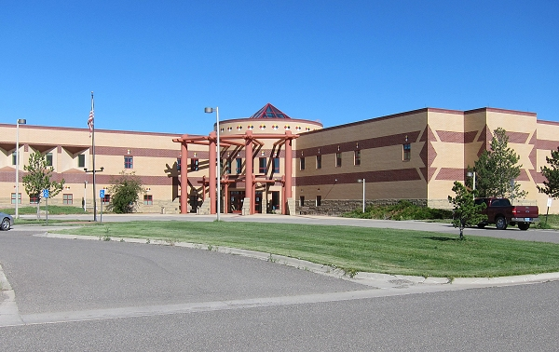
Our Facility
Located on the Crow Reservation
Main hospital in Crow Agency, MT
Two field clinics in Lodge Grass and Pryor, MT
Crow: ~11,200 enrolled with ~8,000 living on reservation
Northern Cheyenne: ~11,266 enrolled and ~5,000 on reservation

Slide 4
The Journey

Slide 5
Before Clinic
Hepatitis C positive patients were being referred to Billings for care
High cost
No patient transportation
Many lost to follow-up
Patients without insurance had limited options
Low screening rate

Slide 6
Beginning Steps
Attended Hepatitis C Clinical Training hosted by Project ECHO
Completed online training modules: Hepatitis C Online by University of Washington
www.hepatitisc.uw.edu
Created protocol and collaborative practice agreement for facility
Presented at Med Staff and clinic was approved in November 2017
All Hepatitis C medications approved for use with restrictions to HCV Clinic December 2017 by P&T
Approved as non-specialist site by MT Medicaid May 2018
Began seeing and treating patients in collaboration with primary care provider, PHNs, and pharmacist
Clinic Visits, House Visits, Detention Center, etc.

Slide 7
Milestone Steps
Facility wide reminder update to screen all patients age 17 years and older, instead of baby boomer population only
Prior to HCV Clinic (Jan. 2018) was established 2,225 patients (all ages) had been screened for HCV
To date 3,125 patients (all ages) have been screened for HCV (900 in last 2 years)
Previously screening reminder was for baby boomers only (1945-1965) and screening was at an average of 181 patients per year
Since expanding screening age to 18 years or older in January 2019 screening has increased to an average of 331 patients per year (82% annual increase)
Montana Medicaid Requirement Changes in February 2020
Previous requirements for reimbursement
Letter from Project ECHO to Montana Medicaid
New requirements for reimbursement
December 2020 integrated HCV Care into the Pharmacy Primary Care Clinic
April 2022 integrated HCV Care into PHN/PCMH Model for more integrative/comprehensive care
Notes:
Previous MT Medicaid Prior Authorization Requirements:
-No alcohol abuse, injectable drug abuse, or other controlled-substance abuse for at least 6 months prior to approval of HCV treatment
-Patient must be compliant with all current medications for all disease states/conditions
-Compliant with all scheduled appointments and labs preceding approval for HCV treatment
-Compliant with mental health medications and appointments, if have a condition with no treatment, patient must be referred to behavioral health
-Send liver assessment, labs, notes, etc pertaining to HCV
Current MT Medicaid Prior Authorization Criteria
-Provider attests to discussing treatment plan and importance of adherence with the patient
-Provider attests to discussing barriers to treatment and readiness of beginning treatment with the patient
-Provider attests to evaluating current medications for any DDIs with HCV treatment and confirms active infection with HCV RNA and that an SVR will be drawn 12 weeks after treatment completion
-Both provider and patient sign the importance of adherence to treatment course and limited retreatment options
-Brief overview of disease with checkboxes for treatment naïve, fibrosis stage, and requested drug regimen with duration
-Fax to MT Medicaid and typically hear back within one business day

Slide 8
Integration into PHN/PCMH Model
Current Process
Team Members & Roles
Detention Center Visits
Home Visits
Day to Day Schedule & Tasks

Slide 9
The Team

Slide 10
Team Approach to Care

Slide 11
Referral to Clinic

Slide 12
PHN Role
Locate Existing Patients
iCare, RPMS/QMAN, Montana Infectious Disease Information System (MIDIS), Chart Reviews, Diagnosis Codes and Problem Lists
Find New Patients
Provider/nurse education (in-house, local facilities, regional)
Initial Patient Contact & Investigation
At clinic, home visits, phone calls, neutral locations, jail
Screening reminder in EHR for patients 17 years and older
Community screenings (CLIA waived)
Detention Center Visits
Provide patient education, ECHO investigation, draw labs, collect documents and signatures
Patient Follow-Up Throughout Treatment Process and After
Present during ECHO presentation
Reminder calls to patients
Home visits for lab draws and medication delivery
Administer Immunizations
Baby Check Ups

Slide 13
Pharmacist Role
Connect patients with SUD resources
Encourage HCV testing in Primary Care, Inpatient, and ER
Support PHNs and detention center clinics, conduct patient interviews, provide patient education
Medications!
Order and dispense HCV treatments, perform medication reconciliations, provide OTC supportive care if side effects occur or refer patients to PCP

Slide 14
Visit Overview

Slide 15
Initial Visit
Order & Obtain Initial Labs for ECHO Presentation
Complete ECHO Case Presentation Form
Counsel on HCV Infection & Disease Progression
Counsel on Prevention of HCV Transmission
Check for Insurance
If no insurance, try to set up appointment with benefits coordinator
Assess Compliance
Medication Refills, Appointments, PREP-C Survey
Obtain Reliable Contact Information & Assess Transportation
Provide Overview of Appointments & Treatment
Notes:
Discuss what ECHO is

Slide 16
Order & Obtain Initial Labs for ECHO Presentation
Notes:
Brief Review of Lab Order Menu that Dawn showed earlier
Will help you to easily order all labs needed to complete ECHO form for case presentation
CDR Troutt will be building this menu to place in WRSU EHR for use

Slide 17
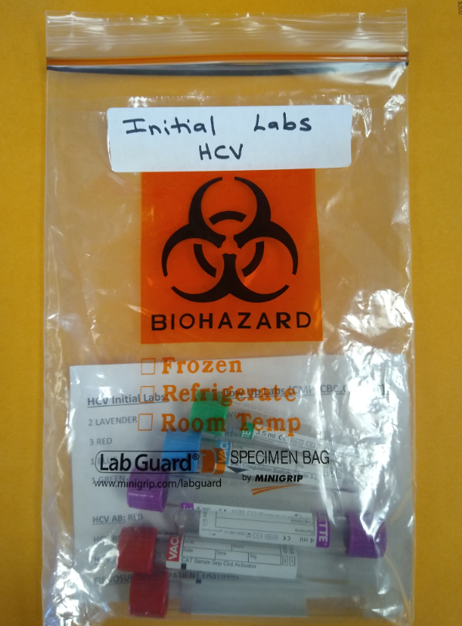
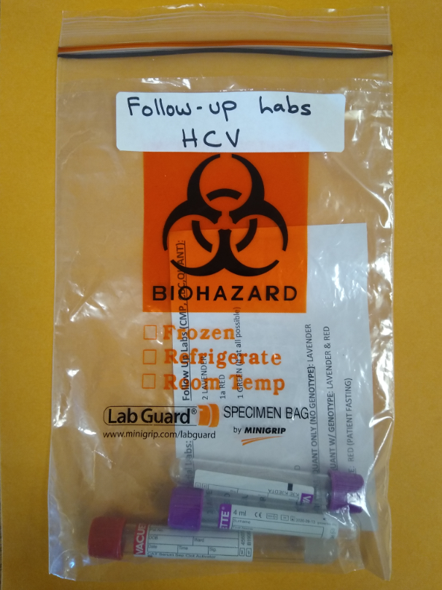
Obtaining Labs
At Clinic
Home Visit
Detention Center

Slide 18
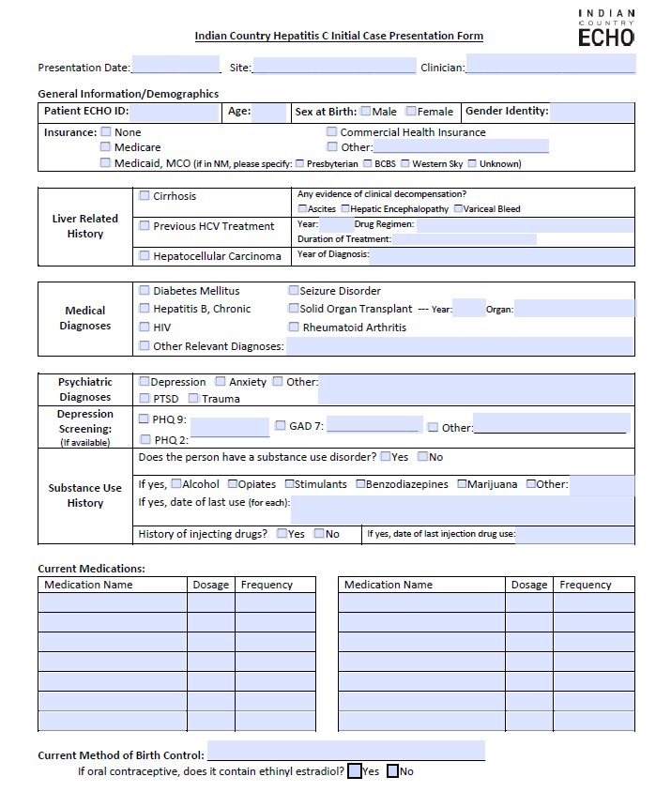
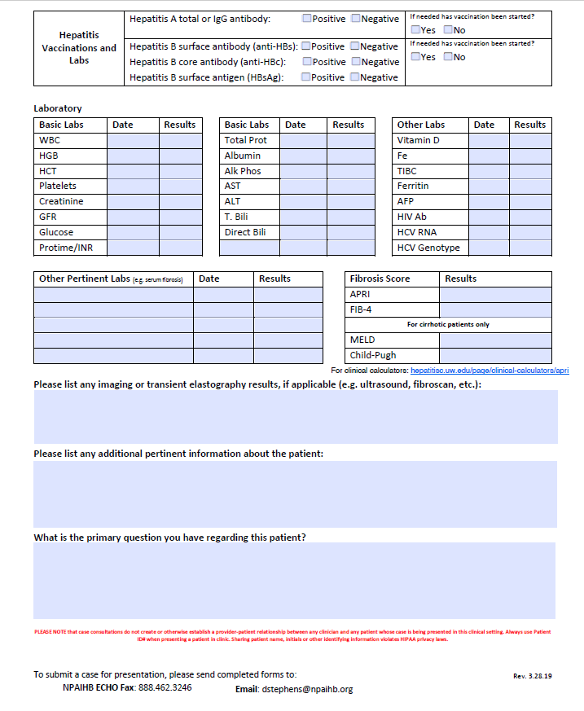
Complete ECHO Case Form
https://www.indiancountryecho.org/wp-content/uploads/2020/01/Indian-Country-HCV-ECHO-Case-Presentation-Form-fillable_NPAIHB.pdf
Notes:
Form can be found at URL link
Once completed submit to David Stephens at NPAIHB (email at bottom of form)
He will email back with treatment tree attached and available ECHO clinics for presentation
You will see an ECHO clinic later today after this training
Questions: Get details on alcohol, drug, substance use, treatment history, behavioral health, drug-drug interactions

Slide 19
Counselling Patient on Hepatitis C

Slide 20
Hepatitis C & Injection Drug Use

Slide 21
Counsel on Prevention of HCV Transmission
Heterosexual transmission of HCV is low. Persons in long-term monogamous relationships should be advised they do not need to alter their sexual practices.
Sexual transmission of HCV can occur among MSM and the risk may be substantial with sexual practices that result in bleeding or damage to rectal mucosal tissue; this risk is significantly higher among men with HIV.
Hepatitis C is transmitted efficiently via injection drug use and reinfection can occur. Transmission can occur when sharing needles, syringes, or other equipment used to prepare and inject drugs, and through sexual contact.
Household transmission of HCV (not related to sexual or injection drug transmission) can rarely occur. Household transmission may potentially result from sharing of a blood-contaminated item, such as a razor, toothbrush, or nail clipper.
Women with HCV do not need to avoid pregnancy, nor do they need to avoid breastfeeding; infants born to mothers with HCV infection should have follow-up for evaluation of possible HCV infection. Transmission occurs in approximately 6% of pregnant women with HCV infection.

Slide 22
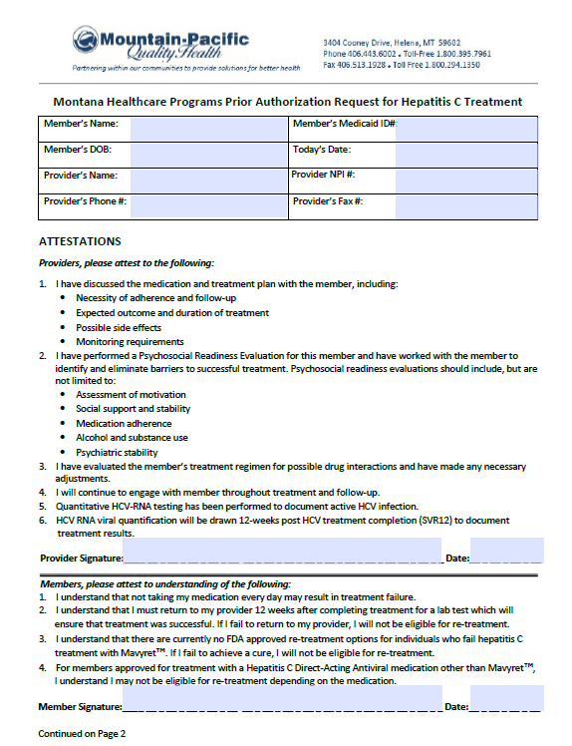
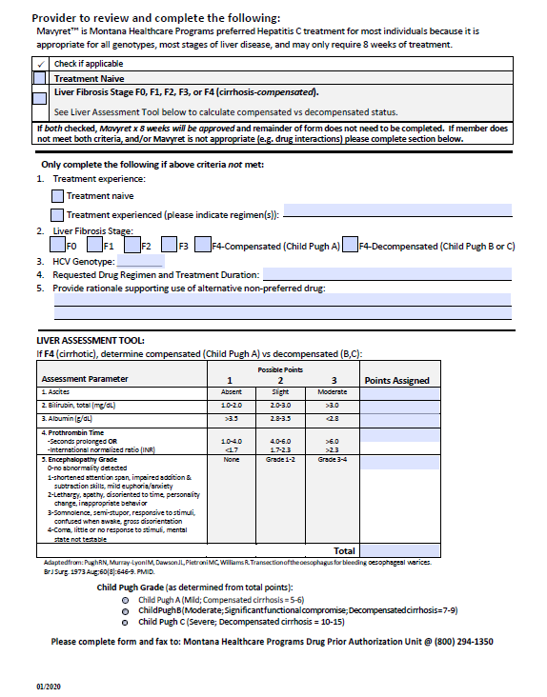
Check for Insurance
Notes:
MT Medicaid Prior Auth Form
Refer to Benefits Coordinator if Available for Patients without insurance
Pharmacy POS

Slide 23
Assess Compliance
Adherence to HCV treatment should be a focus prior to and throughout HCV therapy to achieve SVR
Adherence has been shown to decline over treatment course
Important to emphasize maintaining compliance throughout entire course of treatment
Shorter treatment regimens may provide an advantage
Clinicians should not be reluctant to initiate HCV treatment in patients with a history of uncontrolled depression, bipolar disorder, post-traumatic stress disorder, or schizophrenia, particularly if these conditions have been controlled, since observational studies suggest that these conditions are not associated with lower antiviral adherence.
Medical providers should implement strategies individualized to each patient’s needs to help increase adherence or maintain high levels of antiviral adherence during HCV treatment.
Notes:
Can check previous appointments and refills
Why its important?: Resistance
WY Medicaid Prior Auth helps with this as they have disclosure agreement and PREP-C Program
Obtain reliable contact information and assess transportation

Slide 24
Provide Overview of Next Appointments & Treatment
Will present patient’s case to ECHO
Some labs take 7-10 days to result
ECHO Presentation can usually be scheduled within 1-2 weeks
Initiate Treatment
Typically 8 or 12 weeks
Follow-Up Visits Every 4 Weeks
Draw CMP, CBC, and HCV RNA
Get Medication Refill
Assess Compliance and Tolerance
SVR
Draw HCV RNA 12 weeks after completion of HCV Treatment (Why?)
HCV Antibody vs RNA

Slide 25
Second Visit
Prior to Visit
Receive treatment recommendations from ECHO specialist and order medication for treatment initiation
Submit Prior Authorization form to MT Medicaid
During Visit
Dispense Medication & Counsel
Duration of Treatment, Side Effects, How to Take
Follow-Up Appointments for Labs & Refill (Card or Reminder Sheet)
Importance of Compliance
Resistance, Expensive, Etc.
Fill Out Monitoring Sheet or Schedule Follow-Up Visits

Slide 26
Follow-Up Visits
Follow-Up Every 4 Weeks During Treatment
Draw CMP, CBC, and HCV RNA
Dispense Medication Refill
Assess Compliance and Tolerance
Obtain End of Treatment Labs
CMP, CBC, HCV RNA
12 Weeks After Treatment Completion
Draw SVR Labs for Cure
Congratulations Packet for Cure
Counsel on Prevention of Reinfection

Slide 27
Tracking Tools
Crow Service Unit Patient Monitoring Excel Sheet
OneNote ComLog for Hand-Offs
Other Tools & Resources can be found here: Clinical Resources | Indian Country ECHO

Slide 28
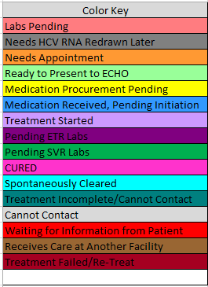
Tracking Sheet Features

Slide 29
Next Steps & Goals
Screen & educate 100% of incarcerated individuals at both the local detention center and county jail for HCV/HIV/STD/SUD
Integrate substance use disorder treatment and SSP program
Provide mobile community screenings and education in locations where high risk individuals congregate
Provide HIV/HCV/STD/SUD education and resources to youth at local schools
Pharmacy led communicable disease treatment program
Telehealth (behavioral health) availability at detention center
Medicaid provision of care to incarcerated inmates

