Slide 1
Indian Country ECHO: Ending the Epidemics
May 3, 2022
Eliminating HIV in Indian Country: The Primary Care Approach
Jonathan Iralu, MD, FACP, FISDA | Chief Clinical Consultant for Infectious Diseases | Indian Health Service | Jonathan.Iralu@ihs.gov
STDs: Review of Surveillance, Screening and Treatment Recommendations for Chlamydia, Gonorrhea, and Syphilis
Melanie Taylor, MD, MPH | Medical Epidemiologist | Division of STD Prevention | U.S. Centers for Disease Control and Prevention | mdt7@cdc.gov

Slide 2
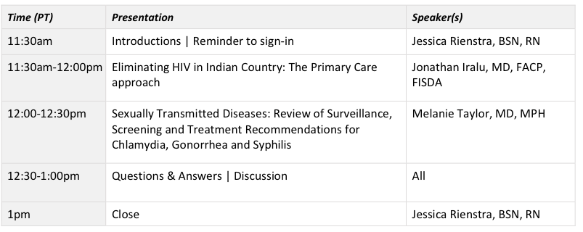
Today’s Agenda

Slide 3
*Program Schedule
CME, CNE and CPE offered
Tuesday, May 3rd 11:30am - 12pm PT:
HIV and STIs: Plans and strategies for screening, prevention, and treatment
-Dr. Jonathan Iralu, MD and Dr. Melanie Taylor, MD
Tuesday, May 10th 11:30am - 12pm PT:
HCV: Treatments, screening, prevention, and resources
-Dr. Jorge Mera, MD and Dr. Kelsey Kroon, PharmD
Tuesday, May 17th 11:30am - 12pm PT:
SUD and Harm reduction: Plans and strategies for screening, treatment of SUD and behavioral health in primary care settings
-Dr. Jessica Gregg, MD and LCDR Samantha Gustafson, Pharm D
Tuesday, May 24th 11:30am - 12pm PT:
Ending the epidemics in a real and clinical way: Sharing your clinics’ goals and plans
-Dr. Jorge Mera, MD
*Connect information will be sent to registered participants only. Invite your colleagues and staff to join the program: https://www.surveymonkey.com/r/EndingtheEpidemicsinIndianCountry

Slide 4
Contact Information
Please email the following contact with any questions or concerns:
Jessica Rienstra, BSN, RN she/her/hers ECHO Case Manager
Northwest Portland Area Indian Health Board jrienstra@npaihb.org

Slide 5
National Clinician Consultation Center
The National Clinician Consultation Center is a free clinical decision support/educational resource for clinicians.
Consultants are all highly experienced clinicians and educators.
See https://nccc.ucsf.edu/ for more information (online case submission also available!)
Substance Use (855) 300-3595
Substance use evaluation and management
Perinatal HIV/AIDS (888) 448-8765
Preventing and treating HIV-infected pregnant women & their infants
PrEP (855) 448-7737
Managing Pre-Exposure Prophylaxis for persons at risk of contracting HIV
HIV/AIDS (800) 933-3413
Preventing and treating HIV, from initiating treatment to managing advanced disease
Hepatitis C (844) 437-4636
HCV screening, monitoring, and treatment
PEP (888) 448-4911
Managing occupational and non-occupational Post-Exposure Prophylaxis to HIV, HBV, and HCV

Slide 6
Disclosures
This activity is jointly provided by Northwest Portland Area Indian Health Board and Cardea Services​​
​​
Cardea Services is approved as a provider of nursing continuing professional development by Montana Nurses Association, an accredited approver with distinction by the American Nurses Credentialing Center’s Commission on Accreditation.​​
​​
This activity has been planned and implemented in accordance with the accreditation requirements and policies of the California Medical Association (CMA) through the joint providership of Cardea and Northwest Portland Area Indian Health Board . Cardea is accredited by the CMA to provide continuing medical education for physicians.​​
​​
Cardea designates this live web-based training for a maximum of 1.5 AMA PRA Category 1 Credit(s)TM. Physicians should claim credit commensurate with the extent of their participation in the activity.

Slide 7
Disclosures
The Washington State Pharmacy Association is accredited by the Accreditation Council for Pharmacy Education as a Provider of continuing pharmacy education.​​
​
May 3, 2022, ACPE UAN# | 0130-9999-22-234-L08-P, 1.5 ACPE CPE hrs. | Activity Type: Knowledge
May 10, 2022, ACPE UAN# | 0130-9999-22-235-L08-P, 1.5 ACPE CPE hrs. | Activity Type: Knowledge
May 17, 2022, ACPE UAN# | 0130-9999-22-236-L08-P, 1.5 ACPE CPE hrs. | Activity Type: Knowledge
May 24, 2022, ACPE UAN# | 0130-9999-22-237-L08-P, 1.5 ACPE CPE hrs. | Activity Type: Knowledge

Slide 8
Disclosures
There are no relevant financial relationships with ineligible​ companies for those involved with the ability to control​ the content of this activity.​ ​
​​

Slide 9
Disclosures
COMPLETING THIS ACTIVITY​​
Upon successful completion of this activity 1.5 contact hour will be awarded​​
​
Successful completion of this continuing education activity includes the following: ​​
Attending the entire CE activity; ​​
Completing the online evaluation; ​​
Submitting an online CE request.​​
​
Your certificate will be sent via email. If you have any questions about this CE activity, contact Kat McLaughlin at kmclaughlin@cardeaservices.org

