Slide 1

Pain, Opioids and Buprenorphine: Mini Bootcamp
DATE: June 23, 2022
PRESENTED BY:
Dr. Jessica Gregg, MD, PhD
Dr. Jonathan Robbins, MD, MS

Slide 2
Disclosures
Planning Committee: The speakers and members of the planning committee have nothing to disclose.
Slides adapted from Dr. Robbins, Korthuis, and Gregg.

Slide 3
Part 1: Pain, Opioids, and Opioid Failure

Slide 4
Learning Objectives
1. Employ universal precautions in opioid prescribing.
2. Define opioid success in primary care.
3. Detect opioid failure in primary care.
4. Screen for fibromyalgia in patients on opioids.
5. Use a risk-benefit ratio for opioid prescribing.

Slide 5

https://dumielauxepices.net/wallpaper-2904364
Notes:
Your senior colleague moves on to hospital administration and his panel gets divided up among the newer practioners in the practice

Slide 6
HPI: 45 year-old woman new to my practice
Past medical: DM2 (last A1C 9.2), HTN, tobacco use
Psych: PTSD from abuse during first marriage
Pain generators: Diabetic neuropathy, chronic low back pain
Medications: oxycodone 5 mg 10/day, nortriptyline 10 mg QHS, statin, ASA, glargine insulin, metformin
MEDD: 75
Social: not working, one teenage boy, husband (2nd) owner-operator of tractor trailer, no EtOH or other drugs
Notes:
Overview of the new pt, her dose, etc. several anxious phone calls before the visit
Nice woman, just anxious
No depression history

Slide 7
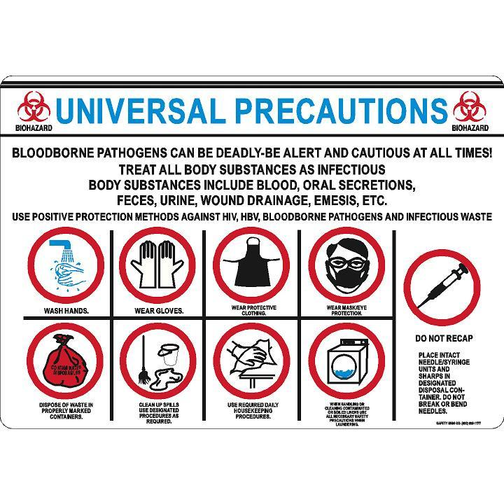
https://safetysignco.com/products/universal-precautions-sign

Slide 8
“Universal Precautions”
(not evidence-based but has become “standard” of care)
Misuse risk assessment
  ORT - Opioid Risk Tool
  SOAPP - Screener and Opioid Assessment for Patients with Pain
Patient Provider Agreements (PPA)
  Informed consent (risks and benefits)
  Plan of care including medication management
Frequent face-to-face visits
  Assess and document risks and benefits
Monitor for adherence, addiction and diversion
  Urine drug monitoring and pill counts
  Prescription Drug Monitoring Program (PDMP) data
Gourlay DL et al. Pain Med 2005, slide courtesy Dan Alford.
Notes:
Set up some new guidelines to ensure safe prescribing

Slide 9
Opioid Success
Efficacy: improved function and quality of life
Safety: minimal current side-effects and minimal long-term risks
Alternatives: explored, optimized, and exhausted

Slide 10
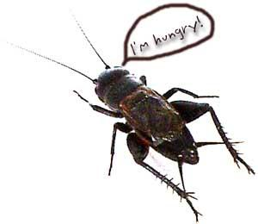
Busse JW et al. JAMA 2018.
Krebs EE et al. JAMA 2018.
Goldenberg DL Clauw DJ et al. Mayo Clin Proc 2016.

Slide 11
Opioid Safety and Risks
Allergies are rare
Side effects are common
    Nausea, sedation, constipation, urinary retention, sweating
    Respiratory depression – sleep apnea
Organ toxicities are rare
    Suppression of hypothalamic-pituitary-gonadal axis
Worsening pain (hyperalgesia in some patients)
Addiction (Opioid use disorder)
Overdose
    when combined w/ other sedatives
    at high doses
Dunn KM et al. Ann Intern Med 2010
Li X et al. Brain Res Mol Brain Res 2001
Doverty M et al. Pain 2001
Angst MS, Clark JD. Anesthesiology 2006
Notes:
Opioid failure

Slide 12
Dose-related Risk of Overdose
Caution > 50 MEDD
Avoid > 90 MEDD
Courtesy Gary Franklin, Roger Chou

Slide 13
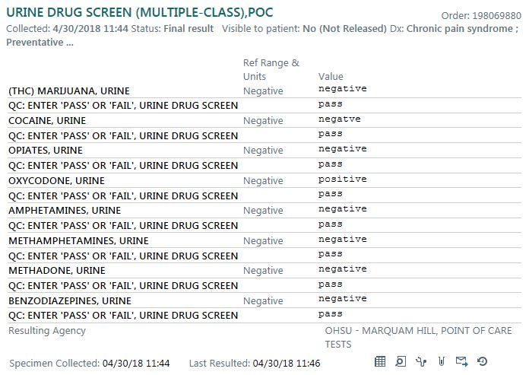
Notes:
Show UDS

Slide 14
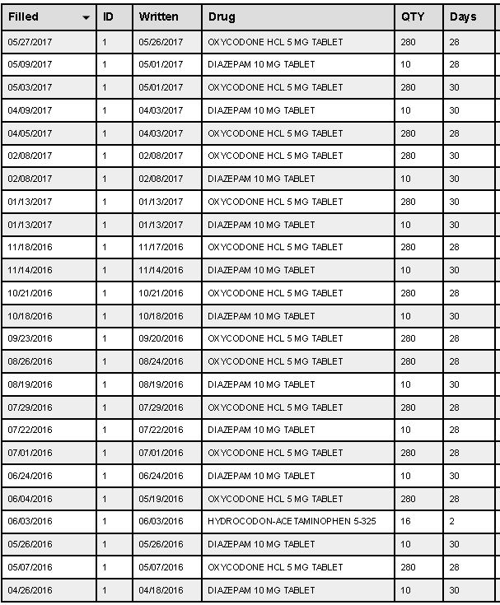
Notes:
Show PDMP

Slide 15

Patient-Provider Agreement
http://www.theolivebranchblog.com/wp-content/uploads/2013/07/agreement.png

Slide 16
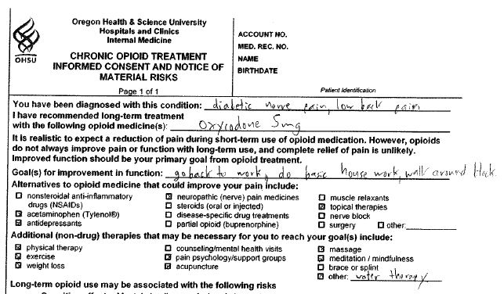

Slide 17

Two-Month Follow-Up
http://girlgonetravel.com/wp-content/uploads/2012/01/calendar.jpg

Slide 18
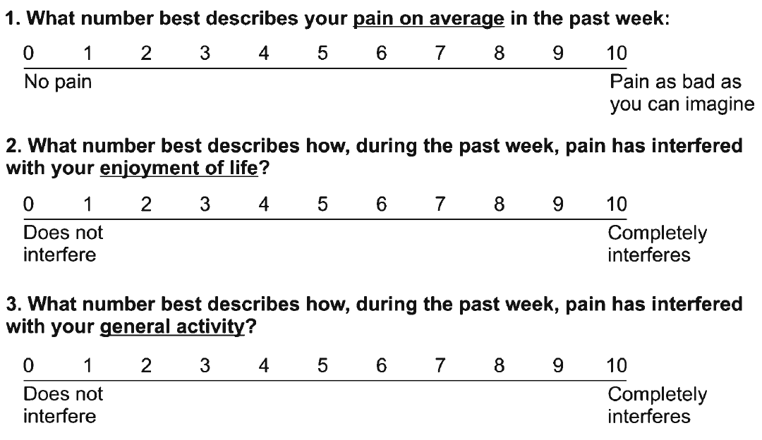
Assessing Benefit: PEG scale
Krebs EE, et al. J Gen Intern Med. 2009
Notes:
No functional benefit by report or by PEG

Slide 19

http://www.reclinercity.com/kns54-rd-os.html

Slide 20
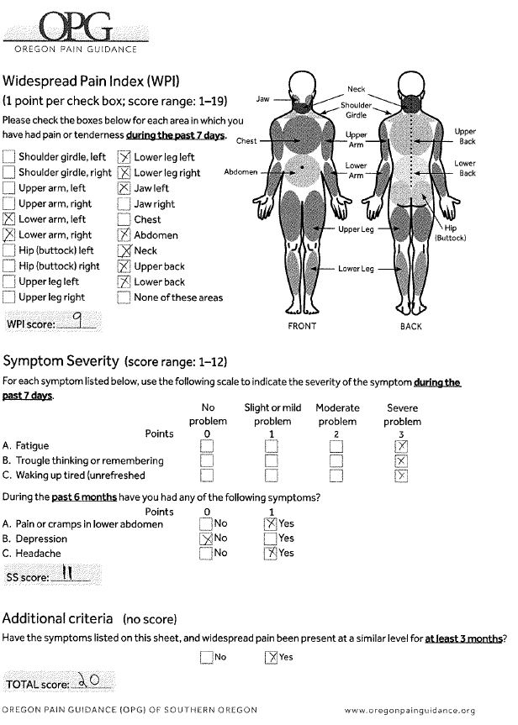
Goldenberg, Clauw et al in Mayo Clinic Proc 2016
https://professional.oregonpainguidance.org/wp-content/uploads/sites/2/2017/05/Fibromyalgia_Screening_Tool.pdf
Notes:
A patient meets the diagnostic criteria for fibromyalgia
if the following 3 conditions are met:
1a. The WPI score (Part 1) is greater than or equal to 7
AND the SS score (Part 2a & b) is greater than or
equal to 5
OR
1b. The WPI score (Part 1) is from 3 to 6 AND the SS
score (Part 2a & b) is greater than or equal to 9.
2. Symptoms have been present at a similar level for at
least 3 months.
3. You do not have a disorder that would otherwise
explain the pain.
Opioid Use in Fibromyalgia: A Cautionary Tale.

Slide 21
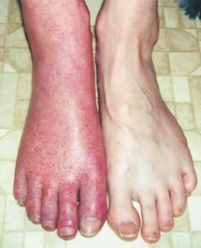
Central sensitization
(fibromyalgia)
Nociceptive ischemic/
inflammatory
Motor/autonomic
Mechanical influence
Nervous system influence
Continuum of Pain Mechanisms
Peripheral neurogenic
Affective
central
Notes:
Central pain:
Location-widespread, nonanatomical
frequency-mostly constant
descriptors-graphic, vivid, ever-changing
onset-chronic, trauma related or no event
24 hour behavior-erratic, unpredictable
medication response

Slide 22
Continuation of Opioids
Before writing the next prescription…you should be convinced that…
  …there is benefit (function, QOL, pain)
  …benefits outweigh observed harms/risks
Slide courtesy Dan Alford

Slide 23
Conclusions
Use universal precautions in opioid prescribing to detect opioid failure and to keep patients safe.
Screening tools such as the PEG-3, a risk stratification tool, and the WPI/SSS can help predict/detect opioid failure.
Fibromyalgia is not an opioid responsive pain condition.
Use a non-judgmental risk-benefit ratio for opioid prescribing.

Slide 24
Part 2: Buprenorphine Basics

Slide 25
Learning objectives
Understand the pharmacology of buprenorphine.
Implement standard and microdose buprenorphine induction.
Integrate buprenorphine into your existing primary care practice.

Slide 26
Pharmacotherapy for Opioid Use Disorder
Full Agonist: Methadone, Heroin
%
Mu Receptor
Intrinsic
Activity
100
90
80
(“How High”)
70
60
Partial Agonist: Buprenorphine
50
40
30
20
10
Antagonist : Naltrexone
0
no drug
low dose
high dose
Drug Dose
(“How Much”)
Notes:
1. Opioid Mu Receptor instrinsic activity varies widely. Increasing full agonist dose produces increasing mu opioid receptor specific activity. Until maximum opioid agonist effects are achieved and no further effects can be produced, even by giving more drug.
2. Opioid antagonists bind and occupy mu opioid receptors but result in no specific intrinsic activity regardless of dose
3. Like full agonists, partial agonist drugs produce increasing mu opioid receptor specific activity at lower doses. At higher doses, even when partial agonist drug completely binds all mu receptors. Maximum opioid agonist effect is never achieved

Slide 27
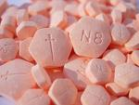
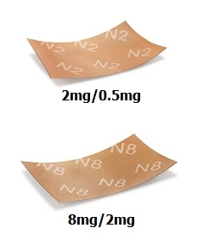
Buprenorphine/naloxone
(4:1 combination)
Partial opioid agonist
  Decreased overdose risk
Naloxone inactive unless injected –then precipitates withdrawal
  Decreased abuse risk
Sublingual, once daily
    Safe for flexible dosing

Slide 28
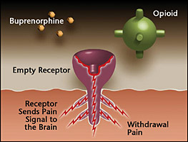
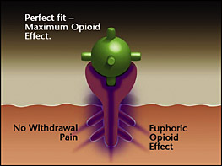
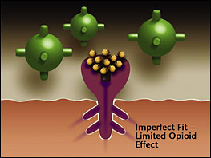
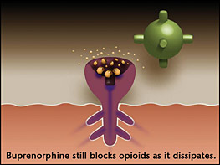
How Does Buprenorphine Work?
Notes:
Opioid receptor is empty – As someone becomes tolerant to opioids, they become less sensitive and require more opioids to produce the same effect. Whenever there is an insufficient amount of opioid receptors activated, the patient feels discomfort. This happens in withdrawal.
Opioid receptor satisfied with a full-agonist opioid. – The strong opioid effect of heroin and painkillers can cause euphoria and stop the withdrawal for a period of time (4-24 hours). The brain begins to crave opioids, sometimes to the point of an uncontrollable compulsion (addiction), and the cycle repeats and escalates.
Opioids replaced and blocked by buprenorphine. – Buprenorphine competes with the full agonist opioids for the receptor. Since buprenorphine has a higher affinity (stronger binding ability) it expels existing opioids and blocks others from attaching. As a partial agonist, the buprenorphine has a limited opioid effect, enough to stop withdrawal but not enough to cause intense euphoria.
Over time (24-72 hours) buprenorphine dissipates, – but still creates a limited opioid effect (enough to prevent withdrawal) and continues to block other opioids from attaching to the opioid receptors.

Slide 29
Mortality Risk during and after buprenorphine treatment
Mortality Risk during and after opioid substitution treatment: systematic review and meta-analysis
of cohort studies. Sordo, et al. BMJ 2017.
Notes:
A meta-analysis of 19 cohort studies demonstrated increased all cause mortality and overdose mortality

Slide 30
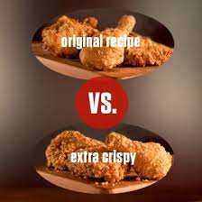
Buprenorphine Inductions
Bup Induction
In opioid withdrawal
Not in opioid withdrawal
Standard
Low Dose (Microinduction)

Slide 31
Prior to Induction
Counsel patient on
  Alternative treatments
  Induction timing
  Precipitated withdrawal
  Need for behavioral treatment
Treatment agreement
Labs:
  UDS, HIV, HCV, HBV, HCG, liver enzymes
Write prescription

Slide 32
  Timing of Buprenorphine Induction
Schedule patient for induction soon after intake visit
Must be in at least mild-to-moderate opioid withdrawal in order to begin induction
  The more severe the withdrawal, the greater the relief
Withdrawal symptoms typically begin
  12-24 hours after last dose of a short-acting opioids like heroin
  2-4 days after last dose of long acting opioids like methadone

Slide 33
Clinical Opioid Withdrawal Scale (COWS)
Rates 11 Withdrawal Symptoms:
Resting pulse rate
Sweating
Restlessness
Pupil size
Bone or joint aches
Runny nose
GI upset
Tremor
Yawning
Anxiety or irritability
Goose bumps
Guides timing of first dose of buprenorphine

Slide 34
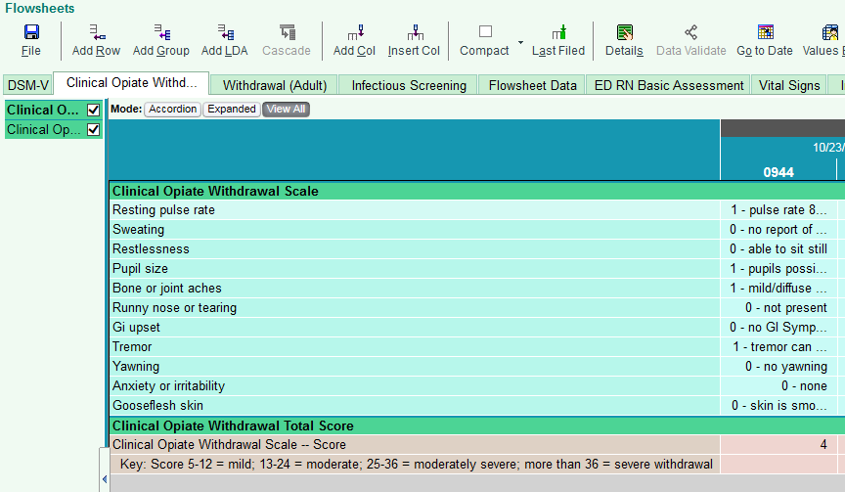
Withdrawal severity:
Mild 5-12; Moderate 13-24; Moderately severe 25-36; Severe >36

Slide 35
Criteria for Giving First Dose Buprenorphine
COWS ≥ 12, or…
COWS < 12, and no self-reported opioid use in the past 3 day and clinical UDS negative for opioids

Slide 36
Induction & Stabilization Dosing Schedule
Tailor to Patient
 | Suggested Dosing* | Maximum Dose
Day 1 | 2-4mg (wait 45 min) + 4mg if needed | 8-12mg
Day 2 | Day 1 dose + 4mg if needed (single dose) | 12-16mg
Day 3 | Day 2 dose + 4mg if needed (single dose) | 16mg
Day 3-28 | May increase dose 4mg per week, if needed (single dose) | 24mg
SAMHSA, Medications for Opioid Use Disorder. Treatment Improvement Protocol (TIP) Series 63; 2018. Available at https://store.samhsa.gov/product/SMA18-5063FULLDOC

Slide 37
Home Induction
Office-based induction can be a barrier to initiation
Pilot trials of home vs. office-based inductions demonstrate comparable retention rates and safety
Patient selection:
  Understands induction process
    Prior bup experience predicts success
  Can contact provider for problems
Provider available for phone consultation
Lee, JD, JAM 2014
SAMHSA, TIP-63

Slide 38
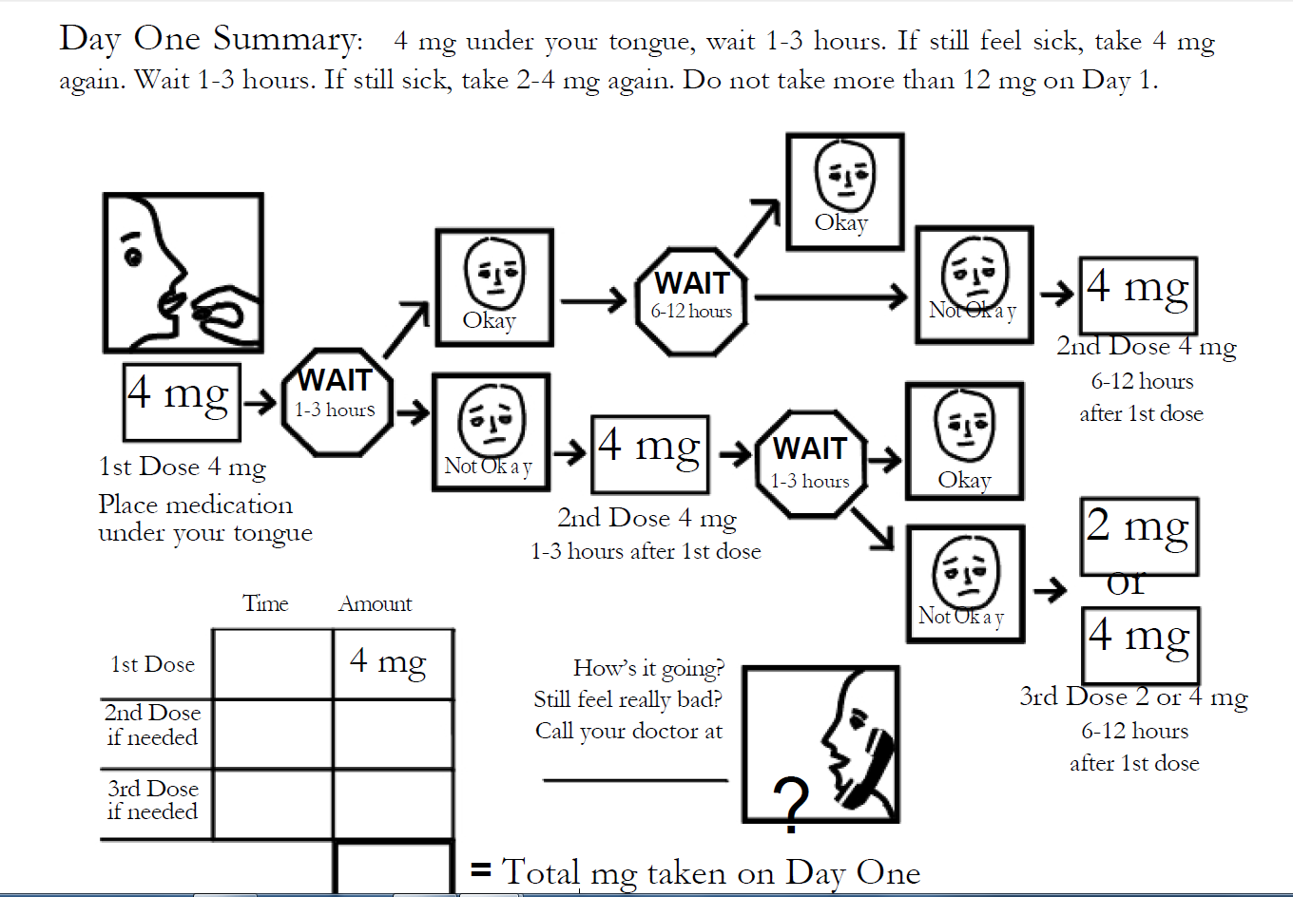
Home Induction Hand-Out
Lee, J. D., Vocci, F., & Fiellin, D. A. (2014). Journal of Addiction Medicine, 8(5), 299–308.

Slide 39
Alternative Practice: Microinduction
Low-dose initiation of bup while still on opioids
Example:
Day 1: 0.5 mg (1/4 of a 2 mg tab)
Day 2: 0.5 mg BID
Day 3: 1 mg BID (1/2 tabs)
Day 4: 2 mg BID
Day 5: 4 mg BID
Stop or taper full agonists

Slide 40
Integrating Buprenorphine into Clinical Practice
Preparing the Whole Team
  Front desk/phone room staff
  Medical assistant
  Nurse
  Physicians
  Counselor
  Clinic medical director
Designate a coordinator (“the glue person”)
OK to start small and slow -- just start!

Slide 41
Typical Buprenorphine Clinic Schedule
 | Before Induction | Induction (Days 1-3) | Month 1 | Month 2 | Month 3 and after
Prior auth | X
Treatment Agreement | X
Clinic Visit | X | 2x/week | Weekly | Every 2 weeks | Every 4 weeks
Counseling | X |  | Weekly | Every 2 weeks | Every 4 weeks
Prescription | +/- | 1-3 day supply | 7 day supply | 14 day supply | 28 day supply
UDS | X | X | weekly | every 2 weeks | monthly
Labs | X (HIV, HCV, HBV, urine HCG)
PDMP | X (then with refills at least monthly)
Very stable patients often require less frequent visits & UDS
Relapse reverts to Month 1 schedule until stable again

Slide 42
Part 3: Medications for Opioid Use Disorder
Who should get what when?

Slide 43
Objectives
Compare methadone, buprenorphine, ER buprenorphine, ER naltrexone in terms of:
Efficacy (on a stable dose)
Induction and other clinical variables

Slide 44
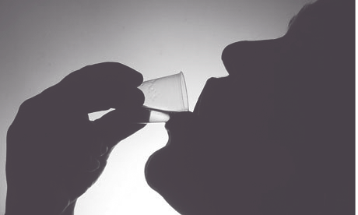
Notes:
We have the most data on methadone, which was FDA approved to treat addiction in 1972

Slide 45
Methadone: efficacy
Cochrane review 2009
  methadone v treatment without medication
  Patients on methadone significantly less likely to have positive urine drug screen
  Decreased new infections with Hep C/HIV
  Decreased criminality
Mattick RP, et al. Cochrane Database of Systematic Reviews 2009
Notes:
Bottom line: it is very effective. A Cochrane review in 2009 showed that patients on methadone maintenance compared to patients in non-medication associated treatments were significantly less likely to use drugs and also lived longer and had lower levels of criminality – though not to levels of signifciantce.

Slide 46
Mortality Risk during and after methadone treatment
Mortality rates/1000 person years (95% CI)
Mortality Risk during and after opioid substitution treatment: systematic review and meta-analysis
of cohort studies. Sordo, et al. BMJ 2017.
Notes:
During methadone treatment, both all cause and overdose mortality were substantially and significantly lower than during periods of treatment disengagement

Slide 47
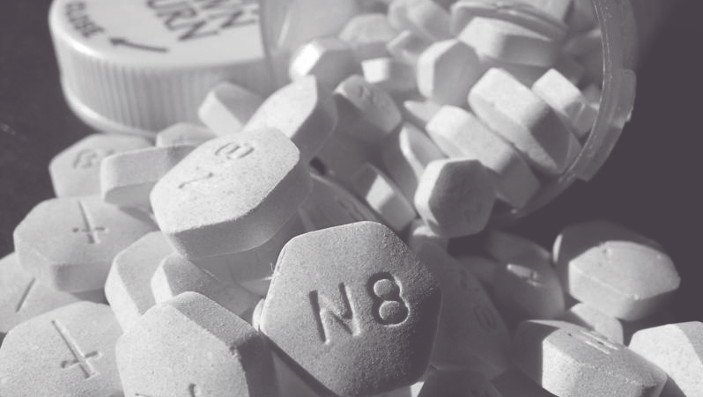
Notes:
Buprenorphine is the other opioid agonist we use to treat addiction. Approved in 2002 for the treatment of opioid use disorder. How does it compare to methadone?

Slide 48
Buprenorphine: efficacy
Cochrane review 2014
  low dose, medium dose, high dose
  Buprenorphine was equivalent to methadone for suppression of illicit drug use except at very low doses
  No difference in mortality
Mattick RP, et al. Cochrane Database of Systematic Reviews 2014.
Notes:
Buprenorphine at low doses was less effective than methadone at low doses for suppression of illicit drug use

Slide 49
Mortality Risk during and after buprenorphine treatment
Mortality Risk during and after opioid substitution treatment: systematic review and meta-analysis
of cohort studies. Sordo, et al. BMJ 2017.

Slide 50
New kid in town: buprenorphine XR
2019 randomized control trial compared three groups over 6 months:
  Six injections of 300mg
  Two injections of 300mg then four of 100mg
  Placebo injections
Results:
  Mean abstinence: 41% for 300mg group;
  42.7% for 300/100mg group
  5% for placebo
  Haight et al The Lancet 2019

Slide 51
New kid in town:buprenorphine XR
Patient Centered Outcomes
  Improved physical and mental health measures
  Increased employment
  Increased medication satisfaction
  Decreased health care utilization
  Ling et al JAM 2019

Slide 52


Naltrexone for Extended Release Injectable Suspension

Slide 53
Naltrexone ER: efficacy
Efficacious compared to placebo
  Comer: 60 U.S. heroin users, 8 weeks (retention in tx and opioid negative urines)
  Krupitsky: 250 Russian heroin users, 24 wks (retention in tx without relapse)
Efficacious compared to buprenorphine
  Tanum: Non-inferior to buprenorphine for decreasing opioid use at 12 wks
  Lee: Non-inferior to buprenorphine for decreasing opioid use at 24 weeks
Comer Arch Gen Psych 2006
Krupitsky Lancet 2011
Tanum JAMA Psychiatry 2017
Lee Lancet 2017

Slide 54
Outcome | XR-NXT (n=283) | BUP-NX (n-287) | Treatment Effect
Inducted to study medication (ITT) | 204 (72%) | 270 (94%) | OR 0.16, 0.09-0.28; P<0.0001
Relapse-free survival (weeks) | 8.4 (3-23.4) 20.4 (5.4-23.4) | 14.4 (5.1-23.4) 15.2 (5.7-23.4) | HR 1.36, 1.10-1.68; p=0.0040 HR 0.92, 0.71-1.18, p=0.49
Opioid relapse, weeks 3-24 | 185 (65%) 106/204 (52%) | 163 (57%) 150/270 (56%) | OR 1.44, 1.02-2.01; p=0.036 OR 0.87, 0.60-1.25; p=0.44
Lee JD, et al. Lancet 2017
Notes:
For patients on naltrexone er v bup.nx

Slide 55
Efficacy: conclusions
All three medications are efficacious once a patient is on the medication
Buprenorphine is equivalent to methadone in terms of decreased illicit drug at clinically useful doses
Extended release naltrexone is equivalent to buprenorphine in terms of decreased illicit drug use.
Both buprenorphine and methadone decrease mortality significantly

Slide 56
Induction and other clinical variables

Slide 57
Methadone induction
No need for withdrawal
Must occur at an OTP or in a hospital setting
BUT the risk of death while on methadone is highest during the initial four weeks of treatment, the induction phase
Mortality Risk during and after opioid substitution treatment: systematic review and meta-analysis
of cohort studies. Sordo, et al. BMJ 2017.
Notes:
On the one hand, its easy. Patient doesn’t have to go into withdrawal to start methadone.

Slide 58
Buprenorphine induction
Requires a brief period of withdrawal (usually 8 – 18 hours off opioids) unless using microinduction
No increased mortality during induction
Notes:
No increased mortality during indct

Slide 59
Extended release buprenorphine: induction
XR buprenorphine: recommend 7 days SL first (8-24 mg)
Subcutaneous abdominal injection that HURTs
Notes:
No increased mortality during indct

Slide 60
Extended release naltrexone: induction
Requires abstinence from opioids 4 – 7 days
About 25% of patients will not complete induction
Notes:
No increased mortality during indct

Slide 61
Outcome | XR-NXT (n=283) | BUP-NX (n-287) | Treatment Effect
Inducted to study medication (ITT) | 204 (72%) | 270 (94%) | OR 0.16, 0.09-0.28; P<0.0001
Relapse-free survival (weeks) | 8.4 (3-23.4) 20.4 (5.4-23.4) | 14.4 (5.1-23.4) 15.2 (5.7-23.4) | HR 1.36, 1.10-1.68; p=0.0040 HR 0.92, 0.71-1.18, p=0.49
Opioid relapse, weeks 3-24 | 185 (65%) 106/204 (52%) | 163 (57%) 150/270 (56%) | OR 1.44, 1.02-2.01; p=0.036 OR 0.87, 0.60-1.25; p=0.44
Lee JD, et al. Lancet 2017
Notes:
That is a big deal. Let’s look at the study oomparing naltrexone to bup again.

Slide 62
Recent mortality data
Original study found 2x the number of overdoses in the naltrexone arm, but not statistically significant
Reanalysis of data: the original study had missed overdoses.
  When those overdoses were counted, the hazard ratio for XR-naltrexone relative to bup/nal was 2.4 for overdose (19 in naltrexone arm, 9 in buprenorphine arm).
  Statistically significant.
  1/3 of naltrexone overdose events occurred among participants who were not induced
Ajazi et al. JAM 2021

Slide 63
Other clinical/patient level considerations
Prolonged QT, family hx of arrhythmia or sudden death – methadone risk
Methadone is only dispensed at OTPs and patients must present daily for at least the first 90 days
Known need for opioids in the future (surgery, sickle cell) – Naltrexone contraindication
Safe place to store medication - methadone, buprenorphine consideration
Other use disorders

Slide 64
 | Methadone | Buprenorphine | Naltrexone ER | Buprenorphine ER
Patient has difficulty with prescriptions | + | +/- | + | +
Daily dispense is problematic (illness, geography) | X | + | + | +
Patient does not have a place to store medication | +/- | +/- | + | +
Patient will require opioids in the future | + | + | X | +
A period of abstinence unlikely/difficult | + | + | X | +/-
Patient want this medication | + | + | + | +
Other clinical variables | + | + | + | +

Slide 65
What questions, comments do you have?
65

