Slide 1
HEADER
Hepatitis B (HBV) :
Serology Interpretation
Karla Thornton, MD, MPH
Professor, Division of Infectious Diseases
Senior Associate Director, Project ECHO
kthornton@salud.unm.edu

Slide 2
Conflicts of Interest Disclosure Statement
I have no conflicts of interest to disclose.

Slide 3
Learning Objectives
Describe the modes of transmission for HBV
Identify appropriate baseline serologies for HBV
Correctly interpret serologic tests for HBV

Slide 4
Hepatitis B: Global Burden
https://www.hepatitisb.uw.edu/

Slide 5
Question # 1
Globally, what is the most common mode of hepatitis B transmission?
Blood transfusion
Perinatal transmission
Injection drug use
Sexual contact

Slide 6
Question # 2
What is the most likely route of transmission of hepatitis B infection in a 23-year-old male who was born in the United States?
A. Vertical (perinatal) transmission
B. Blood transfusion
C. Accidental needle stick
D. Sexual transmission

Slide 7
Hepatitis B (HBV)
DNA virus - viral DNA integrates into the host
Transmission – sexual, MTC, blood-blood
Progression to chronic infection depends on age
90% perinatal
50% children
5% adults
Effective Vaccine

Slide 8
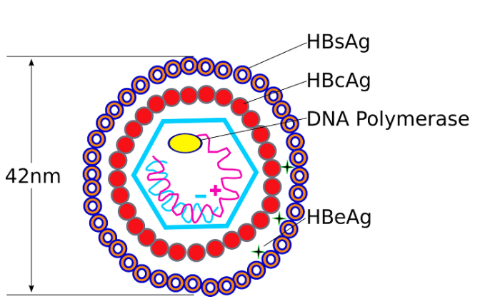
HBV Terminology
Three proteins expressed by HBV
Surface antigen – hallmark of infection
HBsAg
Core antigen
HBcAg
Envelope antigen
HBeAg
https://microbiologyinfo.com/hepatitis-b-virus-structure-epidemiology-symptoms-pathogenesis-diagnosis-treatment-and-vaccines/ Accessed 2_4_22

Slide 9
HBV Terminology
Name | Abbreviation | Interpretation
Hepatitis B Surface Antigen | HBsAg | Indicates active infection. Indicates chronic infection if persistent >6 mos.
Hepatitis B Surface Antibody | anti-HBs | Indicates immunity.
Hepatitis B Core Antigen | HBcAg | The core protein is inner structure of the virus and encloses the DNA. Cannot be measured in serum.
Hepatitis B Core Antibody | anti-HBc | Indicates exposure. NOT seen in those immune because of vaccine.
Hepatitis B e Antigen | HBeAg | Ongoing replication, higher infectivity.
Hepatitis B e Antibody | anti-HBe | Infection resolving.

Slide 10
Hepatitis B Management: Guidance for the Primary Care Provider - HBV Primary Care Workgroup - Hepatitis B Online (uw.edu) Accessed 2_4_22

Slide 12
Question #3
Which is the best test to screen for chronic hepatitis B infection?
A. Antibody against hepatitis B core antigen (anti-HBc)
B. Hepatitis B e antigen (HBeAg)
C. Antibody against hepatitis B surface antigen (anti-HBs)
D. Hepatitis B surface antigen (HBsAg)

Slide 13
Question #4
A patient has the following labs:
Anti-HBs +
What other labs should you request?
A. anti-HBc, HBeAg
B. HBeAg, HBsAg
C. anti-HBc, HBsAg
D. anti-HBe, HBsAg

Slide 14
Question #5
A patient has the following labs:
Anti-HBs -
Anti-HBc -
HBsAg -
Should this patient be vaccinated?
A. Yes
B. No

Slide 15
Question #6
A patient has the following labs:
Anti-HBs -
Anti-HBc +
HBsAg -
Should this patient be vaccinated?
A. Yes
B. No

Slide 16
Key Points
HBV is a major global health problem
HBsAg indicates active HBV infection
HBcAb indicates exposure to HBV
HBV can be prevented by vaccination
Universal HBV vaccine is recommended at birth and for all people ≤ 59 years of age

Slide 17
Resources and Slide Sources
https://www.cdc.gov/hepatitis/
https://www.cdc.gov/hepatitis/resources/professionals/training/serology/training.htm
https://www.hepatitisb.uw.edu/
Hepatitis B Management: Guidance for the Primary Care Provider - HBV Primary Care Workgroup - Hepatitis B Online (uw.edu)

Slide 18
Questions?

