Slide 1
Connection
How do we relate with our patients?

Slide 2
Young Patients
High caries rates
Poor oral hygiene
Missed appointments
Patient doesn’t talk
How do we get through?

Slide 3
Creating an environment of trust
Relatability!
Ask patient their dental history
  Previous dental encounter experiences -
Include the patient
  Ask them what they want to gain from this appointment
Understand their barriers
  Before berating for poor oral hygiene or missed appointments
Authenticity
  Be human, be genuine, be caring
Wit & Humor
Notes:
Get the patient talking. I ask about their previous dental history. If they have dental fear, I relate my story, I also had dental fear as a child. I tell them I used to be so afraid of the dentist my lip used to quiver before the injection, so I don’t let them use topical anesthetic anymore because it has a psychosomatic effect on me.
Patient’s can feel more comfortable if they feel they are heard and have some control.
Before a lecture on not taking care of their teeth, try to learn if there are existing barriers- access to transportation? Oral hygiene education? Money? Home life?

Slide 4
Empowerment
Motivate with history
Show them their potential
Provide hope
Notes:
When giving diet education and oral hygiene instructions – create a feeling of hope, empowerment, pride.
I created an Introduction to Dental Careers course for Tribal High School students. I wanted them to know where they came from. That they didn’t always have a high rate of dental disease. I wanted for them to feel strong, empowered, and have hope they can have a health mouth. These are a few slides from the PPXT.
I ask them, what do you think the teeth of the our ancestors were like?

Slide 5
Oral health of the early American Indians and Alaska Natives

Slide 6
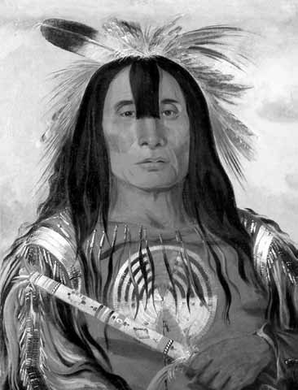
The Teeth of Early Native Americans
Between 1830-1836–an American artist -George Catlin- traveled west of the Mississippi to paint portraits of American Indians
What do you think he found?
“Stu-mick-o-suchs (Buffalo Bull’s Back Fat)” Chief of the Blackfoot Tribe
Henderson, 2009
Notes:
What to you think he found?

Slide 7
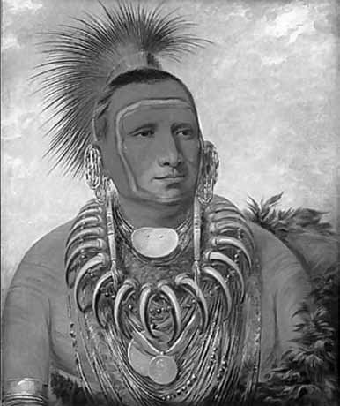
The Teeth of Early Native Americans
Catlin was struck by the beauty of their teeth:
“These people, who talk little and sleep naturally, have no dentists-
their teeth rise from the gums and arrange themselves as regular as the keys of a piano- No decay or aches, strong enamel and jaws”
“Shon-ta-yi-ga, Little Wolf,
a Famous Warrior.”
Painting by George Catlin, 1844
Henderson, 2009

Slide 8
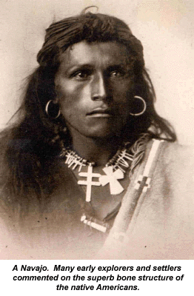
The Teeth of Early Native Americans
In 1933, Weston Price, a Canadian dentist, set out to locate primitive native people in American who might shed light on the health and nutrition of their ancestors.
What he found was an almost complete absence of tooth decay and dental deformities among Native Americans who lived as their ancestors did.
Price, W. (1939). Nutrition and Physical Degeneration. Project Gutenberg Australia (2002). https://gutenberg.net.au/ebooks02/0200251h.html

Slide 9
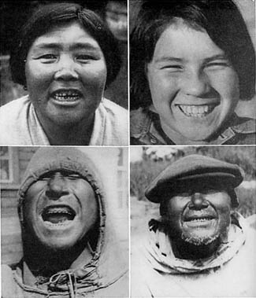
The Teeth of Early Native Americans
In 1933 Price also studied the Alaska Natives who lived only on native foods
What do you think he found?
Price, W. (1939). Nutrition and Physical Degeneration. Project Gutenberg Australia (2002). https://gutenberg.net.au/ebooks02/0200251h.html
Notes:
Very little or no decay
Strong jaws and muscles
Typical Alaska natives. Note no dental caries (tooth decay). Upper left, woman has a broken lower tooth. She has had twenty-six children with no tooth decay.

Slide 10
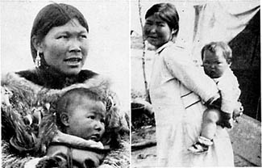
The Teeth of Early Native Americans
Strong, rugged mothers and their babies with no dental decay
(Price, 1933)
What do you think the Alaska Natives ate?
Price, W. (1939). Nutrition and Physical Degeneration. Project Gutenberg Australia (2002). https://gutenberg.net.au/ebooks02/0200251h.html
Notes:
1933 Price’s trip to Kus

Slide 11
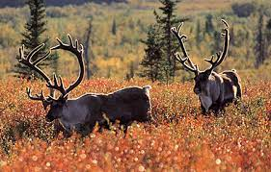
Traditional Native American Diets
Alaska Natives :
Caribou
Ground nuts (gathered by mice)
Kelp (gathered in season and stored for winter use)
Berries
Blossoms of flowers preserved in seal oil
Sorrel grass preserved in seal oil
Fish
Organs of the large animals of the sea
Whale skin
What did your ancestors eat?
Price, W. (1939). Nutrition and Physical Degeneration. Project Gutenberg Australia (2002). https://gutenberg.net.au/ebooks02/0200251h.html

Slide 12
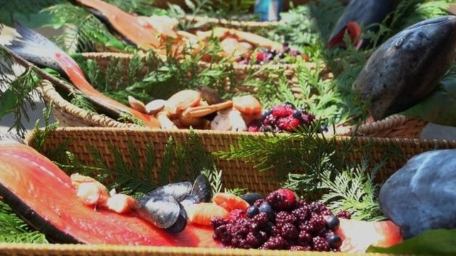
What did the Northwest Natives eat?
  Berries, fish, and mammals with some herbs, birds, and shellfish
  Native plants like quamash (also known as camas) used for flavor, nutrition and additional health benefits like healing
https://www.blendspace.com/lessons/T-xa0AkrT4wDHg/native-americans-of-the-pacific-northwest
Kay and Rush, n.d.
Notes:
Low in Carbs

Slide 13
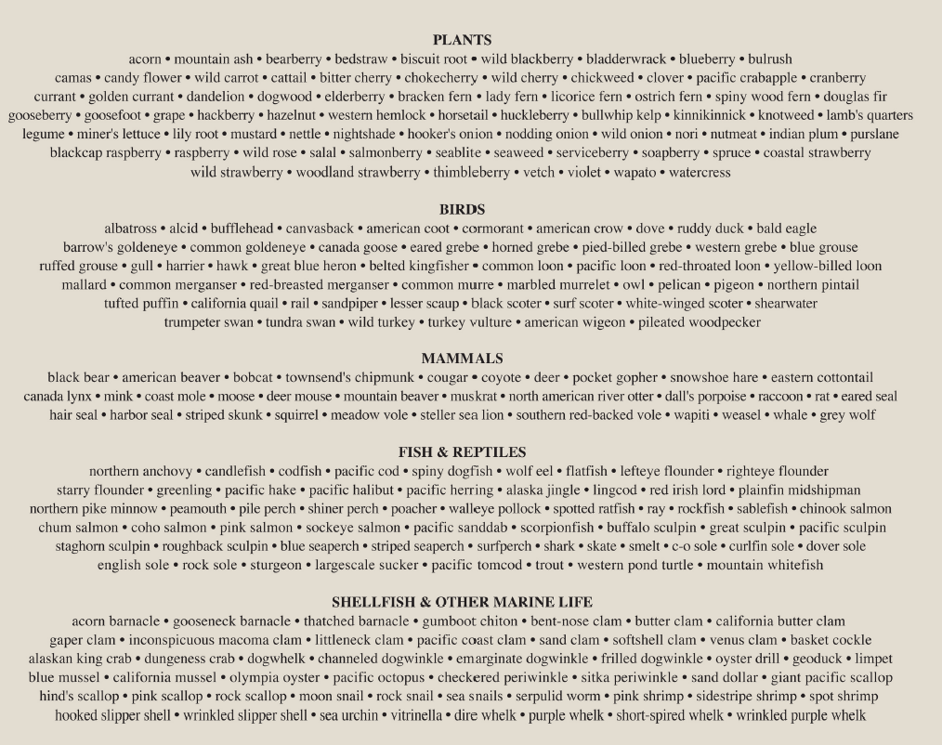
Traditional Coast Salish Foods
Over 300 food sources. How many different kinds of food do you think you eat on a regular basis?
Presently -Americans eat less than 12 different foods on a regular basis (Krohn, E. n.d.)

Slide 14
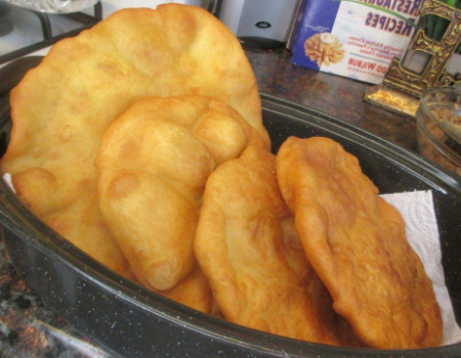
What does food have to do with dentistry?
When the AI/AN were removed from their homelands and forced onto reservations
  Traditional foods were removed
  Few natural resources
  Limited food growing option
  Traditional food sources were replaced
  with foods containing refined carbohydrates
https://1krecipes.com/indian-frybread/2/
Kay and Rush, n.d.

Slide 15
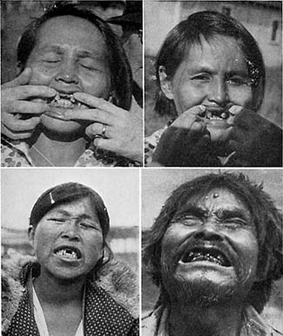
Effects of Colonization on Health
When traditional foods were replaced with processed store-bought foods health deteriorated rapidly:
Rampant tooth decay
Tuberculosis
Crippling arthritis

