Slide 1
Mark Pippenger, MD, Behavioral Neurologist
Care Management: Behavioral and Psychological Symptoms of Dementia (BPSD)
Dr. Pippenger has disclosed that there is no actual or potential conflict of interest in regards to this presentation.
The planners, editors, faculty and reviewers of this activity have no relevant financial relationships to disclose. This presentation was created without any commercial support.

Slide 2
Learning Objectives
At the conclusion of this course, participants will be able to:
Recognize common behavioral and psychological symptoms in patients with ADRD.
Recognize the importance of determining what the behavior is communicating.
Evaluate strategies for managing behavioral issues in patients with ADRD.

Slide 3
What are “BPSD”?
“Non-cognitive” symptoms of dementia
95% of persons with dementia will have BPSD at some point during their life
More common as dementia progresses
Often the cause of significant distress, increased caregiver burden, and may lead directly to institutionalization, greatly increasing cost of care

Slide 4
What are “BPSD”?
Apathy
Depression/anxiety
Disinhibition
Elation/euphoria, moria
Sleep disturbances (insomnia, hyper somnolence)
Psychosis (delusions, hallucinations)
Aberrant motor activity (Wandering, pacing, fidgeting)
Agitation

Slide 5
Causes of BPSD
Factors related to the person with dementia
Factors related to care givers
Environmental triggers

Slide 6
Factors related to the person with dementia
Biological factors
Acute medical conditions (including pain)
Pre-existing personality
Cultural beliefs, prejudices
Pre-existing psychiatric illnesses
Unmet needs (physical, psychological, emotional, or social)

Slide 7
Factors related to caregivers
Stress or depression (in the care giver)
Negative communication styles
Poor coping abilities
Mismatch between caregiver expectations and patient abilities

Slide 8
Factors related to the environment
Objects/tools in the home
Drugs
Safety issues (driving)
Overstimulation
Understimulation (boredom)

Slide 9
Drugs that can cause BPSD
Opioid analgesics (incl tramadol)
Benzodiazepines
Anticholinergic drugs
Dopamine agonists (ropinirole, pramipexole)
Anticonvulsants
Antipsychotic drugs

Slide 10
Management of BPSD
Nonpharmacological management—the “person centered care” approach—should be the first-line treatment for any BPSD
Drugs can provide “chemical restraint” but should be used only as a LAST RESORT

Slide 11
A Person-Centered Behavior Management Approach
When trying to understand the root of a “concerning” behavior:
Specify measurable behavior
Understand dementia etiology
Estimate dementia severity
Explore mediators (what is behavior communicating)
What are desired behaviors, and how do we increase them:
Consider contentment (when is person at her/his best)
Identify target behaviors to increase
Understand person’s history
Notes:
Heuristic we’ve developed over the years to help patients/families/providers conceptualize challenging behaviors.
Beh problems are not uncommon and can often be first sxs
When confronted with beh issue, utilize this heuristic to quantify a behavioral problem.
-First: What does “agitation” mean? Wandering, physical aggression, yelling, etc.
-What about the specific etiology may be contributing to the presentation (e.g., LBD etc)
- How severe is the stage, and what do we know about behaviors typical to that stage?
-Last, Remember that behavior IS communication – what is the behavior telling us?
Now, let’s switch gears, and think NOT about the problematic behavior, but what is the opposite – what behavior do we wish to increase?
- Let’s also think about goals – what does the patient want? Caregiver? They want contentment.
-Using this, we can think about what positive behaviors we want to increase?

Slide 12
Behavior is Communication
As language and cognitive skills decline, overt behavior will fill the void. This implies:
Behavior is not random
Behavior is adaptive for that person
Behavior is goal directed
Notes:
Any of you that have children or grandchildren, can probably relate to the fact that one does not need language to communicate!
Young children communicate their needs quite well in a number of other ways, if we pay attention: They yell, pound their fists, smile, babble, etc and if we look at the Antecedents, we can often understand what this non-verbal communication is telling us
As language declines in dementia, behavior replaces communication. So, behavior is not random…

Slide 13
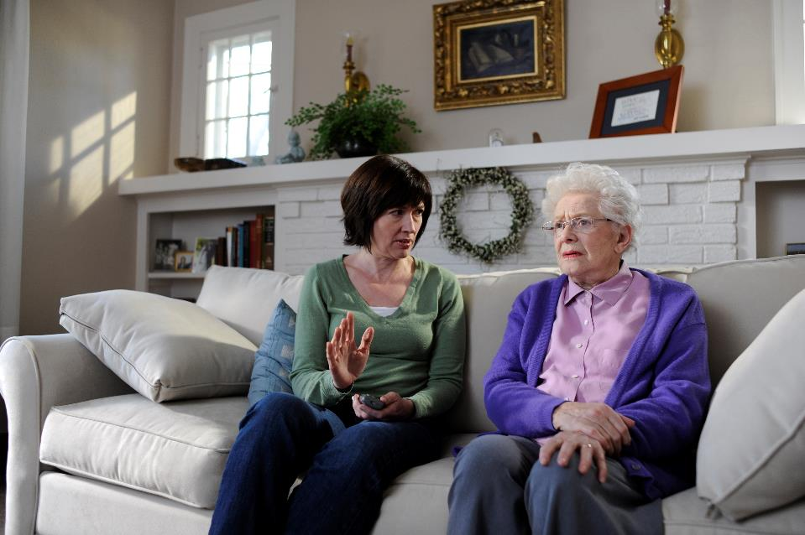
Mediators of Challenging Behaviors in Dementia
Physical Health Factors
Pain/illness
Psychological Health Factors
Depression/worry
Environment, Task, Approach
Over/understimulated
Social History/Habit
Notes:
Our job is to try and understand what the behavior is communicating…
May not be possible in all cases, but often fruitful to try and understand
Phys health factors: Pain, UTI/infection
Psychological: Generally, as dementia advances, pts are less able to tell us how they feel emotionally - boredom, companionship. Look at vegetative signs to identify depression/anxiety (sleep, appetite, interest)
Talked about environment
Every day, pt gets up at 530am, tries to leave house. Maybe they were a baker – always used to get up at sunrise, and go to work early. Well, lets think about antecdenet – maybe need sun-blocking curtains

Slide 14
Cannot Create a Behavior Vacuum
Behaviors compete in real time
Ask “when is the person at their best?”
Increasing frequency of desired behaviors may reduce the frequency of undesired behaviors
Notes:
Shifting our focus away from behavior we DON’T want, to what we do want – an “adaptive” behavior. Let’s think about replacing behaviors.
What is the person doing when most satisfied, and how do we increase frequency of that POSITIVE behavior. Remove antecedent of negative behavior, and think about cue for positive behavior. This is where thinking about social history and what holds someones attention and helps them feel most satisfied and fulfilled. When working with families on this, this is important to collaborate/brainstorm with them on how to achieve this.

Slide 15
Caregiver Education & Support is Vital!
‘Validate, Join & Distract’
Avoiding correcting the patient
Communicate, but don’t argue with/scold the patient
Reasoning not generally effective strategy
Don’t raise your voice with the patient, even if they raise theirs
Change the subject or activity to something more interesting or pleasant

Slide 16
Drugs for Treating BPSD
No drug has proven efficacy above placebo, for treatment of Behavioral and Psychological Symptoms of Dementia
No drug is approved by the FDA to treat agitation, hallucinations, or other behavioral symptoms in people with dementia
Many drugs commonly used off-label to treat BPSD have serious, potentially fatal side effects

Slide 17
Drugs commonly used to treat BPSD
Antipsychotics
Benzodiazepines or other sedatives
Anticonvulsants (esp divalproex)
Antidepressants
Cholinesterase inhibitors and memantine

Slide 18
Take Homes: Approach to Managing BPSD
Identify clearly what the problem behavior is
Try to identify triggers for problem behaviors
Consider the patient’s background and premorbid personality in identifying causes for problems, and way to identify “positive” competing behaviors
Consider physical symptoms or medication effects as a possible cause
Provide caregiver education and support
Turn to medications only as a last resort, if non pharmacological management fails

Slide 19
Alzheimer’s Association Resources
Toll-free helpline: 1-800-272-3900
Managing Behavioral and Psychological Symptoms of Dementia
A guide to treat behavioral and psychological symptoms of dementia through pharmacological and nonpharmacological methods.
Activities at Home for Patients with Middle or Late Stage
A guide to activities for patients at home that may relieve some behavioral and psychological symptoms of dementia.

Slide 20
Questions?

