Slide 1
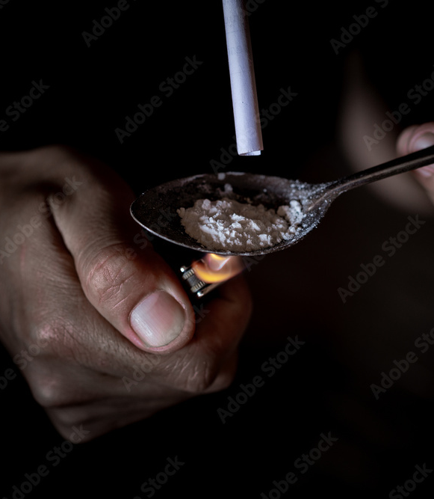
Stimulant Induced Psychosis (SIP) Diagnosis and Management
CDR Venecia Clark DNP APRN PMHNP-BC, NP-C, FNP-BC

Slide 2
OBJECTIVES
1. Discuss and explain the diagnosis of Stimulant Induced Psychosis.
3. Identify differential diagnoses in the treatment of Stimulant Induced Psychosis.
4. Describe appropriate treatment options for Stimulant Induced Psychosis.
2. Discuss clinical manifestation of Stimulant Induced Psychosis.

Slide 3
BACKGROUND
Non-prescription drug use is a significant public health crisis.
Between 2018 and 2021, cocaine and methamphetamines are the second and third most common drugs identified overdose.
Almost one fifth of all psychiatric presentations to emergency department were related to amphetamine use.
Yet the burden of SIP is unknown.

Slide 4
BACKGROUND
Stimulants are drugs that increase the body’s functions by increasing the speed of activity in the central nervous system (CNS).
Stimulates several neural systems.
These drugs increase the amount of dopamine in the brain, resulting in an increase in heart rate, alertness and energy.
Notes:
There is a robust association between stimulant use and the development of psychotic symptoms. Some patients have quick resolution of psychotic symptoms with cessation of substance use, but for other patients, psychotic symptoms are slow to remit.

Slide 5
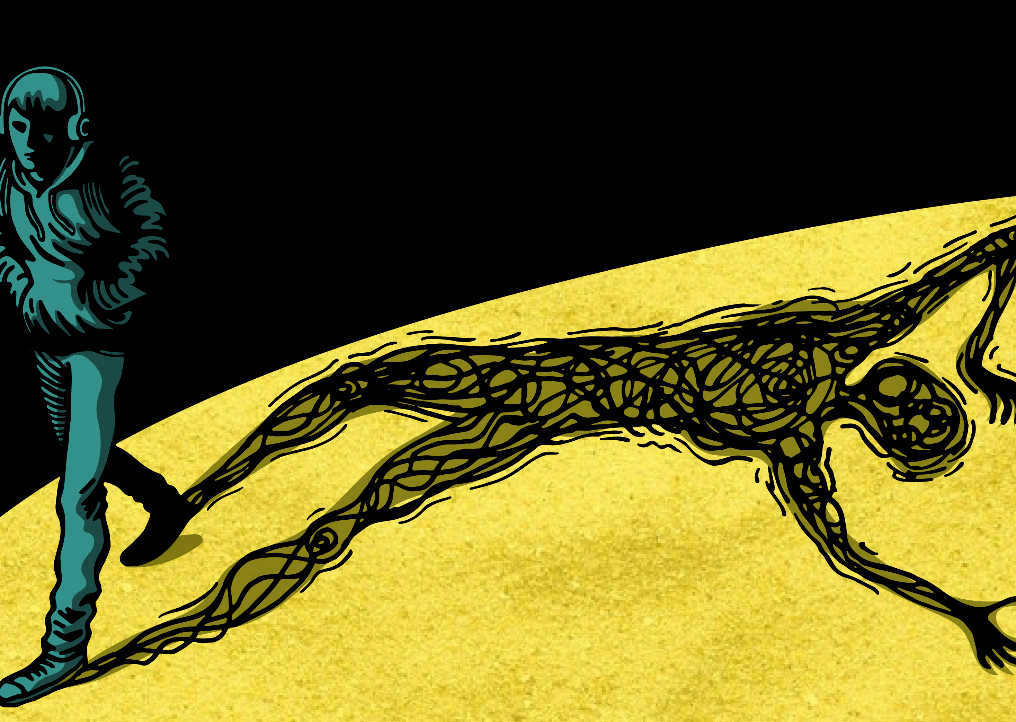
PSYCHOSIS
Conditions that affect the mind.
Person loses contact with reality.
Person’s thought and perceptions are disturbed.
Individual may have difficulty understanding what is real and what is not.
Increase risk for suicide
Increase risk of harming others
Unable to meet basis needs.

Slide 6
Stimulant Induced Psychosis
The DSM-5 defines substance/medication induced psychotic disorder as:
Delusions/or hallucinations, with symptoms occurring soon after the intoxication.
Withdrawal of a substance
Soon after exposure to a medication.

Slide 7
Stimulant Induced Psychosis
Psychosis is a feature of psychiatric but may be a manifestation of substance abuse or underlying medical disease:
Individual may have mood changes, neurocognitive impairments.
Functional decline, social isolation.
Agitation/aggression.
Catatonia
Negative symptoms (Apathy, flat affect, decreased expressiveness).
Neurocognitive deficits-Memory, attention, executive functioning.

Slide 8
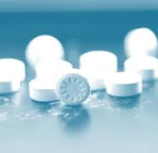
Stimulants of Abuse
Cocaine
Amphetamines
Methamphetamines
Ecstasy/Molly (MDMA)
Alcohol

Slide 10
MORTALITY/MORBIDITY
Notes:
Clinical management of a patient with onset of psychotic symptoms in the context of stimulant induced psychosis continues to be challenging for psychiatric providers in an ambulatory, longitudinal treatment setting.

Slide 11
DIAGNOSIS STIMULANT USE
The most common cause of stimulant-induced psychosis is amphetamine and methamphetamine use.
They inhibit dopamine reuptake into neurons by binding to dopamine transporter, resulting in an increase concentration of dopamine.

Slide 12
THE DOPAMINE HYPOTHESIS
Psychotic symptoms are caused by excessive dopamine.
The Mesolimbic Pathway-hyperactivity of dopamine mediates positive symptoms
Mesocortical-Decreased dopamine to the dorsolateral prefrontal cortex is responsible for negative and depressive symptoms
Notes:
The effects of stimulant use on the central nervous system are primarily mediated through dopaminergic transmission/
The rewarding effects of substances are also mediated through dopaminergic pathways in the mesolimbic system.
Stimulant inhibits dopamine (DA) reuptake through inhibition of the DA transporter and the vesicular monoamine transporter.
This leads to elevated concentrations of DA, potentially to neurotoxic levels. Higher dopaminergic signaling in the mesolimbic, nigrostriatal, and mesocortical pathways causes elevated glutamate levels that damage GABAergic interneurons.
This leads to glutamate dysregulation and impairment of N-methyl-D-aspartate receptors, resulting in damage to the cortex and the onset of psychotic symptoms./

Slide 13
DIAGNOSIS SIP
While diagnosis is critical in the early treatment of psychotic symptoms, information on the diagnosis, treatment, and outcomes for SIP remains inadequate.

Slide 14
DIAGNOSIS STIMULANT USE
Initial
Initial assessment to identify the cause of the psychosis and the effect of the psychosis on the patient’s functioning.
Determine
Determine the etiology.

Slide 15
DIAGNOSING STIMULANT INDUCED PSYCHOSIS
Rule out Organic, medical, Psychiatric, & Neurologic issues
Labs
Family History
Mental Health history
Substance abuse history
Notes:
Acute onset of psychotic symptoms in a previously healthy individual requires a comprehensive evaluation.
In addition to brain imaging, laboratory work including basic metabolic panel, HIV, rapid plasma reagin, and thyroid stimulating hormone can help rule out possible medical causes. I

Slide 16
Notes:
Withdrawal from alcohol or benzodiazepines can present with psychosis, and because methamphetamine is often used in conjunction with other substances, this should be included on the differential diagnosis.

Slide 17
Stimulant Intoxication
Clinically significant problematic behavior
Psychological change :
high feeling, euphoria with enhanced vigour, hyperactivity, restlessness.
Hypervigilance, interpersonal sensitivity, talkativeness.
Anxiety, tension, alertness

Slide 18
DIFFERENTIAL DIAGNOSES
Cannabis Related Disorder
Delirium
Depression
Hallucinogen Use
Opioid Abuse
Schizophrenia
Inhalant Use
Hyperthyroidism/Thyrotoxicosis

Slide 19
Treatment Options for Stimulant Induced Psychosis
Stop using stimulant.
Assess for medical stability.
Physical and Neurological Exam.
Assess Psychomotor agitation.
Evaluate any medical complications: Hyperthermia, Hypertension, Gastrointestinal, Renal failure, cardiac issues.
Notes:
Providers should gather appropriate history to determine if psychotic symptoms or a psychotic prodrome was present prior to methamphetamine use.
If there is no evidence of a preexisting psychotic disorder and if psychotic symptoms have remitted with cessation of methamphetamine use, it is reasonable to try tapering the antipsychotic medication.

Slide 20
Treatment Option for Stimulant Induced Psychosis.
Safety is always first.
Treatment are typically treated with antipsychotics.
Benzodiazepines medications to reduce symptoms of psychosis, to minimize side effects and to contain behavioral.
Neuroleptics to help prevent recurrence of amphetamine psychosis.
. Gastric lavage or charcoal
Naloxone to address opioid dependency or use.
Notes:
Studies suggest that second-generation antipsychotic medications are preferred over first-generation in the treatment of SIP.
Haloperidol and olanzapine have comparable effects with regard to psychotic symptoms; , patients treated with olanzapine appear to tolerate the medication better due to fewer extrapyramidal adverse effects.

Slide 21
Treatment Option for Stimulant Induced Psychosis
Hospitalization for psychiatric issues.
No medication has been approved for the treatment of SIP.
Although anti‐psychotics are used commonly in the management of SIP.
No database to guide a use of these medications.

Slide 22
Conclusion
There is little evidence about the treatment of SIP.
Antipsychotic (Olanzapine) & Haloperidol are shown to be effective.
Psychosis is also noted as a risk when an individual relapse.
Suicide is an increased risk.
Notes:
Treatment of SIP should focus both on alleviating the psychiatric symptoms as well as promoting abstinence from stimulant use.
The treatment of SIP is challenging even in patients who have not presented with psychotic symptoms, as there are currently no US Food and Drug Administration (FDA)- approved medications for this indication.

Slide 23
References
American Psychiatric Association. (2013). Diagnostic and statistical manual of mental disorders (DSM-5). American Psychiatric Pub.
Barbic, D., Whyte, M., Sidhu, G., Luongo, A., Chakraborty, T. A., Scheuermeyer, F., Honer, W. G., & Stenstrom, R. (2022). One-year mortality of emergency department patients with substance-induced psychosis. PloS one, 17(6), e0270307. https://doi.org/10.1371/journal.pone.0270307.
Cressman, A. M., Macdonald, E. M., Huang, A., Gomes, T., Paterson, M. J., Kurdyak, P. A., Mamdani, M. M., Juurlink, D. N., & Canadian Drug Safety and Effectiveness Research Network (2015). Prescription Stimulant Use and Hospitalization for Psychosis or Mania: A Population-Based Study. Journal of clinical psychopharmacology, 35(6), 667–671. https://doi.org/10.1097/JCP.0000000000000406.
Harrington, A., & Fan, X. (2022). Methamphetamine-associated psychosis: What should clinicians know? Psychiatric Times (39), 7.
Henning, A., Kurtom, M., & Espiridion, E. D. (2019). A Case Study of Acute Stimulant-induced Psychosis. Cureus, 11(2), e4126. https://doi.org/10.7759/cureus.4126.
Marder, S., (2023). Psychosis in adults and epidemiology clinical manifestations and diagnosis evaluation. Post Twed. UptoDate. Inc. http:www.Uptodate.com. Access on January 10, 2023.
Sabe, M., Zhao, N., & Kaiser, S. (2021). A systematic review and meta-analysis of the prevalence of cocaine-induced psychosis in cocaine users. Progress in Neuro-psychopharmacology & Biological Psychiatry, 109, 220263.
Shoptaw, S. J., Kao, U., & Ling, W. (2009). Treatment for amphetamine psychosis. The Cochrane database of systematic reviews, 2009(1), CD003026. https://doi.org/10.1002/14651858.CD003026.pub3

Slide 24
Questions

