Slide 1
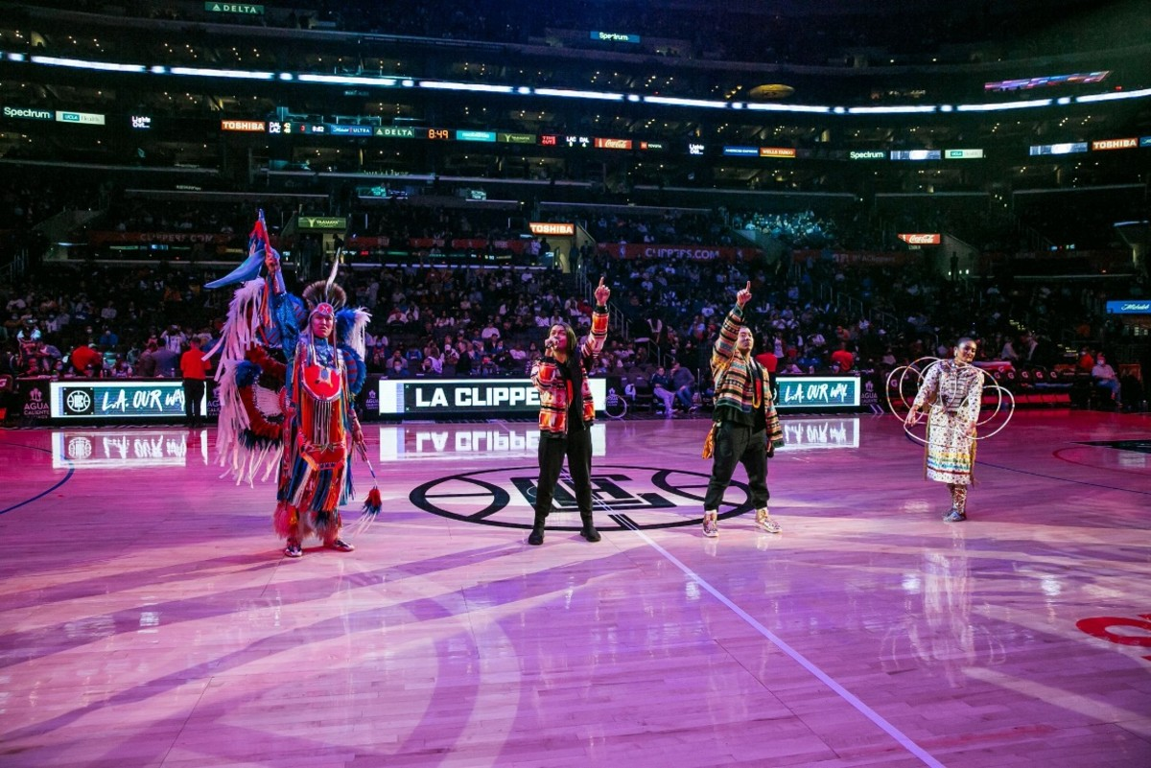
Welcome to the
2023
Reclaiming Native Psychological Brilliance Behavioral Health ECHO Series
While we are Gathering . . . enjoy this Native music video which we will start at 5 minutes before the hour.
“Dream” - Doc Native and Spencer Battiest
Doc Native and Spencer Battiest along with Indigenous Enterprise dance troupe perform their award winning single "Dream" at the Los Angeles Clippers vs Dallas Mavericks NBA regular season game in honor of Native American cultural night.
Notes:
05:08

Slide 2
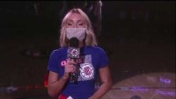

Slide 3


Slide 4
Audience Participation Tips
We are building a community! Please introduce yourself in the Chat (select Everyone) and let your fellow participants know your name, Tribal Nation affiliation if applicable, job title, and organization.
Everyone will be muted until the Participant Reflections portion of the hour. During that segment, use the Raise my Hand icon on zoom, and the host will unmute you to offer your reflection.
You will receive a link to the recording and presentation by the end of the week.
Notes:
Due to the audience size, we encourage you to use the Chat feature for comments and questions.

Slide 5

Disclosures
This activity is jointly provided by United South and Eastern Tribes and Cardea Services​​
Cardea Services is approved as a provider of nursing continuing professional development by the Montana Nurses Association, an accredited approver with distinction by the American Nurses Credentialing Center’s Commission on Accreditation.​​
This activity has been planned and implemented in accordance with the accreditation requirements and policies of the California Medical Association (CMA) through the joint providership of Cardea and United South and Eastern Tribes. Cardea is accredited by the CMA to provide continuing medical education for physicians.​​
Cardea designates this live web-based training for a maximum of 1 AMA PRA Category 1 Credit(s)TM, Physicians should claim credit commensurate with the extent of their participation in the activity.
Notes:
There are no conflicts of interest.

Slide 6
Disclosures
There are no relevant financial relationships with ineligible​ companies for those involved with the ability to control​ the content of this activity.​ ​
​​
​

Slide 7
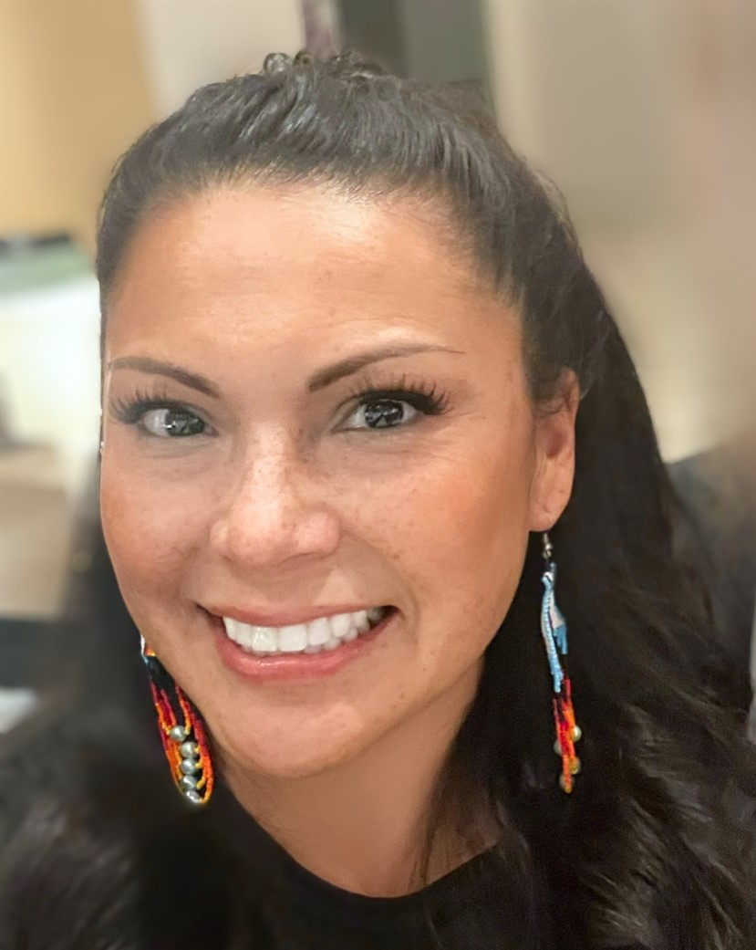
Welcome to All My Relations
"Mitakuye Oyasin"… We are all Related in the Sioux Language.
Bernice Youpee-Jordan, MPH
Citizen of the Fort Peck Sioux Nation
Public Health Program Manager
Tribal Health Program Support
United South and Eastern Tribes, Inc.
Notes:
Introduce self and position
Again, on behalf of USET we welcome you. We are excited to launch this first monthly session of Reclaiming Native Psychological Brilliance, but before we begin:
As Native people, we want to start with a Blessing and we are fortunate to have Chief of the Mohegan Tribe, Chief Malerba - - -

Slide 8
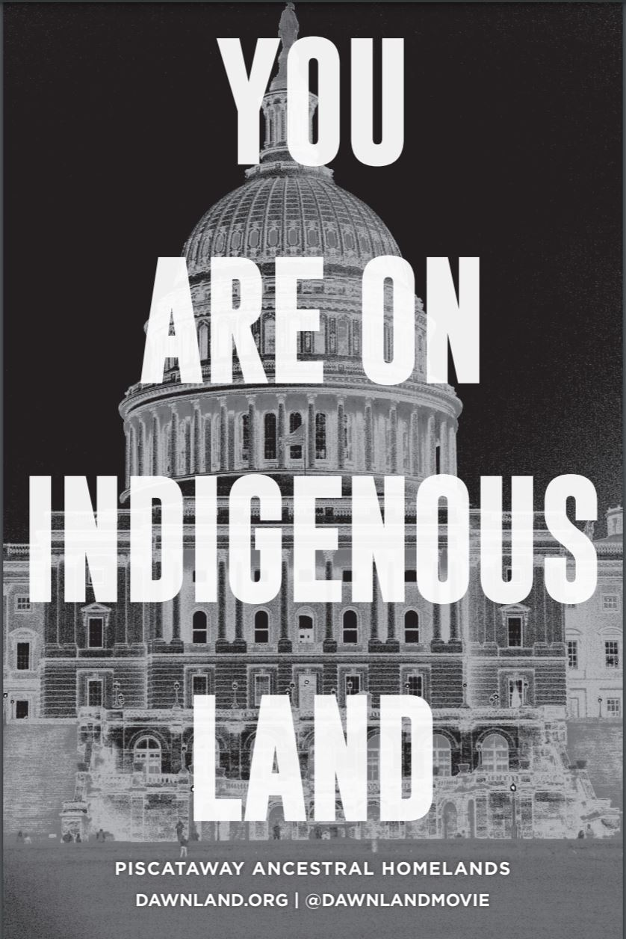
To learn and acknowledge what Tribal Nation land you and your organization are standing on, go to
https://native-land.ca/
or text your zip code or city to
(907) 312-5085.
Notes:
We respectfully acknowledge that we stand on territories where Indigenous and Tribal Nations are traditional stewards of the land.
Please join us in affirming Tribal sovereignty, and always displaying respect and gratitude for Indigenous people.
We honor and recognize the original peoples of this land.

Slide 9
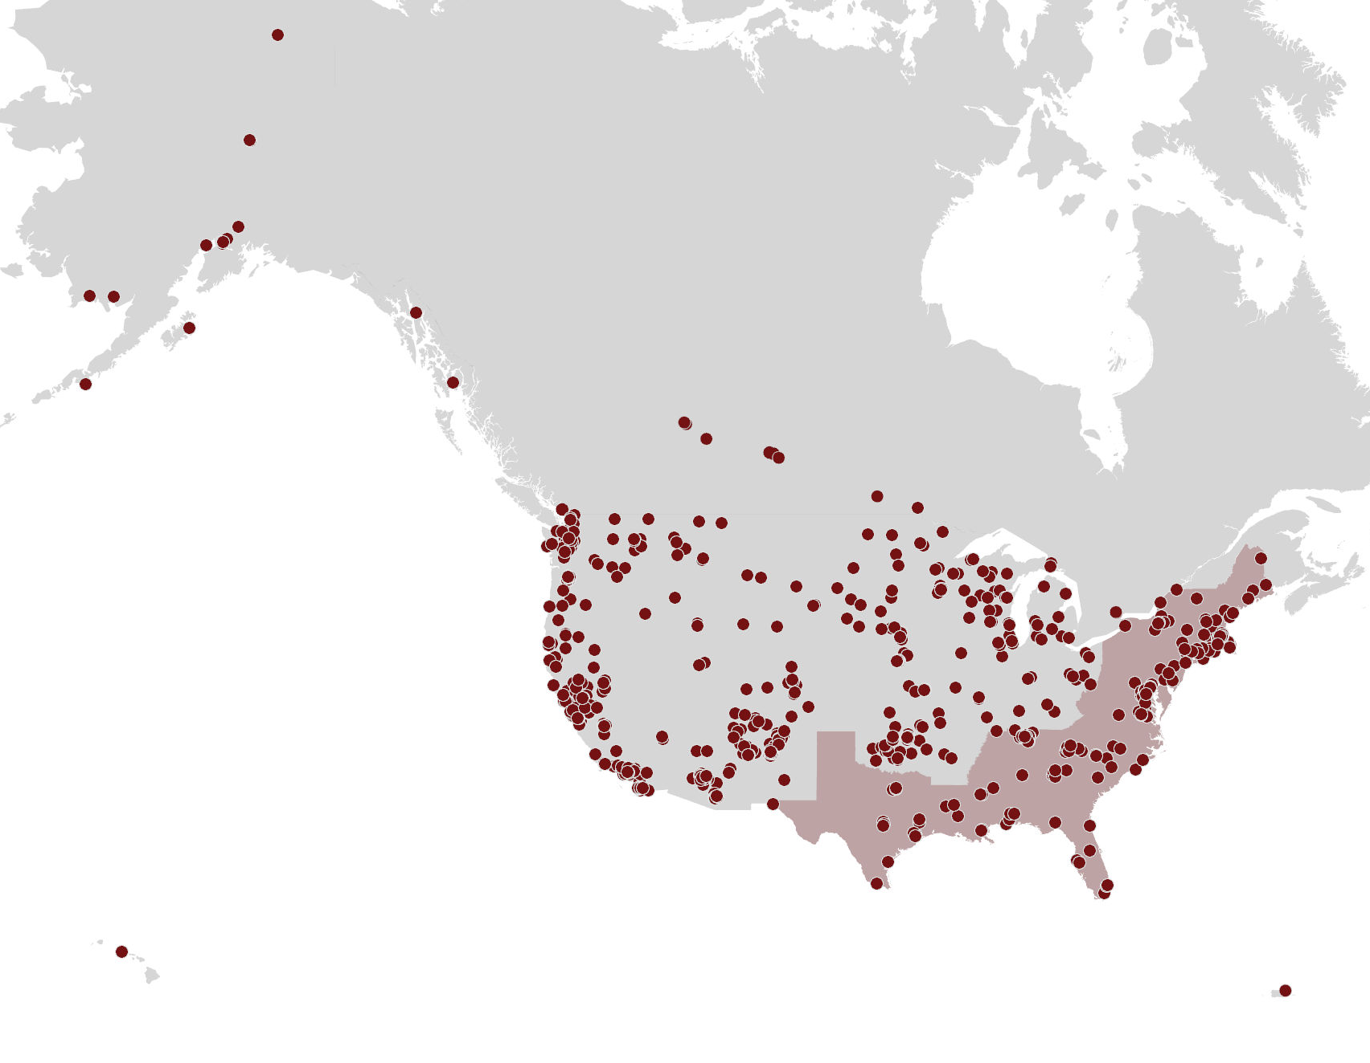
We are reconnecting our Indigenous community!
Thank you for being a part of reclaiming our collective stories.
Data is gathered from registration data

Slide 11
Native Traditional Practices: Culture is Treatment
Holly Echo-Hawk, MSc
January 24, 2023

Slide 12
  Thank you for joining the Native Brilliance series

Slide 13

  Throughout 2022, this series has provided countless examples of the innate intelligence of Native people - - - brilliance that is too often overlooked

Slide 14
Today’s Learning Objectives
Increase knowledge of innate intelligence of Native people and relationship to treatment and lifelong recovery
Deepen understanding of how cultural practices serve as healthy behavior teaching tools and influence behavior change
Learn how culture-centered behavioral health approaches motivate behavior change
Discover how traditional practices support healthy behavior and how traditional practices can correspond to behavioral health services

Slide 15
Why is Healthy Behavior Important
for Native People?
Answer: Because behavioral health (healthy behavior)
is serious business

Slide 16
Despite strengths and resilience of Native people . . .
  Native life expectancy rate has dropped by 6.6 years between 2019-2021, resulting in 2021 life expectancy for AI/AN at 65.2 years. Largely driven by pandemic, Native people had largest decline when compared to all U.S. racial groups (Sources: CDC, August 2022; How the Pandemic Shortened Life Expectancy in Indigenous Communities https://www.nytimes.com/2022/08/31/health/life-expectancy-covid-native-americans-alaskans.html)
  Fatal drug overdose rate is highest for Native people - - - Native people have been disproportionally affected compared to other races/ethnicities
  (Source: CDC NCHS Data Brief No. 394, 12/2020)
  Poverty, inadequate access to health care, crowded housing in today’s virus environment can contribute to poorer health; discrimination and trauma also found to be linked to wearing down of mental and physical health (Source: Neurologists say accelerated brain aging in Black people can be countered by lifestyle changes (nbcnews.com)
Notes:
The term “life expectancy” refers to the number of years a person can expect to live. By definition, life expectancy is based on an estimate of the average age that members of a particular population group will be when they die.
Life expectancy is based on an estimate of the average age that members of a particular population group will be when they die.
The statistic “Life expectancy at birth” actually refers to the average number of years a newborn is expected to live if mortality patterns at the time of its birth remain constant in the future. (World Bank.org)

Slide 17
Drop in Native Life Expectancy
2019
2021
AI/AN Life Expectancy at Birth:
71.8 years
AI/AN Life Expectancy at Birth:
65.2 years

Slide 18
Impact of Chronic Stress
Due to Racism and Health Inequities
Recent study indicated that chronic stress as a result “of racism or health inequalities due to racism” can raise one’s risk of developing cognitive disease
Chronic exposure to social and economic disadvantage leads to accelerated decline in physical health outcomes
Source: Neurologists say accelerated brain aging in Black people can be countered by lifestyle changes (nbcnews.com)
December 2022

Slide 19
What is the Key to Engaging Native People
in Behavior Change?
Cultural Connectedness

Slide 20
Culture Matters.
Tribal Traditions Matter.

Slide 21
Culture Matters
Cultural context has quiet and profound influence on countless aspects of our lives as Native people. For example, tribal culture impacts:
    How we view ourself
    How we convey distress
    Discomfort or ease in seeking help
    Who we turn to for help
    Why we decline help

Slide 22
Tribal Traditions and Behavior Expectations
Tribal ceremonies and traditions model:
    Attitude
    Purpose
    Behavior
    Reinforces something larger than self

Slide 23
Tribal Traditions and SUD Recovery
Return to, or new learning about, traditional practices are important motivator for sustained recovery
Wellbriety Movement & Healing Forest Model provides excellent examples (see August 23, 2022 presentation)

Slide 24
Culture is a Behavioral Asset

Slide 25
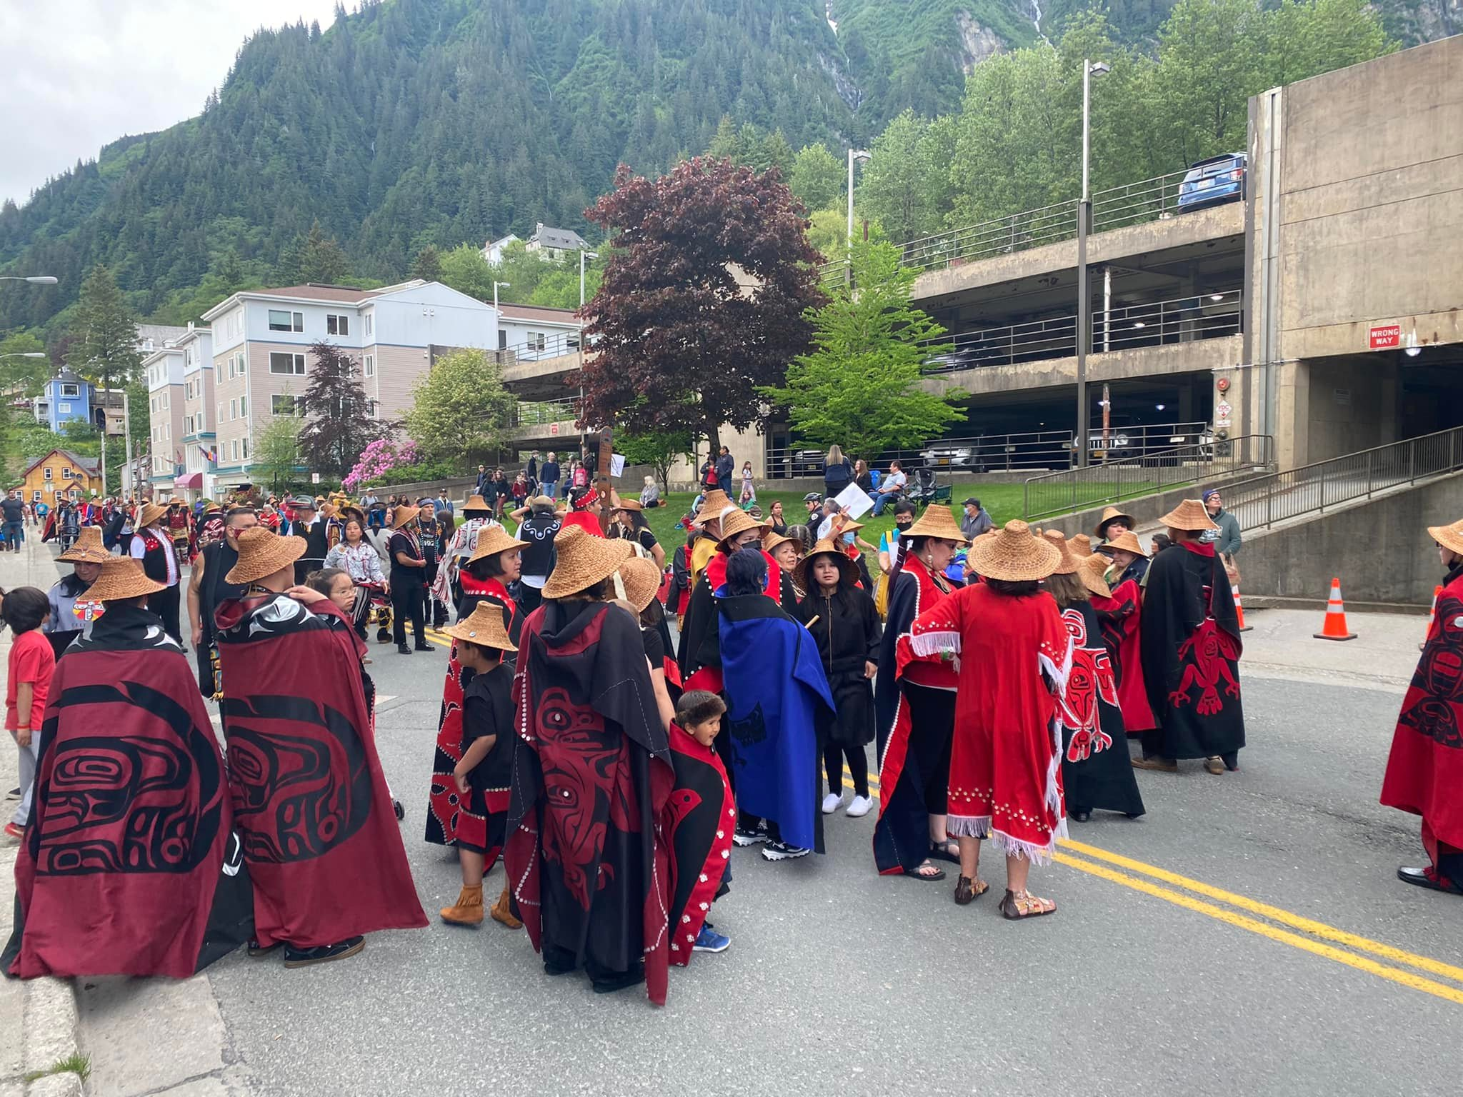
Indigenous Alaska’s “Celebration 2022”
Celebrating 10,000 years of cultural survival

Slide 26
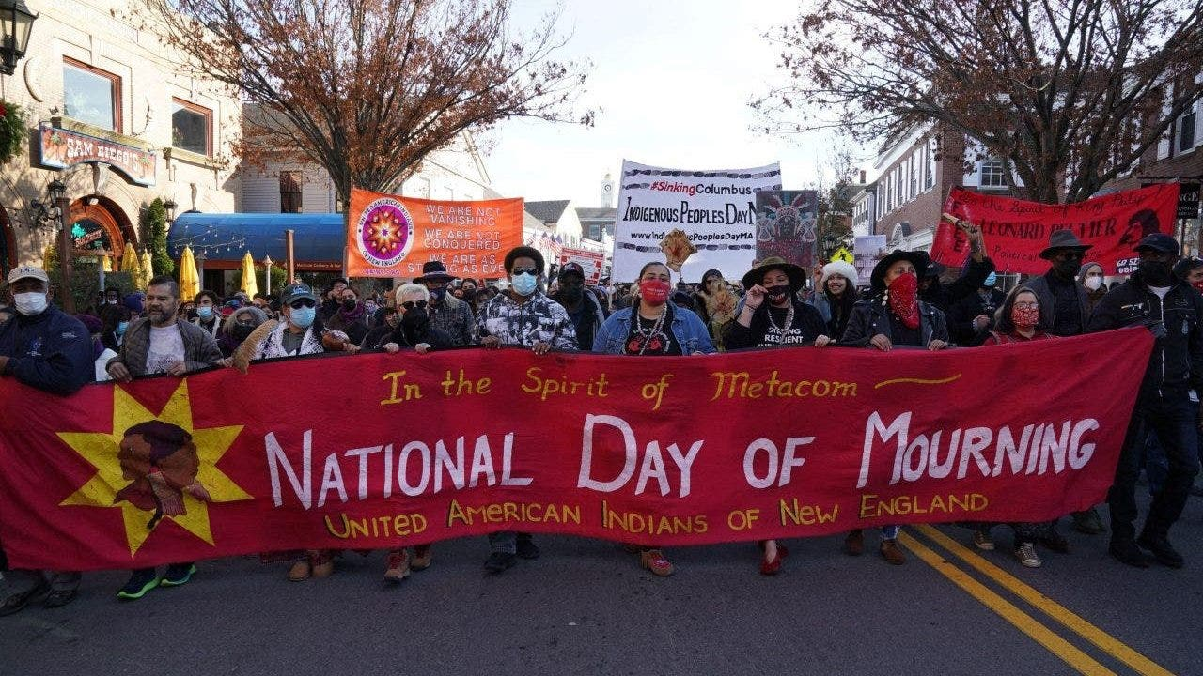
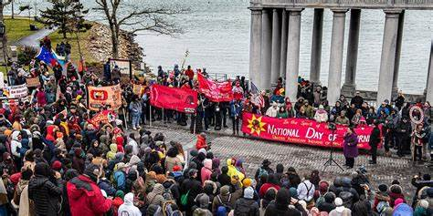
United American Indians of New England

Slide 27
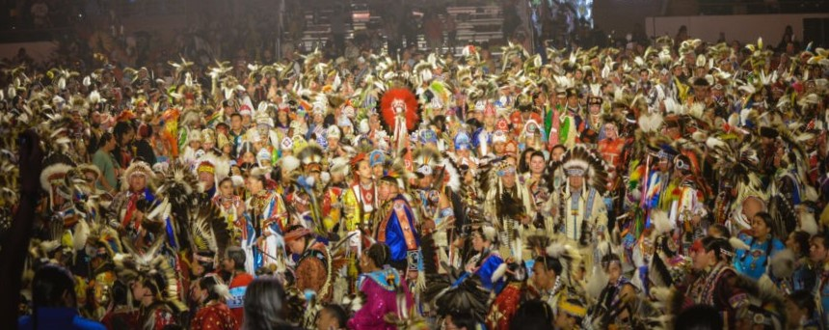
Gathering of Nations - Albuquerque
Insert Photo

Slide 28
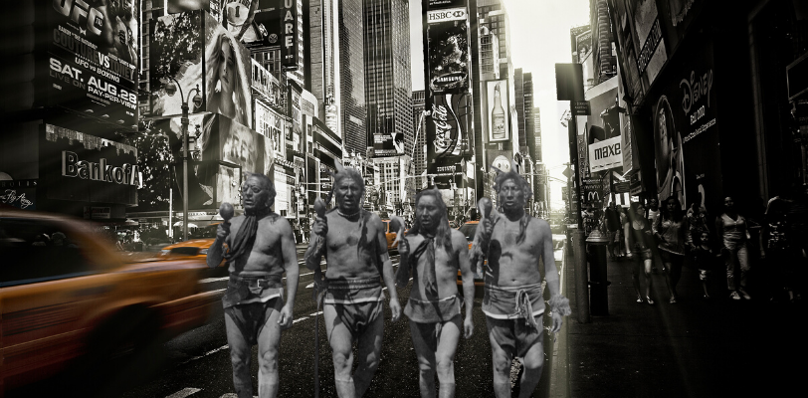
Source: New York Indian Council

Slide 29
Indigenous Culture-as-Health
Supports cultural ways of knowing and being as means to achieving health and well-being for future generations
Study purposes: a) move the continuum of public health practices beyond cultural grounding to Culture-as-Health; and b) expand the concept of Culture-as-Health in addiction and recovery to include a broader range of health (e.g., cardiovascular health), including prevention
Source: Indigenous Culture-as-Health: A systematized Literature Review. Yamane & Helm, 2022

Slide 30
Culture-as-Health Findings
Indigenous Culture-as-Health appears to rely on four modalities:
        Indigenous ways of knowing
        Indigenous cultural practices
        Place-based/sacred sites
        Indigenous spirituality

Slide 31
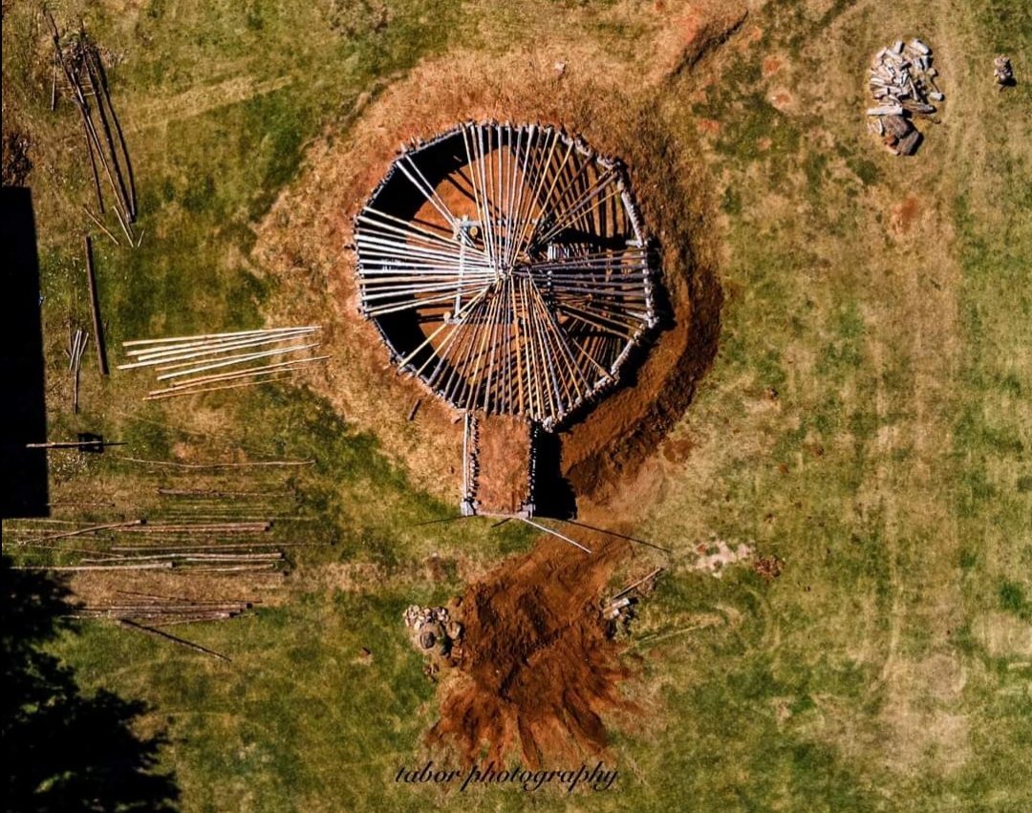

Slide 32
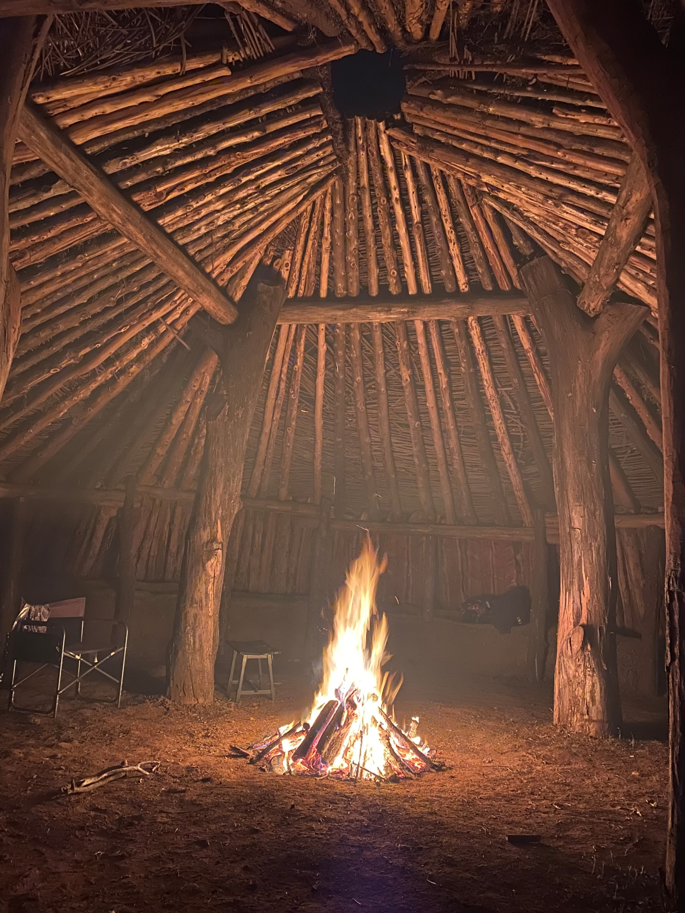

Slide 33
Culture as Practice-Based Evidence
Inherent to PBE is knowledge of:
cultural help-seeking
cultural context of strengths and problem identification
culturally-informed process for therapeutic intervention(s)
Ability to explain and provide therapeutic interventions and supports in a manner that consistently recognizes the values of the cultural self to wellness and recovery
Knowledge of and comfort in engaging cultural resources as partner to healing - -to sustain the long-term positive effects of the intervention and recovery strategies

Slide 34
Growing Support for Cultural Practices
Example: Current SAMHSA TOR grant application language excerpts:
  EBPs have not been developed for all populations and/or service settings, application reviewers will closely examine proposed interventions for evidence base and appropriateness for the population of focus.
  If one does not exist but there are evidence-informed and/or culturally promising practices that are appropriate or can be adapted, these interventions may be implemented in the delivery of services
Source: Tribal Opioid Response NOFO (2022). page 14

Slide 35
Culture as Healthy Behavior Teaching Tools
    Communicating through Silence
        Teachable moments framed in culture
        Behavior modeling
        Through Silence we Speak
    Communicating through Stories and Movement
        Story telling and Humor
        Drumming and Dance
Source: Blue, A. W., Darou, W. G., & Ruano, C. (2015). Through Silence We Speak:
Approaches to Counselling and Psychotherapy with Canadian First Nation Clients

Slide 36
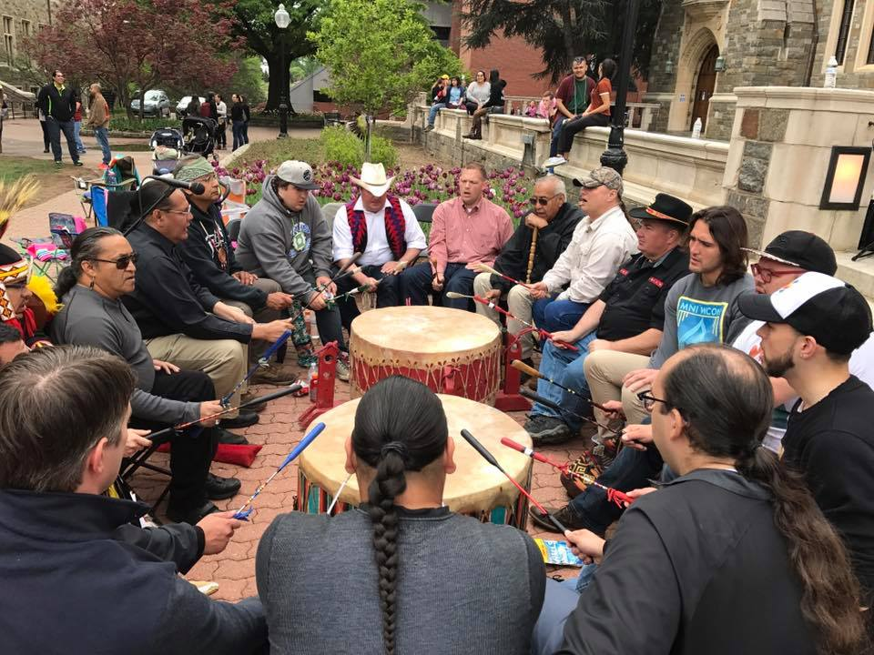

Slide 37
Cultural Practices also Address
[Unresolved] Grief & Loss
        Support for grief and loss
        Ceremony and rituals as stable touchstones and cultural reassurance
        Community support

Slide 38
Numerous Tribal Programs use Culture as Healing

Slide 39
Cultural Practices can
correspond to
Behavioral Health Service Categories

Slide 40
Awareness of Spectrum of
Treatment Services Matters
Engagement
Assessment
Treatment(s)
Recovery

Slide 41
Important to Note
Understanding some cultural practice from behavioral health perspective can strengthen relationship between local culture and behavioral health providers
In some states, cultural practices could potentially become a reimbursable service, but not everyone wants this to occur
Some feel strongly that cultural practices should not be linked to any government restraints that would come from billable service
Tribes have control over billable or not billable - - - Tribal sovereignty means the tribe decides

Slide 42
How Traditional Practices
correspond to Behavioral Health Service Categories

Slide 43
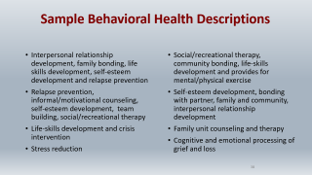
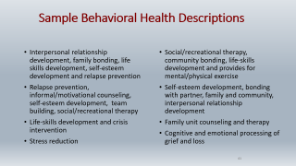
Sample Behavioral Health Descriptions
Interpersonal relationship development, family bonding, life skills development, self-esteem development and relapse prevention
Relapse prevention, informal/motivational counseling, self-esteem development, team building, social/recreational therapy
Life-skills development and crisis intervention
Stress reduction
Social/recreational therapy, community bonding, life-skills development and provides for mental/physical exercise
Self-esteem development, bonding with partner, family and community, interpersonal relationship development
Family unit counseling and therapy
Cognitive and emotional processing of grief and loss

Slide 44
Project Making Medicine
Drs. Dolores BigFoot and Susan Schmidt
(see May 24, 2022 presentation)

Slide 45


HC-MC Invites Traditional Practices into TF-CBT Treatment to Support Healing and Wellness

Slide 46
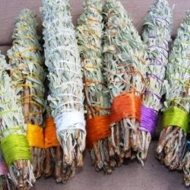

Cognitive Coping Example
Consider using the instruction given when entering a lodge or ceremony to leave bad thoughts at the door and enter in a good way.
Use imagery to send away unhelpful thoughts (stories of places and animals; smudging)

Slide 47
Yup’ik Eskimo
Traditional Modalities-Western Modalities Matrix
Cuilqerluni (Tundra Walk)
Substance Abuse Component: outpatient, continuing care (aftercare)
A directed or a self-imposed walk into the tundra. Time spent to relieve stress or become “centered”; time spent for reflection. A scheduled walk can be done alone or with another person. The walk is a way of demonstrating to a person that he/she is capable of gaining control of himself. Tundra walk with a counselor, Elder, or another person can be time for improvement of interpersonal communication, enhancement of individual growth, bonding, and education. A good way to build trust between counselor and client in beginning stages of treatment. Can also be utilized for relapse prevention.
Source: Yukon-Kuskokwim Health Corporation, 2000

Slide 48
Traditional Modalities-Western Modalities
Steps to Developing Comparison
Create list of Traditional Practices/Modalities used by community (Native language first, followed by English)
Describe purpose of Traditional practice in 1-2 sentences
Describe Traditional practice in Behavioral Health terms (substance use or mental health)
Review State Medicaid Plan allowable services
Align/Crosswalk the Traditional Practice(s) with State Medicaid allowable services
Pay attention to type of staff/credentials needed to bill for services
Pay attention to service documentation needed for reimbursement of service provided

Slide 49
Traditional Practice (Native Name) | Traditional Practice (English Name) | Traditional Practice Description | Behavioral Health Description | Medicaid Billing Modality
Neqlivik | Summer fish camp | Time for families and community to work together during the summer. Fathers or older male relatives fish with sons while the mothers or female relatives teach young girls how to cut and prepare fish | Family bonding and communication skill building; life skill development; promotion of self-esteem; respect of life/self; impulse regulation | Rehabilitative; relapse prevention

Slide 50
Summary
Cultural practices serve as healthy behavior teaching tools and can motivate and influence behavior change.

Slide 51
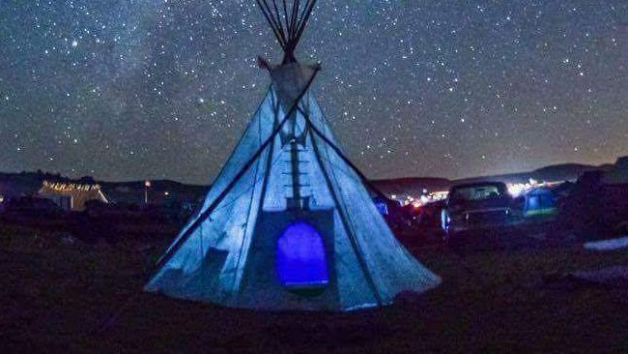

Slide 52
Resources
Culture-as-Health (Yamane & Helm, 2022) https://commissiononnativechildren.org/wp-content/uploads/2022/11/ADDL-READING_Indigenous-Culture-A-Systematized-Literature_C.Y.E.W.-Yamane-and-S.-Helm.pdf
Through Silence We Speak: Approaches to Counselling and Psychotherapy with Canadian First Nation Clients (Source: Blue, A. W., Darou, W. G., & Ruano, C. (2015)
Wellbriety Movement https://welbrietymovement.com

Slide 53
Upcoming Resource:
TELL ME A STORY:
Talks on spirituality, trauma, addiction, and healing
Allyson Kelley, DrPH MPH CHES & Dolores Subia BigFoot, PhD
This book is dedicated “to everyone we lost, because something was broken that did not get healed”

Slide 54
Thank You for your Presence
Holly Echo-Hawk, MSc
Email: echohawk@pacifier.com
Voice: 360.737.4747

Slide 56
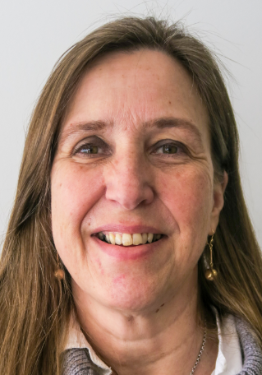
Facilitated Reflections
Facilitator: Livia Davis, MSW
C4 Innovations, Chief Learning Officer
Vice President, Recovery and Behavioral Health
Livia views herself as a non-Native guest in this Native space.

Slide 57
See you in February – Same time on the 4th Tuesday
February 28, 2023 Topic:
Native Trauma and Healing: Releasing the Trauma Our Body Holds

Slide 58
CEU Information
Don’t forget to complete your survey!
https://survey.alchemer.com/s3/6826778/Reclaiming-Native-Psychological-Brilliance-Learner-Evaluation-October-25
Follow-up questions?
  Bernice Youpee-Jordan at bjordan@usetinc.org
  Bryan Hendrix at bhendrix@usetinc.org

Slide 59
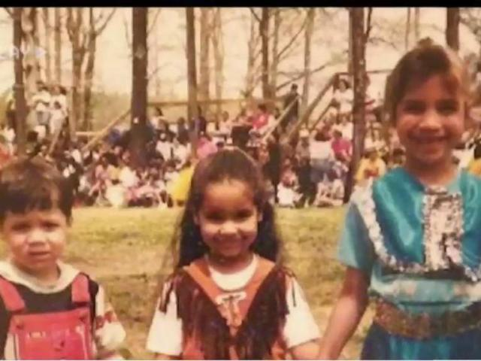
“Haliwa" by Brooke Simpson
Instagram https://www.instagram.com/brookesimpsonofficial
TikTok https://www.tiktok.com/@brookesimpsonofficial
Twitter https://twitter.com/brookesimpson
Facebook https://www.facebook.com/brookesimpsonofficial
Notes:
05:08

Slide 60
