Slide 1
Managing Polysubstance Use Disorder
Mishka Terplan MD MPH FACOG DFASAM
Medical Director, Friends Research Institute
Substance Use Warmline Clinician, UCSF

Slide 2
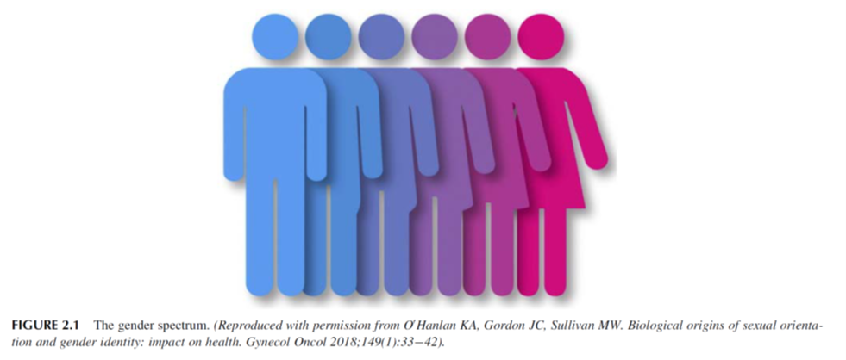
Sex and Gender: Definitions
Sex is Biological
Gender is Social/Cultural
Male, Female
Not strictly binary
Sex assigned at birth
Sex modifies health via genetics & hormones
“Socially constructed norms that impose and determine roles, relationships and positional power for all people across the lifetime” (Global Health 50/50)
Not binary
Women, men, intersex identities
Gender-related characteristics (roles, relations, etc.) influence health in multiple ways
Jenkins MR, Newman C. How Sex and Gender Impact Clinical Practice. London, UK: Elsevier; 2021.

Slide 3
Both Sex and Gender Relate to Reproduction and Both Intersect with Substance Use, Misuse, and Addiction

Slide 4
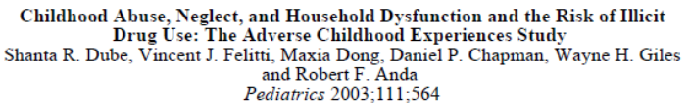
ACES are experienced more by girls than boys

Slide 5
Sex and gender: AUD trajectories
Telescoping:
  Substance use in women progresses more quickly to addiction and to the onset of medical problems and disorders
  Women tend to enter treatment at later stage of addiction
Originally described for AUD
Notes:
?? Add more data to this point ??

Slide 6
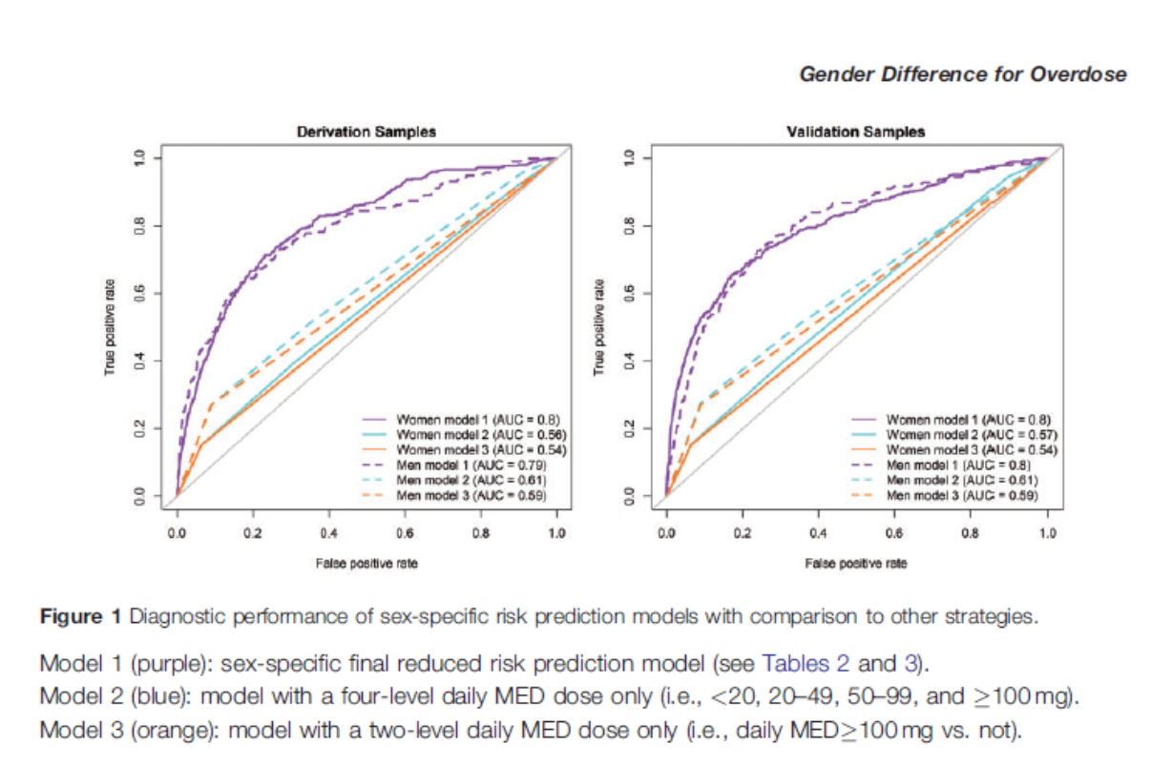
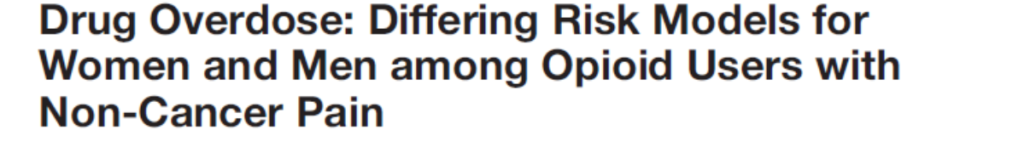
Example: Sex differences in OUD morbidity risk
Females can have more severe opioid withdrawal and have higher risk of opioid overdose
  Smaller body mass, and higher fat-to-water ratio
  Differences in metabolism, absorption, and elimination
TIP-51-Substance-Abuse-Treatment-Addressing-the-Specific-Needs-of-Women/SMA15-4426archives.drugabuse.gov/NIDA_Notes/NN0013.html
Notes:
Over 200,000 subjects filling over 2 opioid prescriptions from January 2009 to July 2012
Women more likely than men to have a drug overdose over 3.5 year frame – despite receiving a significantly lower opioid dose

Slide 7

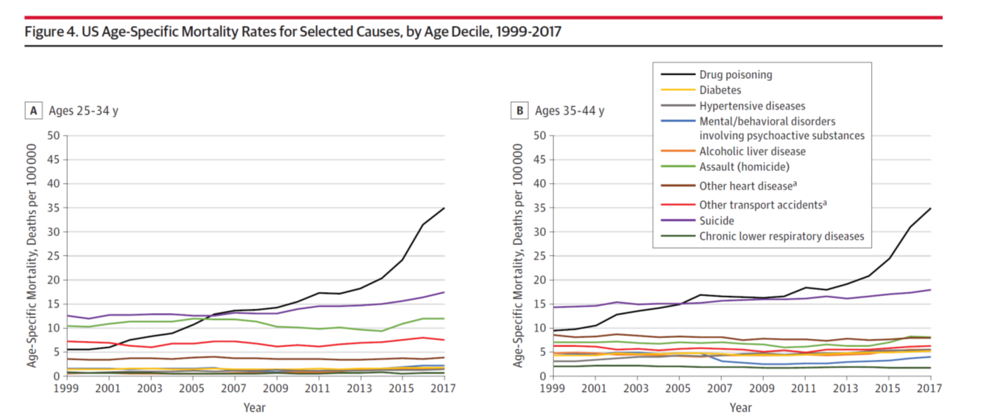
“…although men across age groups generally had higher cause-specific mortality rates… a pronounced female disadvantage emerged for certain major causes of death… between 1999 and 2017, the relative increase in midlife fatal drug overdoses was 485.8% among women, 1.4 times higher than among men (350.6%)…3.4 times higher [among women than men] for alcohol-related liver disease…and 1.5 times higher for suicide…”
Woolf SH, et al. 2019
Notes:
(1) give an overview of the epidemiology of the opioid crisis and substance use disorders through a gender lens
In the opioid crisis, women have and continue to be adversely impacted by the negative consequences of substance use
Life expectancy began to advance more slowly in the 1980s
and plateaued in 2011 (after which the APC differed non significantly
from zero). The National Center for Health Statistics
reported that US life expectancy peaked (78.9 years) in 2014 and
subsequently decreased significantly for 3 consecutive years,
reaching 78.6 years in 2017.
although men across age groups generally had
higher cause-specific mortality rates and larger relative increases in
mortality than did women, a pronounced female disadvantage
emerged for certain major causes of death
For example, between
1999 and 2017, the relative increase in midlife fatal drug overdoses
was 485.8% among women (from 3.5 deaths/100 000 to 20.2
deaths/100 000), 1.4 times higher than among men (350.6%,
from 10.0 deaths/100 000 to 44.8 deaths/100 000). The relative
increase in midlife mortality among women was 3.4 times higher
for alcoholic liver disease (increasing from 3.2 deaths/100 000 to
5.8 deaths/100000 among women and from 9.8 deaths/100000
to 12.2 deaths/100 000 among men) and 1.5 times higher for suicide
(increasing from 5.8 deaths/100 000 to 8.7 deaths/100 000
among women and 21.3 deaths/100000 to 28.6 deaths/100000
among men).20 This is consistent with reports elsewhere of
gender-specific influences on mortality and a growing health disadvantage
among US women, including smaller gains in life expectancy
than among US men, larger relative increases in mortality
from certain causes, and inferior health outcomes in comparison
with women in other high-income countries.11,33,42-46

Slide 8
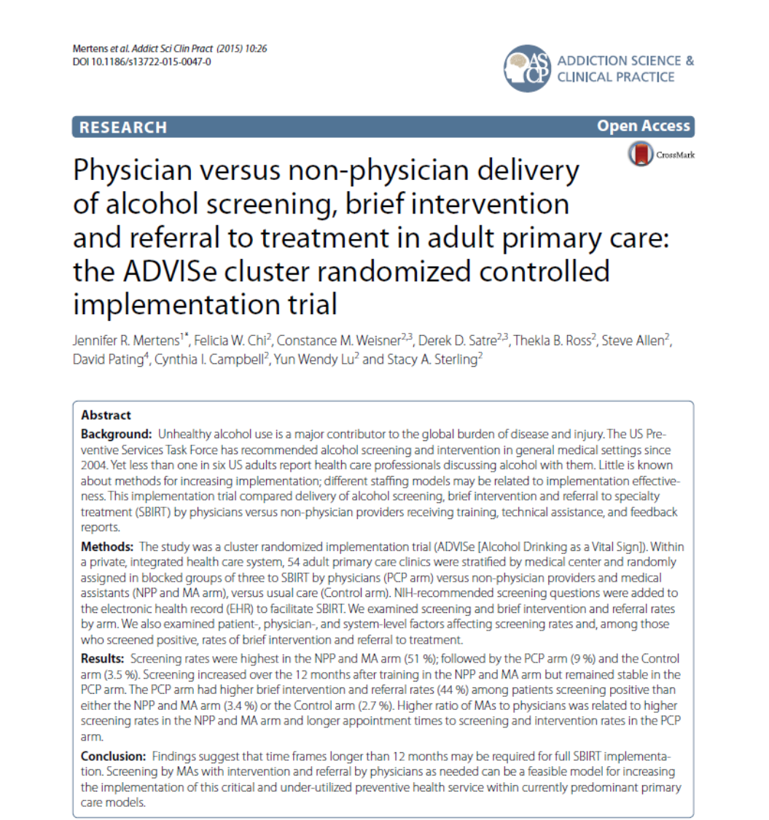
Sex and Gender: AUD Screening
  640,000 adult patients
  Women less likely to be screened:
    PCP arm OR=0.78 (0.75, 0.82)
    Non MD OR=0.82 (0.77, 0.87)
  Among those screened, women less likely to receive BI/RT
    PCP arm OR=0.60 (0.48, 0.76)
    Non MD OR=0.62 (0.51, 0.77)
Campbell C, Weisner C, Chi FW, Ross T, Sterling S, Mertens J. Gender differences in alcohol Screening, Brief Intervention, and Referral to Treatment in primary care. J Patient Cent Res Rev. 2016;3:211.
Notes:
Healthcare professionals tend to miss signs of addiction in women
Especially in older women and younger girls

Slide 9
A stepwise approach to integrating sex and gender into daily clinical practice
Jenkins MR, Newman C. How Sex and Gender Impact Clinical Practice. London, UK: Elsevier; 2021.

Slide 10
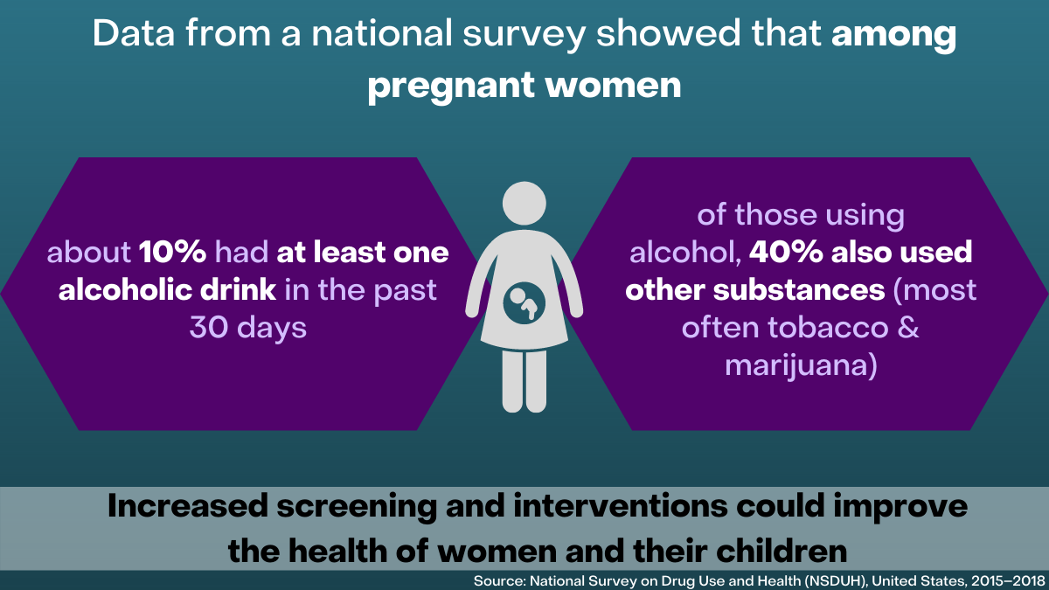
Managing Polysubstance Use (Disorder) in Pregnancy

Slide 11
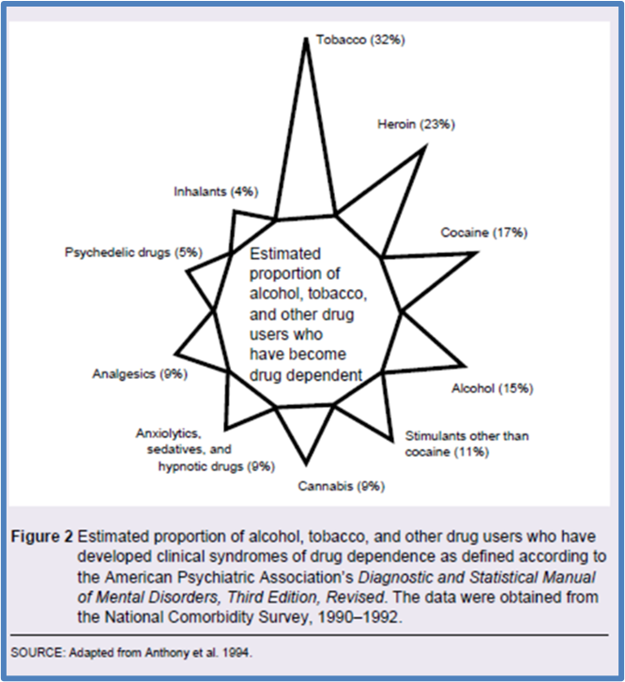
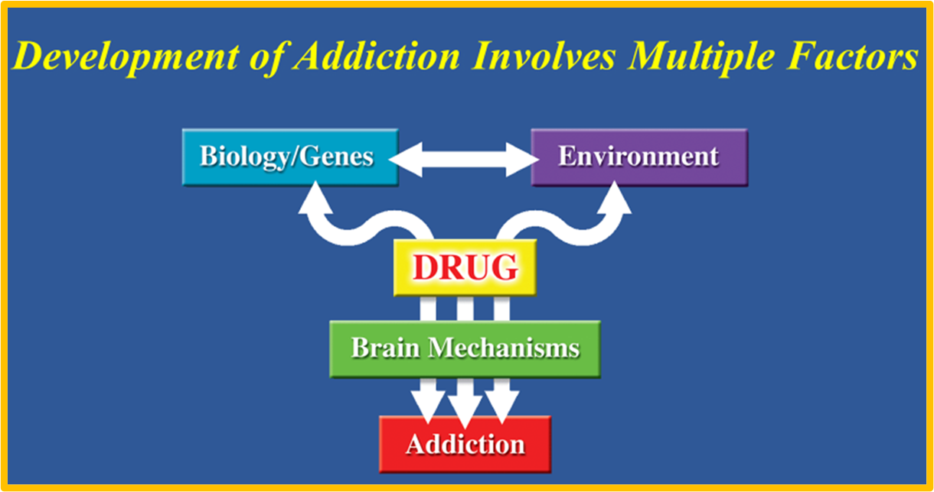
Most People Use Drugs but Only Some Develop Addiction

Slide 12
Use Is Not Use Disorder
Universal Screening/Assessment
“Can I ask you some questions about drinking, smoking, and other drugs?”
  Screening can be declined (right of refusal)
  Establishing trust requires trusting and time

Slide 13
Use Is Not Use Disorder
Addiction – Treatment
Misuse – Brief Intervention
Use – Education (?)
SUD
Misuse
Use

Slide 14
DSM-5 Substance Use Disorders¹
1. Tolerance²
2. Withdrawal²
Loss of Control
  3. Larger amounts and/or longer periods
  4. Inability to cut down on or control use
  5. Increased time spent obtaining, using or recovering
6. Craving/Compulsion
Use Despite Negative Consequences
  7. Role failure, work, home, school
  8. Social, interpersonal problems
  9. Reducing social, work, recreational activity
  10. Physical hazards
  11. Physical or psychological harm
Addiction: A Brain-centered Condition Whose Visible Symptoms are Behaviors
¹ Mild (2-3), moderate (4-5), severe (≥6)
² Not valid if opioid taken as prescribed
APA. (2013). Diagnostic and statistical manual of mental disorders (5th ed.)

Slide 15
Polysubstance Use Tips
Diagnostic categories overlap across substance type.
Therefore: First treat what you can
Not all use is sue disorder
Involve patient/person in decision making
Note that the neuroscience “final common pathway” of addiction would suggest some effectiveness of (any) treatment modality across substance types

Slide 16
Alcohol Use Disorder Treatment
Mainstay of AUD treatment is medication with behavioral interventions
FDA-approved medications for AUD:
  Disulfiram, Naltrexone, Acamprosate
  Very limited data on both safety and efficacy in pregnancy
However, naltrexone and acamprosate likely safer than alcohol and untreated AUD in pregnancy and should be considered on individual case basis

Slide 17
Nicotine Use Disorder Treatment
Addiction to and dependence on cigarettes is physiologic and psychologic, and cessation techniques should include psychosocial interventions and medication (Sex and Gender Differences)
  Nicotine replacement therapy (decrease effectiveness in women)
  Bupropion hydrochloride sustained release
  Varenicline (possibly more effective in women)
Cognitive behavioral therapy and contingency management are associated with a reduction in smoking during pregnancy and decreased risk for infants with low birth weight
Intervention context and strategies should be individualized

Slide 18
Cannabis Use Disorder Treatment
No approved medications
Behavioral therapies: motivational enhancement, cognitive behavioral therapy, contingency management

Slide 19
Stimulant Use Disorder Treatment
Treatment with hydralazine for hypertensive emergencies
No FDA approved medication for the treatment of Stimulant Use Disorder
Treatment rests upon behavioral interventions
Many medications have been studied with modest effect
  Topiramate
  Buprenorphine

Slide 20
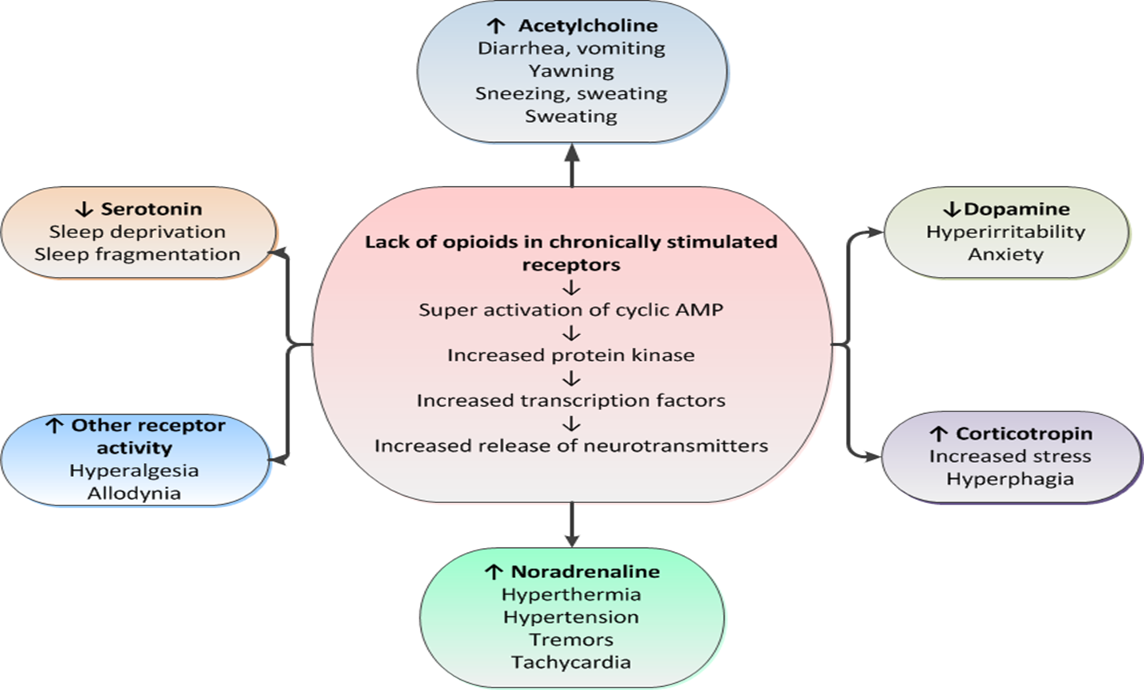
Neonatal Abstinence Syndrome
Adapted from Kocherlakota P. Pediatrics, 2014; American Academy of Pediatrics Committee on Drugs. Neonatal drug withdrawal. Pediatrics, 2012
Credit: Anne Johnston, MD

Slide 21
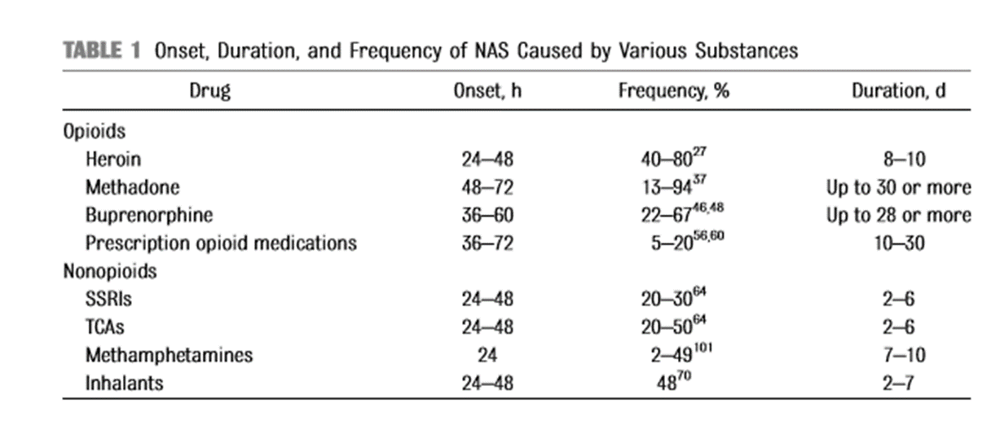
Polysubstance / Polypharmacology and NAS
Nicotine / Cigarettes (MOTHER Study)
Benzodiazepines
Gabapentin

Slide 22
Conclusions
Locate pregnancy with discussion of sex and gender
Recognize sex and gender differences in substance trajectories and treatment effectiveness
Polysubstance is the norm
Not all use is use disorder
Cigarette reduction = dose-dependent reduction in NAS
Involve patient in decision-making

Slide 23
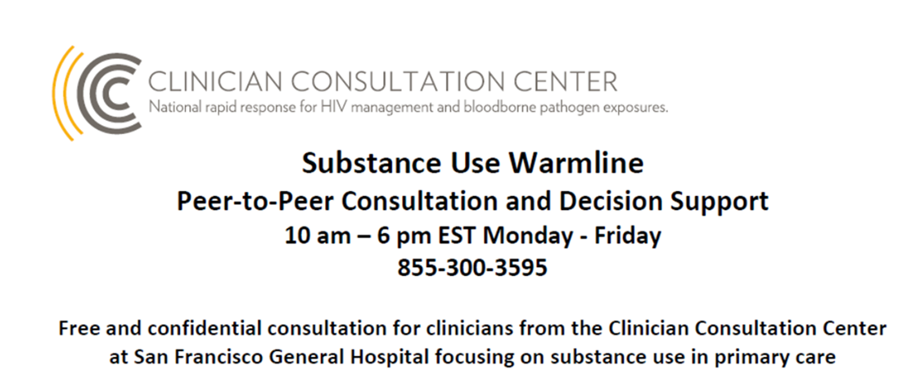
Thank you
Mishka Terplan
@Do_Less_Harm
mterplan@friendsresearch.org

