Slide 1

Methamphetamine Use Disorder

Slide 2
Objectives:
Review the scope of the problem
Describe two evidence-based behavioral interventions that can be implemented in the hospital: contingency management and harm reduction
Discuss clinical considerations for MUD in the hospital and research (past and present) on medications to treat MUD

Slide 3
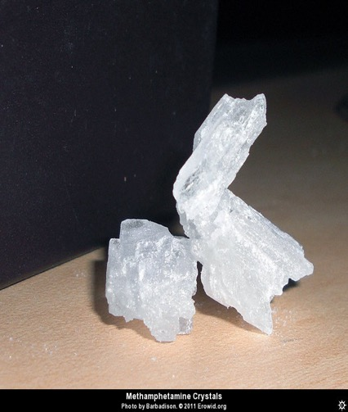
Crystal methamphetamine
Form of d-methamphetamine
Closely related to amphetamine
Longer lasting and more toxic to the CNS

Slide 5
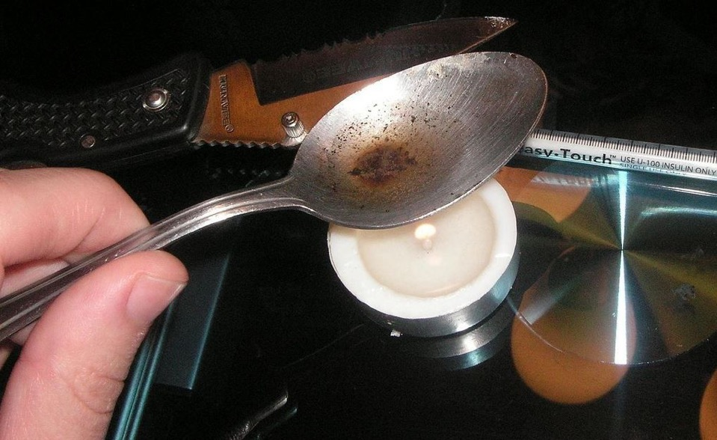

Slide 7
Notes:
It can be made from pseudophedrine

Slide 8
Notes:
You can find recipes for creating that structural change all over the internet. Because it really a pretty simple process, in the late 90s and early 2000s..

Slide 9
Notes:
We saw the emergence of meth labs where methamphetamine was created from Sudafed for use and sale

Slide 10
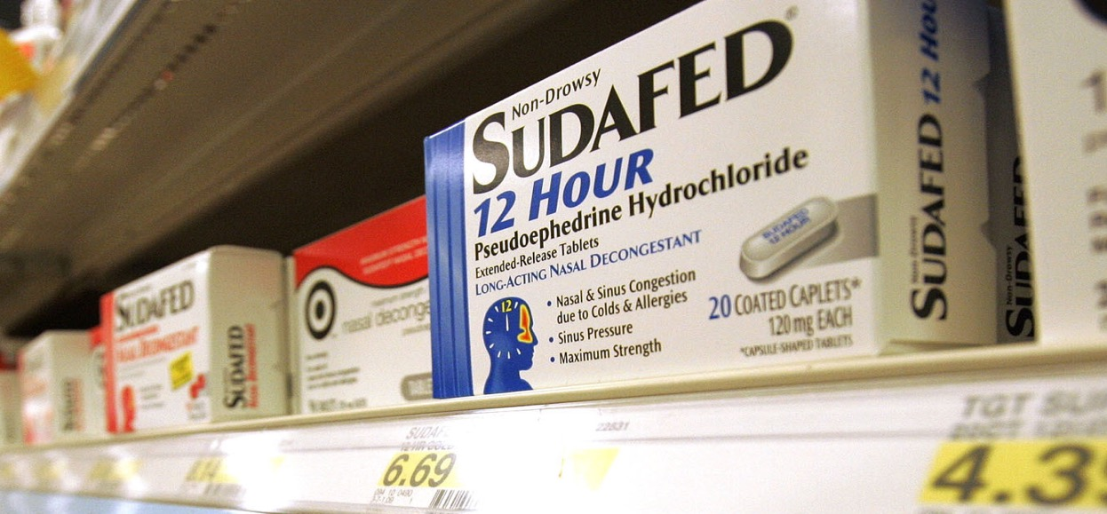
2005: CMEA
(Combat Methamphetamine Epidemic Act)
Notes:
The labs became enough of a problem that in 2005, Congress passed the Combat Methamphetamine Act, which put pseudoephedrine behind the counter, limited sales to 7.5 grams per customer in a 30-day period and required pharmacies to track sales. In 2006, Oregon went further, passing a law requiring a prescription for pseudophed. As a result…

Slide 11
Result?
In Oregon, from 2004 to 2011, methamphetamine lab incidents decreased from an average of 24 per month to less than one per month
http://www.oregondec.org/pse.htm
Notes:
So, in some senses the law achieved its intended effect. And yet

Slide 12
And Yet…
Notes:
It ultimately had little effect on methamphetamine use. Methamphetamine overdose did dip briefly, but soon began increasing again and by 2015, the rate and number of accidental/undetermined overdose deaths from methamphetamine and psychostimulants surpassed the rate and number of heroin overdose deaths

Slide 13
Notes:
The small local meth houses have been replaced by huge industrial level manufacturing plants in Mexico. The drugs have no problem making their way across the border and up the I-5 pipeline. Another example of limitation of supply strategies

Slide 14
Increase dopamine to +/- 200 times basal output

Slide 15
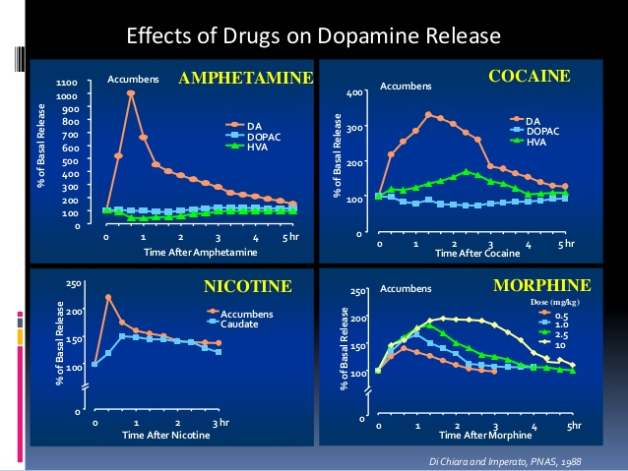
Di Chiara and Imperato, 1988
Notes:
A tremendous rush of dopamine. Know that more often get that rush, stronger that habit becomes

Slide 16
Medical issues related to methamphetamine use
Neurotoxicity, cognitive effects
  Excessive DA damaging cell structures
  Disruption of blood-barrier
  Use associated with poorer performance on motor and processing tasks, visual and verbal fluency
  More than 2/3 of those with MUD show cognitive impairment
  May limit ability to follow through with treatment, understand advice, and achieve treatment outcomes
Paulus and Stewart, JAMA Psychiatry, 2020

Slide 17
Medical issues related to methamphetamine use
Cardiovascular and cerebrovascular
  Leading cause of death with MUD
  Strokes more common in young men (hemorrhagic)
  Also associated with pulmonary htn, cardiac arrhythmia, cardiomyopathy
Lappin et al., 2017

Slide 18
Medical issues related to methamphetamine use
Chemical and street drug contaminants
  Opioid overdose
General health consequences of drug-using
  Delayed health care seeking
Lifestyles (needle sharing, malnutrition)
  Abscesses, HIV, hep C

Slide 19
Objectives:
Review the scope of the problem
Describe two evidence-based behavioral interventions that can be implemented in the hospital: contingency management and harm reduction
Discuss clinical considerations for MUD in the hospital and research (past and present) on medications to treat MUD

Slide 21
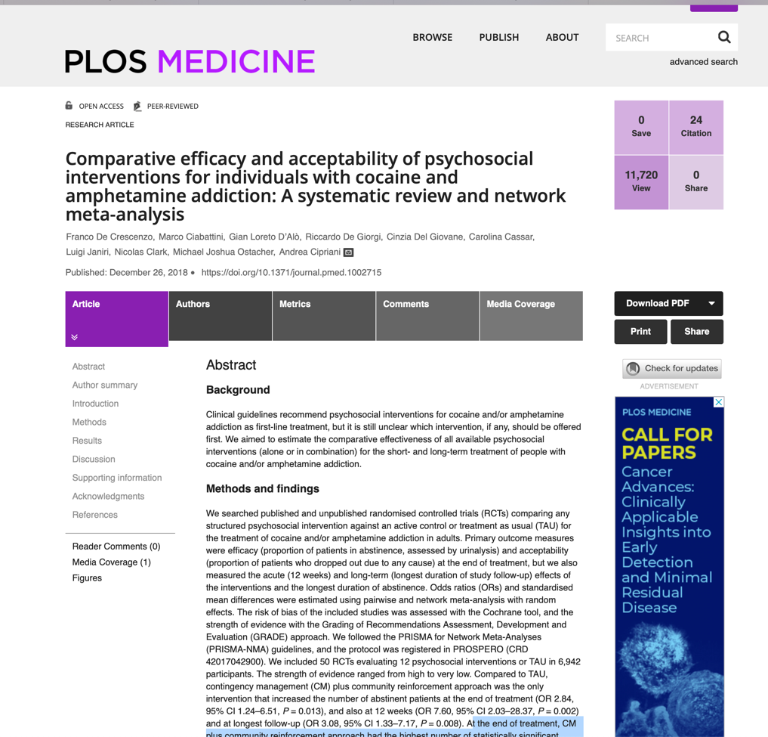
Notes:
Community reinforcement approach

Slide 22
Behavioral interventions = first line treatment for MUD
Most behavioral interventions (CBT, MI, Matrix model, exercise, CM) demonstrated some efficacy in reducing methamphetamine cravings and use
Contingency management most consistently showed reduced use, increased retention in treatment, better quality of life
Asharani et al Drug and Alcohol Dependence 2020
De Crescenzo et al PLOS Medicine 2018

Slide 23
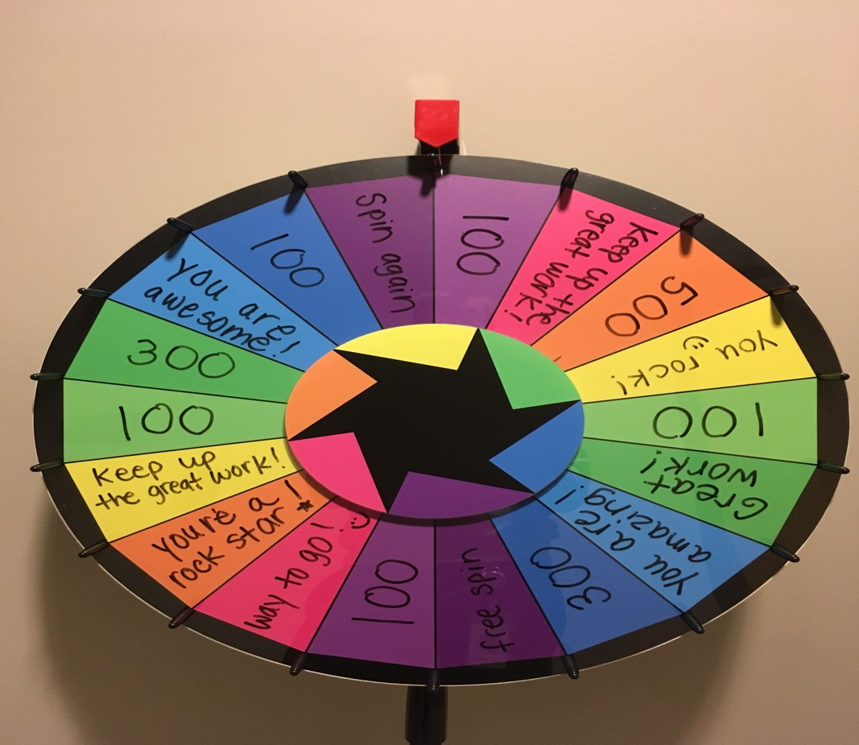
Photo courtesy of John Mahan MD

Slide 24
Contingency Management: Theory
Addiction is sustained through reinforced learning
We cannot simply unlearn habits – we must learn new and competing habits
CM entrains new behaviors that support the process of recovery
Breaks recovery process down into a series of concrete, attainable goals
> 100 RCTs affirm the effectiveness of CM in treating addiction
Roll JM et al. Am Jnl Psych 2006
Roll JM et al. Addict Behav 2013
Rawson, RA et al. Addiction 2016

Slide 25
Contingency Management: Practice
Identify a target behavior that can be objectively measured, attainable, and reinforced in real time.
2. Reward that behavior immediately when it occurs, using rewards that are valuable to participants (but not necessarily expensive).
3. Use an escalating schedule of reinforcement.

Slide 26
Photo courtesy of John Mahan MD

Slide 27
Example
Patient on long term IV antibiotics who is often not in her room when it is time for her antibiotics. She likes chocolate and Starbuck’s Frappuccinos
Target behavior: be in the room 8:00 am, noon, and 5 pm
Reward: Hershey’s kiss each time she is in the room when the nurse arrives with antibiotics
Escalating schedule: $5 Starbuck’s card after she has accumulated 10 Hershey’s kisses
Center for Substance Abuse Treatment. Substance Abuse: Clinical Issues in
Intensive Outpatient Treatment. Treatment Improvement Protocol (TIP) Series 47.

Slide 28
Harm Reduction
A set of practical strategies and ideas aimed at reducing negative consequences associated with drug use. Harm Reduction is also a movement for social justice built on a belief in, and respect for, the rights of people who use drugs.
Harm reduction coalition https://harmreduction.org/about-us/principles-of-harm-reduction/

Slide 29
Harm reduction is also
Part of the continuum of care
Relationship building
Treatment

Slide 30
Harm reduction is not
What we do when nothing else works

Slide 31
Harm reduction practices: methamphetamines
Safe injecting:
  Clean needles/rigs (including don’t share filters, cookers)
  Don’t use alone
  Use needles bevel up
  Use a filter whenever possible
  Test for fentanyl
  Clean water
Collins S et al. Intl Jnl of Drug Policy 2019
Thakarar K, Weinstein ZM, Walley AY. Postgrad Med J. 2016;92(1088):356–363.

Slide 32
Harm reduction practices: methamphetamines
2. Hydration
3. Toothbrushes
4. Condoms
5. Naloxone
6. Patient Centered: Ask the patient/client: what harms most concern you?
Collins S et al. Intl Jnl of Drug Policy 2019
Thakarar K, Weinstein ZM, Walley AY. Postgrad Med J. 2016;92(1088):356–363.

Slide 33
Objectives:
Review the scope of the problem
Describe two evidence-based behavioral interventions that can be implemented in the hospital: contingency management and harm reduction
Discuss clinical considerations for MUD in the hospital and research (past and present) on medications to treat MUD

Slide 34
Meds for MA/A Use Disorder
No FDA-approved meds for MA/A use disorder (MUD)
Lots of research looking into possible treatments
Will review published findings from 2 recent trials
Systematic reviews of medications for MUD

Slide 35
Mirtazapine
FDA-approved antidepressant
Main side effects weight gain and somnolence
Mixed monoamine agonist-antagonist
Cisgender men & transgender women sex w/ men
Double blind RCT of 120 participants
↓ in methamphetamine + UDT despite low adherence
Coffin P et al, JAMA Psychiatry 2019
Notes:
Also had improved mood symptoms (less depressive symptoms) and less insomnia severity

Slide 36
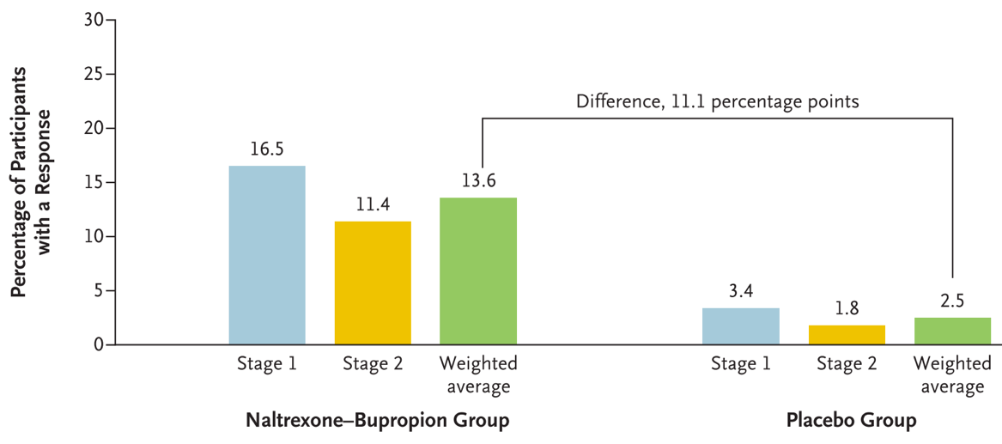
Naltrexone IM + Bupropion
Large multi-center RCT, ﻿two-stage, sequential parallel comparison design.
Number needed to treat – 9, low treatment improvement
Trivedi M, et al NEJM 2021
Notes:
Primary outcome was a treatment “response” ﻿defined as at least three methamphetamine-negative urine samples out of a possible four samples obtained at the end of stage 1 (during week 5 through week 6) or the end of stage 2 (during week 11 through week 12). At the end of stage 1, a total of 16.5% (18 of 109 participants) in the naltrexone–bupropion group and 3.4% (10 of 294 participants) in the placebo group had a response. At the end of stage 2, a total of 11.4% (13 of 114 participants) in the naltrexone–bupropion group and 1.8% (2 of 111 participants) in the placebo group had a response (Table 2).

Slide 37
Sufficient Evidence of No Benefit
Dopamine agonists (levodopa, cabergoline, pramixpexole)
Antipsychotics – aripiprazole
Antidepressants – SSRIs
Anticonvulsants/muscle relaxants
Varenicline
Briones M et al. Drug Alcohol Depend 2018
Ronsley C et al PLoS ONE 2020
Chan B et al Addiction 2019

Slide 38
Insufficient Evidence of Benefit
Prescription psychostimulant agonist therapy – methylphenidate, modafinil, lisdexamphetamine, dextroamphetamine, mixed amphetamine salts
Antidepressants – non-SSRI (mirtazapine, bupropion)
N-acetylcysteine (NAC) – ﻿acts as a physiological reservoir of neuronal glutamate
Coffin P et al JAMA Psychiatry 2020
Ronsley C et al PLoS ONE 2020
Tardelli VS et al Psychopharmacology 2020
Chang C-T et al Clin Psychopharmacol Neurosci 2021
Notes:
Prescription psychostimulants in high doses being particularly helpful in cocaine use disorder.

Slide 39
Summary
Methamphetamine use and use disorders are escalating in Oregon
There are effective behavioral interventions
Harm reduction is treatment
Medications are being investigated
Should offer symptom relief for withdrawals, acute intoxication; diagnose and treat co-occurring conditions

Slide 40

Thank You
Jessica Gregg, MD, PhD
Chief Medical Officer
Fora Health
Jessica.Gregg@forahealth.org
Ximena Levander, MD, MCR
Assistant Professor
Division of General Internal Medicine
OHSU
levander@ohsu.edu

Slide 41
Questions?

