Slide 1
How to Talk with Others about Vaccines
Notes:
When it comes to keeping our community healthy, we know it's important for everyone who can get vaccinated to do so. When healthy people get vaccinated, they are less likely to spread infections to those who are more vulnerable, like our Elders and newborns. However, many of us have family members, friends, or acquaintances who are hesitant to get vaccinated. Even though we want them to be well, having meaningful conversations about vaccination can be hard. In this presentation, we will discuss strategies you can use to successfully talk with others about vaccines.
Speaker recommendation: You can add your own photos from your tribal community onto this introduction slide by fitting and placing them over the preset images. To do so:
1) Click the “Insert” button on the toolbox above.
2) Then, click the “Pictures” button and select “This Device.”
3) A pop-up box with access to the folders on your computer will open. Look for the image you’d like to add.
4) Once you select the image, it should come up on the slide. Use your mouse to move and place the image to your liking. That’s it!

Slide 2
Your Presenter
HEADSHOT HERE
Title
Organization
Email Address
Notes:
[Introduce yourself and any co-presenters if applicable]
Speaker recommendation: You can add your headshot onto this slide by doing the following:
1) Click the “Insert” button on the toolbox above.
2) Then, click the “Pictures” button and select “This Device.”
3) A pop-up box with access to the folders on your computer will open. Look for the image you’d like to add.
4) Once you select the image, it should come up on the slide. Use your mouse to move and place the image over the “HEADSHOT HERE” place holder. That’s it!

Slide 3
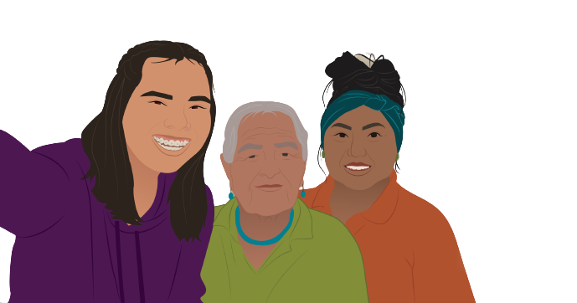
Introductions
Share your:
Name
Pronouns
Tribal Nation(s)
Community Roles
Notes:
Now, let’s take a moment for you to introduce yourselves. Please share your name, pronouns, your tribal affiliation or the tribal community you work for, and your roles in the community. I'll call on someone, and after you've finished introducing yourself, call on someone else.

Slide 4
Agenda
Vaccine hesitancy
Vaccine confidence
How to build vaccine confidence
Conversational tips
Accurate sources of information
Notes:
During this presentation, we will discuss why some people are hesitant to get vaccinated. We will also talk about vaccine confidence, and how to increase vaccine confidence among your friends, family, and acquaintances. We will share some conversational tips you can use while talking with others about vaccines. Lastly, we will highlight accurate sources of information.

Slide 5
Vaccine Hesitancy
Notes:
Before we discuss vaccine confidence and how to build it, let's briefly talk about vaccine hesitancy.

Slide 6
What are some reasons people in your community might be hesitant to get vaccinated?
Notes:
We know that not everyone is confident in vaccines. What are some reasons people in your community might be hesitant to get vaccinated? What have you heard?
Speaker recommendation: A word cloud can be imbedded in the slides. Participants’ responses will appear on the screen as they submit them. You can create a word cloud using PollEverywhere.com/Word-Cloud.

Slide 7
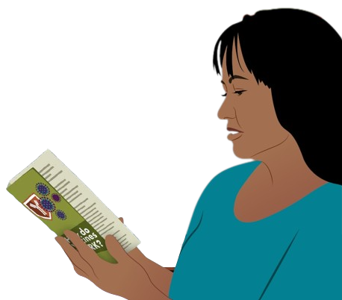
Reasons for Vaccine Hesitancy
Some common reasons for vaccine hesitancy may include:
Misinformation
Pressure from family
Fear of needles
Concern of vaccine safety
Notes:
Thank you all for providing some reasons people might be hesitant to get vaccinated. Some common reasons for vaccine hesitancy are misinformation obtained from online platforms, like social media, pressure from family, a fear of needles, and a concern of vaccine safety, such as the ingredients in the vaccine.

Slide 8
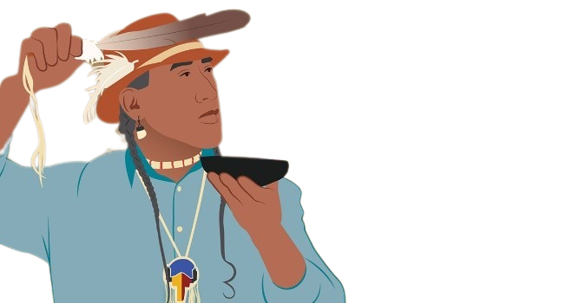
Historical Trauma
Indigenous communities have resisted:
Colonization
Boarding schools
Forced sterilization
Medical racism
Notes:
Also, as we know, Indigenous communities have resisted colonization, boarding schools, forced sterilization, and medical racism. Due to this history, there is a mistrust in the federal government and medical care, including vaccines and those who distribute them, like pharmaceutical companies. This is something that is important for us to acknowledge in our conversations with others.

Slide 9
Vaccine Confidence
Notes:
Now that we've talked about some reasons why people are hesitant to get vaccines, let's discuss what exactly vaccine confidence is.

Slide 10
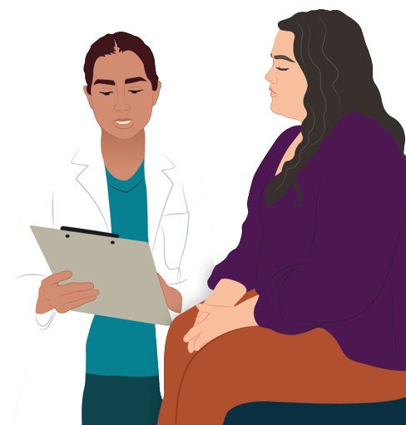
Vaccine Confidence is…
The trust people have in:
Recommended vaccines
Professionals who administer vaccines
Processes and policies
Notes:
Vaccine confidence is the trust that people have in recommended vaccines, professionals who administer vaccines, and processes and policies that lead to vaccine development, licensure, manufacturing, and recommendations for use. To build vaccine confidence, we have to build confidence in the vaccines themselves, the professionals who give vaccines, and vaccine development.

Slide 11
Building Vaccine Confidence
Notes:
We understand the importance of vaccine confidence, but how can we build vaccine confidence in those we speak with?

Slide 12
Conversational Tips for Building Vaccine Confidence
To increase vaccine confidence:
Set the tone before you begin the conversation
Ask open-ended questions to promote conversation
Listen to their concerns about vaccination
Notes:
To increase vaccine confidence in friends, family members, and acquaintances, set the tone before you begin the conversation. Try asking open-ended questions to promote open conversation. Listen to their concerns about vaccination.

Slide 13
Conversational Tips for Building Vaccine Confidence
To increase vaccine confidence:
Show empathy and understanding
Share your reasons for getting vaccinated
Ask for permission to share more information
Notes:
When listening to them, show empathy and understanding. Share your reasons for getting vaccinated. Next, ask for permission to share more information about vaccines.

Slide 14
Conversational Tips for Building Vaccine Confidence
To increase vaccine confidence:
Respond with facts about vaccination
Help them find their why
Share accurate sources of information
Help them make a plan to get vaccinated
Notes:
If they are open to hearing more, address any misconceptions with facts. Then, help them find the meaning in vaccination. Share accurate sources of information, such as VacciNative and Native Boost. Finally, if they are ready, help them make a plan to get vaccinated.

Slide 15
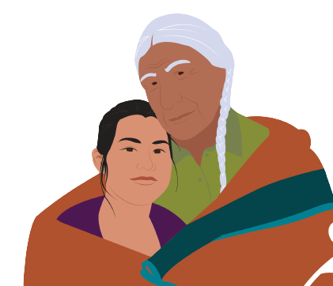
Set the Tone
To create an environment of respect and partnership:
Use positive body language
Speak in a friendly, calm tone
Listen and don’t interrupt
Notes:
Remember that when you’re beginning conversations about vaccines, you’re also building a relationship with that individual or family. To create an environment of respect and partnership, use positive body language. Don’t cross your arms, roll your eyes, or stand above them. Speak in a friendly, calm tone so the person doesn’t feel intimidated or patronized. Try to be open to what they have to say. Lastly, listen and don’t interrupt. Let the other person finish talking before you talk. Keep in mind that setting the tone is important as it may be the first of several conversations to come.

Slide 16
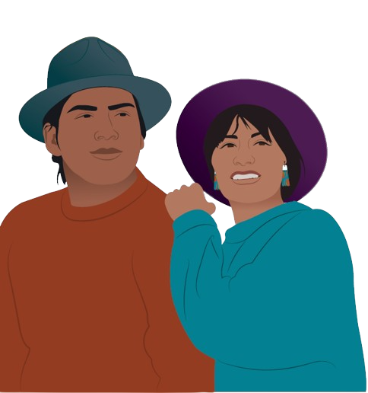
Ask Open-Ended Questions
Asking open-ended questions can help you understand:
What the individual is worried about
Where they learned any troubling information
Sources they’ve used to get answers to their questions
Notes:
Open-ended questions are designed to get more than a yes-or-no answer. Ask open-ended questions, so you can get a sense of what the other person is worried about, where they learned any troubling information, and what sources they've used to get answers to their questions.

Slide 17
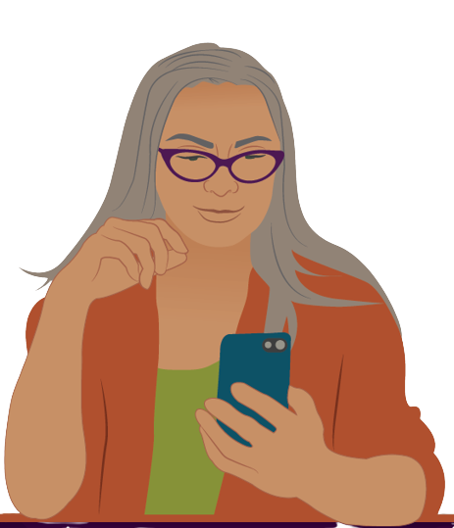
Sources to Find Information
VacciNative
Native Boost
The local health department
Healthcare providers
The Centers for Disease Control and Prevention
Notes:
Share reputable sources with them like VacciNative, Native Boost, the local health department, healthcare providers, and the Centers for Disease Control and Prevention, or the CDC, to answer their questions about vaccination.

Slide 18
What open-ended questions might you ask to understand someone's concerns about vaccines?
Notes:
What open-ended questions might you ask to understand someone's concerns about vaccines?
Speaker recommendation: A word cloud can be imbedded in the slides. Participants’ responses will appear on the screen as they submit them. You can create a word cloud using PollEverywhere.com/Word-Cloud.

Slide 19
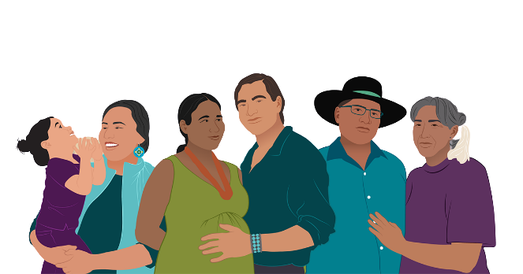
Listen to Their Concerns
Listen without judgment
Be calm, open, and ready to listen
Use positive body language
Be respectful
Don’t interrupt
Notes:
When someone states their concerns or supports their stance with inaccurate information, listen to them without judgment. Make sure you're calm, open, and ready to listen. Throughout your conversation, use positive body language. Try not to roll your eyes or cross your arms. Even if you disagree with them or their thoughts and feelings differ from yours, treat the other person's thoughts and feelings with respect. Don't interrupt them. Let the other person finish talking before you talk.

Slide 20
Show Empathy and Understanding
Showing empathy and understanding can go a long way
“I can understand your concern…”
“It’s understandable that you see things that way…”
Notes:
Simply affirming someone's concerns and experiences can go a long way. Try using phrases like "I can understand your concern" and "'It's understandable that you see things that way.”

Slide 21
Show Empathy and Understanding
Use empathy and understanding to make them feel heard
For example, say:
“That does sound stressful. I’m sorry to hear your vaccine concerns are causing you more stress.”
Notes:
Make the other person feel heard by responding with empathy and understanding. Keep in mind that you may need to acknowledge the chaos of life the person is going through. For example, you can say: “That does sound stressful. I’m sorry to hear your vaccine concerns are causing you more stress.”

Slide 22
Show Empathy and Understanding
Don’t tack on “but” to your words
Instead of: | Try saying:
“I hear what you’re saying, but I don’t agree.” | “I hear what you’re saying.”
Notes:
Don’t tack on “but” to your words. For example, even if you disagree with something the other person says, don’t say something like, “I hear what you’re saying but I don’t agree.” This can put the person you are speaking with on the defense. Leave it at, “I hear what you’re saying.”

Slide 23
Show Empathy and Understanding
Don’t directly challenge something the other person says that you think is wrong.
Instead of: | Try saying:
“No, that’s not true.” | “What I’ve learned from [trusted source] is [share factual information].”
Notes:
Don’t directly challenge something the other person says that you think is wrong. For example, don’t respond by saying, “No, that’s not true.” Instead, try saying “What I’ve learned from [trusted source] is [share factual information].” A trusted source can be a credible provider or health organization, which we discuss later in this presentation.

Slide 24
What can you say to show someone empathy even if you may not agree with what they are saying?
Notes:
What can you say to show someone empathy even if you may not agree with what they are saying?
Speaker recommendation: A word cloud can be imbedded in the slides. Participants’ responses will appear on the screen as they submit them. You can create a word cloud using PollEverywhere.com/Word-Cloud.

Slide 25
Share Your Reasons for Getting Vaccinated
Use phrases like:
“My family and I stay up to date on our vaccines. We want to be protected from illness. We also want to do what we can to protect everyone in our community – including our Elders.”
Notes:
Sharing your reasons for getting vaccinated with those you speak with lets them know that you are not asking something of them that you would not do yourself. Try using phrases like ”My family and I stay up to date on our vaccines. We want to be protected from illness. We also want to do what we can to protect everyone in our community – including our Elders.”

Slide 26
Share Your Reasons for Getting Vaccinated
Use phrases like:
“I get a lot of comfort knowing that this vaccine has been safely given to millions of people.”
Notes:
”I get a lot of comfort knowing that this vaccine has been safely given to millions of people.”

Slide 27
Share Your Reasons for Getting Vaccinated
Use phrases like:
“Because I’m vaccinated, I can safely spend time with my grandparents and participate in ceremonial practices.”
Notes:
And ”Because I’m vaccinated, I can safely spend time with my grandparents and participate in ceremonial practices.”

Slide 28
Ask for Permission to Share More Information
Once you understand the other person’s concerns, ask if you can share information about vaccines.
If they say “no”: | If they say “yes”:
Respect their decision, and let them know you will be there for them in the future if they want to discuss vaccines. | Share accurate sources of information.
Notes:
Once you understand the other person’s concerns, ask their permission to share information about vaccines. If they say “no,” respect their decision, and let them know you will be there for them in the future if they want to discuss vaccines. If they say “yes,” share accurate sources of information. Later in this presentation, we will list accurate sources of information you can share with others.

Slide 29
Respond with Facts About Vaccination
Get accurate facts about vaccination so you respond with them.
VacciNative • Tribal clinics
Native Boost • Health providers
CDC • Local health dept
Tribal Epi Centers
Notes:
Consider sharing these online resources where people can find additional vaccination facts. At the end of this presentation, we’ll have QR codes you can scan and website URLs to access some of these sources.

Slide 30
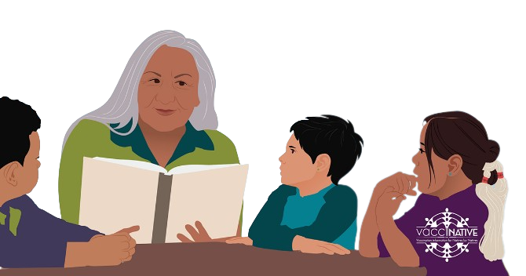
Help Them Find their Why
What positive things can you and your family do when everyone is vaccinated and healthy?
Spend time with grandparents
Keep our culture alive and healthy
Play sports
Dance
Notes:
After addressing the other person’s concerns with empathy, respect, and accurate information from reliable sources, steer the conversation toward why they should consider getting vaccinated. For example, you can ask them "What positive things can you do when everyone is vaccinated and healthy?" Allow them to think and help them with their response by listing positive things they can do when they are vaccinated like: spend time with grandparents, keep our culture alive and healthy, play sports, and dance.

Slide 31
Share Accurate Sources of Information
Native Boost – NPAIHB.org/Native-Boost
VacciNative – IndianCountryEcho.org/VacciNative
Notes:
Share accurate sources of information with the other person to help them make an informed decision about getting vaccinated. Two sources of accurate information you can share with them are VacciNative and Native Boost.

Slide 32
Share Accurate Sources of Information
NPAIHB.org/Native-Boost
IndianCountryEcho.org/VacciNative
Notes:
Both sources have materials designed for American Indian and Alaska Native people, such as (move to next slide).

Slide 33
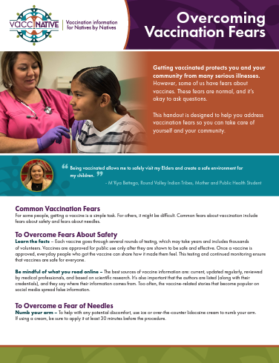
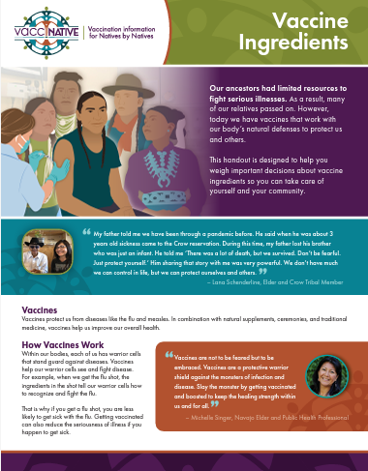
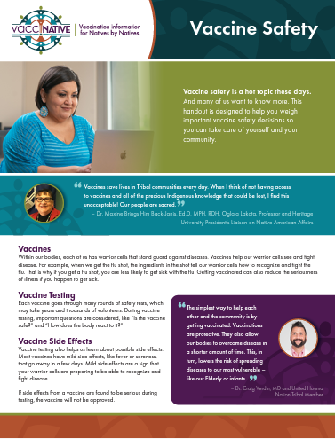
Share Accurate Sources of Information
IndianCountryEcho.org/VacciNative
Notes:
Handouts,

Slide 34
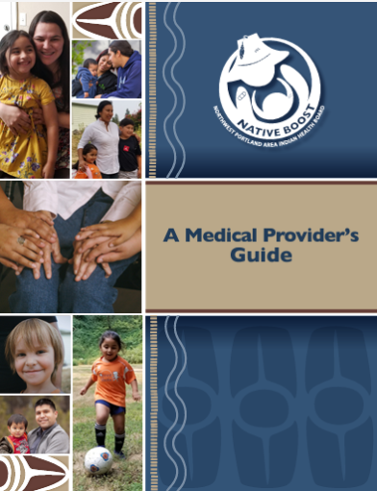
Share Accurate Sources of Information
NPAIHB.org/Native-Boost
Notes:
Guides and booklets,

Slide 35
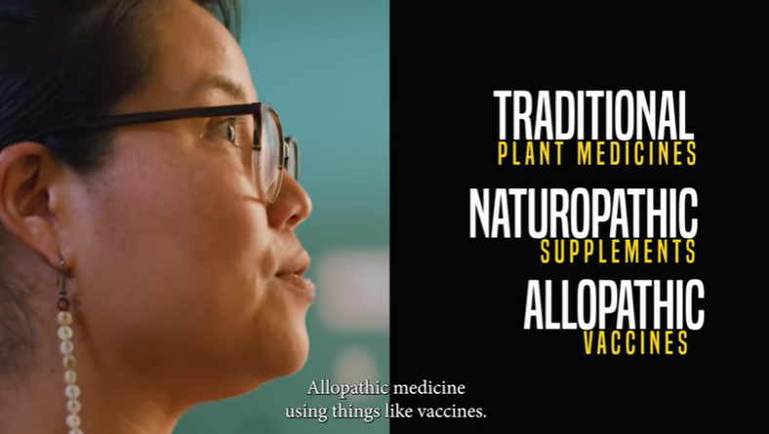
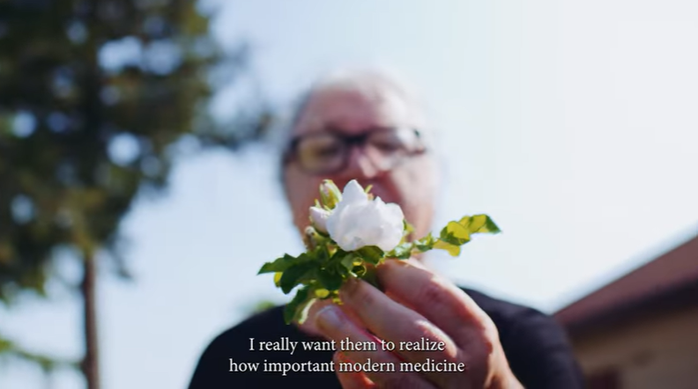
Share Accurate Sources of Information
IndianCountryEcho.org/VacciNative
Notes:
Videos,

Slide 36
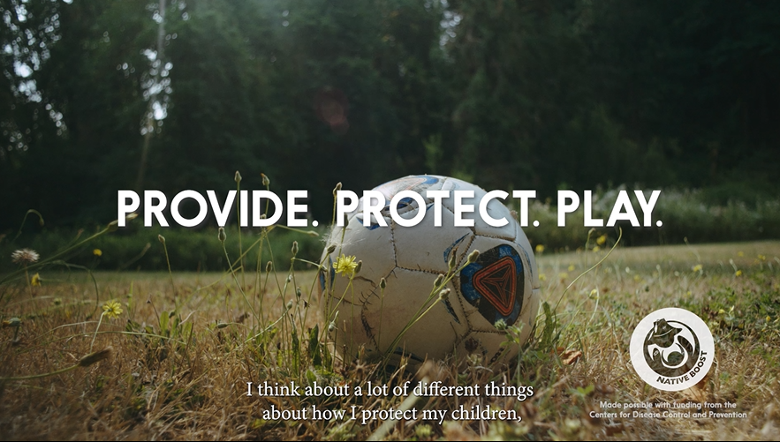
Share Accurate Sources of Information
NPAIHB.org/Native-Boost

Slide 37
Share Accurate Sources of Information
IndianCountryEcho.org/VacciNative
Notes:
And presentations.

Slide 38
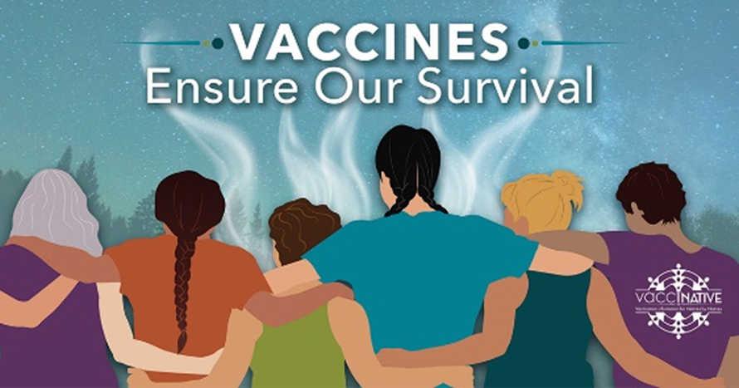
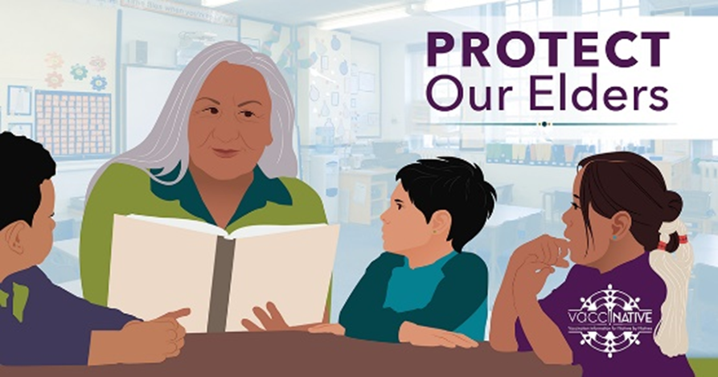
Share Accurate Sources of Information
IndianCountryEcho.org/VacciNative
Notes:
VacciNative also has different social media toolkits for your organization to utilize. Included in each social media toolkit are images to post on Facebook and Instagram and captions for each. You can access these social media toolkits at IndianCountryEcho.org/VacciNative.

Slide 39
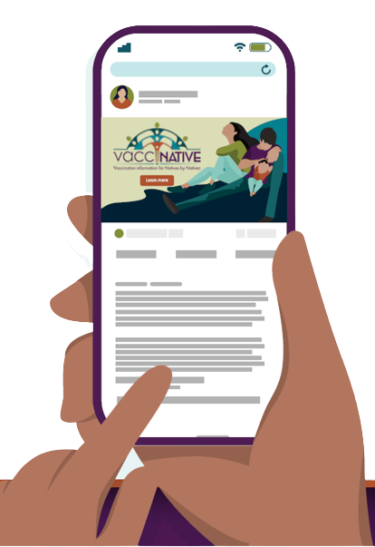
Share Accurate Sources of Information
The local or tribal health department
Healthcare providers
Indian Health Service
The Centers for Disease Control and Prevention
Notes:
Other accurate sources of information others can use to help them make an informed decision about getting vaccinated are the local or tribal health department, healthcare providers like doctors, nurses, and pharmacists, the Indian Health Service, and the Centers for Disease Control and Prevention.

Slide 40
When Finding Information…
Be mindful of what you read online
The best sources of vaccine information are:
Current
Updated regularly
Reviewed by medical professionals, and
Based on scientific research
Notes:
When sharing accurate sources of information with others, be mindful of what you read online. The best sources of vaccine information are current, updated regularly, reviewed by medical professionals, and based on scientific research.

Slide 41
When Finding Information…
It’s also important that:
The authors are listed (along with their credentials) and
Authors say where their information comes from
Notes:
It’s also important that the authors are listed, along with their credentials, and that the authors say where their information comes from.

Slide 42
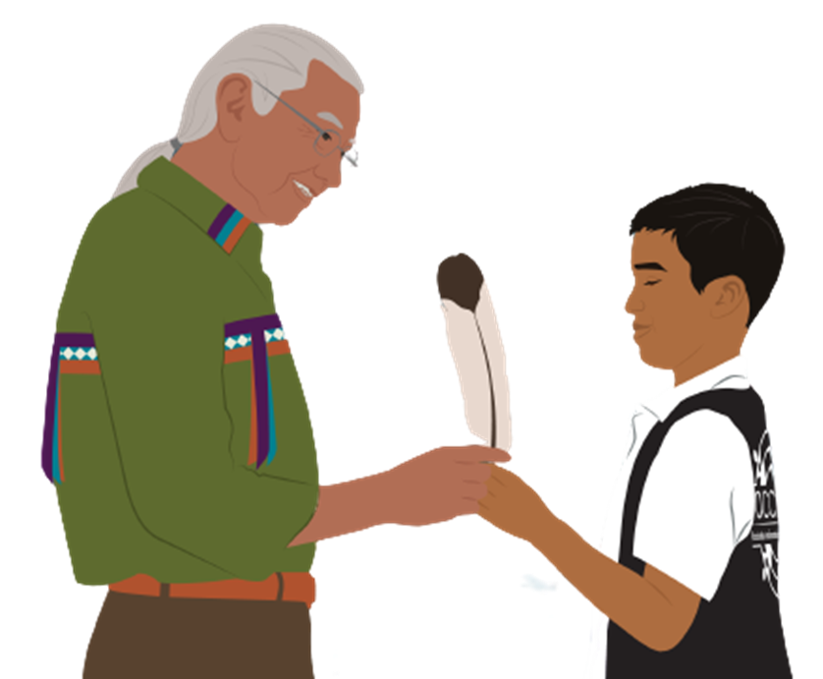
Help Them Make a Plan to Get Vaccinated
Once someone decides why they should get vaccinated, offer to help them make a plan. What’s in their plan?
An appointment
Transportation
Childcare
Notes:
Once someone decides why they should get vaccinated, offer to help them make a plan. Depending on your capacity, this may include helping them make their vaccination appointment, going with them to their appointment, getting vaccinated together, or holding their child while they’re receiving their vaccine.

Slide 43
Any Questions?
Notes:
Does anyone have any questions about what we’ve discussed today? Was anything unclear?

Slide 44
Thank you to Native Boost!
Notes:
We’d like to thank the Native Boost team and credit their website for the information they’ve contributed.

Slide 45
For More Information
Notes:
Thank you for the time you’ve spent listening to this presentation. If you’d like more information about what we’ve discussed today or training on this, you can go to…

Slide 46
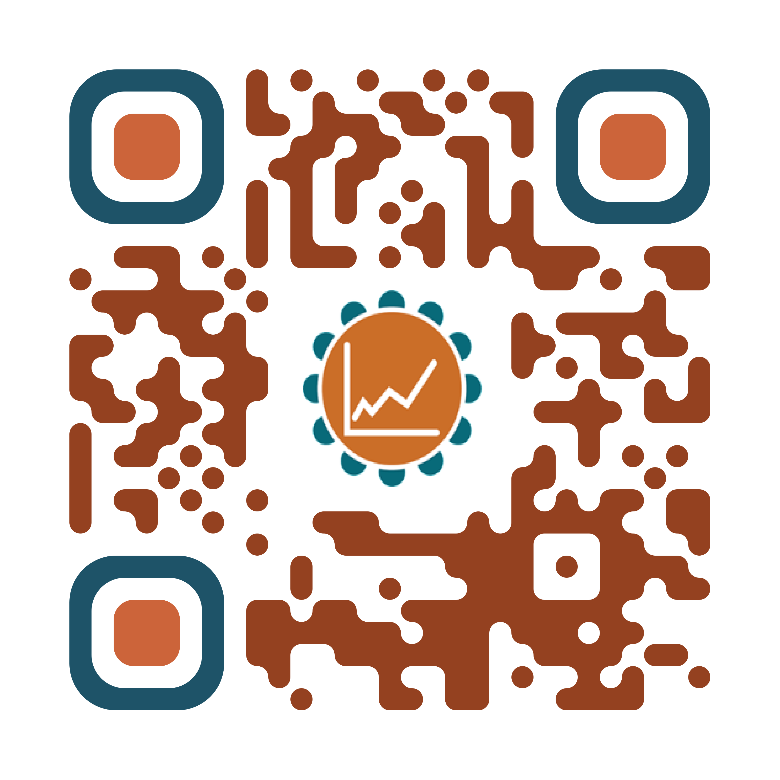
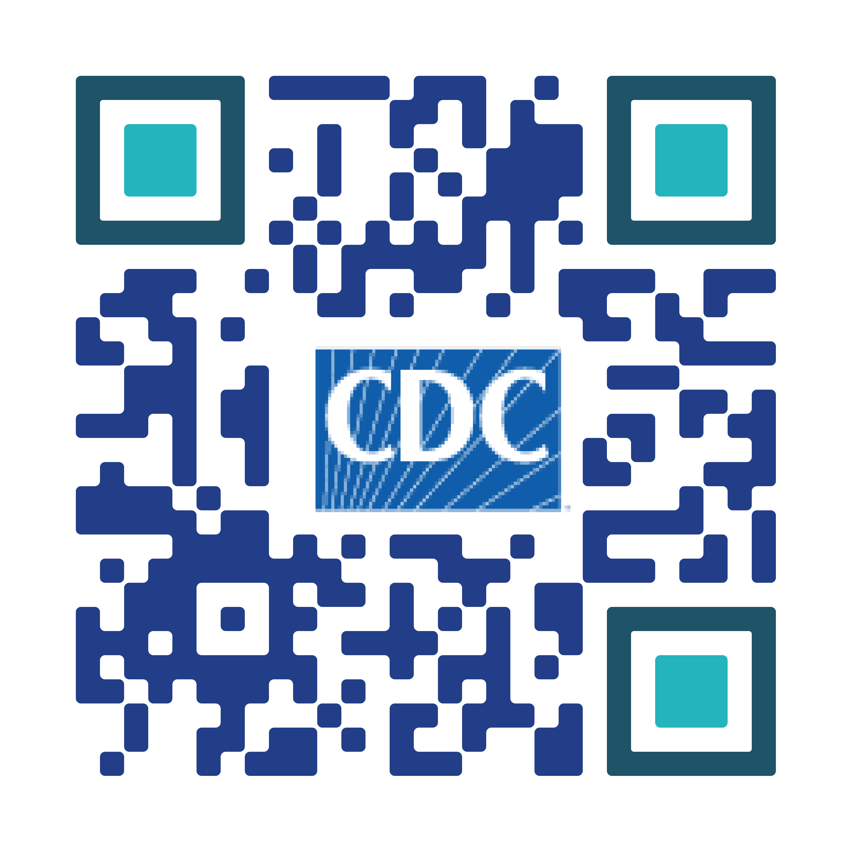
For More Vaccine Information
Visit
TribalEpiCenters.org
IHS.gov
CDC.gov
Notes:
Tribal Epidemiology Centers, Indian Health Service, and the Centers for Disease Control and Prevention websites by scanning their respective QR codes on the screen.

Slide 47
For More Vaccine Information
Visit
IndianCountryEcho.org/VacciNative
NPAIHB.org/Native-Boost
Notes:
You can also visit the VacciNative and Native Boost websites by scanning their respective QR codes on the screen.

Slide 48
Notes:
VacciNative is a project dedicated to creating accurate vaccine information for Native people by Native people. VacciNative does this by gathering info from trusted Elders, Native health professionals, and other experts. Plus, all of VacciNative’s materials are reviewed by the VacciNative Alliance, a collaboration of staff from Tribal Epidemiology Centers across the nation.

Slide 49
For more information
Org/Tribal
Logo
Title
Organization
Email Address
Notes:
Thank you for the time you’ve spent listening to this presentation. If you’d like more information about what we’ve discussed today or if you have any additional questions about anything we’ve discussed, please feel free to contact me. My contact information is listed in the slide above.

