Slide 1
July 2023

Slide 2
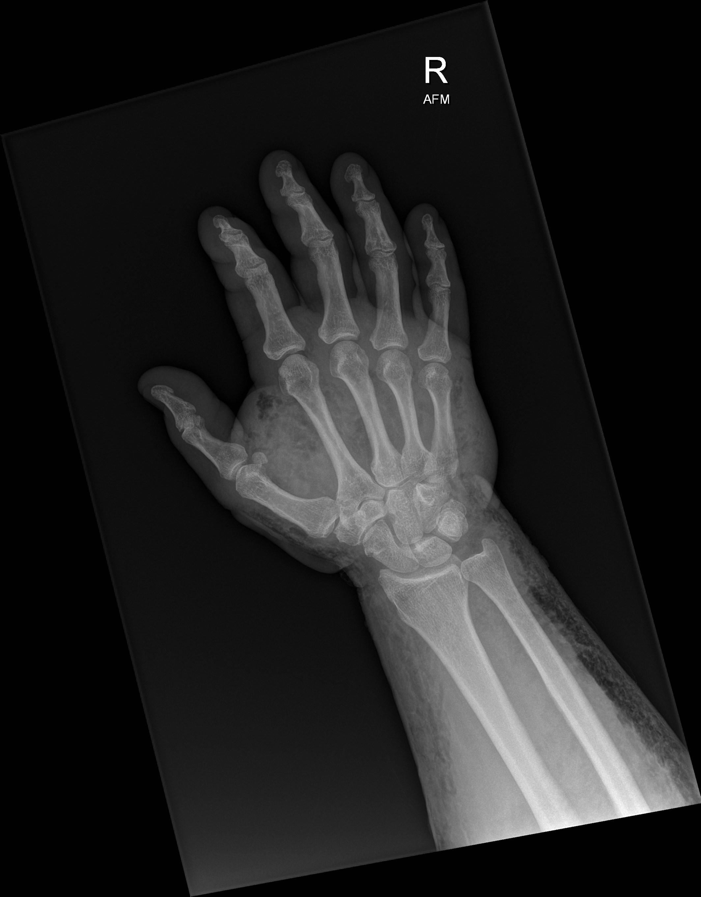
Necrotizing Skin and Soft Tissue Infections
Nick Stadlberger, MD
Tuba City Regional Health Care Corporation

Slide 3
Introductions
Dr. Nick Stadlberger – Emergency Medicine Physician, Tuba City Regional Health Care Corporation
Dr. Johnathan Iralu - Indian Health Service Chief Clinical Consultant for Infectious Diseases, Gallup Indian Medical Center
Dr. Joachim Chino – Surgeon Tuba City Regional Health Care Corporation

Slide 4
Disclosures

Slide 5
Objectives
Discuss the presentation, diagnosis, and treatment of necrotizing soft tissue infections
Review unique aspects of care for patient’s with NSTI in rural settings

Slide 6
Case
47 year old female
PMHx: None reported
CC: right shoulder pain and wrist pain after fall 3 days ago
T 96.8
HR 86
RR 22
BP 153/96
O2 99% RA

Slide 7
Exam
Pain with ROM of shoulder but full ROM passively
No skin findings
ROM wrist limited by pain
+ snuffbox tenderness

Slide 8
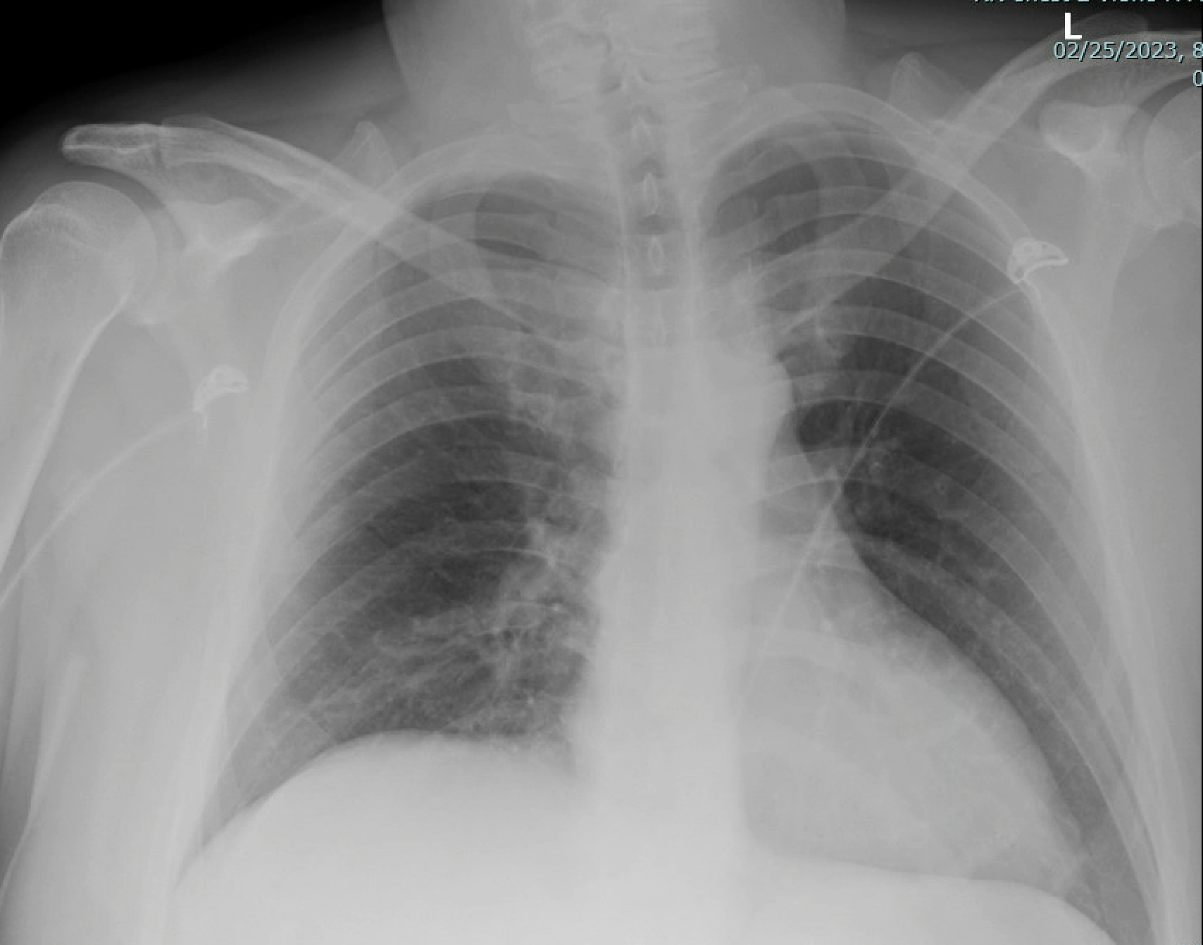
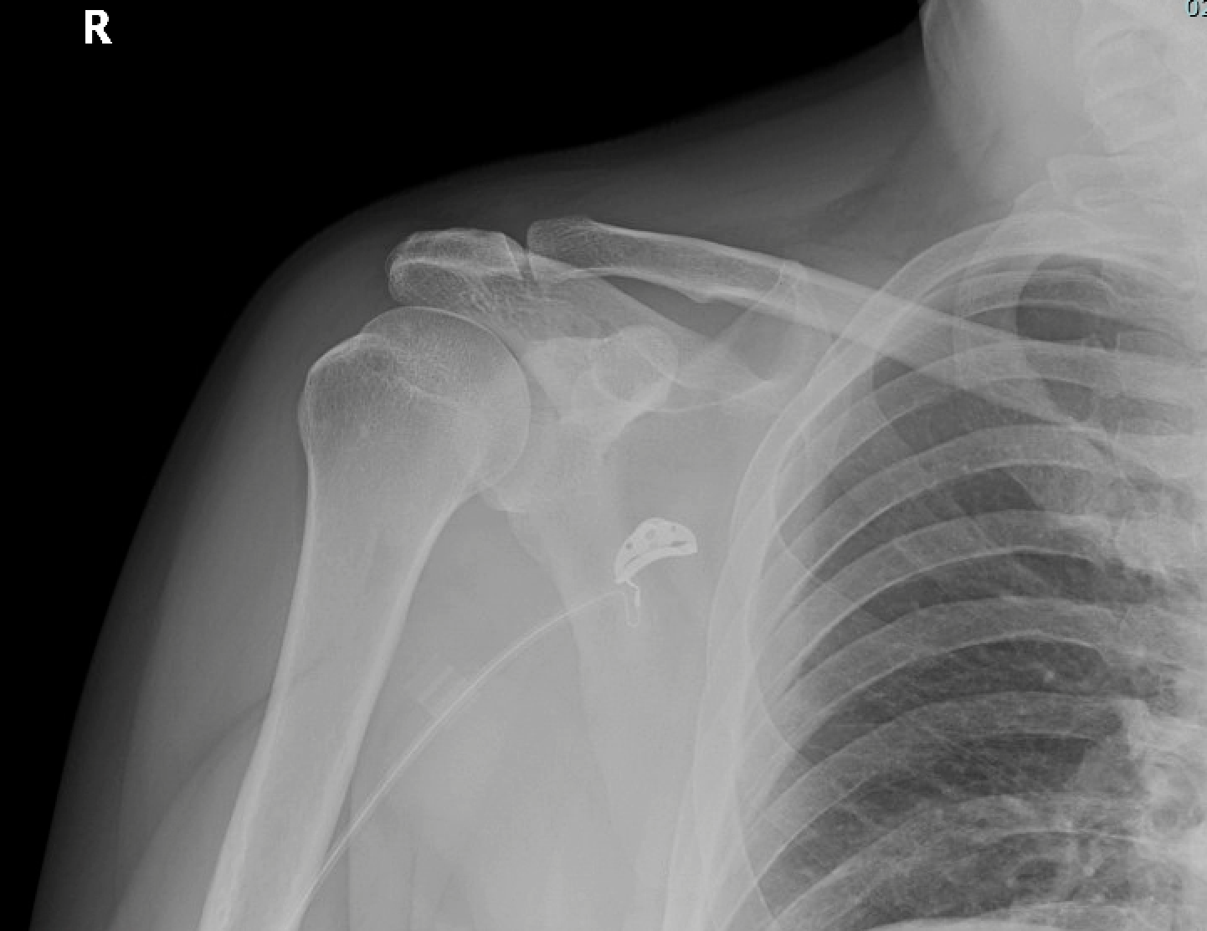
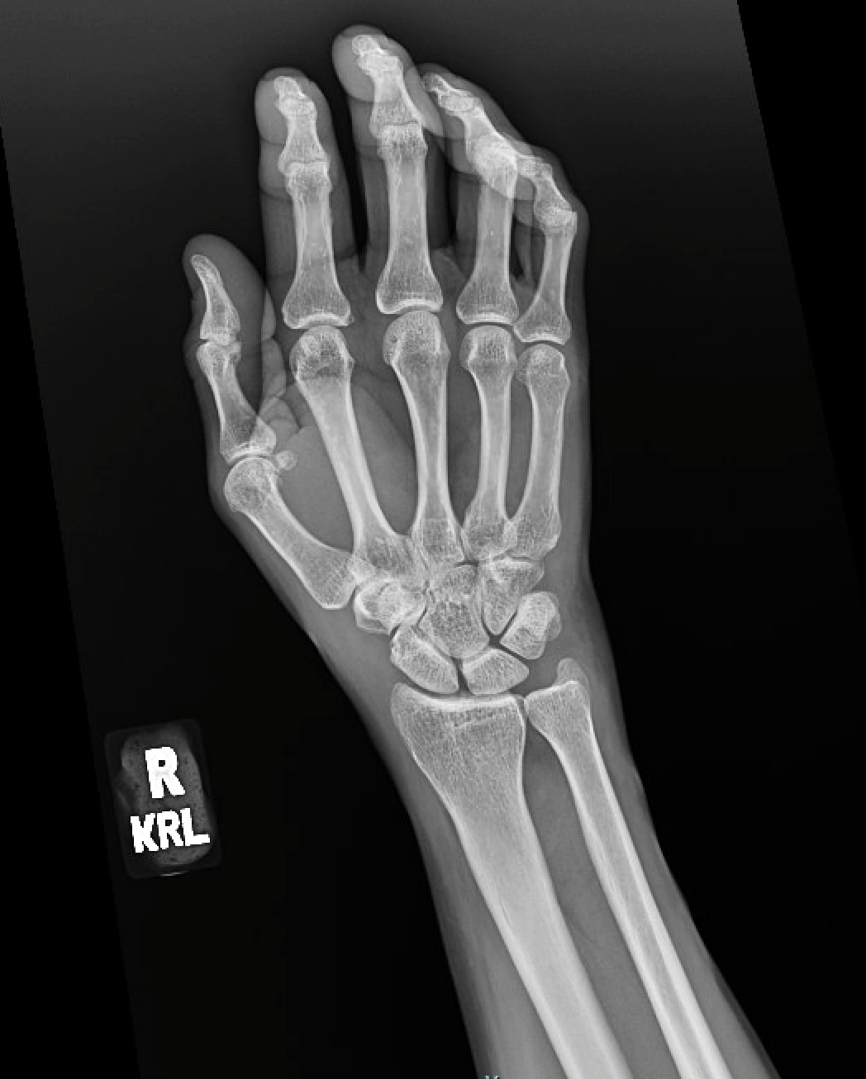
Notes:
Placed in thumb spice then discharged

Slide 9
3 days later
1
2
3
4
5
6
7
8
9
10
11
12
13
14
15
16
17
18
19
20
21
22
23
24
Returns with chest pain and SOB, swelling right shoulder and neck starting 3 hours PTA
T 98.4
HR 109
BP 108/62
RR 18
O2 100%RA

Slide 10
Physical Exam
Cardiac: RRR
Resp: CTAB
GI: Soft, NTTP
LUE – swelling and erythema over left chest and left shoulder with an area of darker color on left anterior chest 2x3cm. Wrist in splint, no overlying skin changes or swelling

Slide 11
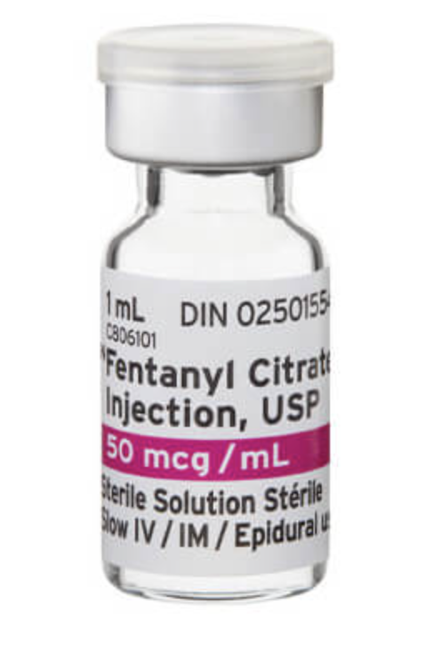
Notes:
ASA, fentanyl for chest pain with improvement

Slide 12
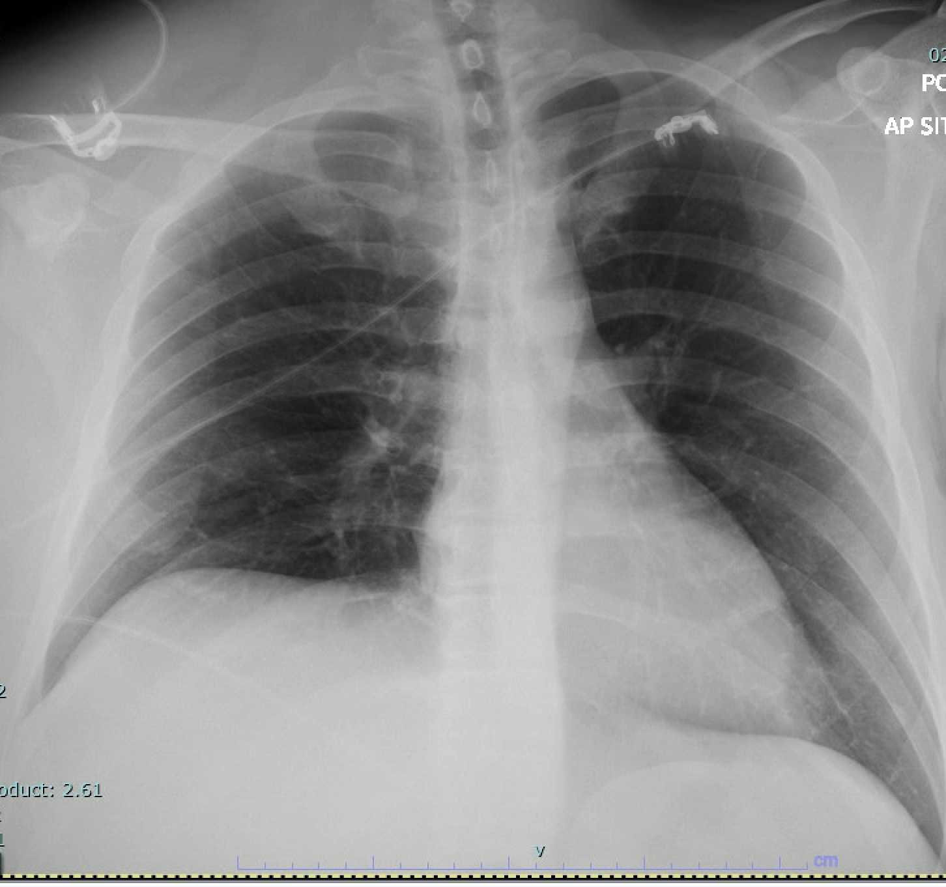
Notes:
XR left shoulder and chest unremarkable

Slide 13
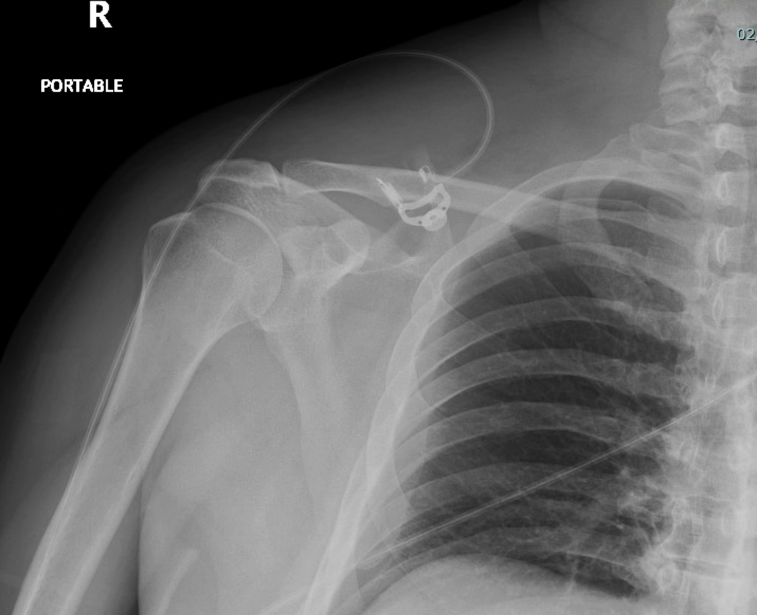

Slide 14
Labs (initial – waiting on CMP)
Hgb 17.5
Plt 75
WBC 13.9

Slide 15
1
2
3
4
5
6
7
8
9
10
11
12
13
14
15
16
17
18
19
20
21
22
23
24
Blisters noted on left shoulder and left anterior chest in the areas of earlier erythema
No crepitus, but lesion more indurated
Vanc/Zosyn, Clinda started
Surgery consulted and immediately came to bedside

Slide 16
Additional Labs
Glucose 521
Cr 3.8
HCO3 10
AG 22
Na 115
Lactate 10
VBG pH 7.17
CRP 33.2
ESR 1

Slide 17
Dispo
No ICU beds at our facility
Call to FMC, Banner facilities, Sunrise Las Vegas
No flights due to weather. No ground crews available

Slide 18
1
2
3
4
5
6
7
8
9
10
11
12
13
14
15
16
17
18
19
20
21
22
23
24
Accepted to Las Vegas, however, surgeon requested CT scan prior to transfer.
Patient admits now to drinking ½ gallon of ETOH daily, was assaulted as initial injury, didn’t actually fall off truck.

Slide 19
1
2
3
4
5
6
7
8
9
10
11
12
13
14
15
16
17
18
19
20
21
22
23
24
CT results
Las Vegas called regarding imaging
Nursing assessment, patient comfortable

Slide 20
Hour 7
1
2
3
4
5
6
7
8
9
10
11
12
13
14
15
16
17
18
19
20
21
22
23
24
Labs worsening despite abx, insulin, aggressive fluid (4L NS, maintenance 200/hr)
Lactate 10—12.4—15.9
pH 6.7
Mental status deteriorating, confusion

Slide 21
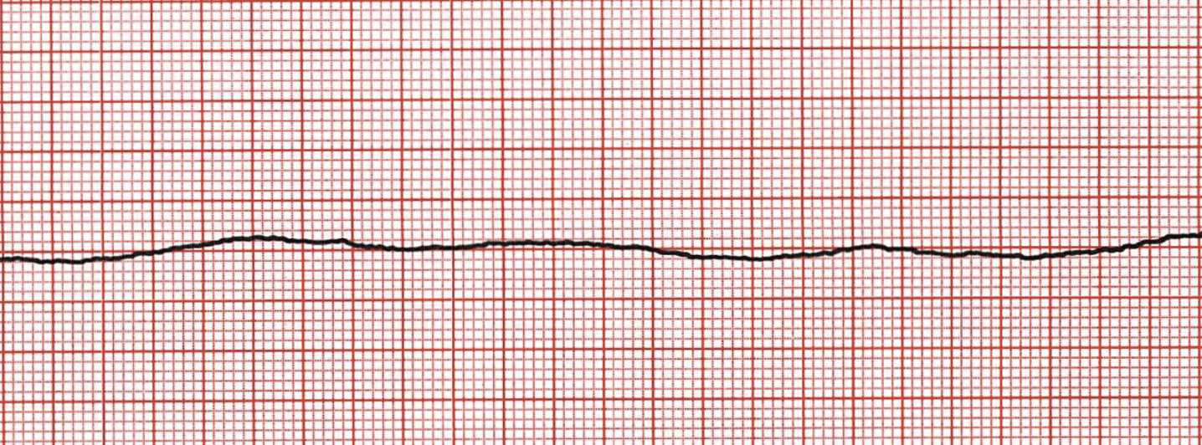
1
2
3
4
5
6
7
8
9
10
11
12
13
14
15
16
17
18
19
20
21
22
23
24

Slide 22
1
2
3
4
5
6
7
8
9
10
11
12
13
14
15
16
17
18
19
20
21
22
23
24
Epi x 3
Bicarb x 4
CaCl x 1

Slide 23
1
2
3
4
5
6
7
8
9
10
11
12
13
14
15
16
17
18
19
20
21
22
23
24
Epi x 3
Bicarb x 4
CaCl x 1
ROSC

Slide 24
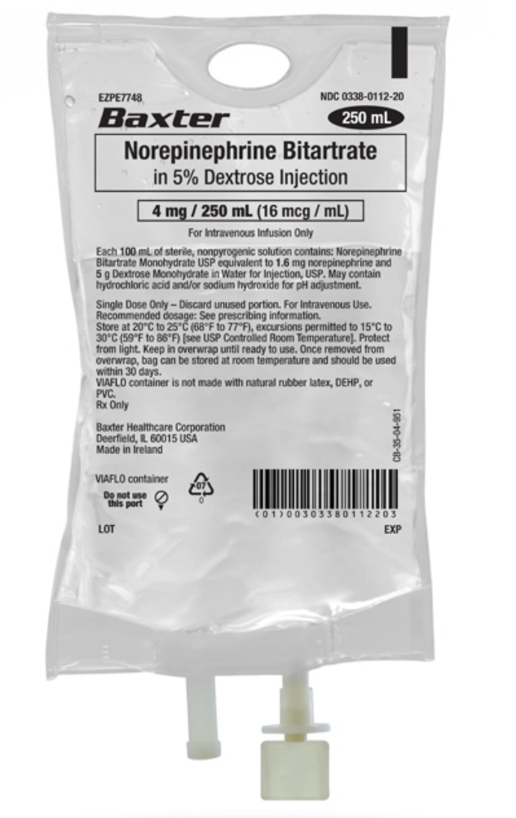
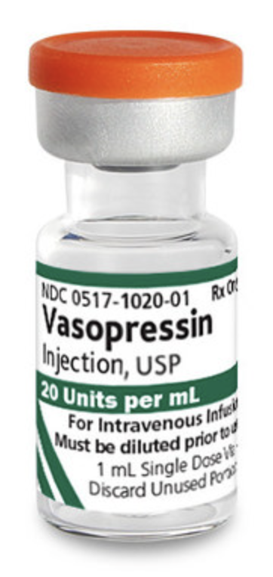
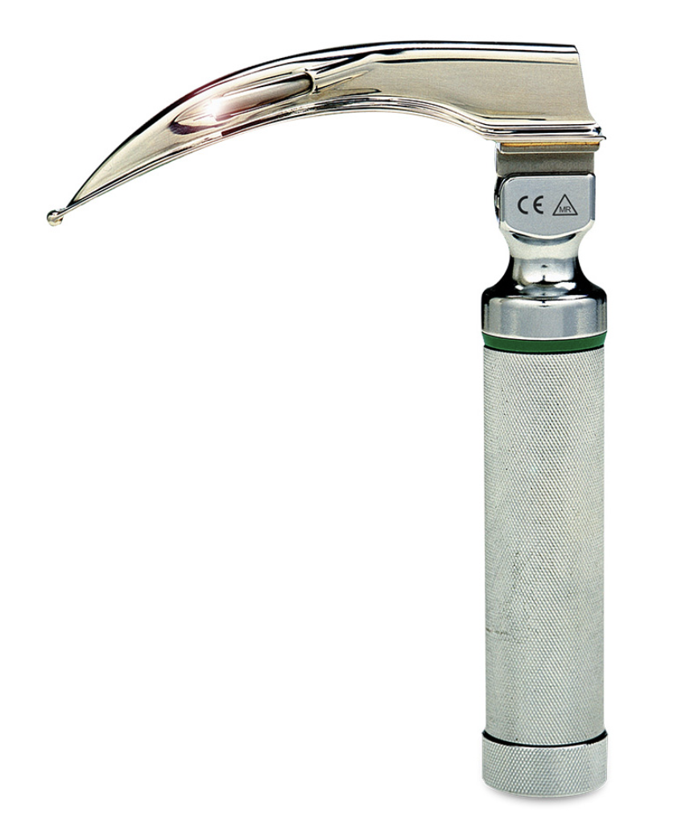
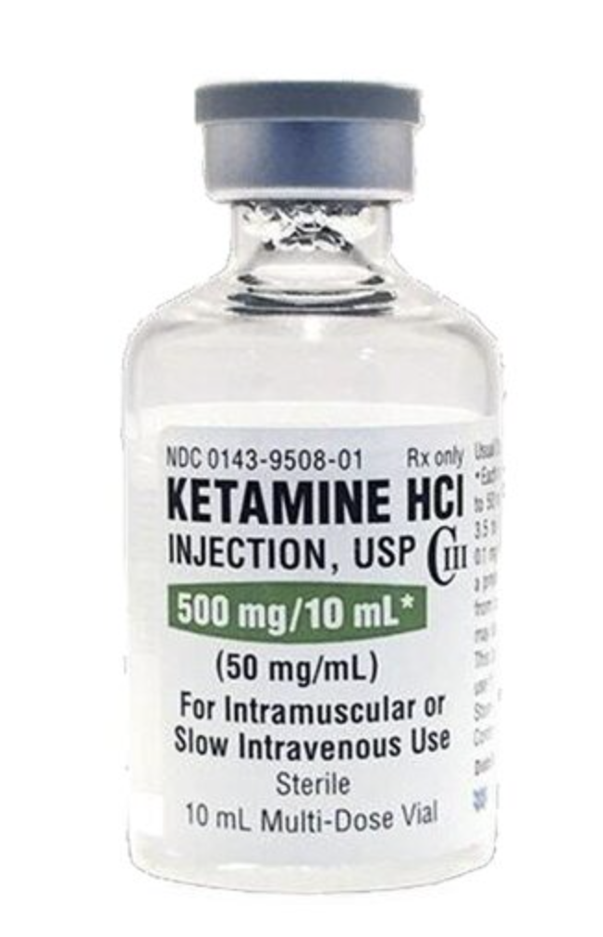
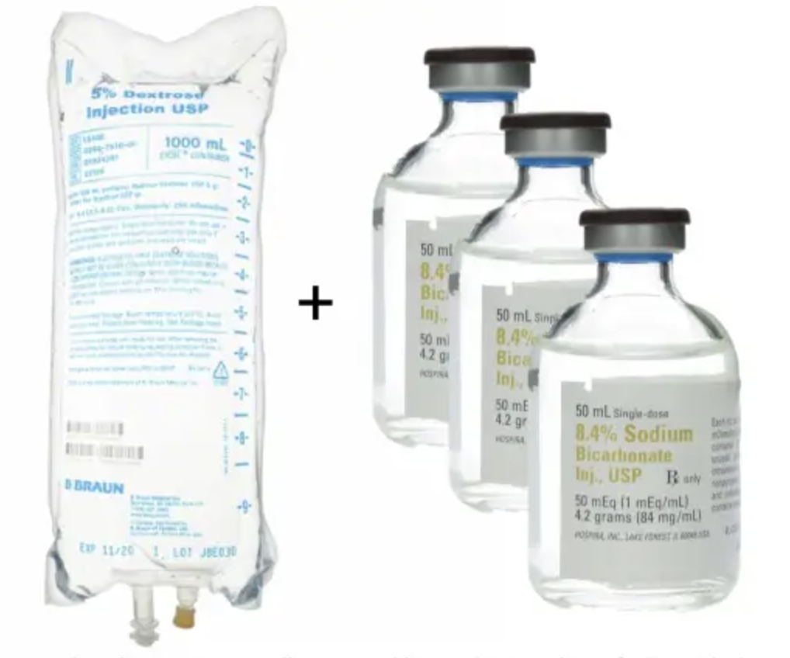

Slide 25
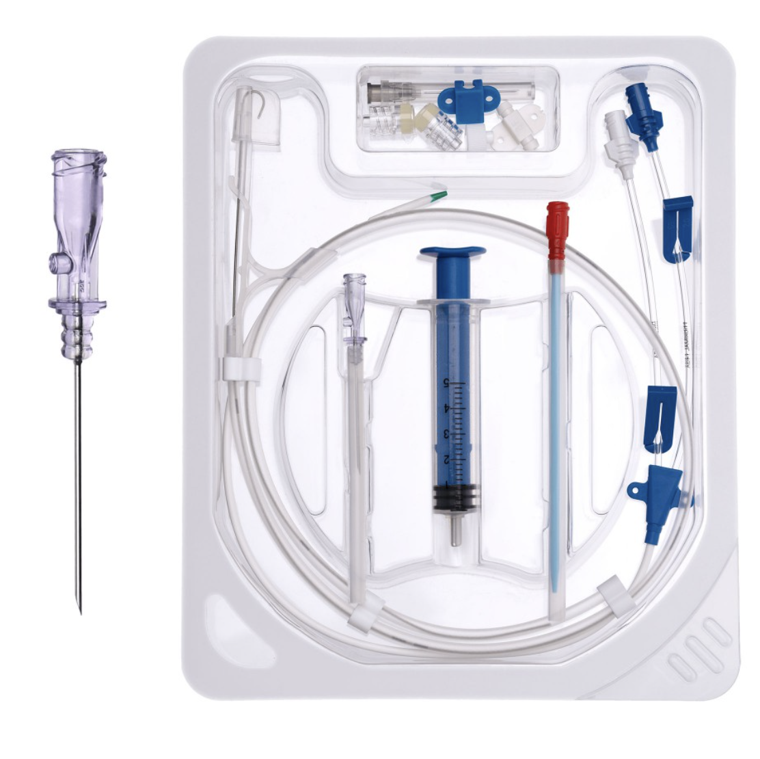
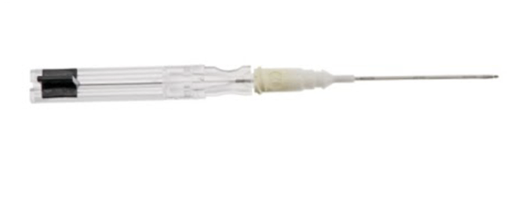
https://invumed.com/cat/cvc/cvc-kit-optimum.html
https://onlinelibrary.wiley.com/doi/abs/10.1111/1742-6723.14148

Slide 26
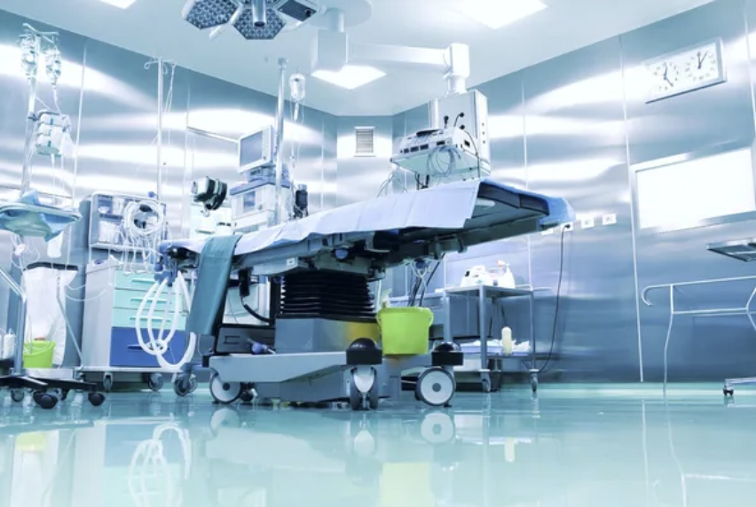
https://depositphotos.com/stock-photos/operating-room.html
Notes:
Discuss with Chino intra-operative findings

Slide 27
1
2
3
4
5
6
7
8
9
10
11
12
13
14
15
16
17
18
19
20
21
22
23
24
OR
ED
Notes:
2 units blood and FFP

Slide 28
1
2
3
4
5
6
7
8
9
10
11
12
13
14
15
16
17
18
19
20
21
22
23
24
Increasing bleeding from wounds, ongoing oozing quick clot placed by surgery
Hgb decreasing 9.2-8.4
Cret worsening,
BPs worsening, started on 3rd pressor (epi)

Slide 29
1
2
3
4
5
6
7
8
9
10
11
12
13
14
15
16
17
18
19
20
21
22
23
24
Labs worsening
pH 6.89
WBC 23.3
Plt 39
Hgb 7.4
INR 2.1
NA 124, K 6.5, HCO3 9, Cr 4.8, Glu 233
Additional RBC and FFP given

Slide 30
Crepitus noted left posterior axilla beyond site of prior debridement
Bullae noted in left groin
One hour later, extended into perineum and buttock, blistering started on left wrist and hand

Slide 31
1
2
3
4
5
6
7
8
9
10
11
12
13
14
15
16
17
18
19
20
21
22
23
24
Epi x 2
Bicarb x 2
Calcium x 1
ROSC
Phenylephrine
Insulin
Albuterol
Calcium
Bicarb
Notes:
Phenyleprhine ordered in addition to Norepi, Vaso, Epi. Treated for HyperK with insuling bolus, albuterol, Calcium, additional bicarb
Family discussion – maximal medical management but DNR

Slide 32
1
2
3
4
5
6
7
8
9
10
11
12
13
14
15
16
17
18
19
20
21
22
23
24
Code Status
DNR
Notes:
Patient too unstable to go back to OR (intermittent coding, escalating pressors)
Family discussion – maximal medical management but DNR

Slide 33
1
2
3
4
5
6
7
8
9
10
11
12
13
14
15
16
17
18
19
20
21
22
23
24

Slide 34
Necrotizing Soft Tissue Infections

Slide 35
Necrotizing Soft Tissue Infections
20-30% Mortality*
Notes:
Some studies Report up to 80% mortality – Bonne
Higher for GAS than for polymicrobial

Slide 36
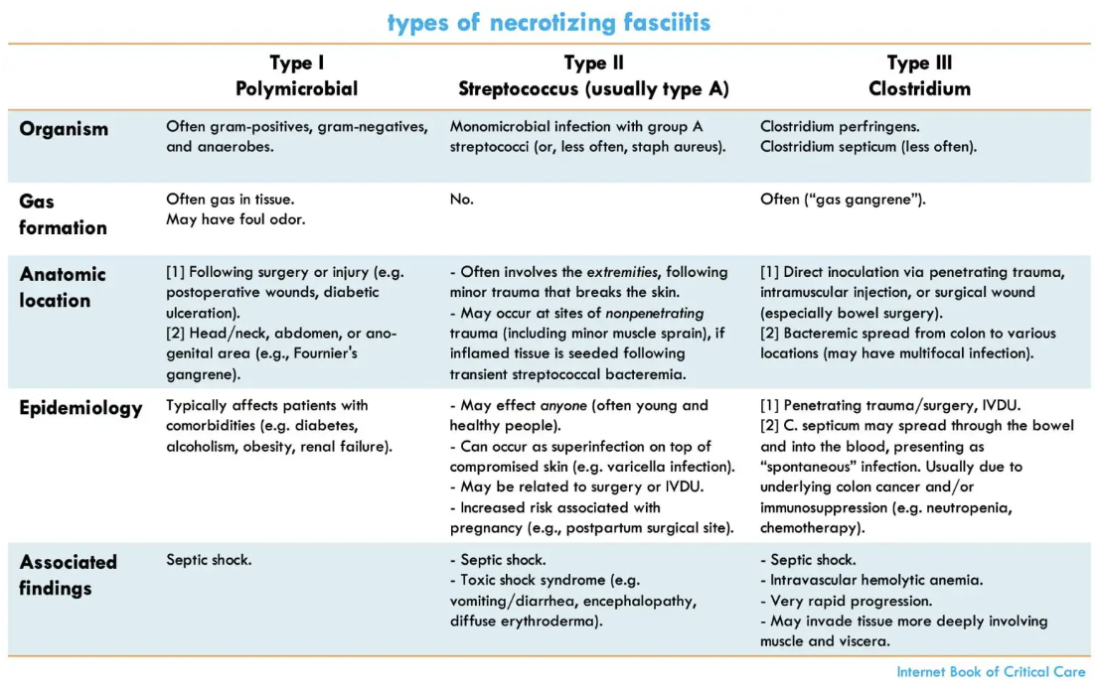
EMCrit.org
Notes:
https://emcrit.org/ibcc/necfas/#ultrasonography

Slide 37
EMCrit.org
Notes:
https://emcrit.org/ibcc/necfas/#ultrasonography

Slide 38
Nearly 50% of patients with necrotizing fasciitis caused by S. pyogenes have no portal of entry but develop deep infection at the exact site of nonpenetrating trauma such as a bruise or muscle strain.
Notes:
IDSA citation

Slide 39
Polymicrobial infection is most commonly associated with 4 clinical settings: (1) perianal abscesses, penetrating abdominal trauma, or surgical procedures involving the bowel; (2) decubitus ulcers; (3) injection sites in illicit drug users; and (4) spread from a genital site such as Bartholin abscess, episiotomy wound, or a minor vulvovaginal infection
Notes:
IDSA citation

Slide 40
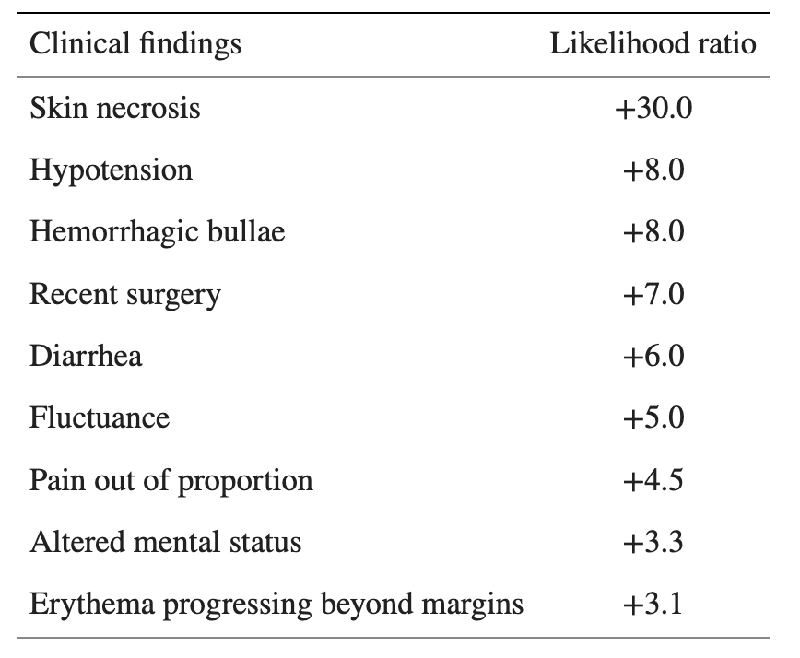
Presentation of NSTI
Al Alayed 2015
Tso 2018
Notes:
This is the first study to directly assess diagnostic accuracy of the clinical examination for NF. No individual findings on history or physical examination are sufficiently sensitive to rule out NF. However, the absence of all 9 ‘red flags’ may rule out NF. Presence of 3 or more ‘red flags’ may rule in NF – Al Alayed

Slide 41
Iralu
Epi in Indian Country
Diagnostics (LRNEC)
Treatment

Slide 42
Questions for Chino
Is there a role for bedside incision by ED provider to look for “dishwater” fluid?
What goes into your decision (and the decision in general) on whether to keep or send these patients?
What are the surgeon-surgeon conversations typically like after you’ve taken a patient to the OR but they still need to be sent out?
How often do these patients need to go back to the OR? What determines this – is it just standard or based on clinical picture? When do you stop debridement when in the OR?
Are these wounds typically left open after the final debridement? Wound vacs?

Slide 43
Imaging

Slide 44
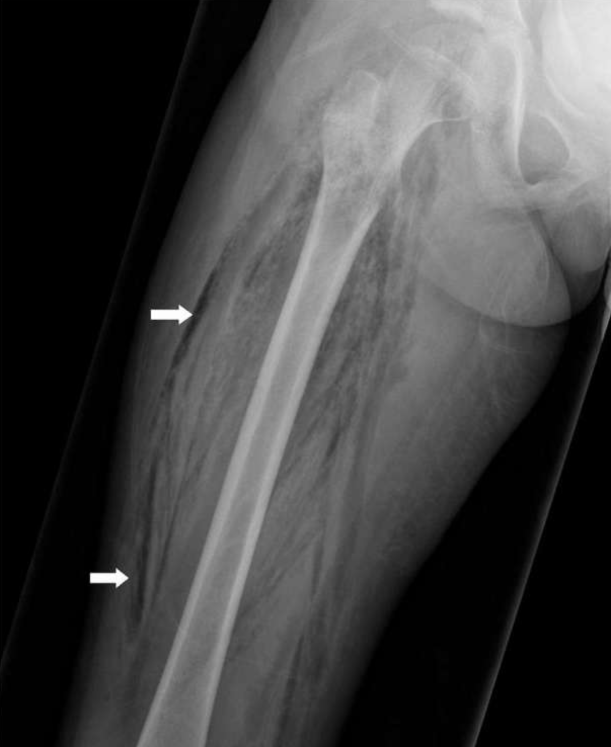
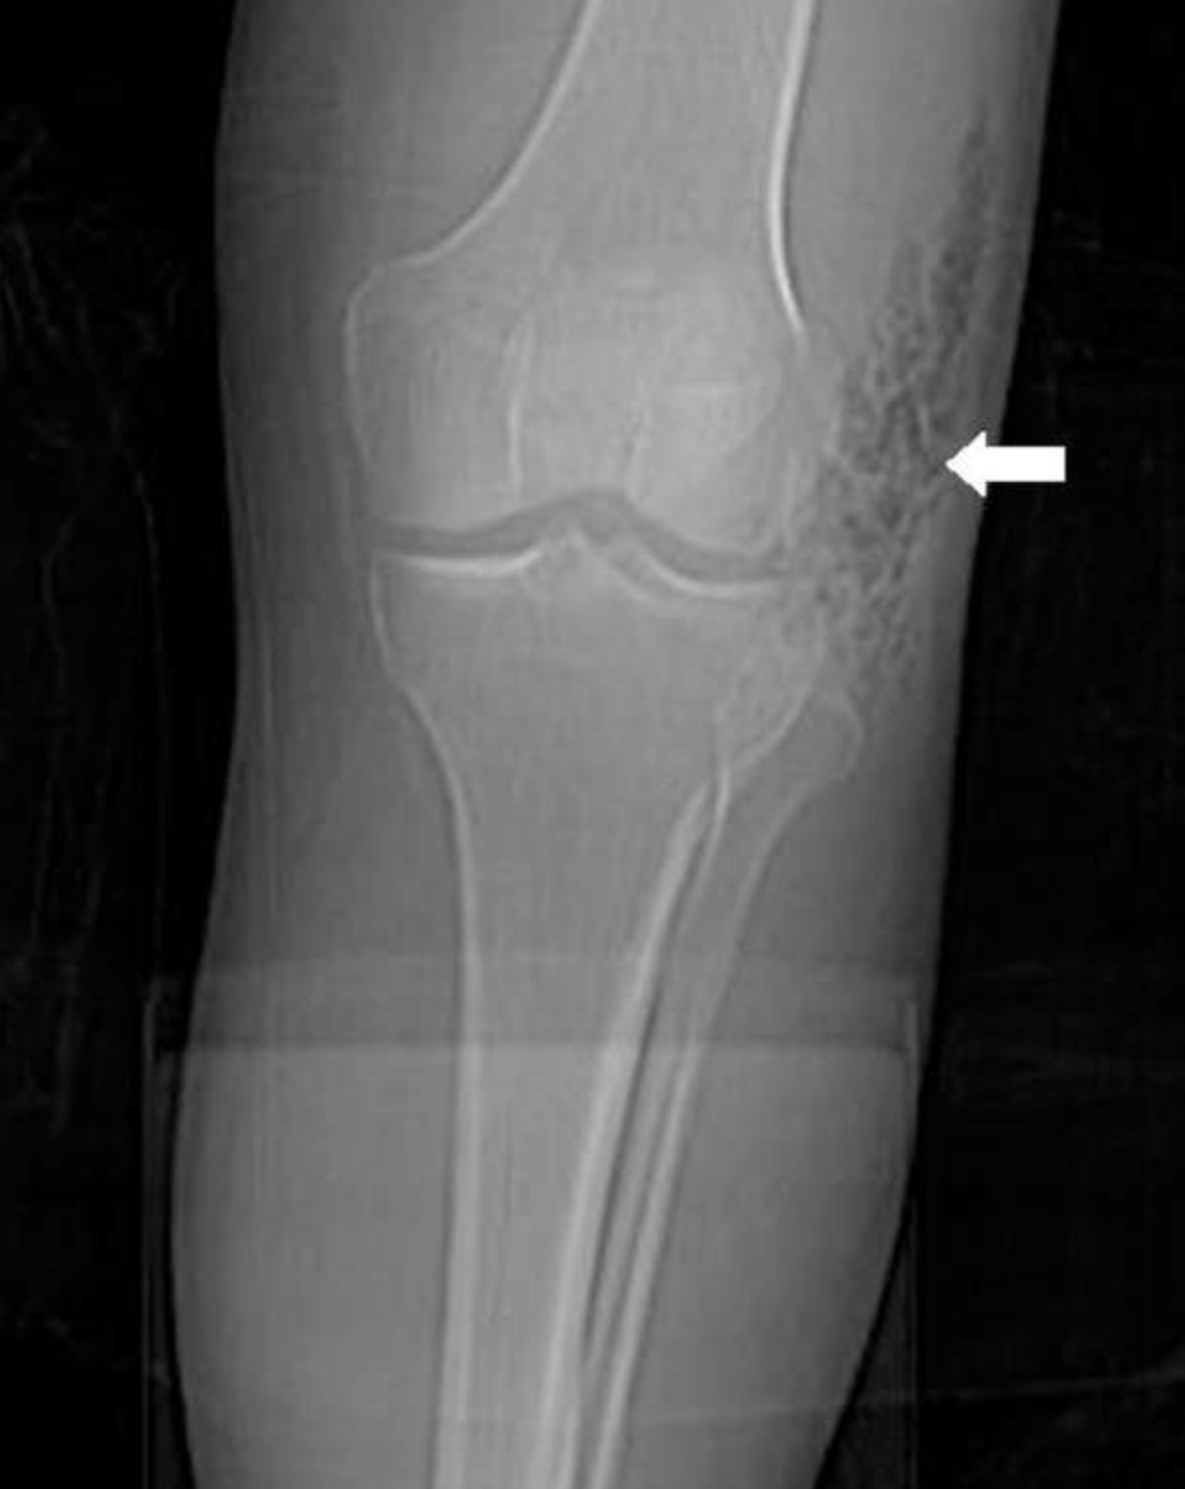
Tso 2021
Notes:
XR – gas highly supportive but absence doesn’t rule it out
Neither Sensitive nor specific but could show gas tracking along fascial planes which would be highly suggestive of NSTI. Could also eval for other causes of infection such as FB – Tso 2021

Slide 45
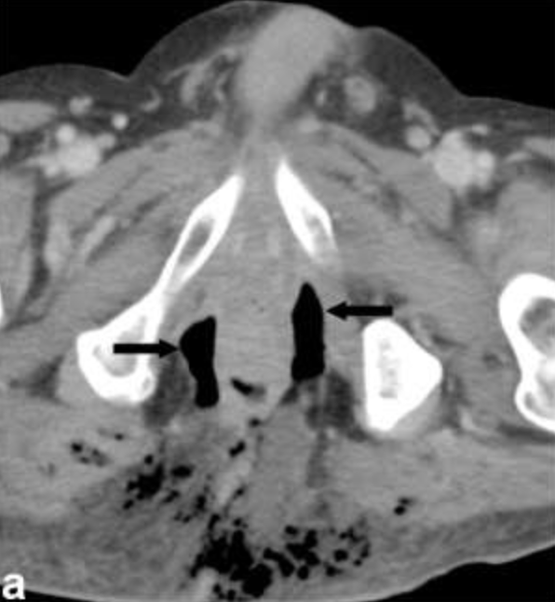
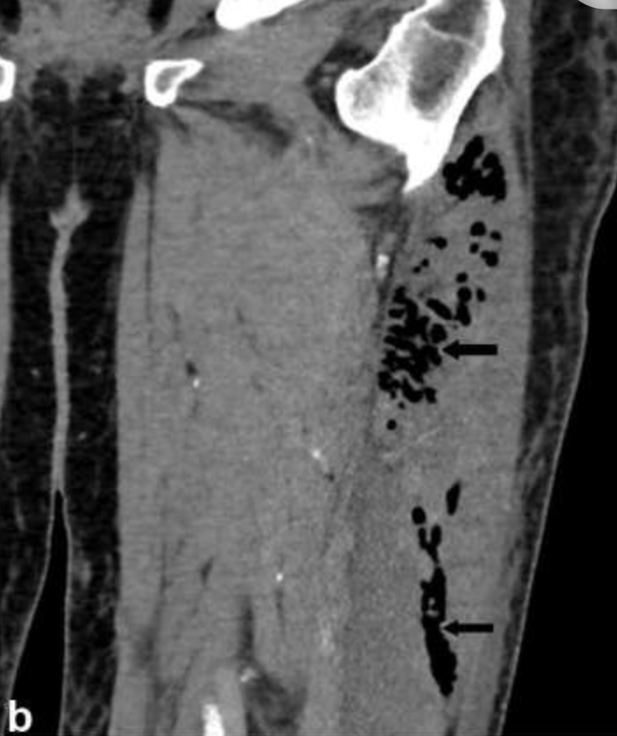
Tso 2021
Tso 2021
Gas Specificity 93.2%, Sensitivity 48.6%
Subcutaneous edema Specificity 11.2%, Sensitivity 98.1%
Kwee 2021
Notes:
CT is the primary imaging modality in the work-up of necrotizing fasciitis given its wide availability and high spatial resolution compared to radiography or ultrasound. Soft-tissue gas is a pertinent CT finding, but absence of it should not exclude the diagnosis of necrotizing fasciitis if clinically suspected. \Gas within fluid collections along subfascial planes is the hallmark of necrotizing fasciitis The lack of soft-tissue gas on CT may be due to early disease, aerobic infections, or if the patient is diabetic. - Tso

Slide 46
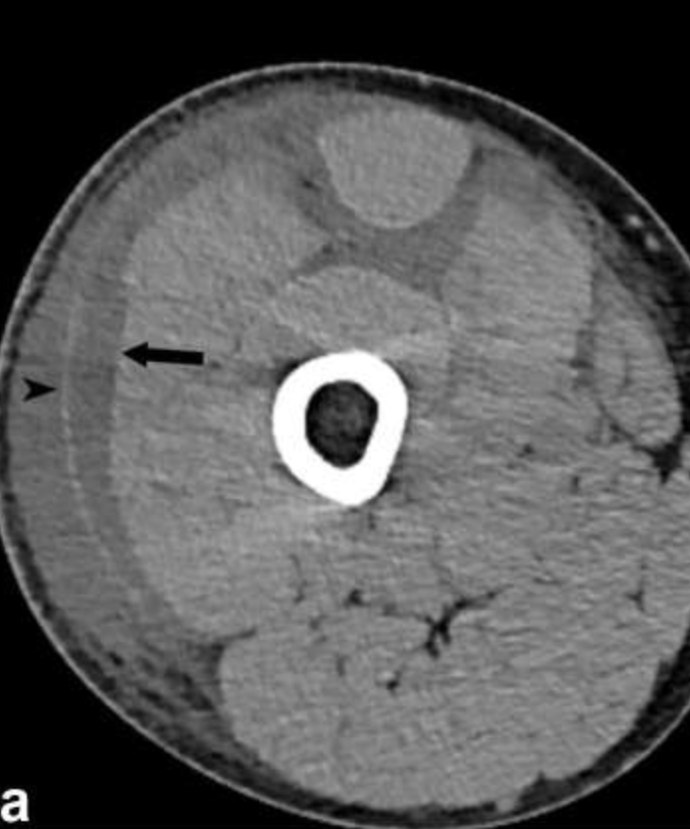
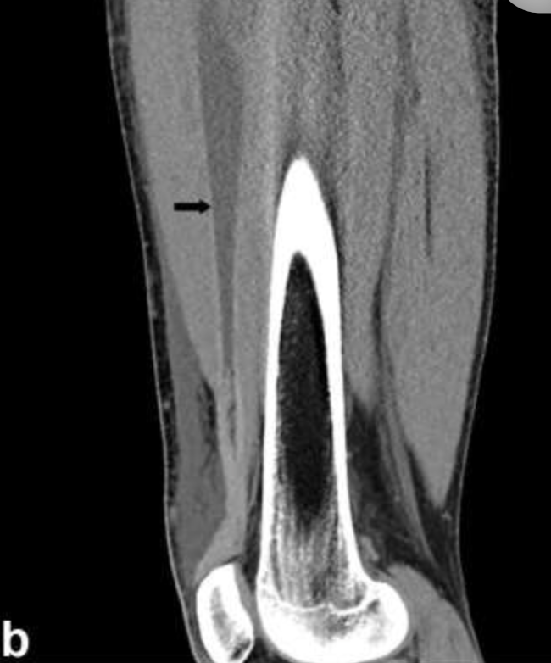
Tso 2021
Tso 2021
Notes:
Subfascial and intermuscular fluid accumulation can also be seen on CT, and may represent early findings of necrotizing fasciitis – Tso
When CT is non-diagnostic, it could still help the surgeon by identifying the ideal spot to explore

Slide 47
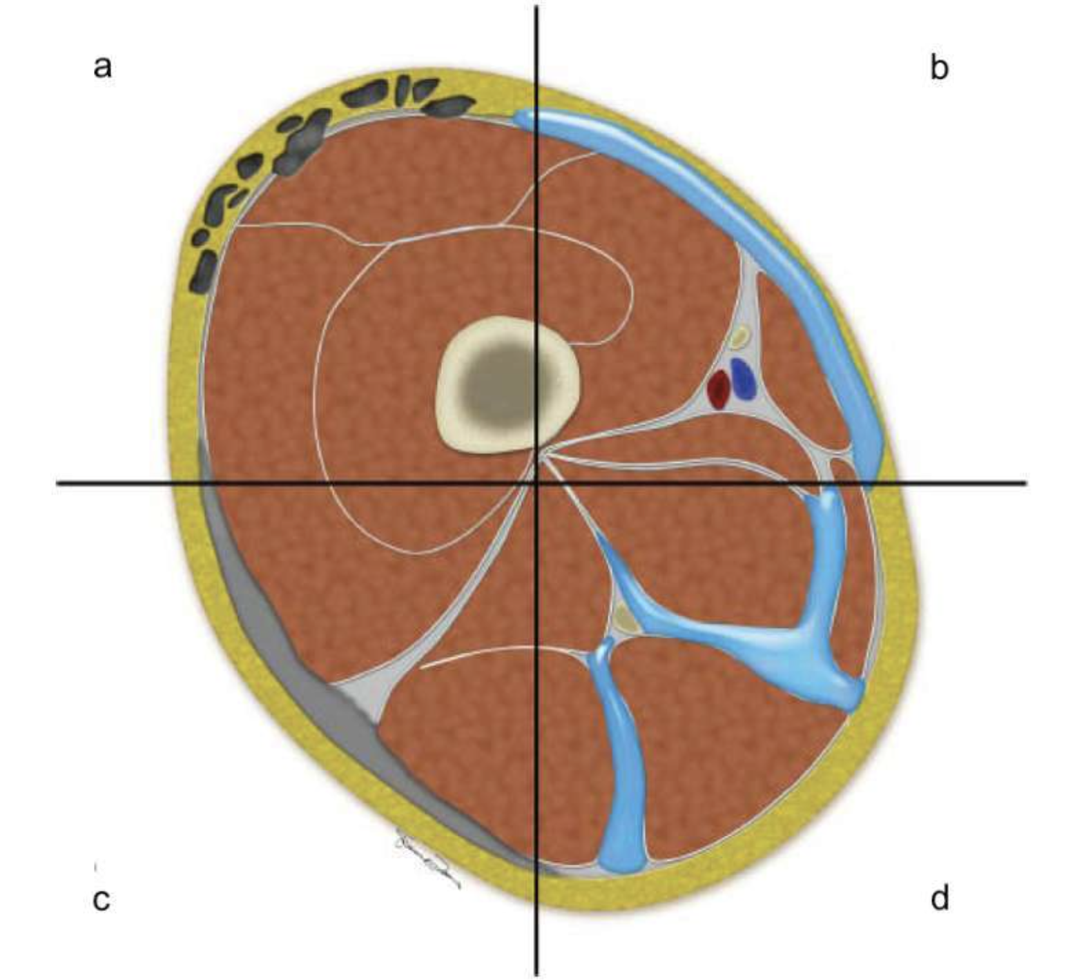
Notes:
Cross-sectional schematic diagram through the right thigh demonstrating the various findings of necrotizing fasciitis. Subcutaneous and subfacial emphysema, which are classical finding of necrotizing fasciitis (a). Subfacial fluid along the superficial fascial layers, which can be seen in early necrotizing fasciitis (b). Diffuse thickening of the superficial fascia, which can be seen in the early phase of necrotizing fasciitis (c). Fluid tracking along deep and intermuscular fascia, which can be seen in advanced cases (d). - Tso

Slide 48
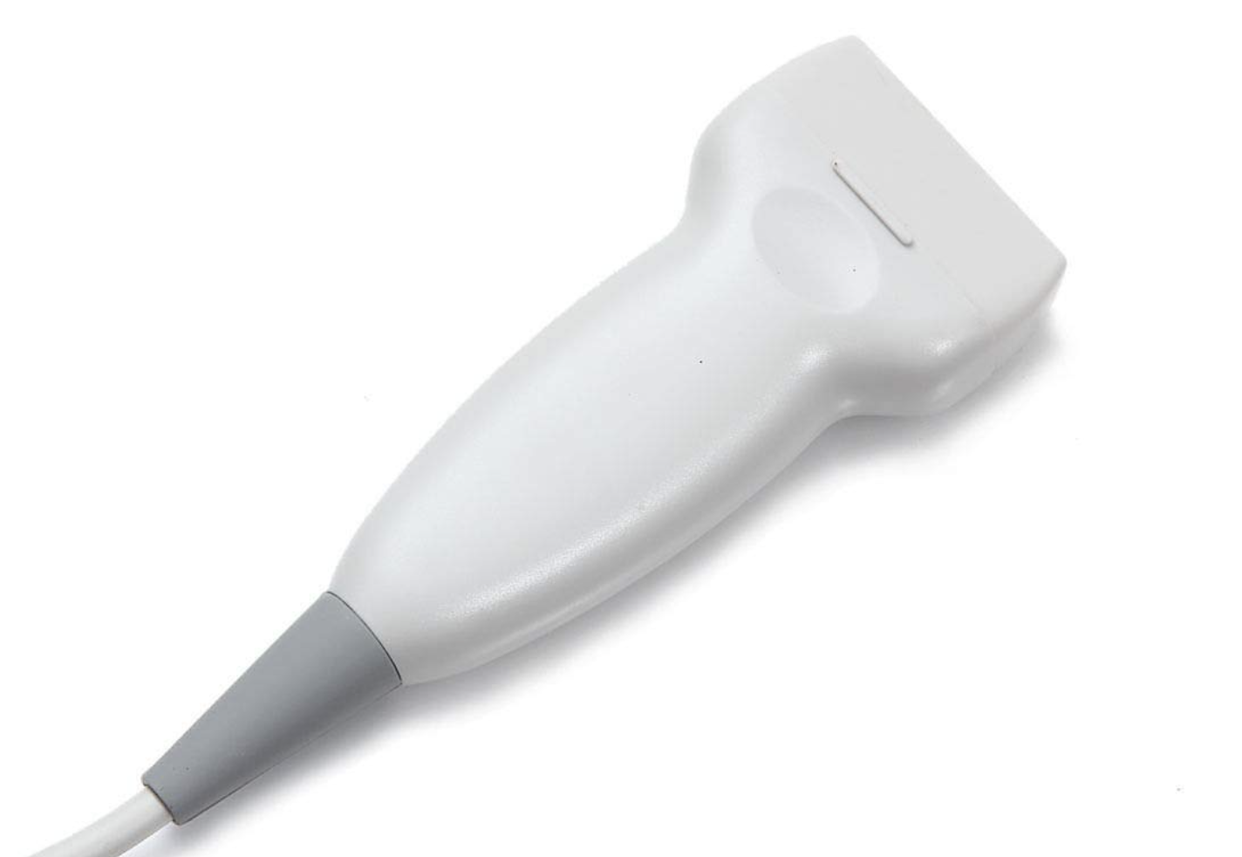
Sensitivity 85-100
Specificity 45-98
-Marks 2022
PPV 83.3%
NPV 95.4%
- Yen 2002

Slide 49
STAFF
Subcutaneous Thickening
Air
Fascial Fluid - Castleberg 2014
Fluid accumulation along the fascial plane Sn 85.4%
Subcutaneous Air Sp 100% (in appropriate clinical setting) - Marks 2022
Notes:
Some ultrasound findings, including an irregularity of the fascia and an abnormal fluid collection along the fascial plane can help distinguish between the NSTI and cellulitis [16]. However, this evaluation is more difficult, strengthening the importance of taking the information obtained by POCUS together with the clinical evaluation and laboratory results. - Luís Magalhães 2020
May be useful similarly to FAST exam in Trauma patients, to expedite surgical intervention prior to more lengthy imaging modalities (Casteleberg)
** Gas will not form in aerobic monomicrobial infections like GAS

Slide 50
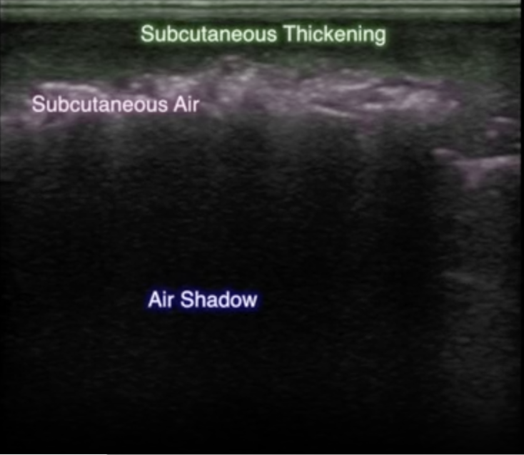
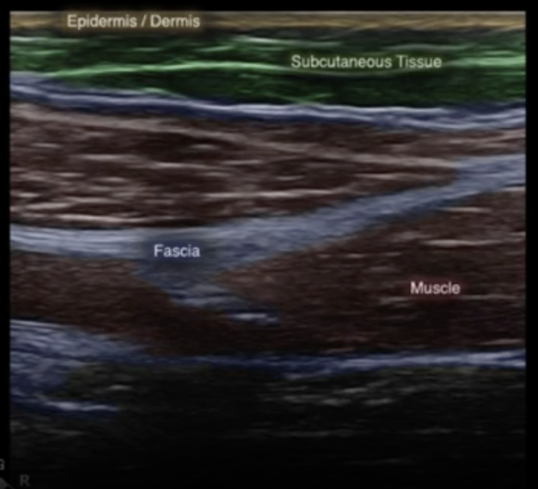
Castleberg 2014

Slide 51
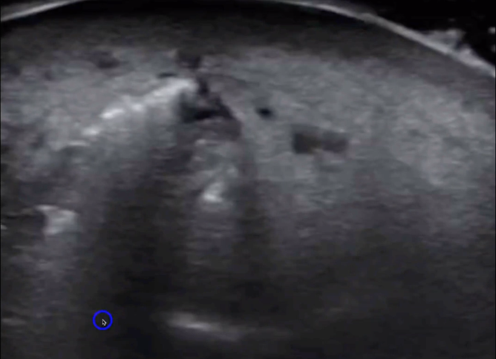
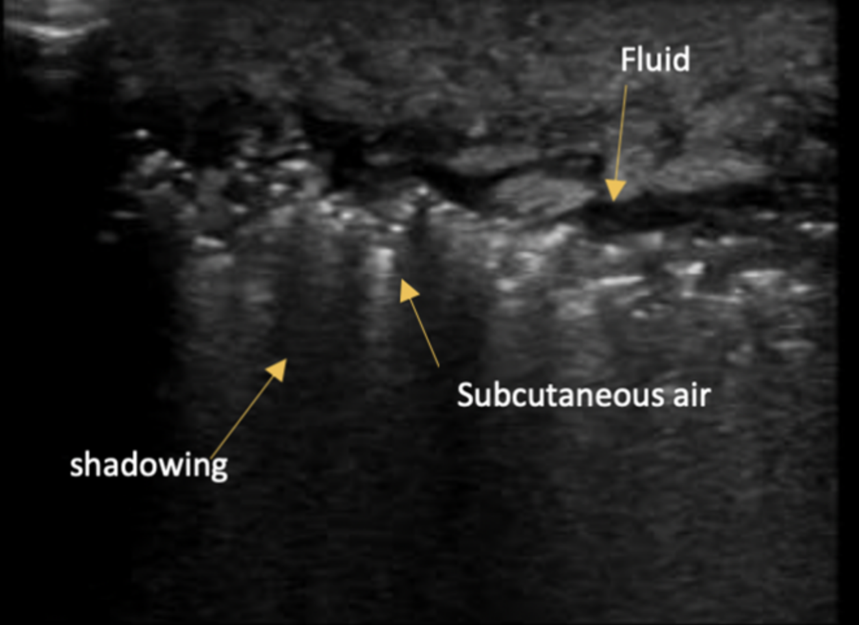
5 Minute Sono by Dr. Jacob Avila
BrownEMBlog.com

Slide 52
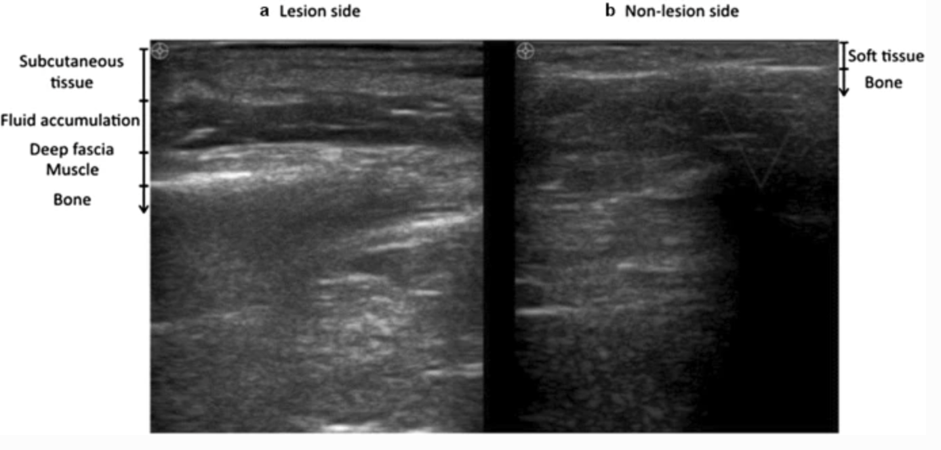
Lin 2019; Gan 2023
Notes:
Note that it could be useful to compare findings to the unaffected contralateral side

Slide 53
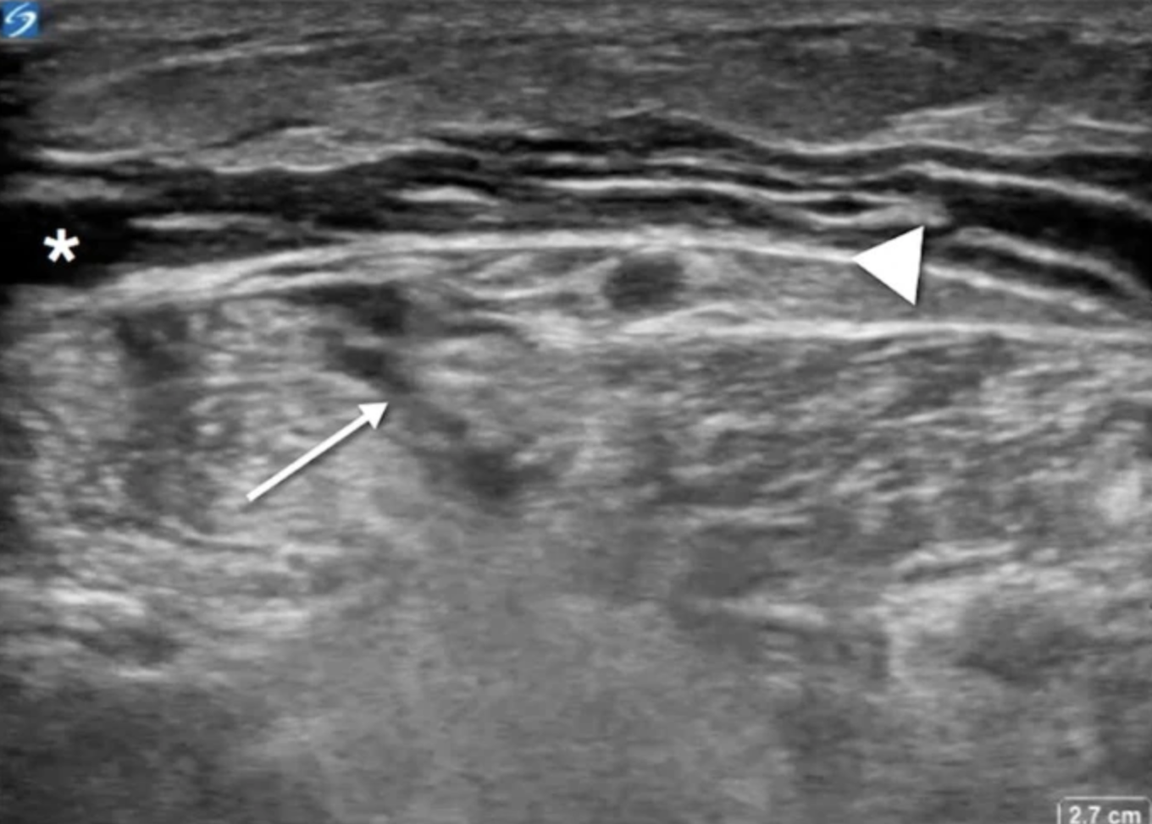
Fozard 2020
Notes:
Transverse view of posterior left lower extremity distal to popliteal crease. Fascia is indicated by arrowhead. Anechoic fluid collection is noted anterior to fascia (*). Deep to fascial layer, a complex fluid collection is noted (arrow) with diffuse hyperechogenicity of gastrocnemius

Slide 54
Notes:
None of these imaging modalities is 100% Sensitive so the only way to not miss necrotizing infections is to surgically explore the area.

Slide 55
Treatment

Slide 56
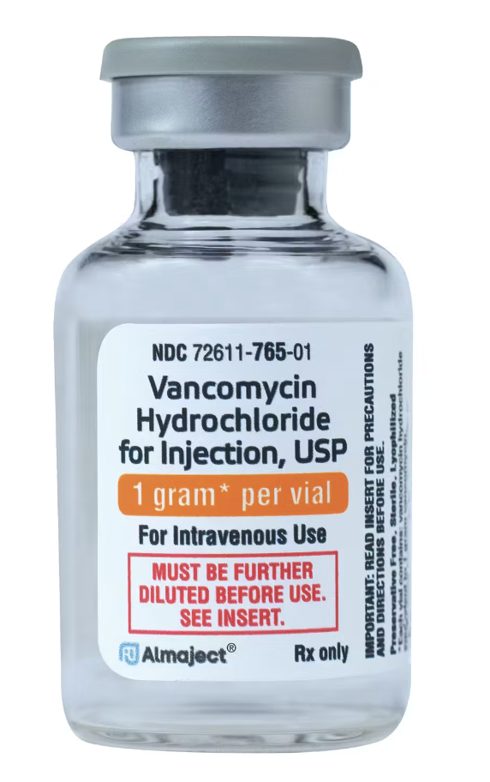
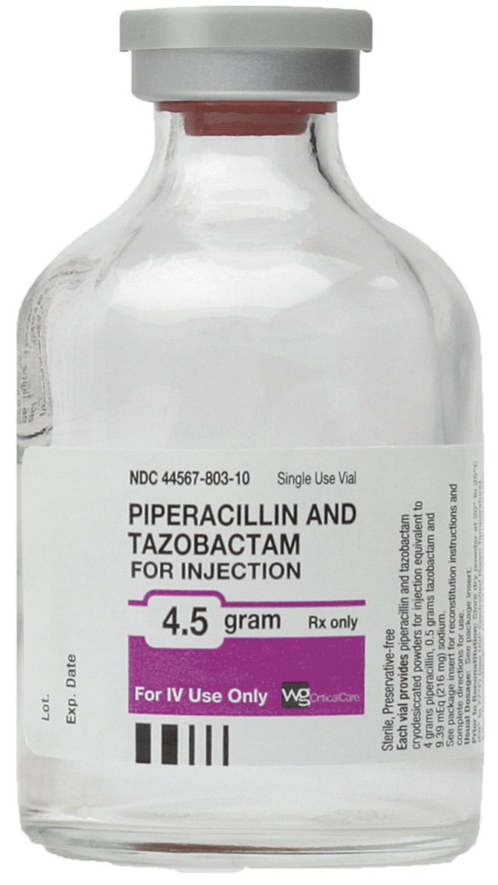
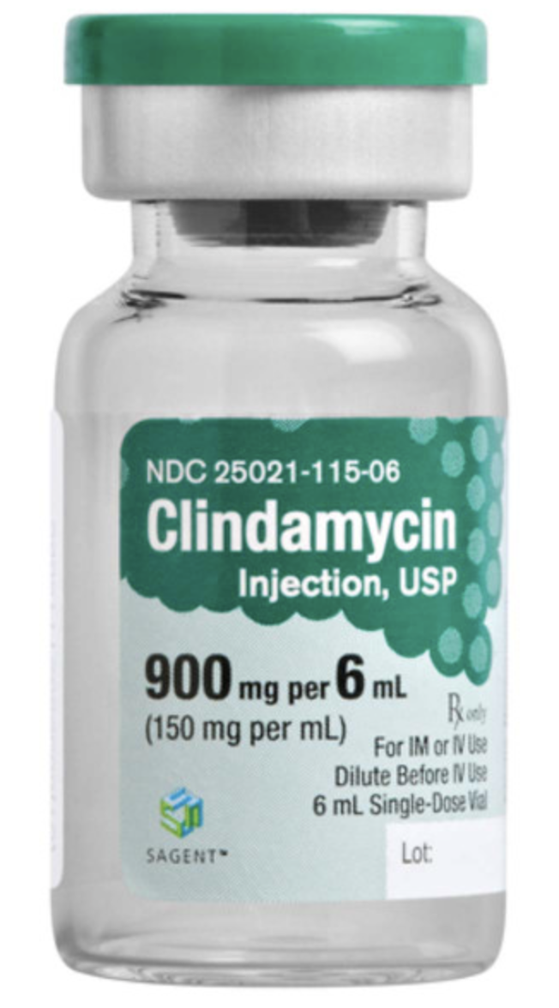
Notes:
Of course you want o get antibiotics in these patients as soon as possible, but the definitive diagnosis is surgical debridement and washout
Polymicrobial infections get MRSA and anaerobe coverage Vanc/linezolid and one of piperacillin/tazobactam, carbapenem, CTX/metronidazole, fluoroquinolone/metronidazole
GAS infections should be treated with a penicillin and clindamycin since clindamycin has been shown to suppress strep toxin and cytokine production

Slide 57
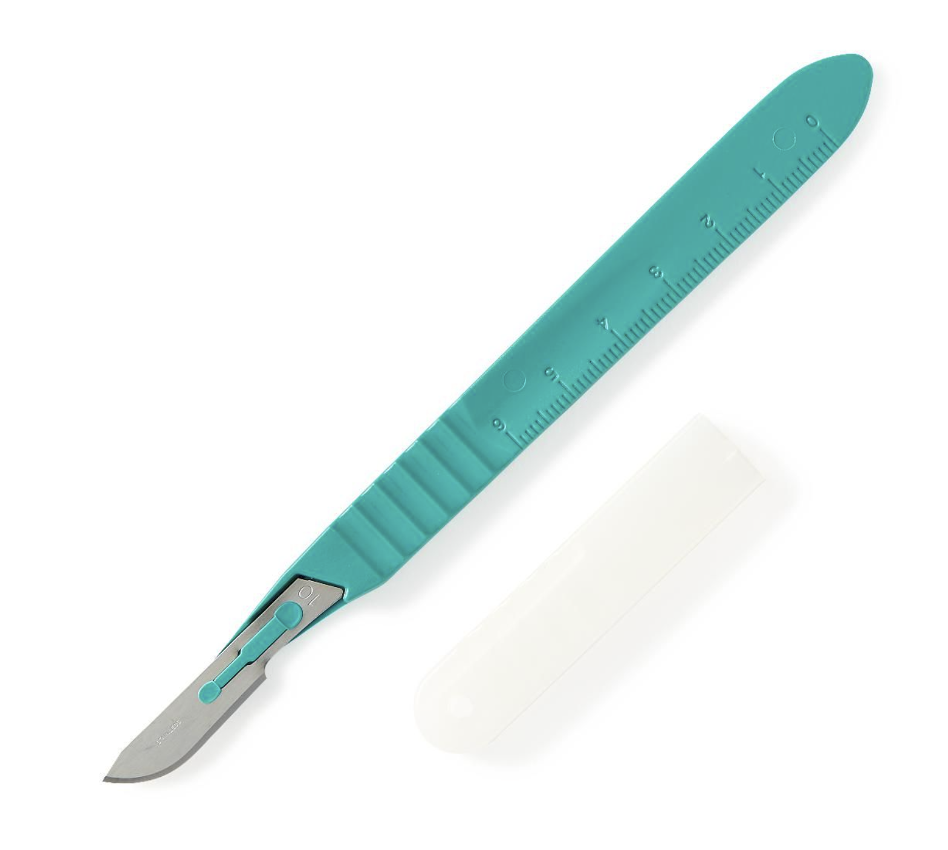

Slide 58
Questions for Iralu
How long do you recommend continuing antibiotics in these cases?
Is Linezolid a reasonable alternative to clindamycin as an agent to reduce toxin production?
Is there a role for IVIG in necrotizing soft tissue infections?

Slide 59
Diabetic foot infections
Polymicrobial, associated with anaerobic environment, compromised vasculature, and can sometimes progress to NSTI - Bonne

Slide 60
Resources
Bonne, Stephanie L., and Sameer S. Kadri. "Evaluation and management of necrotizing soft tissue infections." Infectious Disease Clinics 31.3 (2017): 497-511.
Al Alayed, Khalid, Charlie Tan, and Nick Daneman. "Red flags for necrotizing fasciitis: a case control study." International Journal of Infectious Diseases 36 (2015): 15-20.

Slide 61
Resources (radiology)
Tso, D. K., & Singh, A. K. (2018). Necrotizing fasciitis of the lower extremity: imaging pearls and pitfalls. The British Journal of Radiology, 91(1088), 20180093.
Kwee, R. M., & Kwee, T. C. (2022). Diagnostic performance of MRI and CT in diagnosing necrotizing soft tissue infection: a systematic review. Skeletal Radiology, 1-10.
Yen, Zui‐Shen, et al. "Ultrasonographic screening of clinically‐suspected necrotizing fasciitis." Academic emergency medicine 9.12 (2002): 1448-1451.
Gan, Rick Kye, et al. "Point-of-care ultrasonography in diagnosing necrotizing fasciitis—a literature review." Journal of ultrasound (2023): 1-11.
Lin CN, Hsiao CT, Chang CP, Huang TY, Hsiao KY, Chen YC et al (2019) The relationship between fluid accumulation in ultrasonography and the diagnosis and prognosis of patients with necrotizing fasciitis. Ultrasound Med Biol 45(7):1545–1550.
Fozard, Jessica, Krystle Shafer, and Thompson Kehrl. "Sonographic exploration for fascial exploration (SEFE) in necrotizing fasciitis: a case report." The Ultrasound Journal 12 (2020): 1-4.
Marks, A., Patel, D., Sundaram, T., Johnson, J., & Gottlieb, M. (2022). Ultrasound for the diagnosis of necrotizing fasciitis: A systematic review of the literature. The American Journal of Emergency Medicine.
Magalhães, L., Martins, S. R. P., & Nogué, R. (2020). The role of point-of-care ultrasound in the diagnosis and management of necrotizing soft tissue infections. The ultrasound journal, 12(1), 1-6.
Castleberg, E., Jenson, N., & Am Dinh, V. (2014). Diagnosis of necrotizing faciitis with bedside ultrasound: the STAFF Exam. Western Journal of Emergency Medicine, 15(1), 111.

Slide 62
Stevens, Dennis L., et al. "Practice guidelines for the diagnosis and management of skin and soft tissue infections: 2014 update by the Infectious Diseases Society of America." Clinical infectious diseases 59.2 (2014): e10-e52.

