Slide 1

Hepatitis C Virus (HCV):
An Overview for the Primary Care Provider
Jorge Mera, MD, FACP
ECHO Clinic Director
NPAIHB

Slide 2
Objectives:
At the end of this presentation participants will be able to:
Understand the epidemiology of HCV
Describe the clinical manifestations of HCV
Develop a plan to evaluate and treat patients with current HCV in their practice

Slide 3
Outline
The Problem
Diagnosis, evaluation and treatment
Clinical presentation
Epidemiology

Slide 4
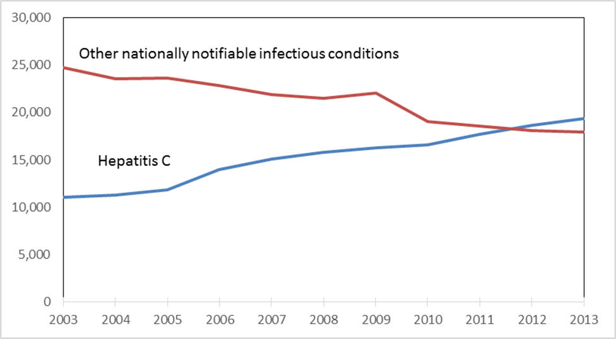

HCV Deaths and Deaths from Other
Nationally Notifiable Infectious Diseases,* 2003- 2013
* TB, HIV, Hepatitis B and 57 other infectious conditions reported to CDC
Holmberg S, et al. “Continued Rising Mortality from Hepatitis C Virus in the United States, 2003-2013”
Presented at ID Week 2015, October 10, 2015, San Diego, CA

Slide 5
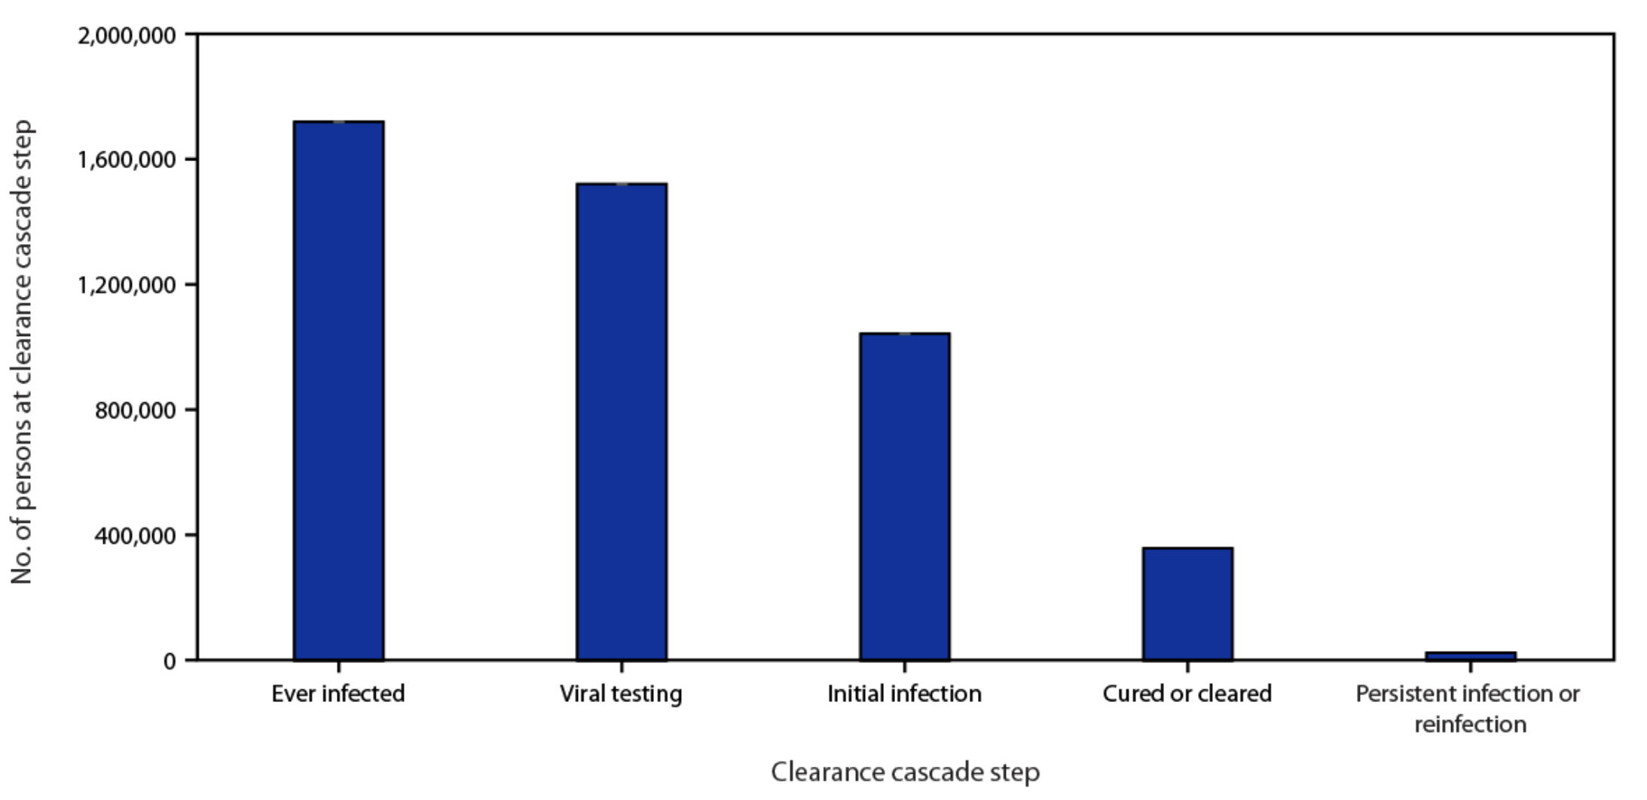
Hepatitis C virus clearance cascade using national commercial laboratory data — United States, 2013–2022
The prevalence of viral clearance among persons with diagnosed hepatitis C was only 34% overall
This clearance was even lower (16%) among persons aged 20–39 years with other payor (client or self-pay) insurance.
Wester C, Osinubi A, Kaufman HW, et al. Hepatitis C Virus Clearance Cascade — United States, 2013–2022. MMWR Morb Mortal Wkly Rep 2023;72:716–720

Slide 6
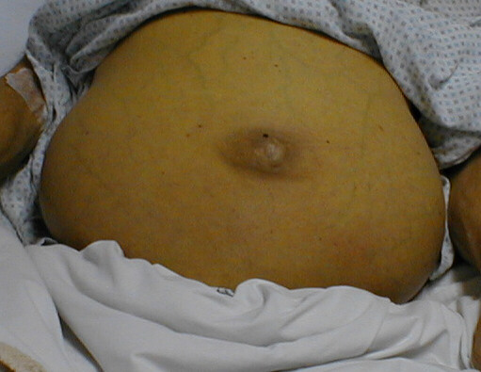
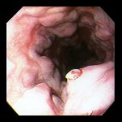
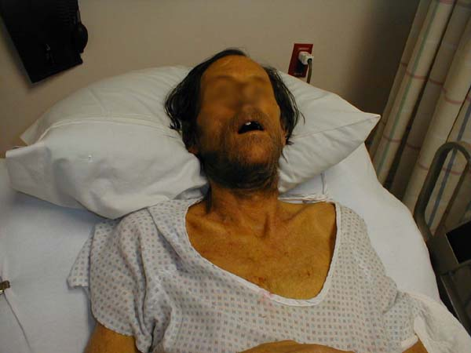
What Are We Trying To Achieve?
At the individual level
At Public Health Level
Decrease
Decrease Mortality by 65%*
Decrease
Decrease Incidence by 90%*
Eliminate
Eliminate HCV as a Public Health Problem*
Ascites
Esophageal Varices
End Stage Liver Disease
* WHO 2030 goals for HCV Elimination

Slide 7
Outline
The Problem
Diagnosis, evaluation and treatment
Clinical presentation
Epidemiology

Slide 8
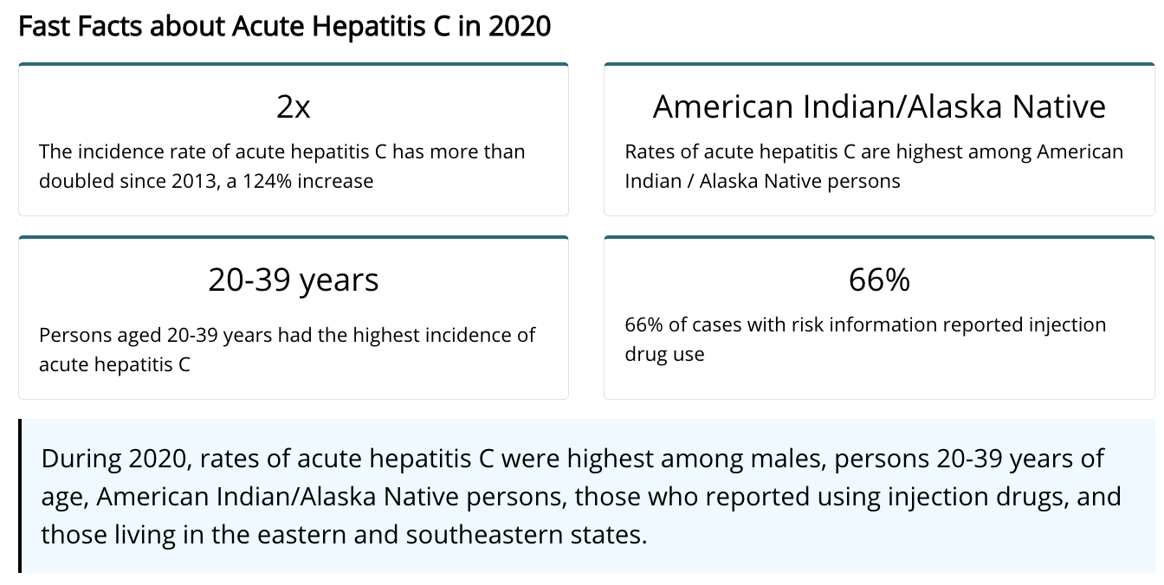
HCV FACTS in the United States, 2020
HCV-associated deaths increased 4% compared to 2019
Death rates were 3.2 times higher among AI/AN compared to white persons

Slide 9
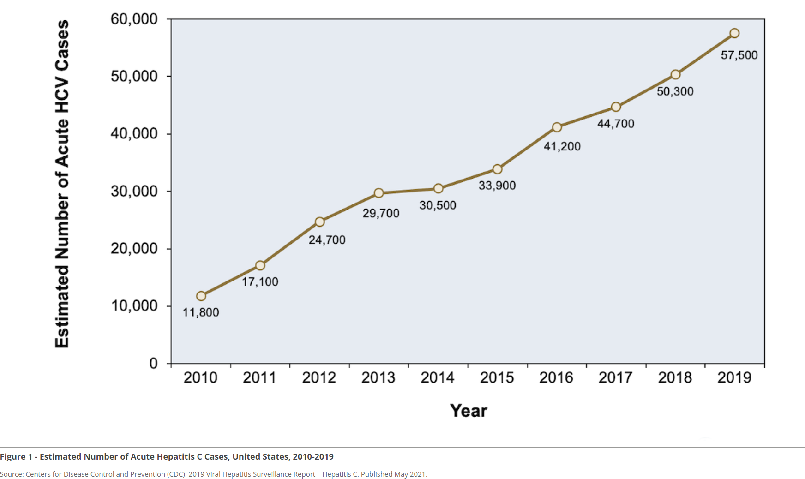
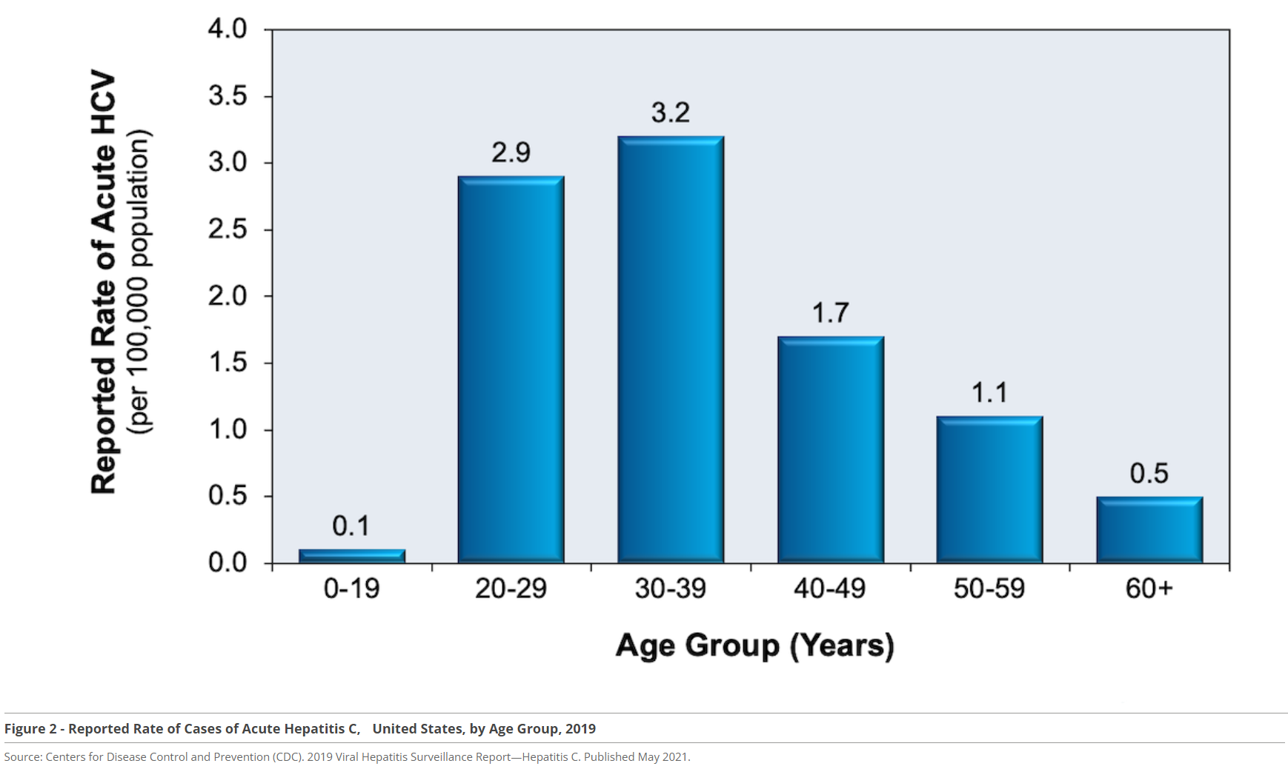
Acute HCV on the Rise: Younger People Affected

Slide 10
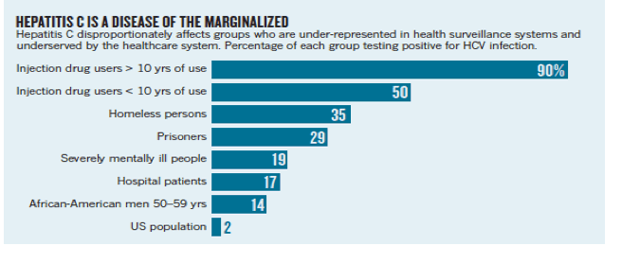
Social Determinants of Health Define the HCV Epidemic in the U.S.
Edlin, B.R., 2011. Perspective: test and treat this silent killer. Nature 474 (7350),S18–S19.

Slide 11

HCV: Transmission
Blood
  IVDU is the leading cause in the United States
    Snorting
  Percutaneous injuries
  Dental
  Tattooing
  Blood transfusion (Before 1992)
Sexual contact
  Rare in heterosexual
  More frequent in HIV + MSM
Mother-to-child
  The rate is 1.7% - 4.3 %
  Increased in IVDU, HIV co-infection, VL (?)
PWID
Sexual
Transfusion
Other*
Unknown
*Nosocomial; Health-care work; Perinatal
Centers for Disease Control and Prevention. Viral Hepatitis Surveillance—United States, 2016.
Atlanta: US Department of Health and Human Services, Centers for Disease Control and Prevention; 2018.
Available at: https://www.cdc.gov/hepatitis/statistics/2016surveillance/index.htm.
Notes:
OVERVIEW OF RISK FACTORS FOR HCV ACQUISITION
Investigators and public health officials have identified multiple risk factors for acquiring HCV in the United States: injection drug use, history of receiving a blood product transfusion prior to July 1992, receipt of a solid organ transplantation, hemophilia with receipt of factor concentrates made before 1987, male-to-male sex, body tattoos, and intranasal cocaine use.^{[17,21,22,23]} Among these, injection drug use is the most common and important risk factor for acquiring HCV in the United States. Several studies have indicated that approximately 45% of persons with HCV infection do not report an exposure. Many of these patients, after undergoing careful questioning, eventually identified injection drug use as a risk factor. In the 1970s and 1980s, receipt of HCV-infected blood products or organs accounted for nearly 50% of new cases of HCV, but after the discovery of HCV as the cause of non-A, non-B hepatitis in 1989 and introduction of blood screening tests in the early 1990s, the proportion of new HCV cases caused by contaminated blood or organs dramatically declined.^{[7,22,24,25]} Persons in different ethnic groups may have relatively different routes of acquiring HCV.
INJECTION DRUG USE
Injection drug use remains the most common risk factor for acquiring HCV in the United States, accounting for more than 60% of all cases of HCV.^{[26]} Approximately 20 to 30% of persons who inject drugs become infected with HCV within the first 2 years of starting to inject drugs and 50% within 5 years.^{[27]} Transmission risk is greatest with “direct sharing” of needles and syringes, but may also occur indirectly via sharing of injection paraphernalia, such as water, cookers, and cotton filters.^{[28,29,30]} The incidence of HCV in persons who inject drugs markedly declined from early 1992-2002, likely due to increased availability of needle exchange programs that arose in response to the HIV epidemic.^{[29,31]} Since about 2002, however, multiple reports have documented a surge in HCV infections in the United States among young persons who inject drugs.^{[3,4,5,32]} This surge in HCV infections in the United States is intricately connected with the ongoing opioid epidemic and its associated injection drug use.^{[3,5,6]} These reports identified a new cohort of persons diagnosed with HCV who inject drugs and have the following characteristics: age younger than 30 years, White race, residence in nonurban areas, and use of oral prescription opiates prior to using heroin.^{[5,6]} Regions of the United States east of the Mississippi River have been most heavily impacted, with a particularly high intensity of new HCV cases in the central Appalachian region.^{[3,5]}
NONINJECTION DRUG USE
The role of noninjection drug use, such as snorting crack cocaine, powder cocaine, methamphetamines, or heroin, as a risk factor for acquiring hepatitis C remains controversial.^{[33]} The risk of acquiring HCV is plausible with use of pipes that may cause burns in the oral mucosa (with possible open mouth sores) or use of straws or tubing that causes erosion of nasal membranes (with bleeding in the nasal passage). Sharing these blood-contaminated devices could then lead to HCV transmission. The prevalence of HCV in people who use noninjection drugs ranges from 2.3 to 35.3%. It is possible that use of noninjection drugs is a surrogate for other risk activities associated with HCV acquisition.
SEXUAL EXPOSURE
The risk of acquiring HCV through sexual contact with a person who has HCV infection remains highly controversial. Overall, sexual transmission has accounted for up to 15% of cases of HCV in the United States, but very close interrogation revealed that most cases of sexual transmission also involved injection drug use as a risk factor. Multiple studies involving monogamous heterosexual couples have shown a rate of HCV transmission less than 1% per year.^{[34,35,36,37]} In a study involving 500 anti-HCV-positive, HIV-negative subjects and their long-term monogamous heterosexual partners, investigators reported transmission of HCV by sex at a rate of 0.07% per year among the couples, which translates to approximately 1 per 190,000 sexual contacts.^{[38]} In recent years, multiple reports have identified cases of sexual transmission among men who have sex with men (MSM), particularly men with HIV who have sex with other men.^{[39,40,41,42]} Specific factors identified with HCV transmission among MSM include coinfection with HIV, use of recreational drugs during sex, and certain sex practices that result in rectal bleeding or damage to the rectal mucosa, including fisting and use of shared sex toys.^{[39,43]}
CHRONIC HEMODIALYSIS
The prevalence of HCV infection in persons receiving hemodialysis is approximately 8%, which is nearly 5-fold higher than the general United States population.^{[44]} Several risk factors have been identified for dialysis patients acquiring HCV, including number of blood transfusions received, number of years on dialysis, mode of dialysis (hemodialysis poses greater risk than peritoneal dialysis), and the prevalence of HCV in the dialysis unit. In the United States, multiple dialysis-associated HCV outbreaks have occurred. In most cases, HCV transmission likely resulted from inadequate infection control practices, particularly in situations when patients received dialysis immediately after a patient with HCV infection received dialysis.^{[45,46,47,48]} The CDC does not recommend using dedicated dialysis machines for patients with HCV, but recommends universal precautions and strict sterilization procedures for all dialysis machines.^{[49]}
RECEIPT OF CLOTTING FACTOR CONCENTRATES
Two types of clotting factor concentrates are used in clinical practice: plasma factor concentrate and recombinant factor concentrate. Most often, these involve use of factor VIII or factor IX concentrates. In the late 1970s through the mid-1980s, most persons with hemophilia acquired HCV infection via the receipt of contaminated plasma clotting factor concentrates.^{[50,51,52]} In 1985, several companies introduced virus inactivation procedures for hemophilia blood products and by 1987 these procedures were uniformly used, virtually eliminating the risk of transmission of HCV via clotting factor concentrates. Use of recombinant factor concentrate also provides an option for providing factor concentrate with no risk of viral contamination.
RECEIPT OF TRANSFUSION OF BLOOD PRODUCTS
In the 1960s, the risk of acquiring HCV from a blood transfusion was approximately 33%. The universal screening of blood and organ donors with routine use of second-generation HCV antibody tests in 1992 nearly eliminated subsequent risk of transfusion-associated HCV.^{[25,31,53]} In the mid-1990s, the risk of acquiring HCV from a blood transfusion had declined to less than 0.3%.^{[25,54]} The estimated risk of acquiring HCV from a blood transfusion decreased further following the introduction, in 1999, of HCV nucleic acid testing (NAT) as a supplement to HCV antibody testing of blood products.^{[54,55]} Blood banks in the United States now use a combination of the third-generation enzyme-linked immunosorbent assay (ELISA) and NAT screening of mini-pool testing (16 samples). The current estimated risk of acquiring HCV from a transfusion in the United States is approximately 1 in 2 million.
RECEIPT OF IMMUNE GLOBULIN
Scattered cases and outbreaks of HCV transmission via gamma globulin have occurred in the United States and in Europe.^{[56,57,58]} In 1993 and 1994, a major outbreak of HCV transmission in the United States occurred following patient receipt of HCV-contaminated lots of intravenous immune globulin, with a total of 23 persons acquiring HCV.^{[56]} Advances in virus inactivation procedures have nearly eliminated any risk of HCV transmission with immune globulin, and the manufacturers of intravenous immune globulin use vigorous viral inactivation and removal procedures. No cases of HCV transmission have been documented with administration of intramuscular immune globulin. All immune globulin products undergo solvent detergent.
ORGAN AND TISSUE TRANSPLANTATION
Rare cases of inadvertent HCV transmission via organ or tissue transplantation have occurred in the United States.^{[59,60]} Most cases of transmission have involved HCV antibody-negative, HCV RNA-positive donors.^{[59,60]} Among transplant recipients who receive HCV-infected organs or tissues, the risk of developing chronic HCV infection is high. With the advent of more accurate testing methods for donors, the risk of HCV transmission in this setting has markedly declined. In 2013, the U.S. Public Health Service drafted updated guidelines for prevention of HCV transmission through organ transplantation and these guidelines recommend HCV RNA testing (NAT) of all organ and tissue donors.^{[61]}
PERINATAL
In the United States, due to the opioid epidemic, there has been a significant increase in HCV infection in recent years among women of childbearing age; this trend has raised concerns for a potentially significant increase in perinatal HCV infections.^{[62,63]} Among pregnant women with chronic HCV infection, approximately 6% will transmit HCV to their child.^{[64,65,66]} Nearly all cases of perinatal HCV transmission have involved mothers who had detectable HCV RNA in plasma during pregnancy. Women coinfected with HIV and HCV have an approximately twofold higher risk of perinatal HCV transmission when compared with women who have HCV monoinfection.^{[64]} The risk of HCV transmission via breastfeeding appears to be negligible.^{[64,65,66]}
HOUSEHOLD CONTACT
Acquiring HCV via nonsexual household contact with a person infected with HCV can occur, but the number of documented cases is extremely low.^{[67,68]} Transmission in this setting would most likely involve sharing a razor or toothbrush, since this process could involve transmission via a blood-tainted device.
TATTOOS AND PIERCINGS
In the United States, the risk of acquiring HCV from a licensed, regulated professional tattoo or piercing center is extremely low.^{[69]} Tattoos performed in unregulated and unlicensed tattoo centers, such as with tattoos applied by friends or in prison, increases the risk for HCV acquisition.^{[69,70]}

Slide 12
HCV Transmission and Injection Drug Use
Today, > 80% Occurs in PWID
All paraphernalia are involved in Transmission
  Needle
  Syringe
  Cooker
  Table
  Tourniquet
~20 to 30% of PWID become infected with within the first 2 years of starting to inject drugs
Transmission risk is greatest with “direct sharing” of needles and syringes
But may also occur indirectly via sharing of injection paraphernalia
50% within 5 years
PWID: People Who Inject Drugs
Palmateer N, Hutchinson S, McAllister G et al. Risk of transmission associated with sharing drug injecting paraphernalia: analysis of recent hepatitis C virus (HCV) infection using cross-sectional survey data. J Viral Hepatol 2014 Jan;21(1):25-32

Slide 13
Outline
The Problem
Diagnosis, evaluation and treatment
Clinical presentation
Epidemiology

Slide 14
Symptoms of HCV
Most patients are asymptomatic
Impaired Cognitive Function - "Brain Fog"
Migratory arthralgia/myalgia
Often misdiagnosed as rheumatoid arthritis
Depression
Common symptoms
Fatigue

Slide 15
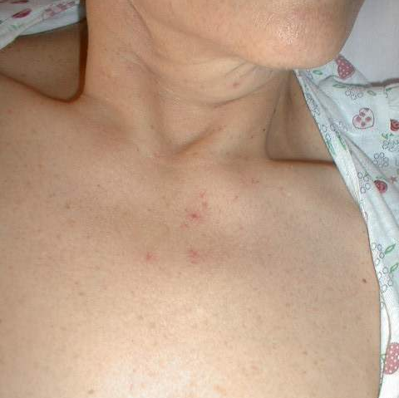
Physical Findings
Most Patients do not have any abnormal physical findings
In patients with cirrhosis, you may find
  Spider angiomas
  Palmar erythema
  Gynecomastia
  Testicular atrophy
  Jaundice
  Firm liver
  Parotid hypertrophy

Slide 16
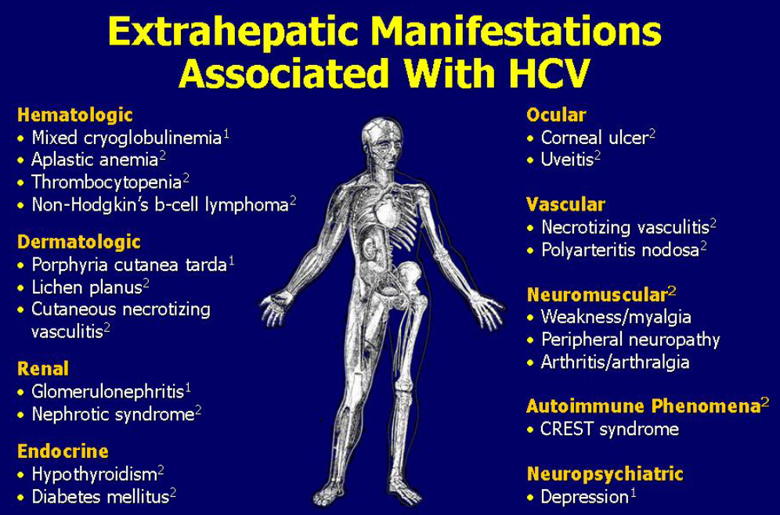

HCV Extrahepatic Manifestations
40% of people with HCV will develop at least 1 extrahepatic manifestation often not clinically recognized
Consider HCV as a potential etiology of these conditions in patients who do not carry an HCV diagnosis
Extrahepatic manifestations can occur at any stage of disease
High index of suspicion is needed for these conditions regardless of the presence of cirrhosis

Slide 17
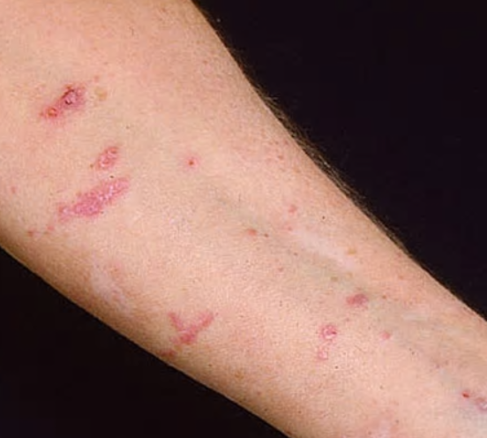
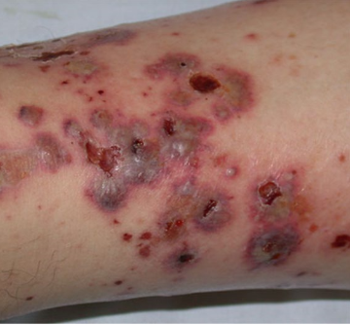
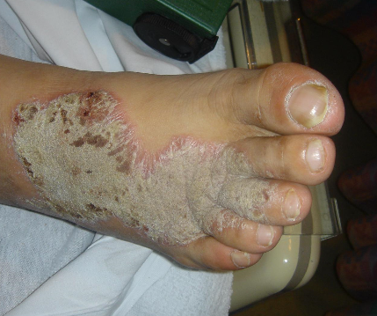
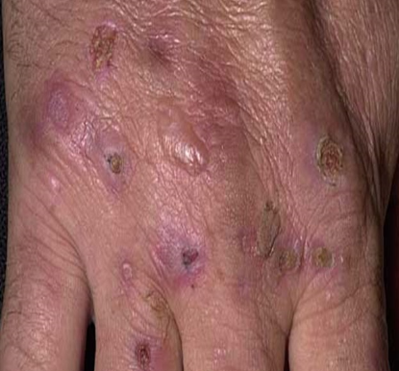
Dermatologic Manifestations
1
2
1: Lichen planus
2: Leukocytoclastic vasculitis
3: Necrolytic acral erythema
4: Porphyria cutaneous tarda
3
4

Slide 18
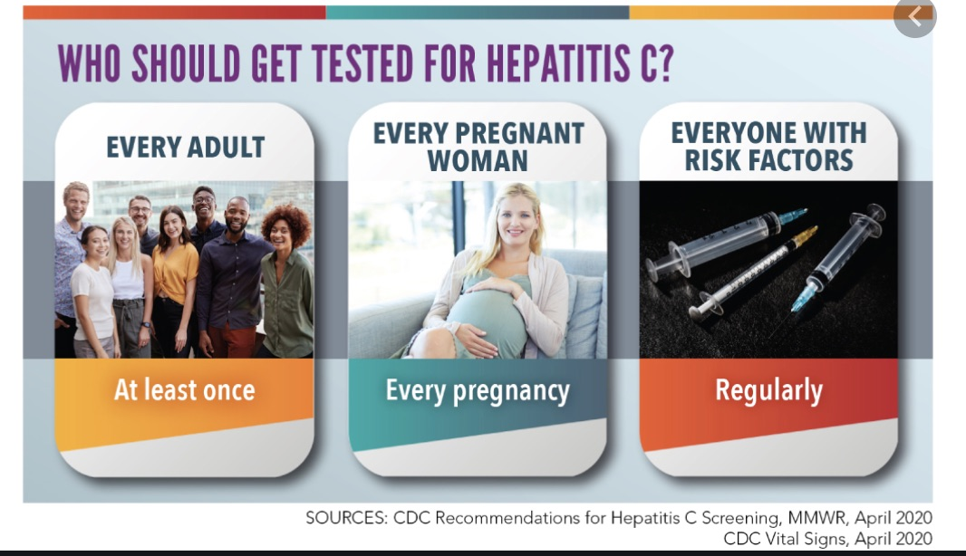
CDC is Augmenting Previous Guidance With Two New Recommendations:
Hepatitis C screening at least once in a lifetime for all adults aged ≥18 years, except in settings where the prevalence of HCV infection is <0.1% and
Hepatitis C screening for all pregnant women during each pregnancy, except in settings where the prevalence of HCV infection is <0.1%.
The recommendation for HCV testing that remains unchanged is regardless of age or setting prevalence, all persons with risk factors should be tested for hepatitis C, with periodic testing while risk factors persist.
Any person who requests hepatitis C testing should receive it, regardless of disclosure of risk, because many persons might be reluctant to disclose stigmatizing risks.
Schillie S, Wester C, Osborne M, Wesolowski L, et al. MMWR Recomm Rep 2020;69(No. RR-2):1–17.

Slide 19
CDC HCV Screening Recommendations:
At least once in a lifetime for all adults aged ≥18 years
All pregnant women during each pregnancy
All persons with risk factors should be tested for hepatitis C, with periodic testing while risk factors persist.
Any person who requests hepatitis C testing should receive it, regardless of disclosure of risk, because many persons might be reluctant to disclose stigmatizing risks.
Schillie S, Wester C, Osborne M, Wesolowski L, et al. MMWR Recomm Rep 2020;69(No. RR-2):1–17.

Slide 20
How to Improve HCV Screening
Think outside of traditional screening sites
1
Incentives
2
Patients
Point of care testing
3
Immediate link to care
Health care workers

Slide 21
HCV Screening: Beyond Baby Boomers and Primary Care
Opioid treatment programs
Behavioral health clinics
Emergency department/Urgent cares
Prisons/Jails
Homeless Shelters
Clinics on the move – mobile units
Community events
Surgery centers
Universal Screening
Expanded Sites
Age-based
Without regard for risk factors

Slide 22
Outline
The Problem
Diagnosis, evaluation and treatment
Clinical presentation
Epidemiology

Slide 23

HCV Workflow
Confirm Diagnosis
Lab/Imaging workup
Fibrosis Staging
Critical Information
Treatment
Cure
Surveillance

Slide 24
Confirm the Diagnosis
HCV
antibody
Nonreactive
Reactive
No HCV antibody detected
Not detected
HCV
RNA
Detected
No current HCV infection
Current HCV infection
STOP*
Additional testing as appropriate**
Link to care
* For persons who might have been exposed to HCV within the past 6 months, testing for HCV RNA or follow-up testing for HCV antibody is recommended. For persons who are immunocompromised, testing for HCV RNA can be considered.
** To differentiate past, resolved HCV infection from biologic false positivity for HCV antibody, testing with another HCV antibody assay can be considered. Repeat HCV RNA testing if the person tested is suspected to have had HCV exposure within the past 6 months or has clinical evidence of HCV disease, or if there is concern regarding the handling or storage of the test specimen. CDC. Testing for HCV infection. MMWR. 2013;62(18).
Notes:
CDC. Recommended Testing Sequence for Identifying Current Hepatitis C Virus (HCV) Infection. http://www.cdc.gov/hepatitis/hcv/labtesting.htm.
*For persons who might have been exposed to HCV within the past 6 months, testing for HCV RNA or follow-up testing for HCV antibody is recommended. For persons who are immunocompromised, testing for HCV RNA can be considered.
†To differentiate past, resolved HCV infection from biologic false positivity for HCV antibody, testing with another HCV antibody assay can be considered. Repeat HCV RNA testing if the person tested is suspected to have had HCV exposure within the past 6 months or has clinical evidence of HCV disease, or if there is concern regarding the handling or storage of the test specimen. Source: CDC. Testing for HCV infection: An update of guidance for clinicians and laboratorians. MMWR 2013;62(18).

Slide 25
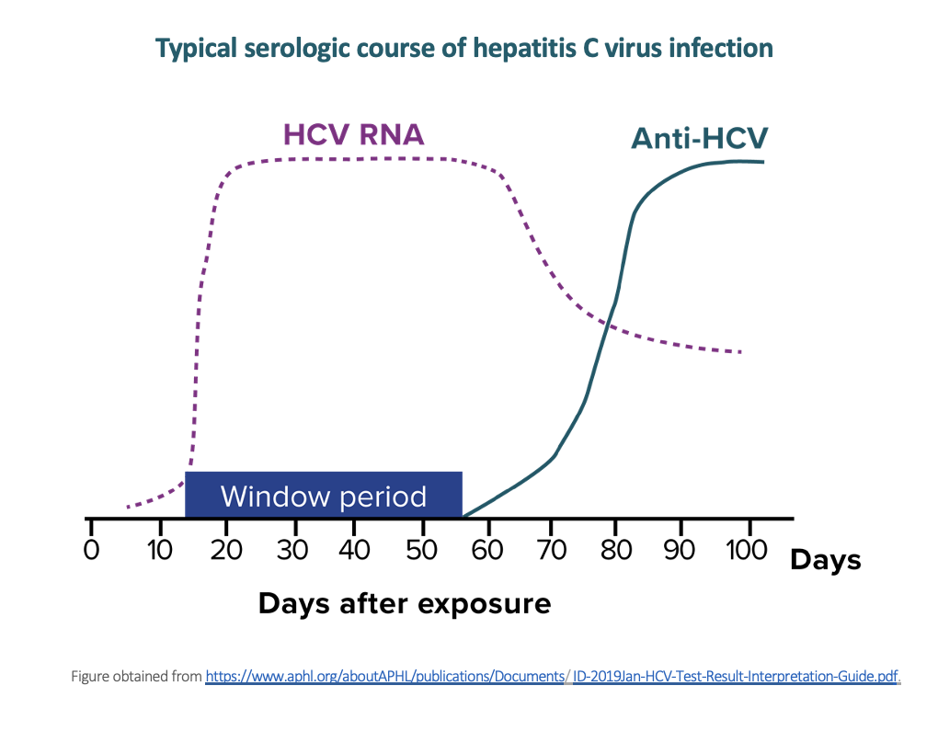
HCV antibody False Negative

Slide 26

HCV RNA: Viral Load
Number of virus particles (RNA) per mL of blood
Confirms current infection
  15-30% of acutely infected patients spontaneously resolve
It defines cure
  When the viral load is not detected 12 weeks after treatment is complete - sustained virological response (SVR 12)
Does not predict liver disease progression

Slide 27
HCV Workflow
Confirm Diagnosis
Lab/Imaging workup
Fibrosis Staging
Critical Information
Treatment
Cure
Surveillance

Slide 28
Laboratory Workup
Genotype
Determines treatment in certain cases
Three main genotypes in the US: GT1, GT2 and GT3
Hep A serology
Order Hep A total antibody or IgG antibody
If non-reactive, patient needs vaccination
Hep B serology
Immunization and to monitoring reactivation
Order HBsAg, HBcAb (total or IgG) and HBsAb
HIV serology
Important to treat HIV
Important to treat HCV (interaction with some HIV medications)

Slide 29
Laboratory Workup
CBC
Platelets are important for liver fibrosis staging
CMP
ALT/AST are important for liver fibrosis staging
UDS
Important to detect and address SUD
CMP: Comprehensive Metabolic Panel, SUD: Substance Use Disorder, UDS: Urinary Drug Screen

Slide 30

What is the Earliest Laboratory Marker for Cirrhosis?
Low albumin level
Elevated AST
Elevated ALT
Thrombocytopenia
Anemia
Leucopenia

Slide 31
What is the Earliest Laboratory Marker for Cirrhosis?
Low albumin level
Elevated AST
Elevated ALT
Thrombocytopenia
Anemia
Leucopenia

Slide 32
Imaging
Ultrasound
Specific for advanced liver disease but not sensitive
Nodular liver, ascites, splenomegaly, portal vein flow
Screens for liver cancer
May find other comorbidities such as fatty liver
Fibroscan
Used for liver fibrosis staging

Slide 33
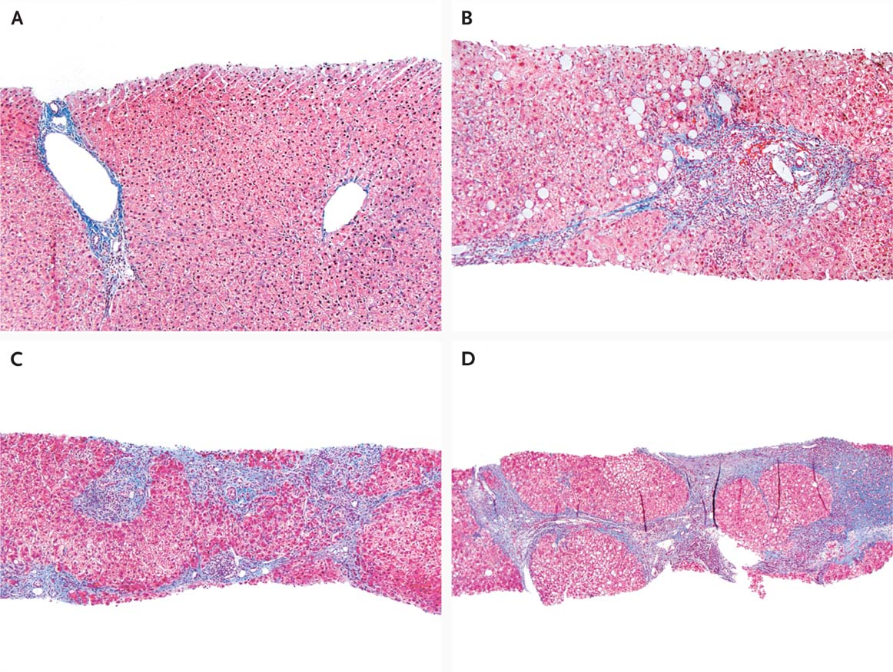

Liver Biopsy
Portal tract
Central vein
Stage 2: Portal and periportal fibrosis
F0: No fibrosis
F1: Scattered portal fibrosis
F2: Diffuse periportal fibrosis
F3: Bridging fibrosis
F4: Cirrhosis
        Compensated
        Decompensated
          History or presence of ascites
          History of esophageal bleeding due to esophageal varices
          History or presence of hepatic encephalopathy
Stage 3: Bridging Fibrosis
Stage 4: Regenerative nodules
Liver Biopsy
Rosen HR. N Engl J Med 2011;364:2429-2438
Notes:
Figure 2 Histologic Features of HCV Infection, According to Different Scoring Systems. Panel A (trichrome stain) shows the portal tract (left) and central vein (right) without substantial fibrosis. This corresponds to Batts–Ludwig stage 0, Metavir stage 0, and Ishak stage 0. Panel B (trichrome stain) shows portal fibrous expansion with periportal fibrosis. This corresponds to Batts–Ludwig stage 2, Metavir stage 2, and Ishak stage 3. Panel C (trichrome stain) shows bridging septal fibrosis with architectural distortion in the absence of regenerative nodules. This corresponds to Batts–Ludwig stage 3, Metavir stage 3, and Ishak stage 4. Panel D (trichrome stain) shows marked bridging fibrosis with numerous regenerative nodules. This corresponds to Batts–Ludwig stage 4, Metavir stage 4, and Ishak stage 6. Photographs courtesy of Maxwell Smith, M.D., Department of Pathology, University of Colorado, Denver. In the Metavir scoring system (0 to 4), stage 1 denotes minimal fibrosis, 2 scarring that extends outside the areas that contain blood vessels, 3 bridging fibrosis, and 4 cirrhosis. In the Batts–Ludwig system (0 to 4), stage 1 denotes portal fibrosis, 2 periportal or early bridging fibrosis with intact architecture, 3 fibrosis with architectural distortion, and 4 cirrhosis. In the Ishak system (0 to 6), stage 2 denotes fibrous expansion of most portal areas, 3 fibrous expansion of most portal areas with occasional portal-to-portal bridging, 4 fibrous expansion of most portal areas with marked bridging (both portal-to-portal and portal-to-central), 5 incomplete cirrhosis characterized by marked bridging and occasional nodules, and 6 probable or definite cirrhosis.11

Slide 34
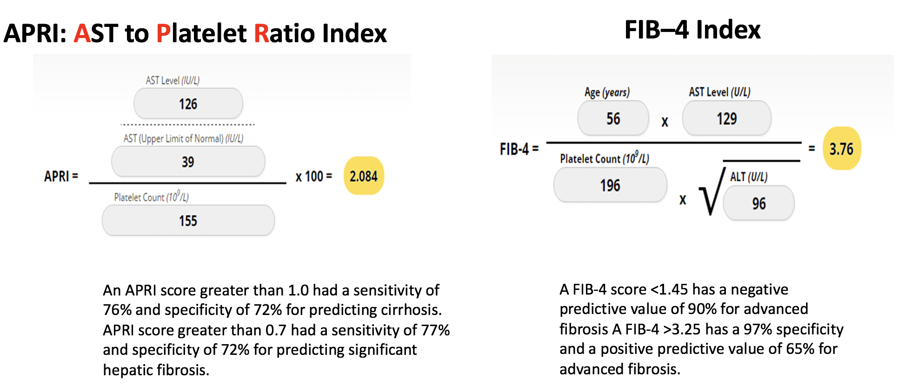
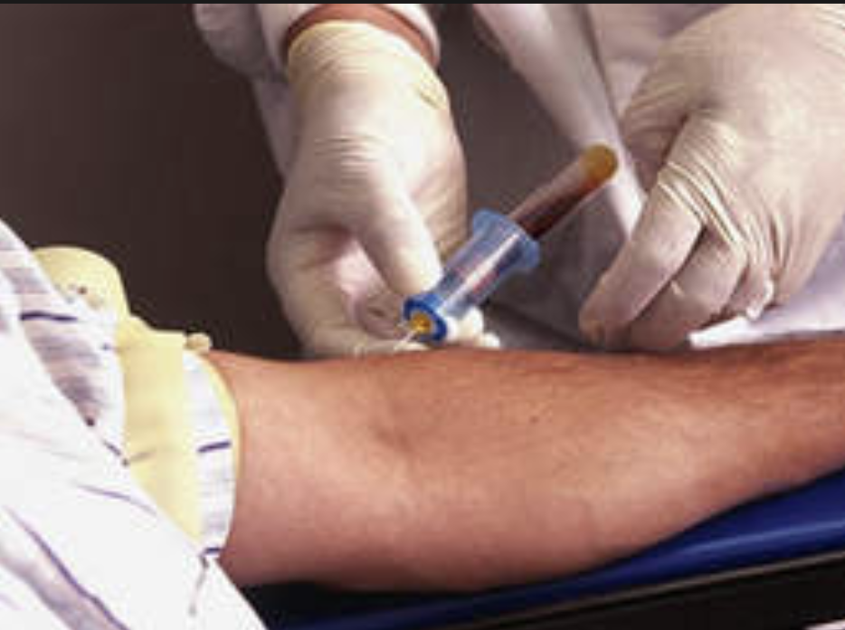
Non-Invasive Liver Fibrosis Staging in the Office
Fibrotest/Fibrosure
Lin ZH, Xin YN, Dong QJ, et al. Hepatology. 2011;53:726-36
Sterling RK, Lissen E, Clumeck N, et. al. Hepatology 2006;43:1317-1325
University of Washington: Hepatitis C Online www.hepatitisc.uw.edu/

Slide 35

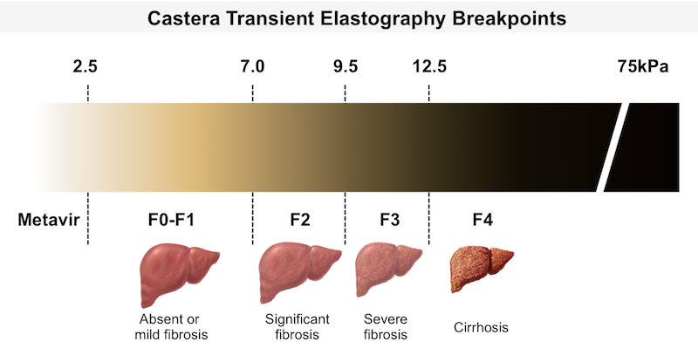
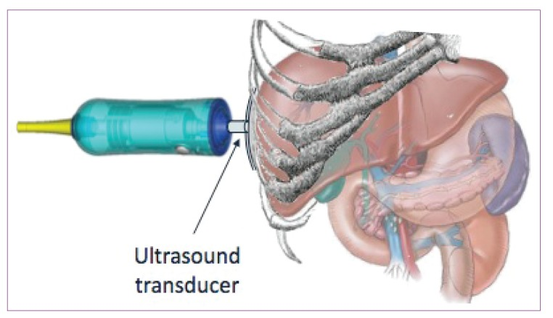
Liver Fibrosis Staging by Imaging: Transient Elastography
The probe of the Fibroscan device is positioned in an intercostal space near the right lobe of the liver, and a 50-MHz wave is passed into the liver from a small transducer on the end of the probe. The device then measures the velocity of the shear wave (in meters per second) as this wave passes through the liver, and this measurement is converted to a liver stiffness measurement.
http://www.ncbi.nlm.nih.gov/pmc/articles/PMC3594956/

Slide 36
Fibrosis Staging Interpretation
Metavir | Biopsy | Fibroscan | Fibrosure | APRI | FIB-4
F4 | F4 | > 12.5 kPa | > 0.75 | > 1.0 | > 3.25
F3 | F3 | 9.6 12.4 kPa | 0.58 – 0.74
F2 | F2 | 7.1-9.5 kPa | 0.49 – 0.57 | < 1.0 | < 1.45
F1 | F1 | < 7.0 kPa | 0.23 – 0.48 |  | < 1.45
F0 | F0 |  | < 0.22

Slide 37
Fibrosis Staging Algorithm
Chronic HCV
Concordant
Two Non-Invasive liver fibrosis Staging Tests
(APRI,FIB-4)
Discordant
Obvious Signs of Cirrhosis
Fibroscan/Fibrosure
Treat
Screen for Varices and HCC
HCC: Hepatocellular Carcinoma
Adapted from Boghal H, Sterling RK, Infect Dis Clin N Am 26 (2012) 839-847

Slide 38

Why is it important to stage Liver Fibrosis?
Treatment may be different between cirrhotic and non cirrhotic patients and will be different in patients with decompensated cirrhosis vs non decompensated cirrhosis
All patients with liver fibrosis (F3 or F4) will need:
  Liver cancer surveillance
All patients with liver fibrosis F4 (Cirrhosis) will need:
  Upper GI Endoscopy: For esophageal varices screening
  Screening for hepatic encephalopathy
Patients with decompensated cirrhosis need to be referred to a liver transplant center

Slide 39
HCV Workflow
Confirm Diagnosis
Lab/Imaging workup
Fibrosis Staging
Critical Information
Treatment
Cure
Surveillance

Slide 40
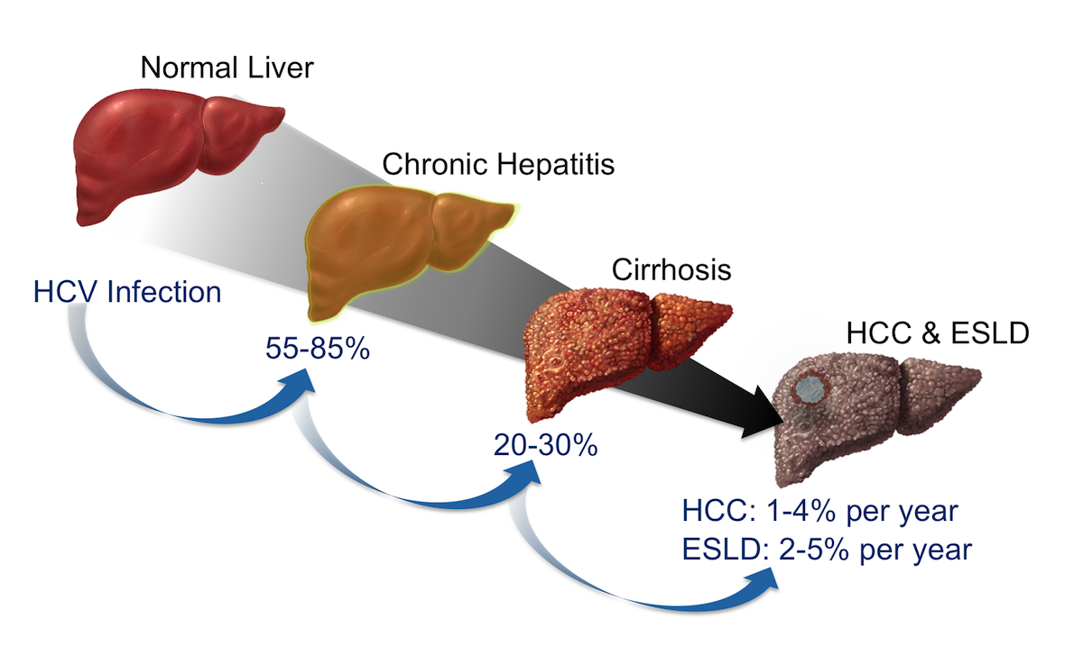
Natural History Following Initial HCV Infection
Rates of progression to cirrhosis are increased in the presence of a variety of factors, including:
  Being male
  Being age >50 years
  Consuming alcohol
  Having nonalcoholic fatty liver disease, hepatitis B, or HIV coinfection
  Receiving immunosuppressive therapy^{1,2,3}
4
Abbreviations: ESLD = end-stage liver disease HCC = hepatocellular carcinoma
Liang TJ, Rehermann B, Seeff LB, Hoofnagle JH. Pathogenesis, natural history, treatment, and prevention of hepatitis C. Ann Intern Med. 2000;132(4):296-305. 2. Thomas DL, Seeff LB. Natural history of hepatitis C. Clin Liver Dis. 2005;9(3):383-98. 3. Westbrook RH, Dusheiko G. Natural history of hepatitis C. J Hepatol. 2014;61(1 Suppl):S58-68. 4. Lingala S, Ghany MG. Natural History of Hepatitis C. Gastroenterol Clin North Am. 2015;44:717-34.
Notes:
Following initial infection with HCV, approximately 55 to 85% of persons develop chronic infection. Among those with chronic infection, approximately 20 to 30% will eventually develop cirrhosis. Patients who have HCV-related cirrhosis have a 2 to 7% per year risk of developing either end-stage liver disease or hepatocellular carcinoma. Abbreviations: ESLD = end-stage liver disease HCC = hepatocellular carcinomaSource: Lingala S, Ghany MG. Natural History of Hepatitis C. Gastroenterol Clin North Am. 2015;44:717-34.

Slide 41
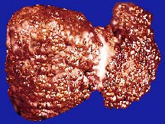
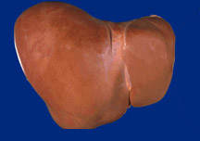
What Does HCV Treatment and Cure Accomplish?
70% Reduction of Liver Cancer
50% Reduction in All-cause Mortality
90% Reduction in Liver Failure
Lok A. NEJM 2012; Ghany M. Hepatol 2009; Van der Meer AJ. JAMA 2012

Slide 42
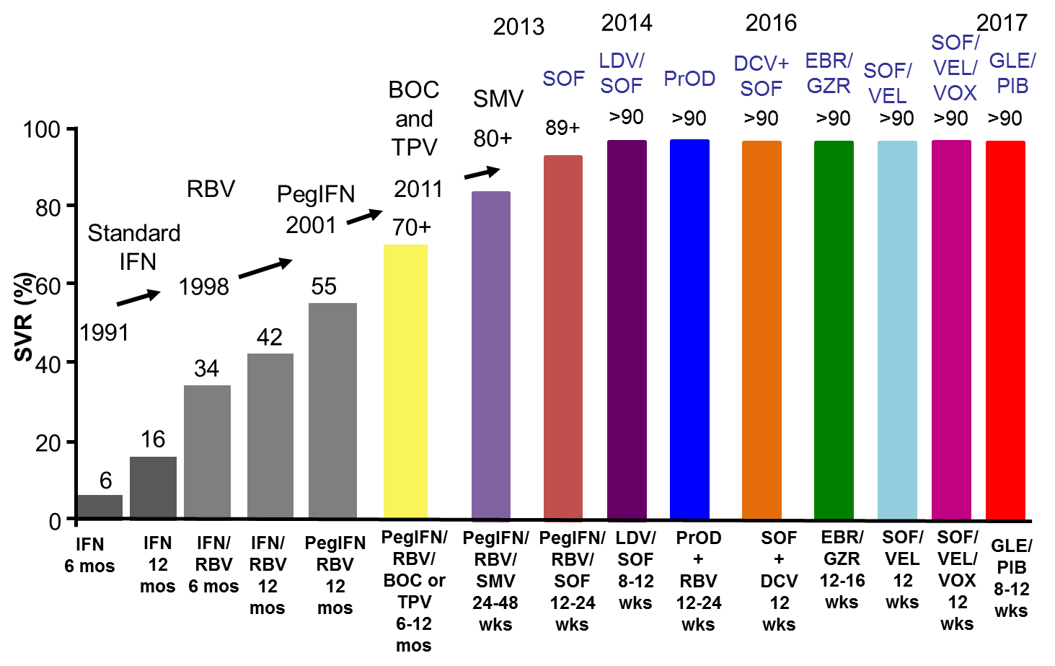
The Evolution of Highly Effective Treatment

Slide 43
HCV Therapies – Direct Acting Antivirals (DAAs)
Medication | NS5B Inh | NS5A Inh | NS3/4A PI | Other
Harvoni® | sofosbuvir | ledipasvir
Epclusa® | sofosbuvir | velpatasvir
Vosevi® | sofosbuvir | velpatasvir | voxilaprevir
Mavyret® |  | pibrentasvir | glecaprevir
Zepatier® |  | elbasvir | grazoprevir
NS5B Inh – Nonstructural protein 5B Polymerase Nucleotide Analog Inhibitor
NS5A Inh – Nonstructural protein 5A Inhibitor
NS3 PI – Nonstructural protein 3/4A Protease Inhibitor
Notes:
Harvoni = le DIP as vir and soe FOS bue vir
Epclusa = soe-FOS-bue-vir, vel-PAT-as-vir
Vosevi = soe-FOS-bue-vir, vel-PAT-as-vir, vox-i-LA-pre-vir
Mavyret = glec A pre vir and pi BRENT as vir
Zepatier = ELB as vir and graz OH pre vir

Slide 44
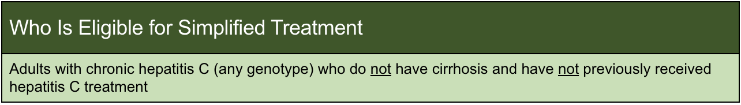
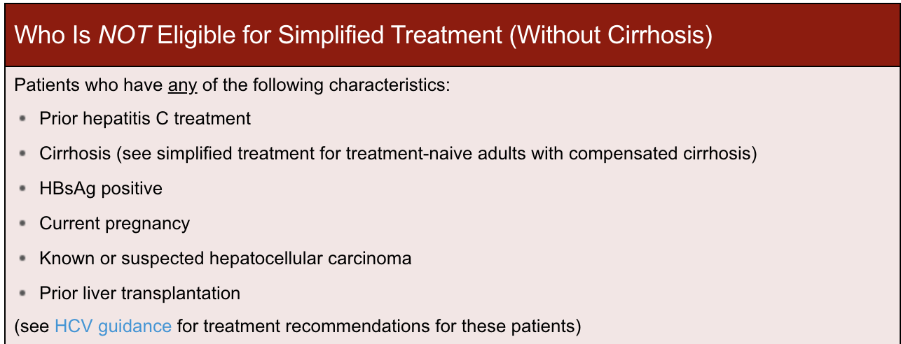
Simplified HCV Treatment Algorithm for Treatment-Naive Adults Without Cirrhosis
https://www.hcvguidelines.org/

Slide 45
A Patient has Cirrhosis if any of the following are present:
FIB-4 > 3.25
Transient elastography indicating cirrhosis (eg, FibroScan stiffness >12.5 kPa)
Noninvasive serologic tests above proprietary cutoffs indicating cirrhosis (eg, FibroSure, Enhanced Liver Fibrosis Test, etc)
Clinical evidence of cirrhosis (eg, liver nodularity and/or splenomegaly on imaging, platelet count <150,000/mm³, etc)
Prior liver biopsy showing cirrhosis
https://www.hcvguidelines.org/

Slide 46
Simplified Pretreatment Laboratory Testing in Patients with HCV Without Cirrhosis
Within 6 months of initiating treatment:
Complete blood count (CBC)
Comprehensive metabolic panel (CMP) Hepatic function panel
Any time prior to starting antiviral therapy:
Quantitative HCV RNA (HCV viral load)
HIV antigen/antibody test
Hepatitis B surface antigen
Before initiating antiviral therapy:
Serum pregnancy testing and counseling about pregnancy risks of HCV medication
https://www.hcvguidelines.org/

Slide 47
Simplified Pre-Treatment Assessment in Patients Without Cirrhosis
Medication reconciliation:
Record current medications, including over-the-counter drugs and herbal/dietary supplements.
Potential drug-drug interaction assessment:
Drug-drug interactions can be assessed using the AASLD/IDSA guidance or the University of Liverpool drug interaction checker.
Drug-drug interactions are particularly important in HIV co-infection
In those with HIV and receiving TDF do not use the simplified treatment approach
Education:
Educate the patient about proper administration of medications, adherence, and prevention of reinfection.
https://www.hcvguidelines.org/

Slide 48
Recommended Regimens in Patients Without Cirrhosis
Glecaprevir (300 mg) / pibrentasvir (120 mg) to be taken with food for a duration of 8 weeks
Sofosbuvir (400 mg) / velpatasvir (100 mg) for a duration of 12 weeks
Monitoring During Treatment
No laboratory or clinical monitoring is required for the majority of patients
Monitor for hypoglycemia In diabetic patients
Monitor INR in patients taking warfarin
Consider in-person or telehealth/phone visit if needed for patient support
NOTE: Patients with genotype 3 require baseline NS5A resistance-associated substitution (RAS) testing. Those without Y93H can be treated with 12 weeks of sofosbuvir/velpatasvir. If Y93H is present, see HCV guidance for treatment recommendations.
https://www.hcvguidelines.org/

Slide 49

Post-Treatment Assessment of Cure (SVR12) in Patients With or Without Cirrhosis
Assessment of quantitative HCV RNA and a LFTs
Assessment for other causes of liver disease in patients with elevated LFTs after achieving SVR
Patients with ongoing risk: counselling and HCV RNA testing
Advise patients to avoid excess alcohol use.
https://www.hcvguidelines.org/

Slide 50
Cherokee Nation Comprehensive HCV Care Model
Universal Screening
All patients aged 18 and older
Patient Navigator
Staff contacts HCV+ individuals and arranges follow-up testing and evaluation
HCV Evaluation and Non-Adherence Risk Assessment
Nurse, BH counselor, HCV provider,
case manager, pharmacist,
community health worker
HCV Treatment
All patients offered treatment
Community Health Worker
Home visits for patients at high risk
of non-adherence

Slide 51

Conclusions
Hepatitis C can be cured and eliminated
Simplified treatment algorithms are available
Eliminating HCV as a public health problem will require a multipronged approach
HCV evaluation and treatment should be integrated into primary care
Primary care providers should be at the forefront of HCV treatment, If they are not, nobody will be.

Slide 52
Helpful Resources
http://www.npaihb.org
Text HCV 97779
http://www.hcvguidelines.org/
http://www.hepatitisc.uw.edu/
On-line curriculum on liver disease and HCV, includes clinical studies, clinical calculators, slide lectures
ProjectECHO HCV guidelines

