Slide 1
BURR HOLE: LESSONS LEARNED FROM AN UNCOMFORTABLE SITUATION
Paul Charlton, MD
emRIC ECHO 8.23.2023

Slide 2
M&M peer protection for this case
Peer Review:
Cases are being reviewed for quality improvement purposes and are, for the duration and space of this conference, nondiscoverable. Information disclosed at this conference is not to be discussed outside of this room.
Notes:
This is a sensitive case in which private details of the person involved are identifiable, therefore this is discussed under M&M protection
Not recorded
Read out the disclaimer

Slide 3
Lesson: How it felt for me
Bad Option
#1
Bad Option
#2
Notes:
And quite exposed making that decision
Risk error through inaction vs action

Slide 4
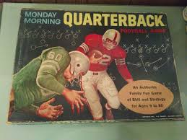

Slide 6
My Patient #1
55 yo F, fell at home
GCS downtrending 15→12→8→3
LMA → ETT
Pupils 6mm, 4mm
Mannitol, elevated HOB
Anticoagulant use
CT finding: large subdural with midline shift
Bluebird day, rapid launch for helicopter
NSG conversation by ED Director, recommended intervention
Bradycardia → died in ED
Notes:
Changed over tube
Mannitol
Elevated HOB
Rapid launch and retrieval
Optimal circumstances, still died
No review
Deb’s conversation with the neurosurgeon
Everything was optimized, but patient still died
Note NO REVIEW—not controversial

Slide 7
No formal review
Did not flag for formal review
T.A.

Slide 8
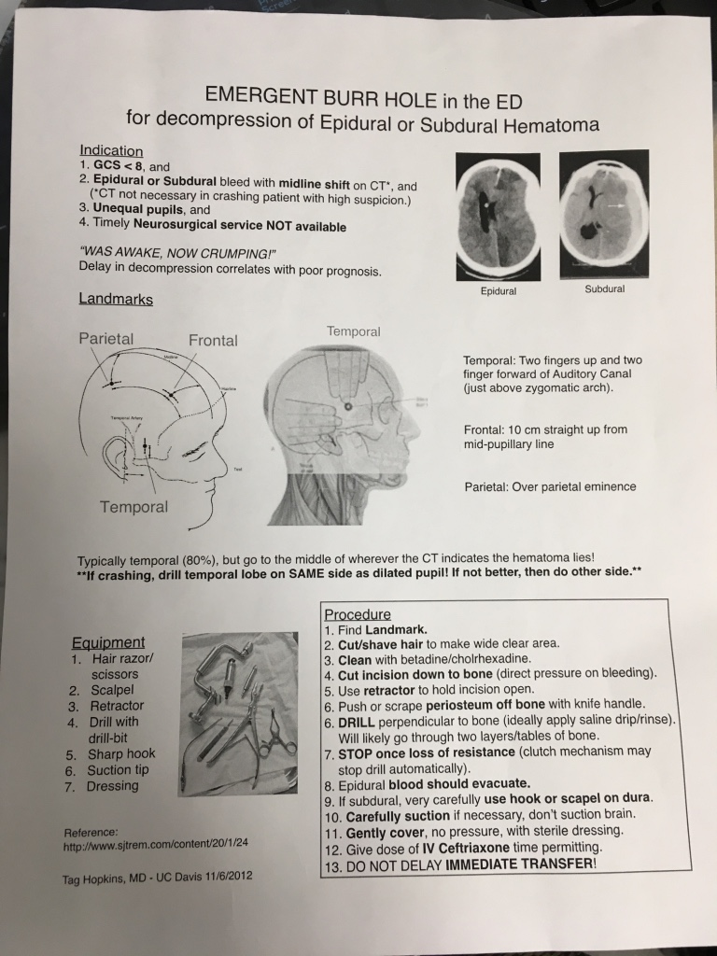
Notes:
Terry Ahern—you should have done a burr hole, met all guidelines

Slide 9
Notes:
Davis indications for doing DC (show the photo)

Slide 10
Story from 1990s at same ED
16 yo M
struck in head with baseball
Increasingly confused, intubated for transfer
CT before transport but departed straight from scanner
Sent in ambulance to local airport for air transfer to Boise
Radiologist called back, large epidural hematoma
No formal burr hole kit prepared
ED physician (Family Medicine trained) performed skull trephination at airstrip in back of ambulance
Full recovery, led normal life
Physician thought he would get fired (but he didn’t)

Slide 11
My Patient #2

Slide 12
56 yo M skier, not wearing helmet, found on the ground by his truck at ski area parking lot
GCS 8→5
Anisocoria
Dual anti-platelet therapy
CT: large SDH, ”Impending herniation”
Snowing, couldn’t fly locally
Transport time estimated 4+ hours by ground
Mannitol, Intubate

Slide 13
Anisocoria
Notes:
From compression of CN 3 (oculomotor nerve), ipsilateral uncal herniation of uncus of temporal lobe
In a patient who is talking but with this finding, it might be a traumatic anisocoria

Slide 14
Initial CT

Slide 15
SDH
Subdural hematoma with “impending uncal herniation”

Slide 16
Anatomy
Notes:
Uncal herniation
Due to compression of CN3 oculomotor nerve near the area of herniation through the tentorium
If it extends you can get compression of brainstem, coma, and death
Note the different types
Uncal is the most common

Slide 17
When to do it

Slide 18
NSG call
Family discussion
Decision to proceed due to anticipated 4+ hour transfer time

Slide 19
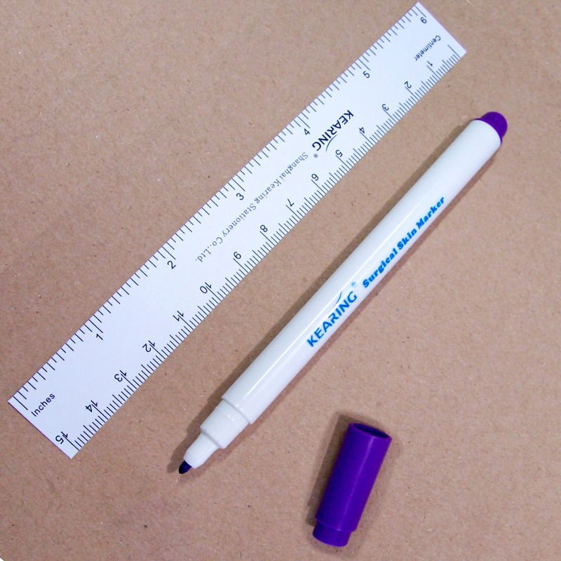

Slide 20
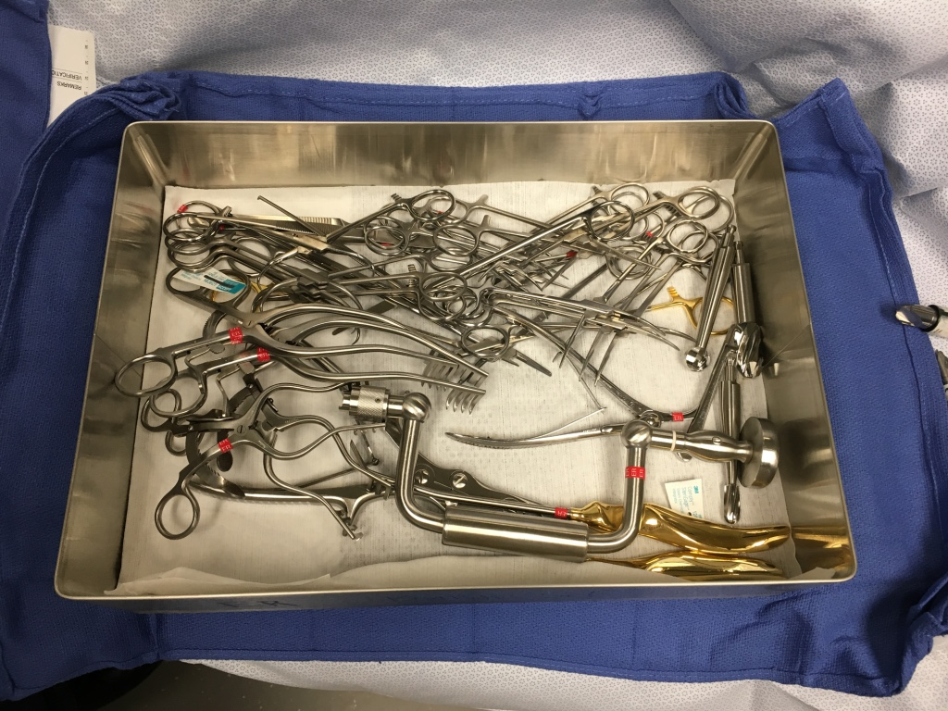

Slide 21
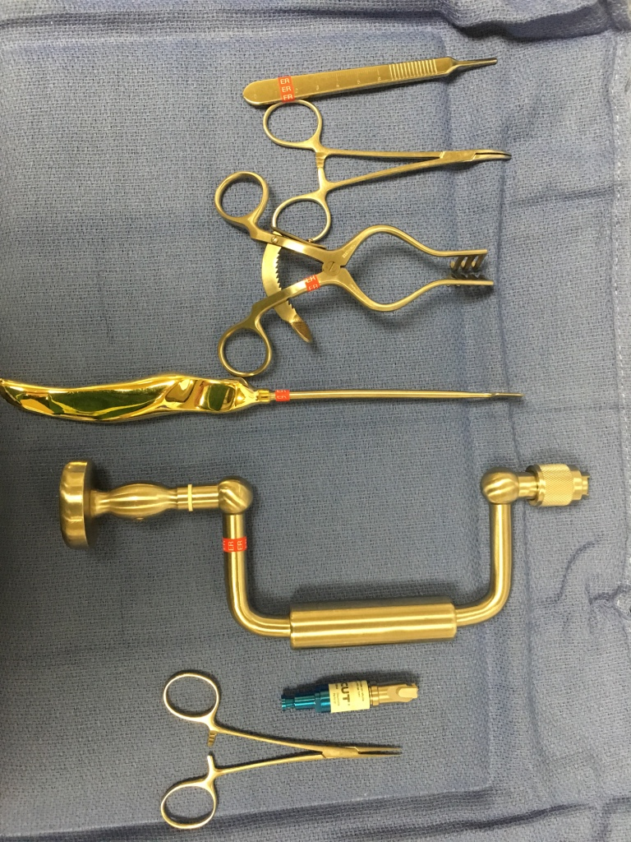

Slide 22
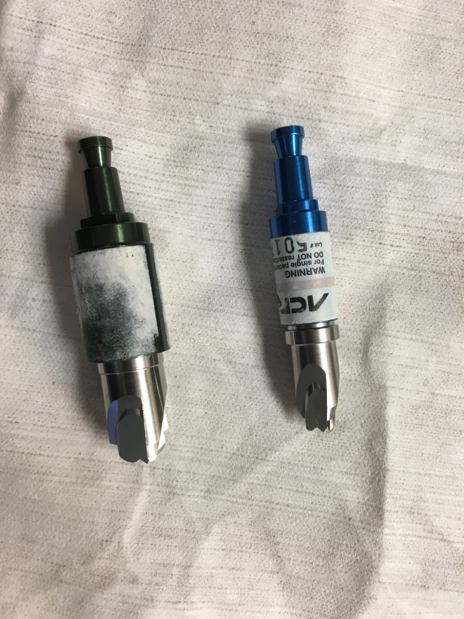

Slide 23
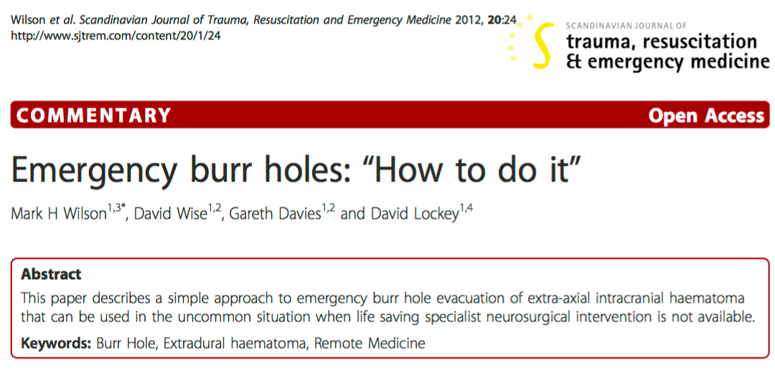

Slide 24
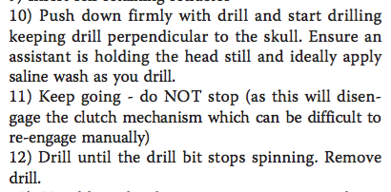
“ 50% have problems”

Slide 25
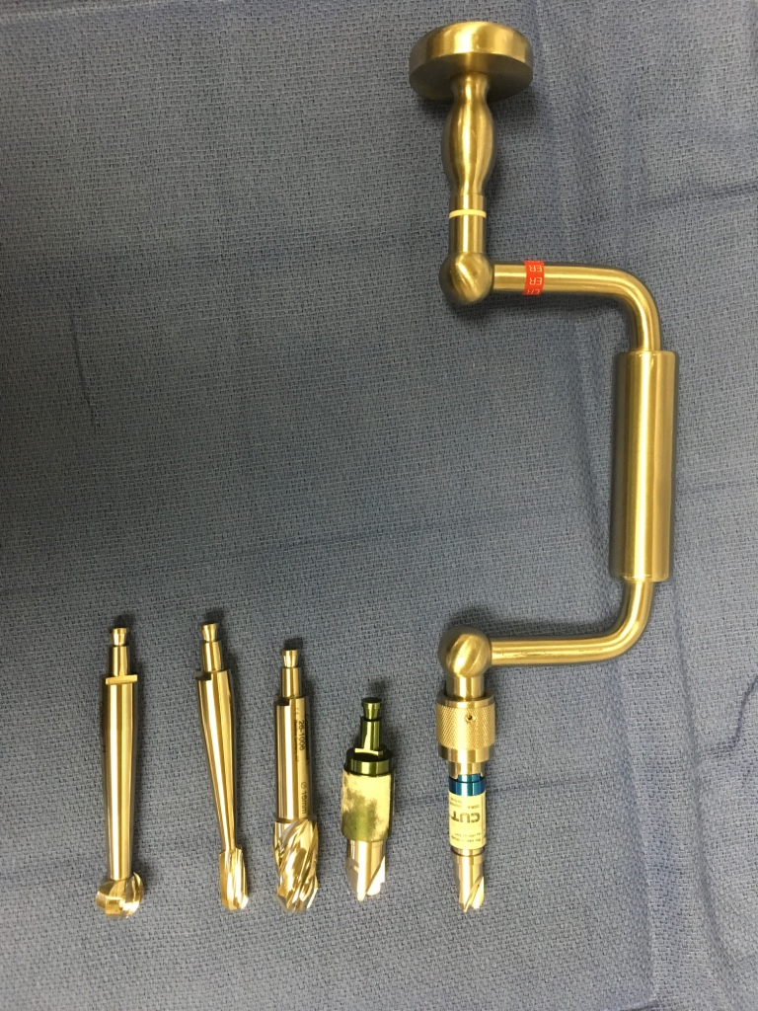

Slide 26
ED → ambulance w/ paramedic + MD, 3% saline → school parking lot → helicopter → hospital 4+ hours

Slide 27
Post NSG craniotomy

Slide 28
Outcome
Home after short hospital stay, some speech difficulties first 6 months, recovered to near baseline with rehab at 1 year
Returned to same ED 1 year later after another fall while skiing and a new SDH on opposite side
Notes:
Craniotomy – remove bone or bone flap, then replace it
Craniectomy – don’t replace it right away
Craniostomy
Decompressive
Emergency
Burr hole

Slide 29
Transport time – >4 hrs
Mortality: 30% (< 4 hrs) vs 90% (> 4hrs)
Notes:
Seeling NEJM article, 1981

Slide 30
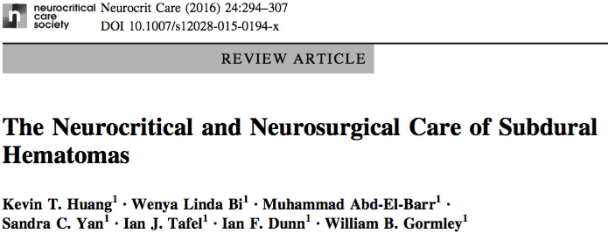
Acute SDH = poor prognosis
GCS ≤8 = mortality 50-90%
Among all aSDH, <25% “achieve full neurological recovery without any major neurological deficits”

Slide 31
Key decision points
At 3 points, clinically the patient appeared that they may die without intervention:
Initial decision to consider burr hole
Declining GCS, prolonged transport time, dual antiplatelet therapy, with recent similar patient who died in transport one week prior in ideal flight condition
Decision felt more exposed by lack of support by NSG
ACRA safe cutting bit was not working—do we continue or abandon?
Nurses stated he was posturing, could not find other alternative bits/options
In the ambulance
Continued extensor posturing with bradycardia—decision to grab and give hypertonic saline

Slide 32
Aftermath
Specific NSG consultant unhelpful before/after case
Self-critical
Later review by the NSG group who talked with the EM group stated the ACRA bits have high rates of not engaging esp with hand-drills—this may have been a limitation of the equipment
Unclear if I would do this again with acute SDH

Slide 33
Take Home
Collegiality: Same team, same mission, caution Monday morning quarterbacking
Hard decisions, hard field
Error of omission vs error of action—would not have been reviewed if had let him die
Self-reflective vs overly critical
Practice the procedures, print checklists
Help others learn from this
Single coverage settings can require different skills
It has been a privilege to be a part of this broader emRIC team
Notes:
Be collegial, be helpful, don’t Monday morning quarterback
Work for self-improvement, not self-destruction
Weighing do no harm with needing to intervene in a way that might cause inadvertent harm in pursuit of a higher need
This is a hard field where we are placed in difficult contexts with no good options
Error of omission vs. error of action **this would never have been discussed if I had not done the procedure, even if they died
It is a privilege to work in this field
Single coverage settings can require different skills
It has been a privilege to be a part of this broader emRIC team

Slide 34
Select References
Wilson et al. Emergency burr holes: “How to do it.” Scandinavian Journal of Trauma, Resuscitation and Emergency Medicine (2012) 20:24
Guidelines for the management of severe traumatic brain injury. J Neurotrauma. 2007;24 Suppl 1:S1-106.
Bullock et al. Surgical Management of Acute Subdural Hematoma. Neurosurgery. 2006; 58(3 Suppl):S16-24.
Matsushima et al. Emergent operation for isolated severe traumatic brain injury: Does time matter? Trauma Acute Care Surg. (2015)79:5.
Souter et al. Recommendations for the Critical Care Management of Devastating Brain Injury. Neurocritical Care. April 2015.
Society of Critical Care Medicine. Guidelines for the acute medical management of severe traumatic brain injury in infants, children, and adolescents.
Congress of Neurological Surgeons. Diagnosis and Management of Head Trauma. Available at: https://www.cns.org/academic/medical-student-curriculum-neurosurgery/intracranial-disease-topics/diagnosis-and
Bartels et al. Midline shift in relation to thickness of traumatic acute subdural hematoma predicts mortality. BMC Neurology. (2015) 15:220.
Tim Leeuwenburg. “Burr Holes in the Bush”, April 29, 2013, at http://kidocs.org/author/kangaroobeach/ .
Seelig et al. Traumatic Acute Subdural Hematoma. NEJM. (1981) 304:1511-1518.
Huang et al. The Neurocritical care and neurosurgical care of subdural hematomas. Neurocritical Care (2016) 24:294-307.

Slide 35
Burr holes don’t (always) help acute SDH

Slide 36
SDH
Acute = <3 d (thicker clotted blood)
Sub-acute = 3-21 days
Chronic = >21 days (liquefied blood)

