Slide 1
Pediatric
Trauma Care-Starting at the Beginning
John Bealer, MD
Professor of Surgery
Trauma Medical Director
Children’s Hospital Colorado, Colorado Springs

Slide 2
Disclosures:
None

Slide 3
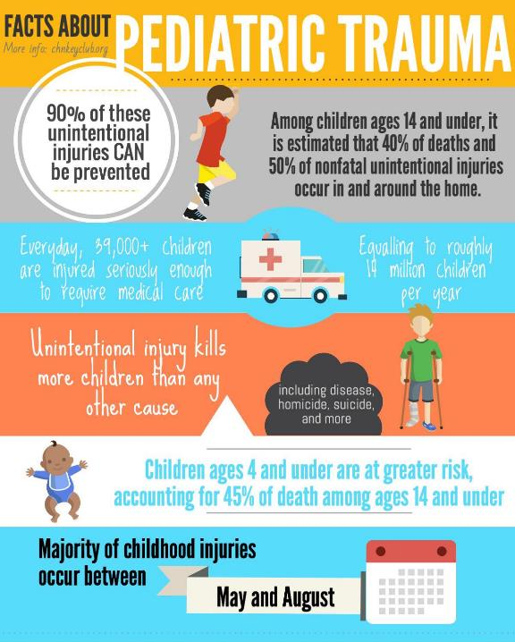

Slide 4
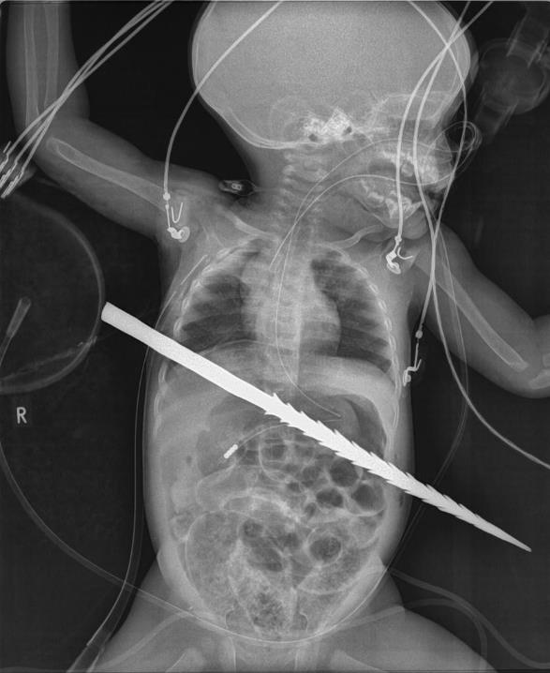

Slide 5


Slide 6
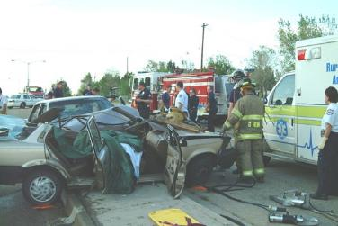
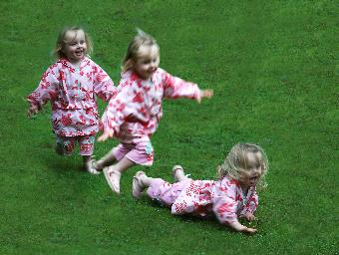
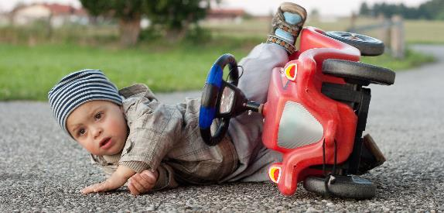
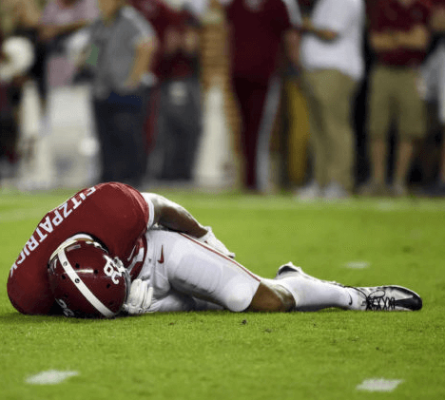
Mechanisms of Injury
Motor vehicle crashes
Falls
Lap belt complex
Sport injuries
NAT

Slide 7
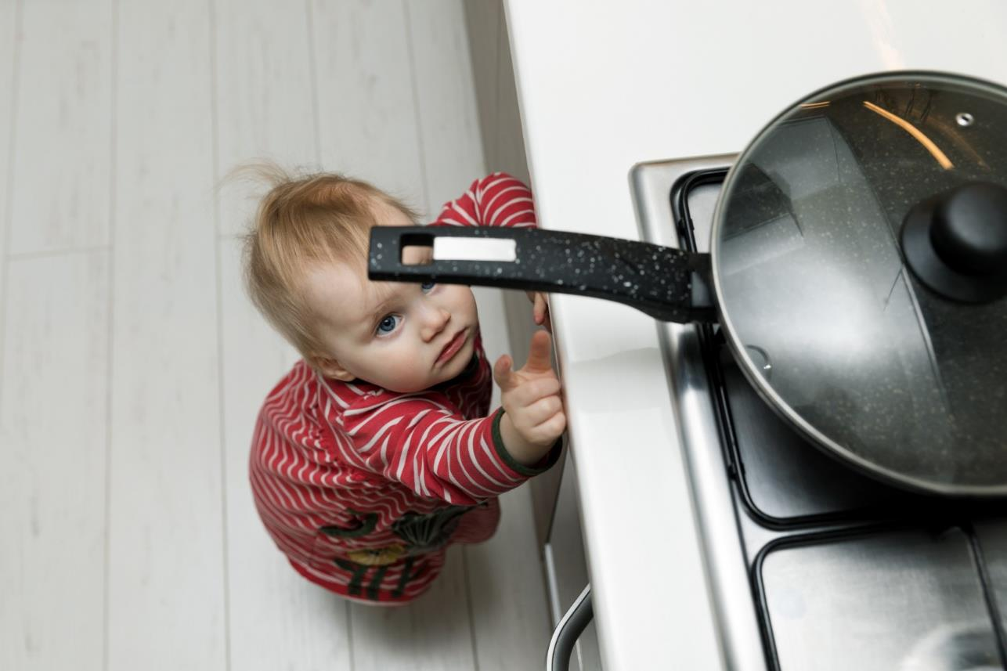

Slide 8
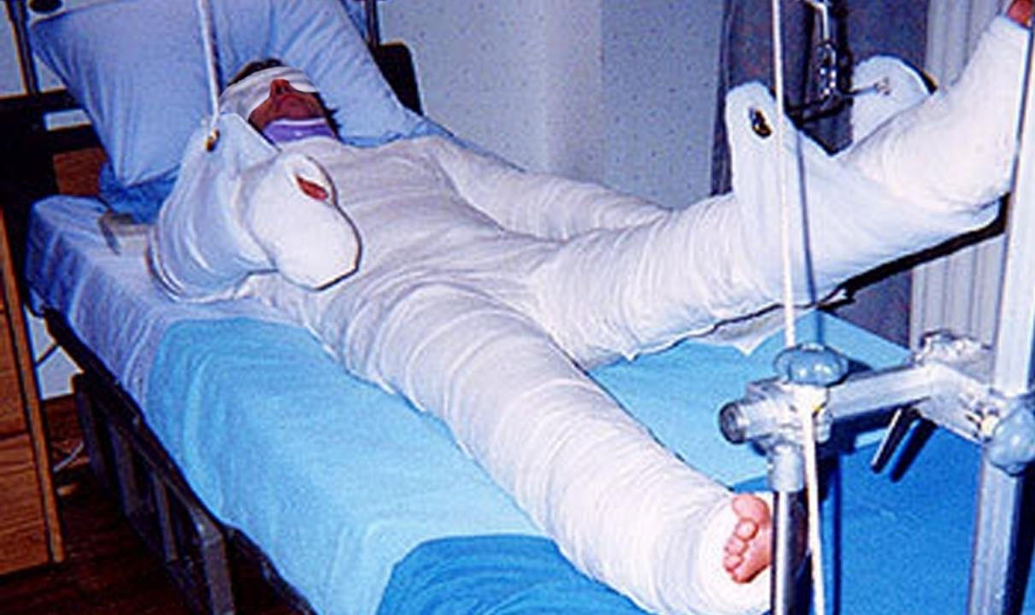

Slide 9
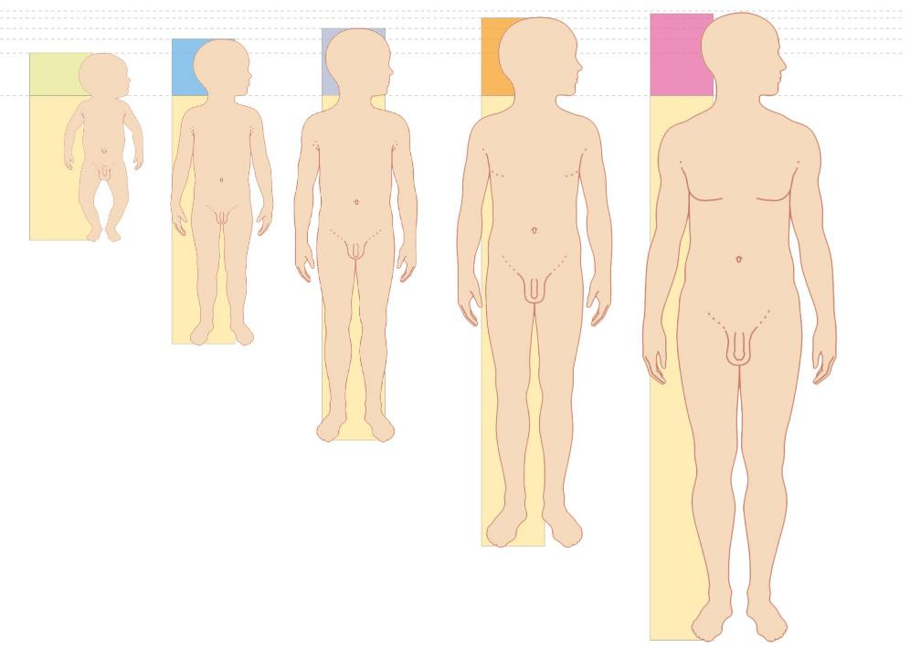

Slide 10
5 year-old-boy hit by a car while crossing the street.
  Estimated speed of the care 30-40 miles/hour
He is crying at the scene and pale
Physical findings
  Left forehead hematoma with laceration
  Bruising along left upper abdomen and flank with generalized abdominal tenderness
  Deformity of the left lower leg
Vital signs
  Pulse 135 bpm
  BP=95/65
  Resp Rate=30 breaths/min
  O₂ sats=91% on room air and 97% with supplemental O₂

Slide 11
Likely Injuries
Left forehead hematoma/laceration
RR=30/min, Decreased O₂ sat
Abdominal/flank bruising &tenderness
Left leg deformity
Closed head injury/concussion
Pulmonary contusion/ pneumo
Abdominal injury/splenic laceration
Fracture-Tib/fib

Slide 12


Slide 13


Slide 14
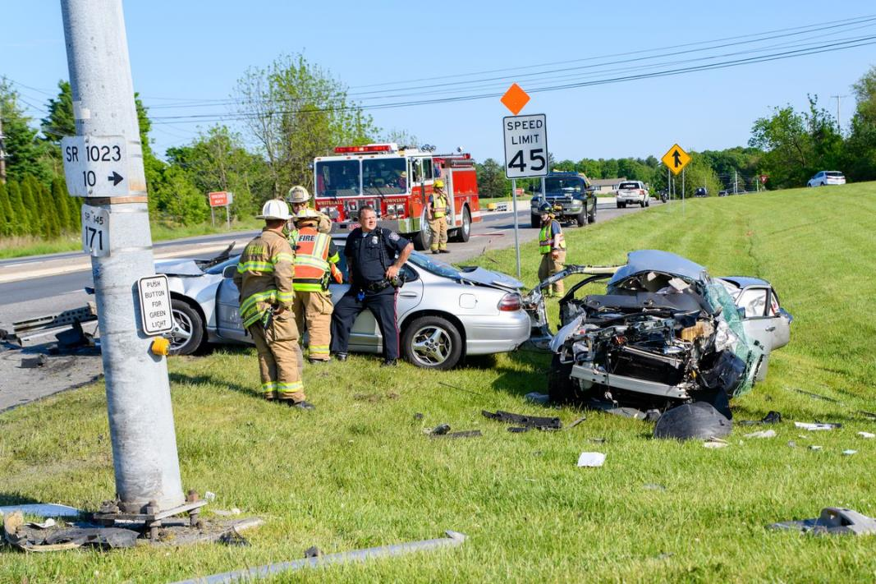

Slide 15
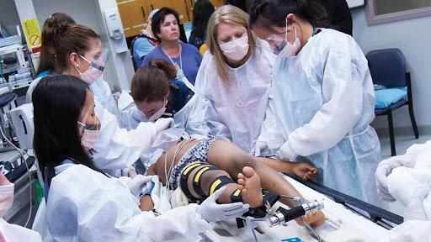

Slide 16
Assess
Act
Reassess
Repeat

Slide 17
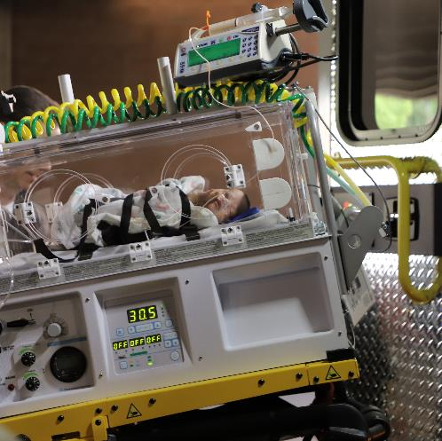
How Kids Are Different
Age-specific vital signs
Smaller blood volume (70 – 80 mL / kg)
Decreased functional residual capacity
Vigorous compensatory response
Sudden deterioration
Increased vagal tone

Slide 18
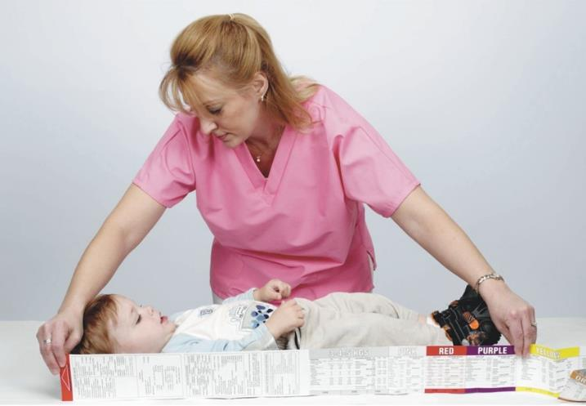


Slide 19
ABCDE priorities are the same.
A
B
C
D
E

Slide 20
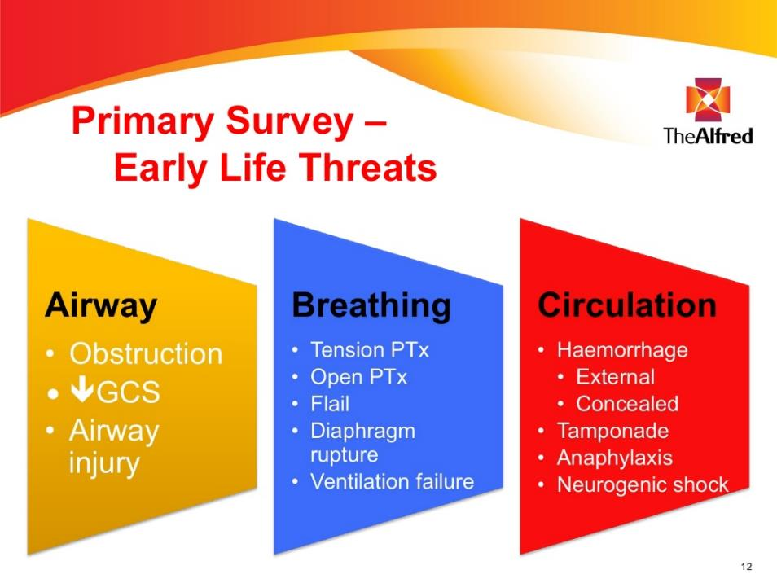

Slide 21
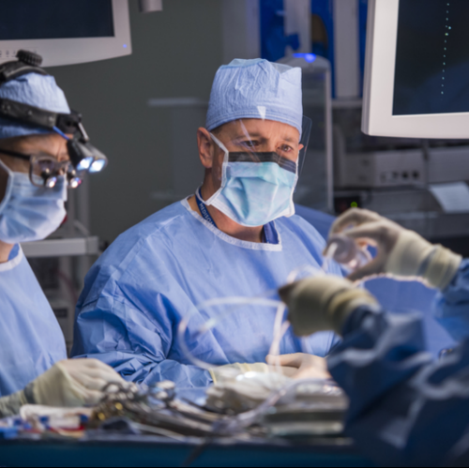
Bealer’s Philosophy on ATLS
ATLS boils down to three plastic tubes:
A tube in the throat (Airway)
A tube in the chest (Breathing)
A tube in the vein (Circulation)

Slide 22
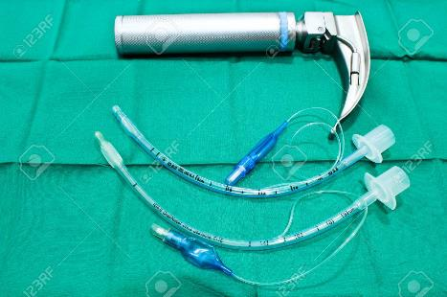
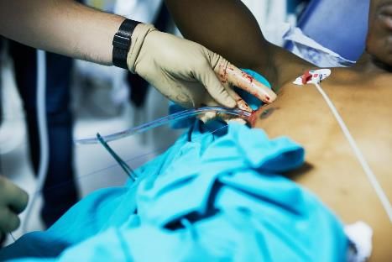
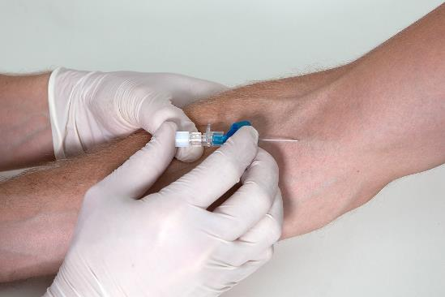
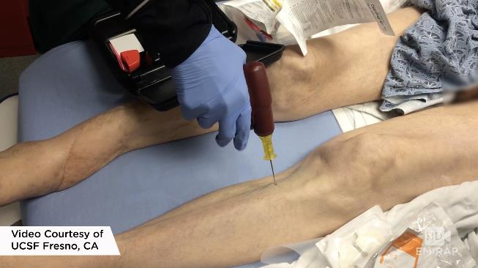

Slide 23

A
B
C
C

Slide 24
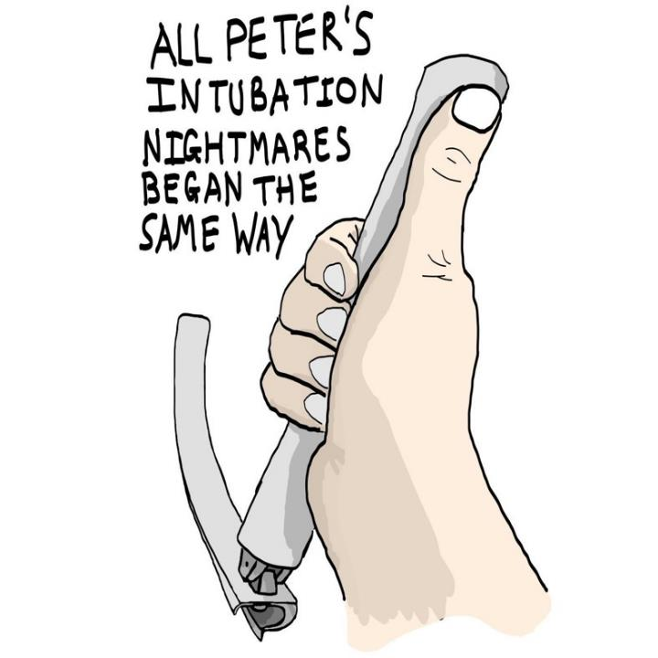

Slide 25
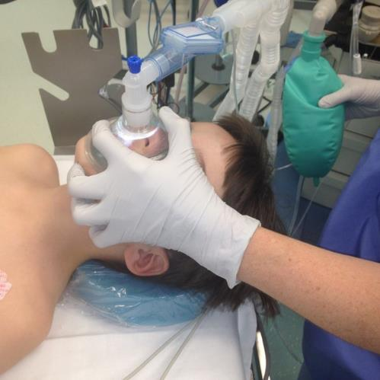
Airway Pitfalls
DANGER!
Short trachea: main stem bronchial intubation
ETT depth is 3 x ETT size
Endotracheal tube easily obstructed
Deceptive presentation of hypovolemic shock

Slide 26
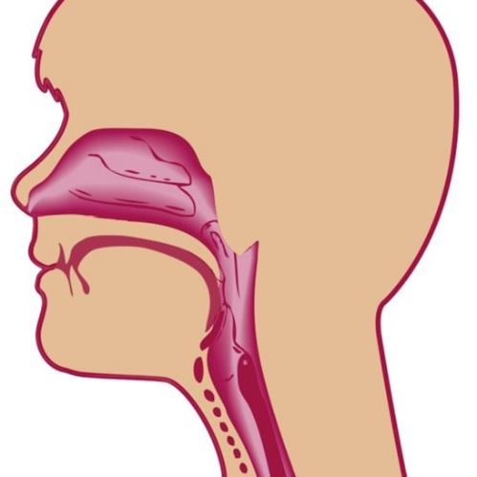
Unique Childhood Anatomy: Airway
Larger tongue
Smaller jaw
Shorter, narrower, funnel-shaped airway
Anterior larynx

Slide 27
Sniff Position
Prominent occiput in younger child
1” pad under torso for neutral position

Slide 28
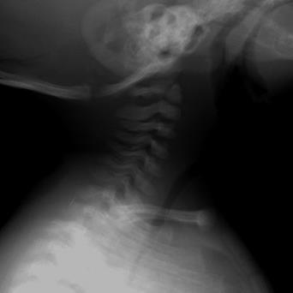
C-Spine
Flexible spinal ligaments
Anteriorly wedged vertebrae
Flat facet joints
Angular momentum
Pseudosubluxation
SCIWORA

Slide 29
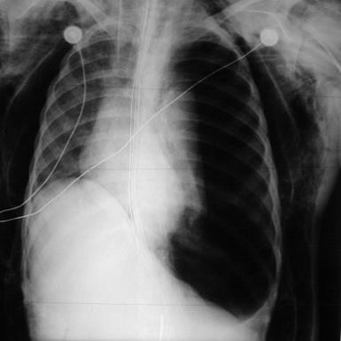
“B”-Breathing
Soft, pliable chest wall – pulmonary contusion
Horizontally aligned ribs, weak intercostal muscles
Rib fractures indicate significant force
Tension pneumothorax more likely due to mobile mediastinum

Slide 30
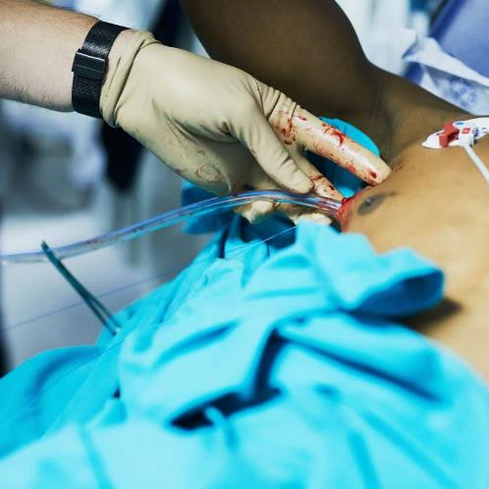
Chest tubes
Sized based on rib spacing
Landmarks identical to adult
Measure length on child prior to insertion.
Manage to closed suction/water seal drainage

Slide 31
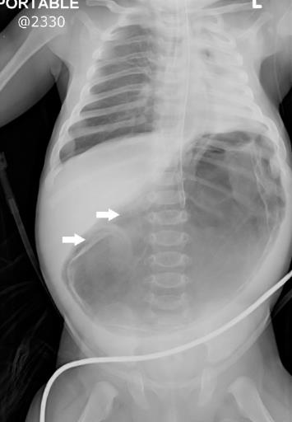
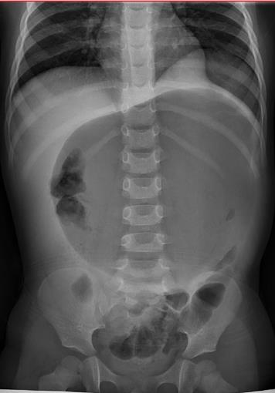
Gastric
Distention

Slide 32
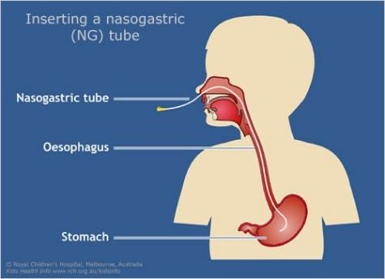
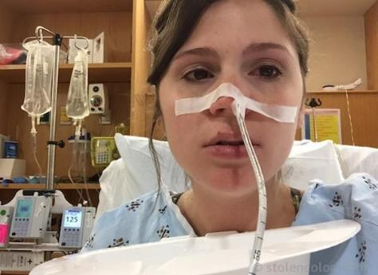

Slide 33
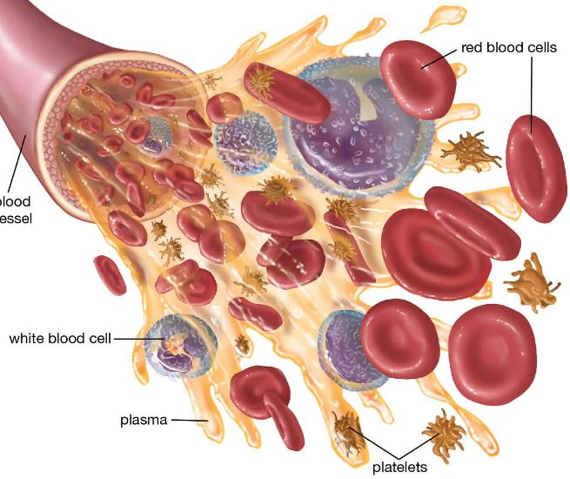
“C”
  Shock

Slide 35
Age-Specific Vital Signs
Sign | Age Group
 | 0 – 2 years | 3 – 5 years | 6 – 12 years
Heart Rate | < 150 - 160 | < 140 | < 100 - 120
Blood Pressure | > 60 - 70 | > 75 | > 80 - 90
Respiratory Rate | < 40 - 60 | < 35 | < 30
Adequate Urine Output | 1.5 – 2 cc/kg | 1 cc/kg | 0.5 – 1 cc/kg

Slide 36
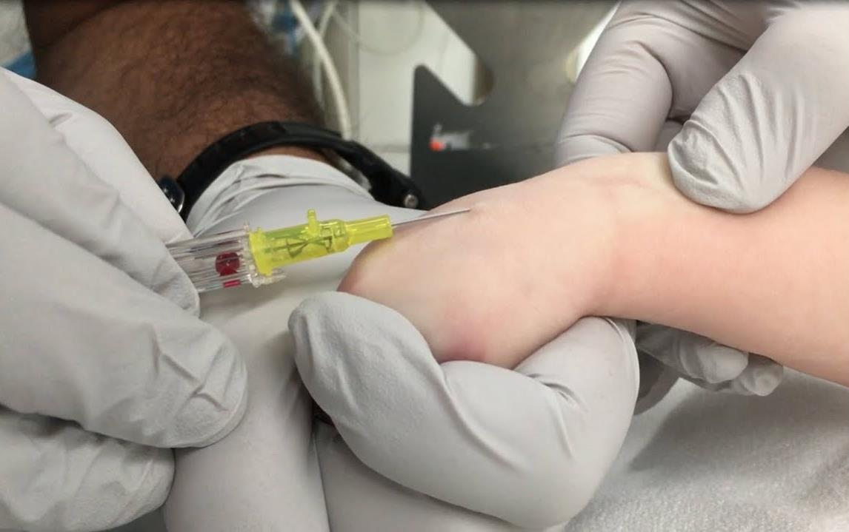

Slide 37
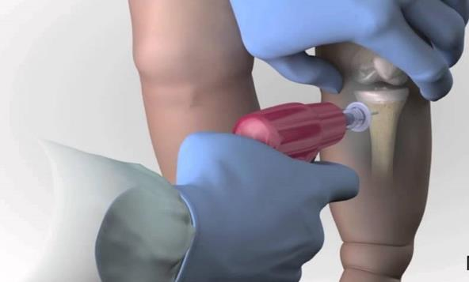
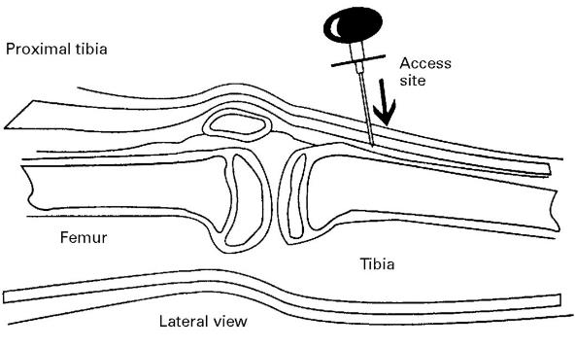

Slide 38
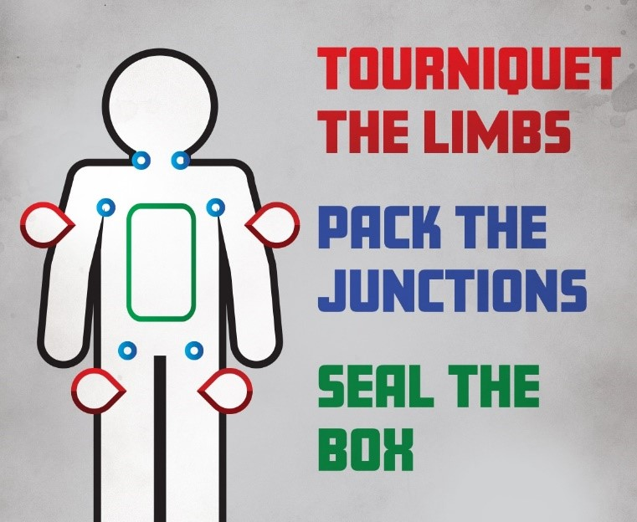
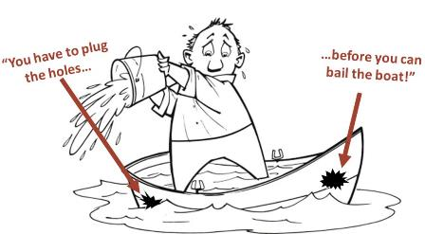

Slide 39
Circulation
With isotonic solution at 20 mL/kg
Blood should be given if resuscitation is needed following two boluses of crystalloid
Early use of plasma and platelets
Bleeding of more than half the child’s blood volume in the first four hours should be resuscitated with PRBCs, and early use of plasma and platelets
Permissive hypotension is an option in patients without traumatic brain injury
Maintenance fluid after resuscitation follows the 4:2:1 rule
4 mL/kg for the first 10 kg
2 mL/kg for the second 10 kg
1 mL/kg for every kg beyond 20 kg

Slide 40
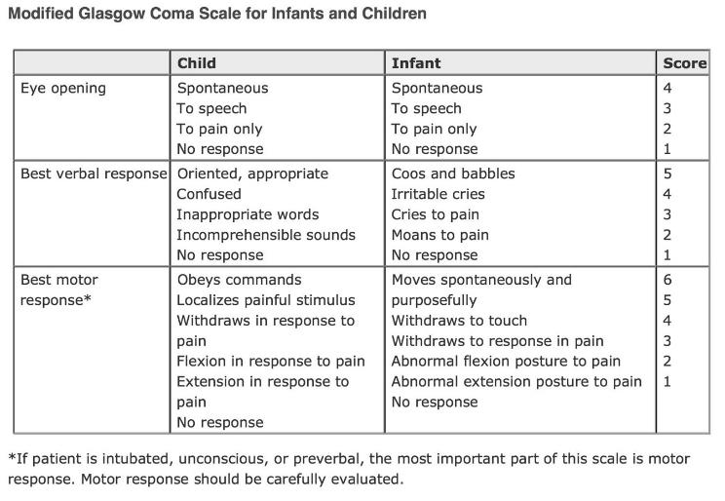
“D”: Disability

Slide 41
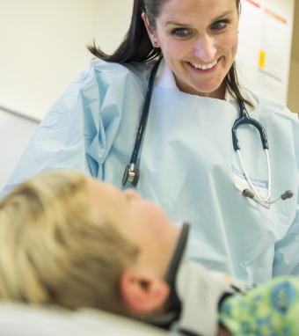
“D” – cont’d
Antibiotics for open fractures
Spinal precautions
Aligning fractures
Assessing for compartment syndrome
Early removal of backboards

Slide 42
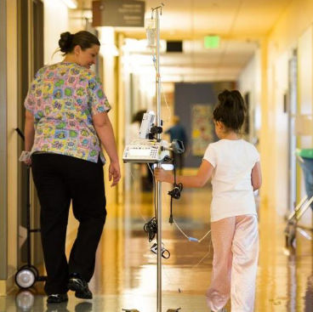
Exposure
Higher body surface area to mass ratio
Thinner skin
Less insulation by subcutaneous tissue
PREVENT HYPOTHERMIA.

Slide 43
A
Obstructs easily – Usual reason for DECOMPENSATION
B
Tension pneumothorax; avoid barotrauma
C
Vascular access; fluid and blood
D
Pediatric GCS score; extremities/compartment syndrome
E
Avoid heat loss

Slide 44
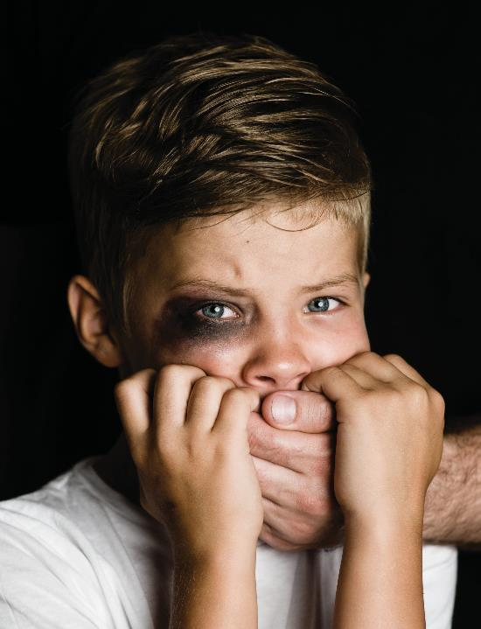

Slide 45


Slide 46
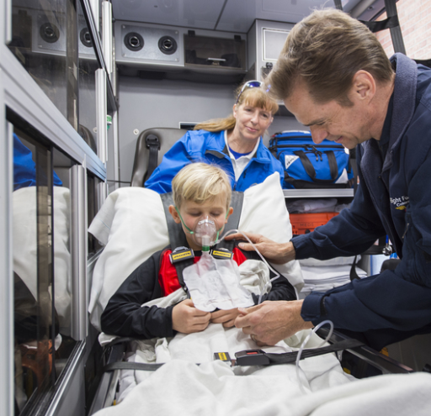
NAT - History
  Discrepancies
  Delay in care
  Repetitive injuries
  Inappropriate responses
  Medical neglect
  Developmentally improbable mechanism
  Evaluate completely for injuries.

Slide 47
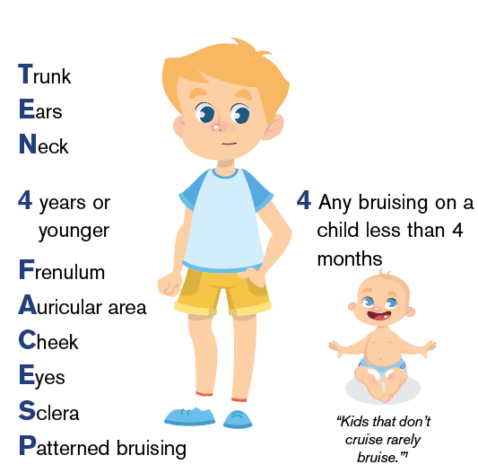

Slide 48
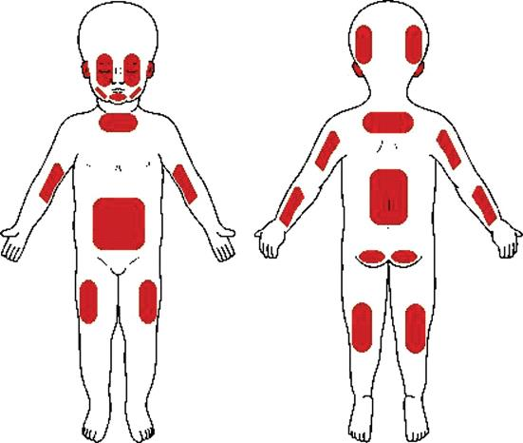
TEN-4 Faces P
Bruising on the Trunk, Ears, or Neck on a child less than 4 years
ANY bruising on a child less than 4 MONTHS
Injuries to Frenulum, Auricular area, Cheek, Eyes, Sclera or
Patterned bruising

Slide 49
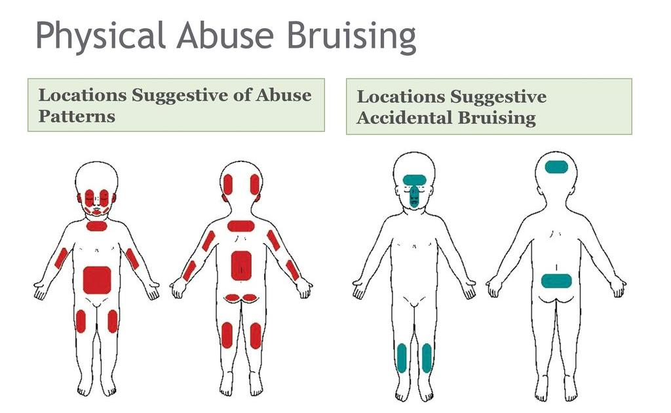

Slide 50
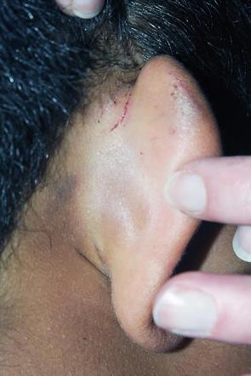
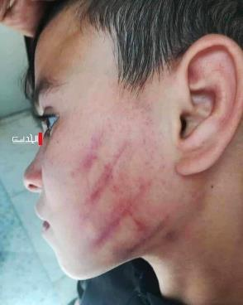
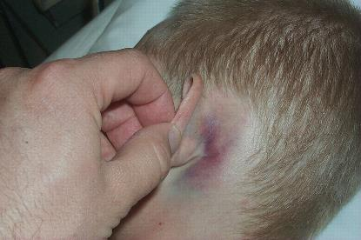
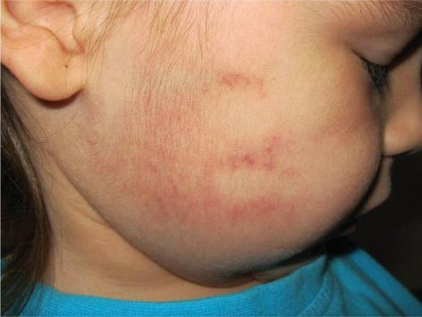
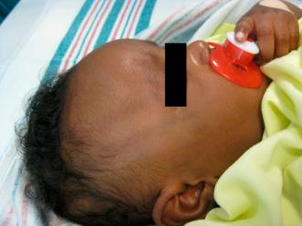
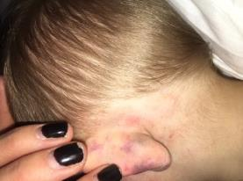

Slide 51
What is your professional responsibility as a provider in cases of suspected abuse?
1. Provide expert testimony in court
2. Provide confirmation to law enforcement that an abusive injury has occurred.
3. Collect evidence and provide prosecutorial opinion confirming abuse
4. Report suspected cases of abuse

Slide 52
What is your professional responsibility as a provider in cases of suspected abuse?
4. Report suspected cases of abuse

Slide 53


Slide 54

Assessment from a PEM
Consultation with Trauma Surgery
CPT specialist consultation
Skeleton Survey
Retinal Examination
Axial imaging where appropriate

Slide 55

?

Slide 56
