Slide 1
Welcome!
Safety Considerations
In Patients Starting Immunosuppression
- and –
How to Measure RA Disease Activity
Jennifer Mandal, MD
October 23, 2023
RAE Initiative| Fall 2023

Slide 5
General Principles of RA Treatment:
Start DMARD therapy ASAP to slow disease progression and prevent irreversible joint damage
Choose initial DMARD based on disease severity
Goal is clinical remission or low disease activity (RAPID-3 ≤2 or CDAI ≤10)
Evaluate patient q3 months until this is achieved
Majority of patients will require life-long medication
RAE Initiative| Fall 2023

Slide 6
DIAGNOSIS & MANAGEMENT OF RHEUMATOID ARTHRITIS
DIAGNOSIS: 2010 ACR/EULAR CRITERIA
1. Synovitis must be present; no other diagnosis to explain it
2. RA diagnosed if ≥6 points from the following:
JOINTS: 2-10 large joints (i.e. any joint except wrist/hand) ...1 point.
1-3 small joints (wrists, any hand joint).....................2 points
4-10 small joints.........................................................3 points
>10 joints, including ≥1 small joint............................5 points
SEROLOGY: RF or anti-CCP low-positive (above ULN).................2 points
RF or anti-CCP high-titer (3x >ULN)..........................3 points
ESR or CRP ELEVATED...................................................1 point
SYMPTOM DURATION ≥6 weeks..................................1 point
Initial visit checklist:
LABWORK: RF, CCP, CBC, CMP, ESR, CRP, PPD or Quantiferon, HBV sAg/sAb/cAb, HCV Ab
IMAGING: bilateral hand and foot xrays (to establish baseline and screen for alternate diagnoses)
MEDS: consider scheduled NSAIDs vs. prednisone 5-10mg daily (temporary measure until patient is stable on DMARD therapy)
Pneumovax/Prevnar, flu shot, Shingrix, HBV vaccine, COVID19 vaccine as early as possible.
If TB screen positive (and active TB has been ruled out), start LTBI treatment at least 1 week before starting methotrexate
Schedule follow-up to review labs/xrays and discuss DMARD initiation
General principles of treatment:
Choose initial DMARD based on disease severity, baseline labs, and comorbidities (MTX is most common first-line tx)
Start DMARD ASAP to avoid progressive joint damage
Goal is remission or low disease activity (RAPID-3 ≤2 or CDAI ≤10)
Evaluate patient q3 months until this is achieved
Vast majority of patients will require life-long medication
VERY MILD RA
ALL of the following: <5 joints involved, no extra-articular disease, minimal limitation in joint function, RAPID-3 ≤2 or CDAI ≤10.
less common
common
MODERATE or SEVERE RA
ANY of the following: >5 joints involved, extra-articular disease, erosions on baseline x- rays, function limited, RAPID-3 >2 or CDAI >10
1st line for most RA patients
HYDROXYCHLOROQUINE 200-400mg PO daily [max dose 5mg/kg]
* May reduce risk of diabetes and improve lipids * Well-tolerated, safe in pregnancy * Retinal exam at baseline and q1yr
METHOTREXATE
10mg PO qWEEK x 4 weeks, then check labs. If no side effects and labs stable then increase to 20mg PO qWEEK. Recheck labs after 4 weeks.
If RA activity still mod-high after 3 months: switch to 25mg subcutaneous qWEEK
MTX monitoring:
* CBC, liver panel, Cr q3months once the dose is stable * Must take with folic acid 1mg daily (increase to 2mg daily if mild side effects)
If not tolerating MTX, might consider:
LEFLUNOMIDE 10mg PO daily x 6 weeks, then check labs. If tolerating, increase to 20mg PO daily * Diarrhea in 20% * Labs and contraindications same as for MTX (see page 2); Avoid in women of childbearing age: risk of birth defects up to 2 years after cessation!
OR
After 3 months, if moderate or high disease activity
SULFASALAZINE 500mg BID x 1 week → 1000mg BID * Better efficacy than hydroxychloroquine, but more likely to cause GI upset * Monitor WBC q2 months
*
After 3 months, if moderate or high disease activity
preferred
When to use prednisone in RA?
Prednisone 5-10mg daily may be considered initially (<3 months, while waiting for DMARD to take effect), but should be avoided as chronic therapy whenever possible, due to long term side effects.
“TRIPLE THERAPY”
Methotrexate + Sulfasalazine + Hydroxychloroquine
Large pill burden makes adherence challenging
Lower infectious risk compared to TNFi
Can be considered in patients who strongly prefer pills over injections
TNF-INHIBITOR
Adalimumab (Humira) 40mg SC q2weeks
or Etanercept (Enbrel) 50mg SC qweek
or Certolizumab pegol (Cimzia) 200mg SC q2weeks
* Ideally, give TNFi AND weekly methotrexate
* Adalimumab and Etanercept are more readily available
* Certolizumab is specifically preferred in pregnancy
Originally developed by: Sara K. Tedeschi, MD¹; Paul Dellaripa, MD¹; Anneliese Flynn, MD²; Michael Weinblatt, MD¹; ¹Brigham and Women’s Hospital, Division of Rheumatology, ²Northern Navajo Medical Center
Updated in 2021 by: Jennifer Mandal, MD³; Wendy Grant, MD⁴; Mary Margaretten, MD³; John McDougall, MD5; 3UCSF Division of Rheumatology, ⁴Centura Health Rheumatology, Durango, CO; ⁵Northern Navajo Medical Center-Shiprock
If still not controlled, discuss second-line biologic options with a rheumatologist

Slide 7
(Google “2021 Rheumatoid Arthritis Guidelines”)
RAE Initiative| Fall 2023

Slide 8
Preview of Upcoming Didactics:
NSAIDs, Glucocorticoids, and Other Conventional DMARDs
Methotrexate
Biologic DMARDs
Wrap Up (RA Key Pearls)
RAE Initiative| Fall 2023

Slide 9
Today: Safety Considerations in Patients Starting Immunosuppressive Therapy
Pre-Immunosuppression testing
Approach to patients with latent TB
Approach to patients with chronic or prior Hepatitis B infection
Vaccine recommendations in immunosuppressed patients
RAE Initiative| Fall 2023

Slide 10
Terminology: DMARDs Disease Modifying Anti-Rheumatic Drugs
“Conventional DMARDs”:
Methotrexate, Hydroxychloroquine, Sulfasalazine, Leflunomide
“Biologic DMARDs”:
TNF inhibitors: etanercept/Enbrel (SQ), adalimumab/Humira (SQ), infliximab/Remicade (IV)
Others: abatacept (T cell costimulatory inhibitor), rituximab (anti-CD20), tocilizumab (IL-6 inhibitor); tofacitinib, upadacitinib (JAK inhibitors)
RAE Initiative| Fall 2023

Slide 11
Poll Question #1
You are seeing a 62 year old woman in clinic with a new diagnosis of RA (high disease activity), and you hope to start treatment with methotrexate ASAP. In addition to CBC, CMP, ESR and CRP, all of the following studies should be completed prior to initiation of therapy EXCEPT:
A. HBV surface antigen, HBV surface antibody
B. HBV core antibody
C. HCV antibody
D. Quantiferon Gold or PPD
E. Baseline eye (retinal) exam
RAE Initiative| Fall 2023

Slide 12
Poll Question #1: Answer
You are seeing a 62 year old woman in clinic with a new diagnosis of RA (high disease activity), and you hope to start treatment with methotrexate ASAP. In addition to CBC, CMP, ESR and CRP, all of the following studies should be completed prior to initiation of therapy EXCEPT:
A. HBV surface antigen, HBV surface antibody
B. HBV core antibody
C. HCV antibody
D. Quantiferon Gold or PPD
E. Baseline eye (retinal) exam
RAE Initiative| Fall 2023

Slide 13
Pre-Immunosuppression Testing
TIP: Send these tests as soon as possible, to avoid delays in initiating treatment. If your clinical suspicion for RA is high, send these labs at the same time you send the RF and CCP.
Order on all patients with newly diagnosed RA:
CBC, Cr, LFTs
HCV screen: HCV Ab
HBV screen: HBV surface Ag, HBV surface Ab, HBV core Ab
TB screen: Quantiferon Gold or PPD
For people who may become pregnant:
Discuss contraception and plans for future pregnancy
TIP: Low-dose prednisone (5-10mg) and/or hydroxychloroquine can be started while awaiting the results of these tests. For all other DMARDs, wait for the lab results before initiating.
RAE Initiative| Fall 2023

Slide 14
Poll Question #2
The patient’s lab tests return. She is Quantiferon Gold positive. CXR reveals no evidence of active pulmonary TB. Her other pre-immunosuppression lab tests are unremarkable. How should you proceed?
Initiate methotrexate therapy for RA. No LTBI treatment needed.
Initiate methotrexate therapy for RA and LTBI treatment simultaneously.
Complete treatment for LTBI (6-9 months) before initiating methotrexate
Methotrexate is contraindicated. Complete LTBI therapy and choose a different DMARD.
RAE Initiative| Fall 2023

Slide 15
Poll Question #2
The patient’s lab tests return. She is Quantiferon Gold positive. CXR reveals no evidence of active pulmonary TB. Her other pre-immunosuppression lab tests are unremarkable. How should you proceed?
Initiate methotrexate therapy for RA. No LTBI treatment needed.
Initiate methotrexate therapy for RA and LTBI treatment simultaneously.
Complete treatment for LTBI (6-9 months) before initiating methotrexate.
Methotrexate is contraindicated. Complete LTBI therapy and choose a different DMARD.
RAE Initiative| Fall 2023

Slide 16
Risk of latent TB reactivation with different RA medications (very thin data, except for TNFi)
Low Risk
Higher Risk
Abatacept,
Tocilizumab,
JAKi
(little increased risk? Thin data.)
Very low risk:
Hydroxychloroquine
Sulfasalazine
Methotrexate
Rituximab
TNF inhibitors (adalimumab/Humira & infliximab/Remicade = 10-20x risk. Less risk for etanercept/Enbrel)
Prednisone >15mg/day
RAE Initiative| Fall 2023

Slide 17
Risk of latent TB reactivation with different RA medications (very thin data, except for TNFi)
Low Risk
Higher Risk
Abatacept,
Tocilizumab,
JAKi
(little increased risk? Thin data.)
Very low risk:
Hydroxychloroquine
Sulfasalazine
Methotrexate
Rituximab
TNF inhibitors (adalimumab/Humira & infliximab/Remicade = 10-20x risk. Less risk for etanercept/Enbrel)
Prednisone >15mg/day
?
Screen for LTBI. If LTBI is confirmed, okay to initiate LTBI therapy and these RA medications simultaneously (no need to delay RA treatment).
Delay starting biologic until pt has completed at least 1 month of LTBI therapy
RAE Initiative| Fall 2023

Slide 18
Chronic or Prior Hepatitis B infection in patients on immunosuppressive therapy
Pre-immunosuppression HBV screening labs, and how to interpret the results
For patients starting immunosuppressive therapy for rheumatic disease:
Who needs HBV prophylaxis?
Who needs monitoring with serial HBV viral load + LFTs?
RAE Initiative| Fall 2023

Slide 19
Who is potentially at risk for HBV reactivation during immunosuppression?
Anyone who is surface Antigen positive
- OR -
core Antibody positive
The 2 scenarios:
1. Chronic infection (higher risk): HBV Ag positive/core Ab positive 2. Prior infection (can think of this as “latent HBV”; lower risk): HBV Ag negative/core Ab pos
Key Teaching Pearl:
HBV Core Ab positivity is associated with risk of HBV reactivation during immunosuppression, even if HBV Ag is negative!
RAE Initiative| Fall 2023

Slide 20
Using DMARDs in patients with chronic or prior Hep B
Key Pearls:
Always screen with HBV Surface Ab, Surface Ag, and Core Ab
HBV Core Ab positivity confers risk of activation during immunosuppression, even if Ag is negative
2 resources to bookmark/save to review guidelines for when to use HBV prophylaxis vs. just monitor VL:
American College of Rheumatology (ACR) 2021 Rheumatoid Arthritis Guidelines
American Gastroenterological Association (AGA) 2015 Guidelines for Prevention of HBV Reactivation During Immunosuppressive Drug Therapy
Highest risk biologic for Hep B reactivation = Rituximab
Low risk: Conventional DMARDs (including MTX) | Moderate-High risk: Other biologics Whether or not to give prophylaxis depends on Surface Ag+/Core Ab+ (prophylaxis) or Surface Ag-/Core Ab+ (serial VL monitoring) | High risk for HBV reactivation: Rituximab
<1% risk of HBV reactivation
1-10% risk of HBV reactivation
>10% risk of HBV reactivation

Slide 21
Management of Rheumatology Patients with Chronic or Prior HBV Infection who are on immunosuppressive medication
Low risk: Conventional DMARDs (including MTX) | Moderate-High risk: Other biologics besides Rituximab, or prednisone >10mg daily for >1 month | High risk for HBV reactivation: Rituximab
No prophylaxis.
Serial monitoring?
(No recommendation)
Serial monitoring of HBV viral load & LFTs
Prophylaxis
Prophylaxis
For guidance, check AGA or ACR guidelines
RAE Initiative| Fall 2023

Slide 22
Choice of HBV prophylaxis
AGA recommends use of entecavir or tenofovir over lamivudine (because lamivudine has a high rate of drug resistance, particularly when used >1 year).
Entecavir 0.5mg PO daily (dose-reduce for renal impairment)
Tenofovir alafenamide (Vemlidy): 25mg PO daily (No dose adjustment needed if CrCl>15. For HD: give after dialysis on HD days)
Tenofovir disoproxil fumarate (Viread): 300mg PO daily (AVOID in patients with CKD/ CrCl <50.)
Start prophylaxis before or simultaneously with biologic therapy. Continue prophylaxis for 6-12 months after discontinuation of biologic.
RAE Initiative| Fall 2023

Slide 23
Poll Question #3
You are seeing a 42 year old man in clinic. He was diagnosed with RA 4 months ago and started therapy with methotrexate 3 months ago. All of the following vaccines are recommended for him, EXCEPT
COVID19
HBV
Flu (high dose)
Zoster (Shingrix)
MMR booster
Pneumococcal
RAE Initiative| Fall 2023

Slide 24
Poll Question #3: Answer
You are seeing a 42 year old man in clinic. He was diagnosed with RA 4 months ago and started therapy with methotrexate 3 months ago. All of the following vaccines are recommended for him, EXCEPT
COVID19
HBV
Flu (high dose)
Zoster (Shingrix)
MMR booster
Pneumococcal
RAE Initiative| Fall 2023

Slide 25
Vaccines Considerations in Patients on DMARDs
Recommended vaccines for all patients starting or currently taking immunosuppressive therapy for RA (conventional or biologic DMARDs):
Pneumococcal
Flu (annually, high dose)
HBV
HPV
Zoster (Shingrix)
COVID19 (latest version)
Live vaccines are contraindicated in patients on immunosuppressive therapy:
MMR
Yellow Fever
Inhaled/nasal flu
RAE Initiative| Fall 2023

Slide 26
Measuring and Monitoring: How to Assess RA Disease Activity

Slide 27
General Principles of RA Treatment:
Start DMARD therapy ASAP to slow disease progression and prevent irreversible joint damage
Choose initial DMARD based on disease severity
Goal is clinical remission or low disease activity (RAPID-3 ≤2 or CDAI ≤10)
Evaluate patient q3 months until this is achieved
Majority of patients will require life-long medication
RAE Initiative| Fall 2023

Slide 28
DIAGNOSIS & MANAGEMENT OF RHEUMATOID ARTHRITIS
DIAGNOSIS: 2010 ACR/EULAR CRITERIA
1. Synovitis must be present; no other diagnosis to explain it
2. RA diagnosed if ≥6 points from the following:
JOINTS: 2-10 large joints (i.e. any joint except wrist/hand) ...1 point.
1-3 small joints (wrists, any hand joint).....................2 points
4-10 small joints.........................................................3 points
>10 joints, including ≥1 small joint............................5 points
SEROLOGY: RF or anti-CCP low-positive (above ULN).................2 points
RF or anti-CCP high-titer (3x >ULN)..........................3 points
ESR or CRP ELEVATED...................................................1 point
SYMPTOM DURATION ≥6 weeks..................................1 point
Initial visit checklist:
LABWORK: RF, CCP, CBC, CMP, ESR, CRP, PPD or Quantiferon, HBV sAg/sAb/cAb, HCV Ab
IMAGING: bilateral hand and foot xrays (to establish baseline and screen for alternate diagnoses)
MEDS: consider scheduled NSAIDs vs. prednisone 5-10mg daily (temporary measure until patient is stable on DMARD therapy)
Pneumovax/Prevnar, flu shot, Shingrix, HBV vaccine, COVID19 vaccine as early as possible.
If TB screen positive (and active TB has been ruled out), start LTBI treatment at least 1 week before starting methotrexate
Schedule follow-up to review labs/xrays and discuss DMARD initiation
General principles of treatment:
Choose initial DMARD based on disease severity, baseline labs, and comorbidities (MTX is most common first-line tx)
Start DMARD ASAP to avoid progressive joint damage
Goal is remission or low disease activity (RAPID-3 ≤2 or CDAI ≤10)
Evaluate patient q3 months until this is achieved
Vast majority of patients will require life-long medication
VERY MILD RA
ALL of the following: <5 joints involved, no extra-articular disease, minimal limitation in joint function, RAPID-3 ≤2 or CDAI ≤10.
less common
common
MODERATE or SEVERE RA
ANY of the following: >5 joints involved, extra-articular disease, erosions on baseline x- rays, function limited, RAPID-3 >2 or CDAI >10
1st line for most RA patients
HYDROXYCHLOROQUINE 200-400mg PO daily [max dose 5mg/kg]
* May reduce risk of diabetes and improve lipids * Well-tolerated, safe in pregnancy * Retinal exam at baseline and q1yr
METHOTREXATE
10mg PO qWEEK x 4 weeks, then check labs. If no side effects and labs stable then increase to 20mg PO qWEEK. Recheck labs after 4 weeks.
If RA activity still mod-high after 3 months: switch to 25mg subcutaneous qWEEK
MTX monitoring:
* CBC, liver panel, Cr q3months once the dose is stable * Must take with folic acid 1mg daily (increase to 2mg daily if mild side effects)
If not tolerating MTX, might consider:
LEFLUNOMIDE 10mg PO daily x 6 weeks, then check labs. If tolerating, increase to 20mg PO daily * Diarrhea in 20% * Labs and contraindications same as for MTX (see page 2); Avoid in women of childbearing age: risk of birth defects up to 2 years after cessation!
OR
After 3 months, if moderate or high disease activity
SULFASALAZINE 500mg BID x 1 week → 1000mg BID * Better efficacy than hydroxychloroquine, but more likely to cause GI upset * Monitor WBC q2 months
*
After 3 months, if moderate or high disease activity
preferred
When to use prednisone in RA?
Prednisone 5-10mg daily may be considered initially (<3 months, while waiting for DMARD to take effect), but should be avoided as chronic therapy whenever possible, due to long term side effects.
“TRIPLE THERAPY”
Methotrexate + Sulfasalazine + Hydroxychloroquine
Large pill burden makes adherence challenging
Lower infectious risk compared to TNFi
Can be considered in patients who strongly prefer pills over injections
TNF-INHIBITOR
Adalimumab (Humira) 40mg SC q2weeks
or Etanercept (Enbrel) 50mg SC qweek
or Certolizumab pegol (Cimzia) 200mg SC q2weeks
* Ideally, give TNFi AND weekly methotrexate
* Adalimumab and Etanercept are more readily available
* Certolizumab is specifically preferred in pregnancy
Originally developed by: Sara K. Tedeschi, MD¹; Paul Dellaripa, MD¹; Anneliese Flynn, MD²; Michael Weinblatt, MD¹; ¹Brigham and Women’s Hospital, Division of Rheumatology, ²Northern Navajo Medical Center
Updated in 2021 by: Jennifer Mandal, MD³; Wendy Grant, MD⁴; Mary Margaretten, MD³; John McDougall, MD5; 3UCSF Division of Rheumatology, ⁴Centura Health Rheumatology, Durango, CO; ⁵Northern Navajo Medical Center-Shiprock
If still not controlled, discuss second-line biologic options with a rheumatologist

Slide 29
Diagnosis of RA
less common
common
VERY MILD RA
MODERATE or SEVERE RA
Hydroxychloroquine
or
Sulfasalazine
Methotrexate
(or Leflunomide)
After 3 months, if moderate or high disease activity
After 3 months, if moderate or high disease activity
*
preferred
What about prednisone?
Short-term (>3 months)
Low dose (5-10mg)
Strive to stop/minimize
“TRIPLE THERAPY”
Methotrexate + Sulfasalazine + Hydroxychloroquine
TNF inhibitor
(Add on top of MTX, if possible)
If still not controlled, discuss second-line biologic options with a rheumatologist

Slide 30
Assessment of RA Disease Activity General Principles
Patients should be seen on a regular basis:
1-2 months if severe active disease and/or starting new medication
3-6 months if well controlled disease, with appropriate laboratory monitoring in the interim
Purpose of visits are to screen for drug toxicities and monitor RA disease activity
Clinic visits should include a quantitative composite measure of RA disease activity
RAE Initiative| Fall 2023
Notes:
This is a patient of mine with well controlled RA who developed drug-induced SLE from TNFi. She told me she has “mosquito bites.”

Slide 31
RA Disease Activity Measures
Use RA disease activity measure to guide treatment decisions
RA remission → taper immunosuppression
RA low disease activity → no change
RA moderate/high disease activity → increase immunosuppression
RAE Initiative| Fall 2023

Slide 32
RA Disease Activity Measures
Examples of RA Disease Activity Measures:
DAS28 (Disease Activity Score for 28 joints) = includes patient & provider data & labs
CDAI (Clinical Disease Activity Index) = includes patient & provider data
RAPID3 (Routine Assessment of Patient Index Data 3) = requires only patient-reported data
All of these measures accurately reflect disease activity; are sensitive to change; discriminate well between low, moderate, and high disease activity; have remission criteria; and are feasible to perform quickly in clinical settings
* This is the one we use at UCSF b/c it does not require blood test results and incorporates physician and patient reported outcomes
RAE Initiative| Fall 2023

Slide 33
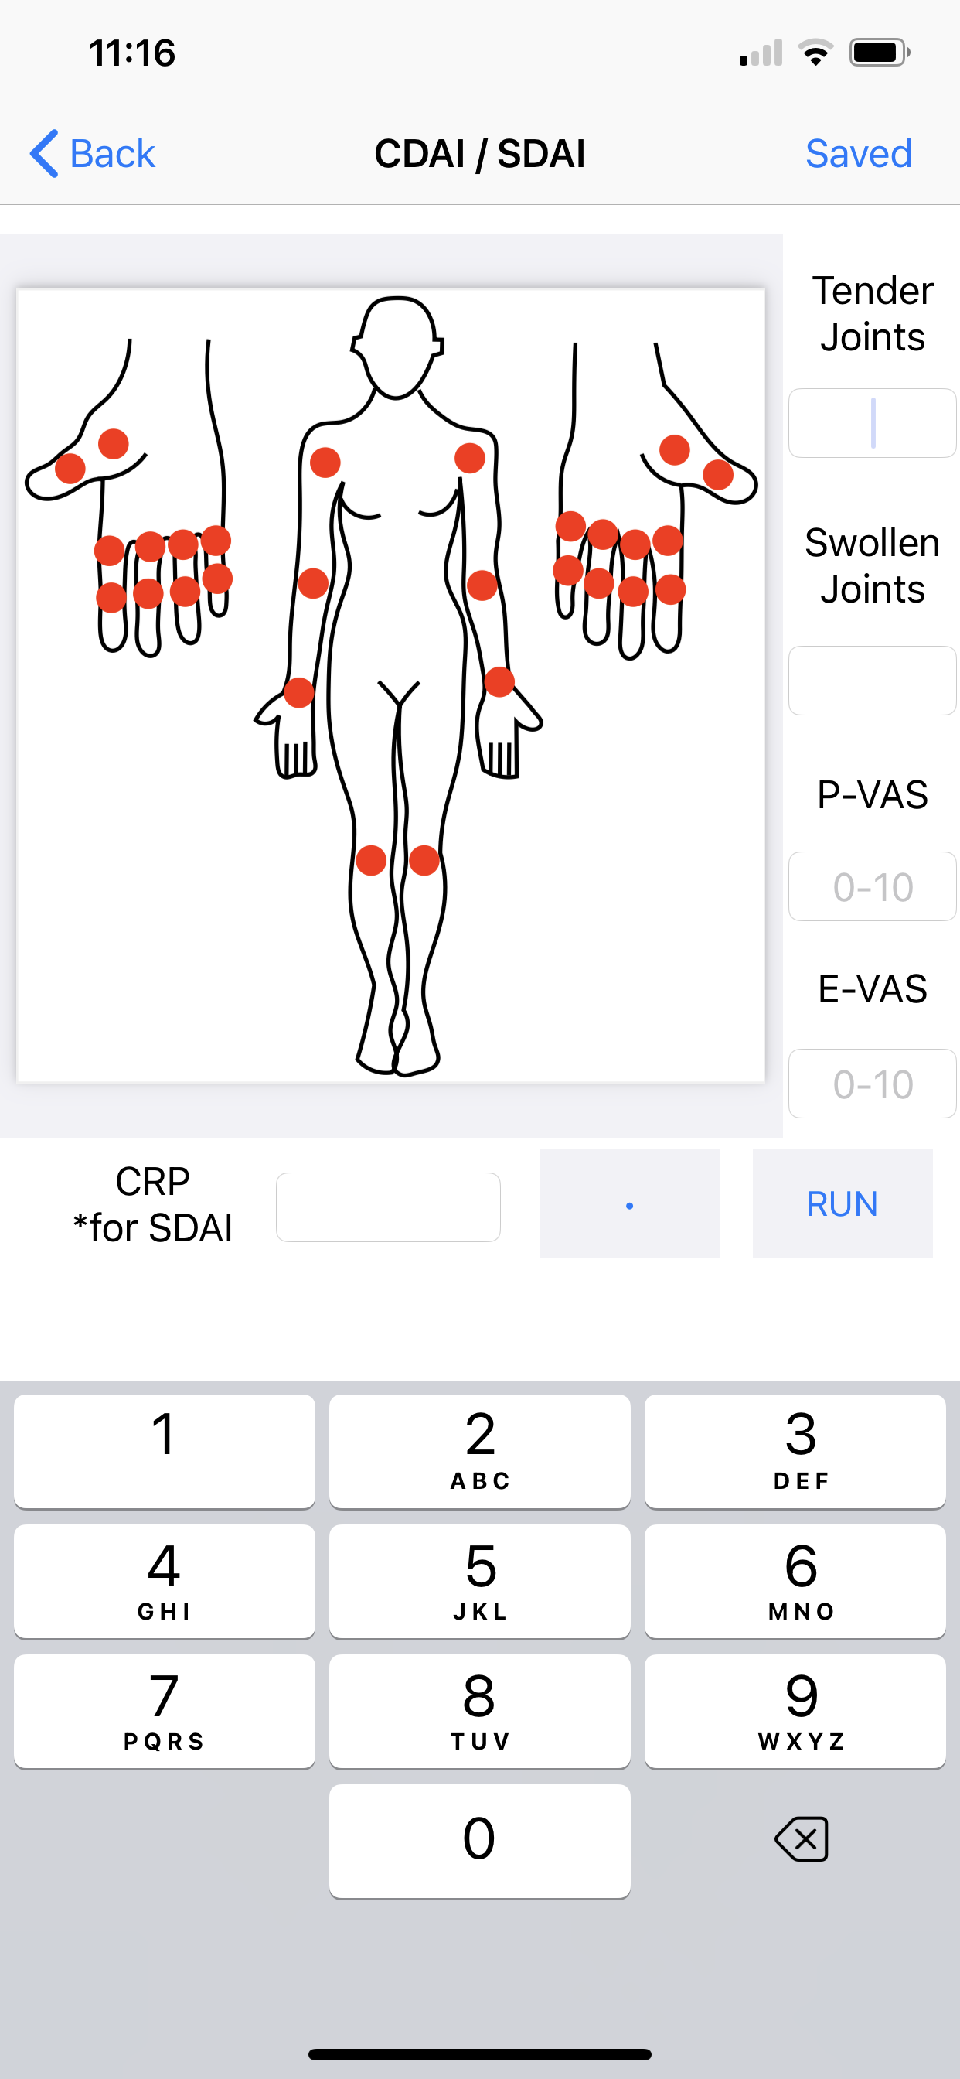
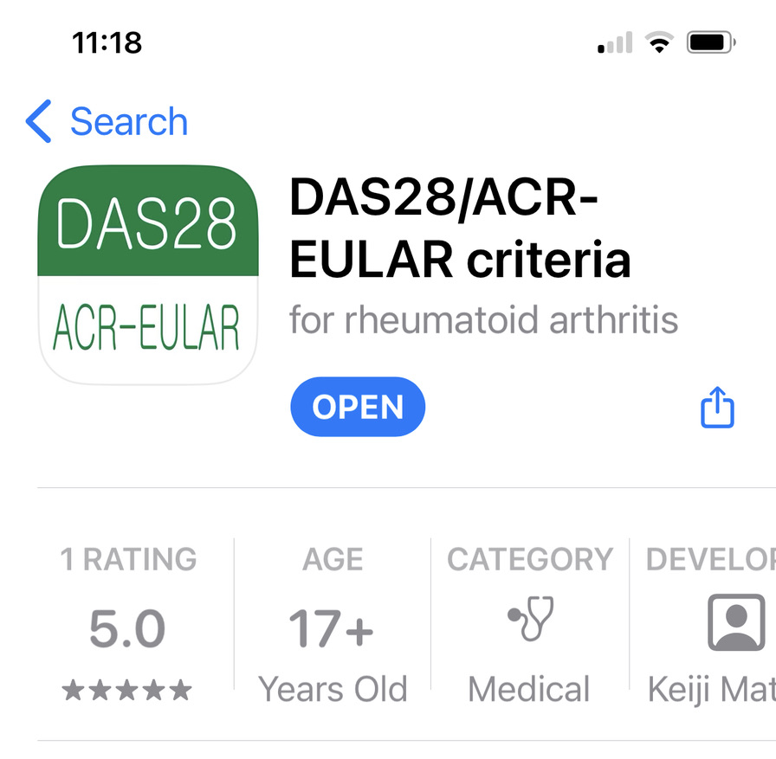
This is the app I recommend
RAE Initiative| Fall 2023

Slide 34
RAE Initiative| Fall 2023

Slide 35
CDAI Components
Patient Global assessment
Provider Global Assessment
Tender Joint Count
Swollen Joint Count

Slide 36
CDAI Components
Patient Global assessment (visual analog scale 0-100 mm)
Provider Global Assessment (visual analog scale 0-100mm)
3. Tender Joint Count
4. Swollen Joint Count
Considering all the ways your arthritis affects you, how well you are doing on this scale:
RAE Initiative| Fall 2023

Slide 37
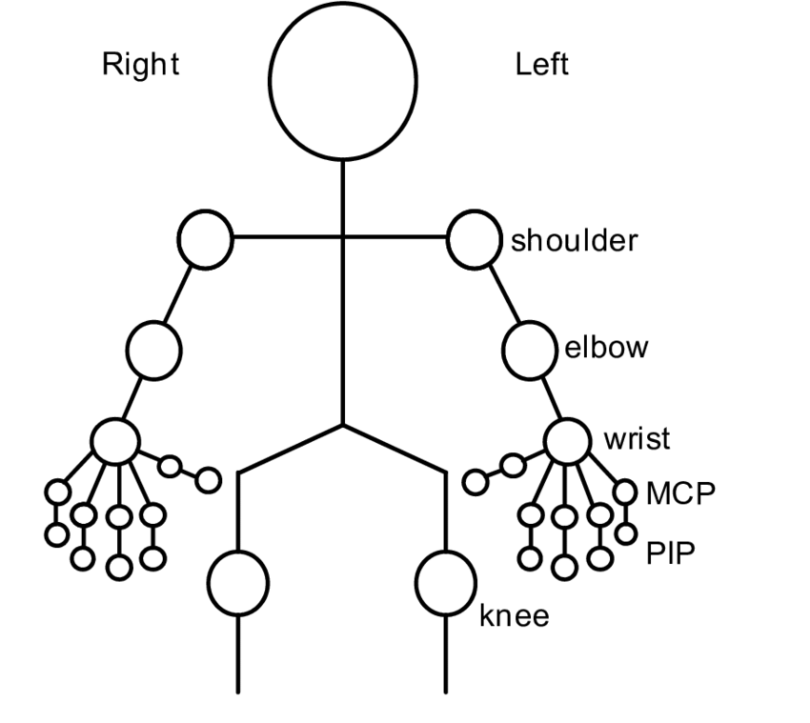
CDAI Components Cont.
Patient Assessment
Provider Assessment
Tender Joint Count
Swollen Joint Count

Slide 38
Case 4. 44 yo woman on hydroxychloroquine and methotrexate with RA presents to clinic and reports her pain from arthritis is 6/10. Exam reveals:
2 swollen & tender wrists
3 swollen & tender PIPs
3 MTPs tender to squeeze
You think her arthritis is pretty active: 5/10. How active is her RA?
CDAI =
RAE Initiative| Fall 2023

Slide 39
Case 4. 44 yo woman on hydroxychloroquine and methotrexate with RA presents to clinic and reports her pain from arthritis is 6/10. Exam reveals 2 swollen & tender wrists, 3 swollen & tender PIPs, MTPs tender to squeeze. You think her arthritis is pretty active 5/10. How active is her RA?
CDAI = 24 (high)
Patient VAS = 6
Provider VAS = 5
Tender joints = 8
Swollen joints = 5
RAE Initiative| Fall 2023
Notes:
Enthesopathy = inflammation at the site where a tendon inserts into a bone, i.e. the insertion point of the Achilles tendon into the calcaneus

Slide 40
Case 4 con’t. You add Humira 40 mg Q 2 weeks to her regimen and she returns 6 weeks later reporting 50% improvement and has 1 swollen and tender wrist and 2 tender PIPs on exam. You think she is better and rate her arthritis as 3/10. What is her CDAI?
CDAI =
RAE Initiative| Fall 2023
Notes:
Enthesopathy = inflammation at the site where a tendon inserts into a bone, i.e. the insertion point of the Achilles tendon into the calcaneus

Slide 41
Case 4 con’t. You add Humira 40 mg Q 2 weeks to her regimen and she returns 6 weeks later reporting 50% improvement and has 1 swollen and tender wrist and 2 tender PIPs on exam. You think she is better and rate her arthritis as 3/10. What is her CDAI?
CDAI = 10 (moderate/low borderline)
Patient VAS = 3
Provider VAS = 3
Swollen Joint = 1
Tender Joint = 3
RAE Initiative| Fall 2023

