Slide 1
Keeping Safe During Respiratory Illness Season
Notes:
Hello! Today we are going to discuss how to protect yourself, your family, and your community during respiratory illness season.

Slide 2
Your Presenters
Add your photos here
Add your information here
Notes:
[Introduce yourself and any co-presenters if applicable]

Slide 3
Your Presenter
HEADSHOT HERE
Title
Organization
Email Address
Notes:
[Introduce yourself and any co-presenters if applicable]
Speaker recommendation: You can add your headshot onto this slide by doing the following:
1) Click the “Insert” button on the toolbox above.
2) Then, click the “Pictures” button and select “This Device.”
3) A pop-up box with access to the folders on your computer will open. Look for the image you’d like to add.
4) Once you select the image, it should come up on the slide. Use your mouse to move and place the image over the “HEADSHOT HERE” place holder. That’s it!

Slide 4
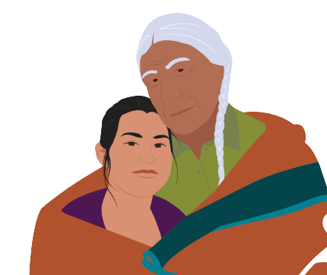
Presentation Overview
General flu information
General COVID-19 information
General RSV information
Why you should get vaccines each year
Vaccine side effects & safety
Resources
Notes:
During this presentation, we will discuss general information about the flu, COVID-19, and RSV. We will also share important information about how vaccines work, why you should get vaccines each year. Then, we will talk about typical vaccine side effects and vaccine safety. Finally, we will discuss where you and your loved ones can get vaccinated.

Slide 5
General Flu Information
Notes:
So, what exactly is the flu?

Slide 6
What is Flu?
An infection that attacks your whole body
Symptoms may include:
Fever
Chills
Cough
Sore throat
Runny nose
Headaches
Muscle aches
Tiredness
Notes:
The flu is an infection caused by a virus that attacks your whole body. Symptoms of flu include fever, chills, cough, sore throat, runny nose, headaches, muscle aches, and tiredness.

Slide 7
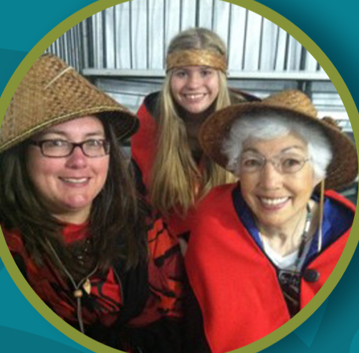
“My great grandma lost multiple children to the flu. Before we had the flu shot, it was common for people to get very sick or die from the flu.”
– Tam Lutz | Lummi Nation Tribal Elder
Notes:
The flu can also result in hospitalization and death – especially for those most vulnerable, like people with certain medical conditions and Elders. In this quote, Tam Lutz, a Lummi Nation Tribal Elder, shares her thoughts. She says “my great grandma lost multiple children to the flu. Before we had the flu shot, it was common for people to get very sick or die from the flu.”
Note to presenter: Take this opportunity to share your own story related to the dangers of flu if you have one.

Slide 8
General COVID-19 Information
Notes:
Now we will talk a little bit about COVID-19

Slide 9
What is COVID-19?
An infection that attacks your whole body
Symptoms may include:
Fever
Chills
Cough
Sore throat
Runny nose
Headaches
Muscle aches
Mental fog
Notes:
COVID-19 an infection caused by the SARS Co-V-2 virus that attacks your whole body. Common symptoms include fever, chills, cough, sore throat, runny nose, headaches, muscle aches, and tiredness. Other symptoms include loss of taste or smell, mental fog or confusion, nausea, diarrhea, or vomiting.

Slide 10
What is long COVID?
Effects that can develop after COVID-19 infection and can last weeks, months, or even years
Symptoms may include:
Fever
Shortness of breath
Cough
Depression
Runny nose
Headaches
Muscle or joint pain
Mental fog
Notes:
Long COVID is a wide range of new, returning, or ongoing health problems that people experience after being infected with the virus that causes COVID-19. Most people with COVID-19 get better within a few days to a few weeks after infection, so at least 4 weeks after infection is the start of when Long COVID could first be identified. Anyone who was infected can experience Long COVID.
The best way to prevent long-COVID is to prevent illness. Staying up-to-date with vaccines will help keep you safer.

Slide 11
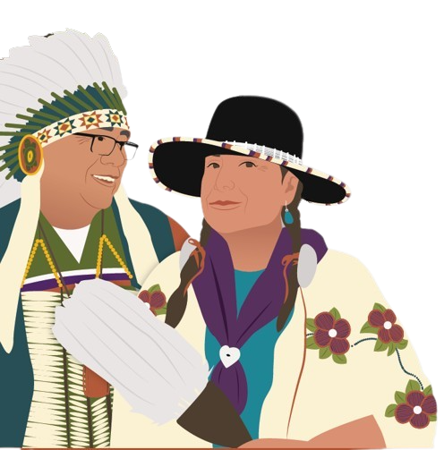
Diseases associated with long-COVID
Diabetes
Dementia
Notes:
COVID and long-COVID are not the only issues associated with the disease. Other diseases have been linked to COVID-19 infection as well.
Several studies have linked new-onset of diabetes to COVID-19 infection. It’s very important to ask your provider about diabetes screening if you have had infection.
https://www.ncbi.nlm.nih.gov/pmc/articles/PMC9917823/
Studies taking place right now that show that COVID-19 causes severe neurological complications in people with dementia. According to these results, COVID-19 appears to accelerate disease progression in all types of dementia. Further research is needed to understand why COVID-19 accelerates brain deterioration in patients with dementia.
https://covid19.nih.gov/news-and-stories/rapid-progression-dementia-following-covid-19#:~:text=This%20study%20shows%20that%20COVID,deterioration%20in%20patients%20with%20dementia.
More research is taking place to see if other diseases are associated with COVID-19.

Slide 12
General RSV Information
Notes:
Have you heard about RSV? We will now share some general information that you might not know.

Slide 13
What is Respiratory Syncytial Virus (RSV)?
An infection that affects your lungs and breathing passages
Symptoms may include:
Fever
Fatigue
Cough
Sore throat
Runny nose
Congestion
Loss of taste/smell
Runny nose
Notes:
Respiratory syncytial (sin-SISH-uhl) virus, or RSV, is a common respiratory virus that usually causes mild, cold-like symptoms. Most people recover in a week or two, but RSV can be serious.
Infants and older adults are more likely to develop severe RSV and need hospitalization.

Slide 14
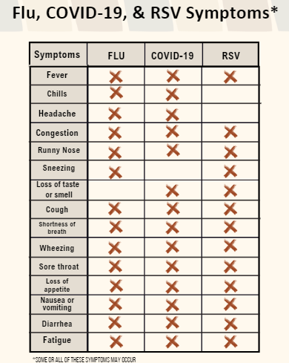
Notes:
Here is chart that shows flu, COVID-19, and RSV symptoms side-by-side. This is one of the resources we have available.

Slide 15
How Illnesses Spread
Notes:
How exactly do respiratory illnesses spread?

Slide 16
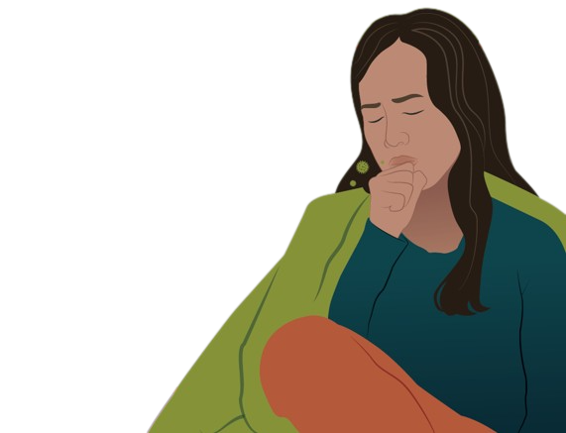
How Respiratory Illnesses Spread
Droplets in the air
When droplets are breathed in
Droplets on surfaces
When you touch your eyes, nose, or mouth after touching surface
Notes:
Respiratory illnesses spread in two ways: through droplets in the air and droplets on surfaces. When you breathe in droplets in the air, you may get sick. When you touch something that has disease droplets on it, like a doorknob or light switch, then you touch your eyes, nose, or mouth, you can also get sick.

Slide 17
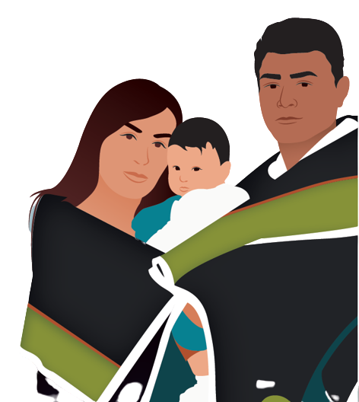
Respiratory Illnesses Can Be Serious
These illnesses can be mild, but for some they can be deadly
We need to get vaccinated
To protect ourselves, our families, and our communities
Notes:
Our ancestors faced many serious illnesses, like the flu and RSV, and some died from these. These illnesses can still be very serious today. However, these days, we are fortunate to have access to vaccines that can help us protect ourselves, our families, and our communities. Everyone 6 months and older needs to get vaccinated against the flu and COVID– including young, healthy people. Pregnant people can also safely get vaccinated against flu at any time during pregnancy. American Indian and Alaskan Native babies should receive the RSV vaccine from birth -19 months of age. Those over 60 years should also get the RSV vaccine.
When everyone who is able gets vaccinated, it makes it less likely that healthy people spread the flu to those that are more vulnerable.

Slide 18
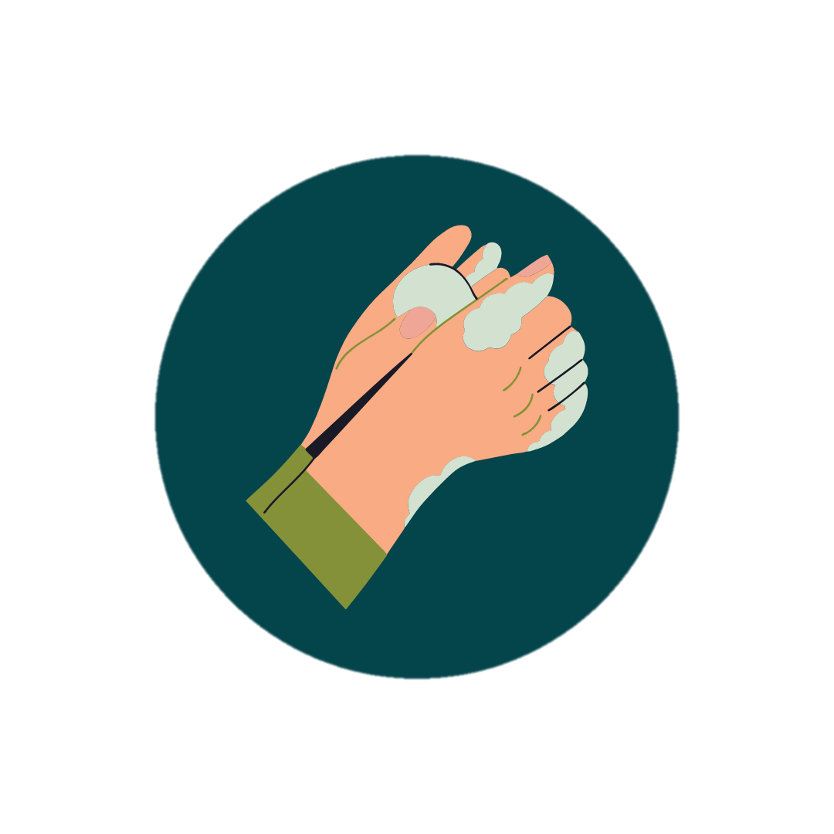
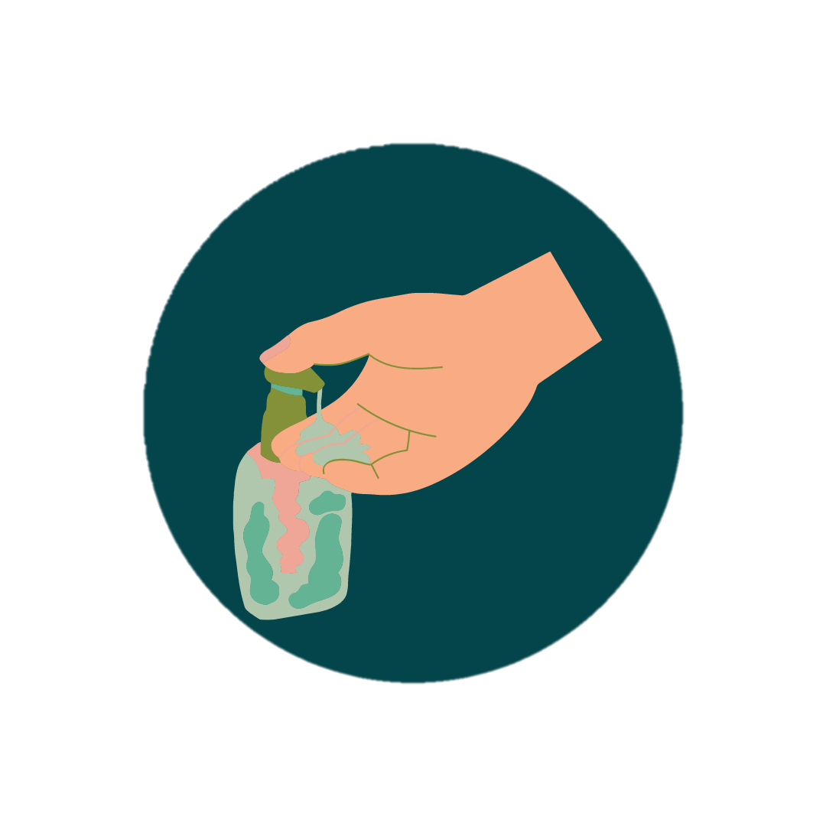
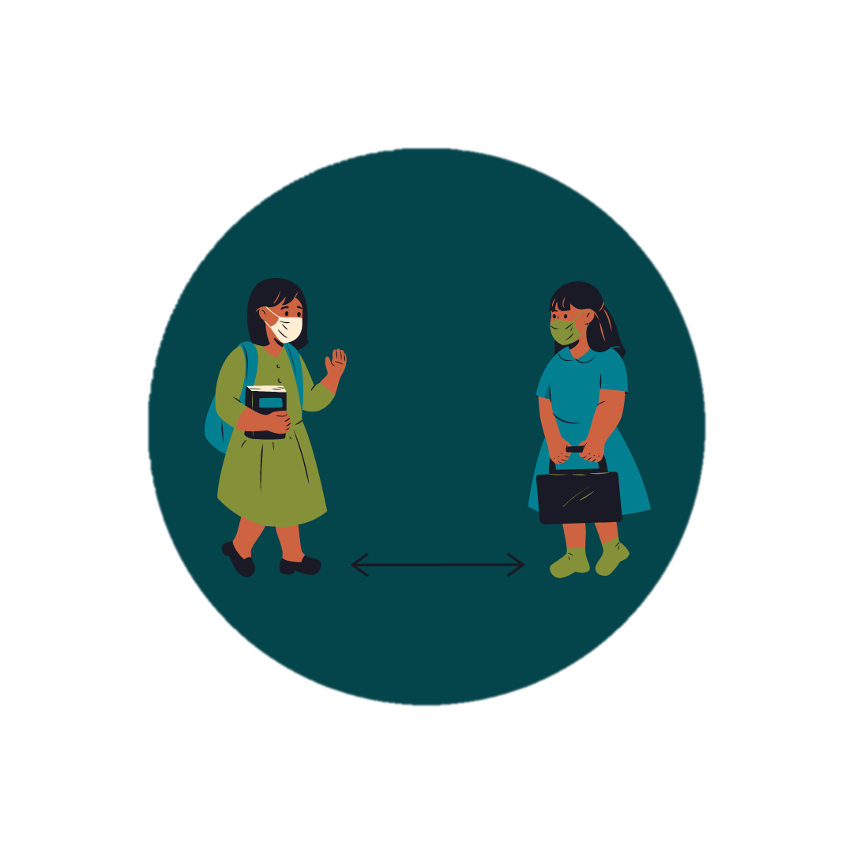
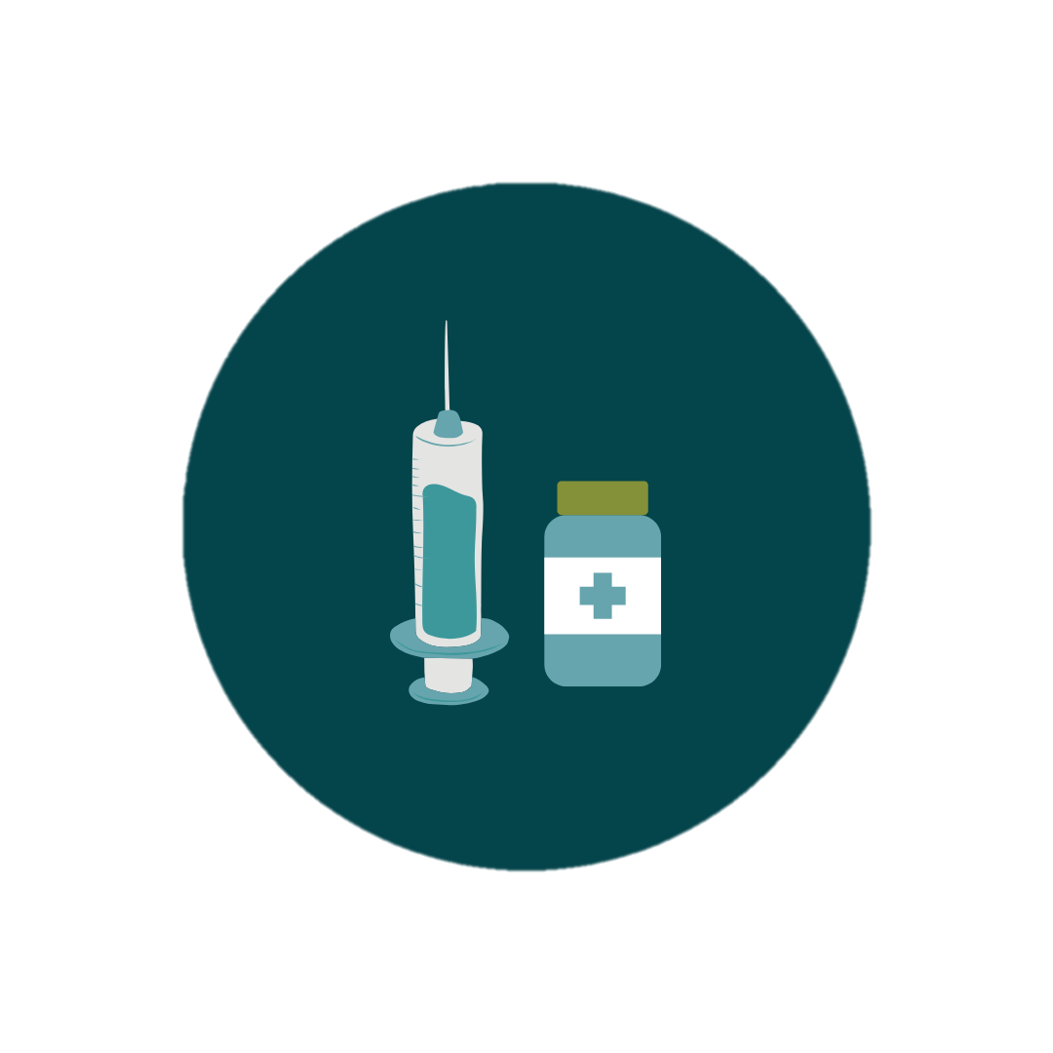
Protecting Yourself From Illness
Wash your hands
Wear your mask
Sanitize your hands
Keep your distance
Get vaccinated
Notes:
There are healthy habits you can practice to protect yourself from illnesses. Wash your hands well and often with soap and water for at least 20 seconds. Wear a mask in public places. If soap and water are not available, use alcohol-based hand sanitizer. To be even safer, consider carrying hand sanitizer with you and using it after touching doors and surfaces. You can also keep your distance from people you know are sick or when in a public place. Another effective way to protect yourself from respiratory illnesses is by staying up-to-date with vaccines. In order to protect our communities, it is important that everyone who is eligible gets vaccinated.

Slide 19
How Vaccines Work
Notes:
Next, we will talk about how vaccines work.

Slide 20
How Vaccines Work
We all have warrior cells that protect us from illnesses
The vaccines tell our warrior cells how to recognize and fight illnesses such as flu, COVID-19, and RSV
Notes:
Within our bodies, each of us has warrior cells that stand guard and attack diseases when they try to infect us.
The vaccines provide instructions to our warrior cells on how to identify and fight disease.

Slide 21
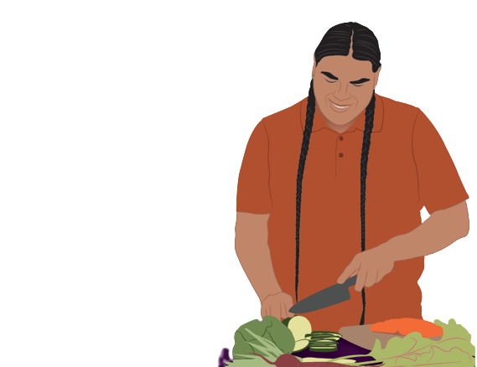
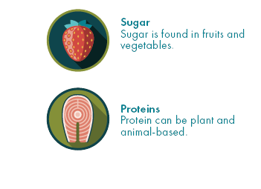
Vaccines Work Naturally
Vaccines contain natural ingredients – including sugars and proteins
Notes:
Vaccines contains natural ingredients that are common in the foods we eat, including sugars and proteins.
After the vaccine helps prepare your body to identify and fight disease, it leaves your body.
Note to presenter: If someone asks how the vaccine leaves your body, respond with “once the vaccine ingredients provide instructions to your warrior cells, the vaccine is cleared from your body the same way other ‘wastes’ may be cleared from your body – through urination and sweat.”

Slide 22
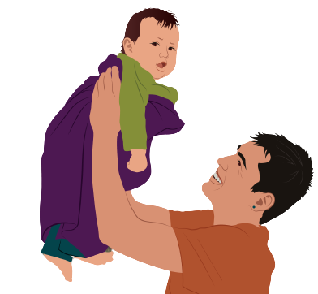
Vaccines
Make it less likely you get sick
Reduce the seriousness of illness if you do get sick
Protect our communities
Notes:
We are less likely to get sick when we get vaccinated. For example, the flu vaccine reduces the chances of you getting sick with the flu by 50%.
Getting vaccinated can also reduce the seriousness of illness if you happen to get sick.
The vaccines don’t only protect us; they protect our must vulnerable, like our Elders and children. Vaccines protect us, our families, and our communities for generations to come.

Slide 23
Why Do I Need to Get Vaccines Every Year?
Notes:
Let’s talk about why it’s important to get these shots every year.

Slide 24
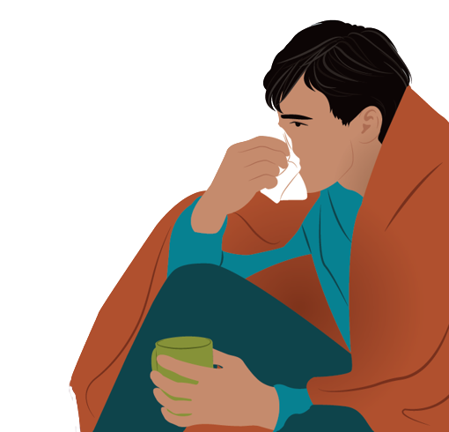
Viruses are Tricksters
Theses diseases are sneaky
Viruses change how they looks to fool your body
Vaccines are updated to keep up with virus changes
Notes:
Viruses are sneaky. For example, about once a year, the flu changes how it looks to try to fool your body.

Slide 25
We need to get vaccines every year, so our body is up to date on how to recognize and fight diseases
Notes:
That’s why we need shots each year – so our bodies can stay up to date on how to recognize and fight the flu, COVID-19, and RSV.
It’s also important to get shots every year, because our warrior cells’ ability to fight disease decreases over time.

Slide 26
Vaccine Co-administration
Flu
Covid-19
RSV (if eligible)
Pneumonia
Shingles
https://www.cdc.gov/vaccines/hcp/acip-recs/general-recs/timing.html
Notes:
It is safe to administer multiple vaccines at the same time, in different areas of the body, in different arms, for instance. If you are eligible for the vaccines for the above diseases, ask your doctor to administer them on the same day. You get all of your potential side-effects done all at once, and you don’t have to go for separate appointments.

Slide 27
Vaccine Safety
Notes:
There are many measures that are taken to ensure that vaccines are safe for everyone.

Slide 28
Vaccine History
The flu shot has been around for 50+ years
COVID-19 vaccine was developed using existing technology
Millions have safely received flu and COVID-19 vaccines including American Indian and Alaska Native people
Notes:
But before we get into vaccine safety, it’s important to mention that the flu vaccine has been around for over 50 years.
Some people think the COVID-19 vaccine was created too quickly, and it was fast because it used existing safe vaccine technology.
Millions of Americans have safely received both COVID-19 and the flu vaccines – including American Indian and Alaska Native people.

Slide 29
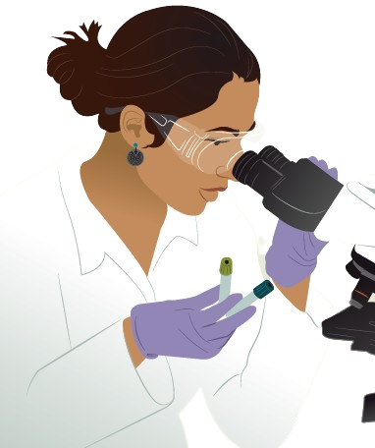
Vaccine Testing
All vaccines go through several rounds of testing
Testing helps us learn about side effects
Notes:
One reason we know vaccines are safe is because they go through several rounds of testing, which often takes thousands of volunteers. During vaccine testing, important questions are considered like “Is the vaccine safe?” and “How does the body react to it?”
This testing process also helps us learn about any possible vaccine side effects.

Slide 30
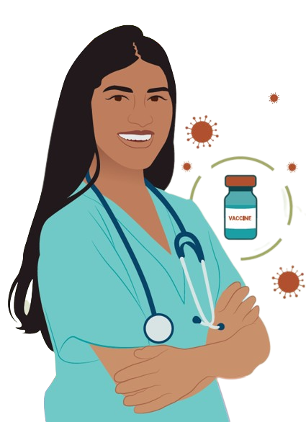
Vaccine Approval
Vaccines are approved after:
They are proven to be safe and effective
Common side effects are shown to be mild
Notes:
All vaccines are only approved for public use after they go through thousands of hours of testing and are found to be safe and effective.
Any common side effects must be mild.
Side effects should not be confused for illness. We'll talk more about this later!

Slide 31
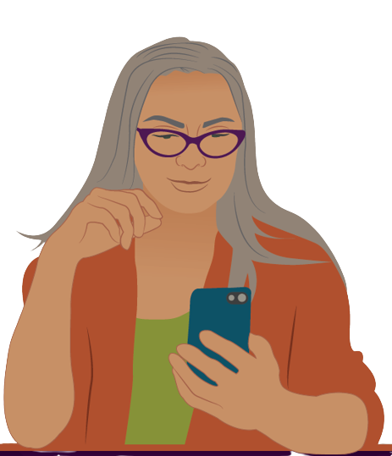
Vaccine Monitoring
Everyday people share how the vaccine made them feel
Monitoring helps to quickly identify any vaccine risks and take action
Notes:
Making sure a vaccine is safe doesn't stop after vaccine approval. Once a vaccine is approved, everyday people who got the vaccine can share how it made them feel. We all have the power to contribute in this way.
The purpose of this kind of monitoring is to identify any possible vaccine risks quickly and take action.

Slide 32
Vaccine Side Effects
Notes:
Next, we are going to discuss vaccine side effects.

Slide 33
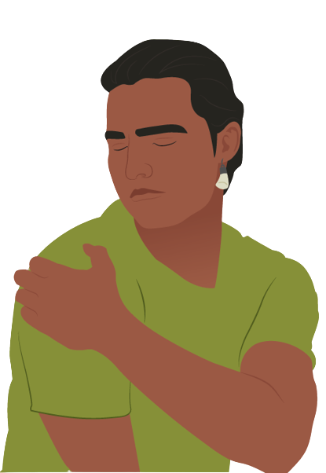
Vaccine Side Effects
Common side effects may include:
Soreness, redness, and swelling where you got the shot
Fever
Headache
Muscle aches
Notes:
Common side effects from the flu vaccine include soreness, redness, and swelling where you got the shot, fever, headache, and muscle aches.

Slide 34
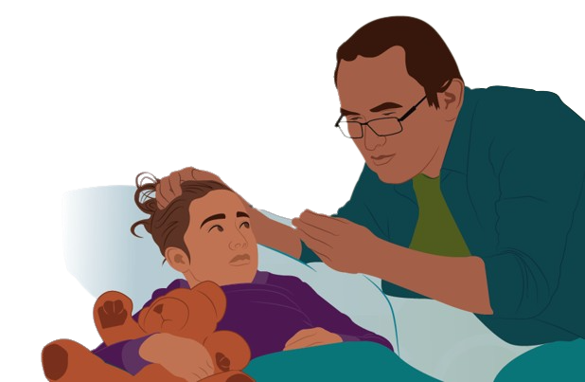
Vaccine Side Effects
Typically go away in a few days
Are a sign your warrior cells are preparing to see and fight disease
Notes:
Side effects from the vaccine typically go away within a few days.
Mild side effects are a good sign that your warrior cells are preparing to recognize and fight the disease.

Slide 35
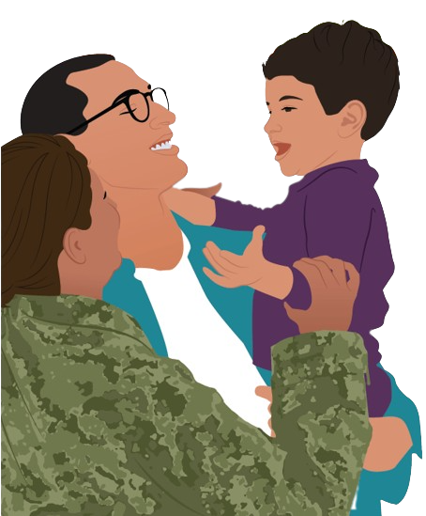
Side Effects Are Not “Sickness”
Vaccine do not make you sick
Vaccine strengthen your warrior cells by helping them see and fight disease
Notes:
Sometimes people make the mistake of thinking that mild vaccine side effects are them "getting sick with the disease." This is not true. Vaccines cannot make you sick with the disease you are getting vaccinated against. It strengthens our warrior cells by helping them see and fight disease.

Slide 36
Serious Side Effects Are Rare
If you experience anything beyond common side effects, please get medical attention
Report your experience to the Vaccine Adverse Event Reporting System (VAERS)- www.VAERS.hhs.gov
Notes:
Serious side effects from vaccines are very rare. However, if you experience anything beyond common side effects, please get medical attention. When you do, make sure that the health provider reports your experience to the Vaccine Adverse Event Reporting System (VAERS). If you are uncertain whether your experience was reported, you can file a report at www.VAERS.hhs.gov.

Slide 37
Getting Vaccinated
Notes:
Let’s talk about where you can get vaccinated.

Slide 38
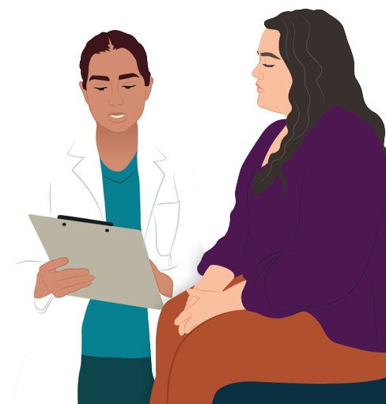
How to Get Vaccinated
Contact your local Tribal clinic or IHS facility to see if vaccines are available
Visit a local pharmacy or clinic
Contact your state health department
Check local news outlets
Notes:
If you are uncertain about where to get vaccines, you can contact your local Tribal clinic, IHS facility, or visit a local pharmacy or clinic. You can also check your local pharmacy’s website to see if vaccination appointments are available.
You can learn more information about where to find vaccine locations in your area by contacting your state health department. Finally, your local news outlets often have information on how to get a vaccination appointment.
Note to presenter: Personalize this slide with information specific to your community.

Slide 39
Finding Vaccine Locations
Visit Vaccines.gov
Text your ZIP code to 438829 or call 1-800-232-0233
Source: Vaccines.gov
Notes:
You can also visit Vaccines.gov to find vaccination providers near you. Another way to find vaccination providers near you is by texting your zip code to 438829 or by calling 1-800-232-0233.

Slide 40
Resources
Notes:
We are going to share just some of the many resources available to the tribes.
VacciNative website for adult vaccination information: www.indiancountryecho.org/vaccinative/
Native Boost for childhood vaccination information:
www.npaihb.org/native-boost/

Slide 41
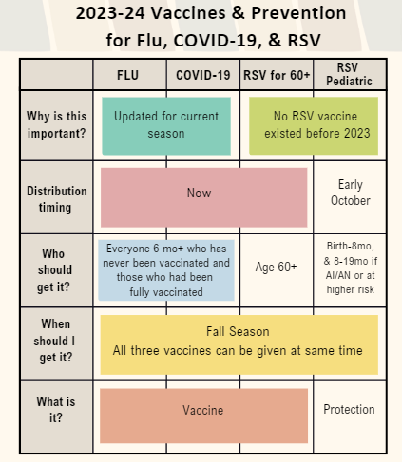
Notes:
Here is an easy-to-read chart that helps understand why the vaccines are important, who should get vaccinated, and when.

Slide 42
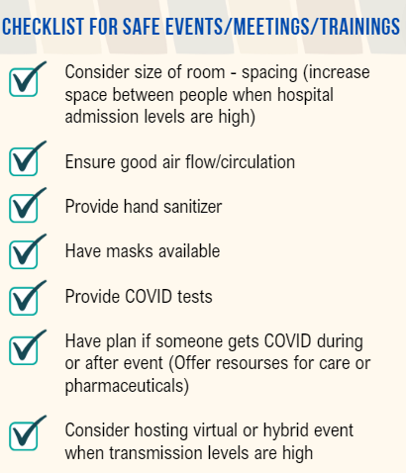
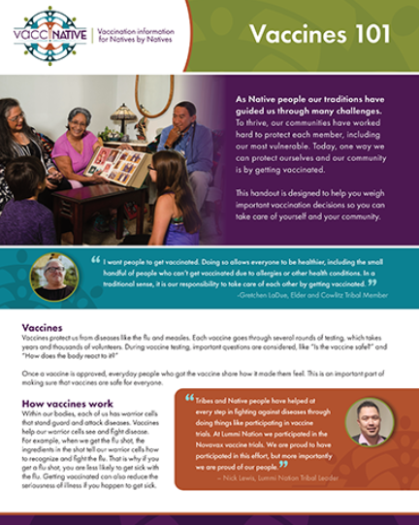
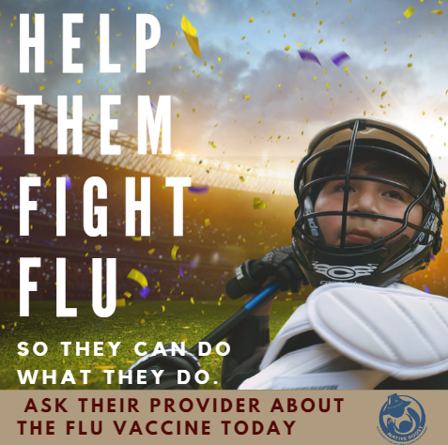
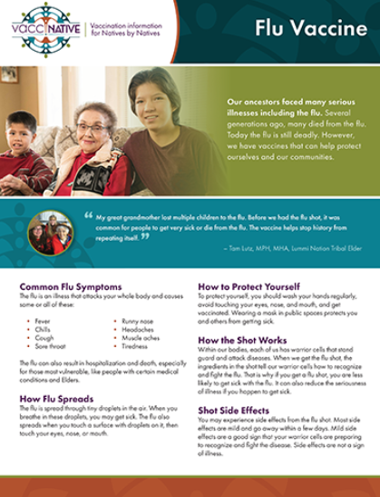
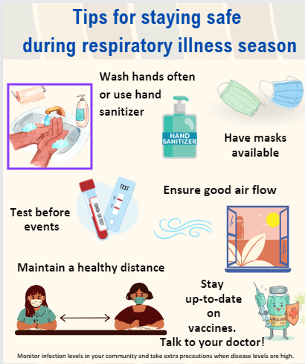
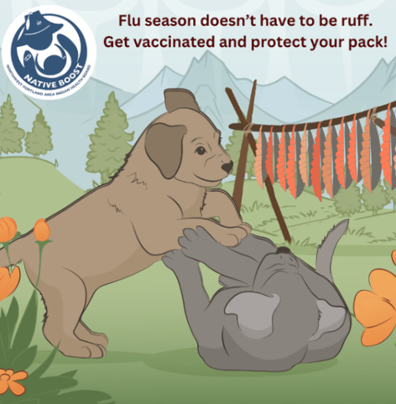
Notes:
Here are some other resources you can find on the VacciNative and Native Boost websites. We will give you the links at the end of the presentation.

Slide 43
Any Questions?
Notes:
Does anyone have any questions about what we’ve discussed today? Was anything unclear?

Slide 44
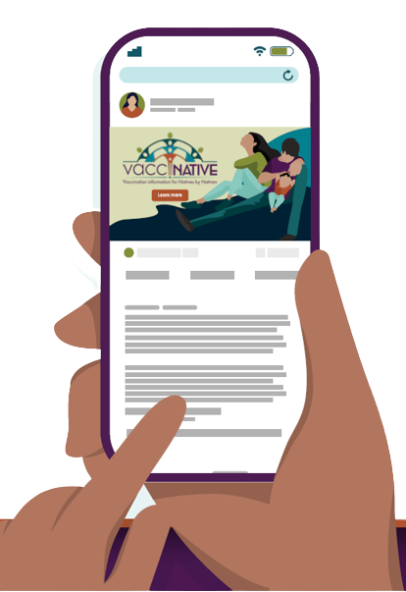
For More Vaccine Information
Visit
www.IndianCountryECHO.org/VacciNative
www.npaihb.org/native-boost/
Notes:
Please visit the VacciNative website at: www.IndianCountryECHO.org/VacciNative
and for childhood vaccination information, visit Native Boost website.
VacciNative is a project dedicated to creating accurate vaccine information for Native people by Native people. VacciNative does this by gathering info from trusted Elders, Native health professionals, and other experts. Plus, all of VacciNative’s materials are reviewed by the VacciNative Alliance, a collaboration of staff from Tribal Epidemiology Centers across the nation.

Slide 45
For more information
Org/Tribal
Logo
Title
Organization
Email Address
Notes:
Thank you for the time you’ve spent listening to this presentation. If you’d like more information about what we’ve discussed today or if you have any additional questions about anything we’ve discussed, please feel free to contact me. My contact information is listed in the slide above.

Slide 46
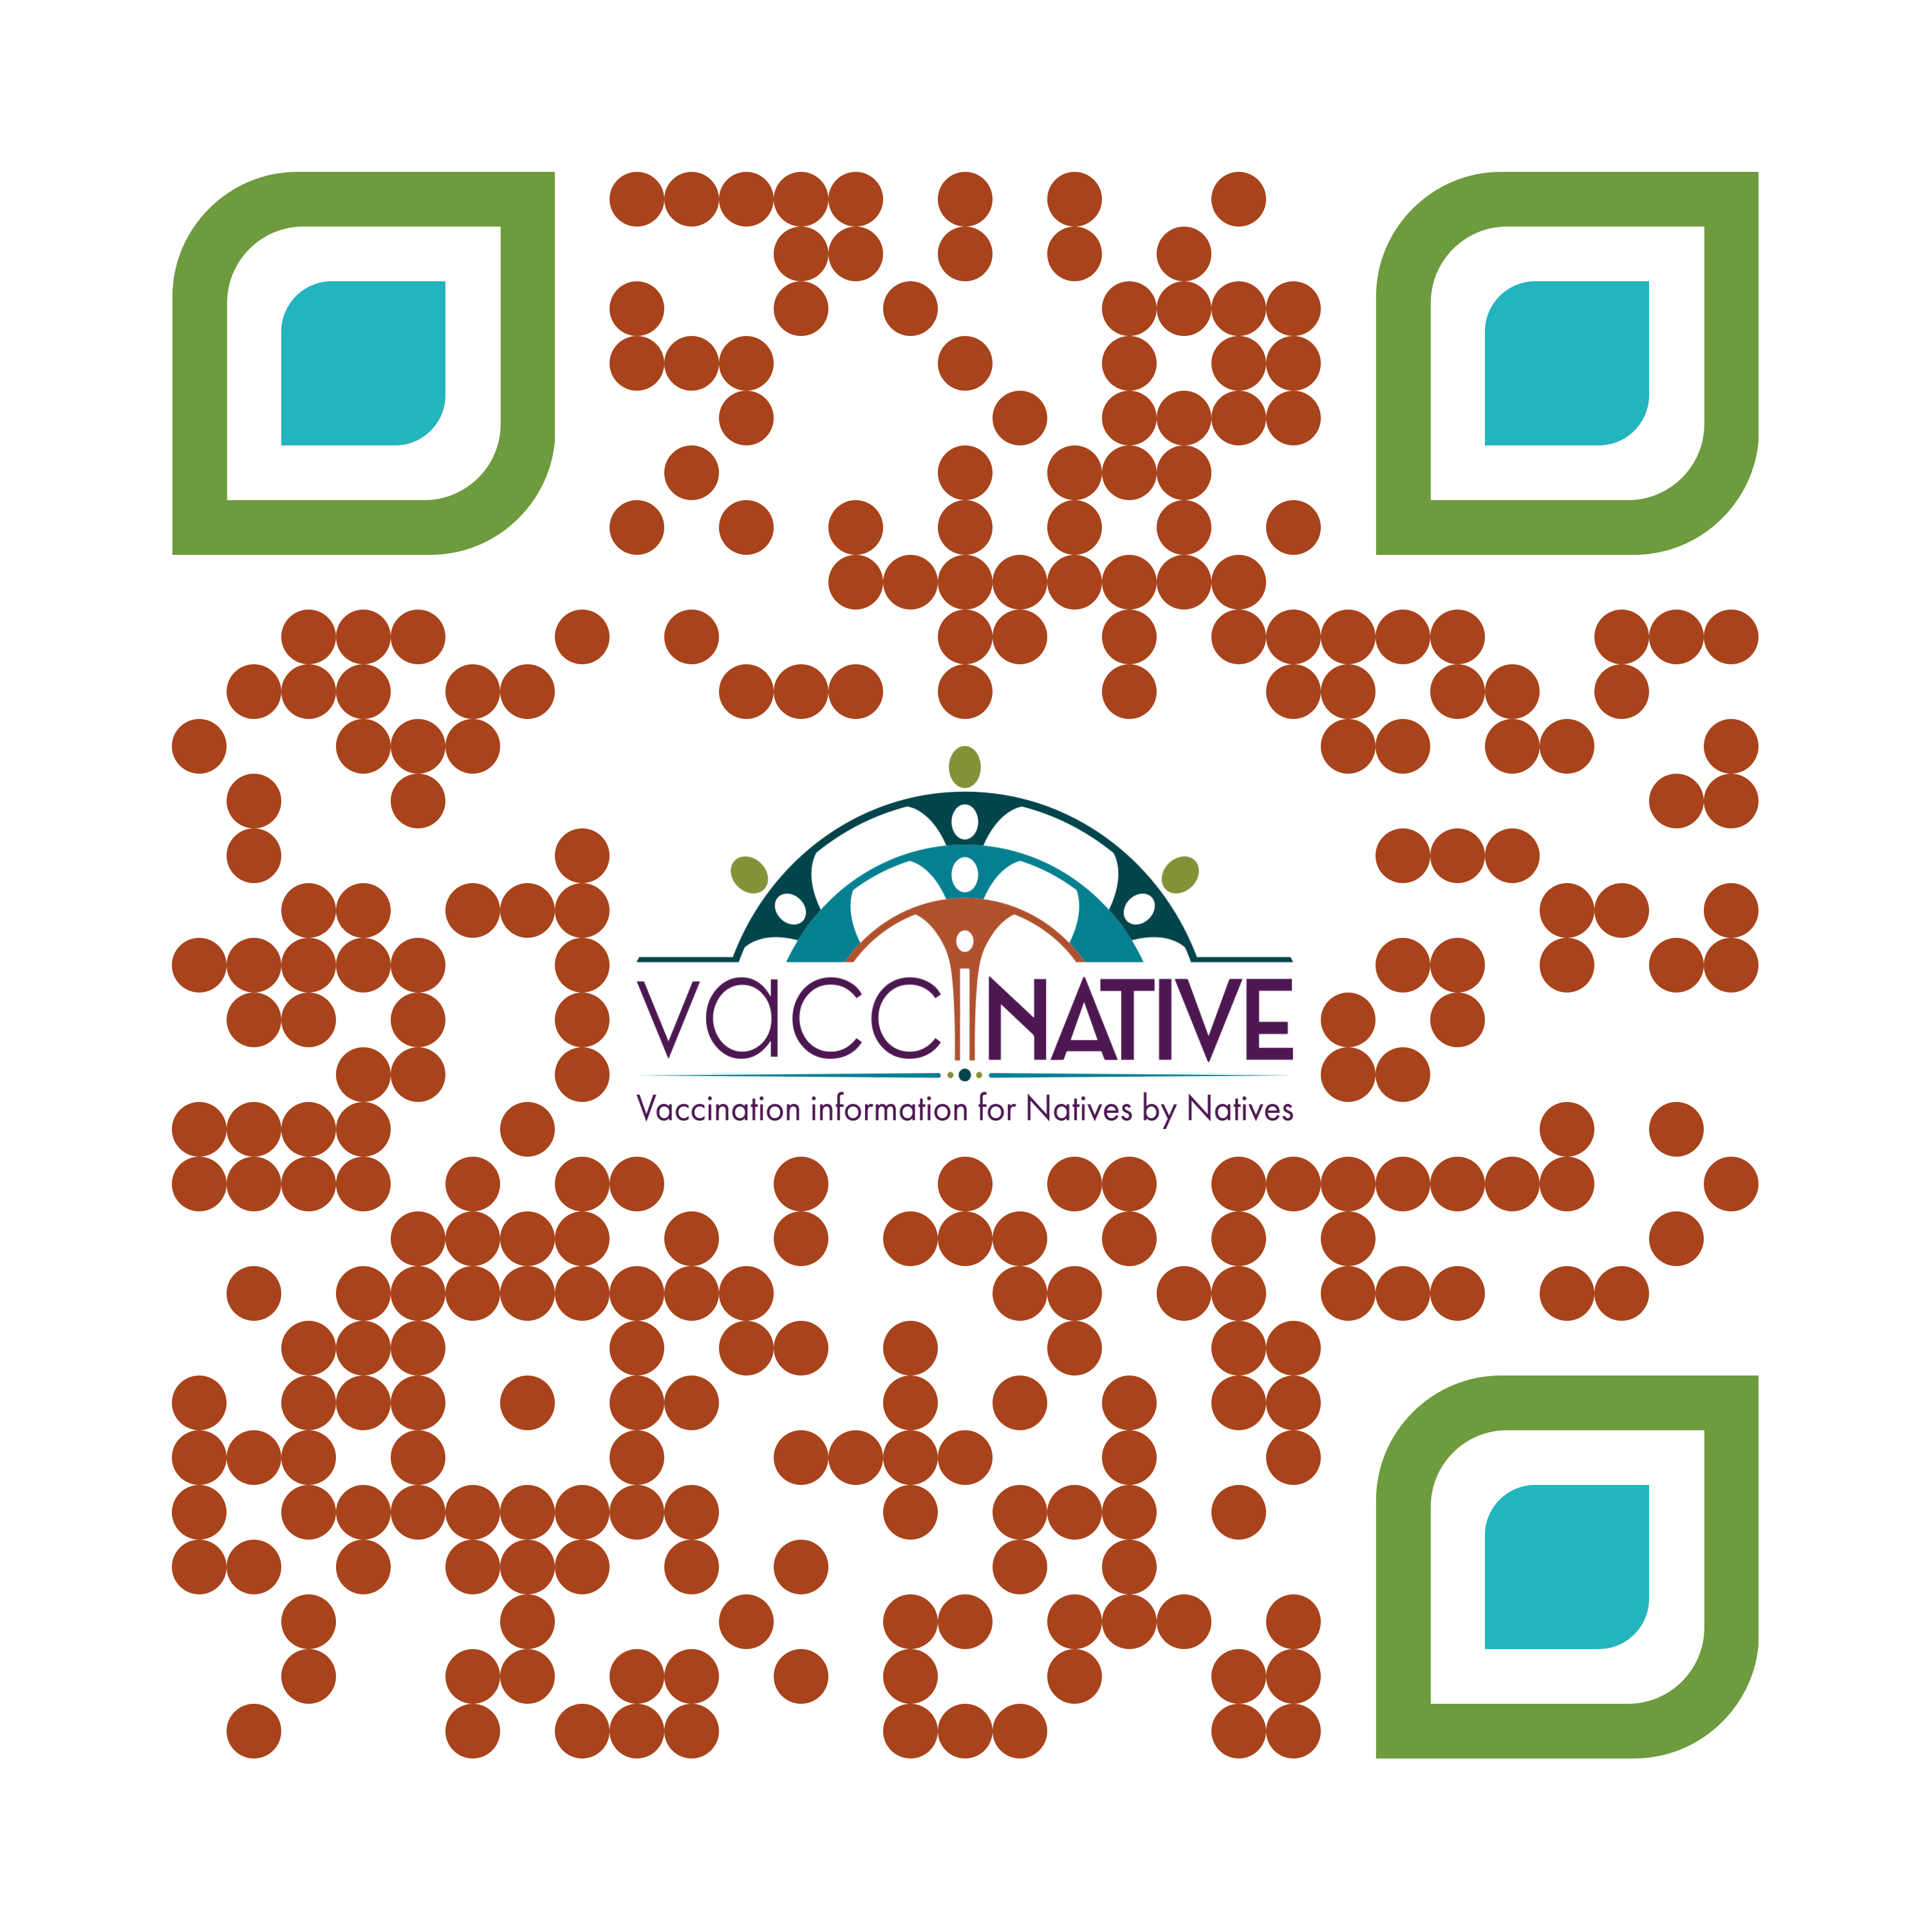
For more information
Vaccinative@npaihb.org
Notes:
Thank you for the time you’ve spent listening to this presentation. If you’d like more information about what we’ve discussed today or if you have any additional questions about anything we’ve discussed, please feel free to contact us at the email address above.
VacciNative website for adult vaccination information: www.indiancountryecho.org/vaccinative/
Native Boost for childhood vaccination information:
www.npaihb.org/native-boost/

Slide 47
Notes:
Thank you for taking the time to come together to discuss this important topic!

