Slide 1


Role of the Clinical Pharmacists in Transgender Care
ICE Health Service Corps (IHSC)
CDR Christina Andrade, PharmD, BCPS, AAHIVP, NCPS
CDR Kristina Melia, PharmD, MSL, BCACP, NCPS, CCHP
December 19, 2023
Notes:
The Standards of Care (SOC) for the Health of Transgender and Gender Diverse People now has a section that is specific to institutional environments (like prisons).
SOC-8: people with gender identities or expressions that differ from the gender socially attributed to the sex assigned to them at birth
Quote: transgender people often report having to teach their medical providers how to care for them due to the latter’s insufficient knowledge and training. Intersectional forms of discrimination, social marginalization ,and hate crimes against transgender people lead to minority stress. Minority stress is associated with mental health disparities exemplified by increased rates of depression, suicidality, and non-suicidal self-injuries than rates in cisgender populations.
Quote: While Gender Dysphoria (GD) is still considered a mental health condition in the Diagnostic and Statistical Manual of Mental Disorders, (DSM-5-TR) of the American Psychiatric Association. Gender incongruence is no longer
seen as pathological or a mental disorder in the world health community. Gender Incongruence is recognized as a condition in the International Classification of Diseases and Related Health Problems, 11th Version of the World Health Organization (ICD-11). Not all societies, countries, or health care systems require a diagnosis for treatment

Slide 2

Disclaimers and Disclosures
The authors of this presentation contributed in their personal capacity. The views expressed are their own and do not necessarily represent the views of the ICE Health Service Corps (IHSC) or the United States government.
We do not have financial relationships with any commercial interests.

Slide 3
Educational Objectives
Discuss development and implementation of the national IHSC transgender policy and procedures
Enumerate important points in offering all trans individuals’ gender-affirming care
Describe clinic pharmacists' roles and their impact on transgender care at IHSC facilities

Slide 4
Introduction

Slide 5
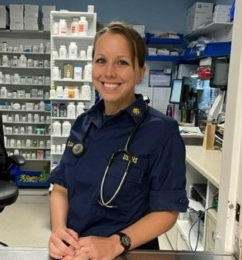
Overview: Caroline Detention Facility
Kristina Melia, PharmD, MSL, BCACP, NCPS, CCHP
Located in Bowling Green, VA
Lead/clinical pharmacist position:
  Oversees pharmacy operations
  Augments patient care of chronic conditions: diabetes, hypertension, thyroid conditions, transgender care, etc.
  Oversees on-site Sexually Transmitted Infection Opt Out Program
  Referrals from mental health providers for initiating psychotropic treatment
    Supports tele-psychiatric provider with monthly follow-up appointments between psychiatric appointments

Slide 6
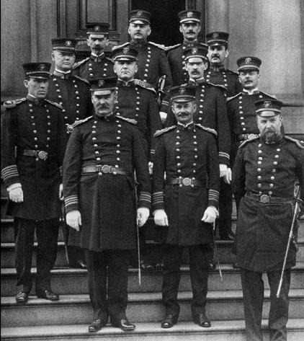

HISTORY
      1889
      Congressional Act to Regulate Appointments in the Marine Hospital Service establishes the uniformed service (future Commissioned Corps) of the U.S. Marine Hospital Service: a “professional, mobile corps of medical specialists who could be deployed anywhere.”
1912
U.S. Public Health and Marine Hospital Service name changed to U.S. Public Health Service.
1798
Congressional Act for the Relief of Sick and Disabled Seamen leads to the creation of a network of marine hospitals, administered by the U.S. Marine Hospital Service, the precursor to PHS.
1891
Immigration Act authorizes PHS to examine and quarantine at Ellis Island.
Reference: Mullan, F. (1998). Plagues and Politics: The Story of the United States Public Health Service. DHHS: Washington, DC.
Notes:
In 1891, the Immigration Act authorized the U.S. Public Health Service (PHS) to examine and quarantine aliens at Ellis Island.
Keeping with the tradition that began at Ellis Island, the PHS role expanded in the 1980s when officers assigned to the Division of Immigration Health Services (DIHS) were detailed from the Health Resources and Services Administration (HRSA) to the Immigration and Naturalization Service (INS) to provide direct health care to detainees held at Krome Service Processing Center located near Miami, Florida.
The demand for DIHS health care staff increased exponentially with the opening of detention centers across the Nation, ultimately growing to a population of nearly 34,000 detainees per day. Now, IHSC is responsible for the direct care of approximately 16,500 individuals per day.
In 2007, DIHS was aligned to ICE in the Department of Homeland Security (DHS) with the name changing to the ICE Health Service Corps (IHSC) in October 2010.
Today, PHS officers are detailed to various federal agencies serving in key public health and administrative roles.
In FY 2018, IHSC employed over 400 PHS officers,

Slide 7


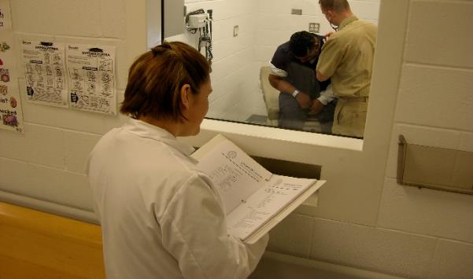


HISTORY
2007
DIHS aligned with the U.S. Department of Homeland Security.
1891
Immigration Act authorizes U.S. Public Health Service (PHS) to examine and quarantine at Ellis Island.
Present
Over 1,650 IHSC PHS, civilian, and contract personnel at HQ and 19 facilities nationwide.
1980s
Division of Immigration Health Services (DIHS). U.S. Public Health Service provided direct health care to detainees at Krome Service Processing Center near Miami, FL.
2010
Name change to IHSC
Notes:
In 1891, the Immigration Act authorized the U.S. Public Health Service (PHS) to examine and quarantine aliens at Ellis Island.
Keeping with the tradition that began at Ellis Island, the PHS role expanded in the 1980s when officers assigned to the Division of Immigration Health Services (DIHS) were detailed from the Health Resources and Services Administration (HRSA) to the Immigration and Naturalization Service (INS) to provide direct health care to detainees held at Krome Service Processing Center located near Miami, Florida.
The demand for DIHS health care staff increased exponentially with the opening of detention centers across the Nation, ultimately growing to a population of nearly 34,000 detainees per day. Now, IHSC is responsible for the direct care of approximately 16,500 individuals per day.
In 2007, DIHS was aligned to ICE in the Department of Homeland Security (DHS) with the name changing to the ICE Health Service Corps (IHSC) in October 2010.
Today, PHS officers are detailed to various federal agencies serving in key public health and administrative roles.
In FY 2018, IHSC employed over 400 PHS officers,

Slide 8
Heath Care System

Slide 9
IHSC Health Care System
1,650 health care staff, including PHS officers, civilian employees, and contractors
Health care delivered in accordance to nationally recognized standards and professional peer-reviewed guidelines
In Fiscal Year 2022, IHSC cared for 118,000 individuals
IHSC’s operating budget approached $324 million
9
Notes:
ICE executed a budget exceeding $315 million on detainee health care in FY 2021, which includes the cost of operating the detention health system administered by IHSC, and the cost of detention contracted facilities. IHSC executed a total of $291,799,912 in FY21 - this includes funds execution and CARES Act (COVID-19) funding.

Slide 10
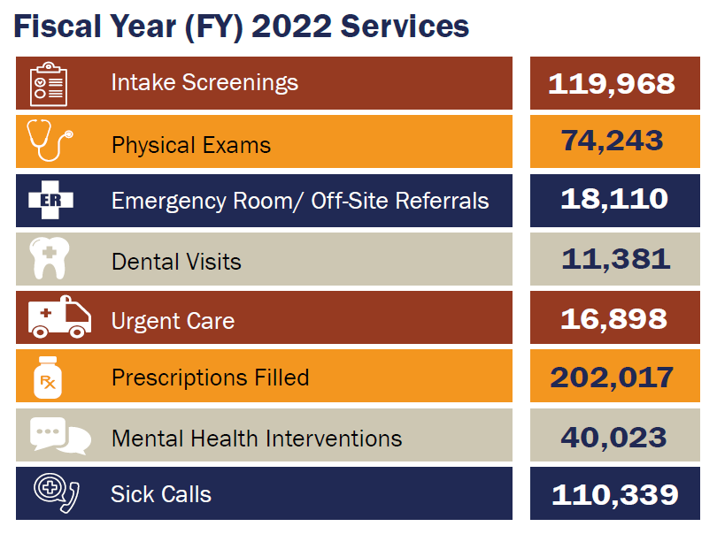
IHSC Health Care Services in FY 2022
Source: ICE Health Service Corps 2021 Year in Review
10

Slide 11
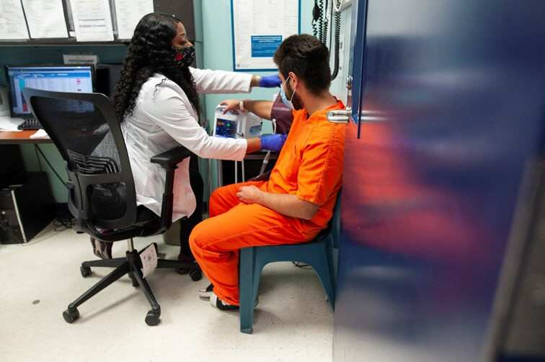
Direct Health Care Delivery
IHSC-staffed facilities
Socio-culturally competent and translated to native language
Universal electronic health care record use
Medical care offered 24 hours a day, 7 days a week
Medical support for ICE ground, air, and sea enforcement operations
Notes:
Direct health care delivery:
Socio-culturally competent and translated to native language
To: adults, children and families
For: ~ 16,500 detainees/day
In: 22 IHSC-staffed facilities across the country
Universal electronic health care record use
Medical case management
For: ~20,000 detainees/day
Housed in: 250 non-IHSC-staffed facilities
Medical support for ICE ground, air and sea enforcement operations

Slide 12
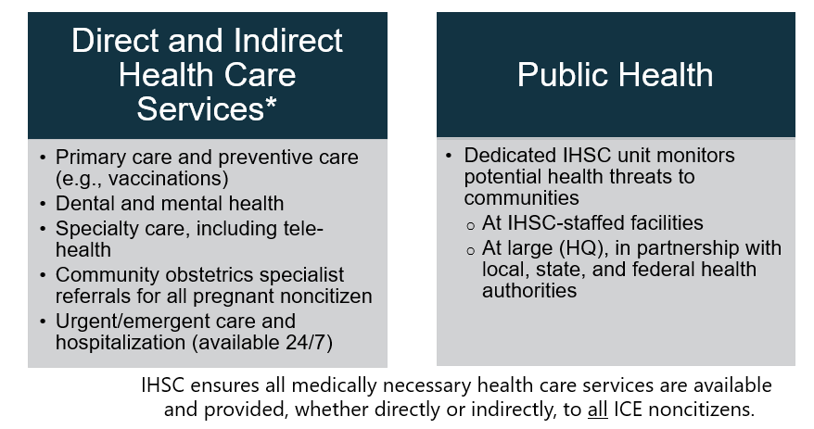
Health Services
Notes:
Direct health care delivery:
Socio-culturally competent and translated to native language
To: adults, children and families
For: ~ 16,500 detainees/day
In: 22 IHSC-staffed facilities across the country
Universal electronic health care record use
Medical case management
For: ~20,000 detainees/day
Housed in: 250 non-IHSC-staffed facilities
Medical support for ICE ground, air and sea enforcement operations

Slide 13
Transgender Care Clinical Approach

Slide 14
Development of Standardized Care
IHSC LGBT working group ➔ multidisciplinary approach
  Collaboration with physicians, advanced practice providers, pharmacists, mental health providers
Agency-wide staff trainings
Development of resources:
  Informed consent
  Clinical guidelines
  Electronic health record (EHR) templates and order sets
Notes:
When I onboarded to IHSC in 2013, there was minimal medical knowledge on the medical management transgender and gender diverse (transgender) patients. In fact, I graduated pharmacy school in 2012 and gender-affirming care was not part of my curriculum at that time. There was lack of a unified approach for housing (some patients were placed in segregation indefinitely) and treatment was nonexistent or without a standardized, thoughtful approach. Some providers continued intake doses without monitoring and above maximum recommended doses and some clinicians believed that starting medication treatment was not medically necessary, but were willing to continue treatment if patient was prescribed upon intake.
Dosage forms and treatment plans have adjusted with Endocrine guidelines since inception of IHSC Clinical Guidelines. For example, male-to-female (MTF) patients previously were prescribed aspirin to mitigate CV side effects of estradiol but after a benefits/risk evaluation, aspirin is no longer recommended. Formulary dosage forms have also been adjusted. Originally, we used estradiol injections but found a varying estradiol levels throughout the month compared to consistent daily oral doses.

Slide 15
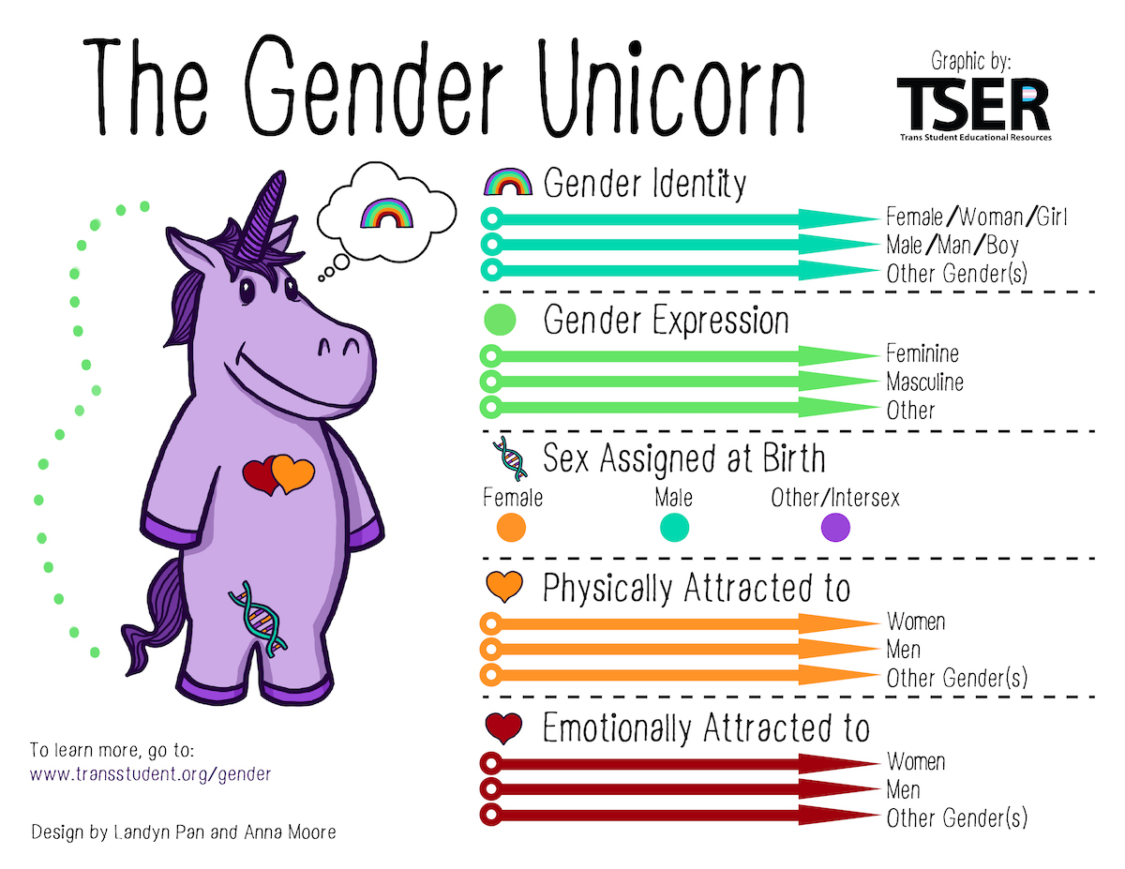
Staff education
Notes:
The first goal of training staff is ensuring understanding gender identity vs. gender expression. It’s not uncommon for providers new to IHSC/corrections have little/no exposure to transgender and gender diverse (transgender) management. The difference between gender identity, gender expression and sex assigned at birth is a first step to management of this patient population.
Gender identity: internal sense of gender (man, women, neither, both)
Gender expression: outward/public appearance of gender
transgender and gender diverse (transgender): gender identity does not align with sex assigned at birth
https://www.npr.org/2021/06/02/996319297/gender-identity-pronouns-expression-guide-lgbtq
Gender identity is one's own internal sense of self and their gender, whether that is man, woman, neither or both. Unlike gender expression, gender identity is not outwardly visible to others.
For most people, gender identity aligns with the sex assigned at birth, the American Psychological Association notes. For transgender and gender diverse (transgender) people, gender identity differs in varying degrees from the sex assigned at birth.
Gender expression is how a person presents gender outwardly, through behavior, clothing, voice or other perceived characteristics. Society identifies these cues as masculine or feminine, although what is considered masculine or feminine changes over time and varies by culture.
Cisgender, or simply cis, is an adjective that describes a person whose gender identity aligns with the sex they were assigned at birth.
transgender and gender diverse (transgender), or simply trans, is an adjective used to describe someone whose gender identity differs from the sex assigned at birth. A transgender and gender diverse (transgender) man, for example, is someone who was listed as female at birth but whose gender identity is male.
Diagnosis: Gender Incongruence: ICD-11
Gender Dysphoria: DSM-5, psychological distress that results from an incongruence between one’s sex assigned at birth and one’s gender identity

Slide 16
Staff Education
What is my role as a primary care provider?
Understanding
Gender identity is not a choice
  Obtaining history of duration of trans-identity and level of expression is helpful
Hormone therapy (HT) is considered medically necessary
  Inquire whether they want HT
Compassion
Realizing rate of trauma and persecution are elevated
    High rates of PTSD, depressive d/o and anxiety
    Ensure they have been referred to BH for an initial evaluation
Prior medical and behavioral health care may be little/none
    Inquire about their past experiences with providers including how they accessed HT
Respect
Ask about names and pronouns
    Use pronouns
    Medical chart name change
Notes:
Slide hidden for now. Love it. It’s from the IHSC TRAIN Training in 2022. Not sure if we should totally copy it or modify it.
Chart name: ICE does not don’t change name

Slide 17
IHSC Transgender Care Policy
Basic tenets of transgender Individuals:
  Transgender treatment is not cosmetic; denial of treatment may lead to worsening mental health and self-harm by distressed noncitizens
  Medical staff offer gender-affirming hormone therapy to all patients who identify as transgender (unless contraindicated)
    No requirement to have been receiving hormone therapy prior to detention, considered for all
    Medical staff will manage newly diagnosed and/or previously untreated transgender individuals with the same liberality as newly diagnosed and/or untreated hypertension or diabetes
Notes:
These points are taken directly from IHSC transgender clinical guidance
Other tenets listed:
-Evaluation/treatment is a multidisciplinary approach
-Use of proper pronoun per patient’s stated preference

Slide 18
IHSC Transgender Care Policy
Gender-affirming hormone therapy initiation requires:
  Evaluation by mental health professional to assess for gender dysphoria and comorbid mental health disorders
  Counselling by trained medical provider on risks/benefits of hormone treatment
  Gender affirming surgery may be considered, but has not yet been approved for detained noncitizens due to relatively short duration of stay
Notes:
Mental health considerations include gender dysphoria which refers to psychological distress that results from an incongruence between one’s sex assigned at birth and one’s gender identity. Though gender dysphoria often begins in childhood, some people may not experience it until after puberty or much later. This is a DSM diagnosis that contrasts with diagnosis of transgender which is defined when patient’s sex assigned at birth does not align with gender identity
Moreover secondary to increased exposure to discrimination, mood disorders,, anxiety disorders, PTSD, etc. are more common in transgender and gender diverse (transgender) individual than the general population and are referred to behavioral health professional. Plan of care determined by BH provider as deemed clinically appropriate
Gender affirming surgery would be considered only after 1 year in custody and on hormone therapy
Please note that many, but not all transgender and gender diverse (transgender) patients desire GAHT or procedures. Treatment is individualized, some patients may not want to be treated with hormone therapy while detained

Slide 19
IHSC Transgender Care Policy
Basic tenets of managing transgender individuals:
  Sexually transmitted infection screening
    HIV, syphilis, hepatitis B and C, chlamydia, gonorrhea, trichomonas (for transmen)
  Preventative care
    Consider immunizations for hepatitis A and hepatitis B (if serologically indicated) and human papilloma virus (HPV) for patients up to age 45
Notes:
More on our basic tenets.
transgender and gender diverse (transgender) individuals are historically a disadvantaged groups who experience discrimination. Employment opportunities may be limited leading to commercial sex work and/or sale (and use) of controlled substances. As such, sexually transmitted infections and blood-borne pathogens are prevalent among transgender and gender diverse (transgender) individuals.
Other considerations are age-appropriate preventative care like cancer screenings (cervical cancer screening for transmen unless uterus has been removed and breast cancer screening for transmen and annually if >10 years on estrogen treatment for transwomen.
Bone mineral density screening for transwomen over 60 years old

Slide 20
Correctional Facility Considerations
Housing: segregation is not required nor encouraged for sole indication of transgender diagnosis
  Prolonged segregation/isolation is associated with worsened behavioral health outcomes including risk of self-harm and suicide
  Housing determination is a joint decision between patient, medical staff and custody
Gender expression special needs considerations
  Undergarments
  Shower/privacy
Notes:
Segregation caveat if patient self-identifies as feeling vulnerable or at risk. Administrative segregation for sole reason of transgender and gender diverse (transgender) status is not valid in our agency. Housing options include: general population (male or female), special unit housing (Gay-Bisexual-transgender) (BGT) or transgender Several factors should be considered including the degree of gender expression of the detainee, comfort and safety of the detainee and the layout of individual housing units including privacy factors.
Undergarments: some patients request both panties and boxers. Discretely give patients these items, personal/medical discretion. Consider what is given and why.
We utilized special needs forms from our EHR to generate medical orders related to gender expression special needs

Slide 21
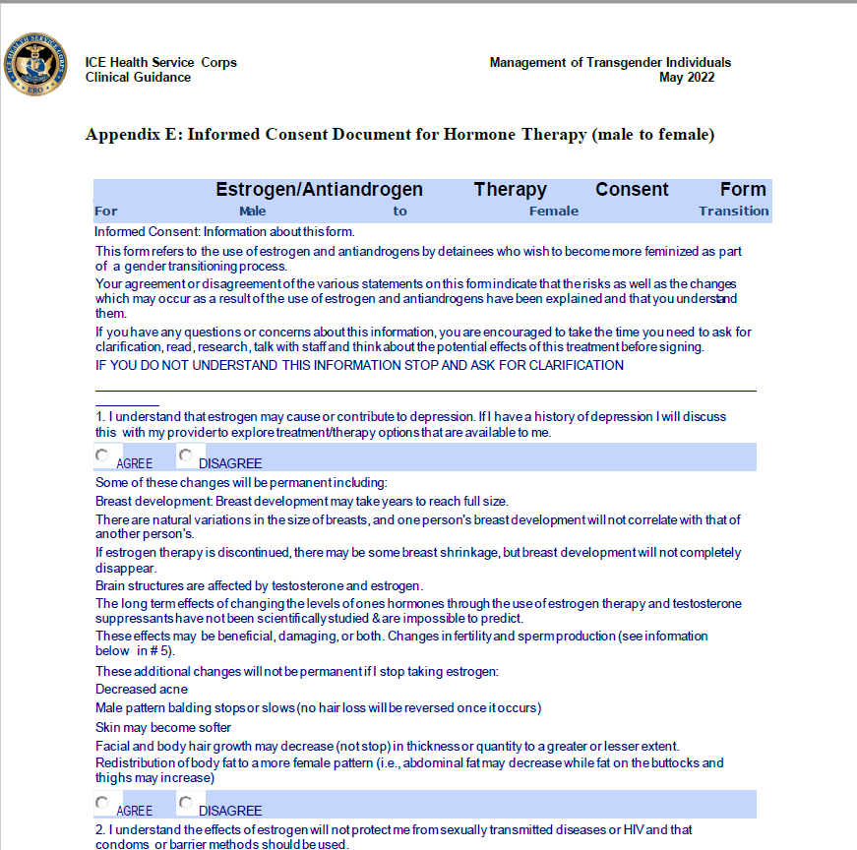
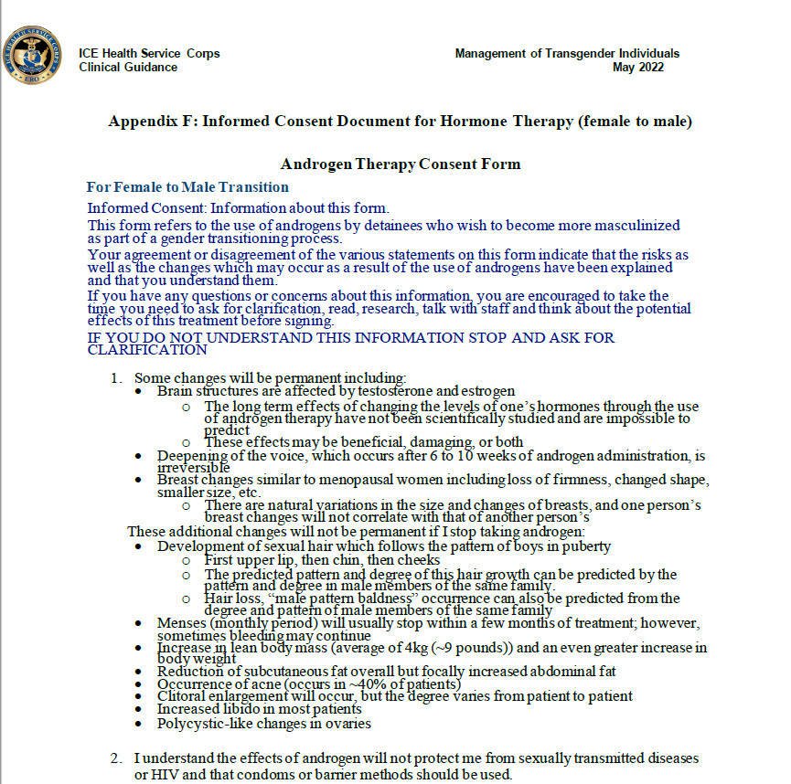
Informed Consent
IHSC Transgender Care Clinical Guidelines
Notes:
We consider informed consent a necessary, perhaps most important, component of GAHT initiation for transgender and gender diverse (transgender) patients. We have two different Consent Documents (MTF and FTM). These are somewhat lengthy and can be time consuming to work through especially using a translator (common for our patient population). MTF is 4 pages long and FTM is 2 pages long.. Included in the informed consent is expectations of physical changes along with the time to maximum effect, preventative care and monitoring recommendations, effects on fertility, potential adverse effects, reasons for discontinuance, agreement to take medications as prescribed and comply with physical exam and monitoring.
These consents are embedded in the EHR and can be printed/signed then scanned in.

Slide 22
Clinical Guidelines
Education and expectation management is key
  Effects of therapy vary, and it may take months or years to see full effects
  Hormone blood levels are the parameters used to monitor and adjust therapy rather than physical changes
Step-by-step agency protocol was developed for:
  Male to Female (MTF) treatment initiation
  MTF treatment continuation
  Female to Male (FTM) treatment initiation
  FTM treatment continuation
Consults for therapy management recommendations available through IHSC Infectious Disease Program (IDP)
Notes:
Understand that not all patients desire hormone therapy and/or gender affirming procedures. Our role is to be supportive of individual choices.
Only soft tissue will be affected, for example may see redistribution of fat from abdominal to thighs/hips and/or decreased muscle in MTF patients but you will not see a change in vocal pitch and patient is still going to have a penis and an Adam’s apple.
FTM patients may notice a development of sexual hair which follows the pattern of boys in puberty. Some changes in breast may be like menopausal women including loss of firmness, changed shape, smaller size, etc.
Counselling on potential, significant side effects is important:
MTF includes venous thromboembolism, osteopenia/osteoporosis, sterility (could be irreversible), etc.
FTM includes: hypercoagulable state secondary to erythrocyosis, changes in voice (irreversible)
Treatment continuation is for patients who arrive at our facility currently prescribed hormone therapy.

Slide 23
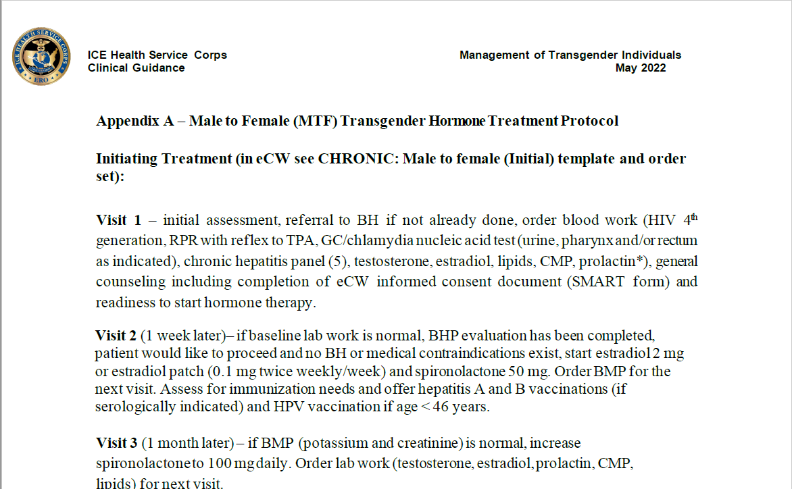
Clinical Guidelines
IHSC Transgender Care Clinical Guidelines
Notes:
MTF treatment protocol for hormone therapy initiation

Slide 24
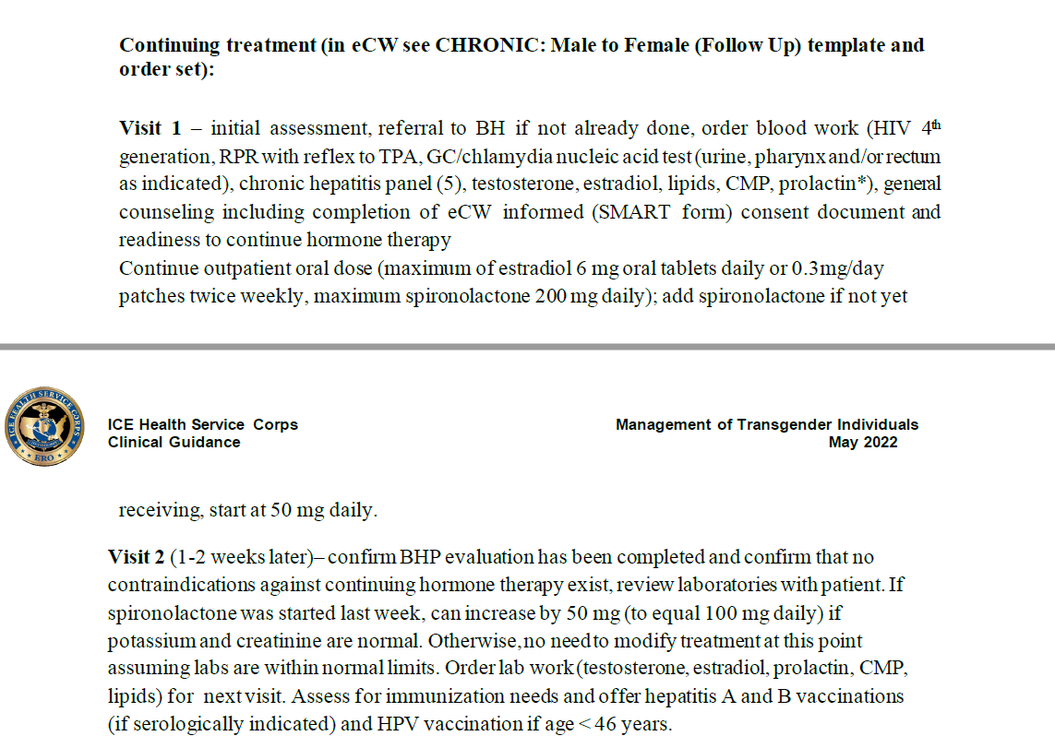
Clinical Guidelines
Notes:
MTF treatment protocol for hormone therapy continuation

Slide 25
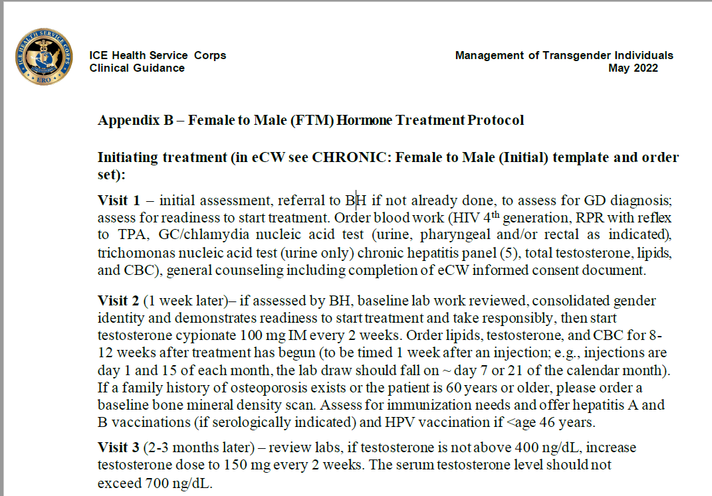
Clinical Guidelines
Notes:
FTM treatment protocol for hormone therapy initiation

Slide 26
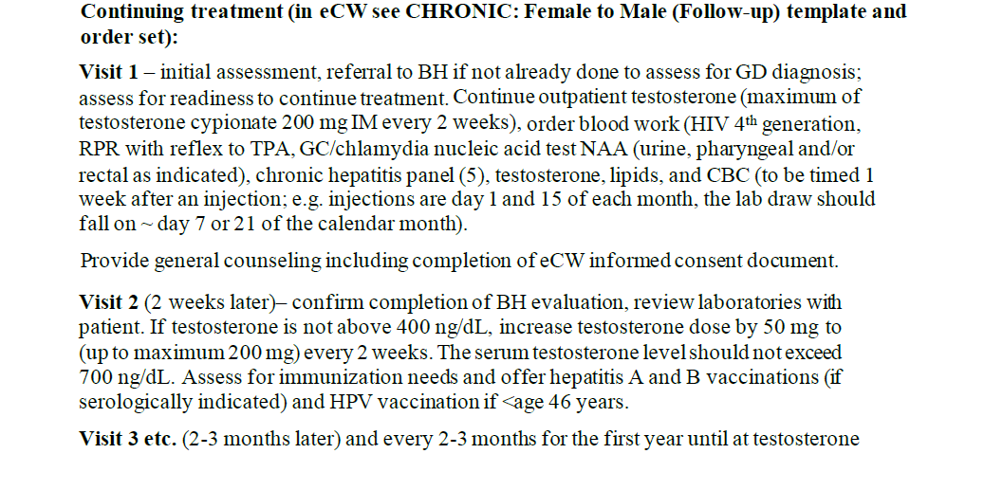
Clinical Guidelines
Notes:
FTM treatment protocol for hormone therapy continuation

Slide 27
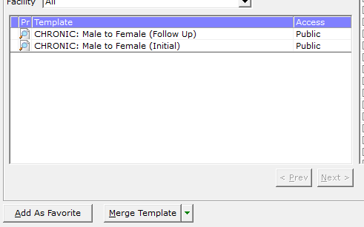
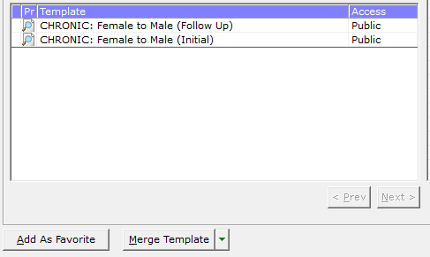
Electronic Health Record Templates and Order Sets
Electronic Health Record (EHR) Templates created to standardize and streamline documentation
Notes:
Moving on to our agency developed electronic health record tools.
Four templates were developed and implanted into our EHR system to assist providers with documentation. These templates can be utilized to ensure a thorough history and ROS is completed.

Slide 28
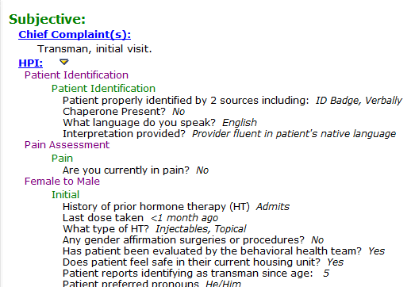
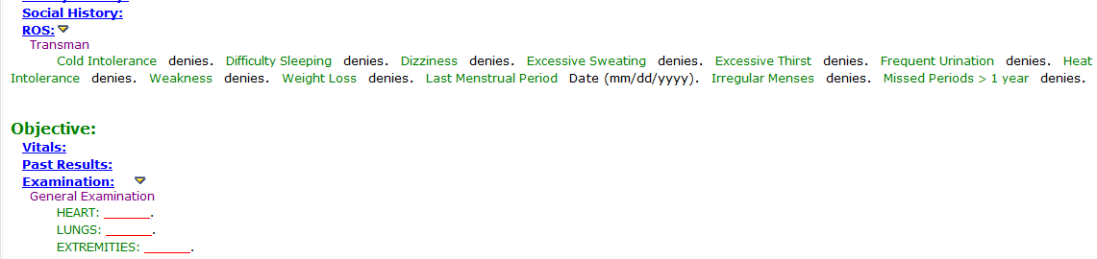
Electronic health record templates and order sets
Notes:
Here is an example of what our templates look like and how it can guide the patient interview.
There is not a robust system for documenting preferred pronoun in our EHR system, but it’s important and included in the initial templates.

Slide 29
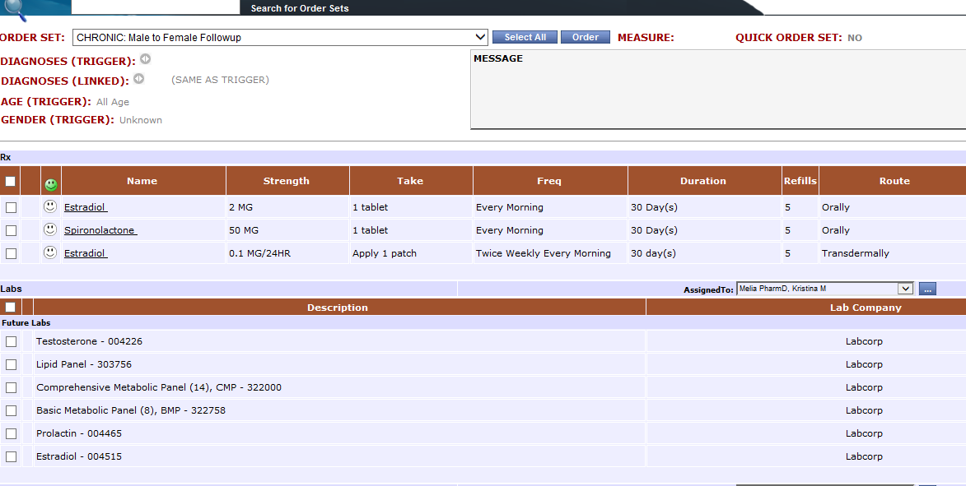
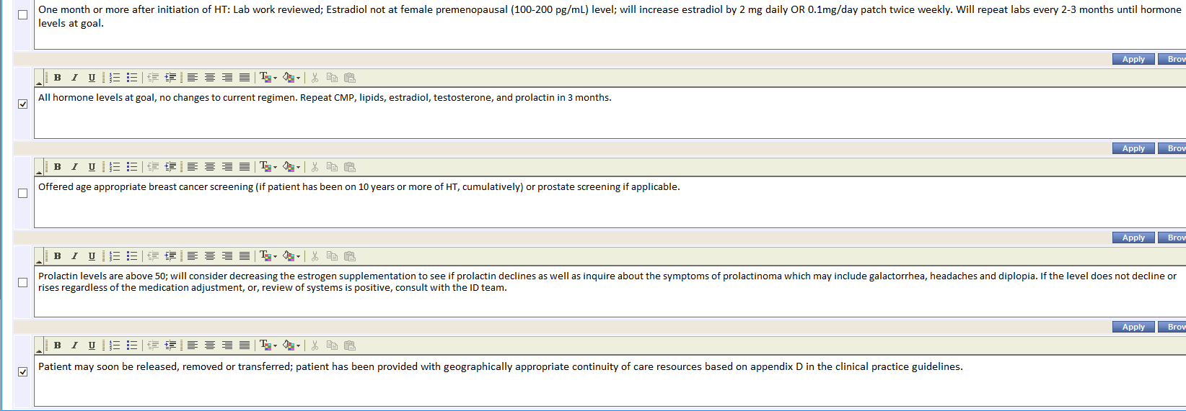
Electronic Health Record Templates and Order Sets
Notes:
Order sets are used for various diagnoses in our agency to assist with treatment plans. Providers can select and order labs and medications from the order set. Notes are pre-populated to assist with documentation and prompt recommended actions.
We have four order sets that correlate with the templates for transgender care.

Slide 30
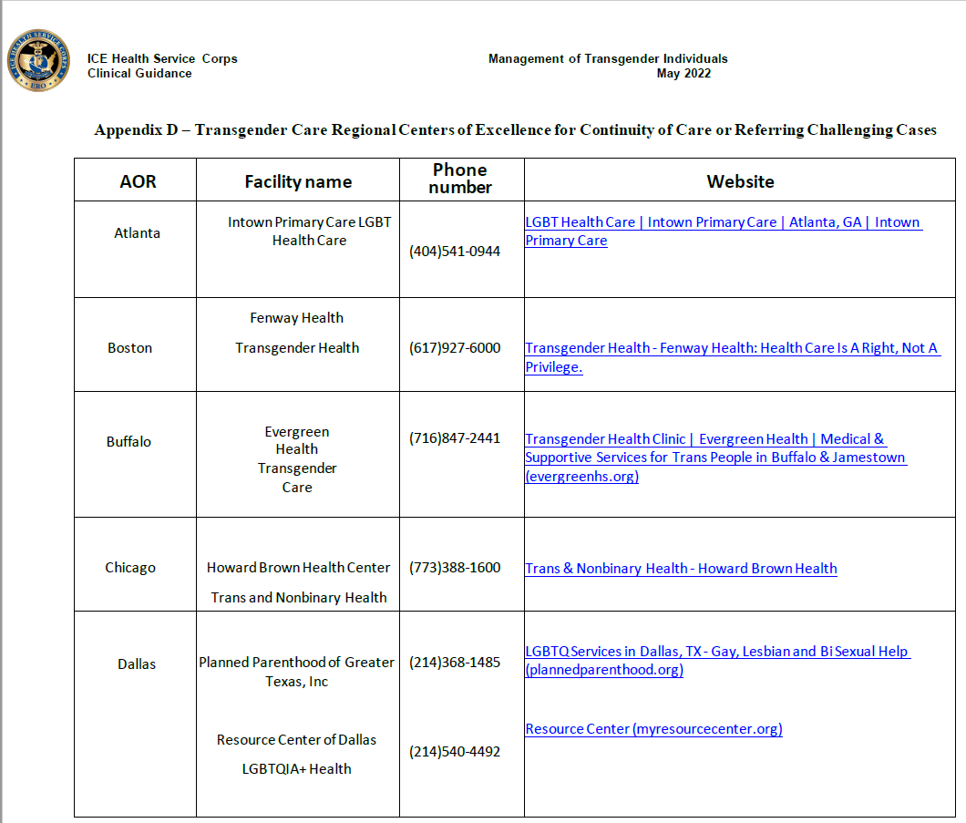
Continuity of Care
IHSC Transgender Care Clinical Guidelines
Notes:
AOR=Area of Responsibility, ICE terminology
Our Clinical Guidelines include an appendix with clinics that patients can utilize upon release. These resources are updated quarterly.
Out of country resources for patients who are deported are more challenged and often limited. We do provide 15 days of medications (IHSC standard) to provide patients a chance to establish care in their country.

Slide 31
Clinical Pharmacist Provided Transgender Care

Slide 32
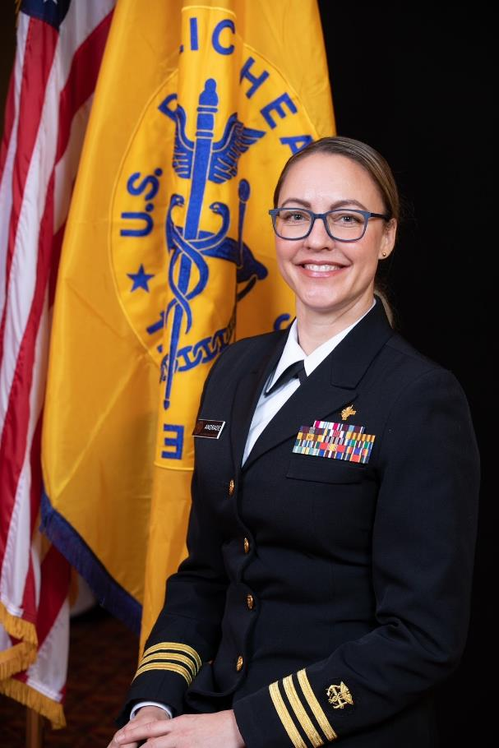
Overview: Montgomery Processing Center
Christina Andrade, PharmD, PhC, BCPS, AAHIVP, NCPS
Facility north of Houston, Texas
IHSC's First Clinical Pharmacist:
    Primary Care: HIV, hypertension, diabetes, hyperlipidemia, transgender care, hepatitis C, hepatitis B, vaccinations
    Scope of practice incudes physical assessment, lab ordering, diagnosis, treatment and patient education
    Holistic approach: if a patient has an acute issue that is managed by medication, it will also be addressed during these visits to include referrals, when medically indicated

Slide 33
Clinical Pharmacist Roles
Clinical pharmacists have taken a lead role in the management of transgender patients at several IHSC facilities
Why are clinical pharmacists a good fit for this role?
  Management is medication-based and hormone therapy is guided by laboratory values
  Pharmacists are well-suited to provide required counselling of risks/benefits and therapy expectations
  Pharmacist representation at the national level with the IHSC LGBT working group ensures consistent subject matter experience with consult availability

Slide 34

Typical Approach to New Patient
Identifying a transgender patient
  Commonly identified at intake
    At times missed during intake
First visit
  Consent
  Historical review
    Determine modality
  Order labs
Second visit
  Review labs
  Start meds if desired
  Offer undergarments
    Confidentiality: towel/t-shirt
    Special needs
Notes:
https://tvtropes.org/pmwiki/pmwiki.php/Main/BollywoodNerd

Slide 36
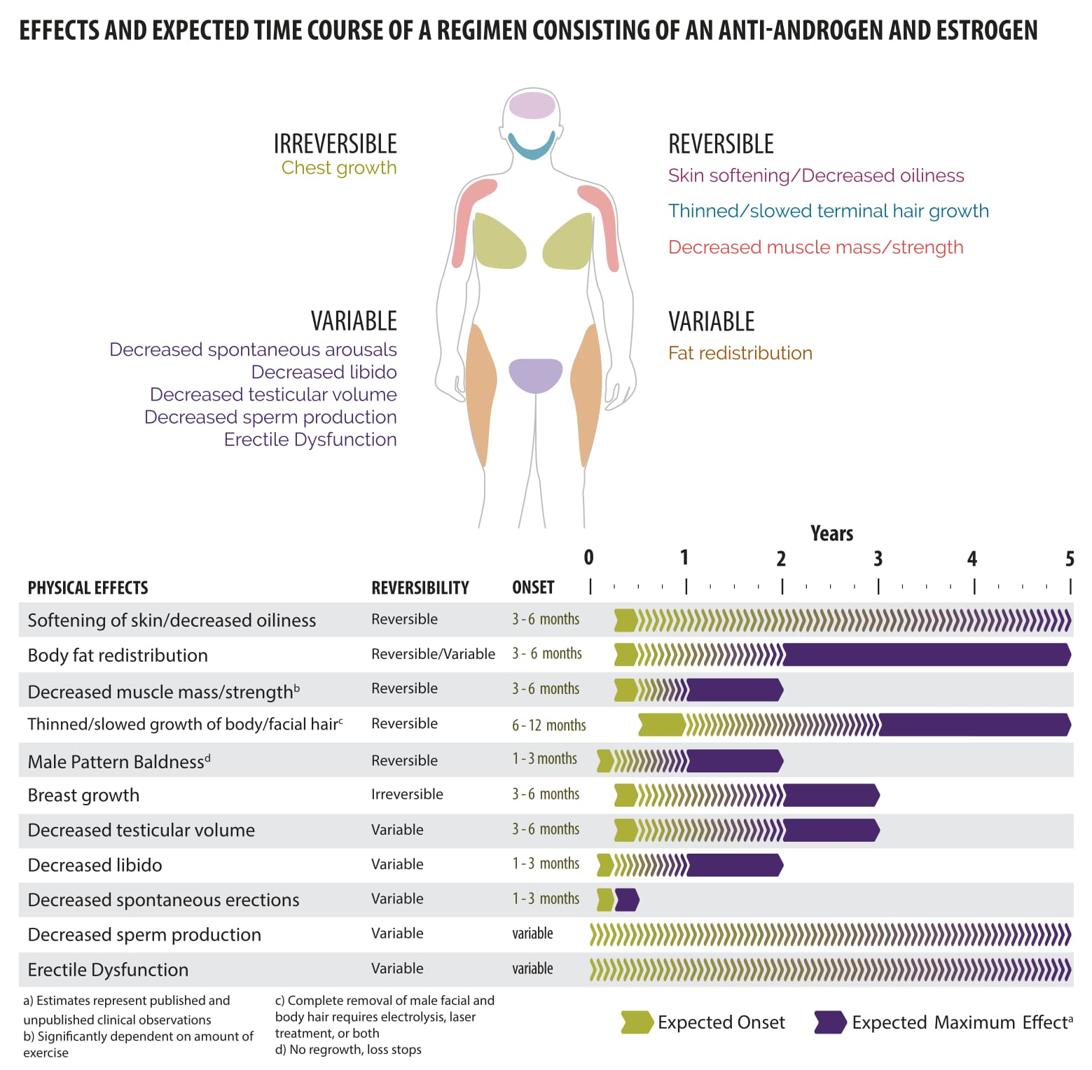
Source: Endocrine Society Guidelines Hembree WC et al 2017

Slide 37
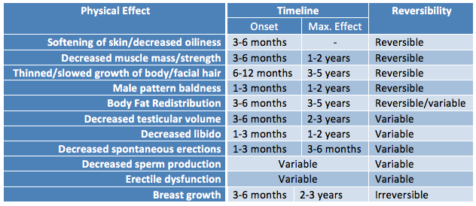
Feminizing Effect Timeline
Source: Endocrine Society Guidelines Hembree WC et. al 2017

Slide 38

Continued Care During Correctional Care
Exposure to discrimination
  Arrival
Immediate questions
Home country terminology
Noncitizens
Security staffing
Medical staff
  Chart nomenclature
Formal name change
Lab results
Pronouns: e-mails
Notes:
https://www.flickr.com/photos/22465661@N02/2696695090/in/photostream/

Slide 39

Expert Navigation of the System
Medication dishonesty
  Stopped taking meds to have lower labs
  Not giving additional patches back
  Overtaking keep on person medication
Non-binary individuals
  “I don’t know”
  “What is trans? There is medication for that?”
Timing of seeking gender affirming care
  180 days at facility, multiple visits with the provider, change in sexual identity
  Security requests
Notes:
https://www.yths.fi/en/news/2020/the-coronavirus-epidemic-may-cause-insecurity-and-worry/

Slide 40
Questions?
What are your patient experiences?
And how have you been creative to find a patient care solution that is acceptable to all?
Notes:
Please let me know if you have any questions.

Slide 41
References
American Psychological Association Transgender People, Gender Identity and Gender Expression
Endocrine Treatment of Gender-Dysphoric/Gender-Incongruent Persons: An Endocrine Society Clinical Practice Guidelines
IHSC Transgender Care Clinical Guidelines
The World Professional Association for Transgender Health Standards of Care Version 8

Slide 42

Thank You!
CDR Christina Andrade, PharmD, BCPS, NCPS
Email: Christina.a.andrade@ice.dhs.gov
Desk: (936) 520-5913
Cell: (936) 203-3058
CDR Kristina Melia, PharmD, MSL, BCACP, NCPS, CCHP
Email: kristina.m.melia@ice.dhs.gov
Desk: (804) 633-0043 ext.: 154
Cell: (202) 536-9871
usphs.gov

