Slide 1
Pediatric Burn Assessment & Management
February 14, 2024
John Wiersch, MD
Medical Director, Burn Program
Pediatric Surgeon
Children’s Hospital Colorado
Assistant Professor of Surgery
CU School of Medicine

Slide 2
No financial disclosures

Slide 3
Objectives
Identify the depth and TBSA of pediatric burns
Discuss the management of minor pediatric burns
Discuss pediatric burn patients requiring referral and their initial management

Slide 4
The Burden of Pediatric Burns
Over 300 pediatric patients are seen in emergency departments every day for burn injuries
Scald burns predominate in young children, however flame burns become more common in older children and teenagers
Locally we see contact burns from fireplace glass or other heat sources, flame burns from outdoor bonfires, and frostbite

Slide 5
Epidemiology slide

Slide 6
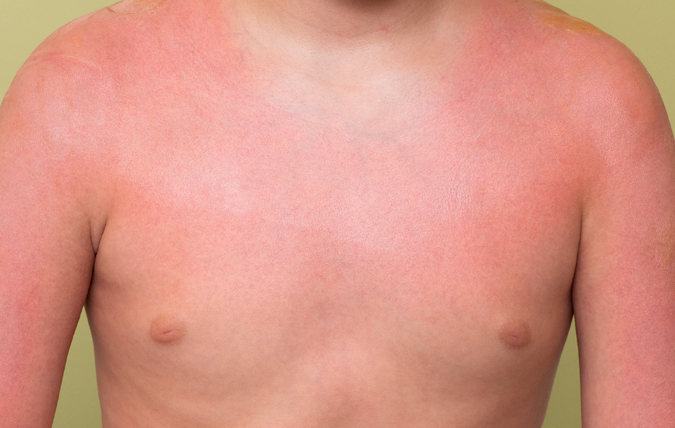
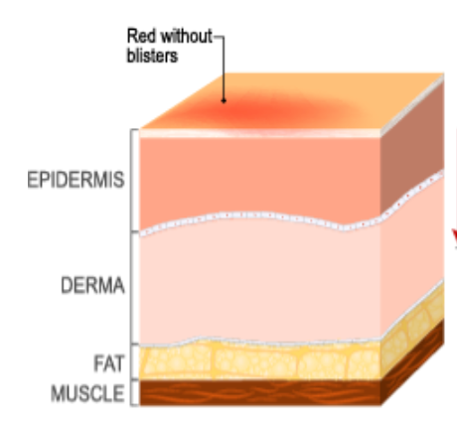
Superficial Burn
1st degree burns
Examples: Sunburns, contact burns with blanching redness with intact skin

Slide 7
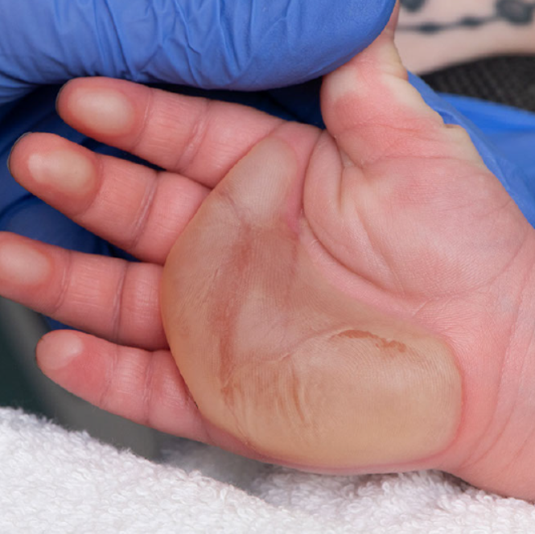
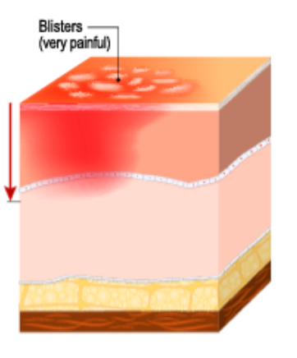
Partial Thickness Burn
2nd degree burns
Can be classified as superficial and deep partial thickness
Key features: Blistering skin, wet, pink appearance underneath, painful to touch

Slide 8
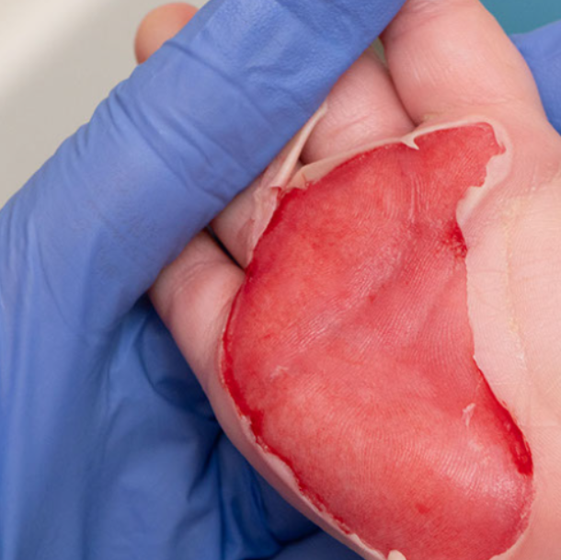
Partial Thickness Burn
2nd degree burns
Can be classified as superficial and deep partial thickness
Key features: Blistering skin, wet, pink appearance underneath, painful to touch

Slide 9
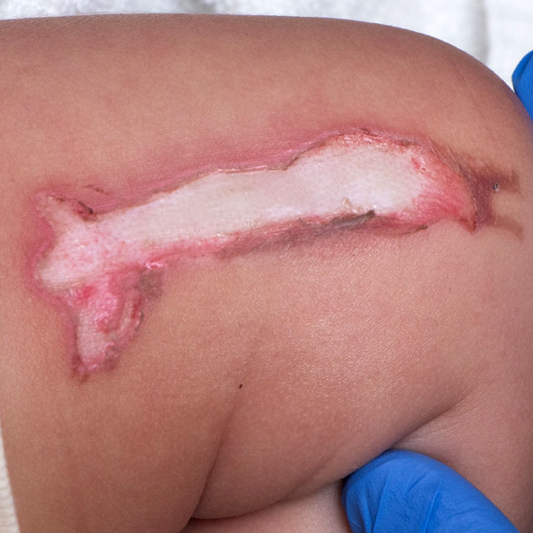
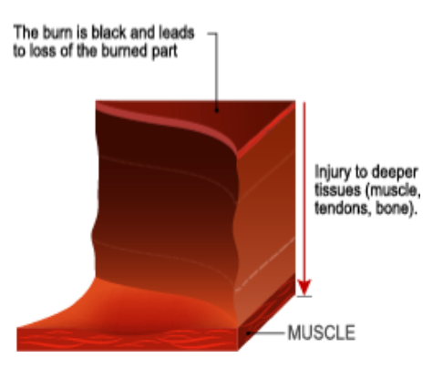
Full Thickness Burn
3rd degree burns
Most often require skin grafting and excision of non-viable skin
Key features: White or black, leathery, insensate

Slide 10
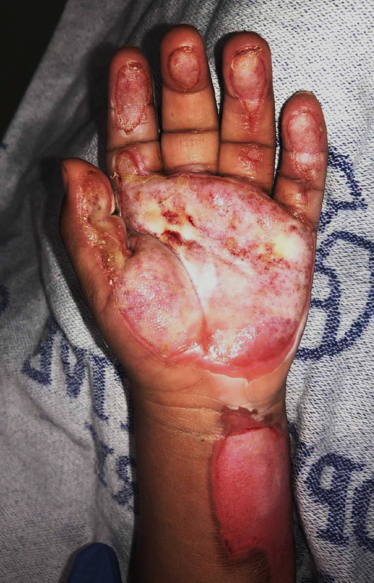
Context Clues to Determine Depth
Flame burns are high risk for causing deep injuries
Contact burns where a child touches a hot object are often limited, whereas a child who falls onto a hot object or hot objects falling onto a child may be deeper
Burns from hot grease and melted sugar are often deeper than those caused by other hot liquids
Abusive burn injuries have a higher potential to be deep

Slide 11
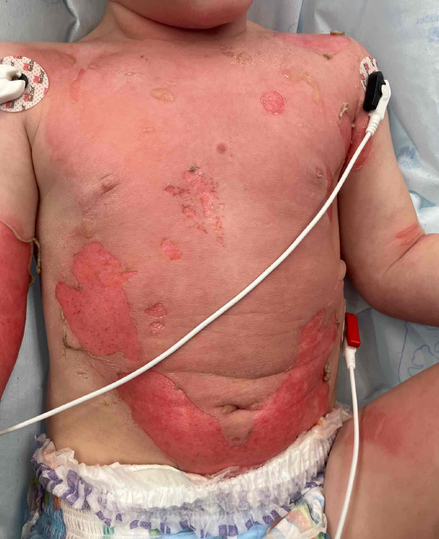
Does Debridement Matter?
2 yr old male pulled a container of recently heated water onto himself from the counter
Initial assessment:
  TBSA 6-7%
  Partial thickness burn
Initial plan:
  Apply burn dressings
  Discharge to home
  Follow-up in burn clinic

Slide 12
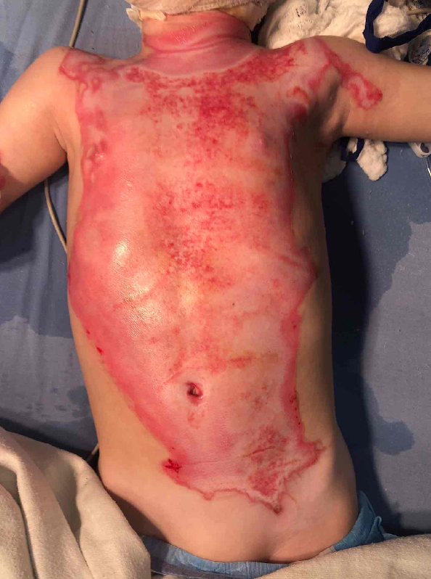
A Look Under the Burn
Patient transferred to our burn center
Debrided under sedation the following day
TBSA 18.5%
  11% TBSA full thickness burn to chest/abdomen/left shoulder
Patient required burn excision and skin grafting

Slide 13
Pediatric Burns Requiring Referral

Slide 14
Who Needs It?
Minor burns (<10% TBSA)
No resuscitation required
Debridement & dressing
Outpatient referral to burn center or care locally
Moderate burns (10-20% TBSA)
Oral resuscitation if appropriate
Debridement & dressing
Transfer to burn center

Slide 15
Severe Burns
(TBSA >20%)
Referral to a burn center and immediate arrangements for transfer
Initiate IV fluid resuscitation
Foley placement
Pre-transfer dressing application
Adequate pain control

Slide 16
Earlier is better…
Early fluid resuscitation after a severe burn injury can reduce multiorgan failure and mortality
RE Barrow et al. Resuscitation 2000

Slide 17
Initial Fluid Rates
Initiated during the primary survey for burns ≥20%
“Starter” rate until accurate TBSA calculation has been performed
Avoids over & under resuscitation problems
TRACK ALL FLUIDS ADMINISTERED

Slide 18
Initial Fluid Resuscitation Rates
Lactated Ringers
≤5 years old
125 mL/hr
6-12 years old
250 mL/hr
≥13 years old
500 mL/hr
D5LR should be administered to pediatric patients ≤12 years at a maintenance rate

Slide 19



Pediatric Maintenance IV Fluid Rates
4 mL/kg for the first 10 kg
2 mL/kg for the next 10 kg
1 mL/kg for each kg over 20 kg

Slide 20
A Word About Boluses
AVOID fluid boluses whenever possible except to treat hemodynamic instability
AVOID treating with medications at doses that may induce hemodynamic instability
Boluses interrupt the steady progression of resuscitation and often lead to over-resuscitation in the course of the next 24 hours

Slide 21
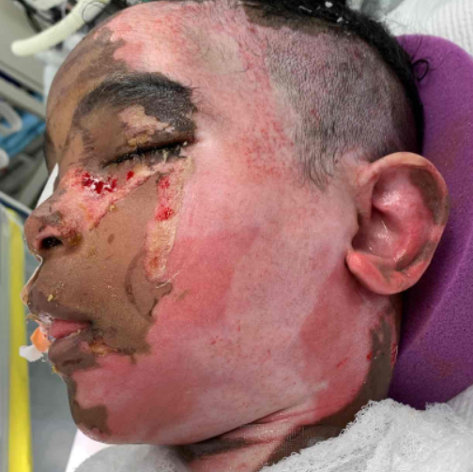
Airway Considerations
Environment of injury:
Type of burn injury
Indoor versus outdoor
Brief intense exposure to thermal injury (flash burn) or smoke/noxious gas inhalation for a prolonged period
Patient’s hemodynamic and respiratory status on arrival
Notes:
Appropriate airway management is critical
Failure to intubate appropriate patients can result in emergent airway interventions and poor outcomes
Overzealous intubations result in over-treatment, unnecessary transfers, ventilator-related complications, resuscitation complications, and death

Slide 22
Indications for Emergent Intubation
Signs of airway obstruction (hoarseness, stridor, accessory muscle use, retractions)
Extent of burn (TBSA >40%)
Extensive and deep facial burns
Burns inside the mouth
Significant edema or risk for edema
Difficulty swallowing
Signs of respiratory compromise (unable to clear secretions, respiratory fatigue, poor oxygenation or ventilation)
Declining mental status
Anticipated transfer of large burn with airway issue without personnel qualified in airway management

Slide 23
Airway Considerations
Use an appropriately sized cuffed endotracheal tube (even in children)
Oral intubation is preferred
The most experienced airway management provider available should be the intubating provider
NG should be placed following intubation
AVOID succinylcholine

Slide 24
Burn Center Transfer Criteria
Partial thickness burns >10% TBSA
Burns involving the face, hands, feet, genitalia, perineum, & major joints
Third degree burns of any size
Electrical burns (including lightening)
Chemical burns
Inhalation injury (with or without cutaneous burns)
Burn injury in patients with significant pre-existing medical comorbidities
Any patient with burns & trauma
All pediatric burns may benefit from burn center referral due to pain, dressing change needs, rehabilitation, patient/caregiver needs, and assessment for non-accidental trauma
ABA 2022 Referral Guidelines

Slide 25
The Difference of a Pediatric Burn Center
Provide psychosocial support to the patient and family throughout the continuum of care
Ability to provide intranasal analgesic and anxiolytic medications during outpatient and inpatient burn care
Availability of pediatric EM and anesthesia specialists to provide sedation for burn care in the ED and operative environments
Same team cares for the patient from the inpatient to the outpatient and aftercare environment
Continued follow-up for patients requiring assessment and management of burn scars and contractures

Slide 26
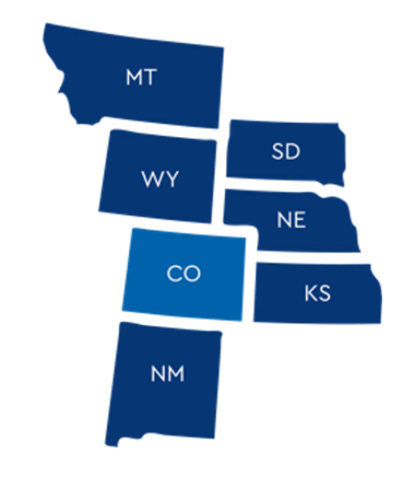

How to Reach Us
720-777-3999
Admissions/Transfers/Referrals
Phone consultation
Telephoto image sharing
Children’s Hospital Colorado Burn Center
720-777-6604
Established patients
New patients scheduling initial appointment

