Slide 1
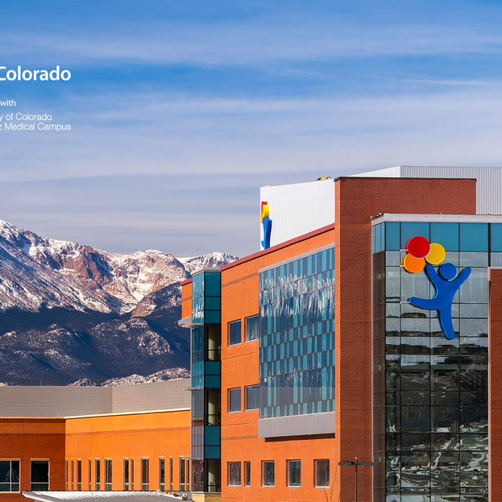
PEDIATRIC SEDATION & ANALGESIA, OUTSIDE OF THE OR
April 2024
David A. Listman, MD
Associate Professor
Section of Emergency Medicine
Department of Pediatrics
University of Colorado School of Medicine
Medical Director CHCO, COS Emergency Dept.
Notes:
Kelly- Pinwheels have been adopted as a national symbol of child abuse prevention- Pinwheels for Prevention.

Slide 2
Disclosure Information
I have no relevant personal financial relationship.

Slide 3
Objectives
Make a case for Pediatric sedation in the ED
Define Sedation
  Distinguish from Analgesia and Amnesia
Describe the depth of sedation continuum
Set-up for safe sedation
  Personnel, equipment, operating procedures
Options and adjuncts
  Personnel, equipment, operating procedures

Slide 4
Objectives
Define “successful” or “effective” procedural sedation for children
  Set the bar
Provide examples of effective and ineffective procedural sedation
Review strategies for successful/effective procedural sedation

Slide 5
Case
2 year old boy fell against the coffee table about 2 hours ago, has a vertical forehead laceration that is 1.5 cm.
  He appears quite anxious when you walk into the room, clutching his mother’s leg, tears are still on his cheeks.
  Mom says he had stitches last year and they had to hold him down.
  Mom is worried about scarring
  Mom gave him ice cream to soothe him after the injury

Slide 6
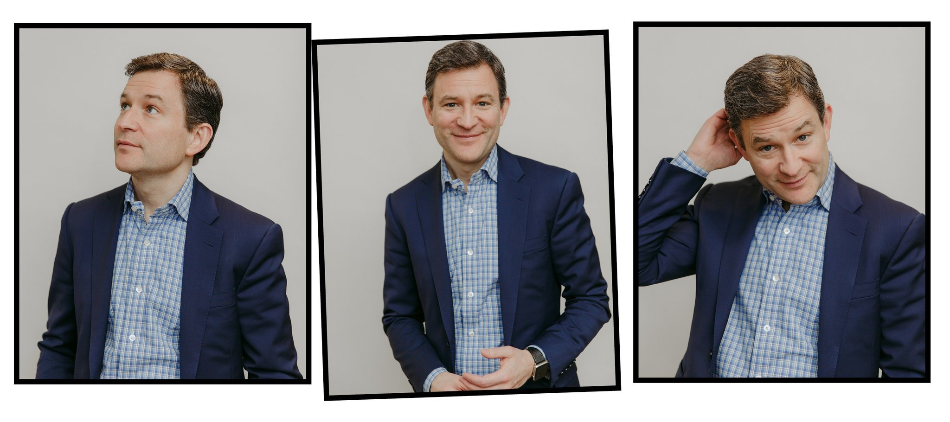
Dan Harris: The First Time I Rushed My Son to the E.R. - The New York Times
DEC. 19, 2017
Dan Harris, the ABC News anchor, has just published “Meditation for Fidgety Skeptics: A 10% Happier How-to Book.” CreditPhotographs by Tawni Bannister for The New York Times

Slide 7
Case – NY Times
2 y/o with forehead laceration
  Jumped off couch into table
  “The wailing was immediate”
    No Loss of consciousness
  “Gaping gash on forehead, directly above his right eyebrow
    ”…permanent, disfiguring scar. Maybe he has a concussion?”
  Went to ED (ER) directly across the street
  “…staff at the ER didn’t seem nearly as concerned…as we were.”
  roomed and “told us to wait for the plastic surgeon”

Slide 8
Case – NY Times
2 y/o with forehead laceration
  Plastic surgeon says, “This is bad.”
  Parents told, rather than sedation, “we would have to tie (him) up” after local anesthesia
  “Mummy game”: child wrapped in bedsheets
  “screaming and writhing”
    “not in pain, just scared”
  “I don’t like the mummy!”
  Successful repair in “a few minutes”

Slide 9
ADVERSE EXPERIENCE?
Studies have shown that traumatic medical experiences change a child’s interaction with medical care providers for years
Traumatic childhood events including negative experiences in the medical setting can impact decisions to vaccinate an individual as an adult and impact decisions about vaccinating one’s children.

Slide 10
Sedation Definition
Procedural Sedation & Analgesia
  Anxiolytic, sedative, analgesic, or dissociative drugs
    Attenuate pain, anxiety, and motion
    Facilitate the performance of a necessary diagnostic or therapeutic procedure
    Provide an appropriate degree of amnesia or decreased awareness, and
    Ensure patient safety.
Bhatt. Quebec Guidelines for sedation. Ann Emerg Med 2009

Slide 11
Sedation Goals
Safe, effective control of pain and patient motion which allows for successful completion of necessary, (often times) painful procedures
  Diminished patient awareness and amnesia
Sedation, Analgesia, Amnesia
Krauss B, Green SM. Sedation and analgesia for procedures in children. N Eng J Med 2000;342:938-945.

Slide 12
Sedation Semantics
Sedation or Procedural Sedation
Procedural Sedation and Analgesia
  Emergency Medicine terminology
Conscious Sedation
  Refers to Moderate Sedation only
  Use of the term “conscious” as a generic term is discouraged in recent Medical literature
    Used in Dental field when moderate, rather than deep, sedation is the goal

Slide 13
Level of Sedation Continuum
Responsiveness & Airway Protective Reflexes
Minimal sedation (Anxiolysis)
Moderate sedation/analgesia (Conscious)
Deep sedation
General Anesthesia
Sedation is individual patient specific
  Drug and dose
Targeted vs. Achieved depth of sedation

Slide 14
Depth of Sedation Continuum
Why important?
Deeper levels of sedation = greater risk for adverse events
  Targeted vs. Achieved depth of sedation
Hospitals may grant privileges for sedation based on depth
  Drugs administered
Must be able to RESCUE from next level of sedation

Slide 15
Levels of Sedation
Minimal sedation (Anxiolysis)
  Patients respond normally to verbal commands
  Ventilatory and cardiovascular functions are unaffected
Many hospitals will not require specific sedation credentials for Minimal Sedation
  Providers are responsible if deeper levels are achieved
Might include intranasal midazolam, nitrous oxide

Slide 16
Levels of Sedation
Moderate Sedation/Analgesia
  Patients respond purposefully to verbal commands or light tactile stimulation
  No interventions are required to maintain a patent airway, and spontaneous ventilation is adequate

Slide 17
Levels of Sedation
Deep Sedation
  Patients cannot be easily aroused but respond purposefully following repeated or painful stimulation
  The ability to independently maintain ventilatory function may be impaired
    Patients may require assistance in maintaining a patent airway, and spontaneous ventilation may be inadequate
    Cardiovascular function is usually maintained

Slide 18
Levels of Sedation
General Anesthesia: a drug-induced loss of consciousness during which patients are not arousable, even by painful stimulation. The ability to independently maintain ventilatory support is often impaired…
Centers for Medicare and Medicaid Services. CMS Manual System. Pub 100-07 State Operations Provider Certification. Appendix A. 42 CFR. Section 482.52. Revised hospital anesthesia services interpretive guidelines. January 14, 2011.

Slide 19
Levels of Sedation Continuum
Targeted vs. achieved depth of sedation
  Depth of sedation is a continuum
    Difficult to identify subtle changes in levels
  Individual patients will respond differently
  ALL sedation drugs and routes of administration may result in significant adverse events
Sedation providers must be prepared to rescue patients
Coté CJ et. al. Pediatrics 2000

Slide 20
Levels of Sedation
Ketamine? (both a drug and a level of sedation)
N-Methyl-D-Aspartate Antagonist
  Blocks NMDA-receptor glutamate binding in CNS
“Dissociative” Agent
  Thalamoneocortical and limbic systems
  Prevents higher centers from perceiving stimuli
    Visual
    Auditory
    Painful
  Protective airway reflexes remain intact
Adverse respiratory events may occur (<1%)
  Apnea
  Laryngospasm
Threshold drug
  Sub-dissociative effects of ketamine

Slide 21
Sedation Safety
How do we ensure safety?
  Presedation assessment
  Physiologic monitors and monitoring plan
  Pediatric Equipment
  Trained and credentialed Personnel
  Standardized discharge criteria
  Take the same precautions EVERY time
    Fully prepared to perform RESCUE

Slide 22
Presedation Assessment
How do we decide appropriate patients for whom we should provide sedation?
  Elective vs. emergent
  Patient factors:
    Age: Is this an age I am ccomforttable with? What are added risks by age?
    ASA physical status classification- asthma, OSAS, Pierre Robin
    Duration of procedure- should this be done in the OR?
    Fasting state
    Goals for this particular sedation
    Sedation, analgesia, amnesia
      Targeted depth of sedation

Slide 23
ASA Physical Status Classification
Class I: Normal healthy patient
Class II: Mild systemic disease (controlled asthma)
Class III: Severe systemic disease (actively wheezing)
Class IV: Disease that is a constant threat to life (status asthmaticus)
Class V: Moribund patient not expected to live without the operation

Slide 24
Safest Sedation?
Non-pharmacologic methods
Distraction, guided imagery
  Music, books, videos,
  Hypnosis, guided imagery
  Child Life Specialists
  Position of comfort
Minimalize pre-sedation agitation
This is not either/ or
Sinha. Evaluation of nonpharmacologic methods of pain and anxiety management for laceration repair in the pediatric emergency department. Pediatrics 2006;117(4):1162.8.

Slide 25
Preparation for Sedation
Set yourself up for victory
Positioning
  Midline
  “Open” airway

Slide 26
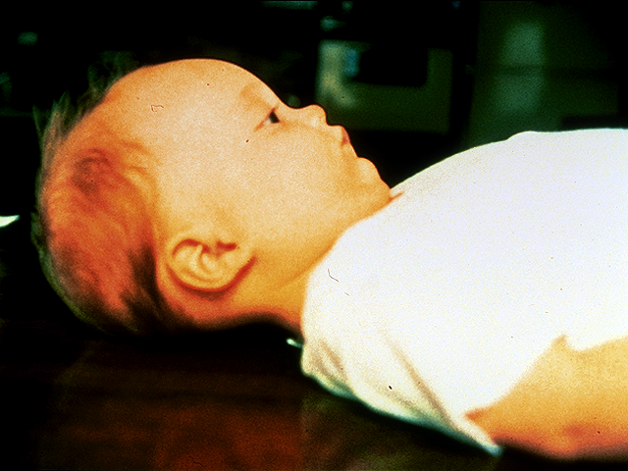
Airway

Slide 27
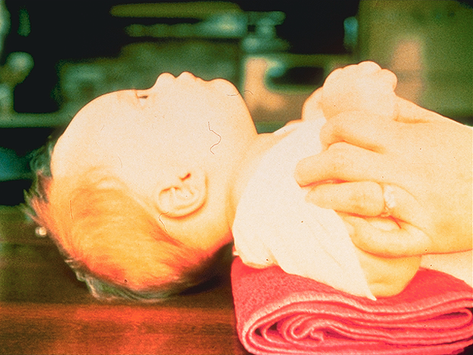
Airway

Slide 28
Preparation for Sedation
Set yourself up for victory
SOAPME
  S – Suction
  O – Oxygen
  A – Airway
  P – Pharmacy
  M – Monitors
  E - Equipment

Slide 29
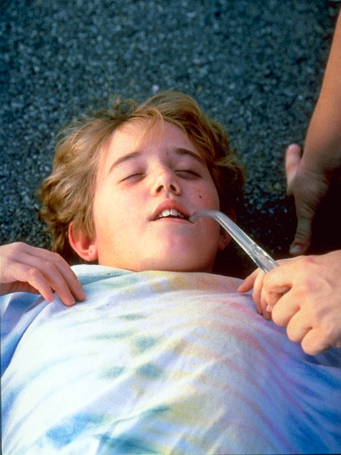
SOAPME
Suction
  Size-appropriate suction catheters and a functioning suction apparatus (Yankauer)
Oxygen
  oxygen supply and functioning flow meters/other devices to allow its delivery- NC/ NRB/ BVM
  Do you routinely apply oxygen

Slide 30
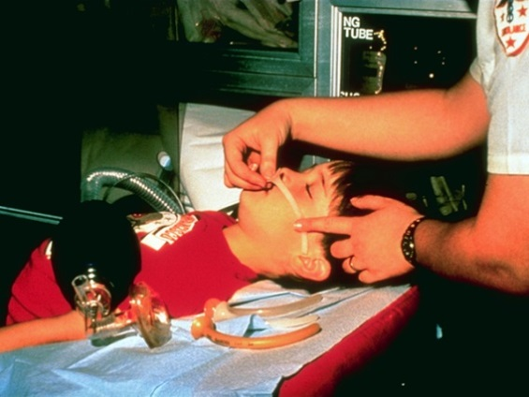
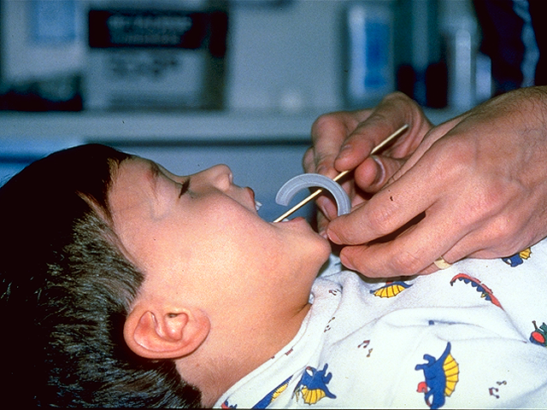
SOAPME
Airway
  Size-appropriate airway equipment
    Nasopharyngeal & oral airways
    Bag-mask apparatus
    Laryngoscopes and endotracheal tubes
Pharmacy
  Life-support drugs
    Oxygen, epinephrine, succinylcholine
    Antagonists: naloxone and flumazenil

Slide 31
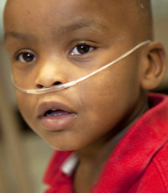
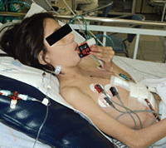
SOAPME
Monitors
  ECG, blood pressure
  Pulse oximeter
  End-tidal CO₂
Equipment
  I.V. and Airway (Rescue)

Slide 32
Vital Signs and Physiologic Monitoring
  Heart rate
  Respiratory rate
  Blood pressure
  Chest rise
  Oxygen saturation by pulse oximetry
    End-tidal CO₂ monitor
  Level of consciousness

Slide 33
Personnel & Monitoring During Sedation
All sedations:
  Observation by a designated, trained provider who is not performing the procedure
Minimal sedation
  pulse oximetry plus a trained observer
Moderate or deep sedation
  pulse oximetry, continuous ECG, blood pressure, exhaled CO₂ (recommended), plus a trained observer

Slide 34
Sedation - Monitoring
All patients receiving sedation are at risk for respiratory insufficiency and apnea
Proper nursing and physician/dentist observation
  Hospital specific sedation “credentials”
Be prepared to manage the airway of all patients receiving sedation!
  Perform rescue

Slide 35
Sedation Adverse Events
  Adverse Events: Associated with ALL routes of administration and ALL classes of medications
  Ability to “rescue” patients
    Prevents adverse events from becoming adverse outcomes
Coté CJ et. al. Pediatrics 2000

Slide 36
Sedation – Discharge Criteria
  Vital signs and pulse ox normal/baseline
  Baseline verbal ability and mental status
  Able to sit unassisted (age-appropriate)
  Demonstrate ability to protect airway
  If reversal drugs given - minimum 2 hours observation post administration

Slide 37
Sedation Summary
Presedation assessment
  Select patients
  Minimize presedation agitation
Proper monitoring
  C-R monitor/BP, Pulse oximeter, capnography
Assemble equipment and personnel
  Oxygen, suction, bag-mask, oral airway
Be prepared to perform Rescue

Slide 38
American Society of Anesthesiologists (ASA) NPO Recommendations
NPO before sedation elective procedures
Clear liquids 2 hours
Breast milk 4 hours
Infant formula, light meal 6 hours
Practice guidelines for sedation and analgesia by non-anesthesiologists. Anesth 2002;96:1004-17.

Slide 39
American Society of Anesthesiologists (ASA) NPO Recommendations
“the literature provides insufficient data to test the hypothesis that pre-procedure fasting results in a decreased incidence of adverse outcomes in patients undergoing sedation/analgesia…”
Practice guidelines for sedation and analgesia by non-anesthesiologists. Anesth 1996;84:459-71.

Slide 40
How did we do?
Defining Efficacy of Sedation
Pediatric Sedation Outside the OR
Fundamentals and Practical Applications in Hospital-based and Dental Sedation
September 14, 2018
Mark G. Roback, M.D.

Slide 41
Efficacy of Sedation
Procedure performed successfully
  Bare minimum! (lowest bar)
Child does not have unpleasant recall
  Sedating team does not have unpleasant recall
Child did not actively resist or require physical restraint
No sedation-related AEs that result in:
  Abandoned procedure
  Unplanned hospital admission or prolonged ED stay
Bhatt Quebec Guidelines. Ann Emerg Med 2009

Slide 42
Case – Options
No sedative drugs
  Controlled setting: dim lights, music, enlist family
  Distraction, guided imagery,
  Use your resources: Child Life, iPad, smart phone
  Pain and anxiety mitigation- topical, local/ regional blocks
Minimal sedation
  Minimize pre-procedural agitation
    Midazolam
      Intranasal 0.3 – 0.4 mg/kg IN; max 5 mg (about)
      PO??
    Nitrous Oxide
Moderate/deep sedation
    Parenteral sedation/analgesia?
      Midazolam
      Ketamine
      Etomidate
      Propofol

Slide 43
Non-Pharmacological Strategies
Team effort
  All staff committed to patient/family comfort
Enlist parents/care-providers
  Patient and Family-centered care
Physical restraint and Voice control are NOT effective

Slide 44
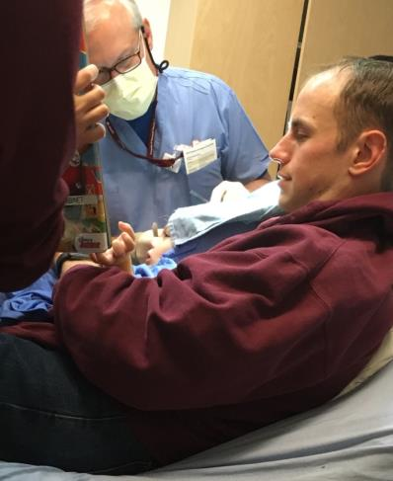
Case: 2 y/o with facial laceration
Painless local anesthesia
  L.E.T.
    Lidocaine, epinephrine, tetracaine
  IN Midazolam
    0.4 mg/kg IN
Positions of Comfort
Distraction
Papoose?

Slide 45
Case: 3 y/o with facial laceration
Painless local anesthesia
  L.E.T.
    Lidocaine, epinephrine, tetracaine
  IN Midazolam
    0.4 mg/kg IN
Positions of Comfort
Distraction
Papoose?

Slide 46
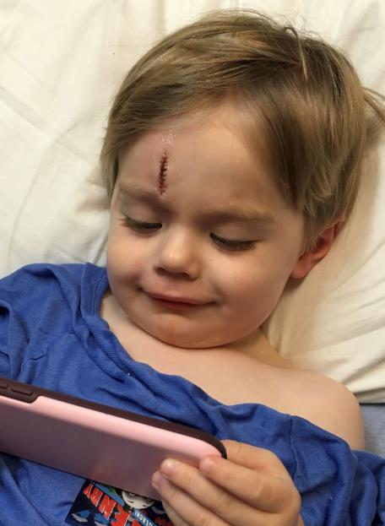
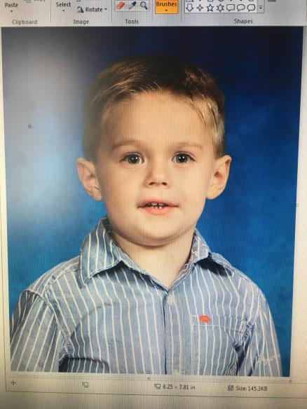
Forehead laceration s/p repair

Slide 47
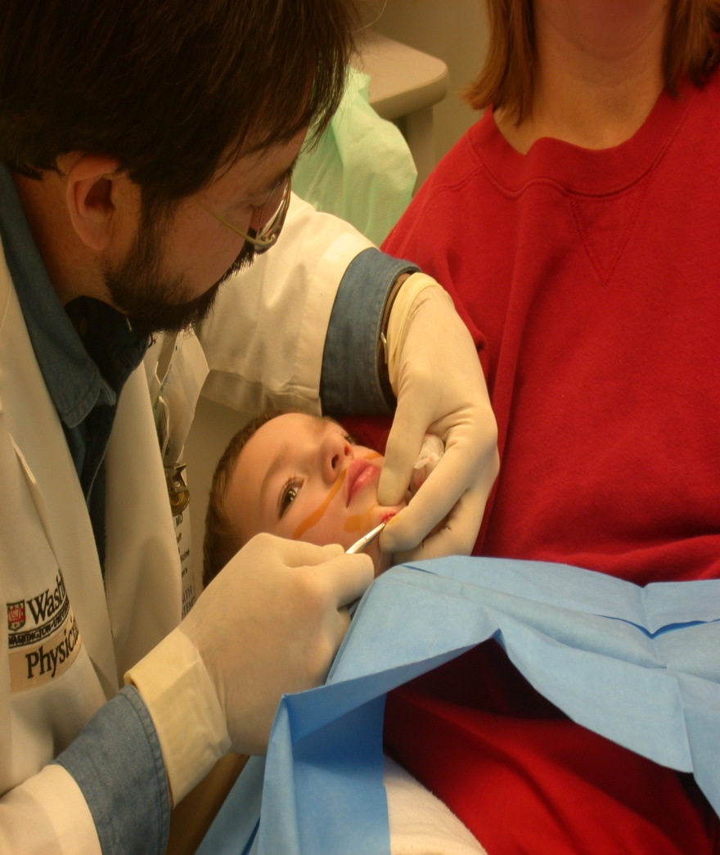
Position of Comfort
Painless local anesthesia
  Buffered Lidocaine
    30 gauge needle
Position of Comfort
Distraction

Slide 48
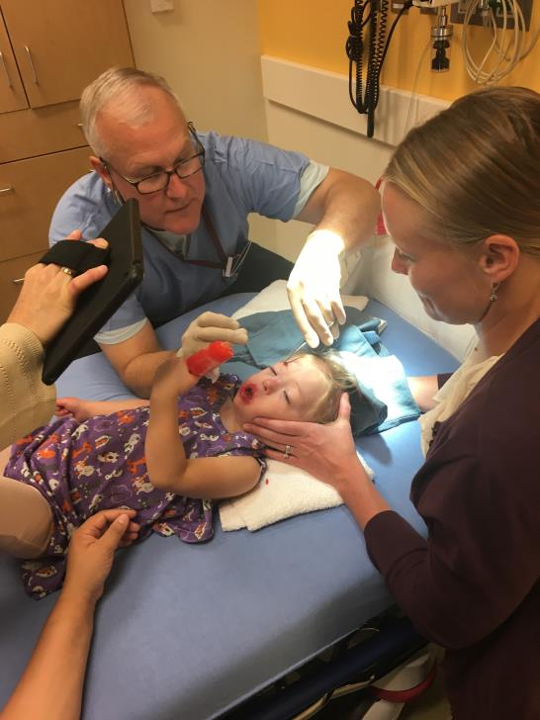
Position of comfort
Distraction

Slide 49
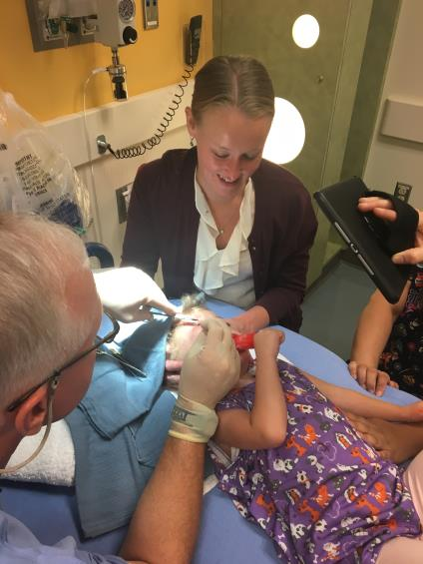
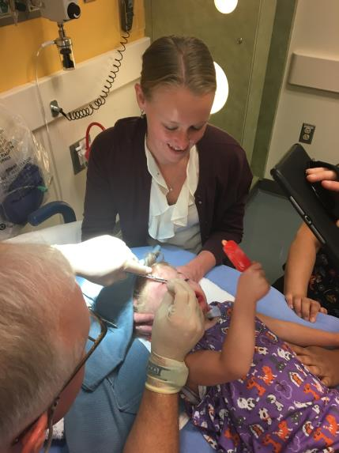
Position of Comfort + Distraction

Slide 50
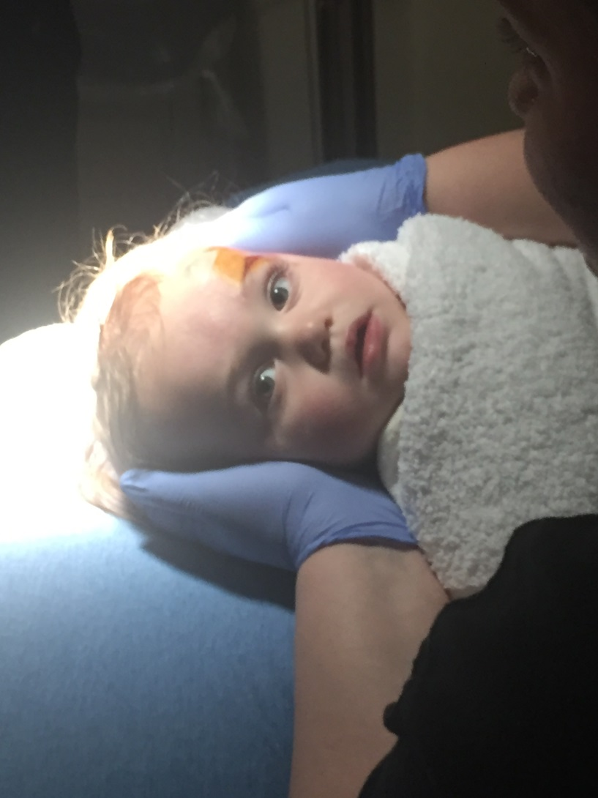
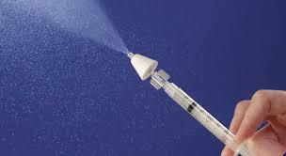
Minimal Sedation
Midazolam 0.4 mg/kg IN
Mucosal Atomizer Device
0.3-0.5 mL/nostril
  Larger volumes becomes PO
Irritates mucosa
  Lidocaine???

Slide 51
? david.listman@childrenscolorado.org
Notes:
David

